Slide 1
HR Employee Attrition
Prediction Analysis
IBM HR Analytics Dataset · Python · scikit-learn · pandas
Mintay Misgano, Ph.D.
People Analytics · I-O Psychology
Seattle Pacific University · 2022

Slide 2
Project Overview
Business Question
What employee characteristics and work conditions are most associated with voluntary attrition — and can we build a model to predict which employees are at highest risk before they leave?
1,470
35
16%
Employees in Dataset
Feature Variables
Attrition Base Rate
IBM HR Analytics (Kaggle)
34 predictors + 1 outcome
Class imbalance addressed with SMOTE

Slide 3
Dataset Overview
Demographics
Data Quality
Age, Gender, MaritalStatus, DistanceFromHome
No missing values
across all 1,470 rows
Job Attributes
JobRole, Department, JobLevel, BusinessTravel, OverTime
26 continuous
9 categorical variables
Compensation
MonthlyIncome, DailyRate, PercentSalaryHike, StockOptionLevel
4 removed
zero-variance columns
Satisfaction Scales
JobSatisfaction, EnvironmentSatisfaction, WorkLifeBalance, RelationshipSatisfaction
Binary encoded
OverTime, Gender, Attrition
Tenure & Growth
YearsAtCompany, YearsInCurrentRole, YearsSinceLastPromotion, TrainingTimesLastYear
SMOTE applied
to balance 84/16 split
Outcome (DV)
Attrition — binary: Yes (quit) / No (stayed)

Slide 4
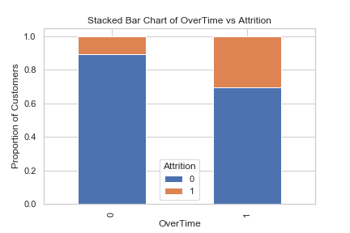
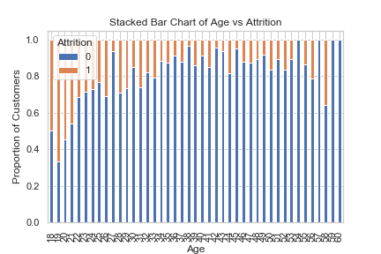
Exploratory Analysis: Key Drivers of Attrition
Overtime
Employees working overtime leave at 3x the rate of those who don't — the strongest single visual predictor.
Age
Younger employees (< 35) show significantly higher attrition. Mid-career employees are more stable.
Job Role
Sales Representatives and Lab Technicians have the highest attrition rates by role.
Marital Status
Single employees leave at higher rates than married or divorced colleagues.
Job Involvement
Low job involvement is strongly associated with leaving — a retention lever.

Slide 5
Handling Class Imbalance
The Problem
The Solution: Oversampling
Only ~16% of employees in the IBM dataset experienced attrition.
SMOTE
Synthetic Minority Oversampling Technique
Stayed (84%) — 1,233 employees
Uses K-Nearest Neighbors to generate synthetic attrition examples, balancing the dataset to a 50/50 split without simply duplicating records.
Left (16%) — 237 employees
A model trained on this imbalanced data would learn to predict 'No Attrition' almost every time and still achieve 84% accuracy — making it nearly useless for identifying who is actually at risk.
ADASYN
Adaptive Synthetic Sampling
A SMOTE variant that focuses synthetic generation on harder-to-classify boundary cases, creating a more challenging and realistic training set.
Both balanced datasets were saved as CSVs and used in all subsequent models.

Slide 6
Modeling Approach
DT
RF
PCA
Decision Tree Classifier
Random Forest Classifier
PCA — Dimensionality Reduction
Trained on original, SMOTE, and ADASYN datasets
Hyperparameter tuning: max depth varied to control overfitting
Outputs interpretable decision rules — explainable to HR stakeholders
Feature importance scores extracted to rank attrition predictors
Ensemble of 300–600 decision trees (n_estimators tuned)
Reduces variance vs. single Decision Tree
Evaluated with F1-score across balanced datasets
More robust to noisy features in HR data
Applied with and without StandardScaler preprocessing
Explored how many components capture majority of variance
Compared model separability: original vs. PCA-reduced features
Reveals latent structure in HR data beyond individual variables
Evaluation metrics: Accuracy · Precision · Recall · F1-Score · Confusion Matrix

Slide 7
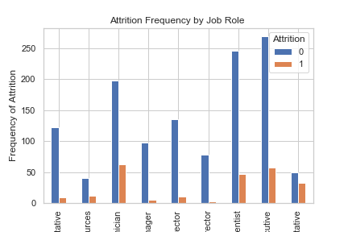
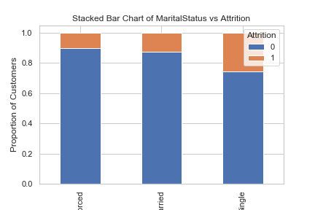
Key Findings
01
Overtime is the top predictor
Employees who work overtime are far more likely to leave. This is both the strongest EDA signal and a key feature importance variable.
02
Class imbalance matters
Without SMOTE/ADASYN, models default to predicting 'No Attrition' — achieving 84% accuracy while being practically useless for HR.
03
Tree-based models are interpretable
Decision Tree rules can be directly shared with HR business partners — explaining why an employee is flagged at risk without a black box.
04
PCA confirms latent structure
A subset of components captures the majority of variance, suggesting core underlying dimensions (tenure/loyalty, engagement, compensation) drive behavior.

Slide 8
Applied Context
Predicting attrition risk is one of the most impactful use cases in People Analytics — enabling organizations to intervene before high-value employees leave, reducing turnover costs and protecting institutional knowledge.
About the Author
▸ Ph.D., Industrial-Organizational Psychology — Seattle Pacific University (2026)
▸ Business Systems Analyst, People Analytics — Intuit (2023–2024)
▸ University Recruiting Analyst — Microsoft (2020–2023)
▸ Research: Inclusive Leadership, Impostor Phenomenon, Career Development · N=215
▸ Publication: Campus Racial Climate & Psychological Wellbeing · Springer (2023)
▸ Methods: Python (sklearn, pandas), R (lavaan), SPSS, SQL, Power BI, Tableau
github.com/skabone · linkedin.com/in/mmisgano · mmisgano@gmail.com

