Slide 1
Pharmacy Management System
Prepared By:
Hrutul Khamar (IU1941050026)
Saad Kadri (IU2041051092)
Pratham Shah (IU2041051095)
Guided By:
Professor Sanjay Makwana
Pharmacy management system

Slide 2
Index
Project Aim
Team Role
Timeline Chart
Project Objective
Project Solution
Structure of Solution
System Design
Pharmacy management system

Slide 3
Project Aims
To develop a web-based application for the pharmacy management tasks for the stores and distributor’s stock variation as well as to provide the integration of the retail store with the distribution channel.
Pharmacy management system

Slide 4
Team Role
Saad Kadri
Hrutul Khamar
Pratham Shah
Pharmacy management system

Slide 5
Timeline Chart
ACTIVITY | START DATE | FINISH DATE
Requirement Analysis
System Analysis
System Design
System Coding
Testing and Integration
Pharmacy management system

Slide 6
Project Objectives
The following are the major objectives of the proposed system:
To improve the user-friendliness of the application with the help of various controls for the elimination of a long procedure of adding data manually when new stock arrives as well as the tally from the excel sheets. A unique approach will be designed to maintain all the tasks by connecting distributors on the panel of the pharmacy stores.
Identify the various classes used to provide file upload and mail features that eliminate the external use of the software.
Research the methods for data mismanagement at any level while the project development is under process.
To develop the Report generation module which is capable of generating various kinds of reports like bar graphs, pie charts and table type charts, etc. With the help of these reports and statistical analysis, vendors can easily eliminate the unwanted requirements of medicines and other kinds of stuff.
To analyze the level of security using different protocols like https etc. An authentication mechanism and recovery and a backup server will be deployed in the proposed system to avoid data loss and cyber theft.
To develop the payment gateway between the distributor and the vendor, which maintains the transaction record and provides an authenticated way of managing all the bills.
Pharmacy management system

Slide 7
Proposed Solution
To solve the problems of existing work, the report generation module is used to monitor the orders and invoices of the stores.
Also using the filtering module it can be found which medicine is used to cure the disease.
To solve the Billing cycle the e-payment module is used between the vendors and distributor to monitor the total amount and orders.
Pharmacy management system

Slide 8
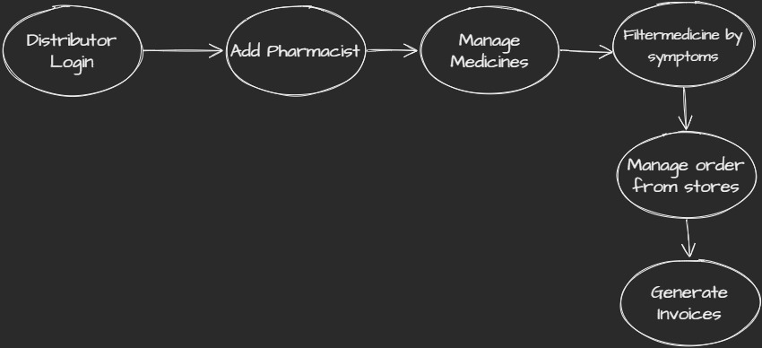
Structure of Solution
Pharmacy management system

Slide 9
System Design
Pharmacy management system

Slide 10
Thank you
Pharmacy management system

