Slide 1
Fault management tool – design review
6-15-2023

Slide 2
Problem
The CUSV system tracks numerous faults with accompanying information for:​
Documentation​
WCA guidebook​
Source Files​
Previously kept in the FM spreadsheet​
Difficult to navigate​
Difficult to teach how to use
Can/has been copied – duplicate information​
Cell formulas break​
Not clear what is up to date​
No limits on information that shouldn’t be changed​
​
Solution: Standalone Fault Management Tool

Slide 3
Solution: Fault Management Tool
Capabilities
Faults
View
Filter/Search
Edit
Create
Delete
Releases
Create New
Mark “released” (read-only)
Emergency Edit
Export
Database Design

Slide 4
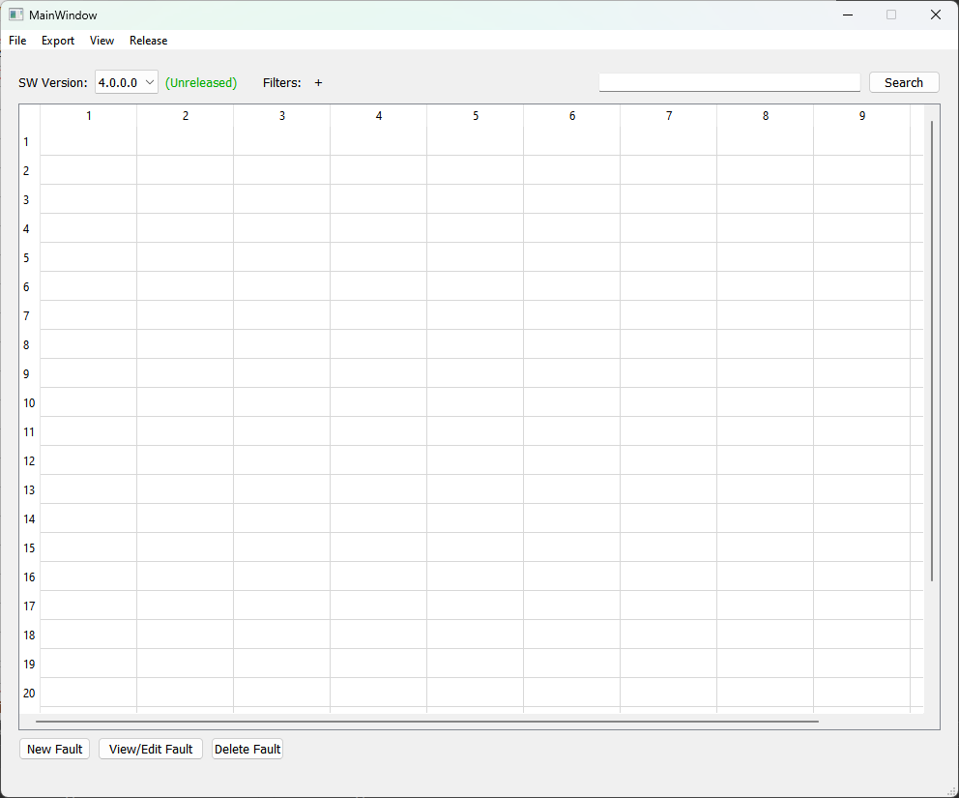
view fault table
Main window upon startup
Select desired release with dropdown
Immediately query database and populate table
Indicator for if faults are editable
Add filters or search
Fault interaction buttons

Slide 5
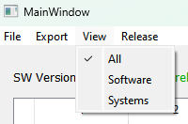
Predefined views
Select view (if any) in menu bar
Mutually exclusive checkboxes
Shows/hides fault attributes
All view: All fields displayed
Software view: Only software specific fields
Systems view: Only systems specific fields

Slide 6
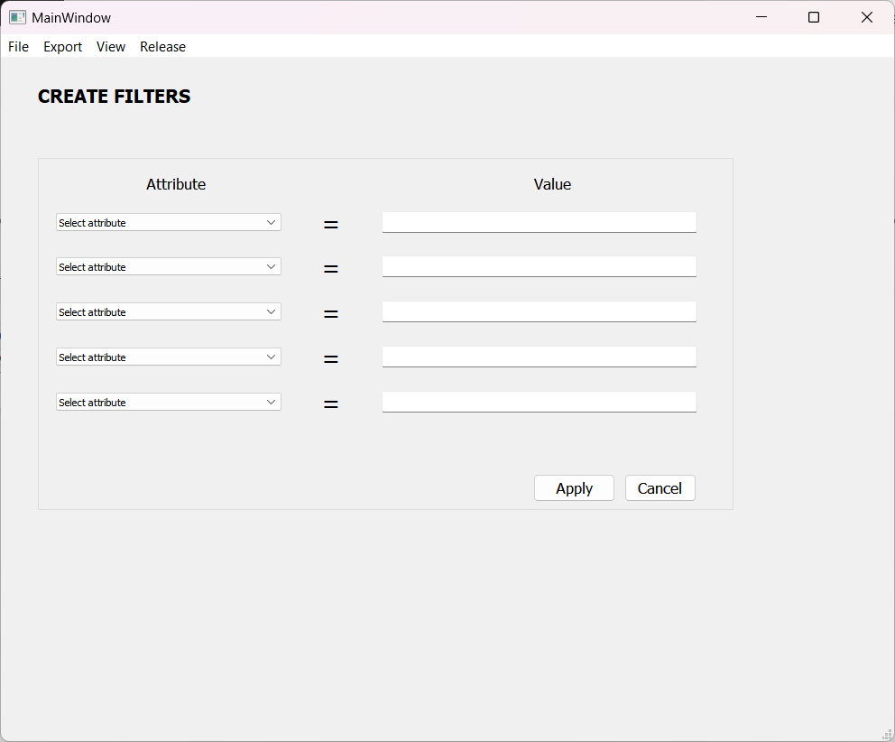
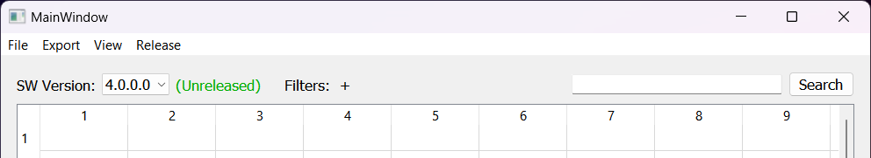
Search & Filters
Global text match with all columns
Adding filters opens new window
Current filters appear at top next to “Filters:”
Support for 5 filters
Manually typed token
Selecting “Apply” returns to main page with new filter

Slide 7
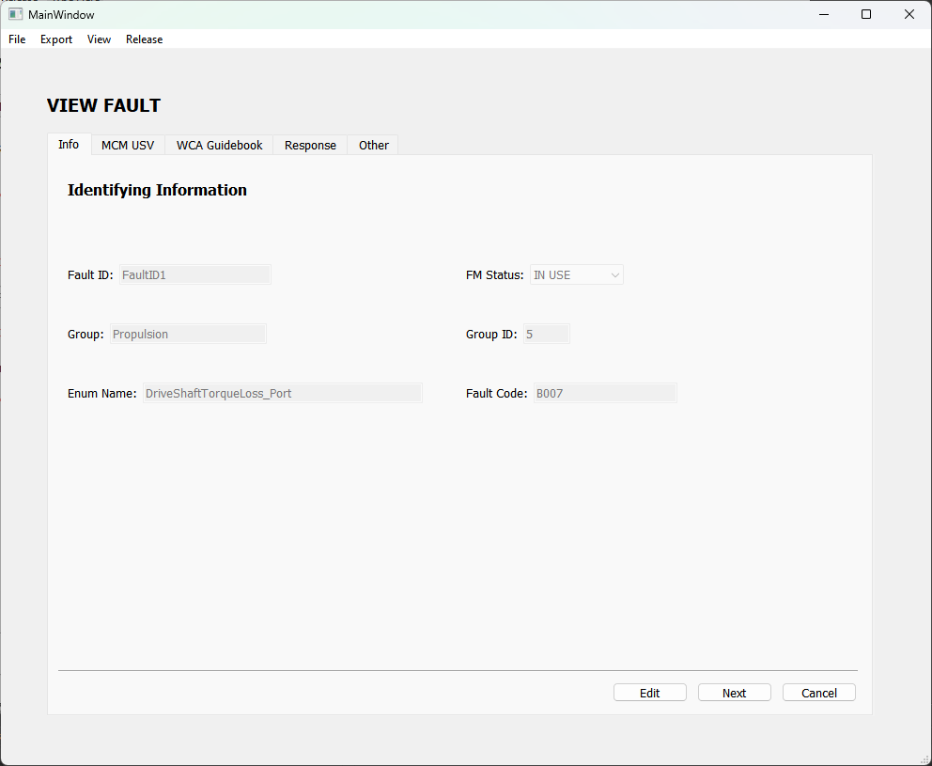
details view
Select a fault in the table and click the “View/Edit Fault” button
Multi tab window with all fault attributes displayed
All fields are read-only
Option to switch to edit mode at bottom

Slide 8
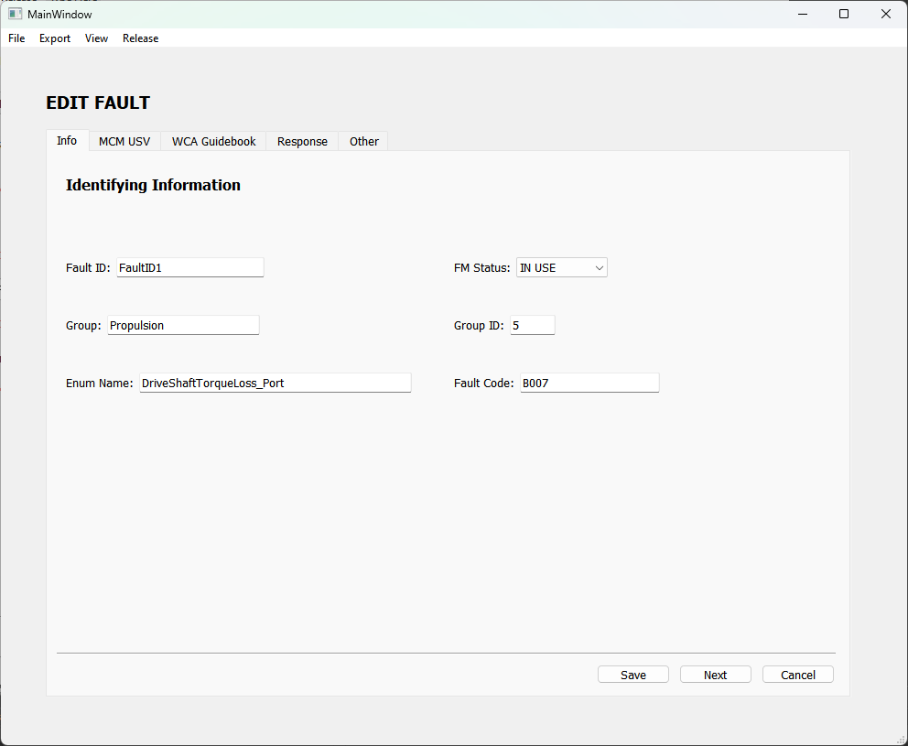
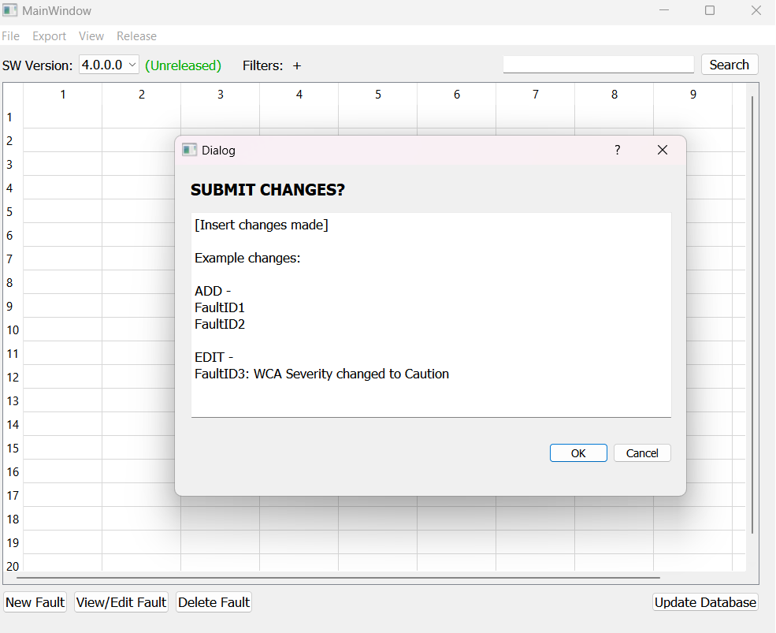
edit fault details
Selecting “Edit” will enable all fields to edit
Edit button changes to “Save” button
Selecting “Save” will trigger a change summary popup
Selecting ok will send the changes listed to the database

Slide 9
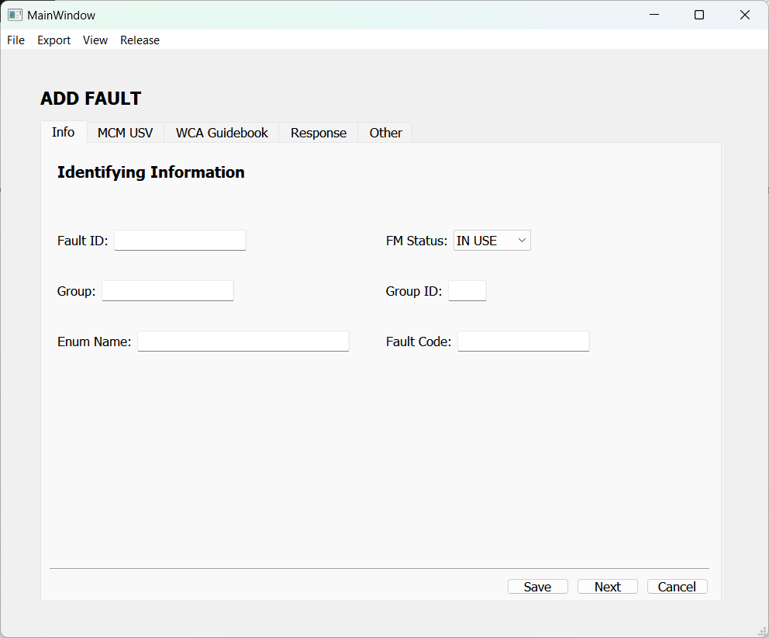
create new fault
Select the “New Fault” button
New fault window will open
Same window as edit fault but with empty fields
Fields editable and “Save” button present
Similar to “Edit” window, “Save” shows change summary page
Selecting ok sends update to database

Slide 10
delete fault
Select a fault (row) and then click the “Delete Fault” button
Simple confirmation prompt to confirm
Selecting ok sends delete command to database

Slide 11
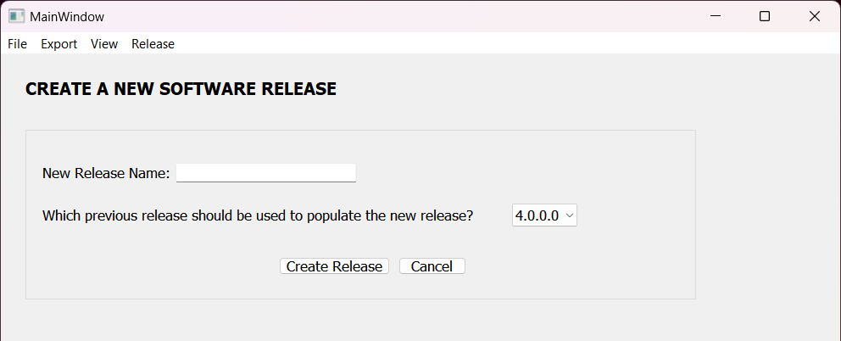
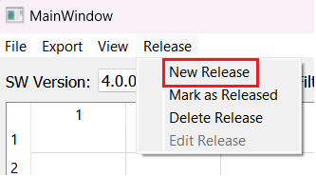
Release: create new release
Option under “Release” menu bar
Select “New Release”
New release window opens
Name
Previous release to inherit faults from
Selecting “Create Release” will create the release in the database
Can also delete release with basic confirmation popup (not pictured)

Slide 12
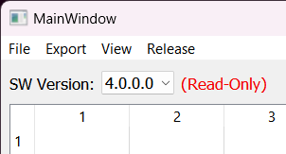
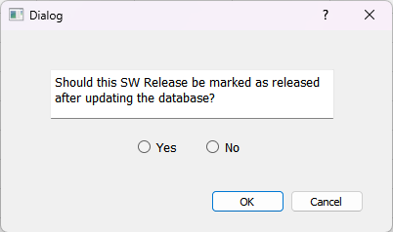
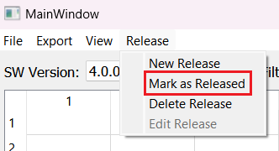
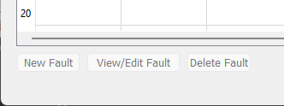
Release: mark release as “released”
Option under “Release” menu bar option
Select “Mark as Released” option
Confirmation dialog appears. Selecting yes and ok sends command to database to mark release as read only
Changes main screen with read only label and disabled buttons

Slide 13
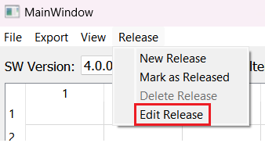
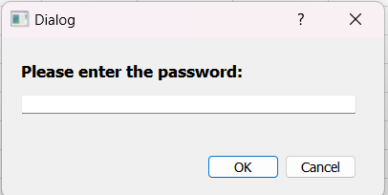
Release: Emergency Edit
User can override the read only setting for a software release
Option under “Release” menu bar option
Select “Edit Release” option
Password prompt will appear
Entering password and selecting ok will enable all buttons at the bottom of main window

Slide 14
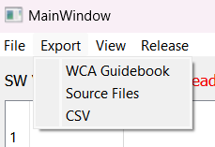
export
Options under “Export” menu bar option
Option to export data as multiple export types
Selecting an item will open a file save popup and export the file(s)
Export types:
CSV
All fault info
Enables diff using external tool
Enables offline (read only) import
WCA Guidebook
Source Files
VLC – FaultConst.h
DSD – FaultStringLib.h/cpp

Slide 15
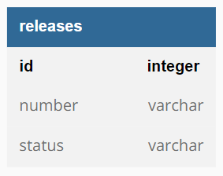
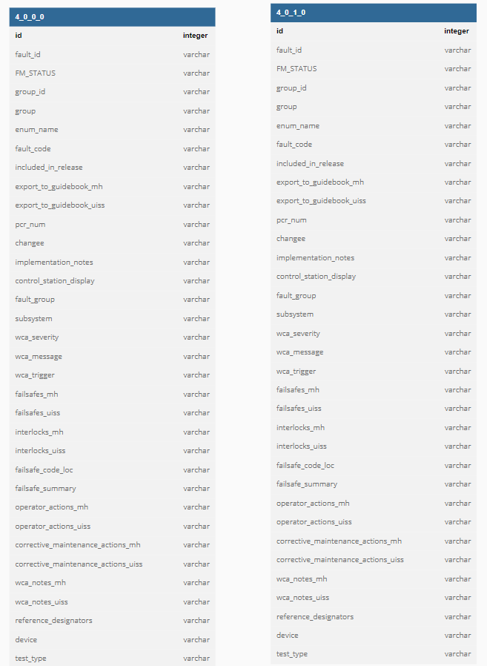
Database
MySQL
Hosted on Hunt Valley network
Not open to internet traffic
One table per release
Table to track release statuses
Example:
Table: 4_0_0_0
All fault information in release
Table: 4_0_1_0
All fault information in release
Table: releases
Release Number | Status
4.0.0.0 | Released
4.0.1.0 | Working

Slide 16
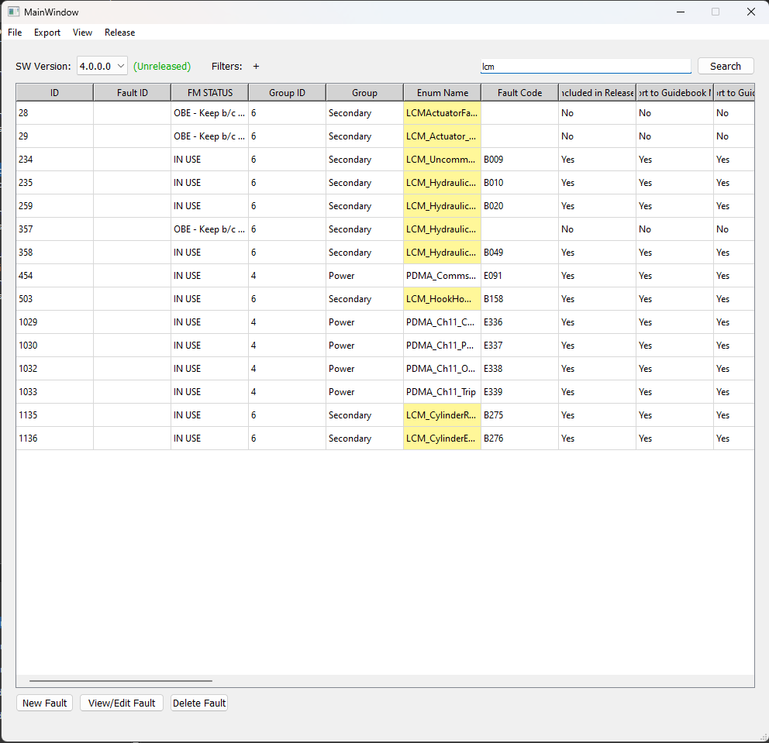
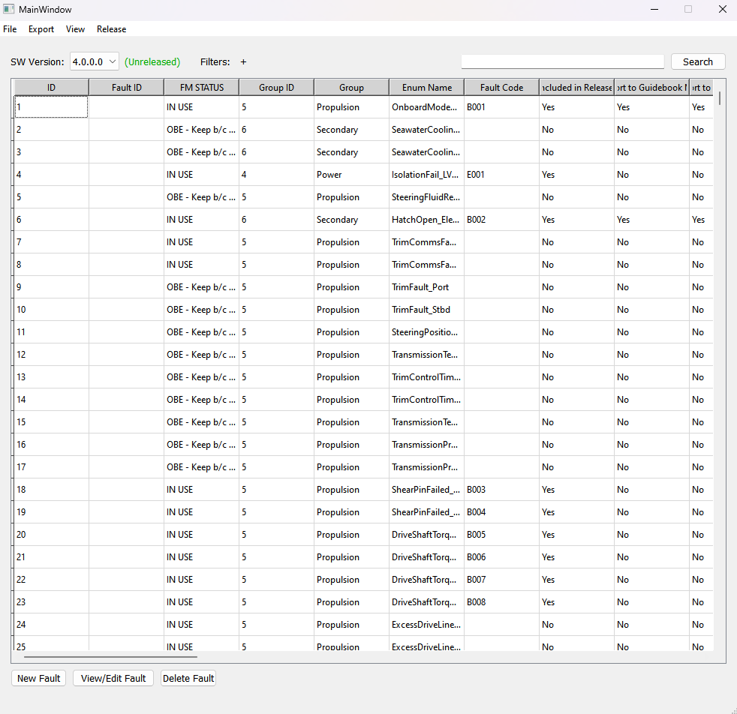
Database usage
Began MySQL database setup
Imported data from version 4.0.1.0
Connected to database in QT Creator
Populated tool’s table with data
Implemented global search

Slide 17
Questions

