Slide 1
2023 Intern Report Outs
Sea Systems

Slide 2

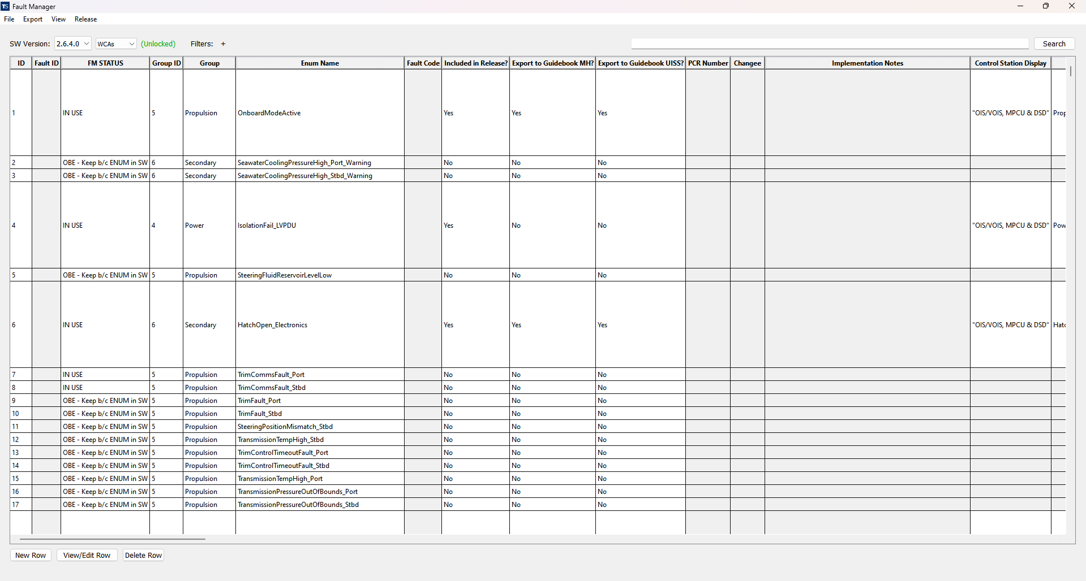
Sahit Kadthala | software engineer
University of Maryland | Computer Science | May 2024
Internship Experience
Internship Takeaways
Fault Management Tool
Developed a tool to track all aspects of faults for the Sea System crafts
Worked in collaboration with Mitchell Files
Database
MySQL – easy to implement, fast data queries
Imported all fault, failsafe, and interlock data
User Interface
Main table contains data from specified SW Release
Options to add, delete, read, and edit faults/failsafes/interlocks
Develop new SW Releases and export specified SW Release to CSV
Planning a project design in advance can save time during implementation
Organizing tasks by priority can improve productivity
Top 3-5 Preferred 2024 Textron Positions
Software Eng. | Hunt Valley, MD | 313787
Software Eng. | Hunt Valley, MD | 313675
Software Eng. | Hunt Valley, MD | 313638
What Would’ve Made Your Experience Better?
9/80 schedule
Intern lunch events

