Slide 1
FITFR Study
Summary Statistics & Key Relationships
Study Objective: To investigate the effect of treatment on AF and PR, accounting for age, sex, and SNP genetic variation.
100 participants · 58 variables
3 treatment groups (A, B, C)
Outcomes: AF (continuous) & PR (binary)
Covariates: age, sex, 51 SNPs
Exploratory Data Analysis by Kailin Xue
Notes:
This presentation summarises the exploratory data analysis (EDA) conducted on the FITFR dataset ahead of formal modelling. It covers the dataset structure, descriptive statistics, the main relationships between treatment and outcomes (AF and PR), the role of potential covariates (age, sex, and SNPs), and key implications for model specification.

Slide 2
OVERVIEW
Dataset at a Glance
100
58
3
Participants
Variables
Treatment Arms
complete cases
4 demo · 51 SNPs · 2 outcomes (AF & PR)
A (n=32) · B (n=29) · C (n=39)
51/49
34.2
61.3
Female / Male
Mean Age (yrs)
Mean AF
approximately balanced
SD = 6.2 · range 25–45
SD = 19.8 · range 26–96
DATA NOTES:
Column 2 (age): 2 missing values recoded from sentinel −99
Column 5 (smoker): all N (zero-variance, excluded from modelling)
Column 56 (rs123456): monomorphic (excluded)
Notes:
Dataset Overview
The dataset contains 100 participants across 58 variables. Treatment groups are reasonably balanced (A: 32, B: 29, C: 39), as are sex (51 female, 49 male) and the PR outcome (51 yes, 49 no). Age has 2 missing values which were originally coded as −99 (a sentinel value indicating missing data) and have been recoded to NA. Smoking status and rs123456 carry no information — all participants are non-smokers and all carry the same genotype at rs123456 — so both are excluded from all models.
Notes: "Zero-variance" means a variable has the same value for every participant — since all participants are non-smokers, smoking status cannot explain any difference between participants and is therefore useless as a predictor. "Monomorphic" means the same thing applied to a SNP — every participant carries the identical genotype at rs123456, so it carries no genetic information for this sample.

Slide 3
DESCRIPTIVES
Table 1 — Key Variables Stratified by Treatment
Variable |  | Overall (n=100) | Group A (n=32) | Group B (n=29) | Group C (n=39) | p-value
Age, mean (SD) |  | 34.2 (6.2) | 34.3 (6.1) | 36.3 (5.7) | 32.4 (6.3) | 0.040*
Sex, n (%) | Female | 51 (51%) | 15 (46.9%) | 17 (58.6%) | 19 (48.7%) | 0.615
 | Male | 49 (49%) | 17 (53.1%) | 12 (41.4%) | 20 (51.3%)
AF, mean (SD) |  | 61.3 (19.8) | 37.5 (6.4) | 76.9 (11.2) | 69.2 (13.0) | < 0.001***
PR, n (%) | Yes | 51 (51%) | 17 (53.1%) | 19 (65.5%) | 15 (38.5%) | 0.084
 | No | 49 (49%) | 15 (46.9%) | 10 (34.5%) | 24 (61.5%)
* p < 0.05 *** p < 0.001 (ANOVA test for continuous variables; χ² test for categorical data)
Notes:
Descriptive Statistics
Table 1 compares the distribution of key variables across treatment groups. ANOVA was used for continuous variables (age, AF) and χ² test for categorical variables (sex, PR). (Note that ANOVA and χ² are the default tests applied by the tableone package for continuous and categorical variables respectively so they are used here for an overall descriptive comparison across all key variables, not as a formal test of the primary hypothesis.)
The results show:
AF differs substantially between treatment groups (since p-value < 0.001) — group A has a much lower mean AF (37.5) compared to B (76.9) and C (69.2), confirming a strong treatment effect on the primary continuous outcome.
Age differs marginally across groups (p = 0.040), with group B being slightly older on average (36.3 years vs 34.3 and 32.4 for A and C respectively) — this imbalance is small but sufficient to warrant including age as a covariate in formal models.
Sex distribution (p = 0.615) and PR rate (p = 0.084) do not differ significantly across treatment groups.
Notes: ANOVA is a statistical test that checks whether the average value of a variable (like AF or age) differs across three or more groups. The chi-squared (χ²) test does the same for counts and percentages (like sex or PR rate). A p-value below 0.05 is the conventional threshold for saying a difference is “statistically significant” — i.e. unlikely to be due to chance alone.

Slide 4
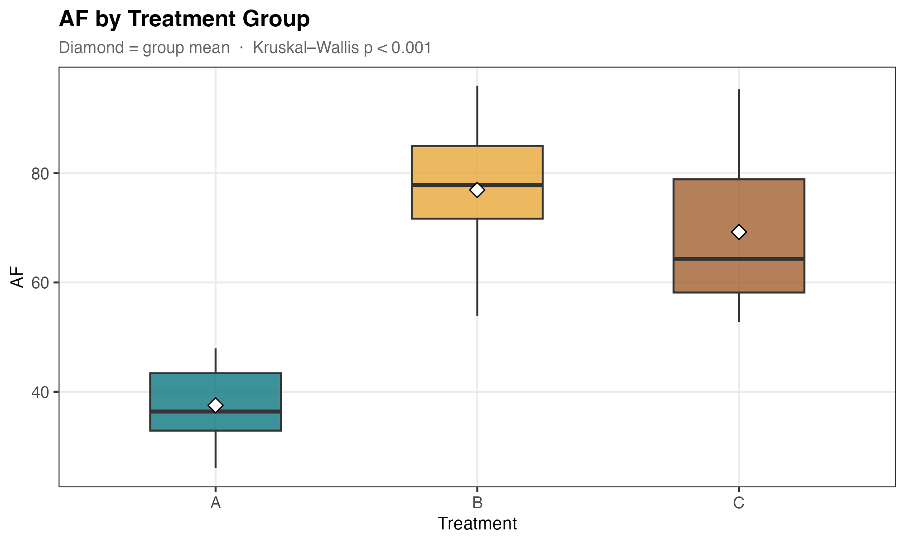
PRIMARY OUTCOME
Effect of Treatment Group on AF
Treatment A (n=32)
Mean AF: 37.5 ±6.4 Median: 36.4
PR rate: 53%
p < 0.001 — strong treatment effect on AF
Treatment B (n=29)
Mean AF: 76.9 ±11.2 Median: 77.8
PR rate: 66%
p < 0.001 — strong treatment effect on AF
Treatment C (n=39)
Mean AF: 69.2 ±13.0 Median: 64.3
PR rate: 38%
p < 0.001 — strong treatment effect on AF
Error bars not shown; Kruskal–Wallis p < 0.001
Notes:
Main Relationships
We first examine the effect of treatment on AF which is the primary outcome of interest. A Kruskal-Wallis test was used as it does not assume normality across groups. (Since AF is the primary outcome of interest, we examine its distribution more carefully before selecting a test. We examined the normality of AF using the histogram, which shows a roughly uniform spread rather than a bell-shaped curve, suggesting that the normality assumption required by ANOVA is not met. A Kruskal-Wallis test was therefore used instead which is a non-parametric alternative to ANOVA that does not assume any particular distribution, making it more appropriate for AF given its observed spread.)
The results show:
AF differs significantly across treatment groups (p < 0.001) — the non-overlapping interquartile ranges between group A and groups B/C confirm a clinically meaningful treatment effect
Group A has substantially lower AF (mean 37.5, median 36.4) compared to B (mean 76.9, median 77.8) and C (mean 69.2, median 64.3)
Group C shows greater variability (SD = 13.0) compared to A (SD = 6.4), suggesting more heterogeneous responses to treatment C — this may be worth investigating in formal modelling
Notes: The box in each boxplot shows the middle 50% of values (the interquartile range, or IQR) — think of it as where most participants sit. The line inside the box is the median. When the boxes of two groups do not overlap at all, the difference between them is very likely to be real rather than random.

Slide 5
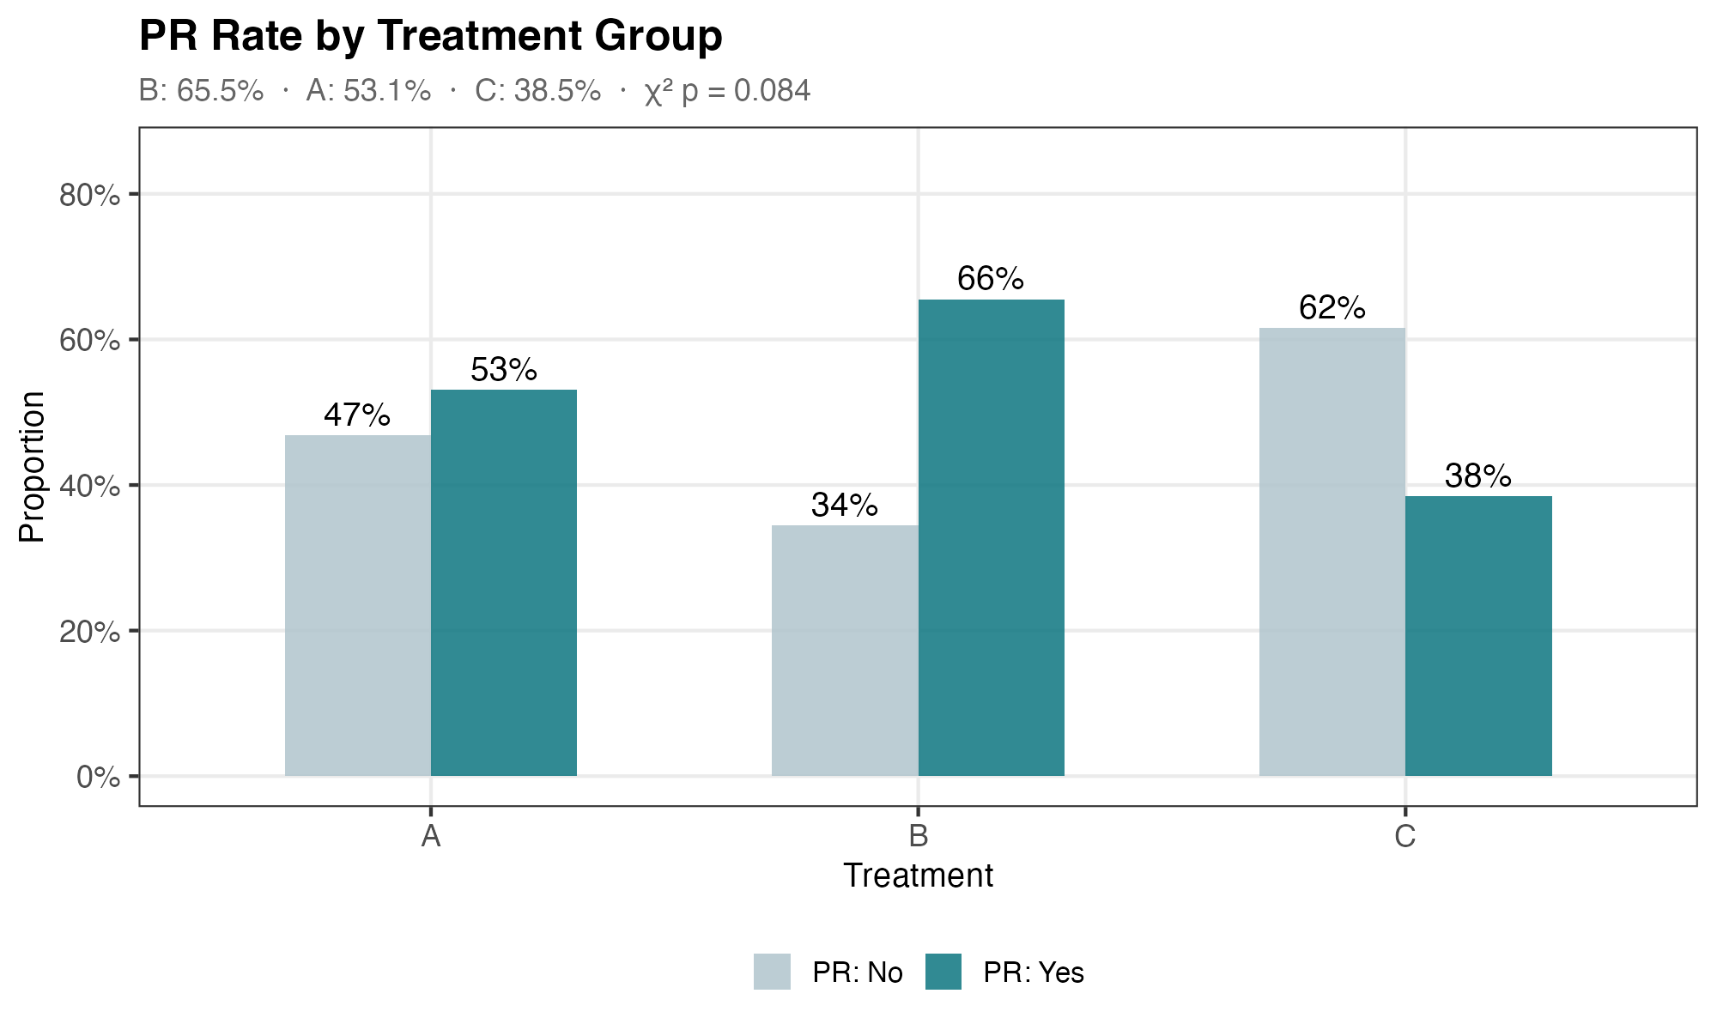
PRIMARY OUTCOME
Effect of Treatment Group on PR
Key Observations
● Treatment B has the highest PR rate (65.5%)
● Treatment A: moderate PR rate (53.1%)
● Treatment C: lowest PR rate (38.5%) despite 2nd highest AF
→ AF and PR do not perfectly align — treatment C may achieve high AF without triggering PR
→ Treatment × outcome relationship warrants formal modelling
χ² test: p = 0.084 (marginal)
Notes:
Main Relationships
We next examine the effect of treatment on PR, the binary outcome. A χ² test was used to compare PR rates across treatment groups.
The results show:
PR rate does not differ significantly across groups (p = 0.084) — the result is marginal and does not reach the conventional threshold of 0.05, so conclusions should be drawn cautiously
Treatment B has the highest PR rate (65.5%), followed by A (53.1%), while C has the lowest (38.5%)
Treatment C shows a notable disconnect — despite having the second highest mean AF (69.2), it has the lowest PR rate, suggesting that high AF does not guarantee a positive response in PR
The relationship between treatment, AF, and PR is non-trivial — both outcomes should be modelled separately rather than assumed to follow the same treatment effect
Notes: You might expect the treatment that produces the highest AF to also produce the highest PR rate — but Treatment C breaks this pattern. It achieves the second highest average AF (69.2), yet has the lowest PR rate (38.5%). This suggests that AF and PR are not simply two measures of the same thing; the two outcomes may be driven by different biological mechanisms, and each should be modelled separately.

Slide 6
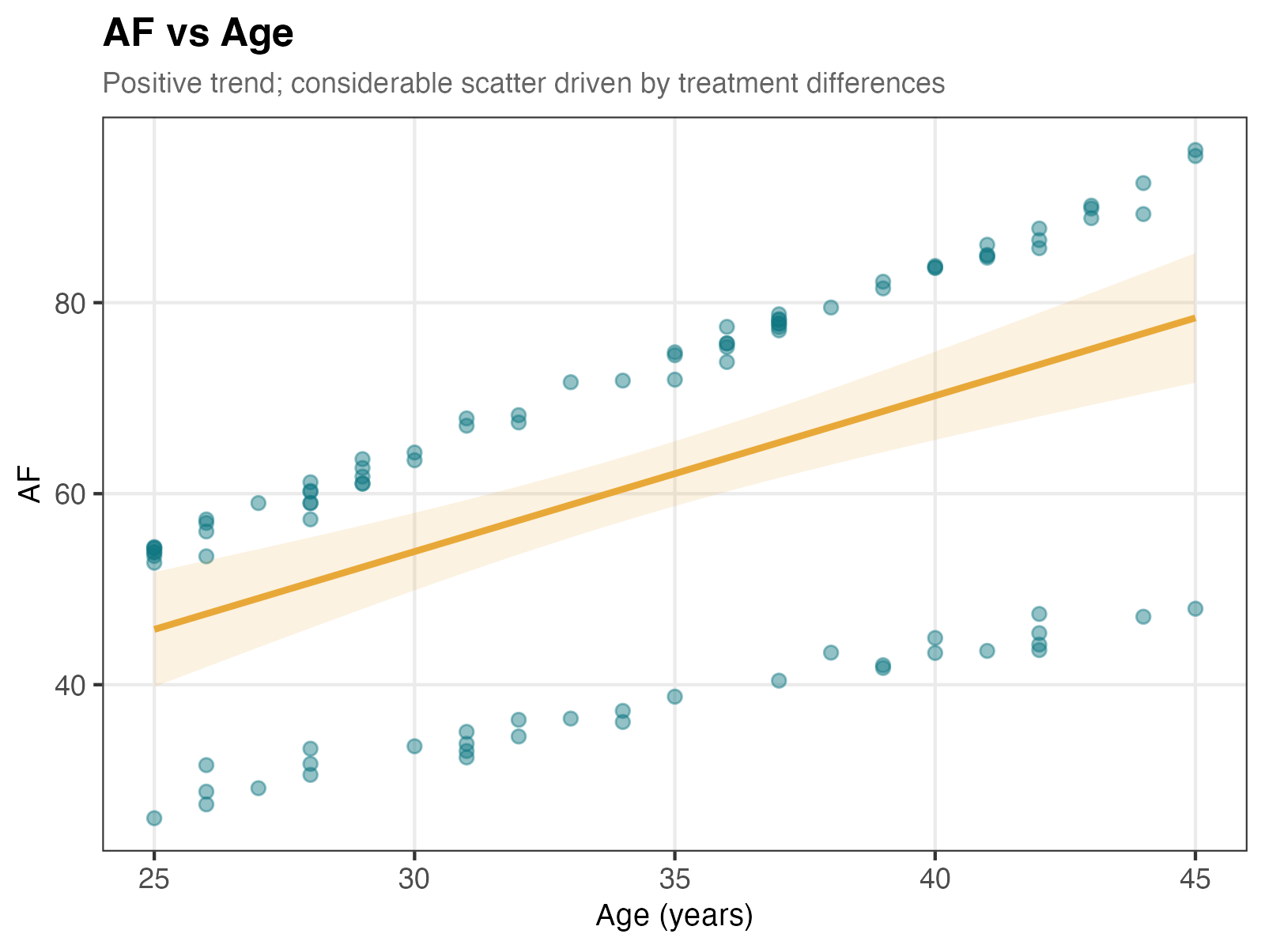
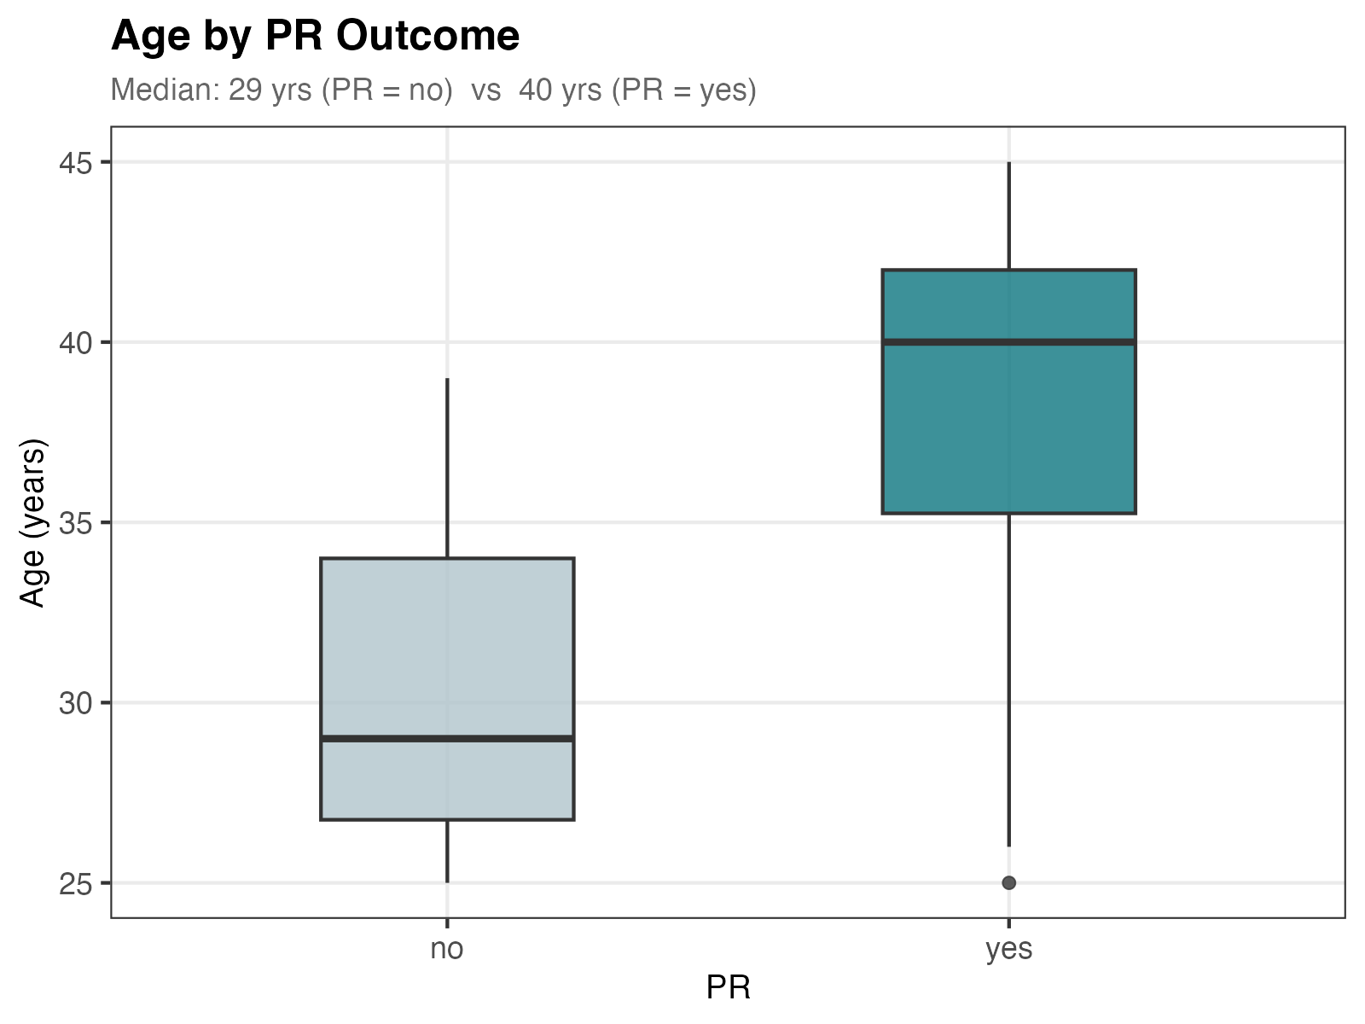
COVARIATES
The Role of Age
Age differs marginally across treatment groups (p = 0.040) and is strongly associated with PR outcome — should be included as a covariate in models.
Notes:
Covariant 1 - Age
We examine whether age is associated with either outcome, as it may confound the relationship between treatment and AF/PR. A linear regression line is fitted for the AF vs Age scatter plot, and a boxplot compares age distribution between PR groups.
The results show:
Age shows a positive association with AF (left plot) — however, the considerable scatter around the regression line suggests the relationship is largely driven by other differences rather than age alone
Age is strongly associated with PR outcome (right plot) — participants with PR = yes are considerably older (median 40 years) compared to those without (median 29 years), with minimal overlap between the two IQRs
Age should be included as a covariate in both models — it differs marginally across treatment groups (p = 0.040) and shows a strong marginal association with PR outcome
Notes: The IQR (interquartile range) is the range covering the middle 50% of participants. When the IQRs of two groups barely overlap — as seen here between PR = yes and PR = no — it means the difference in age between the two groups is large and consistent, not just a fluke driven by a few extreme values. A regression line shows the average trend across all data points — the steeper and tighter the points cluster around it, the stronger the relationship. Here the line has a positive slope (going upward left to right), meaning AF tends to increase with age, but the wide scatter tells us age alone is not enough to predict AF accurately.

Slide 7
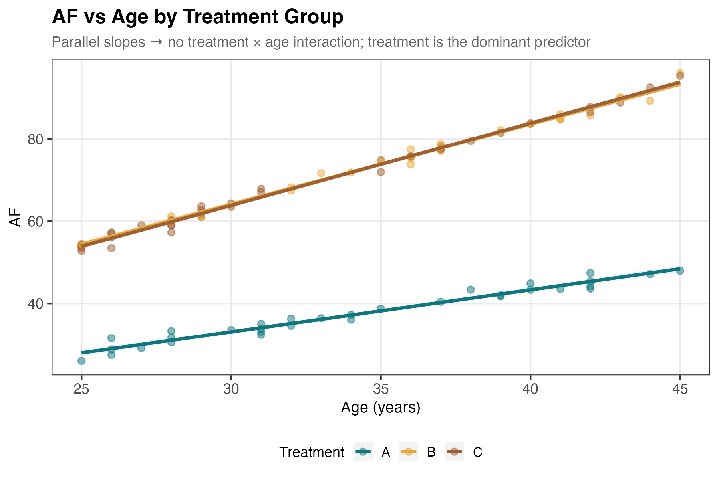
INTERACTION
Treatment × Age → AF
Parallel slopes
Within each treatment arm, AF increases consistently with age — slopes are similar across groups, indicating no treatment × age interaction.
Treatment dominates
The large separation between group A and groups B/C confirms that treatment, not age alone, is the primary driver of AF.
Modelling implication
Age should be included as an additive covariate. No interaction term is needed for age × treatment in the AF model.
Notes:
Covariant 1 – Age
Since age is associated with AF, we examine whether the effect of age on AF differs across treatment groups — which would indicate a treatment × age interaction and require an interaction term in the model.
The results show:
The three regression lines run parallel — the slope of AF on age is consistent across all three treatment groups, indicating no treatment × age interaction
Treatment remains the dominant predictor — the large vertical separation between group A and groups B/C is maintained across the entire age range, confirming that treatment group explains far more variation in AF than age alone
Modelling implication: age should be included as an additive covariate only — no interaction term between age and treatment is needed in the AF model
Notes: The "interaction" between treatment and age would mean that the effect of age on AF is different depending on which treatment a participant received — for example, if age mattered a lot for Treatment A but barely at all for Treatment B. The plot shows this is not the case: the three lines run roughly parallel, meaning age has a similar effect on AF regardless of treatment. This simplifies the model — we can just add age as a straightforward adjustment (an "additive covariate") without needing a more complicated interaction term.

Slide 8
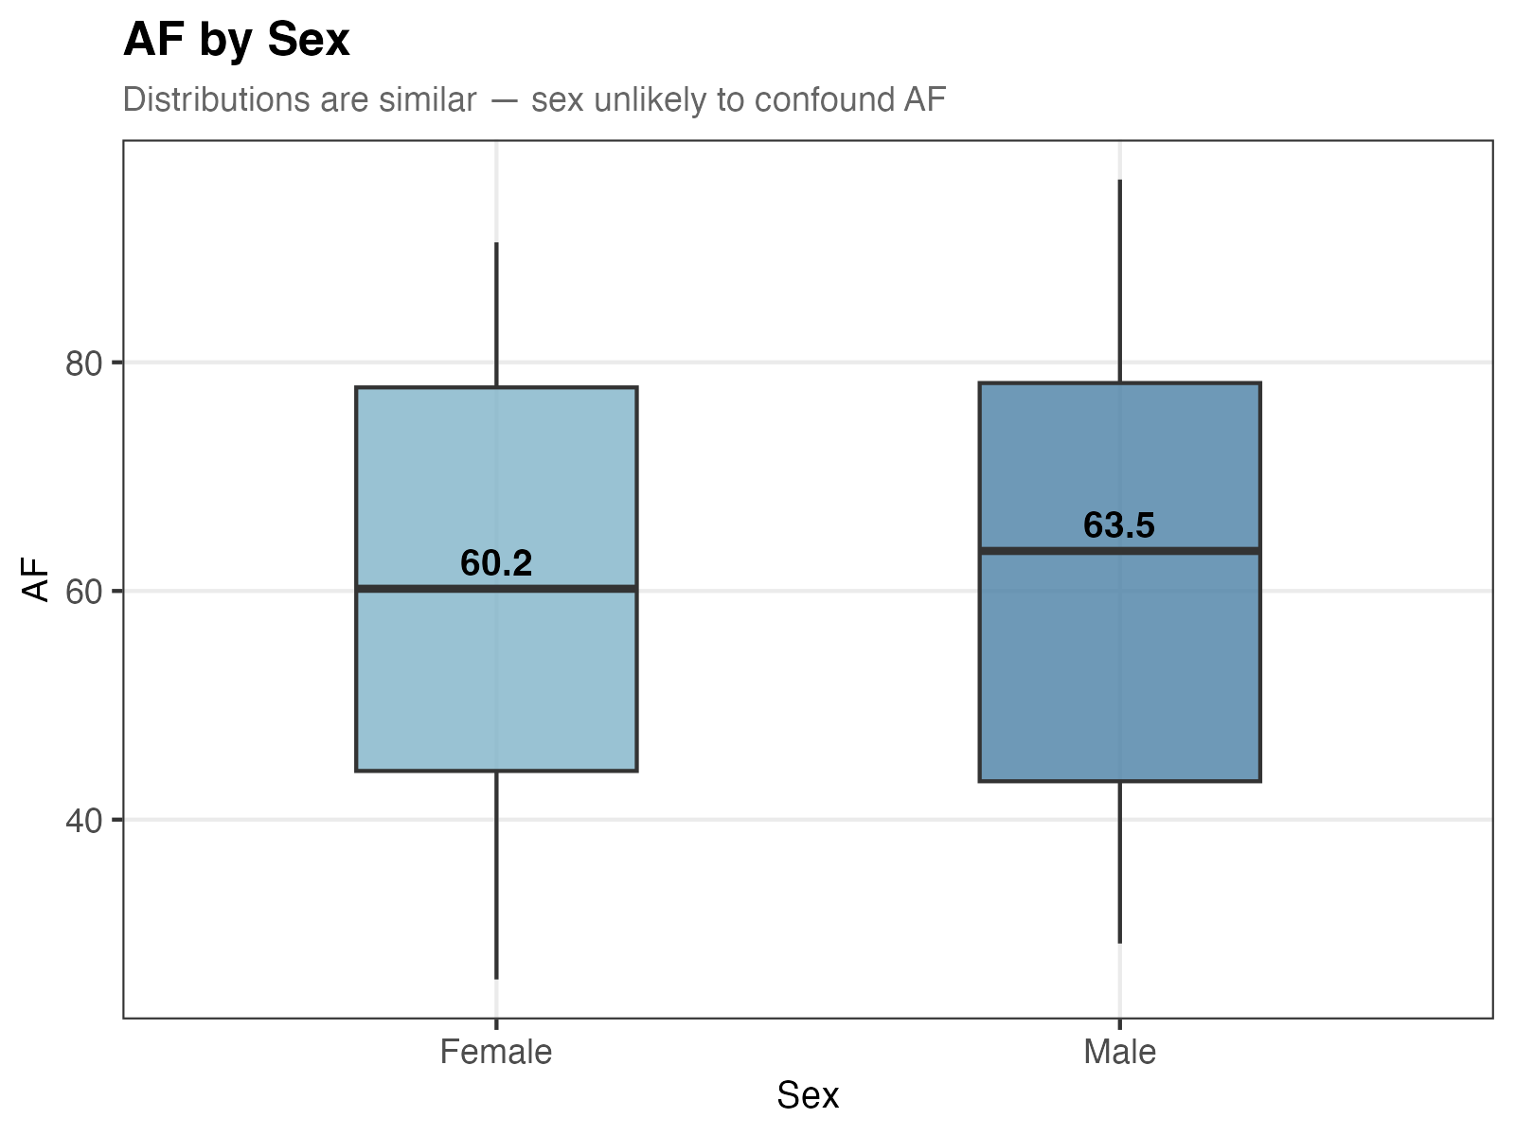
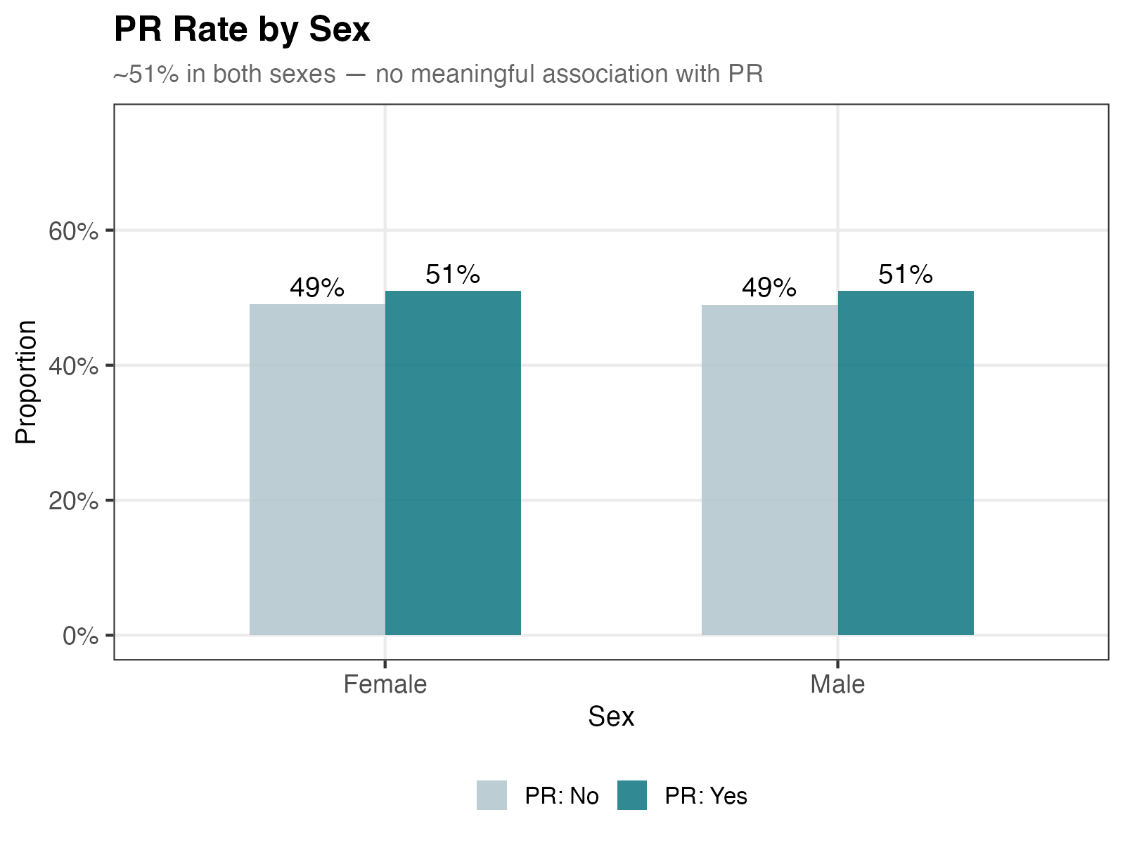
COVARIATES
The Role of Sex
Sex is balanced (F=51, M=49) and shows no meaningful association with either outcome. Inclusion in formal models is optional.
Notes:
Covariant 2 – Sex
We examine whether sex is associated with either outcome, as it may act as a confounding variable in the relationship between treatment and AF/PR.
The results show:
AF distributions are similar between females and males (median 60.2 vs 63.5) — the largely overlapping IQRs suggest sex has little marginal association with AF
PR rate is identical across sexes (51% in both females and males) — sex shows no meaningful association with the binary outcome
Modelling implication: sex is unlikely to be an important covariate for either outcome — inclusion in formal models is optional and unlikely to materially change results

Slide 9
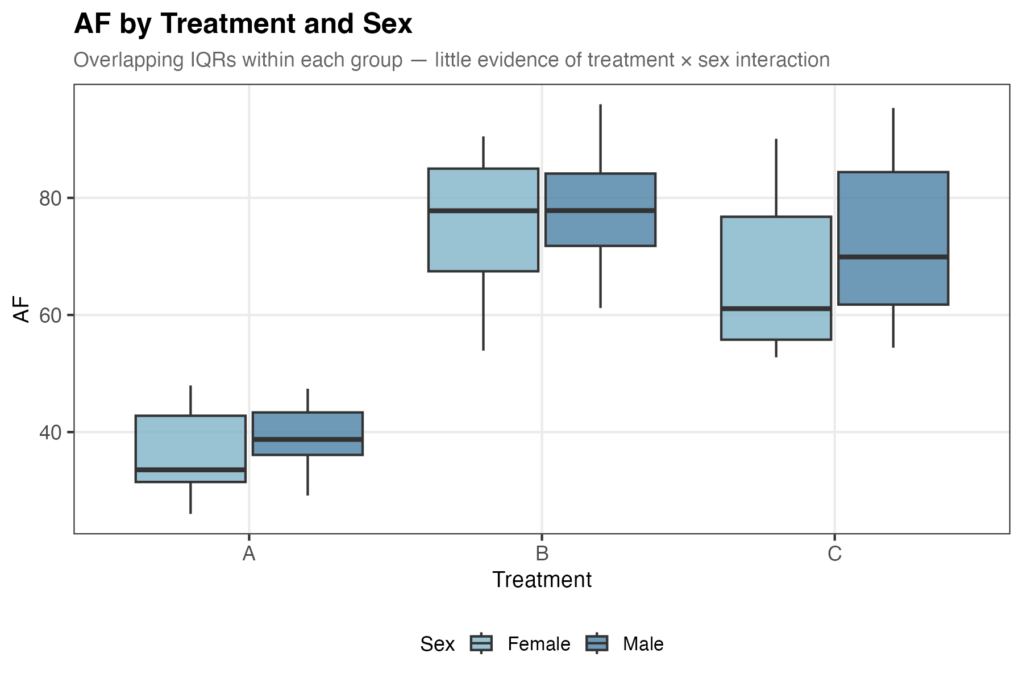
INTERACTION
Treatment × Sex → AF
Overlapping IQRs
Within each treatment group, AF distributions overlap substantially between females and males, suggesting no treatment × sex interaction.
Treatment still dominates
The large separation between group A and groups B/C is consistent across both sexes, confirming treatment remains the primary driver of AF.
Modelling implication
Sex does not appear to modify the treatment effect on AF. A treatment × sex interaction term is unlikely to be needed in the AF model.
Notes:
Covariant 2 – Sex
Since sex shows minimal marginal association with AF, we examine whether the effect of treatment on AF nevertheless differs by sex — which would indicate a treatment × sex interaction requiring an interaction term in the model.
The results show:
AF distributions overlap substantially between females and males within each treatment group — the IQRs are largely overlapping across all three groups, providing little evidence of a treatment × sex interaction
The treatment effect is consistent across both sexes — the large separation between group A and groups B/C is maintained regardless of sex, confirming treatment remains the primary driver of AF
Modelling implication: no treatment × sex interaction term is needed in the AF model
Notes: Same logic as Slide 7 - if there were a treatment × sex interaction, the gap between female and male AF would look very different across the three treatment groups. Because the male/female boxes overlap substantially within every group, there is no evidence of this — sex does not change how strongly treatment affects AF.

Slide 10
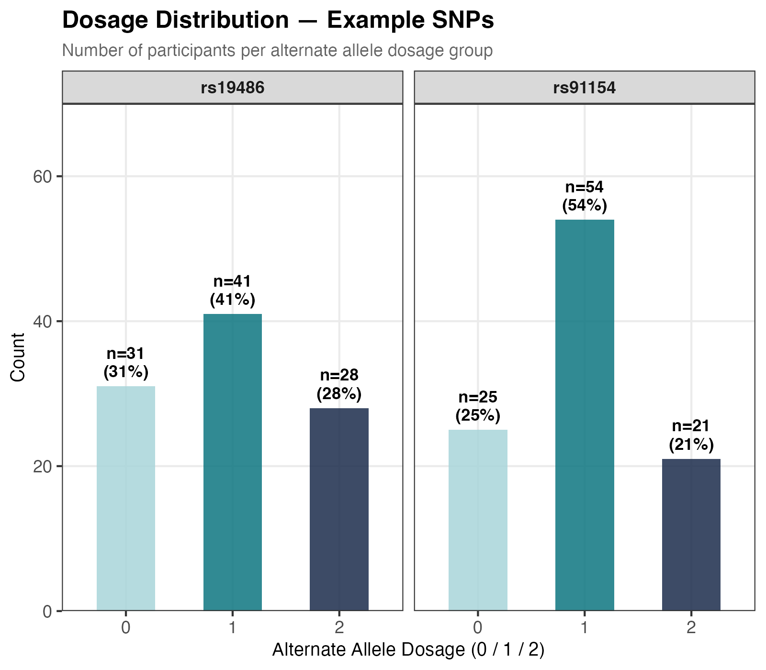
GENETICS
SNP Variables — Additive Encoding & EDA Summary
Additive Genetic Model
Dosage | Genotype (example: ref = A) | Meaning
0 | AA — homozygous reference | No alt alleles
1 | AC — heterozygous | One alt allele
2 | CC — homozygous alternate | Two alt alleles
50 SNPs encoded (rs123456 excluded — monomorphic)
Missing values: none
Dominant genotype: heterozygous (dosage = 1) across most SNPs
Most SNPs in this sample are dominated by heterozygous carriers (dosage = 1), with relatively few participants in the homozygous alternate group (dosage = 2), meaning effect estimates at dosage 2 should be interpreted with caution due to small cell sizes.
Notes:
Covariant 3 – SNPs
The 51 SNP variables are encoded under an additive genetic model, where each SNP is represented as the number of alternate alleles carried by each participant (0, 1, or 2). Two example SNPs are shown to illustrate the typical dosage distribution in this sample.
The results show:
Heterozygous carriers (dosage = 1) dominate across most SNPs — for example, rs91154 has 54% of participants at dosage 1, which is typical across most loci
Dosage 2 groups are consistently small — rs19486 has only 28 participants (28%) and rs91154 only 21 (21%) at dosage 2, meaning effect estimates at this level will have high uncertainty
Modelling implication: interpret dosage 2 effects with caution — small cell sizes limit statistical power for detecting homozygous alternate effects, and results at this dosage level may be unstable
Notes: Every person carries two copies of each gene — one from each parent. "Homozygous reference" (dosage = 0) means both copies are the common version. "Heterozygous" (dosage = 1) means one copy is common and one is the alternate (less common) version. "Homozygous alternate" (dosage = 2) means both copies are the alternate version. The additive model simply counts how many alternate copies a person carries, on the assumption that each extra copy adds roughly the same amount of effect.

Slide 11
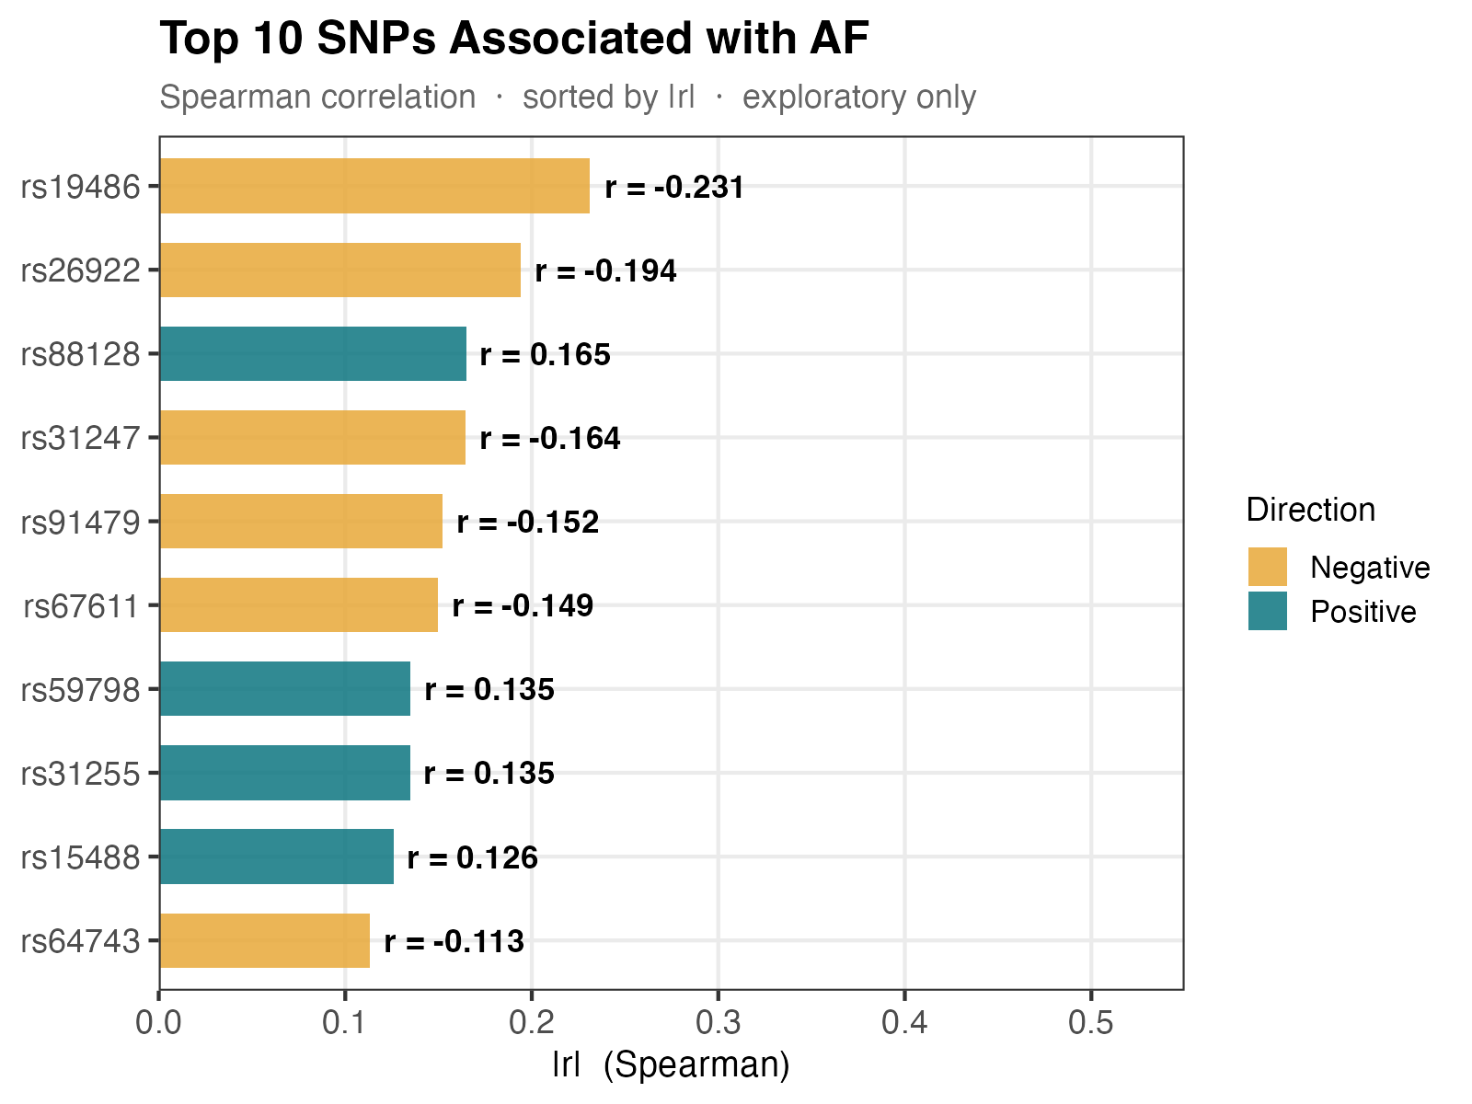
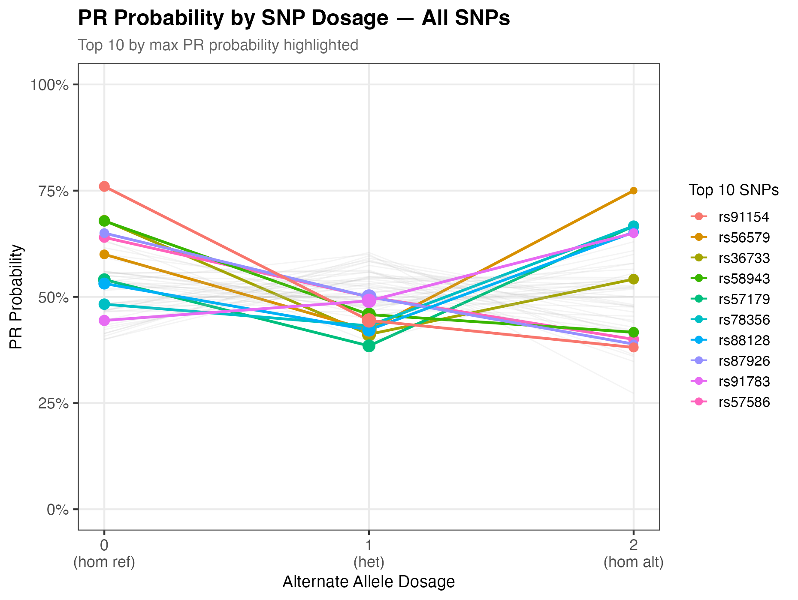
COVARIATES
The Role of SNPs
All SNP correlations with AF are weak (|r| ≤ 0.25), with rs19486 showing the strongest negative association. For PR, rs91154 shows the most consistent dosage-dependent decline, while rs56579 shows a sharp increase at dosage 2 — both warrant further investigation in formal modelling.
Notes:
Covariant 3 – SNPs
To identify which SNPs show the strongest marginal associations with outcomes, we compute Spearman correlations between each SNP's alternate allele dosage and AF (left), and plot PR probability (which refers to the proportion of participants with a ‘PR = yes’ response within a given SNP dosage group—for example, 75% of participants in the rs91154 dosage 0 group have a ‘PR = yes’ response, whereas only 38% of those in the dosage 2 group do) across dosage levels for all 50 SNPs with the top 10 by maximum PR probability highlighted (right).
The results show:
All SNP–AF correlations are weak (|r| ≤ 0.23) — rs19486 (r = −0.231) and rs26922 (r = −0.194) show the strongest negative associations with AF, while rs88128 (r = 0.165) shows the strongest positive association
PR probability patterns are heterogeneous — rs91154 shows a consistent decline from dosage 0 (75%) to dosage 2 (38%), while rs56579 shows a sharp increase at dosage 2 (75%), suggesting different underlying mechanisms
All findings are exploratory — with 50 SNPs tested simultaneously, multiple testing correction will be required in formal modelling before any SNP can be considered a candidate predictor
Notes: A Spearman correlation (r) measures how consistently two variables move together, on a scale from −1 (perfectly opposite) to +1 (perfectly in sync), with 0 meaning no relationship. Values of |r| ≤ 0.25 are considered weak associations — meaning that while there is a slight tendency for AF to rise or fall with SNP dosage, the relationship is not strong or reliable enough to draw firm conclusions without formal modelling. The right plot uses PR rate (the more complex way) rather than correlation because PR is a yes/no outcome and you cannot calculate a meaningful correlation between a dosage number and a binary response the same way you can with a continuous variable like AF. Plotting the actual proportion of "yes" responses at each dosage level is a more direct and interpretable way to show whether carrying more alternate alleles is associated with a higher or lower chance of a positive response.

Slide 12
Summary & Modelling Implications
AF Model
PR Model
Caveats
Treatment is the dominant predictor (p < 0.001)
Age is a significant additive covariate (p = 0.040)
No treatment × age interaction detected
Sex shows minimal marginal association — include optionally
rs19486, rs26922, rs88128 show strongest marginal associations with AF (|r| ≤ 0.25)
Treatment B: highest PR (66%), C: lowest (39%)
Age strongly associated with PR (older → higher rate)
Sex has no meaningful association with PR
rs91154, rs56579 may be worth investigating since rs91154 shows strongest negative dosage-response while rs56579 shows sharp increase at dosage 2
High AF does not guarantee PR — treatment C shows high AF but lowest PR rate (38.5%)
n = 100 — limited power for SNP × treatment interactions
smoker & rs123456 excluded (zero variance)
All covariates should be confirmed in formal modelling
Results are exploratory — interpret with caution
Notes:
This slide summarises the key patterns identified through Exploratory Data Analysis (EDA) — an initial examination of the data to understand its structure, identify relationships between variables, and inform the choice of predictors and model specifications before formal statistical modelling begins.
Conclusion:
The AF model should include treatment as the primary predictor, age as an additive covariate, and no interaction terms for treatment × age or treatment × sex. SNPs rs19486, rs26922, and rs88128 show the strongest marginal associations with AF and are worth testing in formal modelling.
The PR model should similarly include treatment and age as predictors. Notably, high AF does not guarantee PR — treatment C achieves the second highest AF but the lowest PR rate (38.5%), suggesting the two outcomes are driven by partially different mechanisms. SNPs rs91154 and rs56579 show the most notable dosage-dependent patterns for PR.
All findings are exploratory and should be interpreted with caution — formal modelling with appropriate multiple testing correction is required before drawing any conclusions.
Notes: The modelling implications listed here are about which variables to include when building a formal statistical model. "Primary predictor" means the main variable we think is driving the outcome (treatment). "Additive covariate" means a variable we adjust for because it is associated with the outcome but is not the main focus — adding it to the model makes the treatment effect estimate more accurate. The SNPs listed are candidates worth testing, but because 50 SNPs were examined simultaneously, there is a risk of false positives — a correction for multiple testing will be applied in formal modelling to reduce this risk.

