Slide 1
Neat software design with Symfony

Slide 2


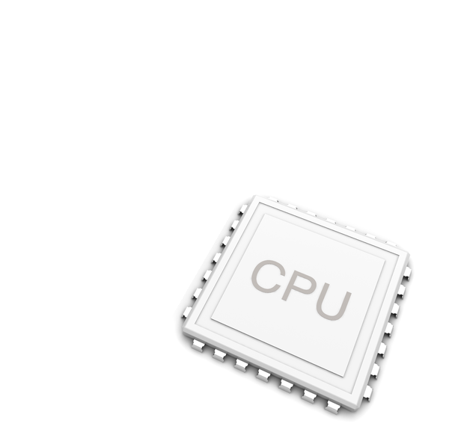

Scalability
RAID

Slide 3

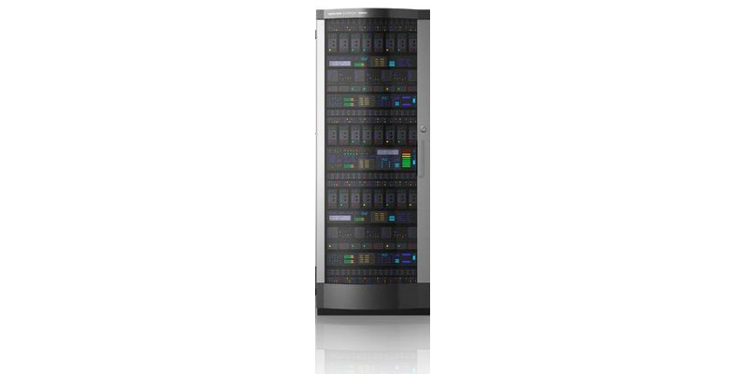

Slide 4
Scalability techniques are changing
Security
Performance
User interface
Portability . . .

Slide 5
The best software architecture?
===
Easy to change

Slide 6

The ivory tower architect

Slide 7

The sculptor architect

Slide 8
class JobPublisher
{
public function publish(Job $job)
{
$user = $job->getUser();
if ($user->getCredit() < $this->creditsToPublish) {
throw new \RuntimeException('Not enough credit to publish');
}
$user->setCredit($user->getCredit() - $this->creditsToPublish);
return $job->setStatus(Job::STATUS_PUBLISHED);
}
}
class JobPublisher
{
public function publish(Job $job)
{
$user = $job->getUser();
if ($user->getCredit() < $this->creditsToPublish) {
throw new \RuntimeException('Not enough credit to publish');
}
$user->setCredit($user->getCredit() - $this->creditsToPublish);
return $job->setStatus(Job::STATUS_PUBLISHED);
}
}
class JobPublisher
{
public function publish(Job $job, User $user)
{
if ($user->getCredit() < $this->creditsToPublish) {
throw new \RuntimeException('Not enough credit to publish');
}
$user->setCredit($user->getCredit() - $this->creditsToPublish);
return $job->setStatus(Job::STATUS_PUBLISHED);
}
}

Slide 9
reader = new BufferedReader(new FileReader(new File("backup/"+i)));
String[] dates = new String[]{"946684800","978307200","1009843200"};
String[] filters = new String[]{"important","Important","for later"};

Slide 10
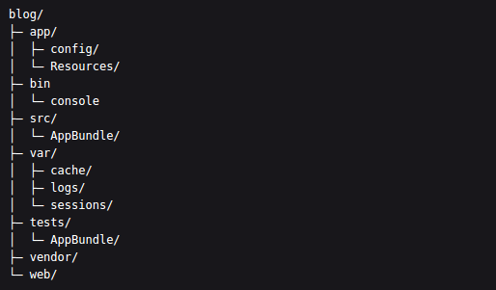

Symfony best practices
http://symfony.com/doc/current/best_practices/index.html
src/AppBundle/, stores the Symfony specific code (controllers and routes), your domain code (e.g. Doctrine classes) and all your business logic
Couple your code to the framework
And we won't give you any cookies

Slide 11
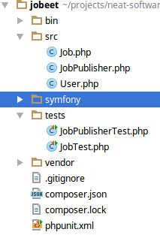
git init
composer init
composer requrie phpunit/phpunit
business logic code
test code
Plug in Symfony

