Slide 1
PRODUCT CHARTER
TM ENGAGEMENT PORTAL
MISSION
Empower employees to connect, recognize, and celebrate each other's successes with our Team Engagement platform. We foster a culture of connection and appreciation, enabling seamless sharing of achievements and valuable insights across the organization.

Slide 2
Business Problem
Objectives
Increase team engagement
Increase team satisfaction for Recognition
Improve TVS score for Appreciation & Recognition
Insights and analytics for leaders to keep track
Lack of a unified platform for TMs to engage (Slack channels/ Outlook emails/ Meetings/ 3rd party app for Reward Redemption)
Inability to keep track of recognitions received over a period
TMs satisfaction level is low for Appreciation & Recognition received, reflecting in low TVS scores in this category.
Success Metrics
Engaged workforce
Improved Performance
Sense of inclusion and belonging
Improved TVS score for Appreciation & Recognition
Product Description
Our Product Team engagement portal is an online application
To recognize peers, award strong performers, celebrate wins, share stories, and gain valuable insights
For Target TMs to have a dedicated platform to engage with the larger teams
Instead of relying on multiple platforms to perform each of these activities
Project team
Product Owner:
Preethi.A
Product coach:
Suvarna.P
Engineers:
Christina
Sai Sanjana
Vijaya Shree
Kavya
Swathi
Benda Siri
Tech Mentors:
Sujanteja.N
Shraddha.D
Lakshmi.V

Slide 3
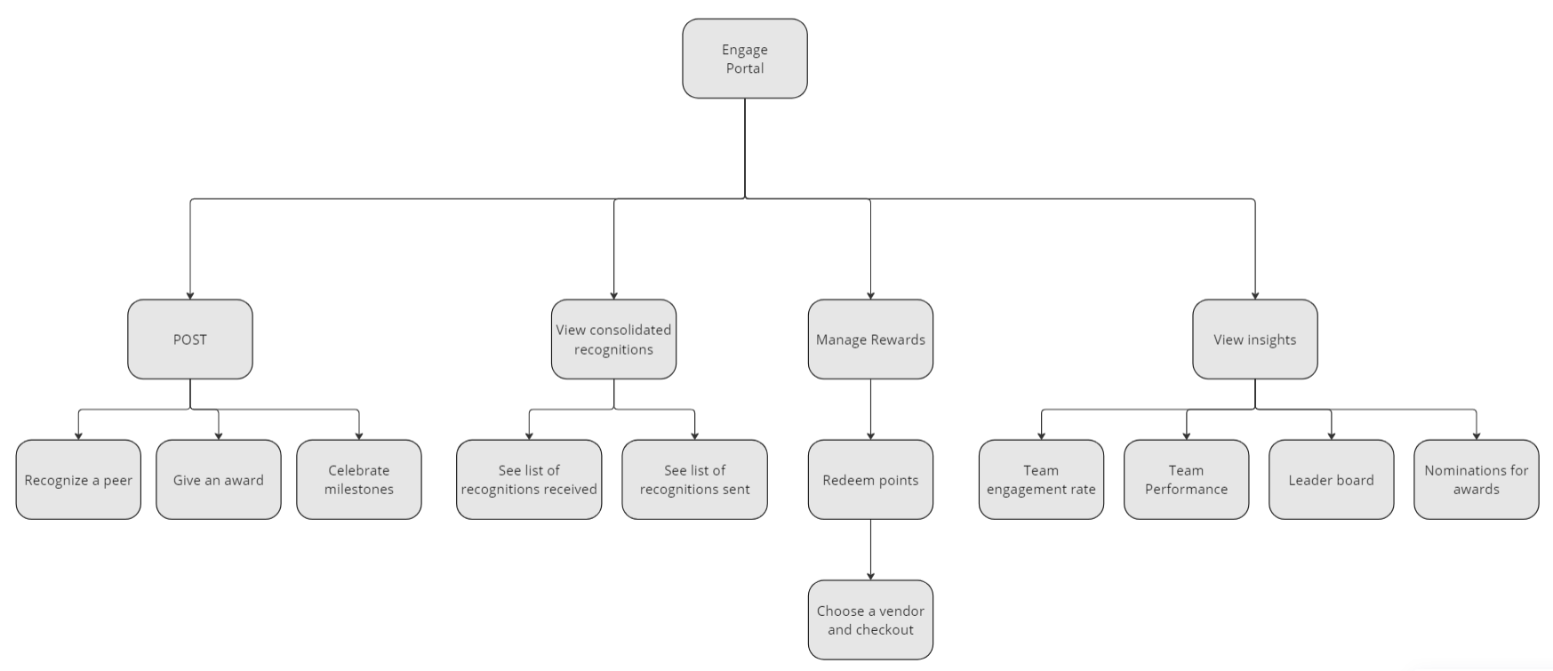
USER STORY MAPPING

Slide 4
POINTS SYSTEM
Every team member gets 100 points each month (ICs and Managers.) This will lapse at the end of the month if it is not used. It will not get carried forward to the next month.
Each recognition counts for 20 points (You can give out 5 recognition/month with points. After you exhaust your points, any recognition you give will not provide the other person with points. You can still recognize people.)
Every team has the following awards to be given out monthly:
Bright Spark – Individual only; Points: 500;
Limit: 2 awards per manager (Note: One team can have 10
managers, which means 20 bright spark awards can be given.)
Above and Beyond – Individual/Group; Points: 1000;
Limit: 2 awards per team. Example: If a group of 3 people
have done exceptional work together, this award can be given
to this group (It won’t be considered as 3 awards, it will be
considered as one award.)
One Team – Group only; Points: 1000;
(Limit: 1 award per team, no limit on the group size. Everyone
on the group will receive 1000 points each.)

Slide 5
MVP Features
User Authentication and Profiles:
User login
TM home page (news feed)
Team view vs Pyramid view
Search for posts (not people)
2. Recognition and Awards:
Ability for TMs to recognize peers for their contribution
Ability to award strong performers.
Include different types of recognition (Badges, points) with customizable categories.
Ability to nominate TMs for awards (Monthly/Quarterly.)
Automate birthday and anniversary celebrations.
3. Sharing Stories and Updates:
Ability to celebrate milestones.
Platform for sharing news, announcements, and stories relevant to the team/pyramid.
Options to interact with these posts (Like/Comment/Repost)
4. Notifications:
Notify TMs on email when they’re mentioned.
Insights and Analytics:
Comprehensive view of the recognitions and awards earned/given over selected period.
Future state:
1. Award Redemption:
Ability to redeem individual rewards.
2. Notifications:
Notify when someone mentions you in a post.
3. Insights and Analytics:
Dashboard showing trends in recognition and awards over a period.
Reporting functionality for administrators to export data.
4. Integration and Scalability:
Integration capabilities with existing HR systems or tools.
Scalability to handle increasing numbers of users and activities.
5. Mobile Responsiveness:
Mobile-friendly interface or dedicated mobile app for accessibility.
6. Feedback Mechanism:
Feature for employees to provide feedback on the platform itself.

Slide 6
WORKING AGREEMENT & DOD
Meeting Cadence:
Student cohort: Daily (Time TBD)
Students + Mentors: Mon,Wed,Fri (6.30pm)
Students + Mentors + Coach: Bi-weekly or Sprint Demo
Sprint Review: Mondays
Sprint Demo: Wednesdays (Last day of Sprint)
DOD:
All code has been written, reviewed, and meets the team's coding standards.
All tests (unit, integration, regression, etc.) have been written and passed successfully.
Documentation, both technical and user-facing, has been completed and updated.
The feature or user story has been accepted by the product owner and meets the desired level of quality and functionality.
The work has been demonstrated and accepted in the sprint review.
DOR:
The user story is well-defined, including clear acceptance criteria.
All necessary stakeholders have provided input and signed off on the user story.
Any dependencies or prerequisites have been identified and addressed.
The user story has been estimated and prioritized appropriately.
The development team has the capacity and necessary skills to complete the work.

Slide 7
PHASE 2 – PROJECT PLAN
KICK-OFF
Product brief
Project plan
Skill matrix
Working agreement
Jira board walkthrough
SPRINT 1
User Sign-in
TM – Home/News feed landing page
Duration: 2 weeks
SPRINT 2
Recognize a TM (Should end up adding points if given)
Give an award
Share a story
Celebrate a milestone
Notify via email when you get mentioned on ‘Engage’
Duration: 2 weeks

Slide 8
SPRINT 3
My dashboard: List of recognitions received; List of recognitions sent for select time frame.
Change view settings
Duration: 2 weeks
SPRINT 4
Trending Hashtags
Top Performers
Duration: 2 weeks
SPRINT 5
Presentation
Demo day
Duration: 2 weeks

Slide 9
COMMUNICATION MODE
Whatsapp Group
For any discussions with Mentors and Team members.
Pre-requisite: Share Phone #
2. Jira – Project management
For weekly sprints and individual tasks
Product Owner will act as the SCRUM master and run the Jira boards. Team members are accountable for owning their tasks and completing on time.
Pre-requisite: Share Email IDs
Team Principles
We choose to believe the best about others' intentions and actions.
We provide recommendations — but we stay open to changing our minds.
Blaming others isn't productive. When a problem comes up, we all work together to define it and solve it.
We don't hide problems - we seek to make them visible.
It is OK to be wrong - but try to be wrong fast. Indecision kills speed.
Schedule things that are important.
Strive to deliver business value quickly. If something can be broken into smaller parts to deliver value faster - do it!
Express urgency (when appropriate) to inspire confidence when a task is assigned.
Be kind and direct in your communication.
Embrace Ambiguity and realize there are often many paths forward instead of one correct answer
Work openly. Create value by sharing knowledge and creating processes that will outlast you, NOT by building walls and hoarding information.

