Slide 1

Introduction to TypeScript SharePoint Framework Series
September, 2016

Slide 2
Intro
SharePoint Framework Overview
Installing TypeScript
TypeScript Overview
TypeScript Demo
SharePoint Framework Demo

Slide 3

Eric Skaggs
eskaggs@outlook.com
Twitter: @skaggej
http://www.ericskaggs.net
Catapult Systems
Pluralsight Author
https://github.com/skaggej/spfx

Slide 4
TypeScript Overview

Slide 5
TypeScript Overview
Typed superset of JavaScript
Compiles to plain JavaScript
Any browser, any host, any OS
Open Source
C#-ish syntax

Slide 6
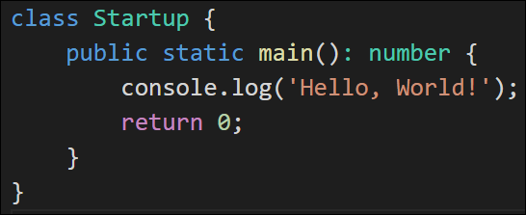
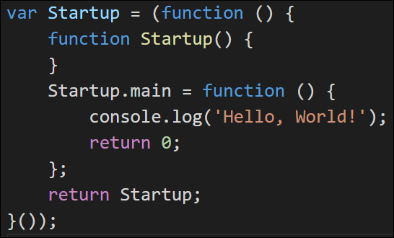
TypeScript Example
Write TypeScript – HelloWorld.ts
Generated JavaScript – HelloWorld.js
Run TSC (TypeScript Compiler)

Slide 7
Installing TypeScript

Slide 8
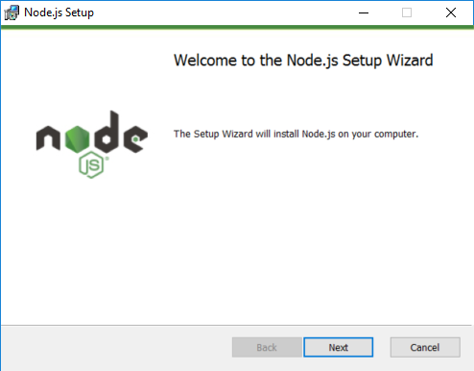
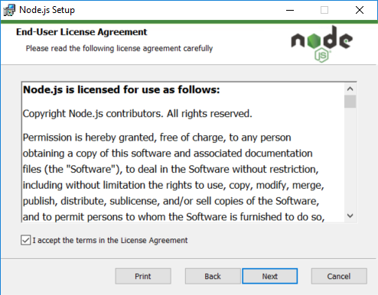
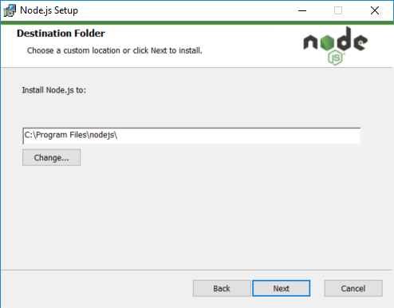
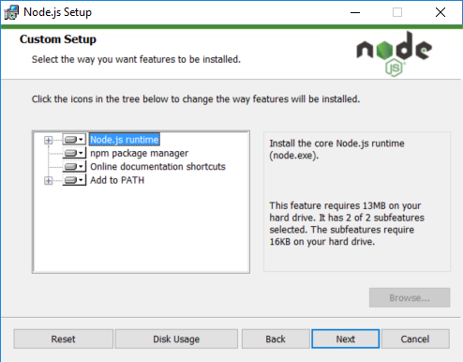
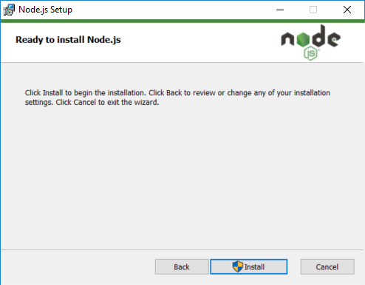
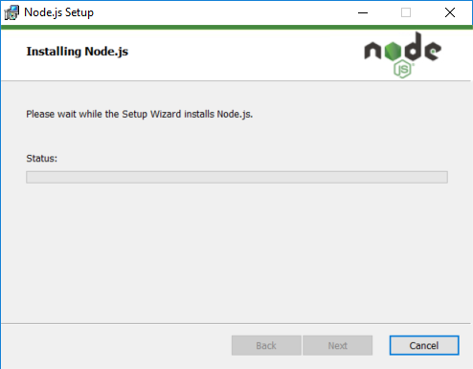
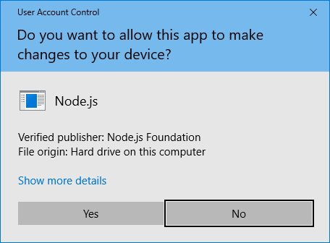
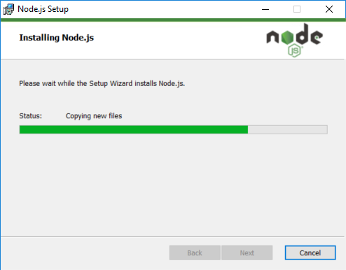
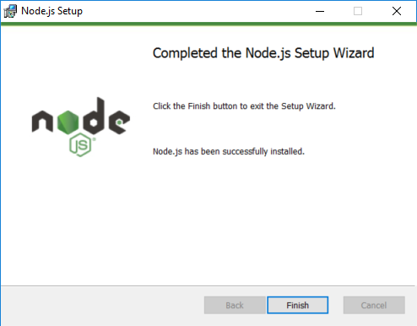
Installing Node.js

Slide 9
Installing TypeScript
Install Node.js
Includes npm (JavaScript Package Manager)
Install TypeScript
Ready to go!

Slide 10
TypeScript Demo
Notes:
Open Visual Studio Code.
Create a new file called HelloWorld.ts.
In HelloWorld.ts, add a class named Sample with a method named main that outputs “Hello, World!” to the console. Ensure the main method is called at the bottom of the TypeScript file.
Press CTRL+` to open the console. Ensure the path matches the current project’s directory.
In the console, type “tsc HelloWorld.ts” and press Enter.
Open the newly created HelloWorld.js file to show what it contains.
Create a new file called HelloWorld.html.
In HelloWorld.html, set up the basic structure of an HTML page and be sure to include a script reference to HelloWorld.js. There’s nothing more you need to do, but I recommend adding something to the body of the page like “Check the console for a message.”
Open HelloWorld.html in a browser, press F12 to open the developer tools, and review the contents of the JavaScript console.
Sample code: https://github.com/skaggej/spfx/tree/master/intro-ts

Slide 11
SharePoint Framework Overview

Slide 12
SharePoint Framework Overview
Page and web part model supporting client-side dev
Easy integration with SharePoint data
Support for open source tooling
Modern web technologies
Works for SharePoint Online and on-premises

Slide 13
SharePoint Framework Overview
No iframes
The controls are responsive and accessible by nature
It's framework agnostic
Performance is reliable
Not a replacement for any current models

Slide 14
Set up Office 365 Dev Tenant
Get an Office 365 developer tenant - http://bit.ly/2c8L50Z
Create an app catalog site collection
Create a development site collection
Add ClientSideApplicationId column to Documents
Upload workbench.aspx to Documents

Slide 15
Set up local dev environment
Follow this guide – http://bit.ly/2bYYChe
Install developer tools
Install Yeoman and gulp
Yeoman – scaffolding, best practices, common tools, and code
gulp – Bundle and minify JavaScript and CSS files, run tools to call the bundling and minification tasks before each build, compile SASS files to CSS, and compile TypeScript files to JavaScript.
Install Yeoman SharePoint Generator
Quickly creates a SharePoint client-side solution project with the right toolchain and project structure

Slide 16
SharePoint Framework Demo

Slide 17
Resources
#SPFx Home: http://dev.office.com/sharepoint
#SPFx Overview: http://bit.ly/2bWijSN
#SPFx Tools and Libraries: http://bit.ly/2ccHkv3
#SPFx GitHub: https://github.com/SharePoint/sp-dev-docs
TypeScript Quick Start: http://bit.ly/2c4Ndt0
TypeScript Playground: http://bit.ly/2c0Dsdq
TypeScript Handbook: http://bit.ly/2c0E2ro

Slide 18
Resources
Node.js - https://nodejs.org
npm - https://www.npmjs.com
TypeScript Package at npm: http://bit.ly/2cmNbve
What’s New In TypeScript – Build 2016: http://bit.ly/2caebC9
Set up your Office 365 developer tenant - http://bit.ly/2c8L50Z

