Slide 1
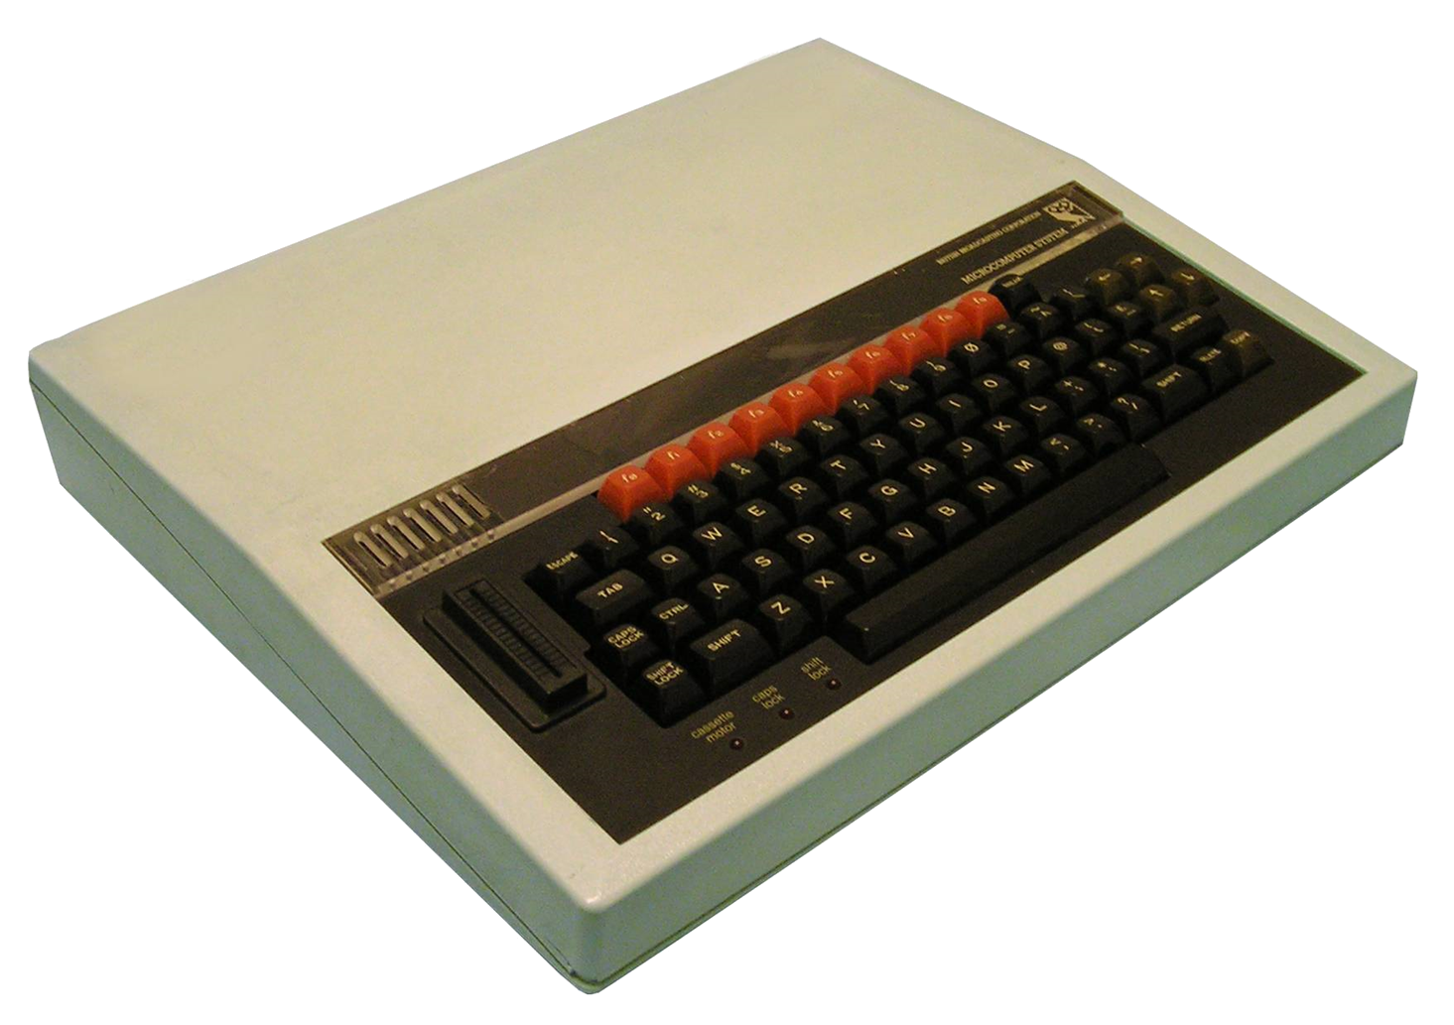
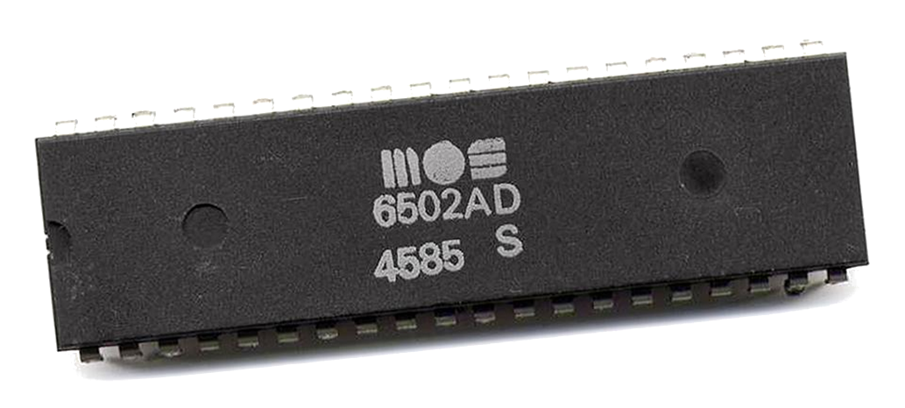
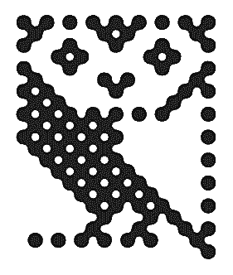
Towards an Emulator of the BBC Micro Computer

Slide 2
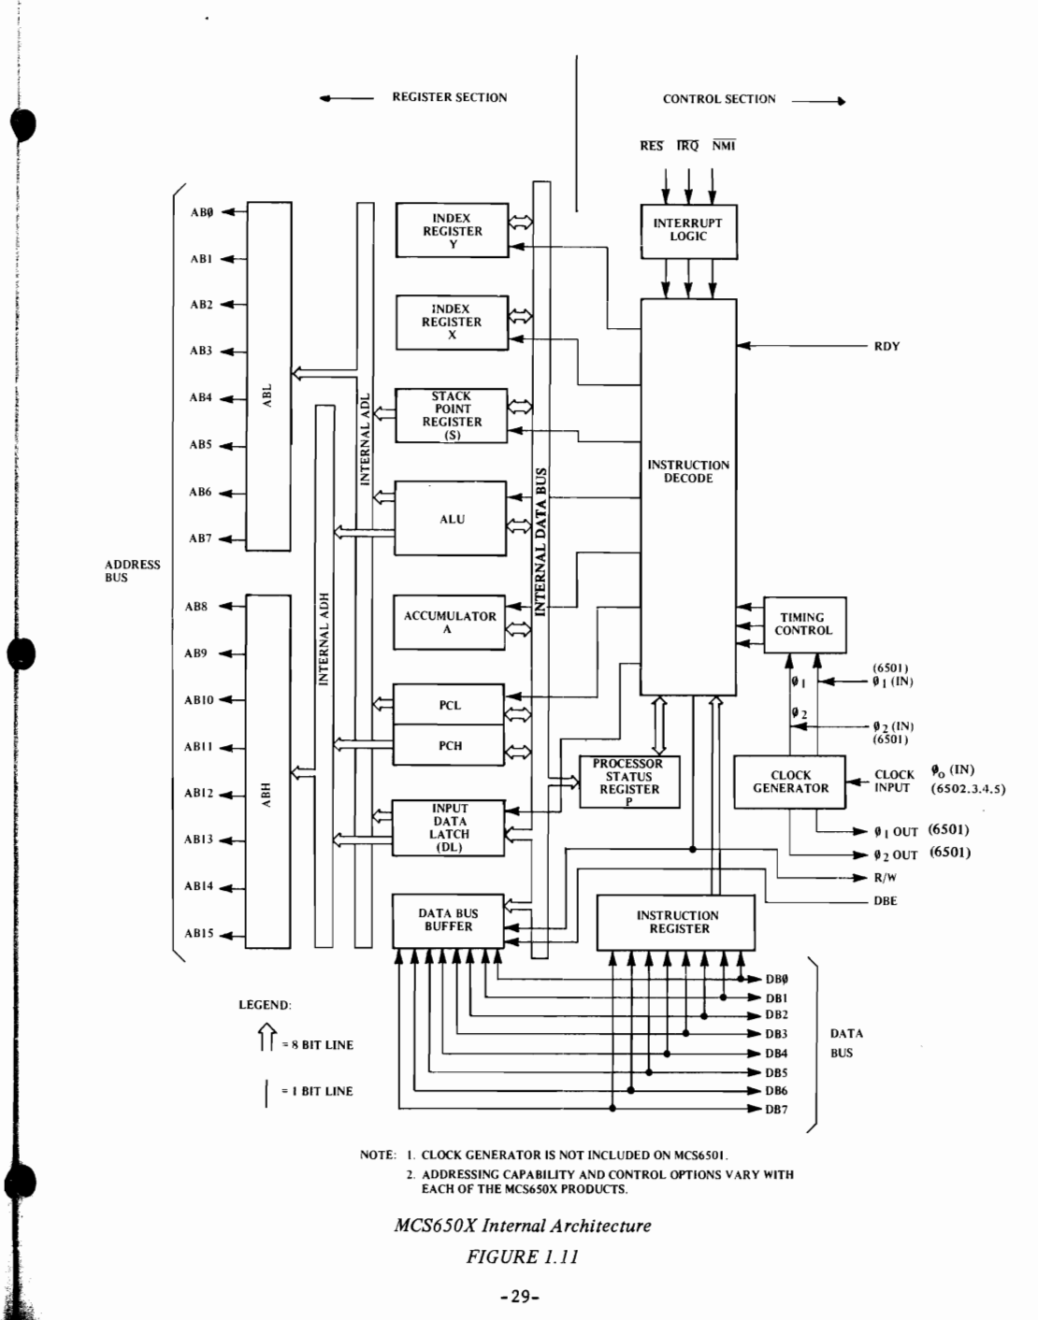
A MOS Technology 6502 processor in a DIP-40 plastic package. The four-digit date code indicates it was made in the 45th week (November) of 1985.
General information
Launched | 1975; 46 years ago
Common manufacturer(s) | MOS Technology, Rockwell, Synertek
Performance
Max. CPU clock rate | 1 MHz to 3 MHz
Data width | 8
Address width | 16
Architecture and classification
Instruction set | MOS 6502
Instructions | 56
Physical specifications
Transistors | 3,510,^{[1]} 3,218^{[2]}
Package(s) | 40-pin DIP

