Slide 1
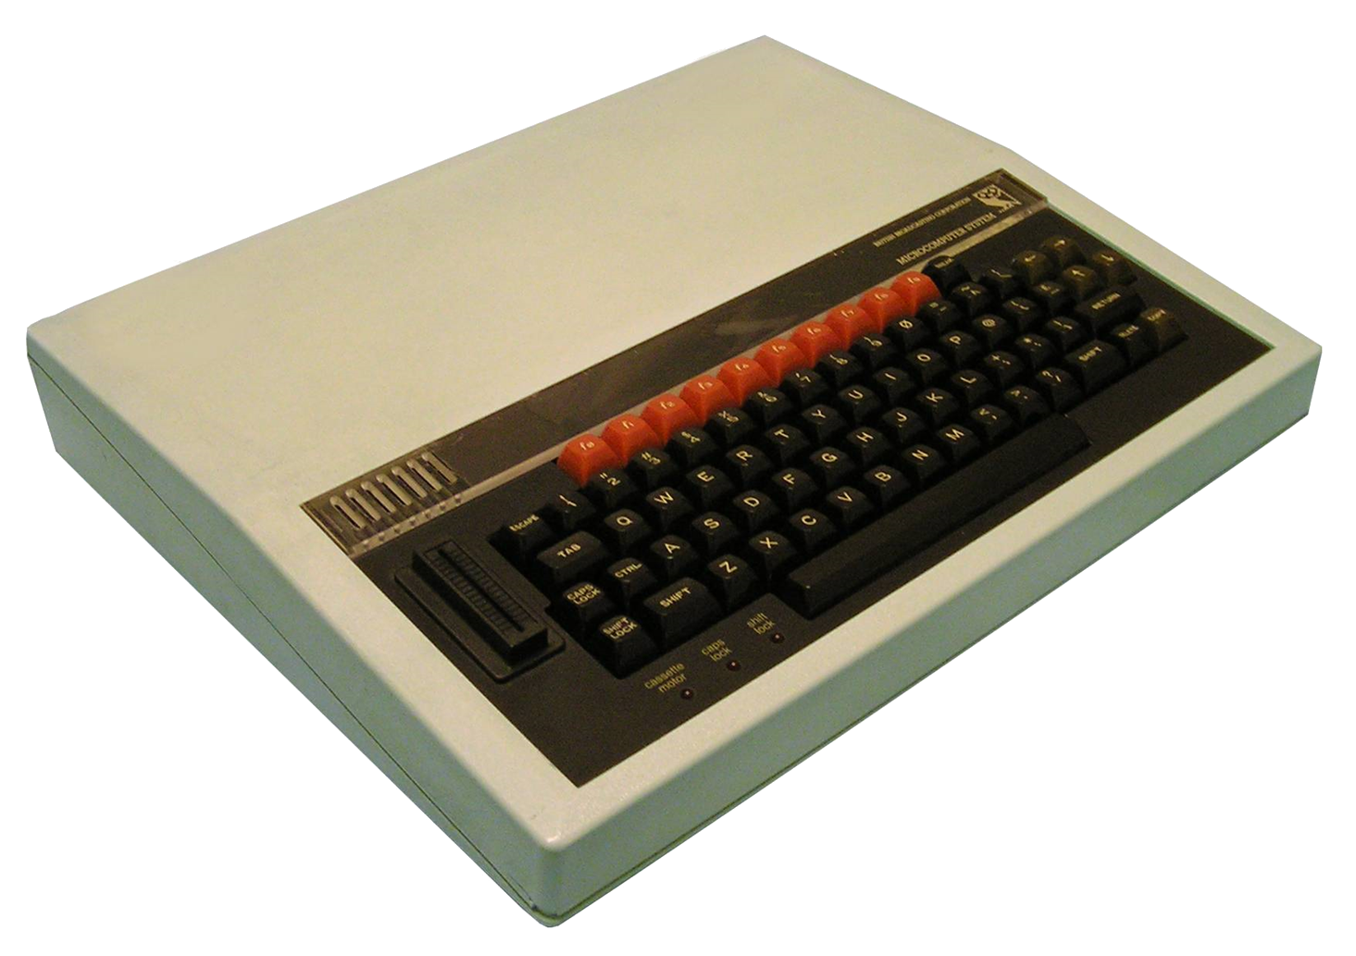
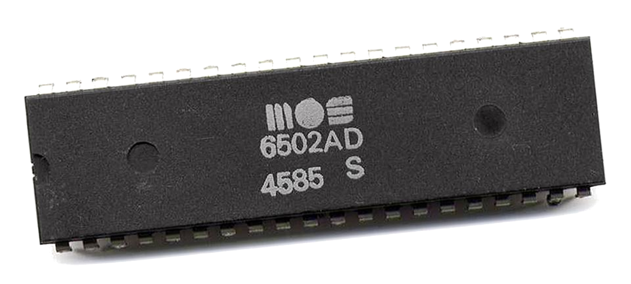

Towards Emulation of the BBC Micro Computer

Slide 2
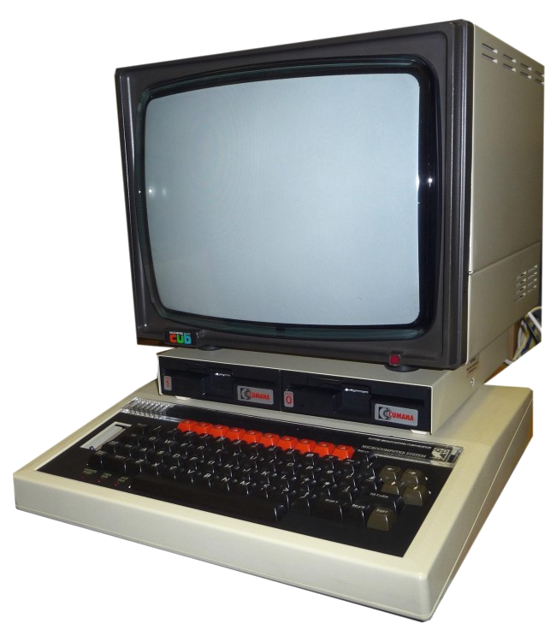
Some History
BBC Computer Literacy Project
Launched 1981
Manufactured by Acorn
2 MHz MOS Technology 6502/6512
RAM 16–32 KiB
Graphics - 6845 CRTC
8 Modes
160 × 256 8 Colours 640 × 256 1 Colours, Teletext
Sound – Texas Instruments SN76489

Slide 3
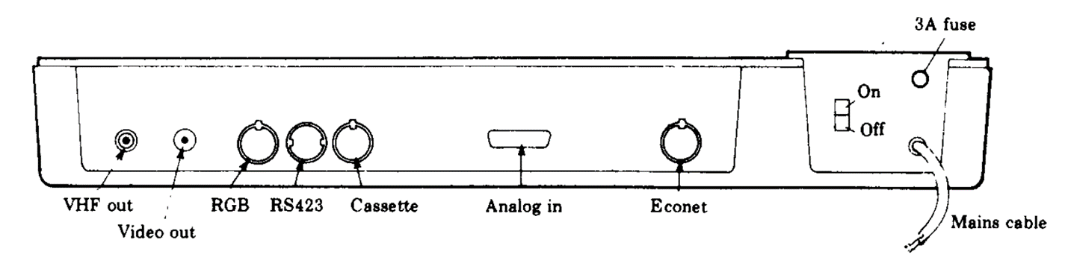
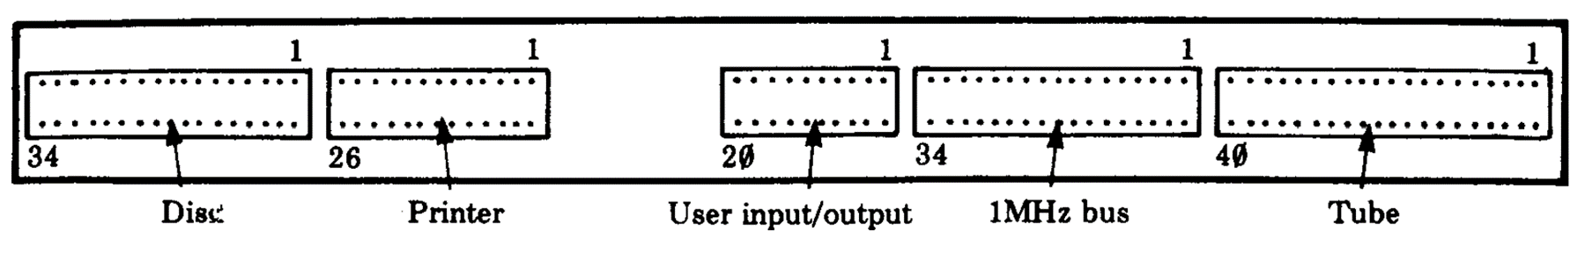
Expansion

Slide 4
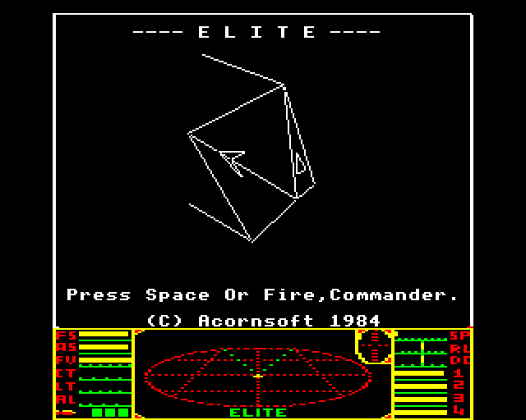
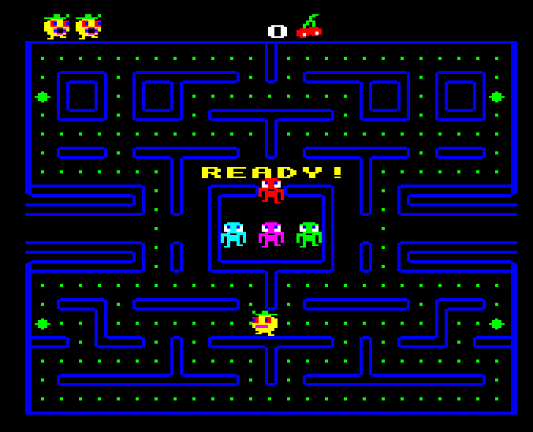
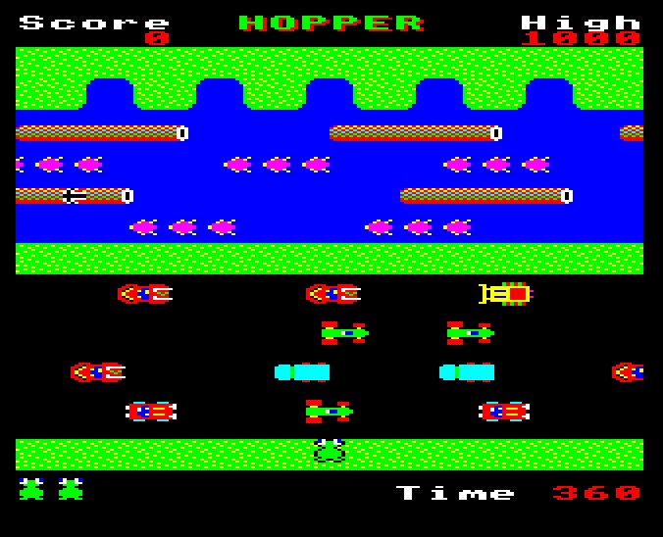
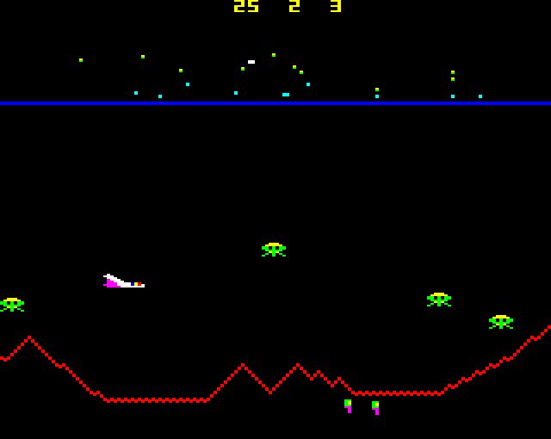
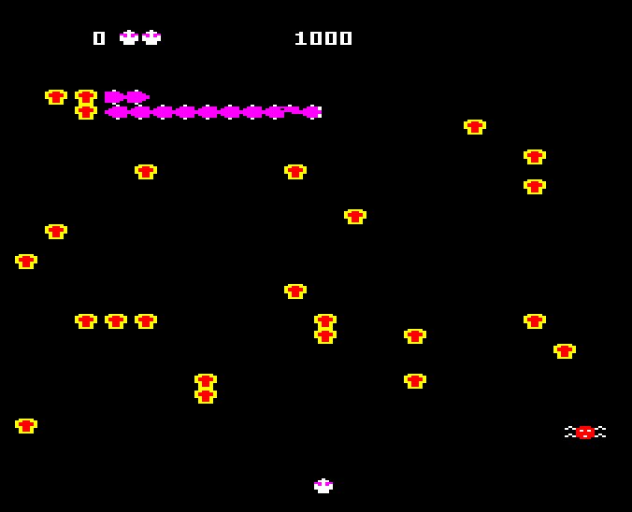
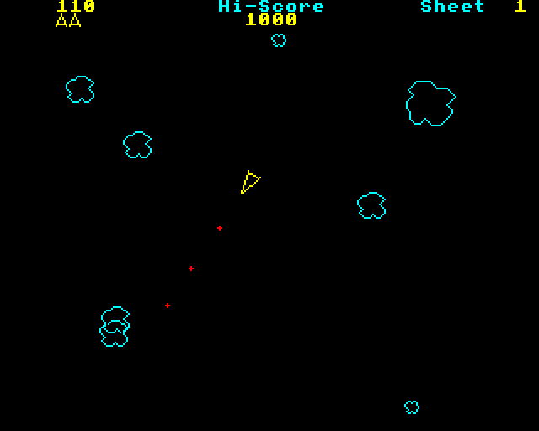
Software - Games
Elite
Pacman (Snapper)
Frogger (Hopper)
Defender (Planetoid)
Centipede (Bug Blaster)
Asteroids (Meteors)

Slide 5
Software - other
Languages (ROMS)
Basic, Pascal, Forth, BCPL, LISP, Logo/Turtle graphics
Business
Word processors (Wordwise), Spreadsheet (ViewSheet), Accounting, Database
Educational
Maths, Physics, Electronics, Geography, Chemistry

Slide 6
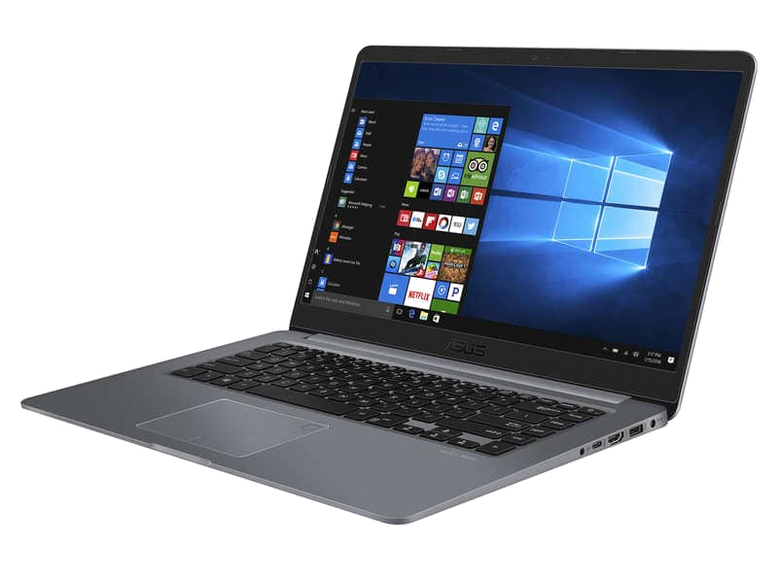
An Emulator you say…
Allows software written for one type of computer to run without modification on another…
… by recreating the hardware of the old system as software on the new system

Slide 7
Stage 1
#1 CPU
#4 Basic image loading
#2 Memory
#5 OS call Interception
#3 Basic I/O

Slide 8
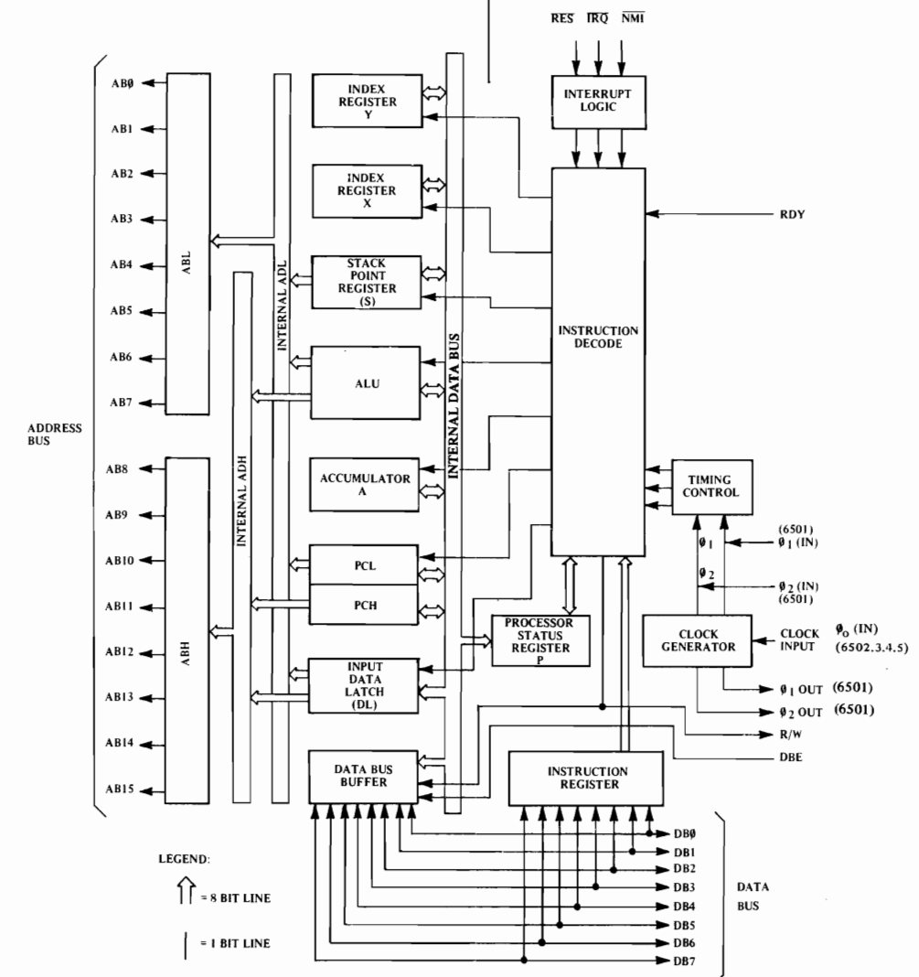
The 6502 Microprocessor
Clock speed – 2 MHz
Transistors - ~3500
Buses
Data – 8 bit
Address – 16 bit => 64K address space
Registers
1 Program counter (PC) 16 bit
1 Stack pointer (S) 8 bit => 256 byte hardware stack!
1 Status register (P)
1 Accumulator (A) 8 bit
2 Index registers (X,Y) 8 bit

Slide 9
Aside – comparison with a modern system
 | BBC (6502) | Modern Desktop (Intel) | Comment
Clock speed | 2 MHz | 4 GHz | x2,000
Size | 21 mm² | 100 mm² | x5
Transistors | 2500 | 16,000,000,000 | x6,400,000
Fabrication | 8 µm | 5 nm | ~1000
Word size | 1 Byte | 8 Bytes | x8
Cores | 1 | 4(8)+ | x4(x8)
L1/L2/L3 cache | 0 | 64K/256K/2M x 4 | -
Memory | 32K | 32G | x1,000,000

Slide 10
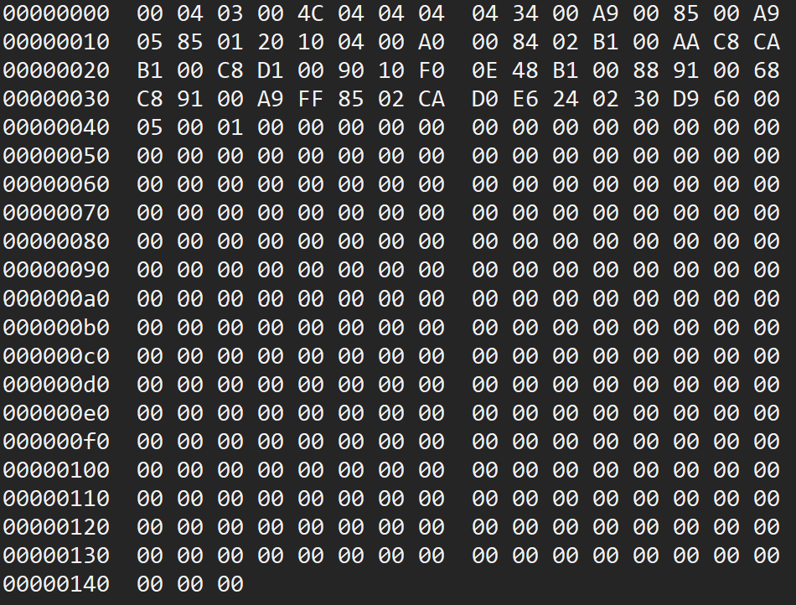
Programming the CPU
Machine Code
When you run any application, this is the code the computer is actually executing!
Lowest level of software
Binary language processed directly by the CPU
Simple instructions
Load a value in to register
Jump to an address
Add two numbers
Branch depending on value of status flag

Slide 11
Structure of an Instruction
OpCode => What to do
Load a value into the Accumulator
Encoded together in 1 byte
Addressing mode => How to resolve the operand
You’ll find the address of the value to load in the next two bytes
0 to 3 byte depending on addressing mode
Operand => What act on
The address of the value to load

Slide 12
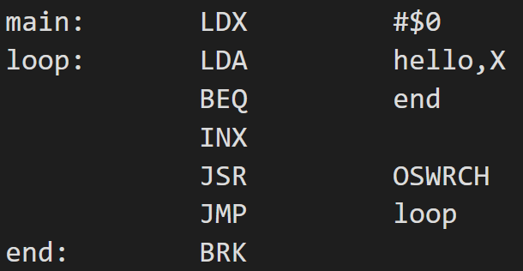
Programming the CPU
Assembly Language
Operand & addressing mode
Label
Op code
Human readable form of machine code
1:1 correspondence with machine code
This is NOT a higher-level language
An assembler translates assembly language into machine code for execution

Slide 13
6502 MC/Assembly Language
56 Op Codes
13 Addressing Modes
CLC – Clear the Carry flag
LDA – Load accumulator
INX – Increase X
ADC – Add to the accumulator
BEQ – Branch if Zero flag is set
ROR – Rotate bits right
JSR – Jump to a subroutine
Implicit - CLC
Accumulator – LSR A
Immediate – LDA #10
Zero-page – LDX $10
Zero-page, X – AND $20, X
Zero-page, Y – STX $30, Y
Relative – BEQ $26
Absolute – JMP $20FE
Absolute, X – STA $3000, X
Absolute, Y – AND $2000, Y
Indirect - JMP ($FFCC)
Indexed Indirect - LDA ($40), A
Indirect Indexed – LDA ($40, A)

Slide 14
Tool Chain & Execution Process
Assembly Language
6502 Emulator
LDA ($00),Y
BEQ $07
Image loader
Memory
6502 cross assembler
$B1 $00
$F0 $07
Basic I/O
6502 Emu
Machine Code
Keyboard
Screen

Slide 15
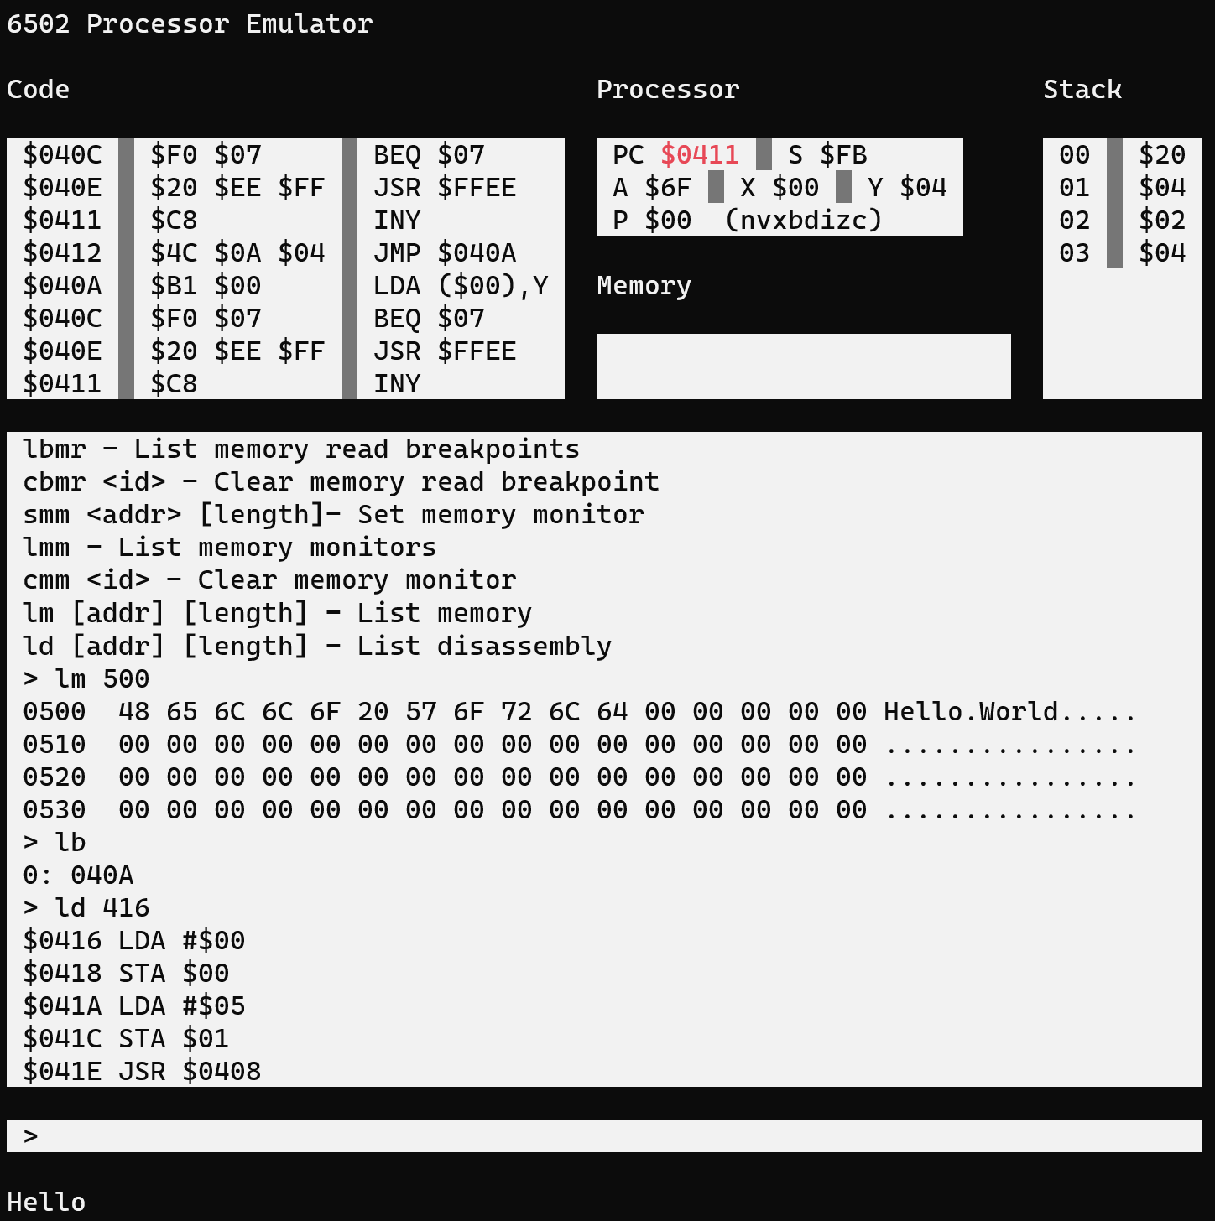
6502 Debugger
Processor Registers
Hardware stack
Disassembly
Memory writes
Functions
Command output
Load DASM images
Load core dumps
Single step
Step over
Disassembly
Memory inspection
Set reg/mem
Break points
Run until RTS
Programme output

Slide 16
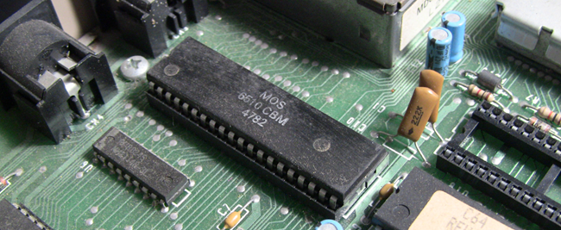
Demo #1 – 6502 Emu & Debugger

Slide 17
Stage 2 – From 6502 to BBC Micro (partial emulation)
#4 OS Boot
#1 6845 CTC Simple Mode 7
#5 Execution of BBC BASIC programmes
#2 OS ROM loading
#3 Paged ROM loading

Slide 18
BBC Micro Emulation
6502 Emulator
Boot/6502 Reset
BBC Basic Programme
JMP (0xFFFC)
10 REM Input a number
20 REPEAT
30 PRINT “Enter "
40 INPUT N
50 UNTIL N >= 0 AND N <= 9
60 PRINT "Thank You"
OS ROM
0xFFFF
0xC000
BBC Basic ROM
$BFFF
$8000
6845 CRTC Emulator
Memory Mapped Screen
$7FFF
Mode 7 (Teletext)
$7C00
Scan
Working Memory
$7BFF
Render
$0000
>

Slide 19
A Different Viewpoint
Native BBC BASIC
BBC Basic programme
Native 6502 MC
Basic interpreter
Native 6502 MC
BBC OS
Hardware emulation
6845 CRTC
6502 CPU
Keyboard interface
C#/.Net Core
IL
X86 MC
JIT
Windows OS
X86 CPU

Slide 20
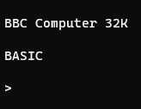


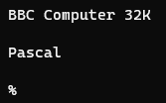
Demo 2 – Simple BBC Emu

Slide 21
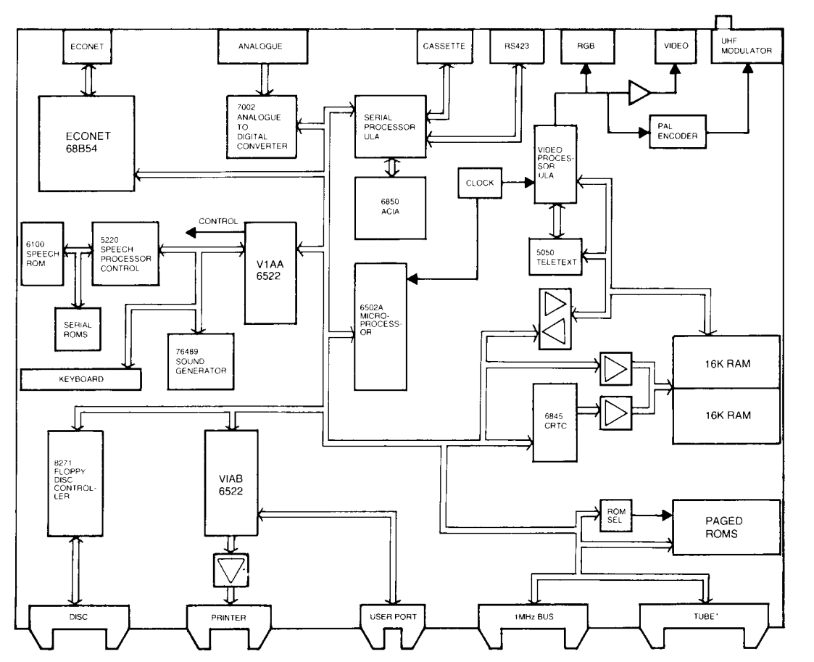
Status & What's Next
Done
Required
Unsure
From the BBC Microcomputer Advanced User Guide

Slide 22

?

