Slide 1
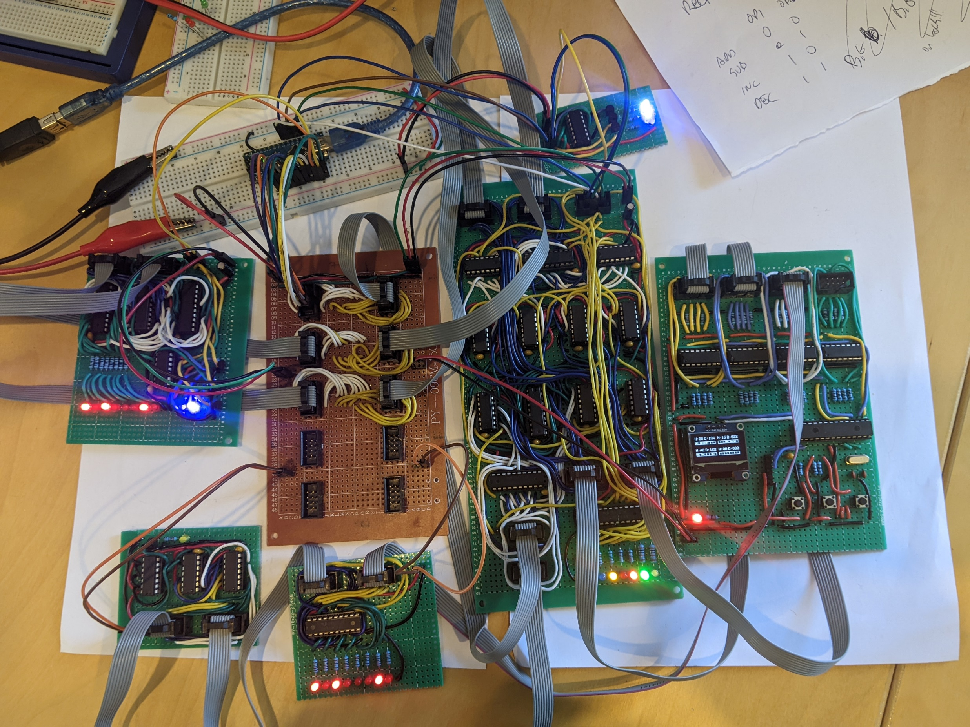
Control Unit
Carry flag
Value monitor
Register
ALUA value
ALUB value
ALU out
Register value
Data, clock, power busses
Zero Detection
Cout LDA LDB Cin OP1 OP0 Out Clck
ALU Out
ALU

