Slide 1
Project Architecture
Machine learning fruit identifier Android App.

Slide 2
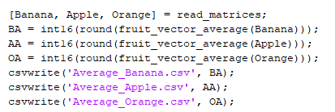
MATLAB general script
The MATLAB portion was broken down into 2 parts, the primary script and the 2 functions used to calculate the average vectors of each dataset of images.
The primary code first took the read_matrices function to create a matrix of row vectors for each image and assigned them matrices.
Fruit_vector_average then took these matrices and calculated the average vectors and created row vectors.
We convert the average vectors to int16 as it makes the java aspect easier, to do this we had to round.
Csvwrite then converts these row vectors into csv files that can be read into other parts of our project for classification.

Slide 3

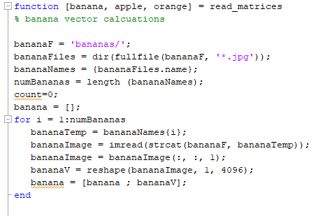
MATLAB read_matrices function
This function would read in the datasets which were formatted as a folder containing every jpg.
Once read into their variables it would find the length used in the for-loop.
In the for-loop it took the images and converted them into row vectors after first turning them into a 64x64x1 matrix.
Since the row vectors were all the same length due to the sizes of the images being the same it then read them into the fruits output row vector matrix with each row being a separate image seen as a vector.
This image shows the function including only the banana calculations, this same cycle was repeated for apples and oranges in the same function
At the end of the function, it converts the matrices into doubles so when calculating the averages, it would be more exact rather than doing integer calculations

Slide 4
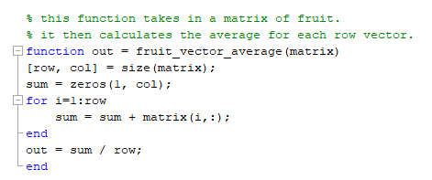
MATLAB fruit_vector_average function
This function took in the matrices created from the previous function and then found the sum of each column and finally output the sum divided by the number of rows to find the average for each vector of the pixels for each image.

Slide 5
Java
The Java portion was used to analyze the image and use image analysis to identify what object was in the picture
It contained multiple functions that were called by later code in order to connect the matrices gathered by the Matlab code and the image taken by the Android app.

Slide 6
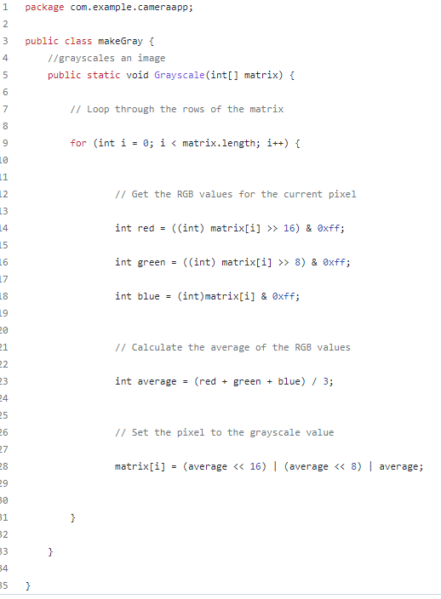
This function in Java takes in a matrix that represents an image and turns it to grayscale. It averages the RGB values and converts that to a grayscale value. This makes analyzing the images more accurate.

Slide 7
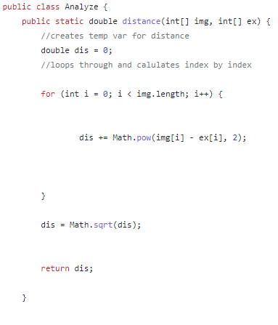
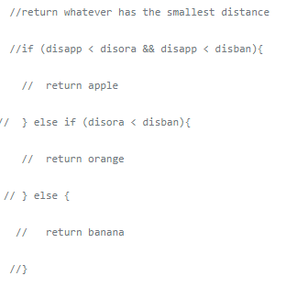
This Java code combines with Kotlin takes the distances between the grayed matrices to see which image matrix of fruits the taken image is closest to in order to identify the object in frame. This would return an int based on the decision that the code comes to.

Slide 8
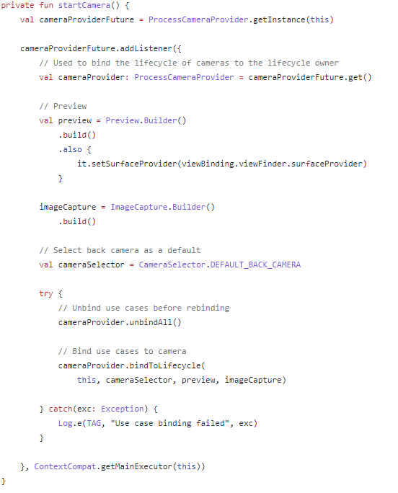
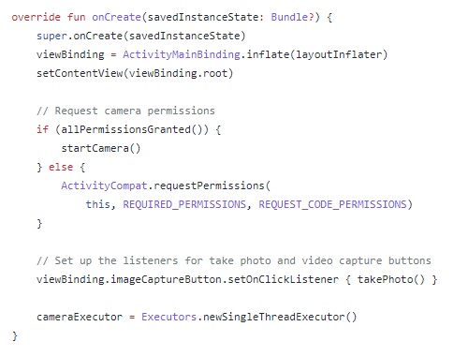
Kotlin
The Kotlin portion of the project was based on the applications of the Camera2 Library in order to create instances of different camera functions which contained both Java and Kotlin Code
Focusing on the Kotilin Code, the majority of the processes are due to the active usage of builders and providers which are very useful for complex data structures (builders create the data structures and providers access them)

Slide 9
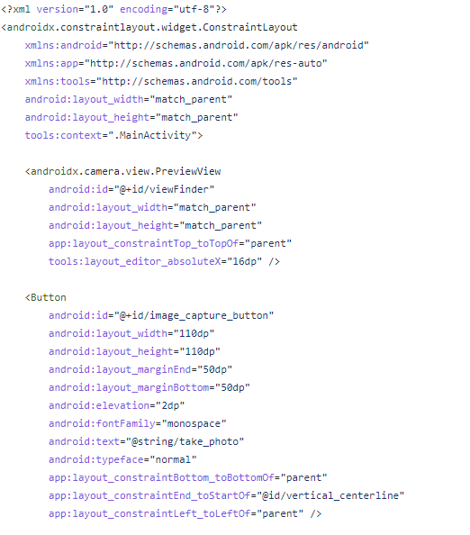
XML
XML Is used for formatting the app in the main layout file as well as setting some predefined constants such as the color and theme.
This is the camera API and the xml file working in tandem in order create the two main aspects of the application. The first the preview which is made to match the screen size of the phone as well as the button which is set to a specific size and is located based on the screen size.

