Slide 1
Jak zacházet s hesly v Unit testech a jak jednoduše testovat Azure Functions
Jan Skála

Slide 2


Kdo jsem
Microsoft Learn Student Ambassador
Student FEL ČVUT
Integrační architekt ve firmě Networg
Vývojář, pisatel článků a příležitostný školitel
C#, Haskell, Python, C++, …
github.com/skalahonza
janskala.cz
Notes:
Jazyky, které mě nejvíc ovlivnily.

Slide 3


Kdo jsem?
VPN
CRM in CLOUD
CRM ON EDGE
Účetnictví
SQL
SQL
REST API

Slide 4
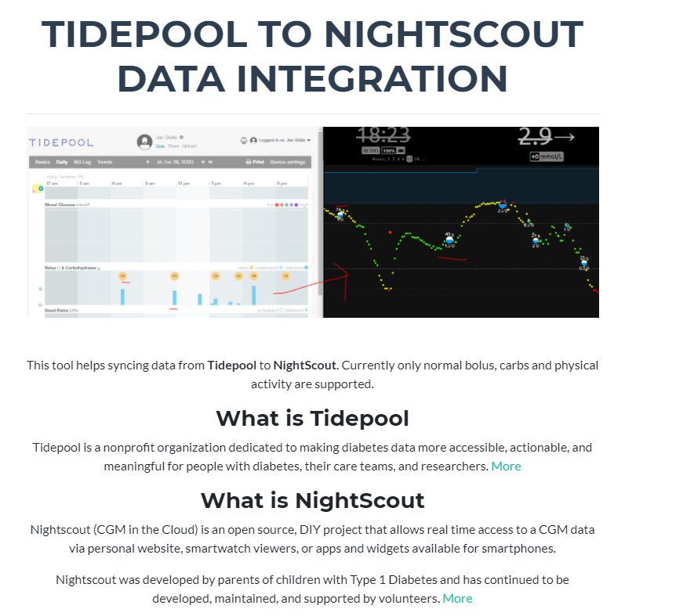

Slide 5
Co dnes budeme používat
C#
Visual Studio
xUnit
Azure Functions
Fluent Assertions
Deskriptivní popisy testů i chyb
Běžné testovací scénáře
Moq
Knihovna pro mockování
Notes:
Správně naimplementované běžné testovací scénáře. Kolekce / stringy.

Slide 6
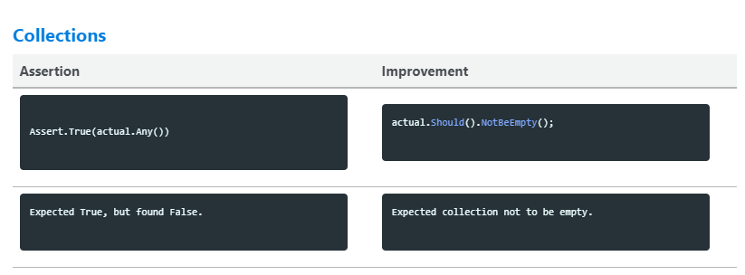
Fluent Assertions
https://fluentassertions.com/tips/

Slide 7
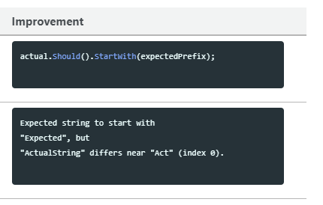
Fluent Assertions
https://fluentassertions.com/tips/

Slide 8
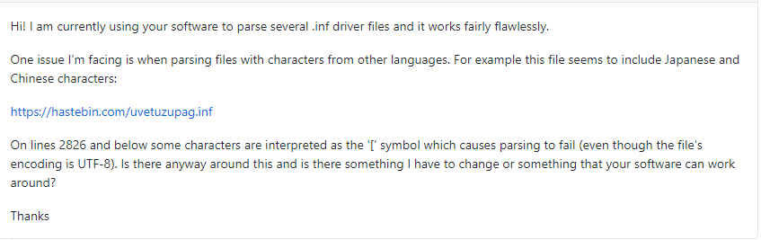
Proč testovat?
https://github.com/skalahonza/InfHelper

Slide 9
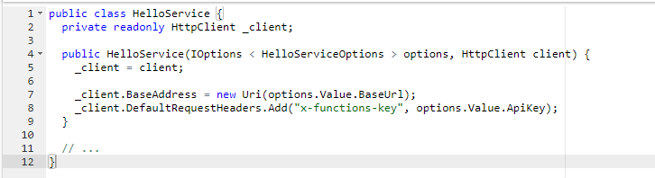
Configuration as code
JSON
Secrets
ENV variables
CMD arguments
HelloServiceOptions
Notes:
Design pattern. Validace. Objekt.

Slide 10
Configuration as code
var configuration = new ConfigurationBuilder()
.AddEnvironmentVariables()
.AddUserSecrets<BasicTest>()
.Build();
services.AddOptions<HelloServiceOptions>().Bind(configuration);
//…
services.AddOptions<HelloServiceOptions>().Bind(configuration).ValidateDataAnnotations()
Notes:
3 animace

Slide 11
Zadání od manažera
Azure Function, která pozdraví uživatele
V odpovědi musí být Ahoj {jméno}
The response should contain Hello {username}

Slide 12
Demo

Slide 13
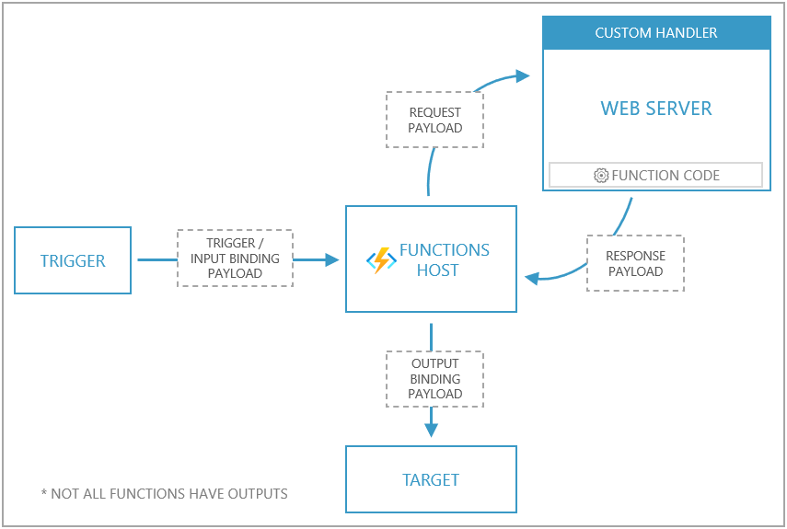
Azure Functions
https://docs.microsoft.com/

Slide 14
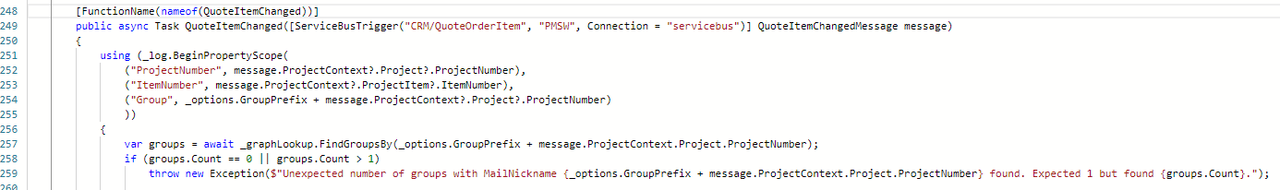
Azure Functions, manuální spuštění
Notes:
2 Animace 1 problém service bus
2 druhý problém, funkce nic nevrací

Slide 15
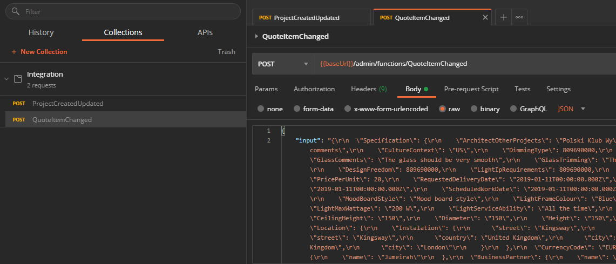
Azure Functions, manuální spuštění
Notes:
2 Animace 1 problém service bus
2 druhý problém, funkce nic nevrací

Slide 16
Demo

Slide 17
Software code slide
This slide layout uses Consolas, a monotype font which is ideal for showing software code.

Slide 18
Demo

Slide 19
Text layout (without bullet points)
Main topic: Segoe UI Semilight, size 28pt
Segoe UI, size 20pt for second level
Segoe UI, size 16pt for third level

Slide 20
Text layout (without bullet points)
Main topic: Segoe UI Semilight, size 28pt
Segoe UI, size 20pt for second level
Segoe UI, size 16pt for third level

Slide 21
Text layout with bulleted text
Main topic: Segoe UI Semilight, size 28pt
Segoe UI, size 20pt for second level
Segoe UI, size 16pt for third level

Slide 22
Example with longer headline text wrapping to a second line
When the headline text is 2 lines, move this text block down to align to the lower blue guide
If you don’t see guidelines, click on the View menu, and then check the box in front of “Guides”
Use a “soft return” Shift + Enter to wrap text without adding extra line spacing

Slide 23
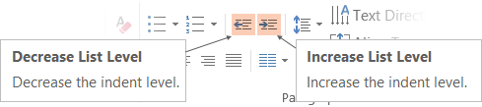
Adjusting list levels
Main topic: Segoe UI Semilight, size 28pt
Segoe UI, size 20pt for second level
Segoe UI, size 16pt for third level
Use the “Decrease List Level” and “Increase List Level” tools on the Home menu to change text levels.
Try this:
Place your cursor in the line of text that says “Segoe UI, size 20pt for second level”
Next click the Home tab, and then on the “Decrease List level” tool. Notice how the line moves up one level.
Now try placing your cursor in one of the top “Main topic…” line of text. Click the “Increase List Level” tool and see how the text is pushed in one level.
Use these 2 tools to adjust your text levels as you work

Slide 24
Bullet points layout with subtitle Set the subtitle to 20pt in the same text block, with character spacing Normal
Move the text block down vertically to align to lower guide
If you don’t see guidelines, click on the View menu, and then check the box in front of “Guides”
Hyperlink style: www.microsoft.com

Slide 25
Slide palette info
The PowerPoint palette for this template has been built for you and is shown below.
Avoid using too many colors in your presentation.
PowerPoint Theme Accent colors
Accent 1
Accent 2
Accent 3
Accent 4
Accent 5
Accent 6
Use Accent 1 and Accent 2 as the main accent colors.
Use Accent 3 and Accent 4 when additional colors are needed.
Use Accents 5-6 sparingly

Slide 26
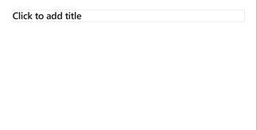
Creating accessible content
Take the following steps to create accessible content that everyone can consume effectively.
Contrast
Use high contrast colors for maximum readability
The recommended contrast ratio is at least 4.5:1
Shape and color
Use different shapes with a legend to indicate statuses to accommodate for color blindness
Example:
Alt text
Alt text helps people with screen readers understand the content of slides
You can create alternative text for shapes, pictures, charts, tables, SmartArt graphics, or other objects
Here’s how:
Right click the image or shape
Select Edit Alt Text
Enter a Title and Description of your image or object
Slide layouts
Using a built-in slide layout that matches your content ensures a hierarchical reading order of text blocks
Example:
If a new slide will have a title, rather than starting with a blank layout and adding a text block for the title, choose one of the built-in layouts with a title placeholder
Reading order
Screen readers describe content on the screen in the order it was created
To ensure your content is read back in the order you prefer, arrange your objects in the Selection Pane appropriately. Objects on the bottom of the selection pane are read first
Here’s how:
Click the Home tab
In the Drawing group, select the Arrange drop-down menu
Click Selection Pane…
Text
Text
Text
Subject 1
Subject 2
Subject 3
Color Contrast Analyzer
Download this tool to determine the legibility of text and the contrast of visual elements
Download
C1
C2
C3
Additional tips
Be sure to run the Accessibility Checker! Go to File click the Check for Issues drop down menu click Check Accessibility
Videos need to be accessible: If your presentation includes a video, ensure it is captioned and audio described (if appropriate)
Visit the Office Accessibility Center to learn more about accessibility in PowerPoint

Slide 27
Demo
Speaker name

Slide 28
Video

Slide 29
Section title

Slide 30
Software code slide
This slide layout uses Consolas, a monotype font which is ideal for showing software code.

Slide 32
Event name or presentation title
Subtitle or speaker name

Slide 33
Event name or presentation title
Subtitle or speaker name

Slide 34
Event name or presentation title
Subtitle or speaker name

Slide 35
Text layout (without bullet points)
Main topic: Segoe UI Semilight, size 28pt
Segoe UI, size 20pt for second level
Segoe UI, size 16pt for third level

Slide 36
Text layout with bulleted text
Main topic: Segoe UI Semilight, size 28pt
Segoe UI, size 20pt for second level
Segoe UI, size 16pt for third level

Slide 37
Text layout with bulleted text
Main topic: Segoe UI Semilight, size 28pt
Segoe UI, size 20pt for second level
Segoe UI, size 16pt for third level

Slide 38
Example with longer headline text wrapping to a second line
When the headline text is 2 lines, move this text block down to align to the lower blue guide
If you don’t see guidelines, click on the View menu, and then check the box in front of “Guides”
Use a “soft return” Shift + Enter to wrap text without adding extra line spacing

Slide 39
Adjusting list levels
Main topic: Segoe UI Semilight, size 28pt
Segoe UI, size 20pt for second level
Segoe UI, size 16pt for third level
Use the “Decrease List Level” and “Increase List Level” tools on the Home menu to change text levels.
Try this:
Place your cursor in the line of text that says “Segoe UI, size 20pt for second level”
Next click the Home tab, and then on the “Decrease List level” tool. Notice how the line moves up one level.
Now try placing your cursor in one of the top “Main topic…” line of text. Click the “Increase List Level” tool and see how the text is pushed in one level.
Use these 2 tools to adjust your text levels as you work

Slide 40
Bullet points layout with subtitle Set the subtitle to 20pt in the same text block, with character spacing Normal
Move the text block down vertically to align to lower guide
If you don’t see guidelines, click on the View menu, and then check the box in front of “Guides”
Hyperlink style: www.microsoft.com

Slide 41
Slide palette info
The PowerPoint palette for this template has been built for you and is shown below.
Avoid using too many colors in your presentation.
PowerPoint Theme Accent colors
Accent 1
Accent 2
Accent 3
Accent 4
Accent 5
Accent 6
Use Accent 1 and Accent 2 as the main accent colors.
Use Accent 3 and Accent 4 when additional colors are needed.
Use Accents 5-6 sparingly

Slide 42
Creating accessible content
Take the following steps to create accessible content that everyone can consume effectively.
Contrast
Use high contrast colors for maximum readability
The recommended contrast ratio is at least 4.5:1
Shape and color
Use different shapes with a legend to indicate statuses to accommodate for color blindness
Example:
Alt text
Alt text helps people with screen readers understand the content of slides
You can create alternative text for shapes, pictures, charts, tables, SmartArt graphics, or other objects
Here’s how:
Right click the image or shape
Select Edit Alt Text
Enter a Title and Description of your image or object
Slide layouts
Using a built-in slide layout that matches your content ensures a hierarchical reading order of text blocks
Example:
If a new slide will have a title, rather than starting with a blank layout and adding a text block for the title, choose one of the built-in layouts with a title placeholder
Reading order
Screen readers describe content on the screen in the order it was created
To ensure your content is read back in the order you prefer, arrange your objects in the Selection Pane appropriately. Objects on the bottom of the selection pane are read first
Here’s how:
Click the Home tab
In the Drawing group, select the Arrange drop-down menu
Click Selection Pane…
Text
Text
Text
Subject 1
Subject 2
Subject 3
Color Contrast Analyzer
Download this tool to determine the legibility of text and the contrast of visual elements
Download
C1
C2
C3
Additional tips
Be sure to run the Accessibility Checker! Go to File click the Check for Issues drop down menu click Check Accessibility
Videos need to be accessible: If your presentation includes a video, ensure it is captioned and audio described (if appropriate)
Visit the Office Accessibility Center to learn more about accessibility in PowerPoint

Slide 43
Demo
Speaker name

Slide 44
Video

Slide 45
Section title

Slide 46
Software code slide
This slide layout uses Consolas, a monotype font which is ideal for showing software code.

Slide 47
Notes (hidden)
Some speakers at Microsoft like to use this slide for hidden “notes slides”.
Delete it if you don’t want to use it.
NEXT: <next slide title>

