Slide 1
Programming Languages
C/C++ Programming
and
Memory Management

Slide 2
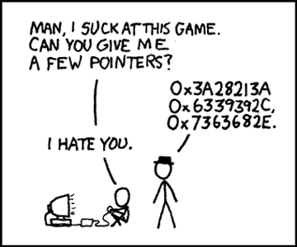
1-<number>

Slide 3
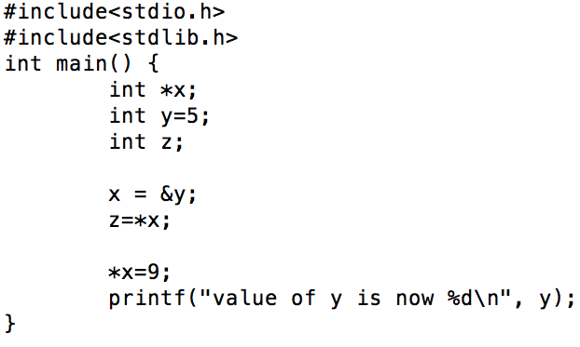
Re-cap
1-<number>

Slide 4
C: Strings
Arrays of characters
char* x = “abcde”;
char y = x[3]
  y = ?
Size of a char is 8 bits (1 Byte)
All strings terminated with a special one byte value 0
1-<number>

Slide 5
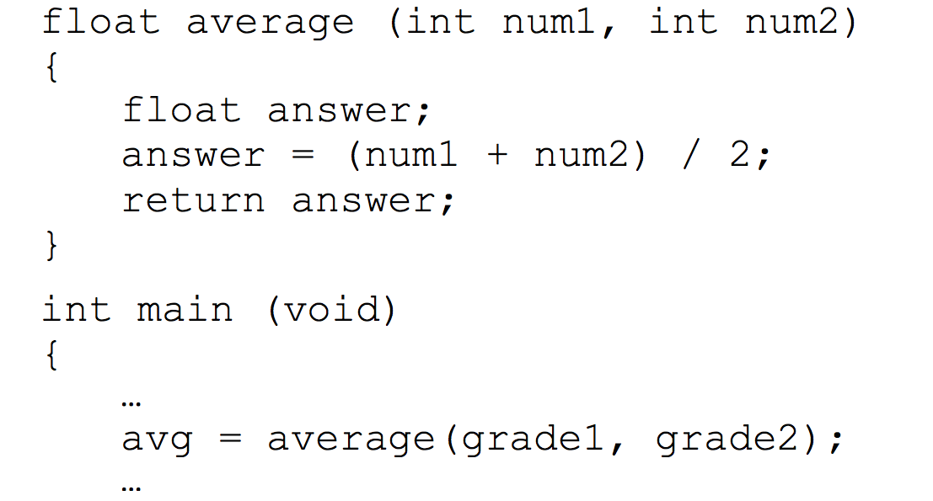
Passing Parameters by Value
1-<number>
Notes:
only one value can be returned from a function using the return statement – if more than one value needs to be returned, passing by value cannot accomplish it

Slide 6
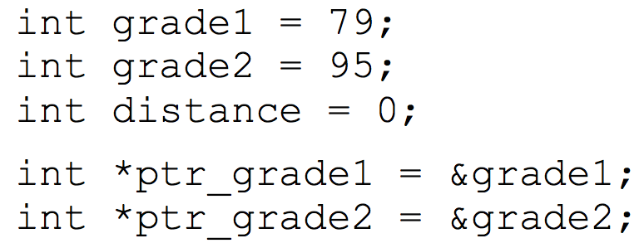
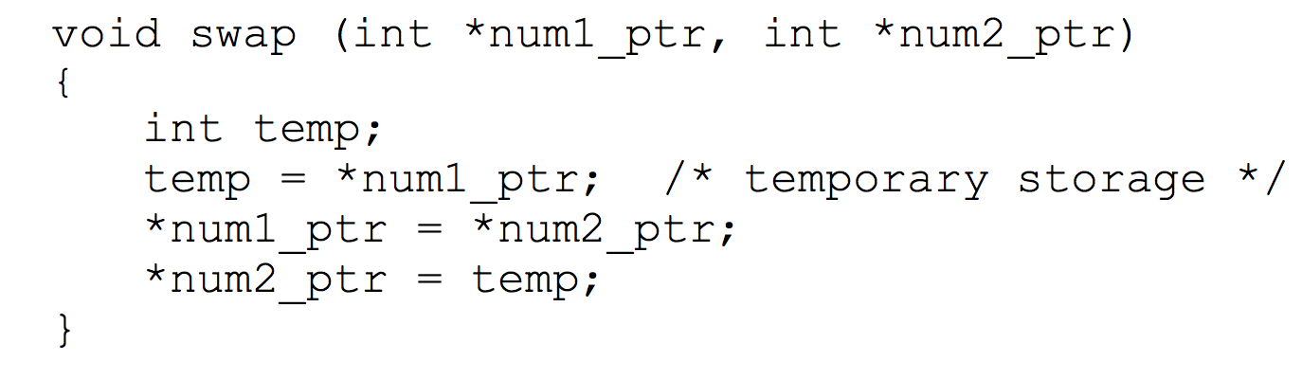
Passing Pointer Variables
Indirect Addressing
  Access/Modify memory locations outside function
  Helps return multiple values from a function
Copyright © 2015 Pearson. All rights reserved.
1-<number>
Notes:
Information gets altered without any explicit return

Slide 7
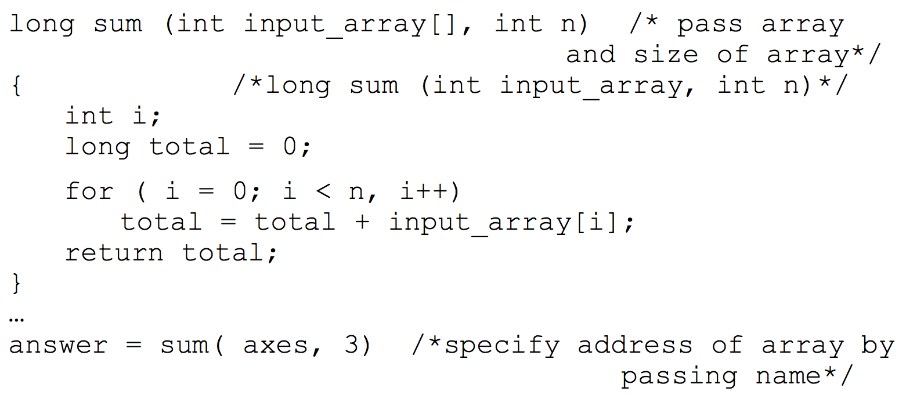
Passing Arrays as Parameters
1-<number>

Slide 8
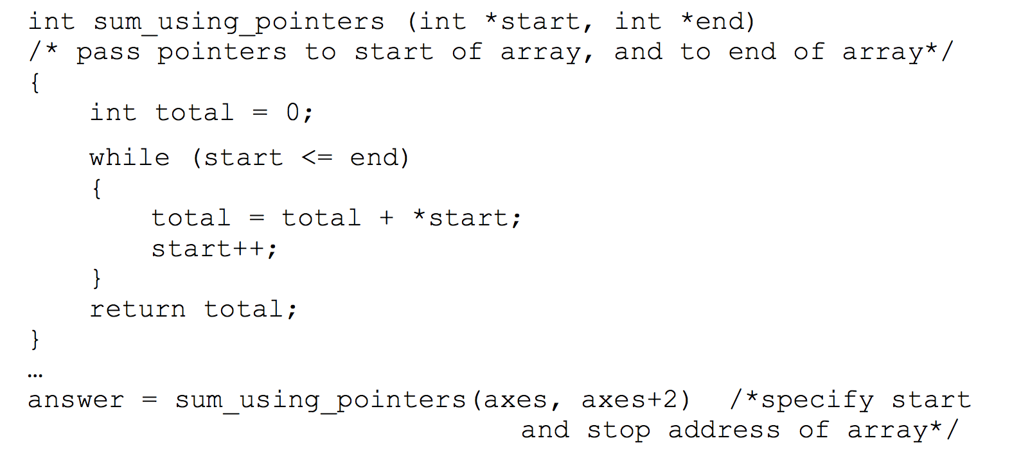
Passing Arrays as Parameters
1-<number>

Slide 9
Output Parameters
Functions can be made to return information by altering the the function parameters
  void getXandY(/*out*/ double *x, /*out*/ double *y)
  incrementMandN(/*in-out*/ int *m, /*in-out*/ int *n)
  getTwoArrays(/*out*/ int **array1, /*out*/ int **array2)
  decrementAandB(int *a, int *b)
1-<number>

Slide 10
More Information
“C for Java Programmers”
1-<number>

Slide 11
Introduction to C++
#include <iostream>
using namespace std;
int main(int argn, char* argv[])
{
int x = 5;
cout << "Hello world " << x << endl;
}
1-<number>
Notes:
#include <iostream> : read and write to the standard i/o stream
C++ built-in functions are kept in a standard namespace (e.g. cout, cin, string, etc)

Slide 12
Introduction to C++
g++ -o fileName.exe fileName.cpp
./fileName.exe
1-<number>

Slide 13
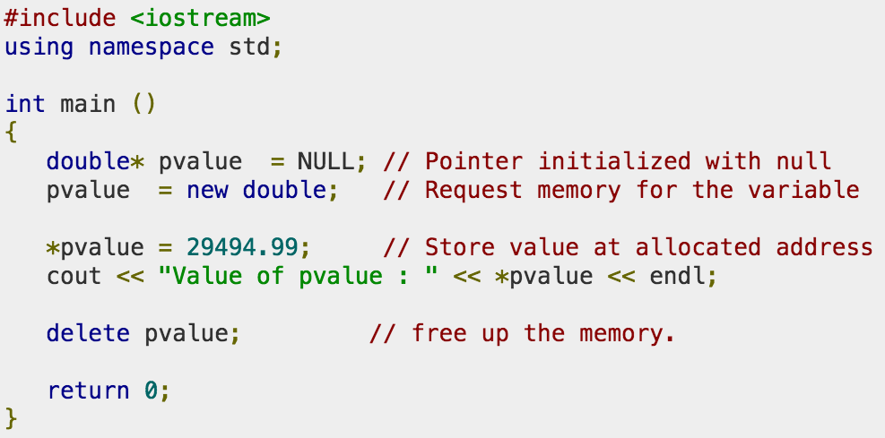
Memory Allocation in C++
1-<number>

Slide 14
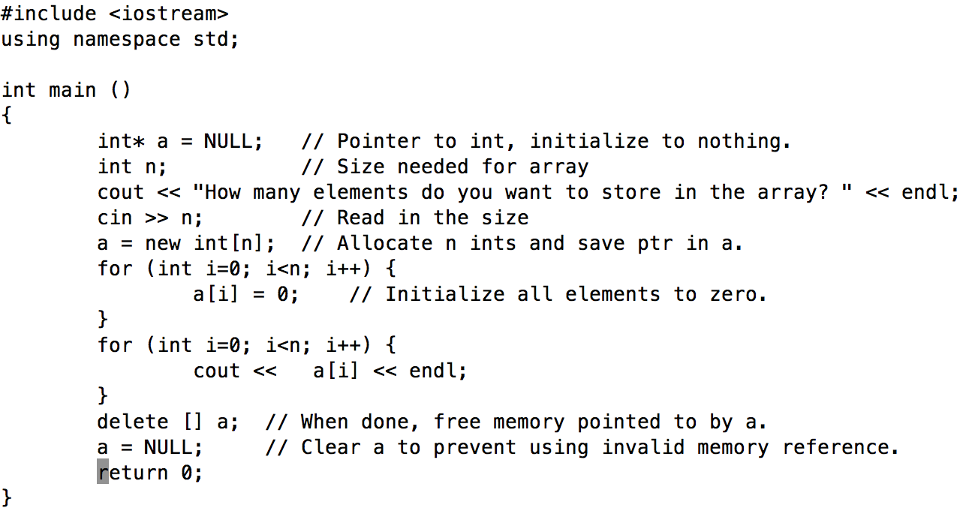
Dynamic Memory for Arrays in C++
1-<number>

Slide 15
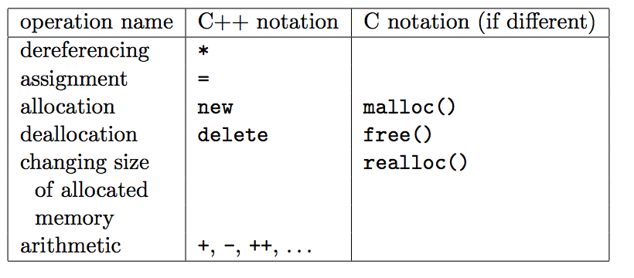
Heap Dynamic Variables
1-<number>

Slide 16
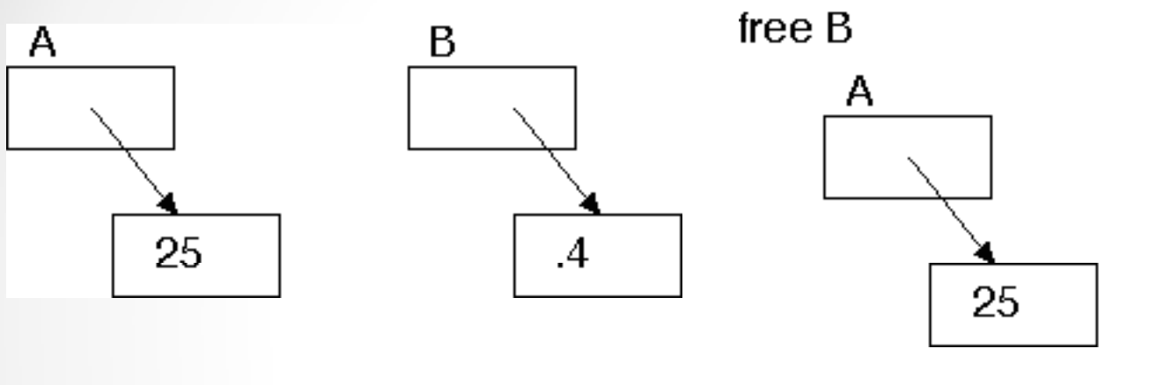
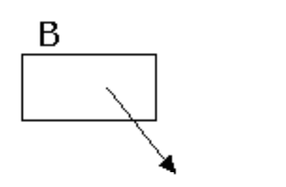
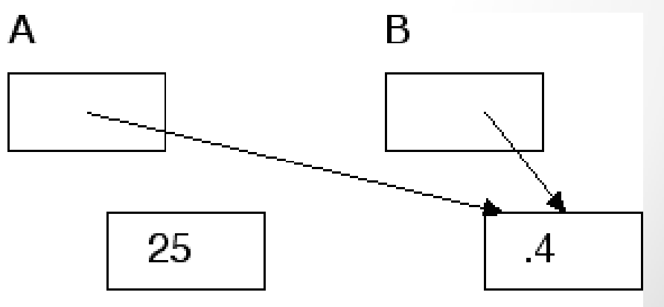
Problems with Pointers
1-<number>

Slide 17
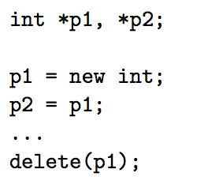
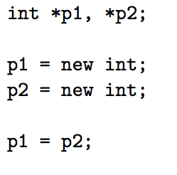
Problems with Pointers
Dangling
Memory Leak due to Garbage
1-<number>

Slide 18
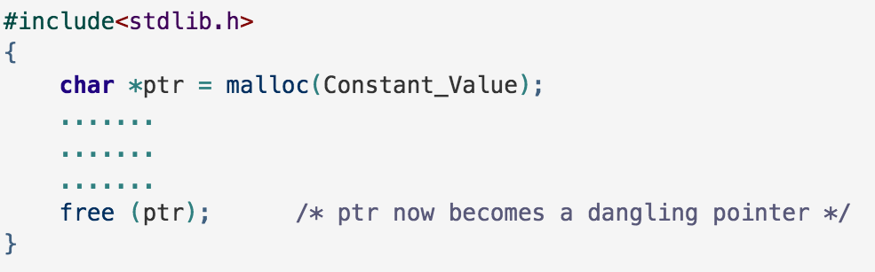
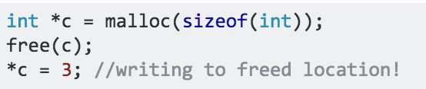
Memory Management
Dangling Pointer
1-<number>

Slide 19
Heap Management
0
Heap: Linked List of available memory cells (free list)
Allocation
  Find memory cell in free list to allocate memory
  Cell portion not used is linked back to the free list
De-allocation
  De-allocated cell linked to free list
    Large number of small cells could result
Operating
System
1000
1200
allocated
2800
allocated
5400
5500
allocated
8500
8900
allocated
9600
FreeList:
MAX
Start: 1000
Size: 200
Start: 5400
Size: 100
Start: 8500
Size: 400
Start: 9600
Size: 10400

Slide 20
Heap-Dynamic Variables: Deallocation
De-allocation of heap-dynamic variables
  Explicit
  Implicit (Garbage Collection)
  Reference Counting (Eager)
    reference count of each cell is maintained
  Mark-Scan (Mark and Sweep) (Lazy)
    the mark bit is used to indicate whether the cell is garbage
1-<number>

