Slide 1
COMP 356
PROGRAMMING LANGUAGE STRUCTURES
Copyright © 2015 Pearson. All rights reserved.
1-<number>

Slide 2
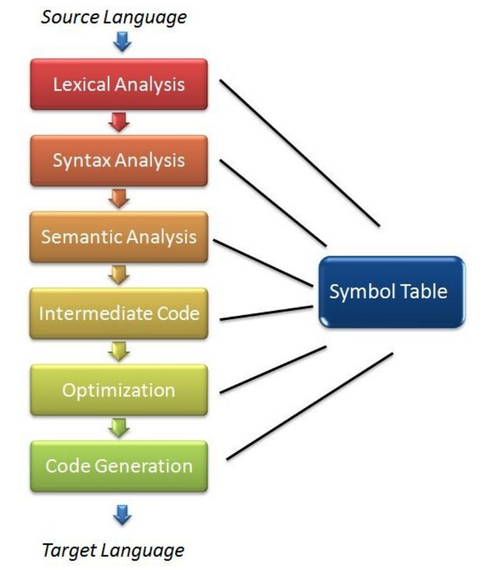
Compiler Stages
1-<number>

Slide 3
Example Grammar
<program> → <stmts>
<stmts> → <stmt> | <stmt> ; <stmts>
<stmt> → <var> = <expr>
<var> → a | b | c | d
<expr> → <term> + <term> | <term> - <term>
<term> → <var> | const
Is a = b + const a valid statement?
Copyright © 2015 Pearson. All rights reserved.
1-<number>

Slide 4
Example Derivation
<program> => <stmts> => <stmt>
=> <var> = <expr>
=> a = <expr>
=> a = <term> + <term>
=> a = <var> + <term>
=> a = b + <term>
=> a = b + const
Copyright © 2015 Pearson. All rights reserved.
1-<number>

Slide 5
Bad examples
<program>x → <stmts>
b → <stmt> | <stmt> ; <stmts>
<program><stmt> → <program>;<stmt>
<stmt> → <stmt>
(THESE ARE BAD!)
1-<number>

Slide 6



Parse Trees
A graphical representation of a derivation
<program>
⇧
<stmts>
<stmt>
⇧
<var>
=
<expr>
a
<term>
+
<term>
<var>
const
b
⇧
Copyright © 2015 Pearson. All rights reserved.
1-<number>

Slide 7
Parse Trees
Parser phase of compiler organizes tokens in to parse trees
Order of Evaluation of constructs is shown in a parse tree
Copyright © 2015 Pearson. All rights reserved.
1-<number>

Slide 8
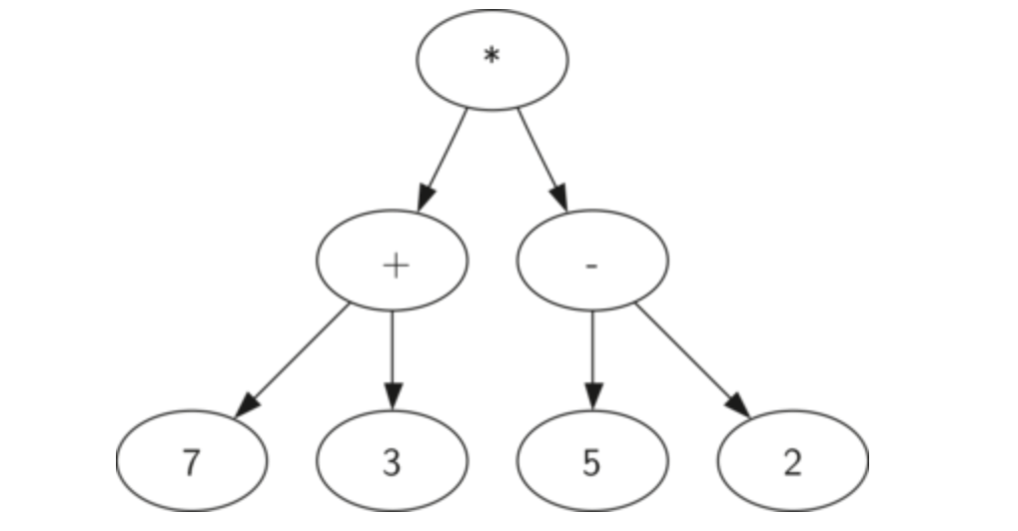
Parse Trees
Copyright © 2015 Pearson. All rights reserved.
1-<number>

Slide 9
Parse Trees
<evennum>-> ed | <number>ed
<digit> -> ed | od
<number> -> <digit> | <digit><number>
Create possible parse trees for “od od ed”
Copyright © 2015 Pearson. All rights reserved.
1-<number>

Slide 10
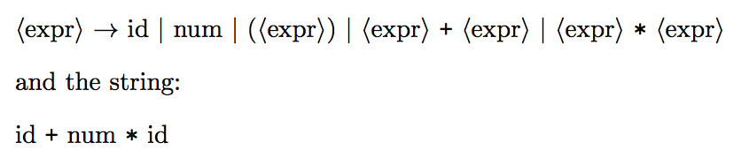
Ambiguity in Grammars
Draw possible parse trees for both strings
id + id + id
Copyright © 2015 Pearson. All rights reserved.
1-<number>

Slide 11
Ambiguity in Grammars
A context free grammar G is ambiguous if it has more than one leftmost derivation for some string w ∈ L(G)
Copyright © 2015 Pearson. All rights reserved.
1-<number>

Slide 12
Ambiguity in Grammars
Why is Ambiguity a Problem?
Copyright © 2015 Pearson. All rights reserved.
1-<number>

Slide 13


Ambiguity in Grammars
How can ambiguity be removed?
  Operator Precedence
  Operator Associativity
id + num * id
1-<number>

Slide 14
Ambiguity in Grammars
Prove that the following grammar is ambiguous:
<s> -> <a> <b>
<a> -> x | xy
<b> -> yz | z
1-<number>

Slide 15
Is this Grammar Ambiguous?
<expr> -> <expr> <op> <expr> | const
<op> -> / | -
Test for string: const – const / const
Copyright © 2015 Pearson. All rights reserved.
1-<number>

Slide 16
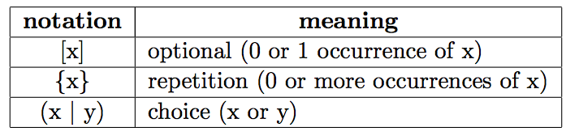

Extended BNF
Copyright © 2015 Pearson. All rights reserved.
1-<number>

Slide 17
Extended BNF
Construct an EBNF grammar for even numbers
Copyright © 2015 Pearson. All rights reserved.
1-<number>

Slide 18
Static Semantics
What does BNF describe?
Categories of constructs that are trouble:
- Type compatibility
- checking that variables must
be declared before they are used
BNFs cannot describe Static Semantics
Copyright © 2015 Pearson. All rights reserved.
1-<number>

Slide 19
Attribute Grammars
Attribute grammars (AGs) have additions to CFGs to carry some semantic info on parse tree nodes
Copyright © 2015 Pearson. All rights reserved.
1-<number>

Slide 20
Attribute Grammars : Definition
Def: An attribute grammar is a context-free grammar G with the following additions:
  For each grammar symbol x there is a set A(x) of attribute values
  rules for computing the attributes
  rules for checking the attributes
1-<number>

Slide 21
Types of Attributes
Synthesized
Inherited
Intrinsic
1-<number>

Slide 22
Attribute Grammars (continued)
How are attribute values computed?
  Inherited attributes: the tree decorated in top-down order.
  Synthesized attributes: the tree decorated in bottom-up order.
  both kinds of attributes: combination of top-down and bottom-up decoration.
Copyright © 2015 Pearson. All rights reserved.
1-<number>

Slide 23
Attribute Grammars: An Example
Syntax in BNF for assignment statement :
  <assign> -> <var> = <expr>
  <expr> -> <var> + <var> | <var>
  <var> -> A | B | C
  Attributes-
actual_type: synthesized for <var> and <expr>
expected_type: inherited for <expr>
1-<number>

Slide 24
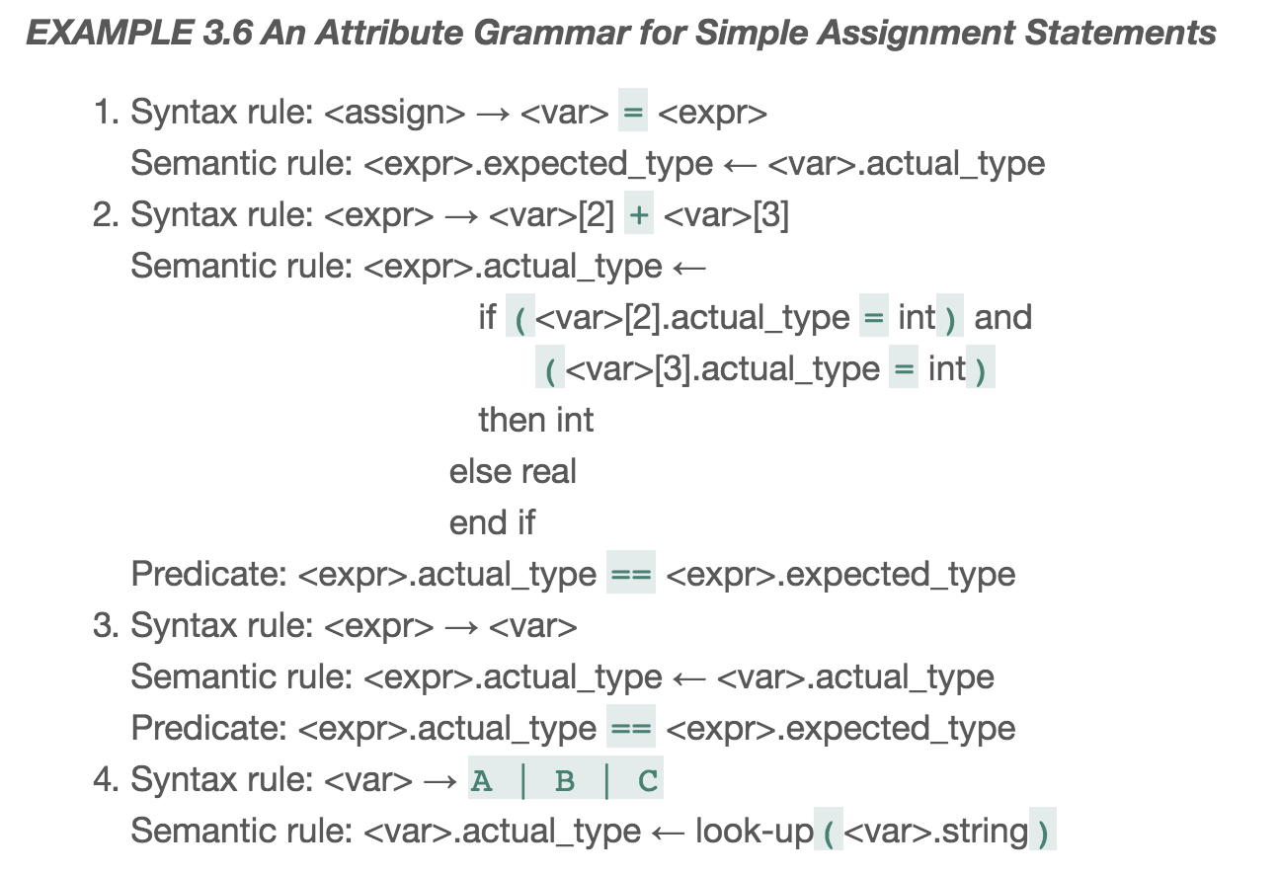
AG for Simple Assignment
1-<number>

Slide 25
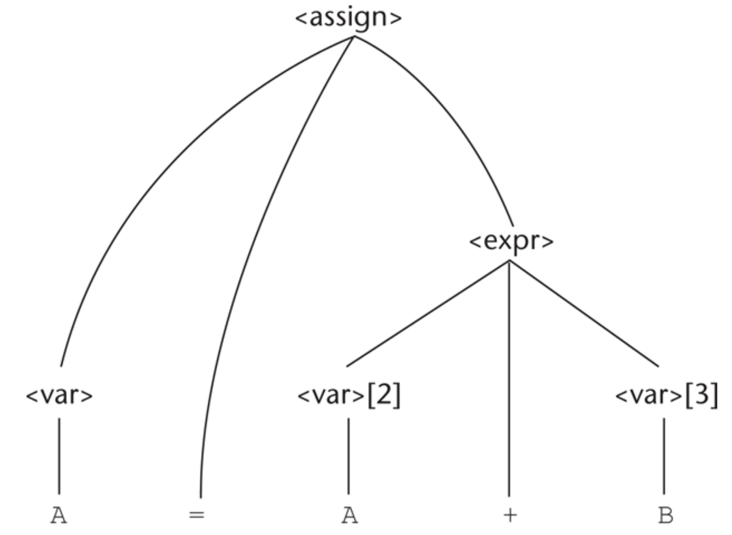
Parse Tree: A=A+B
Copyright © 2015 Pearson. All rights reserved.
1-<number>

Slide 26
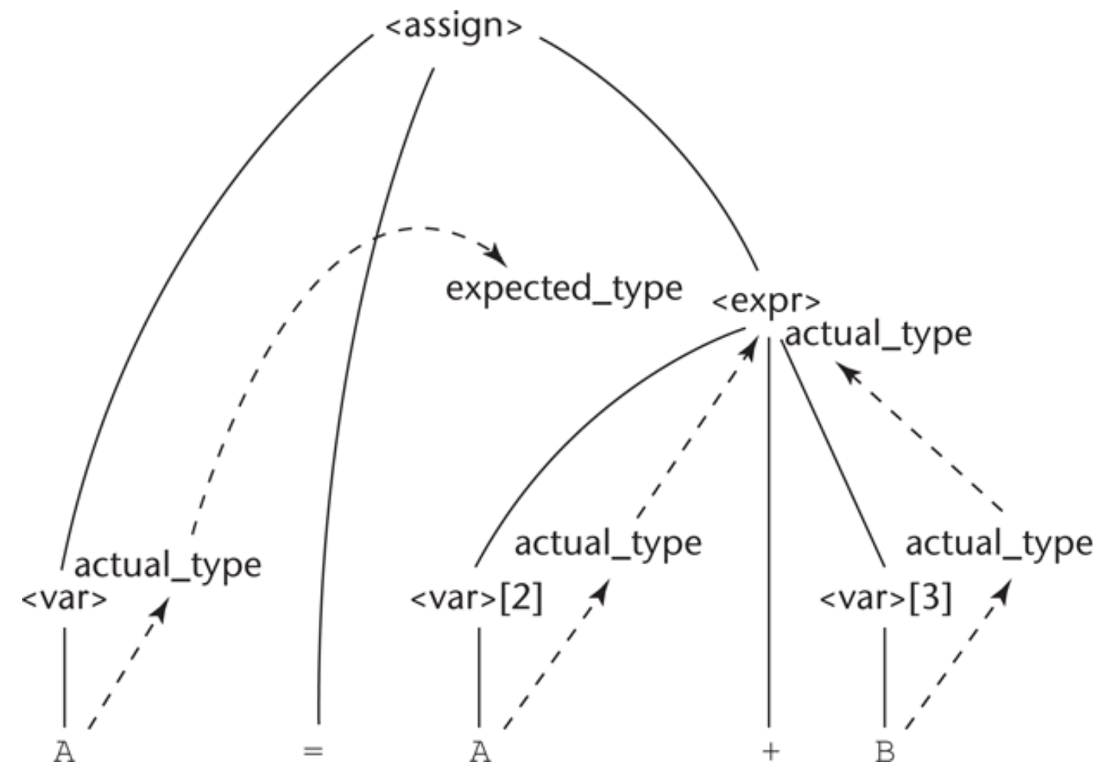
Attribute Derivation
1-<number>

Slide 27
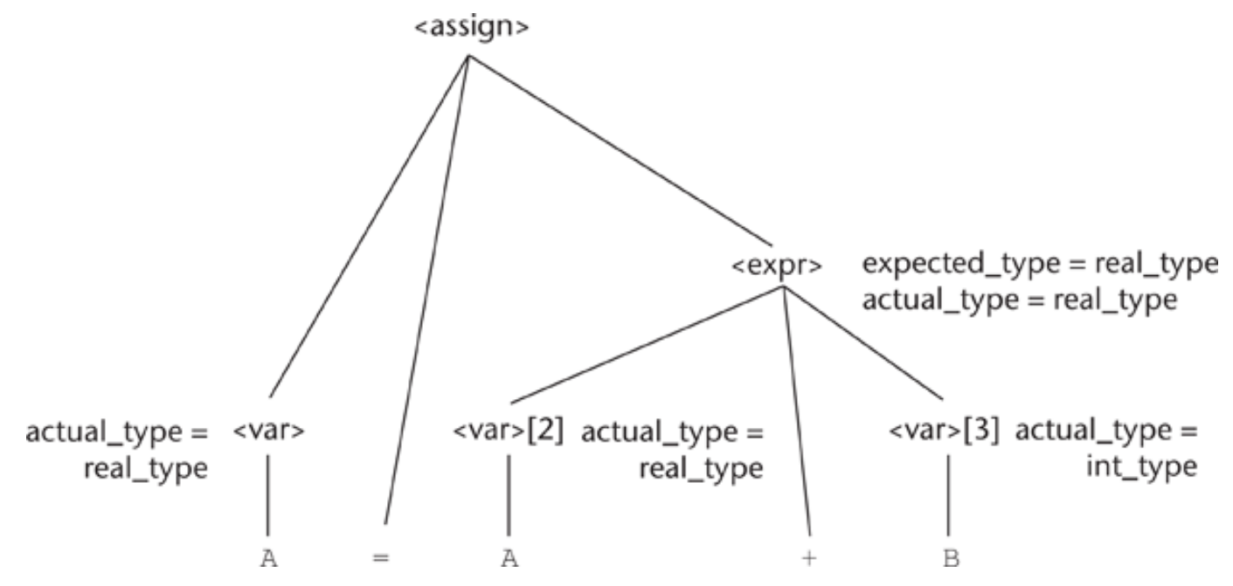
Attribute Derivation
1-<number>

Slide 28
Summary
BNF and context-free grammars are equivalent meta-languages
  Well-suited for describing the syntax of programming languages
An attribute grammar is a descriptive formalism that can describe both the syntax and the semantics of a language
Copyright © 2015 Pearson. All rights reserved.
1-<number>

