Slide 1
C++ Classes
C++ class is stand-alone or derived
Class data : data members
Class functions: member functions
Copyright © 2015 Pearson. All rights reserved.
1-<number>

Slide 2
Header and Implementation Files
Interface vs. Implementation
Interface (.h file) – function signatures
Implementation (.cpp file) – function bodies
Copyright © 2015 Pearson. All rights reserved.
1-<number>

Slide 3
Compiling and Linking Multiple Files
g++ -o <executable file> <sourceFile.cpp>
g++ -o <executable file> <sourceFile1.cpp>
<sourceFile2.cpp>……
Copyright © 2015 Pearson. All rights reserved.
1-<number>

Slide 4
C++ Inheritance
Derived classes can inherit some/all members of base class
Derived classes can add new members
Derived classes can modify inherited member functions
Copyright © 2015 Pearson. All rights reserved.
1-<number>

Slide 5
C++ Inheritance
C++ objects should be initialized (at least one constructor needed)
If data members are pointers to heap-allocated data, constructor allocates storage
Copyright © 2015 Pearson. All rights reserved.
1-<number>

Slide 6
C++ Inheritance
Access Controls for class members:
  Public
  Protected
  Private
Copyright © 2015 Pearson. All rights reserved.
1-<number>

Slide 7
C++ Inheritance
Derived classes can modify accessibility for inherited members
class derived_class_name : derivation_mode base_class_name { data member and function declarations }
Derivation Mode: Public or Private
  Public derivation: public and protected members are also public and protected in subclasses
  Private derivation - inherited public and protected members are private in the subclasses
Copyright © 2015 Pearson. All rights reserved.
1-<number>

Slide 8
Inheritance Example in C++
class base_class {
private:
int a;
float x;
protected:
int b;
float y;
public:
int c;
float z;
};
class subclass_1 : public base_class { … };
// In this one, b and y are protected and
// c and z are public
class subclass_2 : private base_class { … };
// In this one, b, y, c, and z are private,
// and no derived class has access to any
// member of base_class
Copyright © 2015 Pearson. All rights reserved.
1-<number>

Slide 9
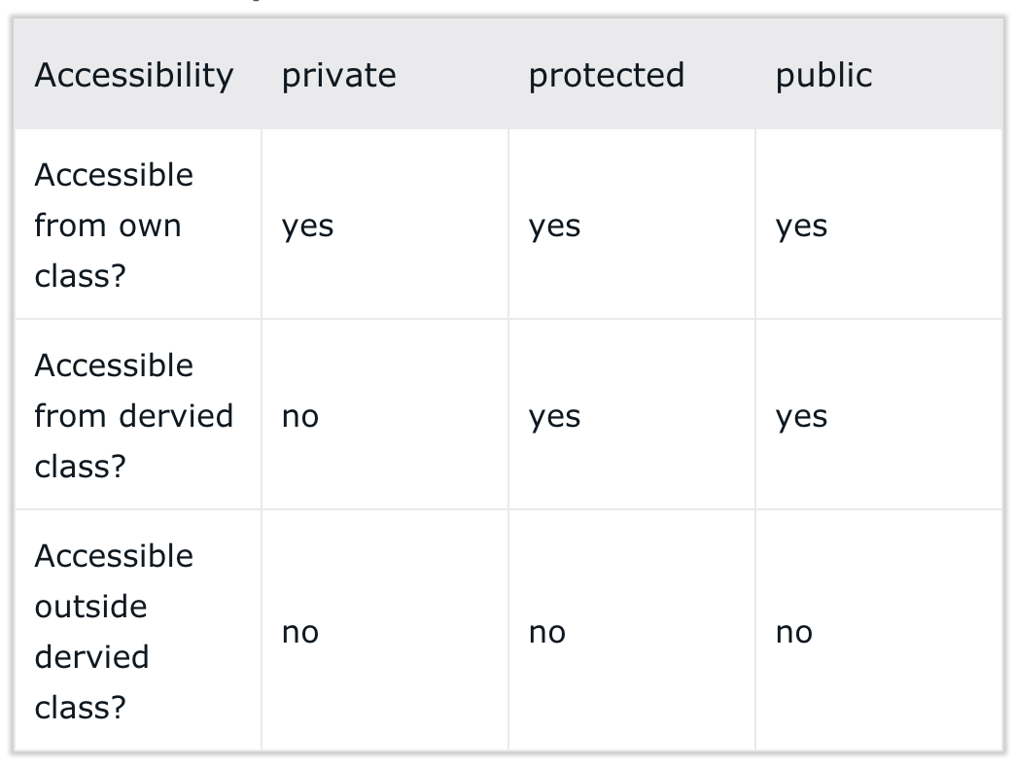
Accessibility in Private Inheritance
Copyright © 2015 Pearson. All rights reserved.
1-<number>

Slide 10
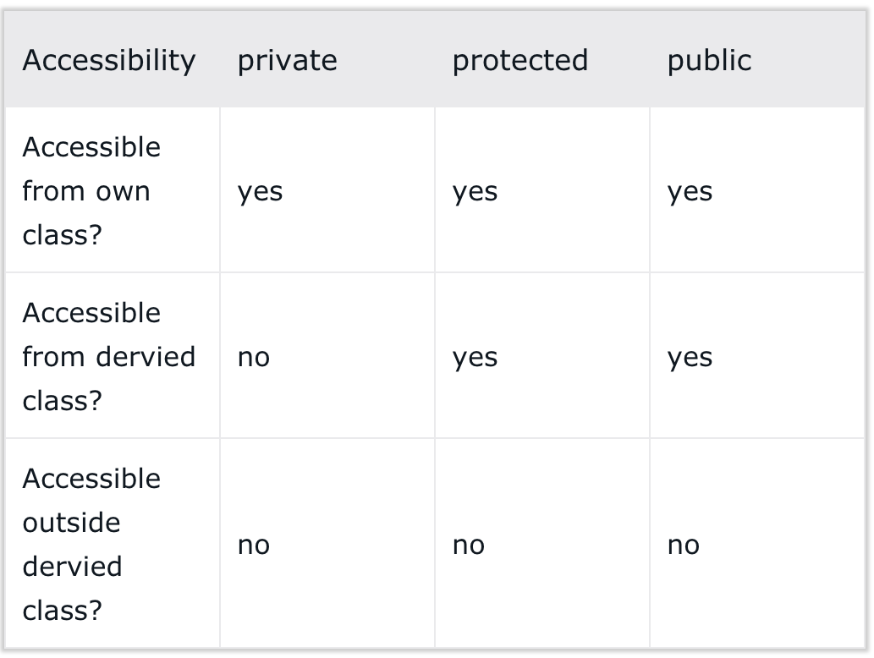
Accessibility in Protected Inheritance
Copyright © 2015 Pearson. All rights reserved.
1-<number>

Slide 11
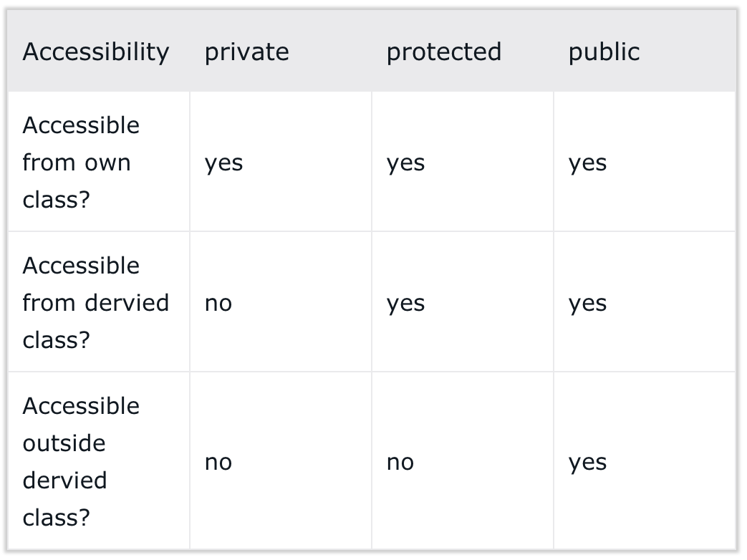
Accessibility in Public Inheritance
Copyright © 2015 Pearson. All rights reserved.
1-<number>

Slide 12
C++ Destructors
Constructor- Invoked when object created
Destructor- Invoked when object destroyed
When are objects on the stack destroyed?
When are objects on the heap destroyed?
Deallocation of memory is generally done inside the destructor
Java’s Finalizer – the finalize() method invoked by Java’s Garbage Collector
Copyright © 2015 Pearson. All rights reserved.
1-<number>

Slide 13
Classes in C++
•Destructor: an operation that is implicitly called when the lifetime of an object ends.
Often used to de-allocate any heap-dynamic data members.
Copyright © 2015 Pearson. All rights reserved.
1-<number>

Slide 14
Classes in C++
access modifiers (public, protected, private)
instances of a C++ class can be stack-dynamic or heap-dynamic. Heap-dynamic instances are referred to by a pointer.
member functions can be defined directly within the class, or in another implementation file.
Copyright © 2015 Pearson. All rights reserved.
1-<number>

Slide 15
Classes in C++
implement methods in an implementation (.C or .cpp) file, using the scope resolution operator (::) to indicate the class they belong to.
Copyright © 2015 Pearson. All rights reserved.
1-<number>

Slide 16
C++ Templates
Similar to generics in Java.
  ArrayList<T> T: class
Function Templates and Class Templates
Copyright © 2015 Pearson. All rights reserved.
1-<number>

Slide 17
Organizing ADTs in to Units
Java Packages – a collection of classes
package packageName;
Instance variables and methods have package access (if declared without an access modifier)
Copyright © 2015 Pearson. All rights reserved.
1-<number>

Slide 18
Organizing ADTs in to Units
Java packages are also useful for avoiding name clashes.
Classes declared in a package are referred to using the package name from outside of the package,
FirstList.LinkedList L=new FirstList.LinkedList();
Copyright © 2015 Pearson. All rights reserved.
1-<number>

Slide 19
Organizing ADTs in to Units
Importing a Package
import FirstList.LinkedList;
...
LinkedList L = new LinkedList();
a package must be defined in a directory with the same name as the package
Nested packages are possible
Copyright © 2015 Pearson. All rights reserved.
1-<number>

