Slide 1
Heap Management
0
Heap: Linked List of available memory cells (free list)
Allocation
  Find memory cell in free list to allocate memory
  Cell portion not used is linked back to the free list
De-allocation
  De-allocated cell linked to free list
    Large number of small cells could result
Operating
System
1000
1200
allocated
2800
allocated
5400
5500
allocated
8500
8900
allocated
9600
FreeList:
MAX
Start: 1000
Size: 200
Start: 5400
Size: 100
Start: 8500
Size: 400
Start: 9600
Size: 10400

Slide 2
Heap-Dynamic Variables: Deallocation
De-allocation of heap-dynamic variables
  Explicit
  Implicit (Garbage Collection)
  Reference Counting (Eager)
    reference count of each cell is maintained
  Mark-Scan (Mark and Sweep) (Lazy)
    the mark bit is used to indicate whether the cell is garbage
1-<number>

Slide 3
Data Types
Basic / Primitive data types
  Not defined in terms of other types
  Fixed size to store in memory
  int, double, char, boolean, etc.
Structured/ Constructed data types
  Varying size
  Defined in terms of other types
  Different layout in memory
  Arrays, classes, etc.
Other data types-
  pointers, references, enumeration, sub-ranges
Copyright © 2015 Pearson. All rights reserved.
1-<number>

Slide 4
Ordinal Types
An ordinal type is one in which the range of possible values can be easily associated with the set of positive integers
Examples of primitive ordinal types in Java
  integer
  char
  boolean
User-defined Ordinal Types
  Enumeration type
Copyright © 2015 Pearson. All rights reserved.
1-<number>

Slide 5
Enumeration Types
All possible values (enumeration constants) listed in declaration
Example in C
  enum day { mon, tue, wed, thu, fri, sat, sun };
  enum day today;
  today = tue;
  if (today == tue) || (today ==thu)
  printf (“comp356 class today);
  else
  printf (“No comp356 class today);
Benefit?
1-<number>
Notes:
Benefit- Readability is enhanced very directly: Named values are easily recognized, whereas coded values are not. No enumeration variable can be assigned a value outside its defined range. No arithmetic operations are legal on enumeration types;

Slide 6
Design Issues with Enumeration Types
Can enumeration constants be treated as integers?
  C (yes), Ada, C#, F#, Java 5.0 (no)
Can the same enumeration constant appear in more than one type definition?
  Ada (yes), C (no)
Copyright © 2015 Pearson. All rights reserved.
1-<number>

Slide 7
Evaluation of Enumerated Type
Advantages specific to Ada, C#, F#, Java 5.0
  No arithmetic operations on enumeration types
  Enumeration variables cannot be assigned values outside their defined range
What about in C and C++ ?
Copyright © 2015 Pearson. All rights reserved.
1-<number>

Slide 8
Enumerated Type
Enumeration types included in C, C++, C#, Ada, Java (not in version 1.4 or prior)
Copyright © 2015 Pearson. All rights reserved.
1-<number>

Slide 9
Records
Non-homogenous collections of data
Data elements are called “fields”
Similar to a class instance
  all fields are public
  has no methods
Copyright © 2015 Pearson. All rights reserved.
1-<number>

Slide 10
Record Layout
fields are allocated in contiguous memory locations
Fields are a fixed offset from the base address
field offsets are computed at compile time
Total Record size is = sum of sizes of all fields
Copyright © 2015 Pearson. All rights reserved.
1-<number>

Slide 11
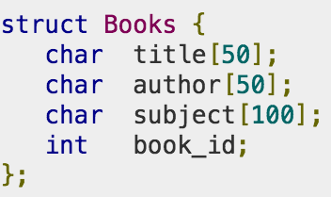

Structures in C
Combines data items of different kinds
Copyright © 2015 Pearson. All rights reserved.
1-<number>

Slide 12
Unions
Allows storing different data types in the same memory location
A union can have many members
only one member can contain a value at a given time
same memory location can be used for multiple purposes
Copyright © 2015 Pearson. All rights reserved.
1-<number>

Slide 13
Unions
union {
  int a;
  double b;
} u;
u: can hold either int or double at a time
used when data of different types must be stored in the same collection
Copyright © 2015 Pearson. All rights reserved.
1-<number>

Slide 14
Variant Record
Some languages require unions to be always embedded in records (variant record)
  Pascal, Ada
Variant records have two parts – common and variant
C, C++ (variant records can be implemented using a struct or class having a union as a field or data member)
Copyright © 2015 Pearson. All rights reserved.
1-<number>

Slide 15
Unions and Variant Records
Size of Union = size of the largest data type
Size of Variant Record = sum of the sizes in the common part + size of largest data type in the variant part
Copyright © 2015 Pearson. All rights reserved.
1-<number>

Slide 16
Unions
Type errors possible due to Unions (e.g. in C, C++, Pascal) – language cannot be strongly typed
union {
  int i;
  double d;
} u;
u.i = 3
cout << u.d; (prints u as a double)
Copyright © 2015 Pearson. All rights reserved.
1-<number>

Slide 17
Discriminated Unions
Union with a discriminant
Type checking can be enabled in unions by-
  including a discriminant (tag) to indicate the type it currently has
  tags have to be checked dynamically (dynamic type checking required)
Copyright © 2015 Pearson. All rights reserved.
1-<number>

Slide 18
Unions
Pascal includes optional tags (not strongly typed)
Ada- tags are mandatory (strongly typed)
Java, C# - no Unions
Copyright © 2015 Pearson. All rights reserved.
1-<number>

Slide 19
Unions
Considered dangerous—why?
  type errors can go undetected
1-<number>

Slide 20
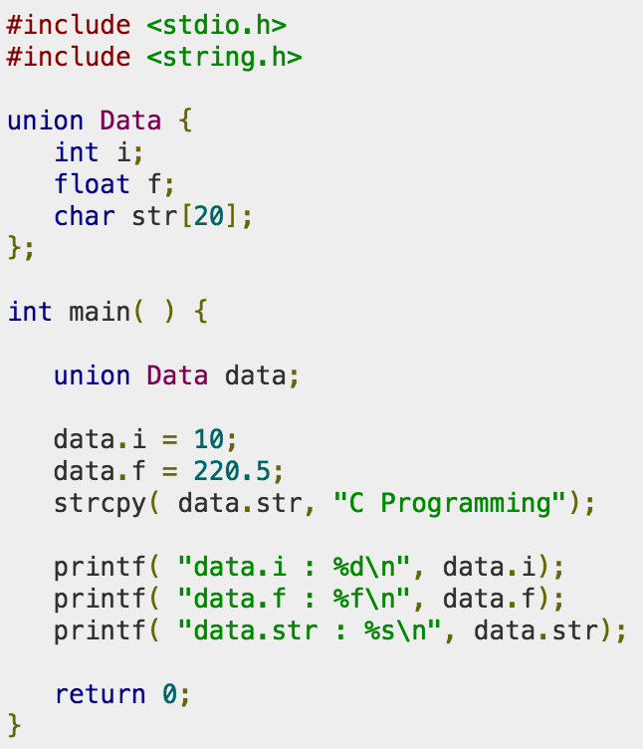
Union in C
1-<number>

Slide 21
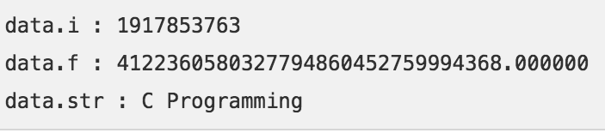
Union in C
1-<number>

