Slide 1
Programming Languages
C Programming
and
Memory Management
1-<number>

Slide 2
Programming in C
IDEs – Visual Studio, Eclipse, CodeLite, Code Blocks
Command Line Compilation (MinGW, Cygwin)
Command Line Execution
Text Editors – pico, Emacs, Aquamacs, vi
1-<number>

Slide 3
Programming in C
gcc – Gnu C compiler
Compile: convert first.c to first.exe
  gcc –o first.exe first.c
Run first.exe
  ./first.exe
Let us create and run HelloWorld.c
Copyright © 2015 Pearson. All rights reserved.
1-<number>

Slide 4
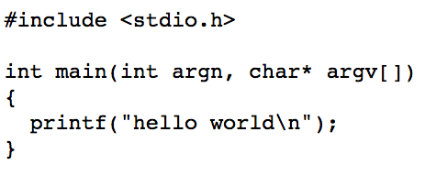
HelloWorld.c
1-<number>

Slide 5
Programming in C – Basic Features
Header Files
  #include <stdio.h>
Printing Outputs
  printf
Placeholders for variables in Print statements
  printf(“Value of a is %d and value of b is %d”,a,b)
  Multiple place holders are allowed
  %s: strings %g: floating point
1-<number>

Slide 6
Programming in C – Basic Features
Signature of main function
  int main (int argn, char* argv[])
Function to convert string to integer
  int a = atoi(“10”);
  #include<stdlib.h>
Loops and Nested Loops (e.g. for loop)
for(int i=1;i<=10);i++) {
----
----
}
1-<number>

Slide 7
Programming in C In-class exercises
Type in, compile, and run a hello world program, also print number of arguments
Type in, compile, and run a program that prints a multiplication table for an integer entered as a command line argument
1 times 1 is 1
1 times 2 is 2
1 times 3 is 3
2 times 1 is 2
2 times 2 is 4
2 times 3 is 6
3 times 1 is 3
3 times 2 is 6
3 times 3 is 9
1-<number>

Slide 8
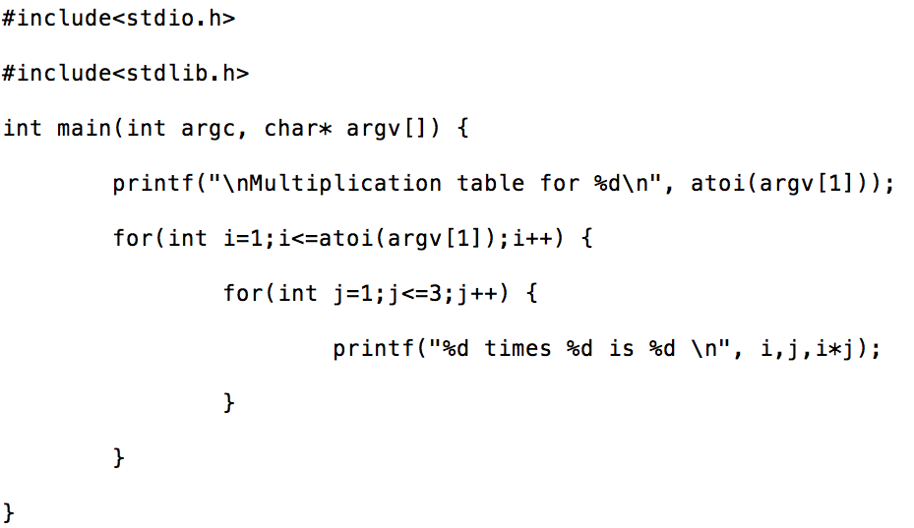
Multiplication Table in C
1-<number>

Slide 9
Memory Management- Pointers in C
Used for directly accessing and manipulating a computer’s memory
Declare a Pointer
int *x;
int *y;
char *z;
1-<number>

Slide 10
Pointers in C
int *x;
int *y;
char *z;
int val=8;
printf(“The address of val is %p\n”, &val);
x = &val;
char c = ‘A’;
z = &c;
int w = *x;
*z = ‘B’;
1-<number>

Slide 11
Memory Management - Stack
Sub-program’s local variables are stored on a stack / runtime stack / call stack
1-<number>

Slide 12
Memory Management- Heap
Storage for Variables
  malloc and sizeof functions in C
    (require #include<stdlib.h>)
  int *x = malloc(sizeof(int));
  *x = 234;
  free(x);
  Memory Leak
    void doSomeWork() {
    int *x = malloc(sizeof(int));
    *x = 234;
    int y = *x;
    }
1-<number>

Slide 13
C: Arrays and Pointer Arithmetic
Declaring an array (on the stack)
int x[5]
int y[] = {23, 57, 83, 29}
x[2]=5
y[0]=2
Array variables = pointer variables
x is int* above
1-<number>

Slide 14
Declaring Arrays on Heaps
int *z = malloc(sizeof(int)*7)
        7 element array of integer values
Addresses can be calculated using pointers
int *a=z+3
  *a is ? , a[2] = ?
*(a+1) = 251
  z[4] = ?
int *b=&(z[3])
  b=?
char* x = NULL; //special value
1-<number>

Slide 15
C: Strings
Arrays of characters
char* x = “abcde”;
char y = x[3]
  y = ?
Size of a char is 8 bits
All strings terminated with a special one byte value 0
1-<number>

Slide 16
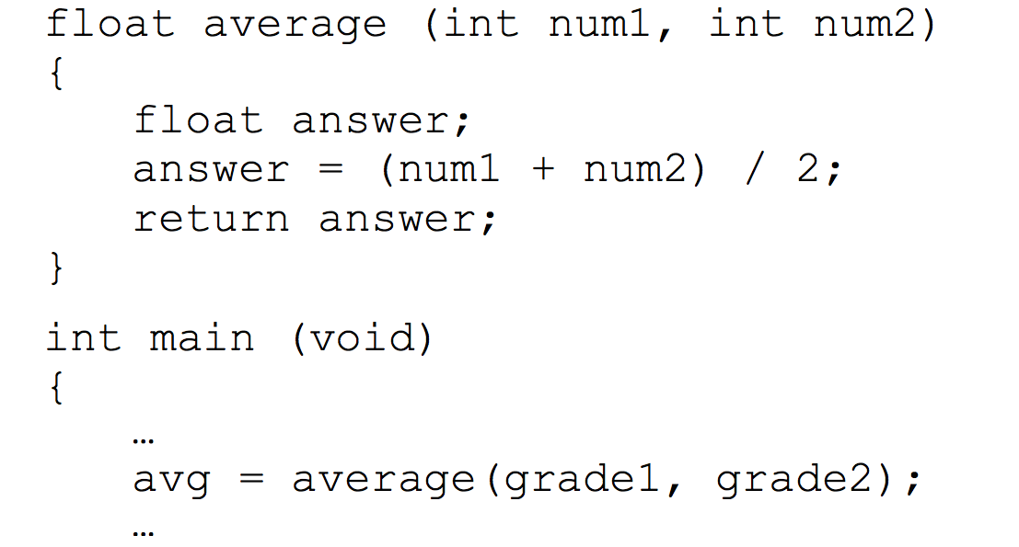
Passing Parameters by Value
1-<number>
Notes:
only one value can be returned from a function using the return statement – if more than one value needs to be returned, passing by value cannot accomplish it

Slide 17
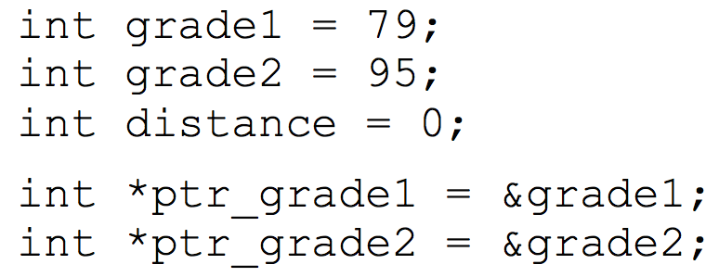
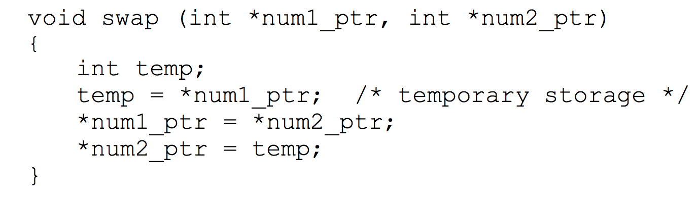
Passing Pointer Variables
Indirect Addressing
  Access/Modify memory locations outside function
  Helps return multiple values from a function
Copyright © 2015 Pearson. All rights reserved.
1-<number>
Notes:
Information gets altered without any explicit return

Slide 18
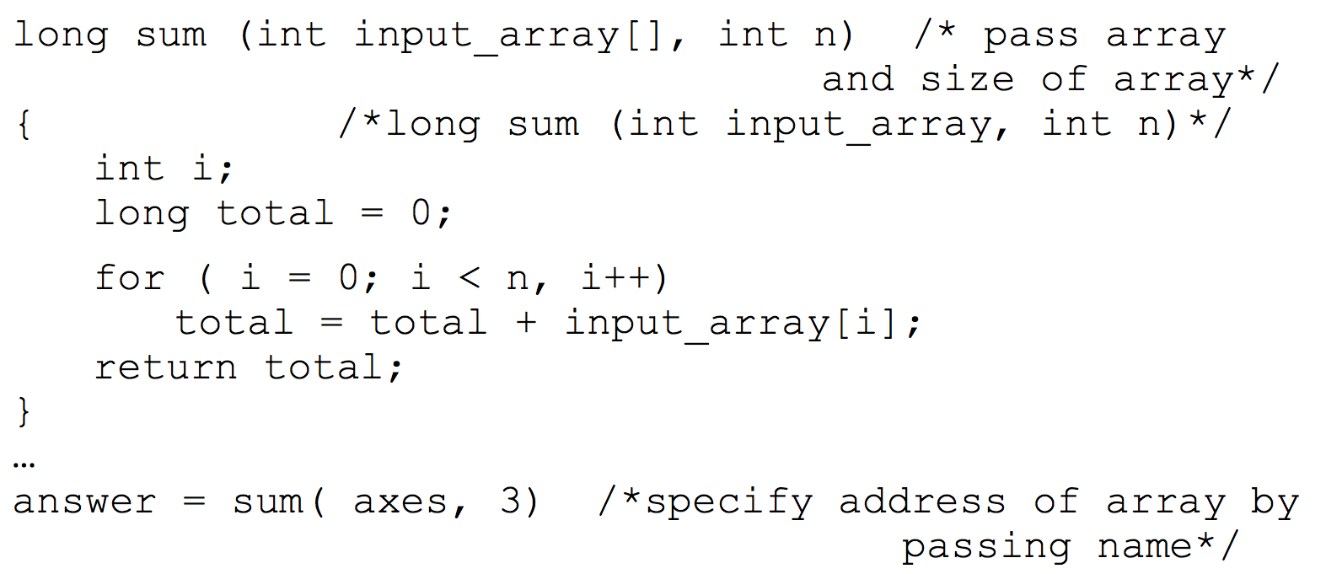
Passing Arrays as Parameters
1-<number>

Slide 19
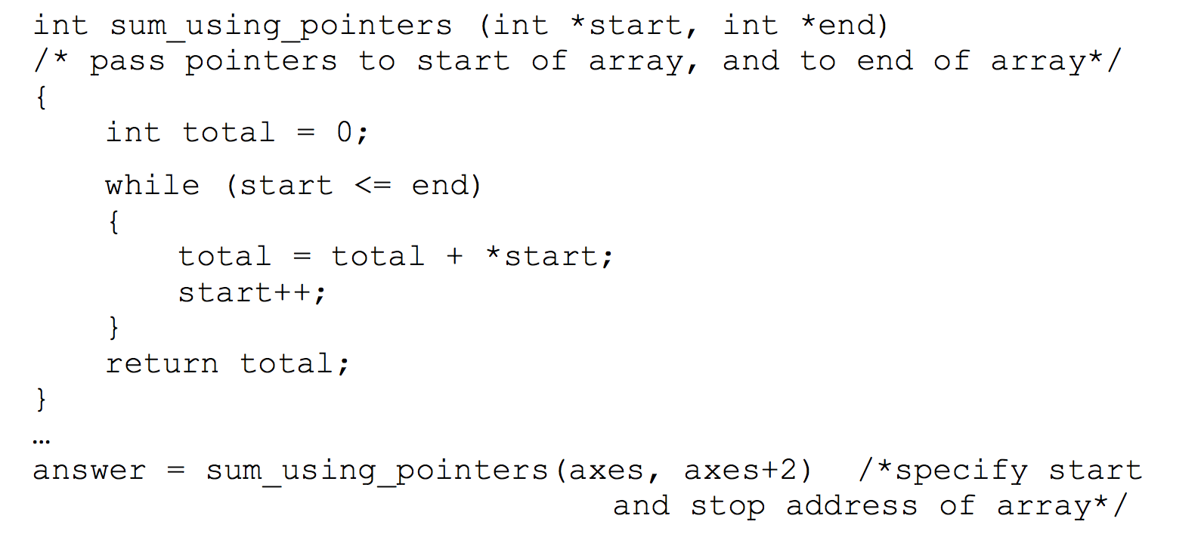
Passing Arrays as Parameters
1-<number>

Slide 20
Output Parameters
Functions can be made to return information by altering the the function parameters
  void getXandY(/*out*/ double *x, /*out*/ double *y)
  incrementMandN(/*in-out*/ int *m, /*in-out*/ int *n)
  getTwoArrays(/*out*/ int **array1, /*out*/ int **array2)
  decrementAandB(int *a, int *b)
1-<number>

Slide 21
More Information
“C for Java Programmers”
1-<number>

