Slide 1
C++ References
Types of variables seen so far:
  Primitive variables
    int x = 25; double y = 5.67;
  Pointer variables
    int* p; char* q;
Third type of variable:
  Reference variable
  Acts as an ‘alias’ to another variable
  Declared by using an & between reference type and variable name
  int x = 5;
  int &y = x;
  &: reference to
Copyright © 2015 Pearson. All rights reserved.
1-<number>

Slide 2
C++ References
int x = 10;
int &y = x;
x = 6;
y =10;
cout << x;
y++;
cout << x
cout << &x;
cout << &y;
Copyright © 2015 Pearson. All rights reserved.
1-<number>

Slide 3
C++ References
References must be initialized and cannot be reassigned
int x = 10;
int z = 20;
int &y = x;
&y = &z; //error
Unlike pointers, references cannot hold a null value
y = z;
1-<number>

Slide 4
C++ References
References cannot be initialized with a constant
const int a = 5;
int &b = a;
Constant Reference can be initialized with a constant value
const int a = 10;
const int &b = a;
Copyright © 2015 Pearson. All rights reserved.
1-<number>

Slide 5
C++ References
Reference to a const value can reference a non-constant variable
int a = 10;
const int &b = a;
a = 5;
b = 7; //error read-only variable is not assignable
Copyright © 2015 Pearson. All rights reserved.
1-<number>

Slide 6
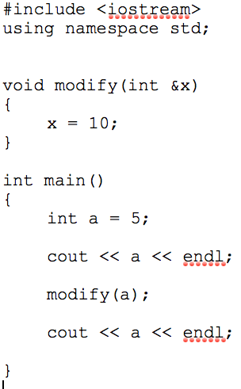
C++ References
1-<number>

Slide 7
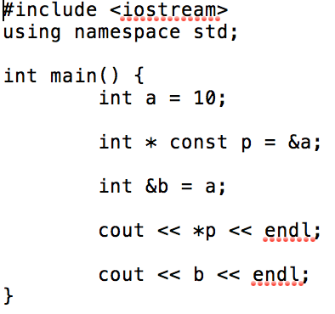
C++ References
Copyright © 2015 Pearson. All rights reserved.
1-<number>

Slide 8
references.cpp
Copyright © 2015 Pearson. All rights reserved.
1-<number>

Slide 9
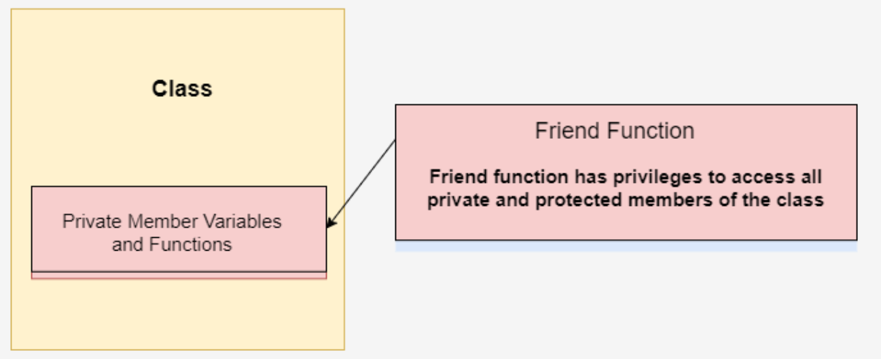
Friends in C++
1-<number>

Slide 10
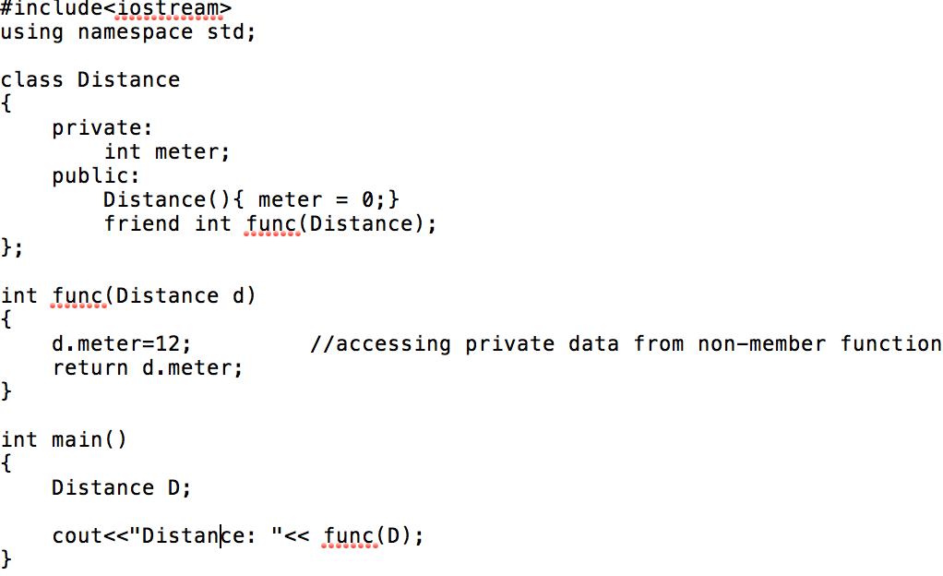
Friend Function
Copyright © 2015 Pearson. All rights reserved.
1-<number>

Slide 11
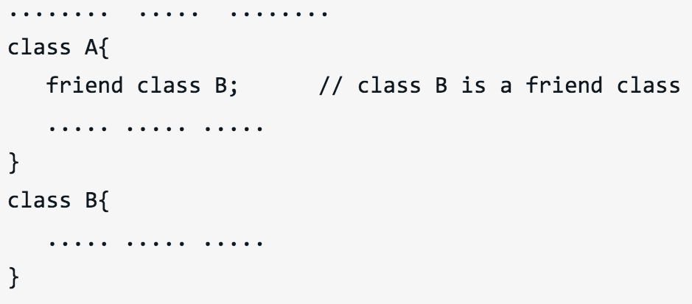
Friend Functions
1-<number>

Slide 12
Operator Overloading
Operators already work with built-in types
Overloading enables C++ operators to work with class objects
Most of the C++ operators can be overloaded
Copyright © 2015 Pearson. All rights reserved.
1-<number>

Slide 13
Operator Overloading- How ?
Write a function
  Function name is keyword operator followed by the symbol for the operator being overloaded
  operator+ used to overload the addition operator (+)
  To use an operator on a class object it must be overloaded
  Note that the Assignment operator by default performs member wise assignment
  No explicit overloading of operators for built-in types allowed
Copyright © 2015 Pearson. All rights reserved.
1-<number>

Slide 14
Operator Overloading
  Operator functions can be member or non-member functions
  Operator functions as non-member functions must be friends if they need to access private or protected members
Copyright © 2015 Pearson. All rights reserved.
1-<number>

Slide 15
operator-overloading.cpp
Copyright © 2015 Pearson. All rights reserved.
1-<number>

