Slide 1
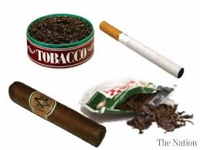
Tobacco Usage in USA
Team 5 - Ivan Aguirre, minu khosla, shweta Kalavar

Slide 2
Why Tobacco?
Tobacco use is one of the leading cause of preventable diseases, disability, and deaths in the United States.
It is associated with deaths related to lung cancer, respiratory diseases and cardiovascular diseases.
Nearly 40 million US adults still smoke cigarettes, and about 4.7 million middle and high school students use at least one tobacco product, including e-cigarettes.
Each year, nearly half a million Americans die prematurely from tobacco usage.
Each year, the United States spends nearly $170 billion on medical care to treat tobacco-related disease in adults.

Slide 3
Hypothesis proposal There are different factors and correlations between tobacco users, such as gender, income and education. What is the percentage of those who use tobacco in the U.S. and what is a common field amongst them. Do they share a similar education and income level amongst the higher tobacco users and what is that percentage.

Slide 4
Where and how did we find the data we used to answer these questions?
We found the tobacco related data on CDC website (Centers for Disease Control and Prevention).
The data is from Behavioral Risk Factor Surveillance System (BRFSS). This is the nation's premier system of health-related telephone surveys that collect state data about U.S. residents regarding their health-related risk behaviors, chronic health conditions, and use of preventive services.
The data is from 2011 to 2018 for all states of America.

Slide 5

Research questions
What is the Percentage of people in the United States who use tobacco?
Does income level lead to an increase or decrease in tobacco usage?
Is the usage of tobacco dependent on the education level of people?

Slide 6
Data Clean-Up and Exploration
Loaded the BRFSS Data File
Read the complete BRFSS data and extract only Tobacco related rows and saved the output to new csv file
Read the new tobacco csv file
Next, we filtered out the year 2018 data for all States and deleted the columns that were not being used.
Next, we filtered out the US territories (like Guam and Puerto Rico)

Slide 7
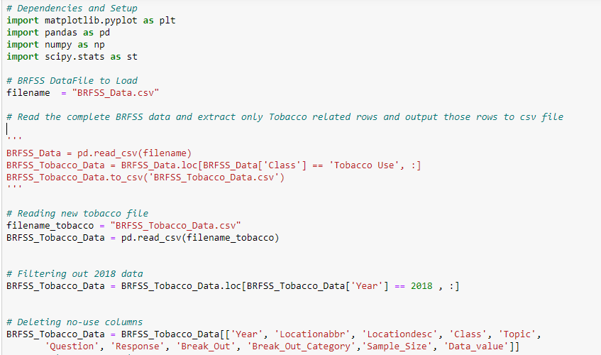

Slide 8
Research Question - 1

Slide 9
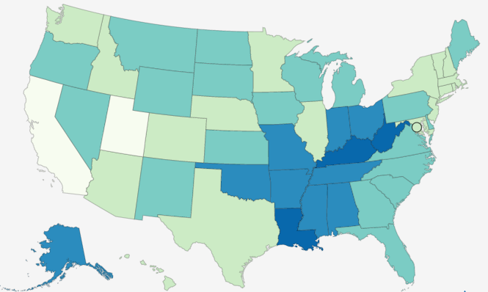
What is the Percentage of Tobacco consumers across the United States?
Steps followed-
Clean up process - consisted of filtering the tobacco related data for year 2018 for all 50 states of America.
Applied group-by function on each state and calculated the Percentage of tobacco users for each state of US.
Selected a bar chart to show percentage of tobacco users across each state within the US.

Slide 10
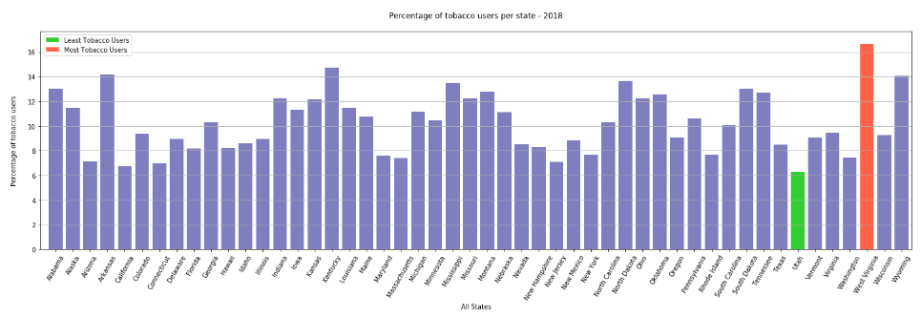
What is the Percentage of Tobacco consumers across the United States?

Slide 11
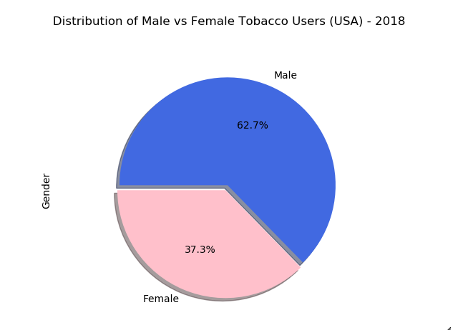
What is the Percentage of Tobacco users (male vs female) across the United States?

Slide 12
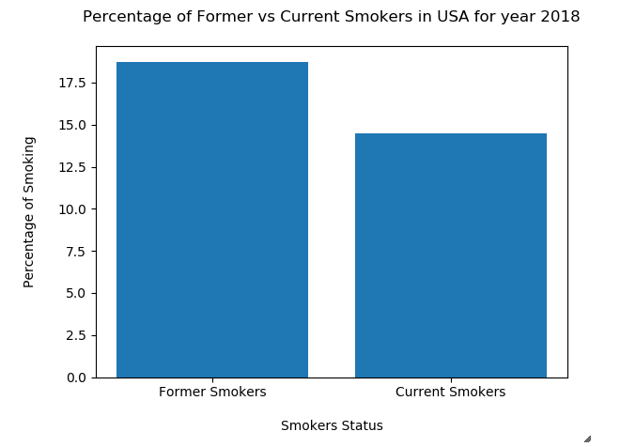
Percentage of Former versus Current smokers

Slide 13
Summary Findings –
Based on research & data analysis, we found that West Virginia (WV) has highest number of tobacco users (approx. 16.66%) and Utah(UT) has least number of tobacco users (approx. 6.27%)
Then, we found out that tobacco usage is not uniform across gender. Adult males(62.7%) were significantly more likely to use tobacco than females(37.3%).
Tobacco use (Smoke & Smokeless) has declined from 18.75% (nearly 19 of every 100 adults) to 14.47% (14 of every 100 adults) in the year 2018 across USA.

Slide 14
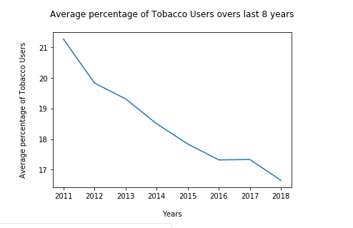
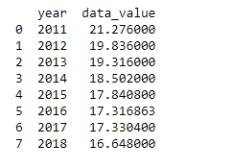
API call to identify the Average Percentage of Tobacco Users over the last 8 years

Slide 15
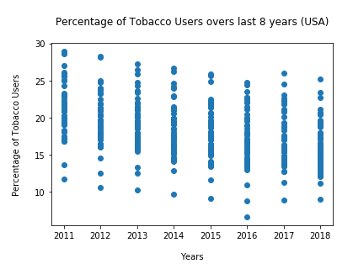
API call to identify the Average Percentage of Tobacco Users over the last 8 years

Slide 16
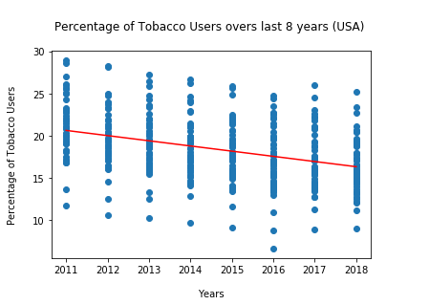
API call to identify the Average Percentage of Tobacco Users over the last 8 years

Slide 17
Summary Findings (API Call) -
Tobacco usage has been significantly decreasing each year from 2011 to 2018, as numerous actions are implementing by CDC and state health department to reduce tobacco use to the point that it is no longer a public health problem for the Nation ( "Healthy People 2020" - The goal is to reduce illness, disability, and death related to tobacco use and secondhand smoke exposer).

Slide 18
Research Question - 2

Slide 19
Does the income level lead to an increase or decrease in tobacco usage?
The clean up process consisted of filtering to only collect household income and every type of income under that category.
Initially believed that socioeconomic level did not have an affect on the tobacco usage but came to find out that those with a lower socioeconomic level have a higher percentage of tobacco usage
Problems that arose were trying to find the proper graph to show information properly.

Slide 20
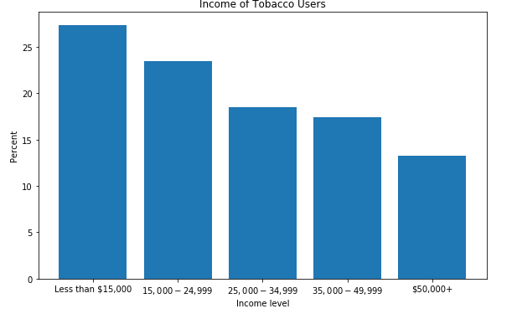
Does the income level lead to an increase or decrease in tobacco usage?

Slide 21
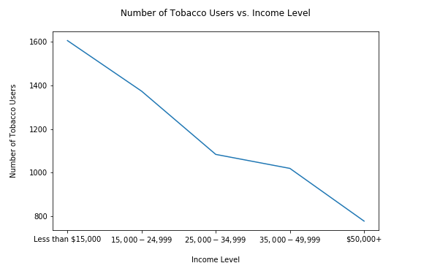
Does the income level lead to an increase or decrease in tobacco usage?

Slide 22
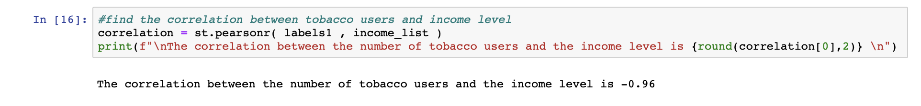
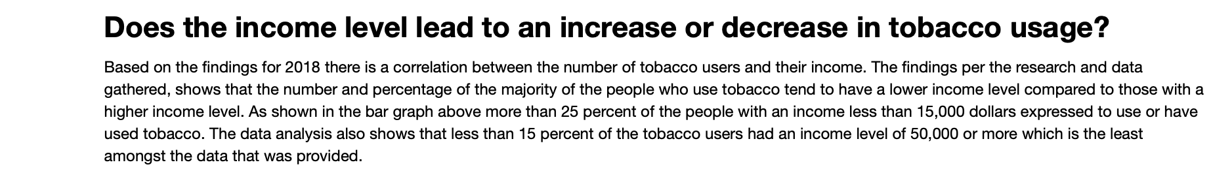
Final analysis on income vs tobacco usage

Slide 23
Research Question - 3

Slide 24
Is the usage of tobacco dependent on the education level of people?
The clean up process consisted of filtering to each type of education level attained.
Identifying the correct graph to use to display the correlation between the education level and the percentage of tobacco users.

Slide 25

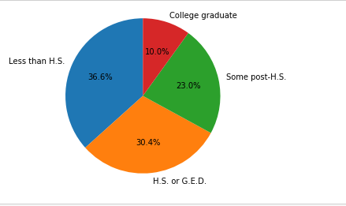
Is the usage of tobacco dependent on the education level of people?

Slide 26

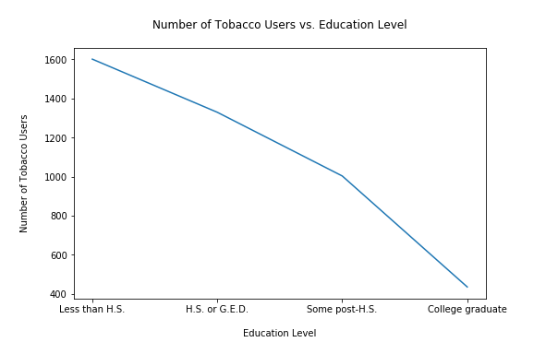
Is the usage of tobacco dependent on the education level of people?

Slide 27
Is the Usage of Tobacco dependent on the Education Level of the consumer? Based on the findings for 2018 there is a correlation between the number of tobacco users and their education levels. The findings per the research and data gathered, shows that the number and percentage of the Tobacco consumer reduces with the level of education. As shown in the Pie chart more 67% of the Tobacco Users have a High School Education or less than High School Education. 33% of the Tobacco Users had Some Post High School or College Degree.

Slide 28
Project Conclusion – Based on our research and data analysis, we have identified that Tobacco usage is higher in males with lower income and lower education.

Slide 29
Post- mortem
Difficulties that arose, and how we dealt with them?
Time to work on project
Uploading to git due to file being too large to be able to upload
Merging the code and making sure it did not give any errors when code runs.
Additional questions that came up, and what would we research next, if we had two more weeks?
Would research any illness that are linked to tobacco usage.
Research the correlation between the amount of tobacco users and the level of healthcare they have.
And finally, research the tobacco usage in every continent and notice any trends with healthcare issues in those regions; maybe even a dive deeper into the countries if we notice a significant rise in a specific illness.

Slide 30
Thankyou

Slide 31

Questions?
This Photo by Unknown Author is licensed under CC BY-SA

