Slide 1

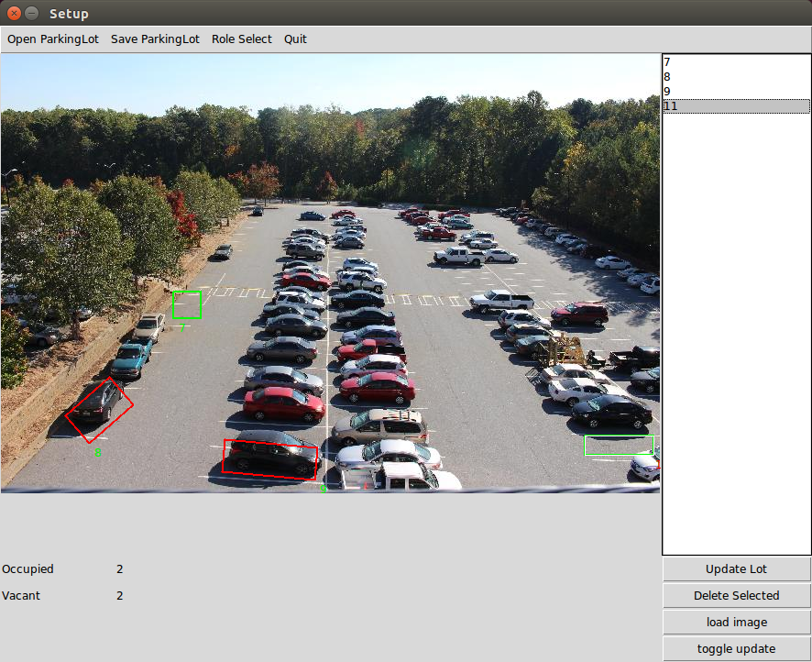
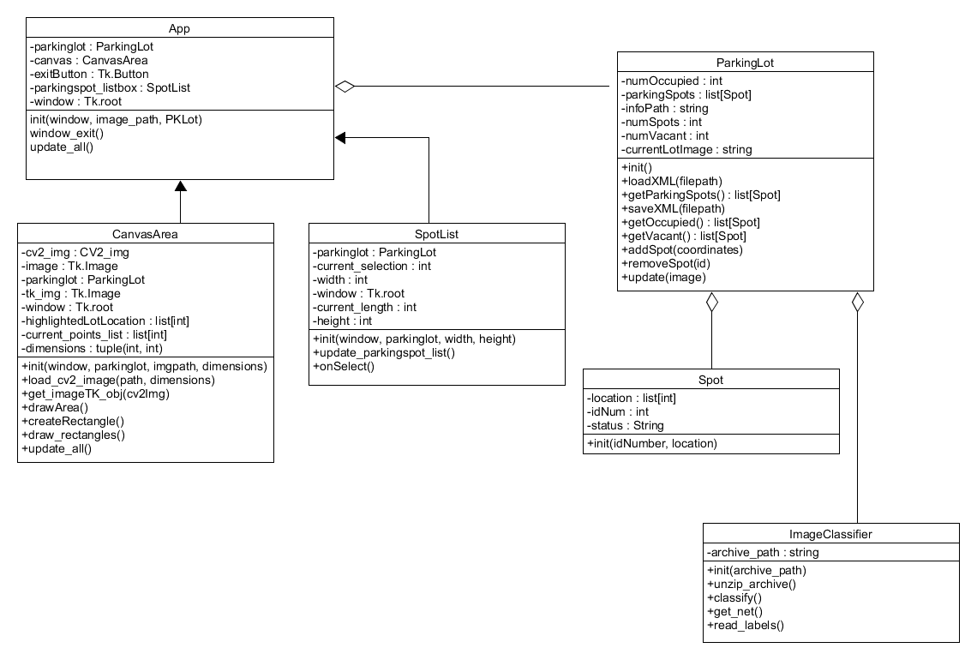
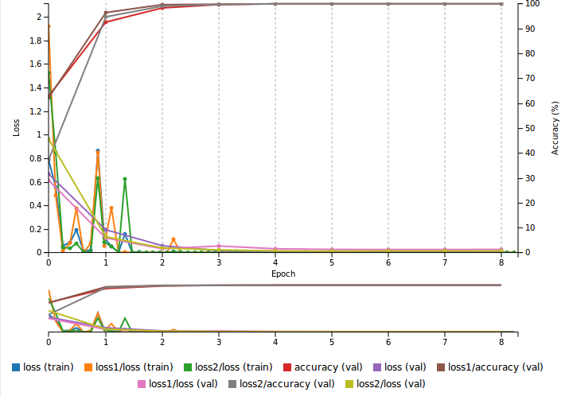
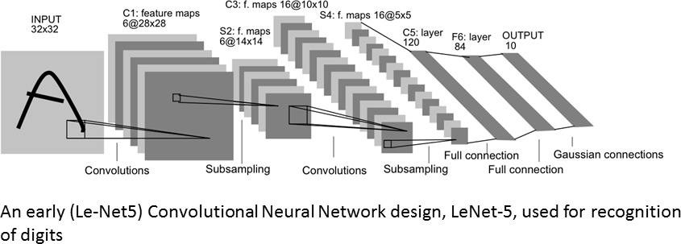
CP-27
Parking Monitoring System
Team Tech Ops
Alex Bates
Lead Developer
abates30@students.kennesaw.edu
Naga Gattupalli
UI Designer ngattupa@students.Kennesaw.edu
Jeswin Abraham
Project Manager
jabraha8@students.kennesaw.edu
Phillip Bouie
Photographer
pbouie@students.Kennesaw.edu
Introduction
This system keeps track of available and occupied spaces in a parking lot.
The goal is to more effectively manage parking in crowded lots, as well as provide information about the typical use of the lot over time.
A focus is low cost of setup. A significant number of parking lots have existing security cameras already in place, and lack installed hardware to individually track each parking spot. Our product will allow the images captured from existing cameras to be used for monitoring.
Materials
Setup:
  Ubuntu 14.04 Installation
  NVidia graphics card
  A Camera to provide images (not implemented)
Software:
  Nvidia’s DIGITS framework and CUDA libraries
  Caffe
  Python 2.7
  OpenCV 2
Resources
Almeida, P., Oliveira, L. S., Silva Jr, E., Britto Jr, A., Koerich, A., PKLot - A robust dataset for parking lot classification, Expert Systems with Applications, 42(11):4937-4949, 2015.
[Basic CNN Layout]. (n.d.). Retrieved from http://parse.ele.tue.nl/
Caffe [Computer software]. (n.d.). Retrieved from http://bvlc.eecs.berkeley.edu/
Program Overview
The final software product was designed so that a new parking lot could be entered into the system easily, and results could quickly be gathered.
The main interface of the program is shown below. This window allows parking spaces to be drawn out, and results to be displayed on the screen. Another similar interface is provided that limits functionality to simply viewing, to avoid accidental changes to the parking lot layout.
Development
Project development began with initial research of the concept. The original goal was simply to design a system that could track how many cars were in a parking lot at a given moment.
After initial research, the overall design of the software was laid out in a state diagram and a class diagram. This provided the general path to follow when actual development began.
The team generally followed agile methodologies, holding weekly meetings with short and long term deadlines laid out at each meeting.
Future Plans
Given more time, future goals include a more refined and automated method for marking parking spots on initial setup, and tooling to assist in retraining the neural network to increase classification accuracy.
Additionally, development of a tool to assist in viewing long term trends of a parking lot would be planned. The tool would take the existing parking lot and identify popular spots, average “fullness” of the lot, and the like.
Final Thoughts
During this project, some of the realities of longer term software development were seen by the team. In some cases, this was the longest and most complete project that team members had taken part in. It went all the way from initial concept to a final working solution.
Several lessons were learned, such as
the importance of communication within the team, how to manage time and meet deadlines, and a sense of overall time that needs to be taken during implementation of an initial idea.
Introduction
Results
Parking Monitoring System
This system keeps track of available and occupied spaces in a parking lot.
The goal is to more effectively manage parking in crowded lots, as well as provide information about the typical use of the lot over time.
A focus is low cost of setup. A significant number of parking lots have existing security cameras already in place, and lack installed hardware to individually track each parking spot. Our product will allow the images captured from existing cameras to be used for monitoring.
Development
Project development began with initial research of the concept. The original goal was simply to design a system that could track how many cars were in a parking lot at a given moment.
After initial research, the overall design of the software was laid out in a state diagram and a class diagram. This provided the general path to follow when actual development began.
The team generally followed agile methodologies, holding weekly meetings with short and long term deadlines laid out at each meeting.
Total development time was approximately three months. November – December, 2016.
Future Plans
Given more time, future goals include a more refined and automated method for marking parking spots on initial setup, and tooling to assist in retraining the neural network to increase classification accuracy.
Additionally, development of a tool to assist in viewing long term trends of a parking lot would be planned. The tool would take the existing parking lot and identify popular spots, average “fullness” of the lot, and the like.
Materials
Setup:
Ubuntu 14.04 Installation
NVidia graphics card
A Camera to provide images (not implemented)
Software:
Nvidia’s DIGITS framework and CUDA libraries, Caffe, Python 2.7, OpenCV 2
Using A Convolutional Neural Network to Classify Images
Elements from an existing dataset of cars in a parking lot were fed into a convolutional neural network. The trained network that was produced is what classifies each marked parking spot in the application as occupied or empty.
The training of the network was done using Nvidia’s DIGITS platform, which utilizes a deep learning library produced by the University of Berkeley named Caffe. The initial dataset was run through several epochs of training, and output of said training is what is used in this project.
Final Thoughts
During this project, some of the realities of longer term software development were seen by the team. In some cases, this was the longest and most complete project that team members had taken part in. It went all the way from initial concept to a final working solution.
During this, several lessons were learned, such as
the importance of communication within the team, how to manage time and meet deadlines, and a sense of overall time that needs to be taken during implementation of an initial idea.
Basic CNN Layout
Network Accuracy Over Time
Notes:
Copyright Colin Purrington (http://colinpurrington.com/tips/academic/posterdesign).

