Slide 1
Satalia Data Engineering Challenge

Slide 2
Introduction
Objective: Cloud-based Data Infrastructure, utilized by team of SQL Analysts
Initial Thought: Design a solution using multiple AWS Services
Use a tech stack AWS Lambda, Kinesis or EMR and RDS along with Terraform for provisioning
Not too familiar with some of the technologies, not enough time to experiment
Limited by the free-tier options
Final Design: Designed a fully custom infrastructure
Designed a custom infrastructure easily deployable on VMs
Interact only with S3 (raw data storage) and EC2 (VM to deploy infrastructure)
Still limited by free tier. Instance t3.micro offers 1GB

Slide 3




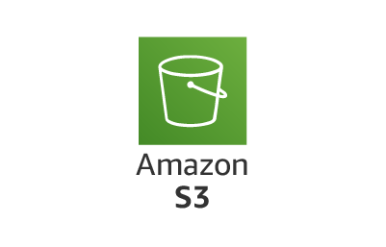

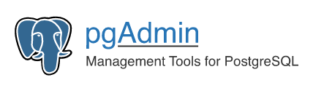

VisitStreamingApp
NetworkStreamingApp

Slide 4
Data Processing Applications
VisitStreamingApp
Source Operators
VisitStreamingApp: PROCESS_CONTINOUSLY Mode to continuously fetch new files from S3
NetworkStreamingApp: Static Data fetch data once from S3
Formatting Operators
VisitStreamingApp: Transform JSONL data and store in table
NetworkStreamingApp: Store Node Data in table
Sink DB Operators
Sent batches of data to DB (1) when configured batch interval elapses, (2) max batch size is reached, (3) Flink Checkpoint has started
c
c
c
Visit
Formatting
PROCESS_CONTINUOSLY
Source
Operator
Sink DB
Operator
NetworkStreamingApp
c
c
c
Source
Operator
Network
Formatting
Sink DB
Operator

Slide 5
./manage.sh execution script
Execution Modes: install | build | visit | network | stop | kill |
install: Install the necessary software stack
Utilities (openjdk, maven, docker, docker-compose)
Apache Flink and necessary plugins
Apache Kafka (not used in the end)
build: Build both VisitStreamingApp and NetworkStreamingApp
visit: Executes VisitStreamingApp in Flink Cluster
network: Executes NetworkStreamingApp in Flink Cluster
stop: Stops Apache Flink Cluster and clean /tmp data
kill: Terminate all services and clean all data (including docker service)

Slide 6
DEMO

Slide 7
Improvements #1: Data modelling
Visits
Engineers
visit_id (PK)
task_id (FK)
node_id (FK)
visit_number
visit_date
original_reported_date
engineer_id (FK)
engineer_skill_level
outcome
engineer_id (PK)
engineer_skill_level
Nodes
node_id (PK)
node_age
node_type
EngineerNotes
note_id (PK)
visit_id (FK)
note_taken
Network
Tasks
node_id
Adj_node
task_id (PK)
task_type

Slide 8
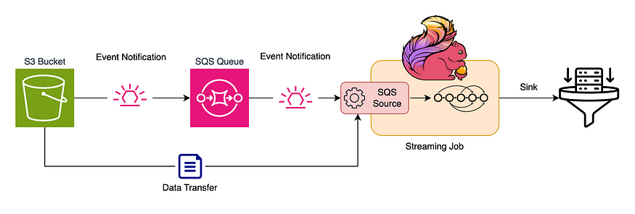
Improvements #2: Data fetching from S3
Continuous polling in intervals
(-) Too many requests
(-) In case large interval, data can wait for long time
(-) Default Source keeps track of already processed files in state store, cannot scale indefinitely
Custom Source Operator
Notification can trigger the processing of the newly uploaded file without waiting for a scheduled scan of the bucket
(+) Reduced latency and overhead.
https://medium.com/datareply/event-driven-file-ingestion-using-flink-source-api-cfe45e43f88b

