Slide 1
Containers Review

Slide 2
Module Outline
Container Basics
Container Images
Container Persistence
Container Networking
Demo: Running a standalone container

Slide 3
Container Basics
Container: Better described as a “Containerized Process”
Built on existing Linux kernel features
No virtual hardware
No independent kernel
Container
Process

Slide 4
Container Basics
Container Runtime
runc (also crun, railcar)
Container Engine
Docker, containerd, CRI-O
Container Tools
Docker CLI, nerdctl, podman

Slide 5
Container Images
Container Image
Container Image
vs.
Container
/
/bin
/lib
/lib/mypackage
/var/html
Container
Process
Container Manifest

Slide 6
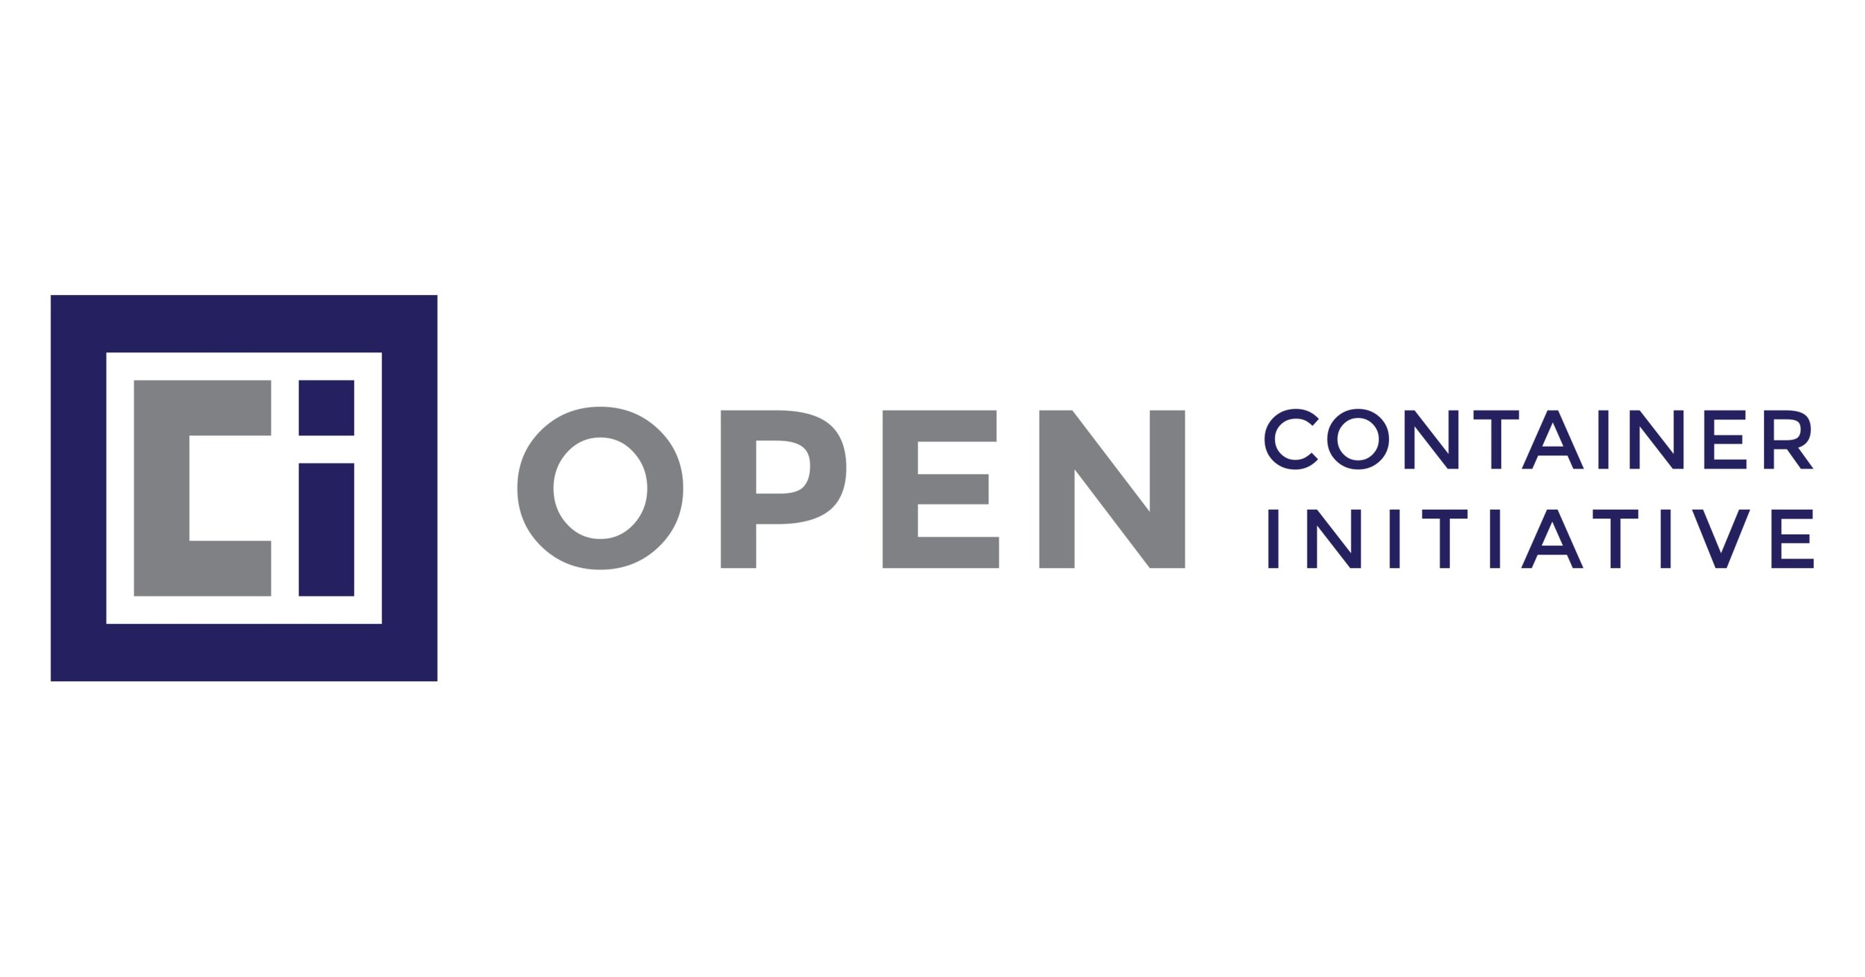
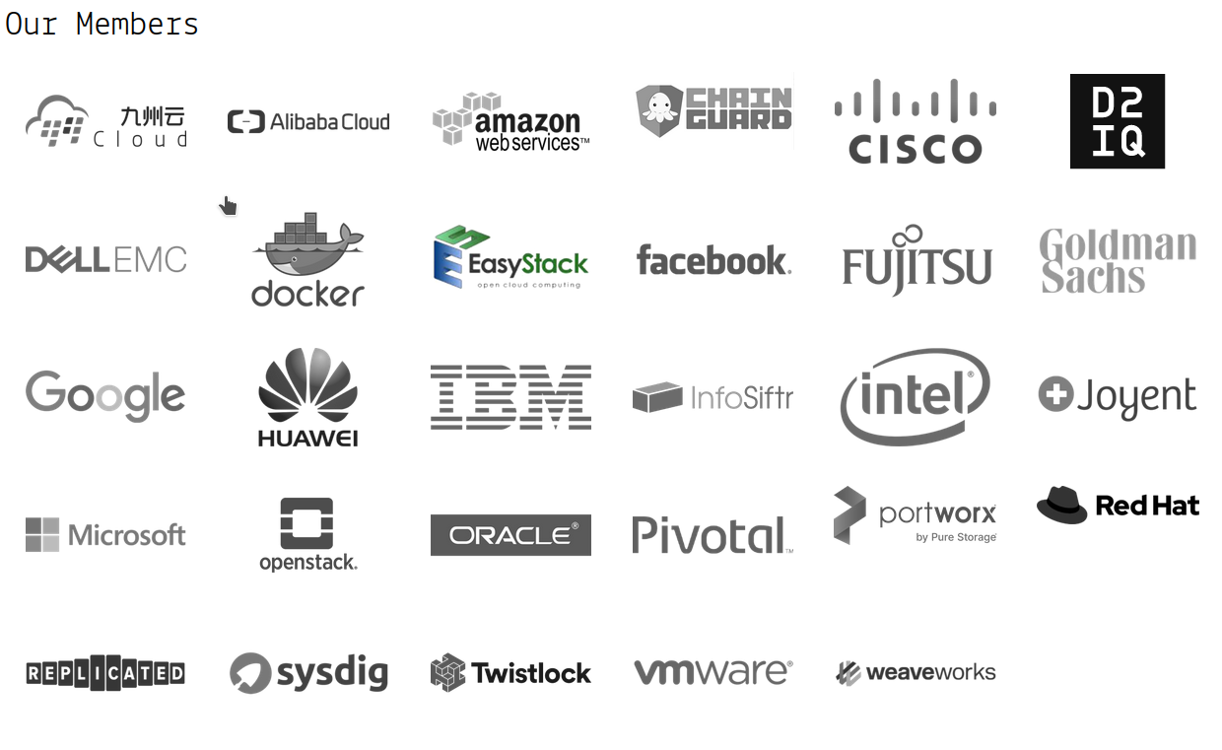

Container Images

Slide 7
Container Persistence
Ephemeral Storage – disappears with the container
Volume Storage – stored external to container
/data
/mnt/data

Slide 8
Container Networking
Containerized Processes use Software-Defined Networks
Still just kernel capabilities
Still no virtualized hardware!
Bridged subnets, host networks, or no network
Subnet
Host Network Adapter
container
Bridge
container
Host Network Adapter
container
container

Slide 9
Demo
Standalone Containers
Kubernetes Basics

