Slide 1
Kubernetes Overview

Slide 2
Module Outline
Kubernetes Origins
Kubernetes Architecture
Kubernetes API
Demo: Kubectl
Lab: Kubernetes Basics

Slide 3
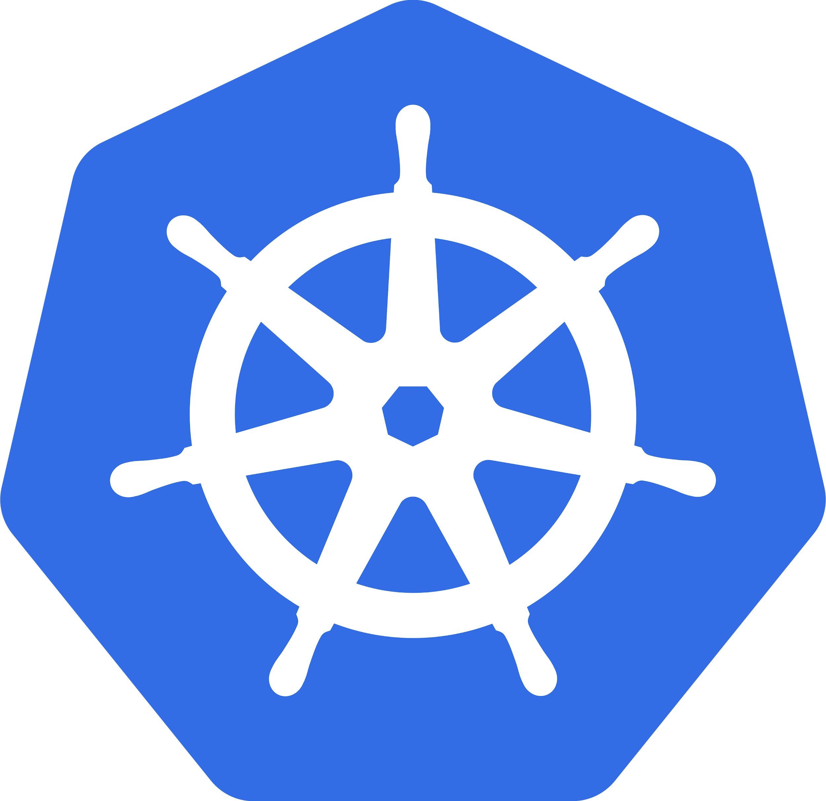

Kubernetes (k8s)
Open-source platform for automating deployment, scaling, and management of containerized applications
Greek for 'Captain' or 'Helmsman' (it's driving the container ship!)
Created inside Google and open-sourced, now managed by CNCF
Notes:
https://kubernetes.io/
https://www.cncf.io/
https://github.com/kubernetes/kubernetes
https://github.com/kubernetes/kubernetes/blob/master/logo/logo.png
https://github.com/cncf/artwork

Slide 4
Kubernetes Clusters
Node
Master
Node
Node
Notes:
Clusters consist of master and application nodes

Slide 5
Kubernetes Clusters
Node
Node
Node
Node
Node
Master
Node
Node
Node
Node
Node
Master
Node
Node
Node
Node
Node
Master
Node
Node
Node
Node
Node
Notes:
Clusters can be Huge! Pokemon GO runs lots of clusters with 1000's of nodes in each.

Slide 6

Kubernetes Clusters
Node
App
App
Run 2 Yellow
Node
Master
App
Node
App
Notes:
The Master nodes handle the scheduling of apps onto application nodes

Slide 7
Kubernetes Clusters
Node
App
App
Master
Kubelet
Engine
API
Scheduler
Controllers
Node
App
Etcd
Kubelet
Engine
Kubelet
Engine
Node
App
Kubelet
Engine
Notes:
The plumbing of Kubernetes consists of many parts.

Slide 8
Kubernetes API
kube-apiserver
Exposes a REST API
JSON request format
Only piece a user should talk to
Master
API
Scheduler
Controllers
Etcd
Kubelet
Engine
Notes:
https://kubernetes.io/docs/reference/generated/kubernetes-api/v1.14/

Slide 9
Kubernetes Scheduler
Master
API
kube-scheduler
Selects node for an app to run based on many factors
Scheduler
Controllers
Etcd
Kubelet
Engine

Slide 10
Kubernetes Controller
Master
kube-controller-manager
Components that watch for changes
Attempt to maintain desired state
API
Scheduler
Controllers
Etcd
Kubelet
Engine

Slide 11
Kubernetes State
Master
API
etcd
Backing store for cluster data
Open-source, distributed key-value store
Scheduler
Controllers
Etcd
Kubelet
Engine

Slide 12
Kubelet Agent
Master
API
Kubelet
Agent running on each node
Runs containers on the node
Reports status back to Master
Scheduler
Controllers
Node
App
Etcd
Kubelet
Engine
Kubelet
Engine

Slide 13
Desired vs Actual State
Node
?
App
App
App
App
App
App
App
Kubelet
Engine
App
App
App
App
Master
Node
App
Kubelet
Engine
Node
App
Kubelet
Engine
Notes:
So we know the pieces, how do we use it?
The job of the master is to continuously reconcile the desired state and actual state. As a user, we just simply declare the desired state.

Slide 14
Desired vs Actual State
Node
?
App
App
App
App
Kubelet
Engine
App
App
App
Master
Node
App
App
Kubelet
Engine
Node
Node
App
App
Kubelet
Kubelet
Engine

Slide 15
Kubernetes Objects
Node
App
App
Master
Kubelet
Engine
API
Scheduler
Controllers
Node
App
Etcd
Kubelet
Engine
kubectl create -f object.yaml
Kubelet
Engine
Node
App
Kubelet
Engine
Notes:
The user declares their desired state for their app via the API. The desired state is described by a set of Object Manifests written in YAML that are uploaded to the K8s API, more on this in the next module. The user does not have to care about what steps must be taken to reach their desired state.

Slide 16
Pods
10.0.2.1
A Pod is a thin wrapper around container(s). It is the smallest deployable unit in k8s.
Networking
Container
App
Node
App
Storage
Pod
Notes:
"Pods" are the most fundamental kubernetes object. We package up our app, put it inside a container, and deploy it on kubernetes inside of a pod. A pod has its own storage and IP address.

Slide 17
One Pod, One App
Container
Container
App
App
Pod
Container
App
Container
App
Pod
Pod
Notes:
A Pod should only contain a single application. There are a couple exceptions to this which we will cover later. This is critical because the isolation of the application is at the pod level, so two containers in the same pod could disturb each other.

Slide 18
Scaling an App
Container
App
Container
App
Container
Container
Pod
App
App
Container
Container
Pod
App
App
Pod
Pod
Notes:
If we want to scale-out our application, we must create more pods that run it. If we had the application running multiple times in a pod, we are not actually giving it any more resources. If we had different apps in a single pod, we would have to scale them together.

Slide 19
Namespaces
Logical
Physical
Node
Logical construct to group resources
Most objects live in a namespace
Does not affect physical topology
App
App
App
Namespace 1
App
App
App
Node
App
Namespace 2
Node
App
App
App
App
App
App
Kubelet
Docker
Notes:
https://kubernetes.io/docs/concepts/overview/working-with-objects/namespaces/
You may use namespaces to separate resources for different teams or maybe environments such as dev, test, and prod. Kubernetes actually runs it's internal objects in a namespace called kube-system.

Slide 20
Lab
Kubernetes Basics
Kubernetes Basics

Slide 21
How do you pronounce Kubectl
1. Cube Cuddle
2. Cube Control
3. Cube See Tee El
4. It doesn't matter

Slide 22
What is Kubelet?
1. An agent that runs on the node and communicates information to the master(s)
2. A lightweight Kubernetes distribution
3. Backend storage service for cluster information
4. A shakespearean tale about a container seeking revenge against the one who killed Kubelet's father

Slide 23
Additional Resources
Kubernetes - https://kubernetes.io
Kubectl Overview https://kubernetes.io/docs/reference/kubectl/overview/

