Slide 1
Continuous Deployment with Keptn Tested by Hey
Anlauf Stefan, GoulD ALINE,
KALTENLEITHNER SOPHIE, Sandler Simone

Slide 2
Create and Deploy an Application
Implemented an Angular web app
Requests weather data from Open Weather API
Health Endpoint
Liveness Probe
Readiness Probe
Created a Docker image and deployed it to Dockerhub

Slide 3


Hey Service
Hey is a load generator for web applications
Tests the response time of the application
Integrated the Hey executable into a template service for Keptn
Implemented in Go
Sends 200 requests and test the availability of the application
Deploy Hey-Service as Docker image

Slide 4
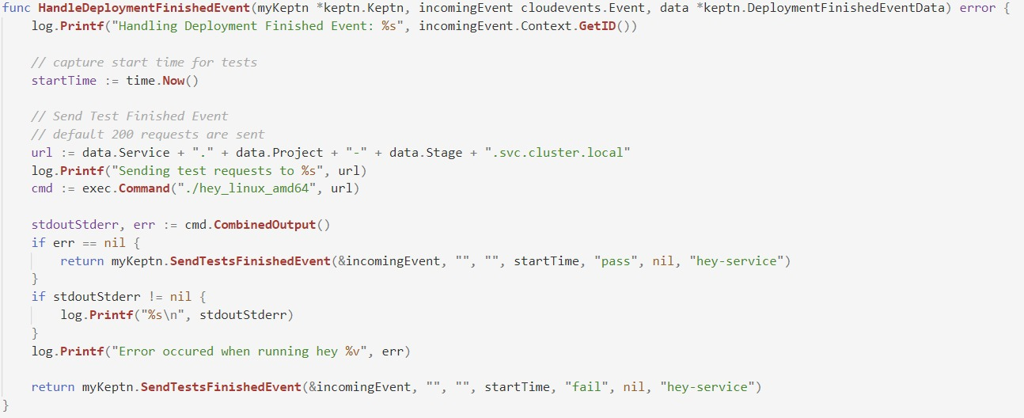
Hey Service

Slide 5
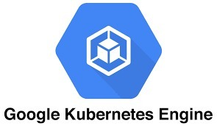
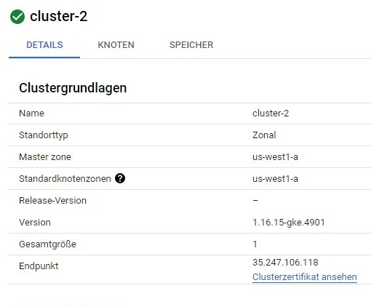
Setup Google Cluster
Create Kubernetes cluster (in GKE)
Cluster Settings:
Nodes: 1
Image Type: Ubuntu
VM: 8v 32 GB

Slide 6


Setup Keptn
Install Istio and Keptn
Istio
Loadbalancer
Creates connection between Google Cluster and Keptn
Configured for traffic routing and as an ingress to the Google Cluster
Keptn
Event-based control plane
Continuous delivery
Automated operations for cloud-native applications.

Slide 7

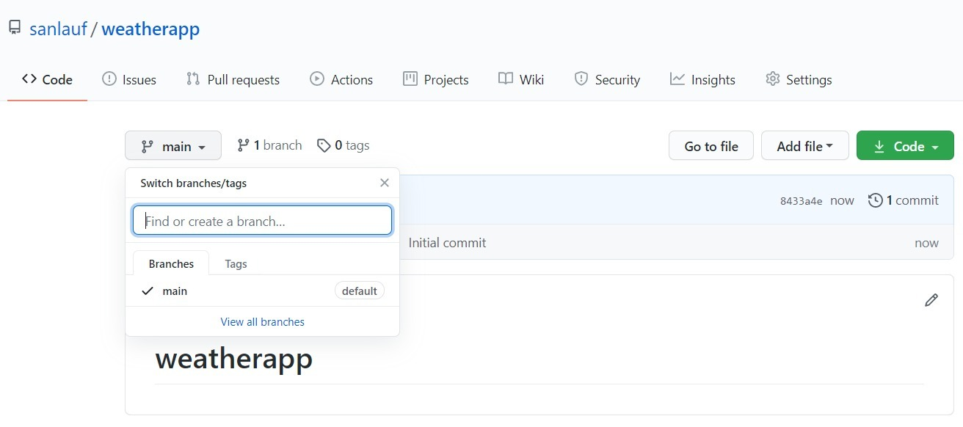
Deploy and Test the Application
Deploy Hey-Service on GKE Cluster
Create a Git Repository

Slide 8
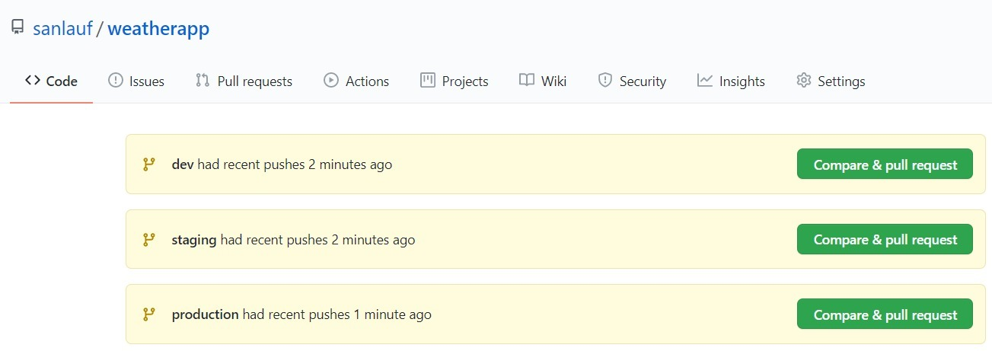
Deploy and Test the Application
Create shipyard.yaml for defining the stages and deployment strategies
Dev: Direct
Staging: Blue Green
Production: Blue Green
Create a Keptn Project

Slide 9

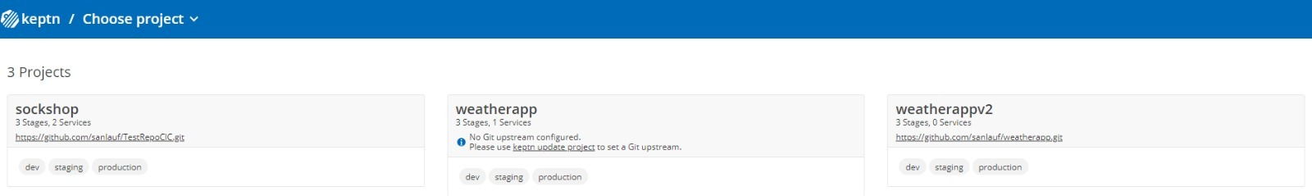

Deploy and Test the Application
Onboard service using a template Helm chart
Describes the Deployment of the Service

Slide 10
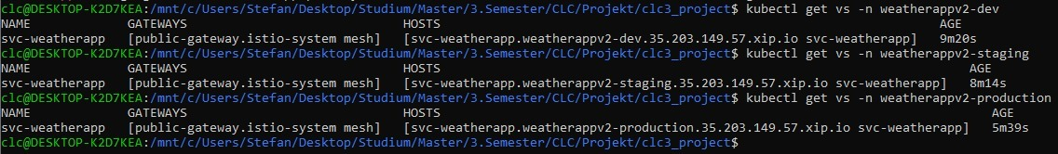
Deploy and Test the Application
Deploy first build
Send a new artefact with Keptn
Automatically created the Pods
View the application in different stages

Slide 11
Lessons learned…
Theoretical background can be helpful
Log outputs provide valuable information
Setup is time-consuming, but is worth it
Keptn reduces implementation effort

Slide 12
Questions?
Try it yourself: https://github.com/skaltenl/clc3_project

