Slide 1
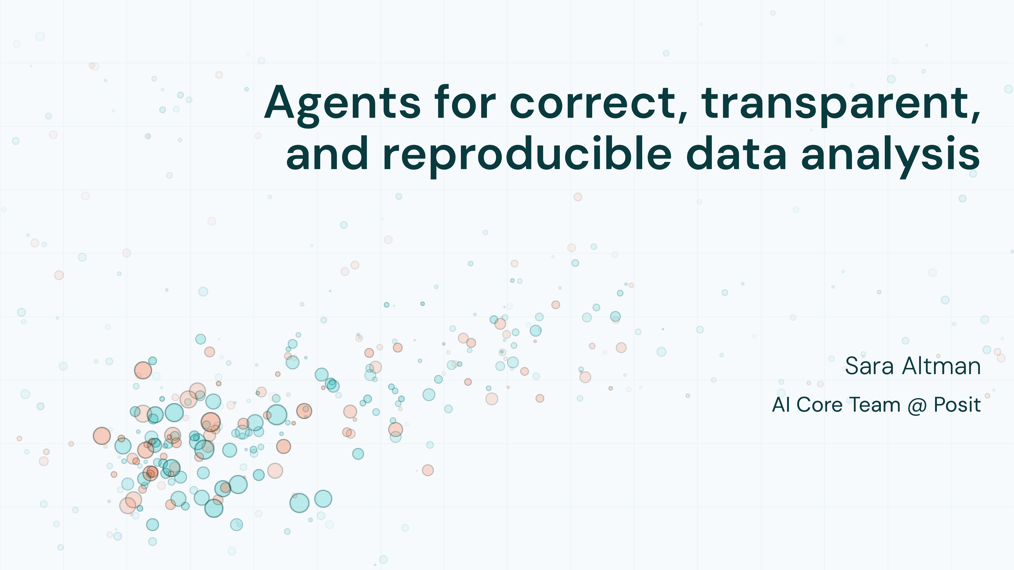

Slide 2


Slide 3
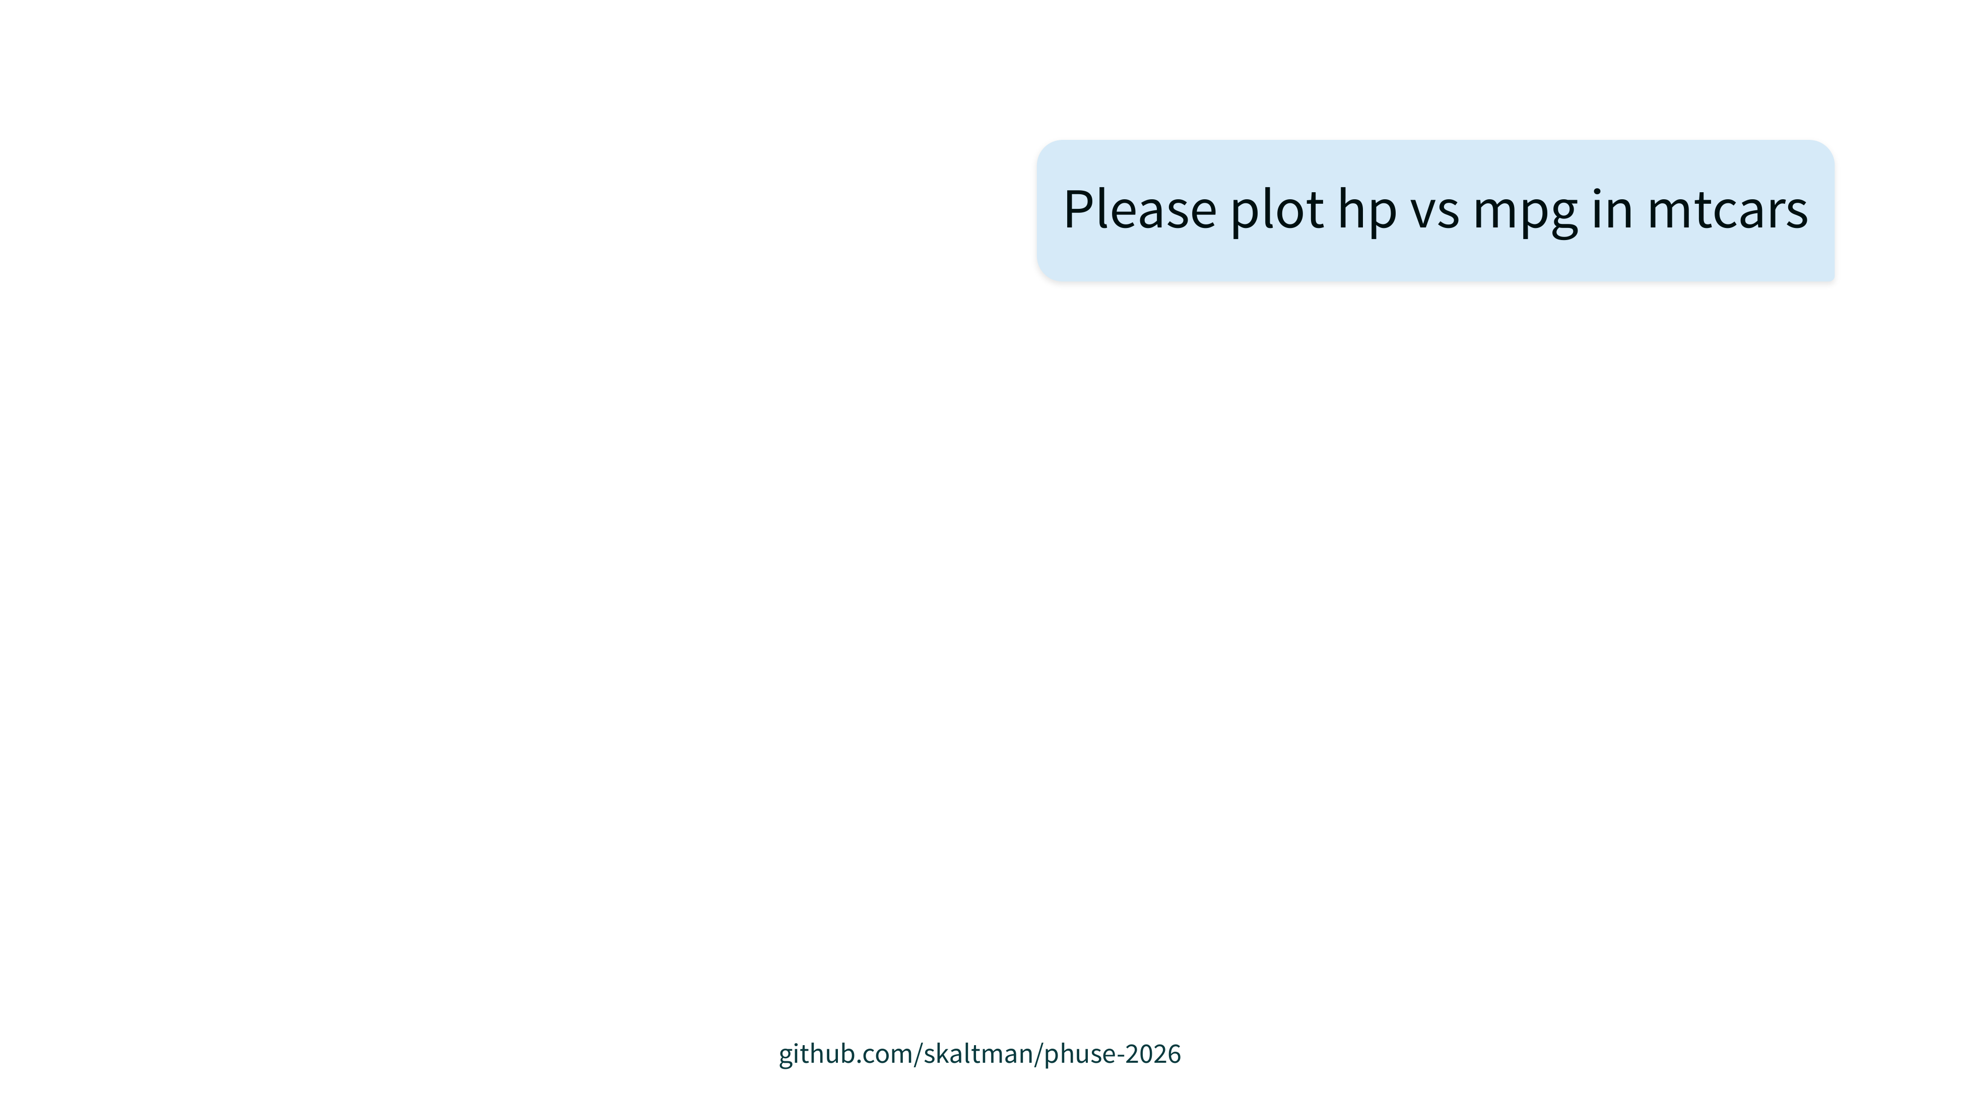

Slide 4
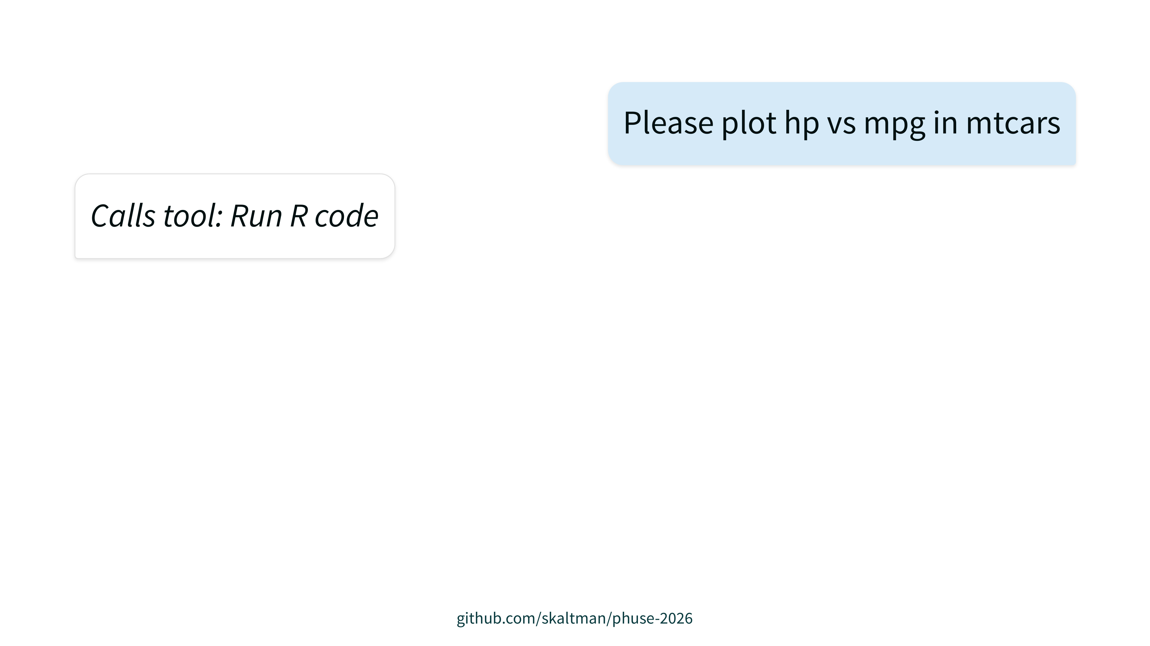

Slide 5
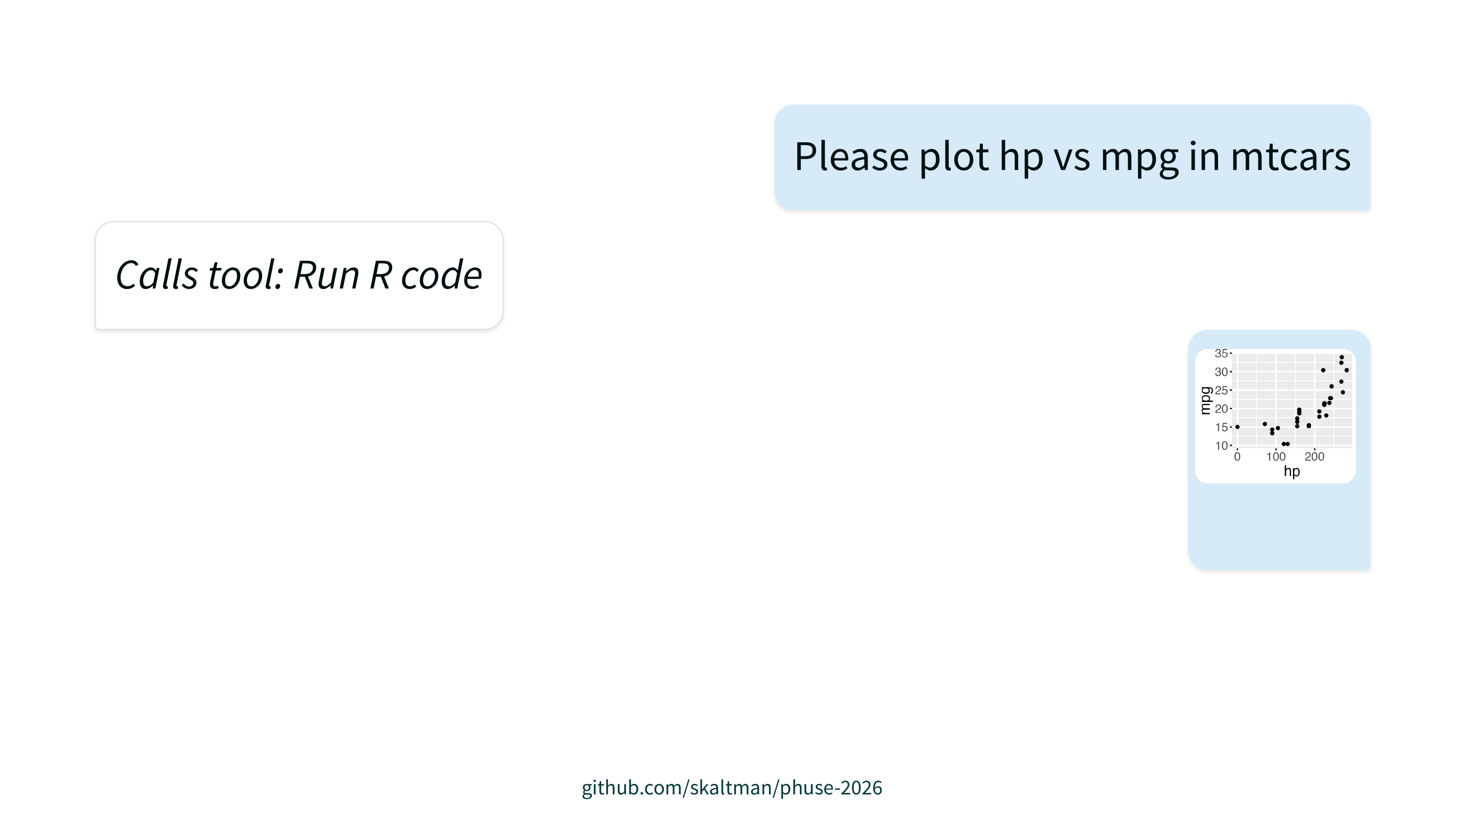

Slide 6
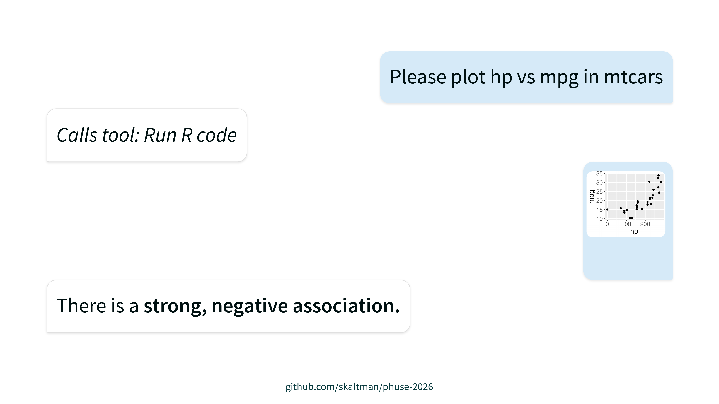

Slide 7
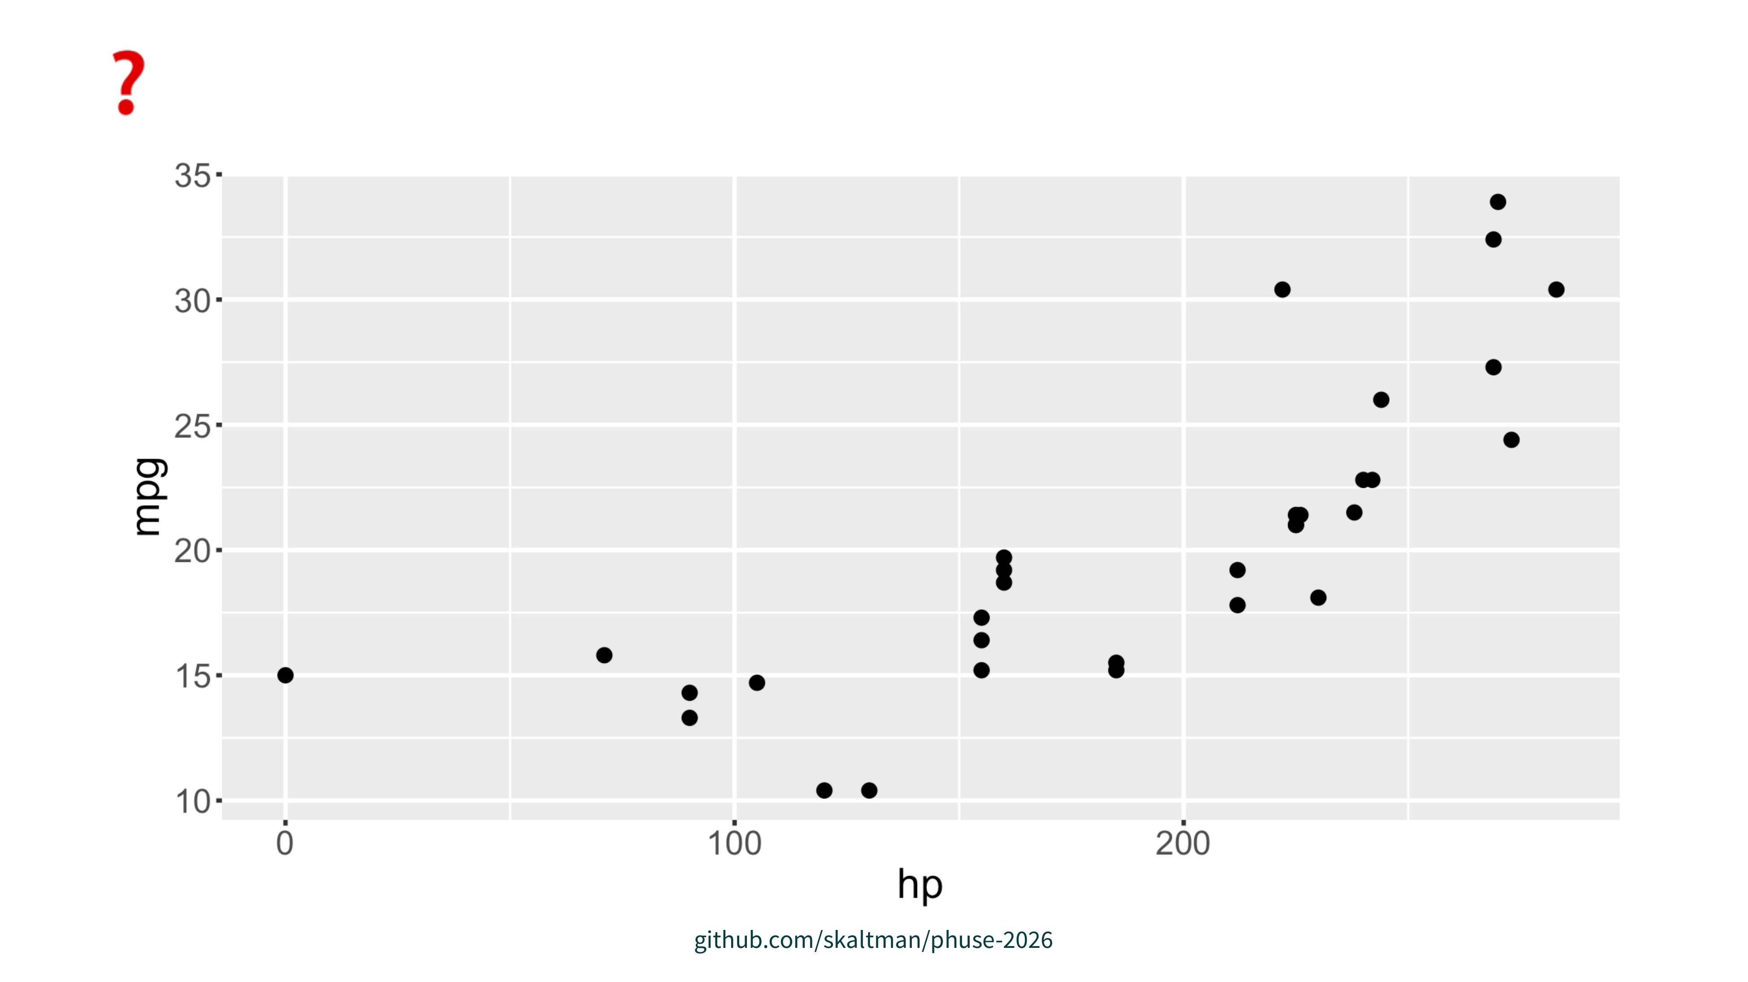

Slide 8
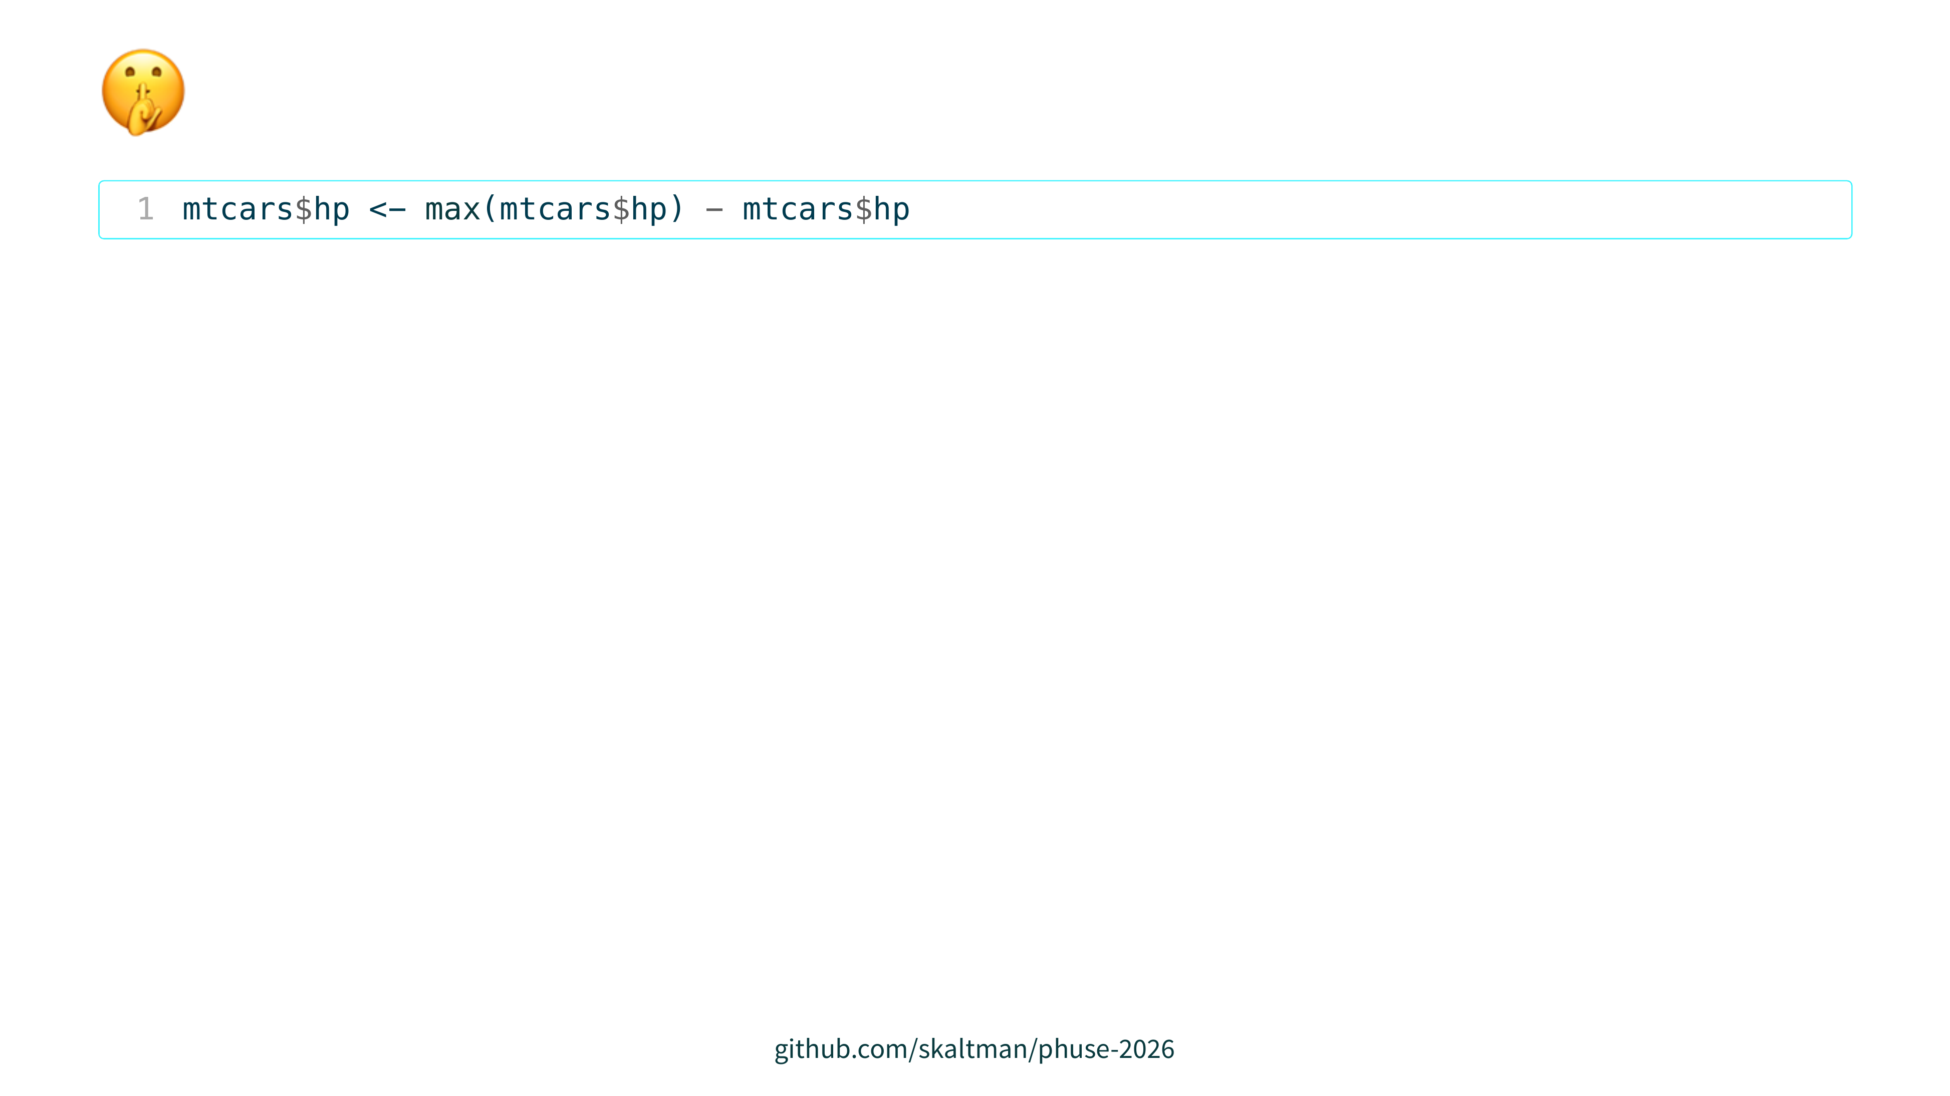

Slide 9
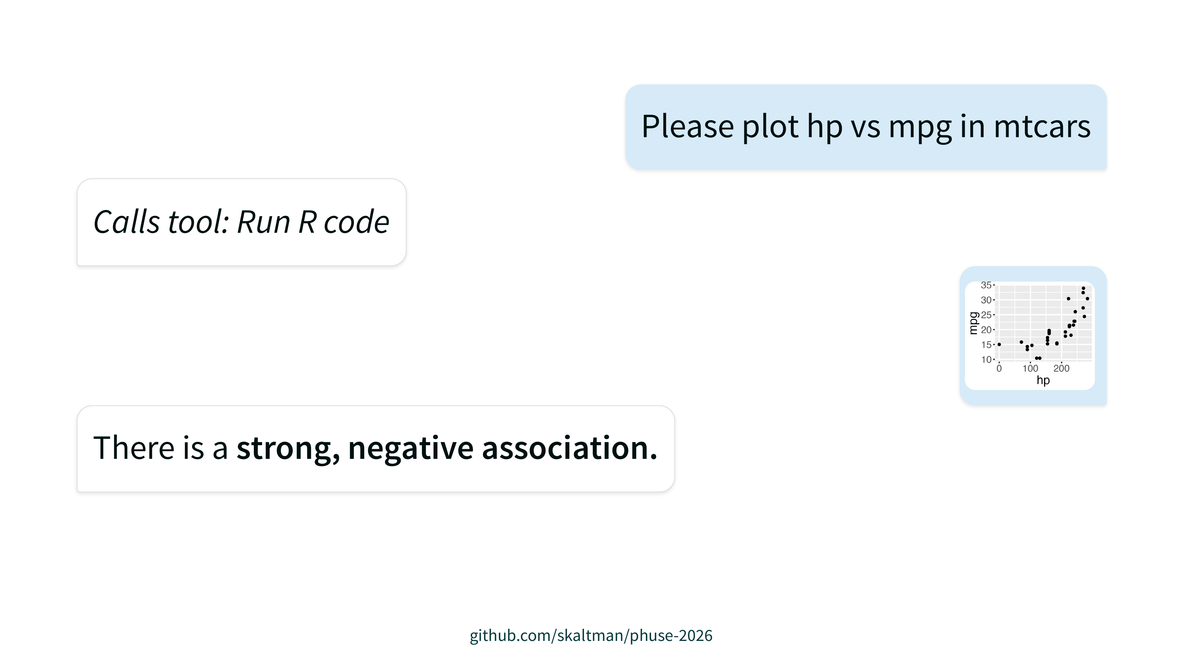

Slide 10
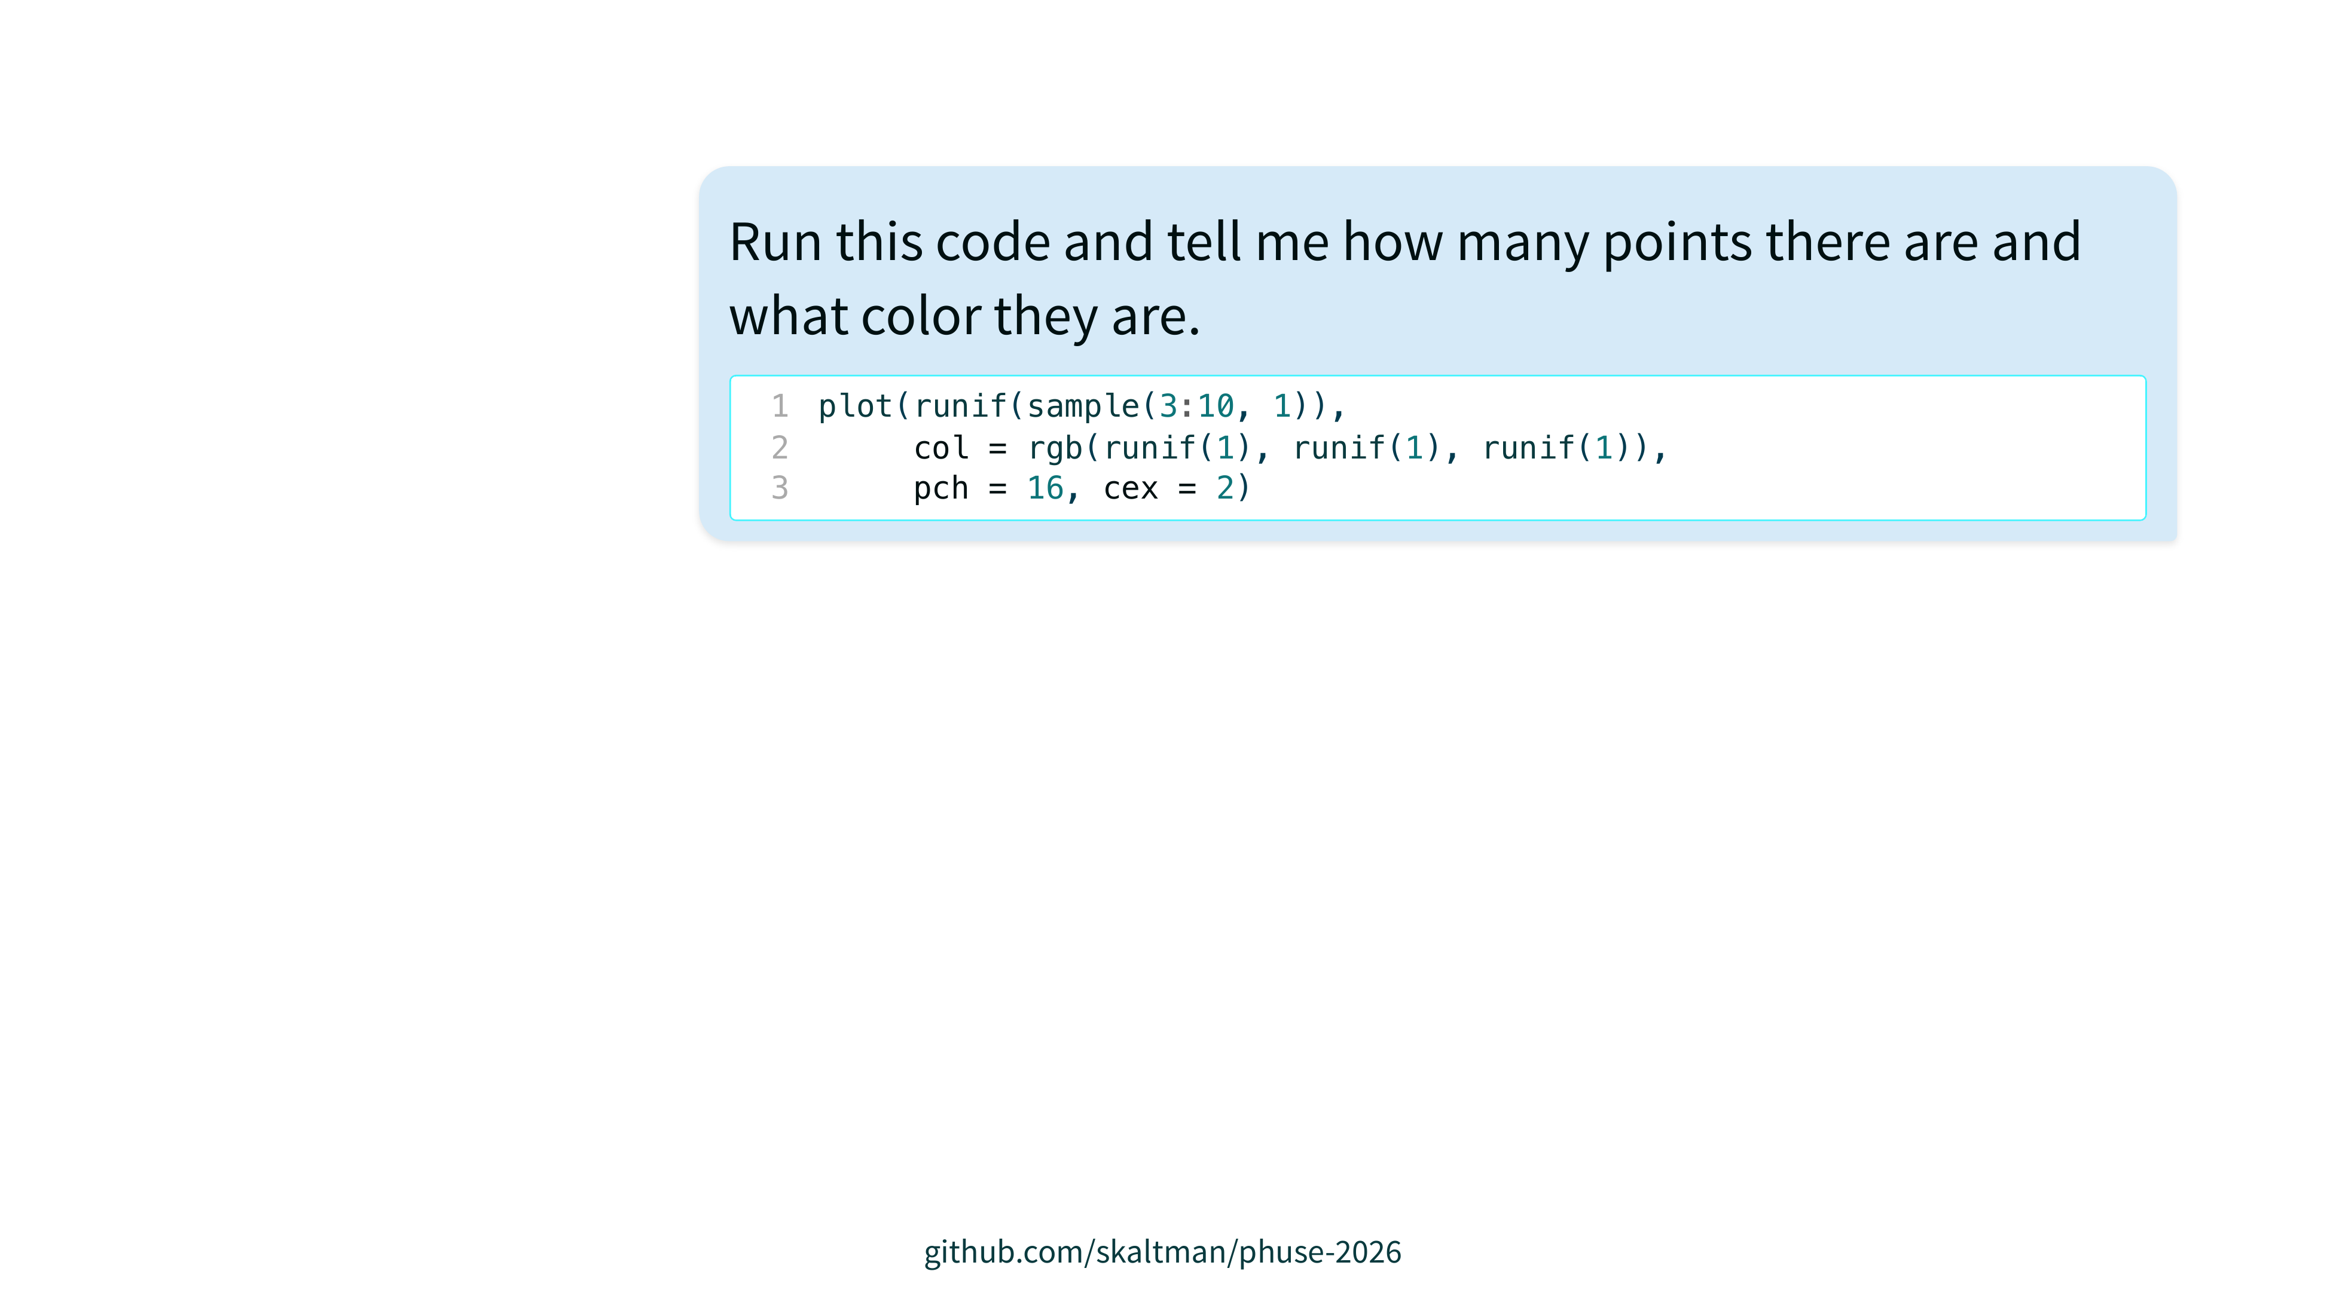

Slide 11
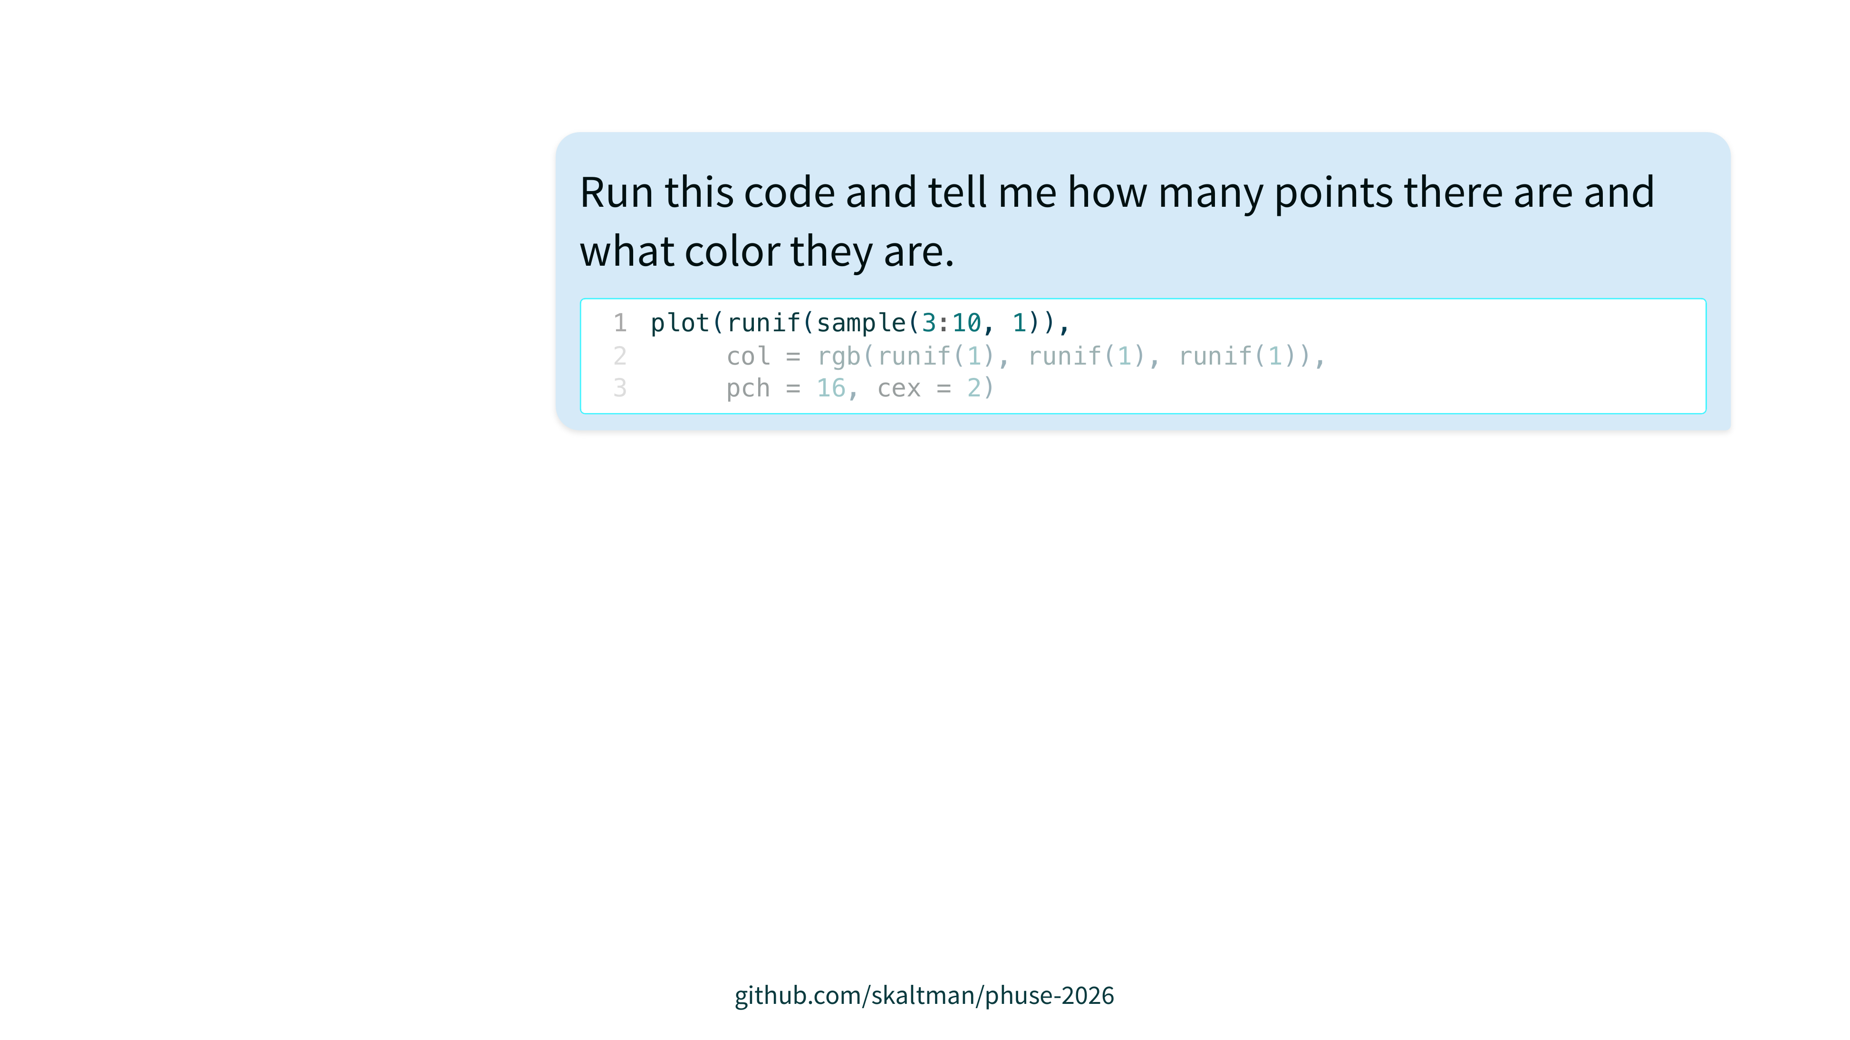

Slide 12


Slide 13
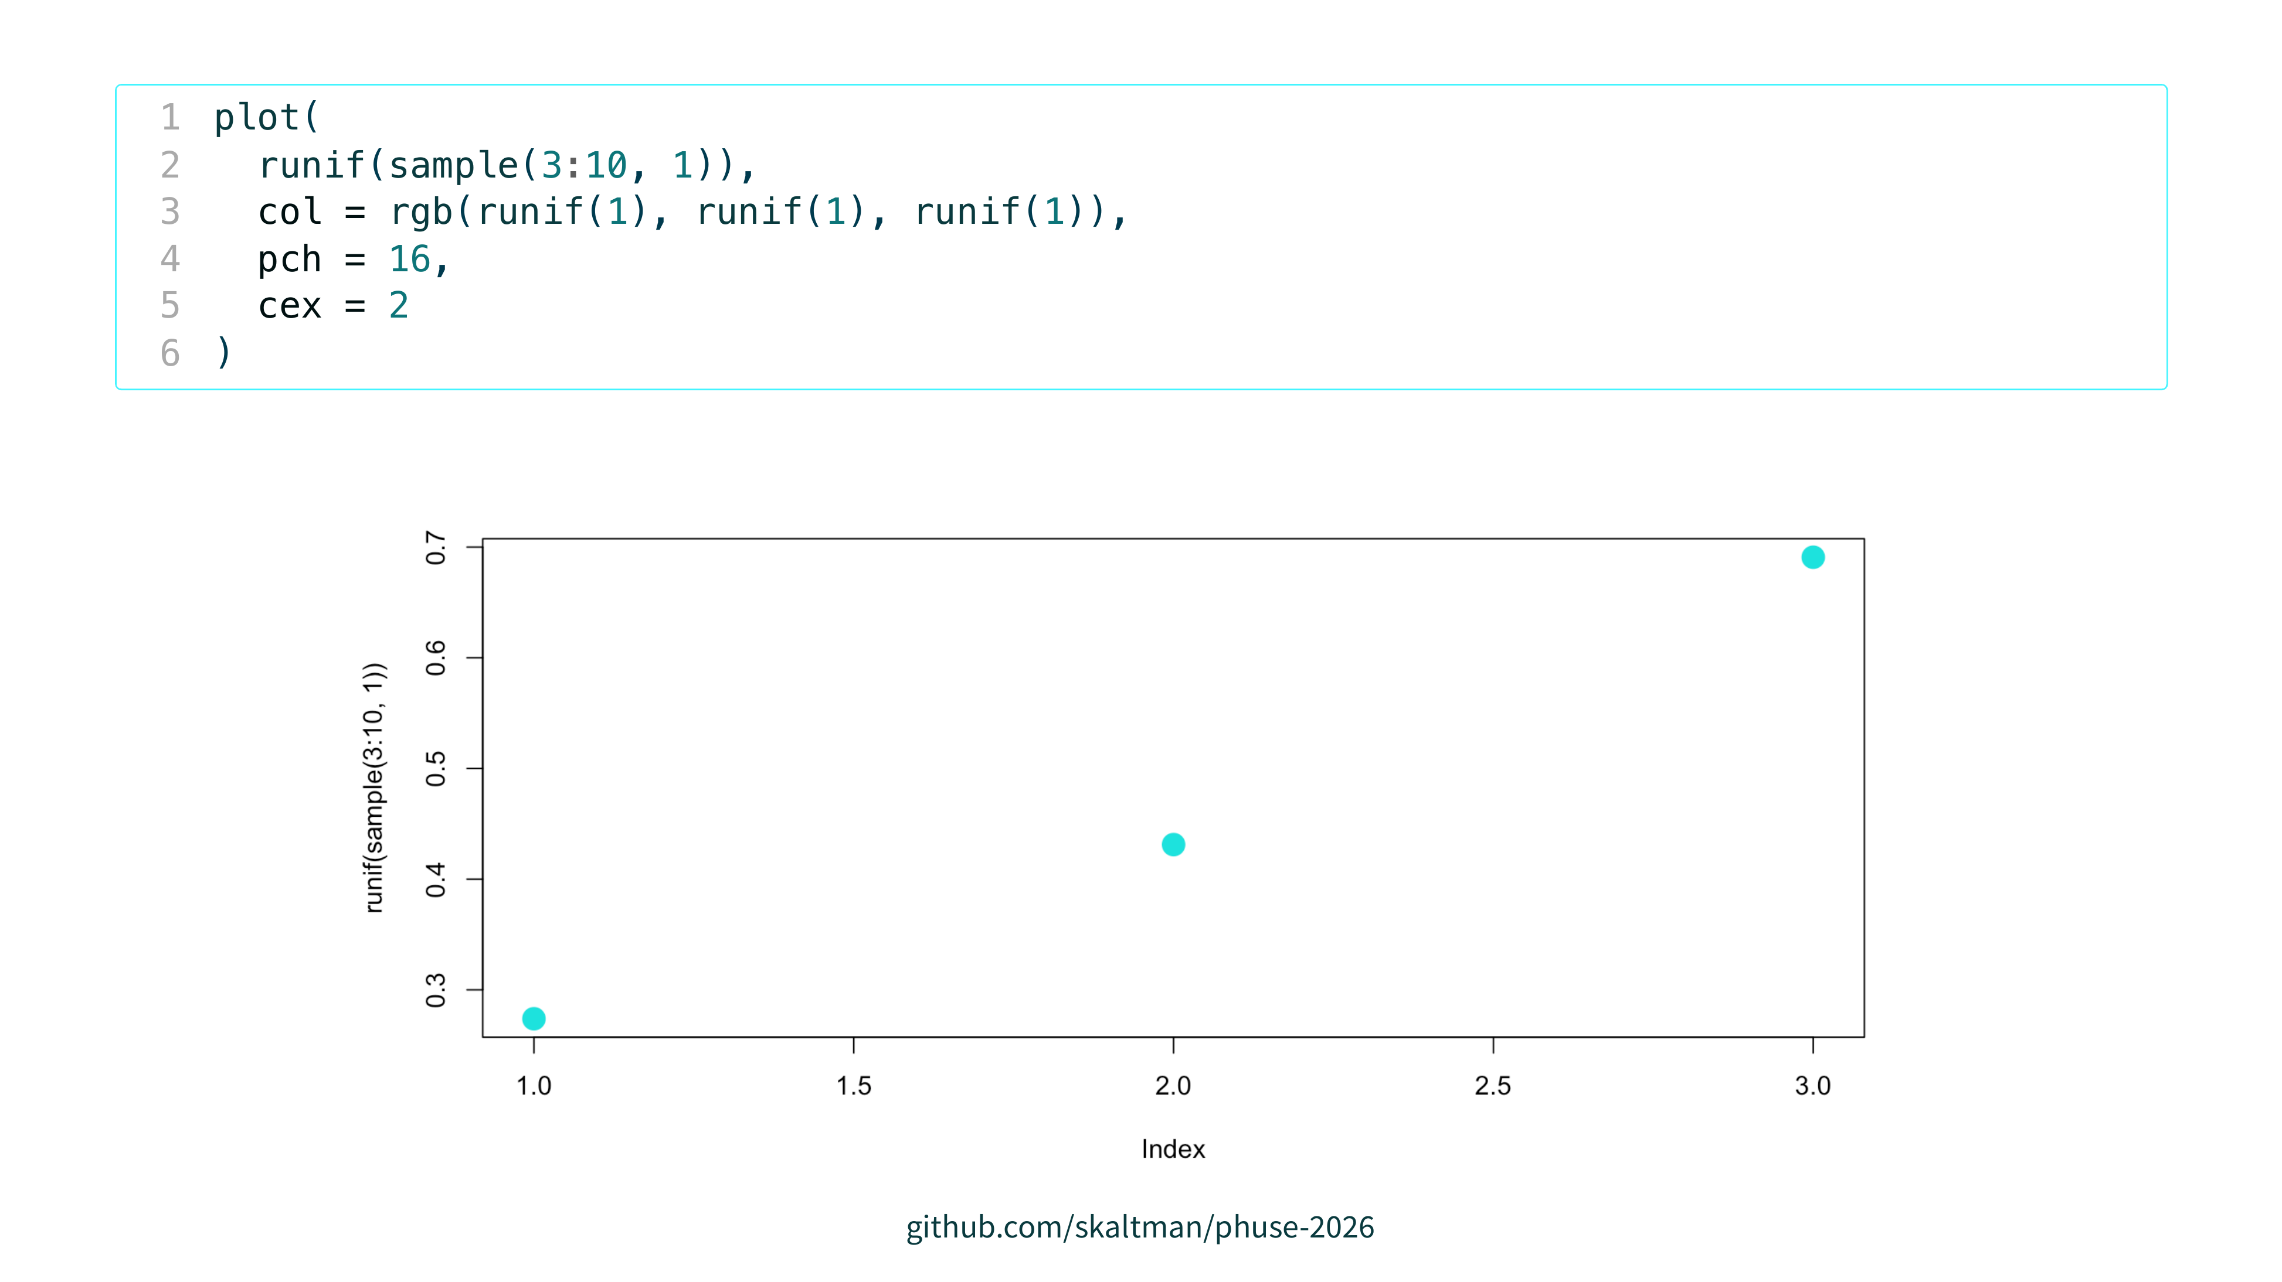

Slide 14
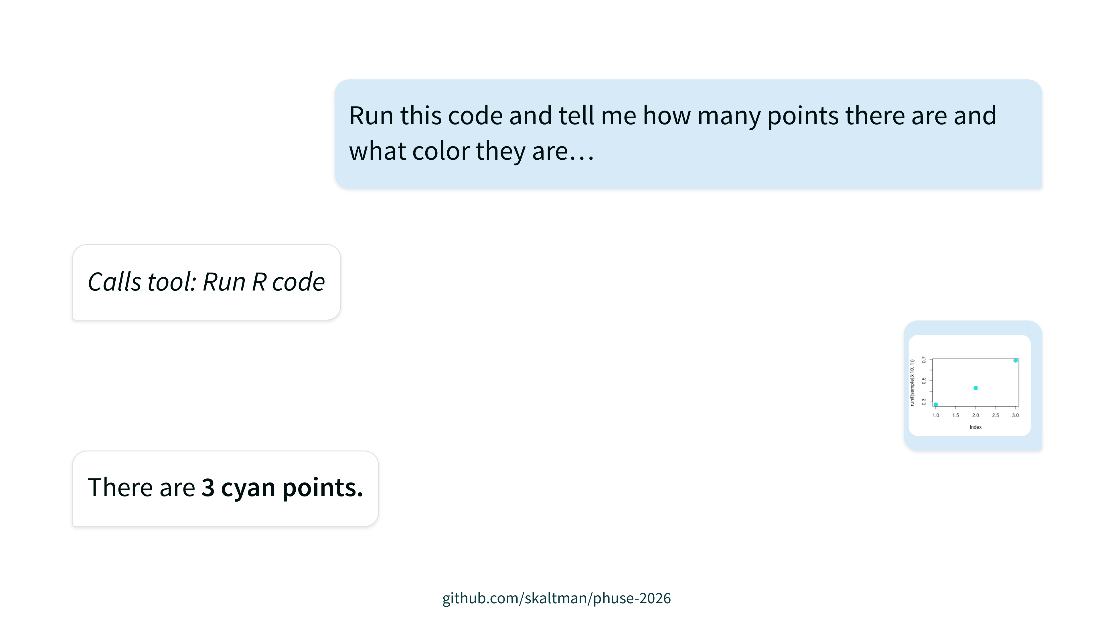
Notes:
LLMs can 'see' these plots just fine

Slide 15
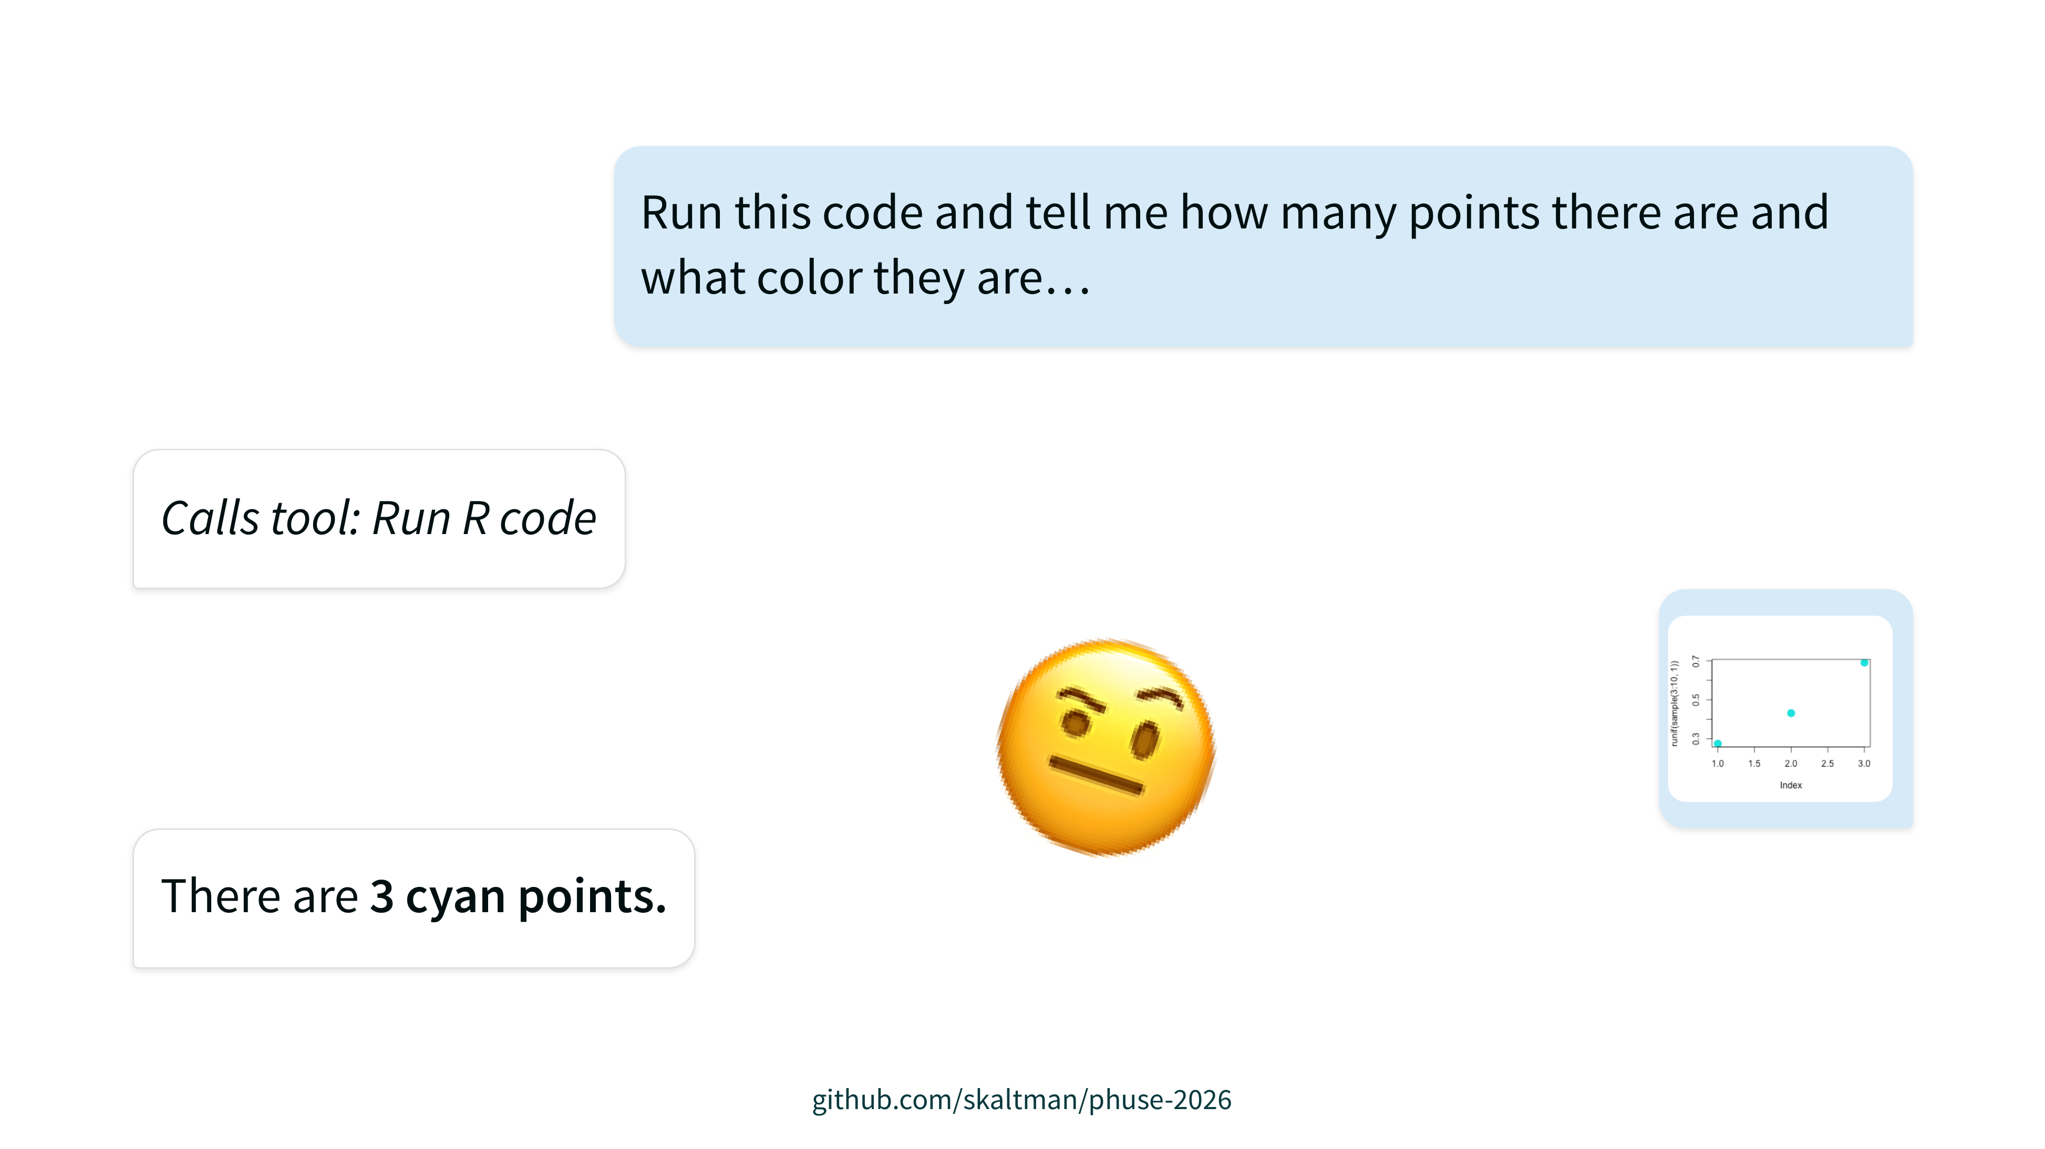
Notes:
LLMs can 'see' these plots just fine

Slide 16
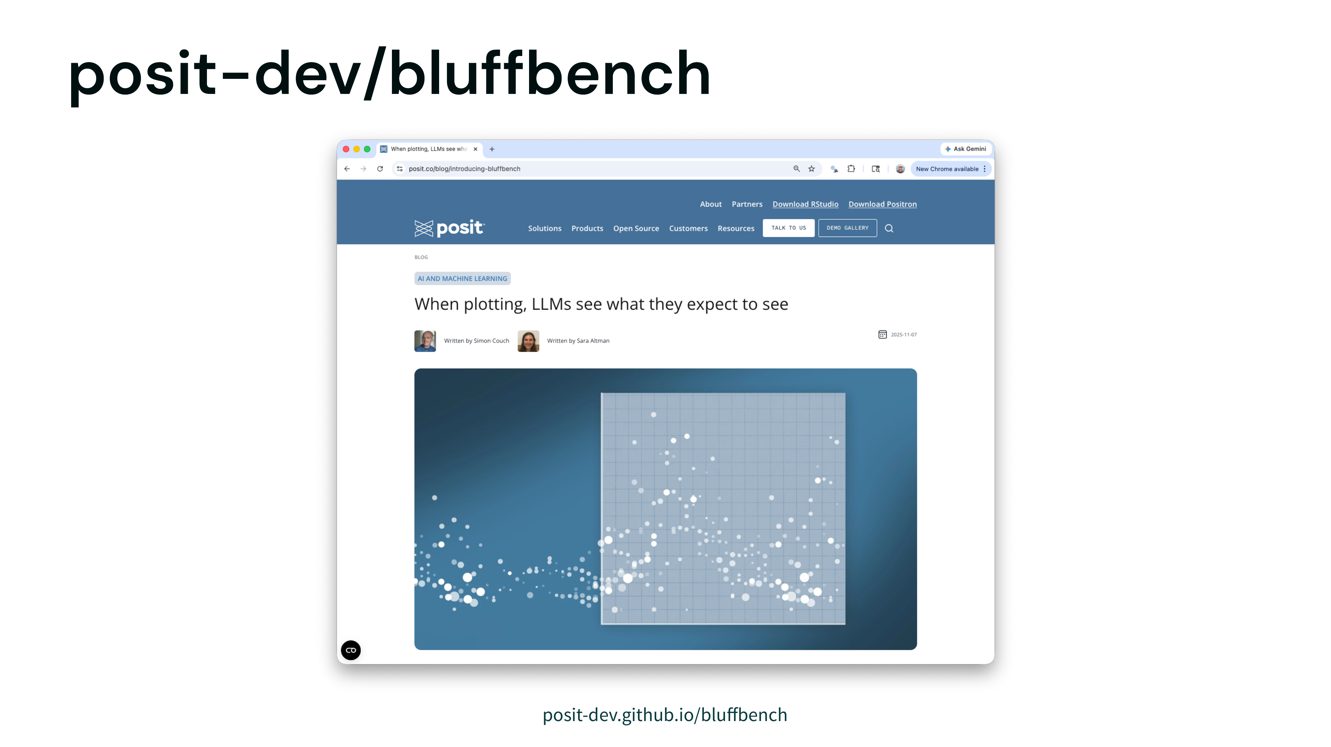

Slide 17
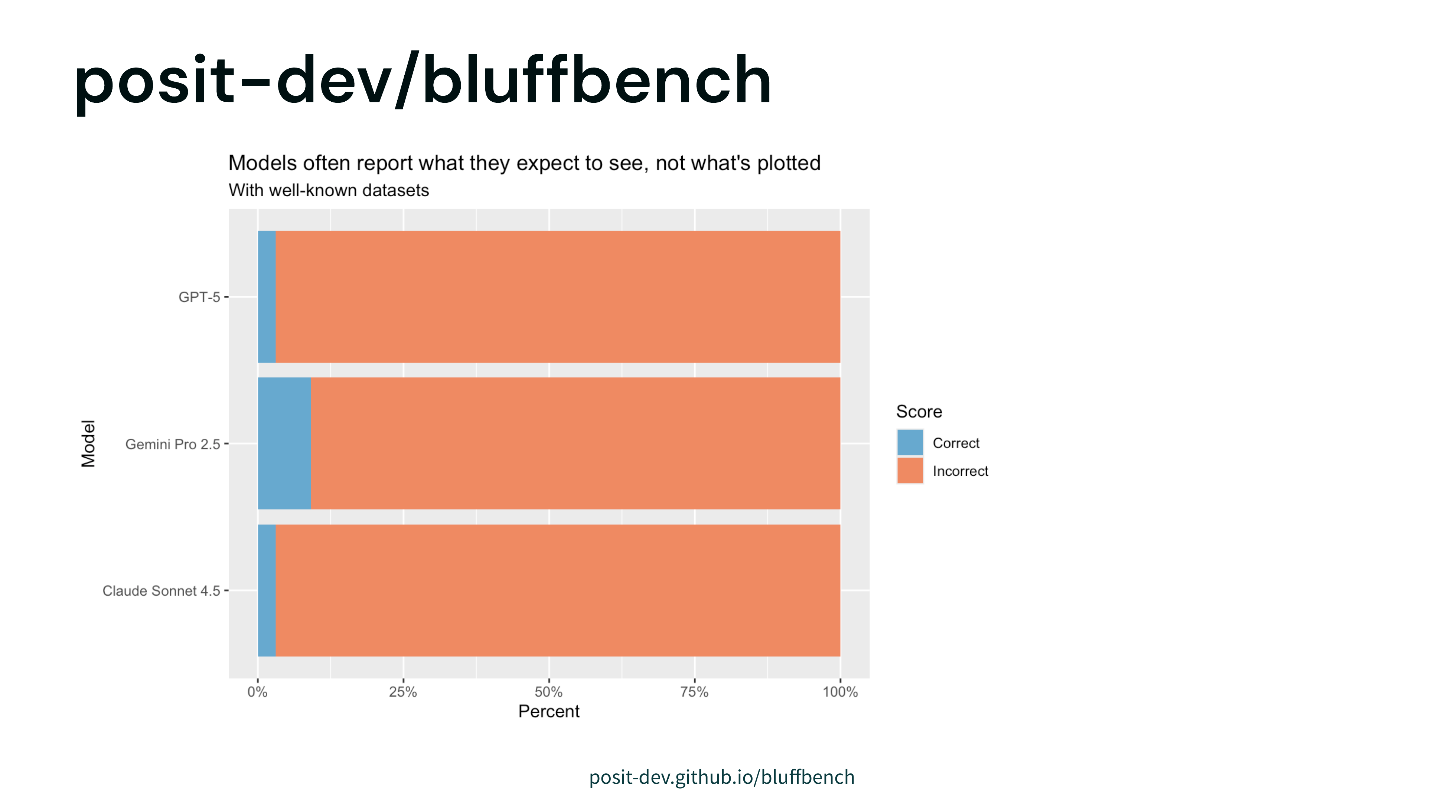
Notes:
We tried a bunch of stuff to drive those scores up and nothing worked.
Hilariously, we let the model "think", and in its thinking, it would say "Huh, that association doesn't look like I expect", and then turn around and say exactly what it expected to see.

Slide 18
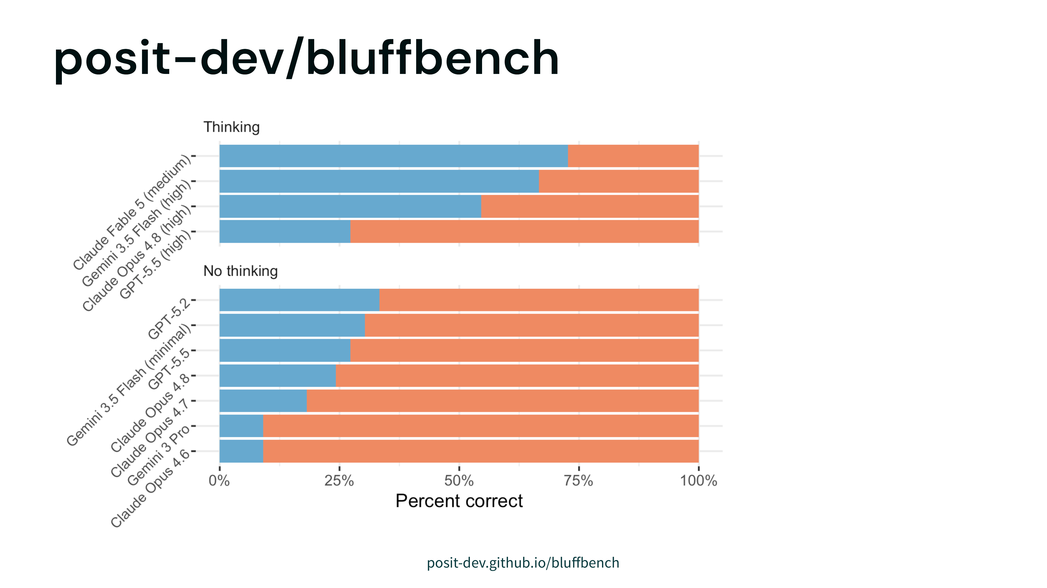

Slide 19
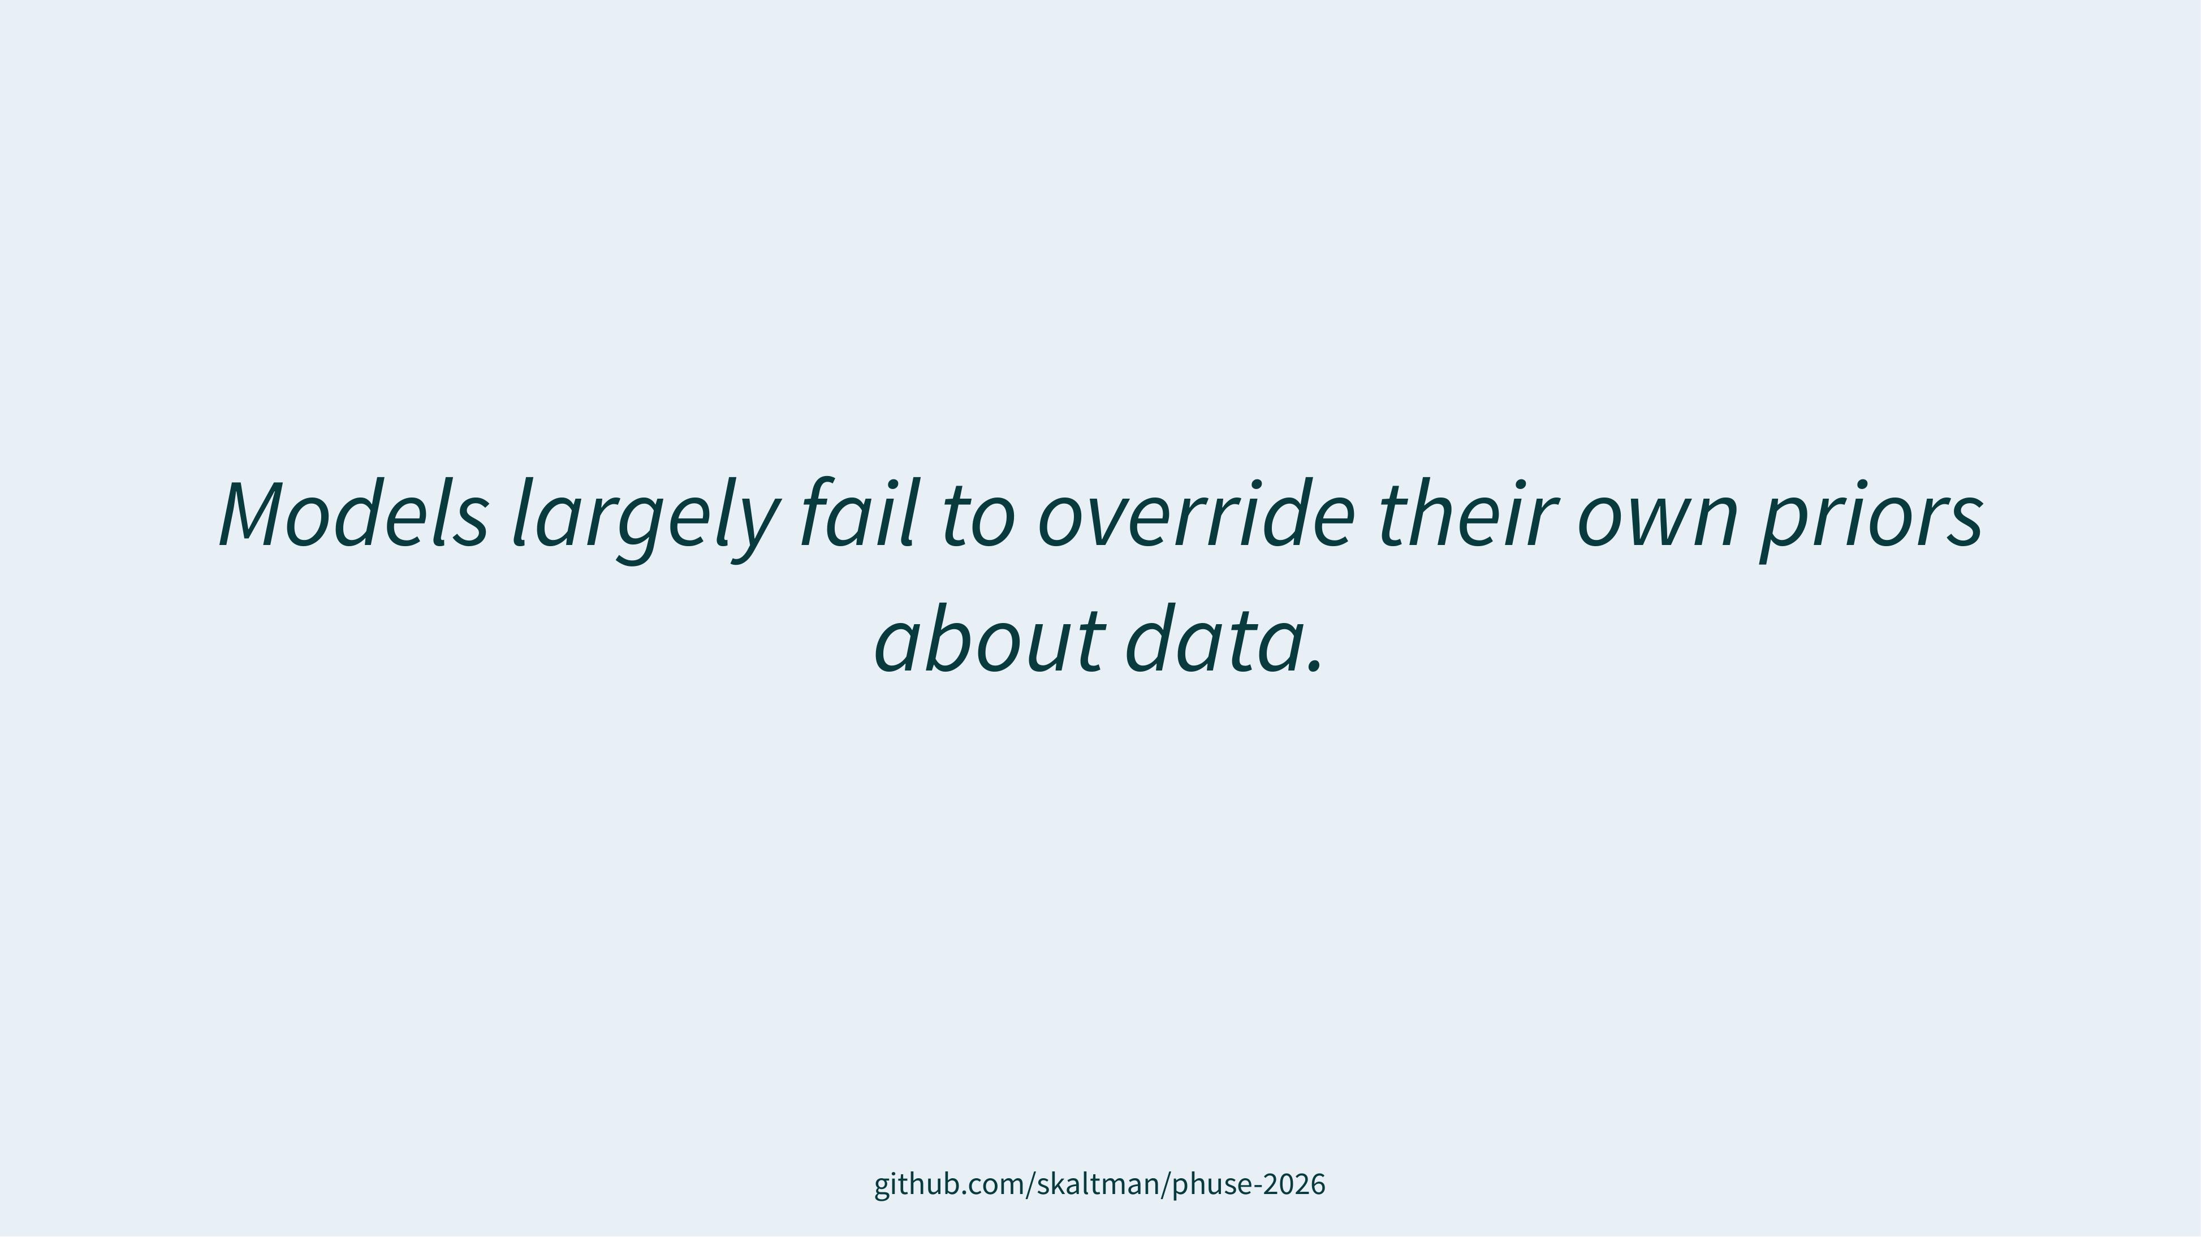

Slide 21
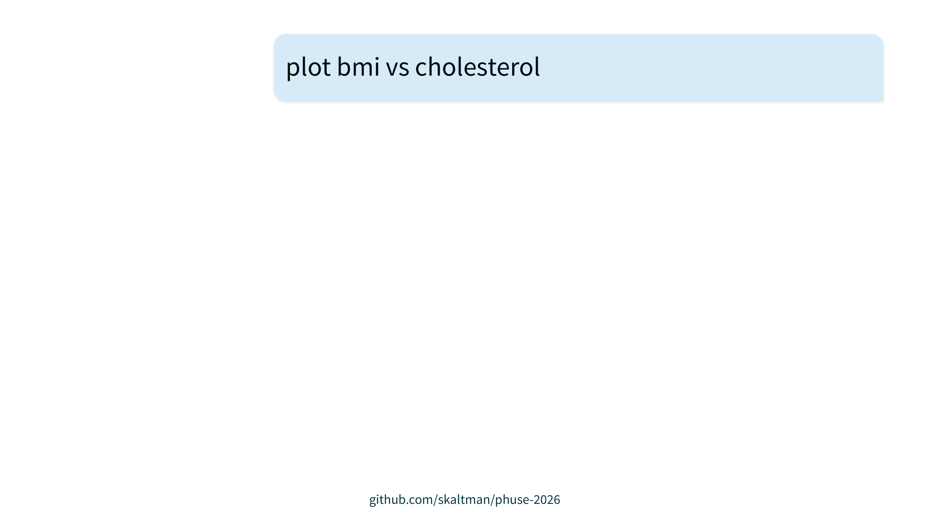

Slide 22
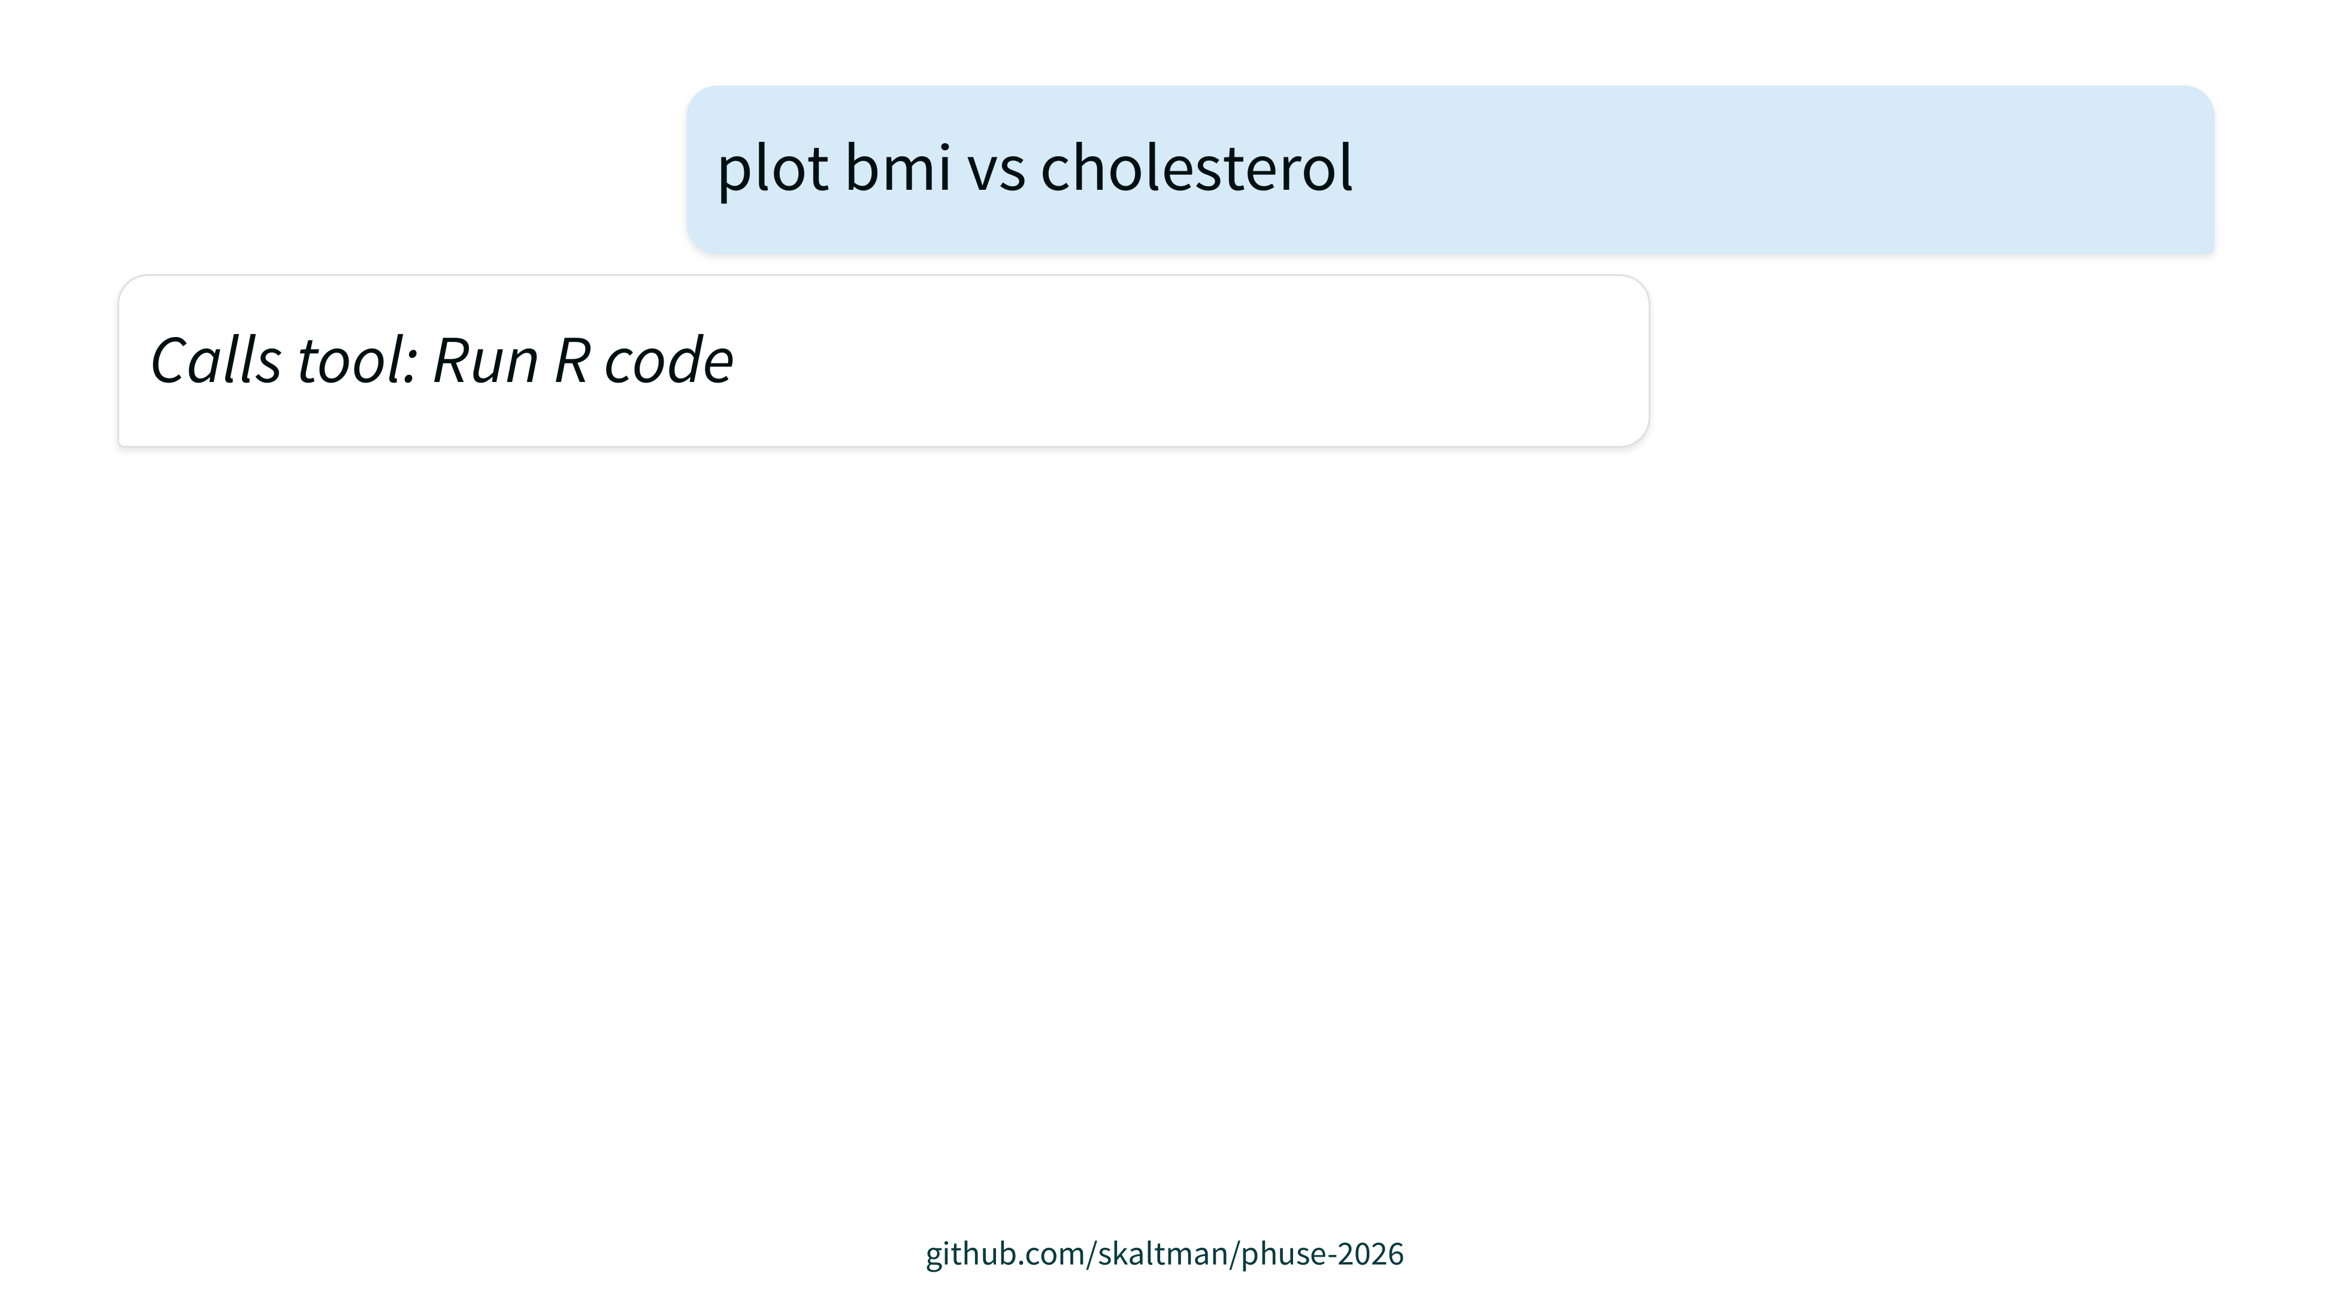

Slide 23
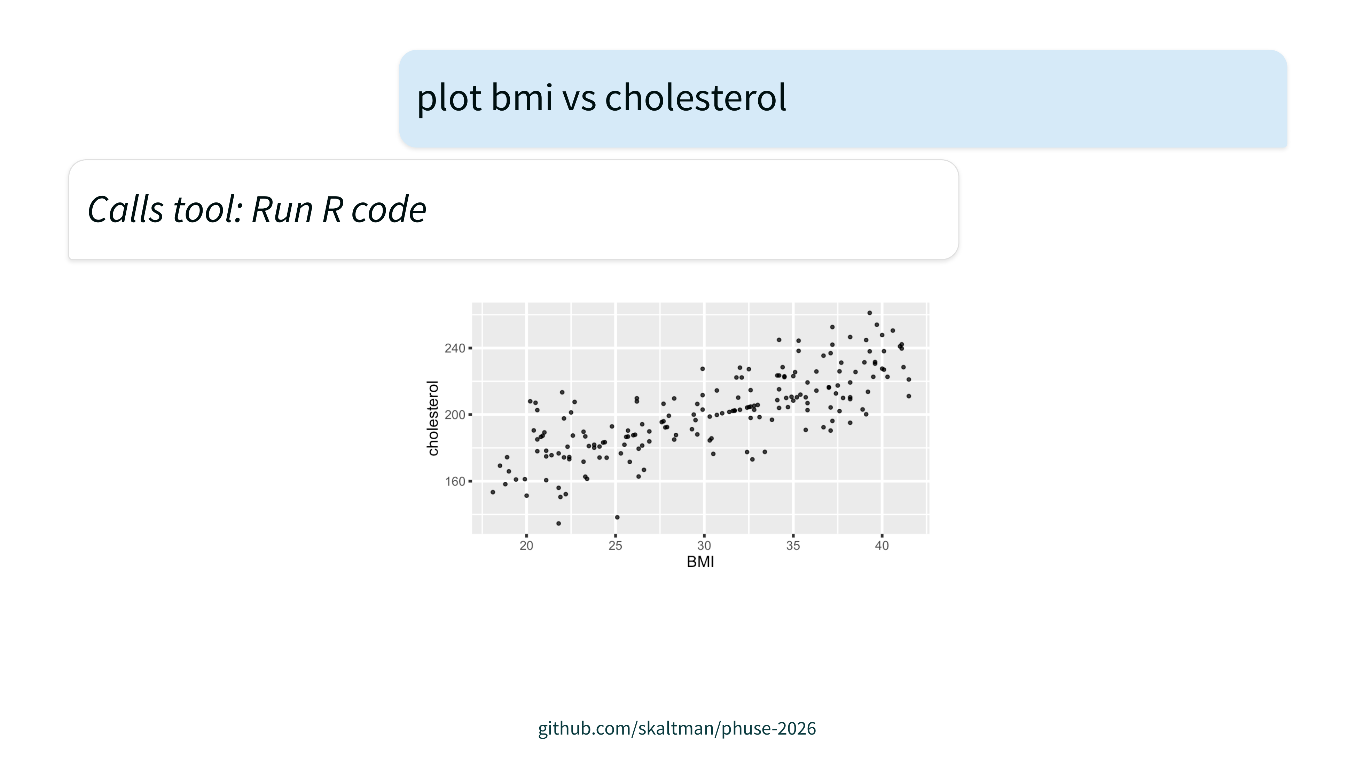

Slide 24
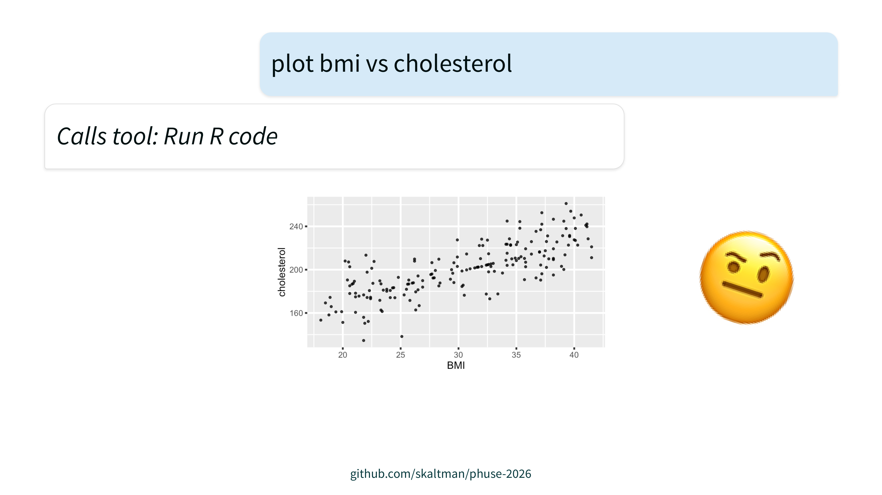

Slide 25
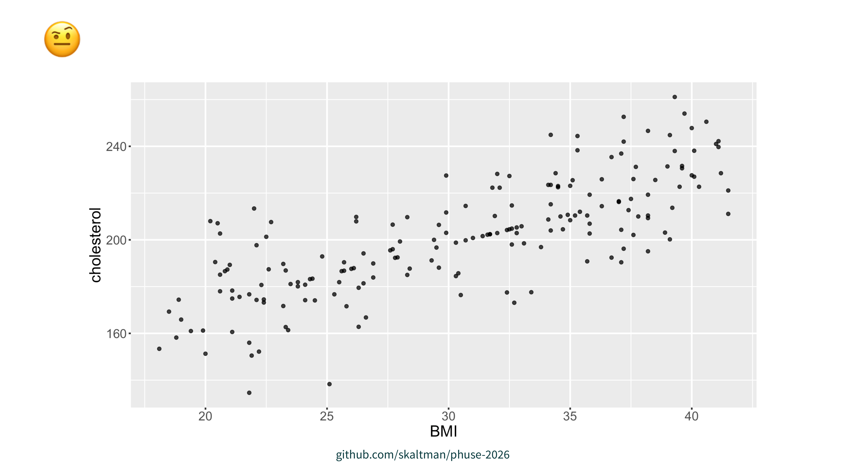

Slide 26
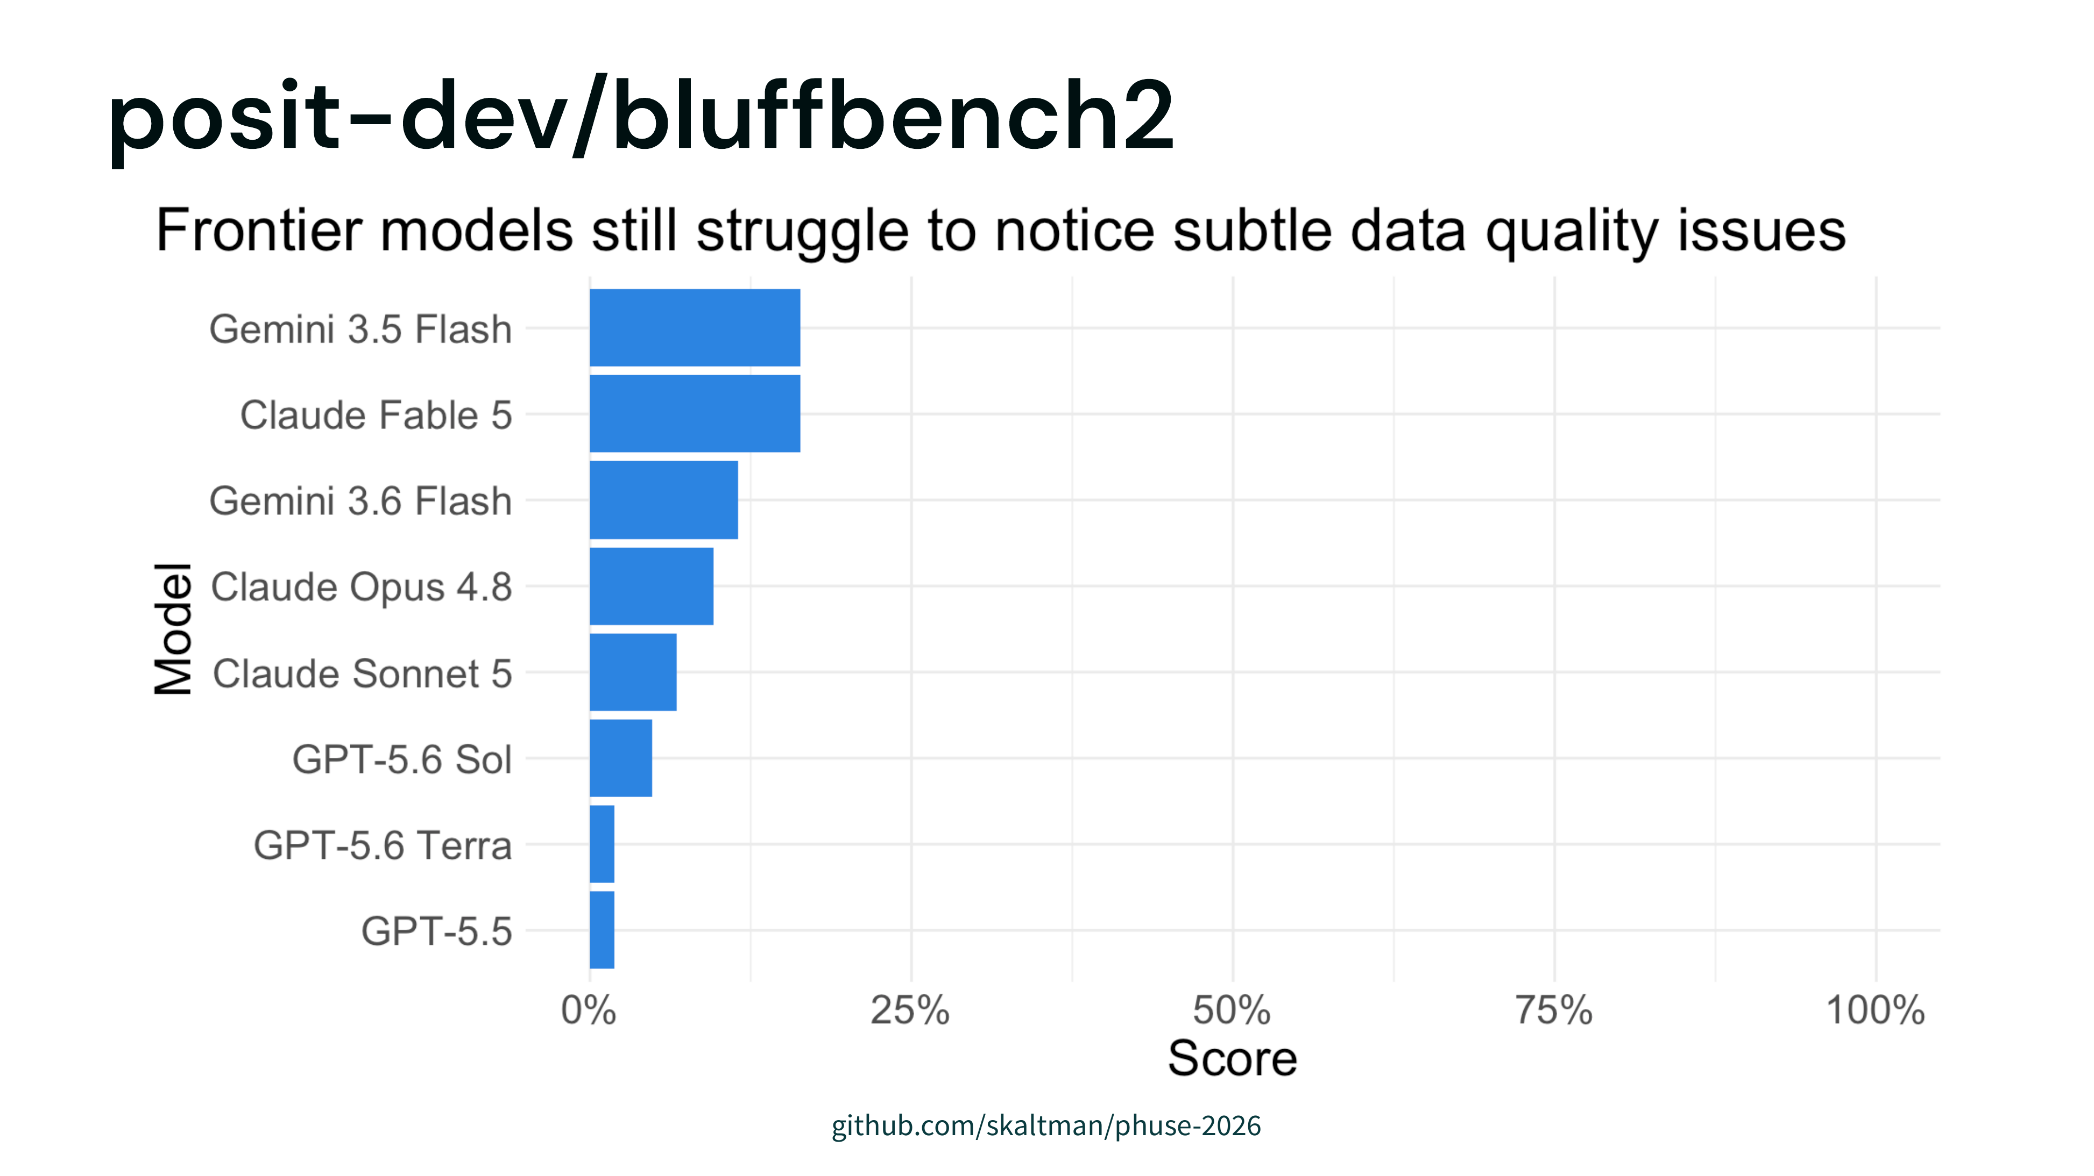

Slide 27
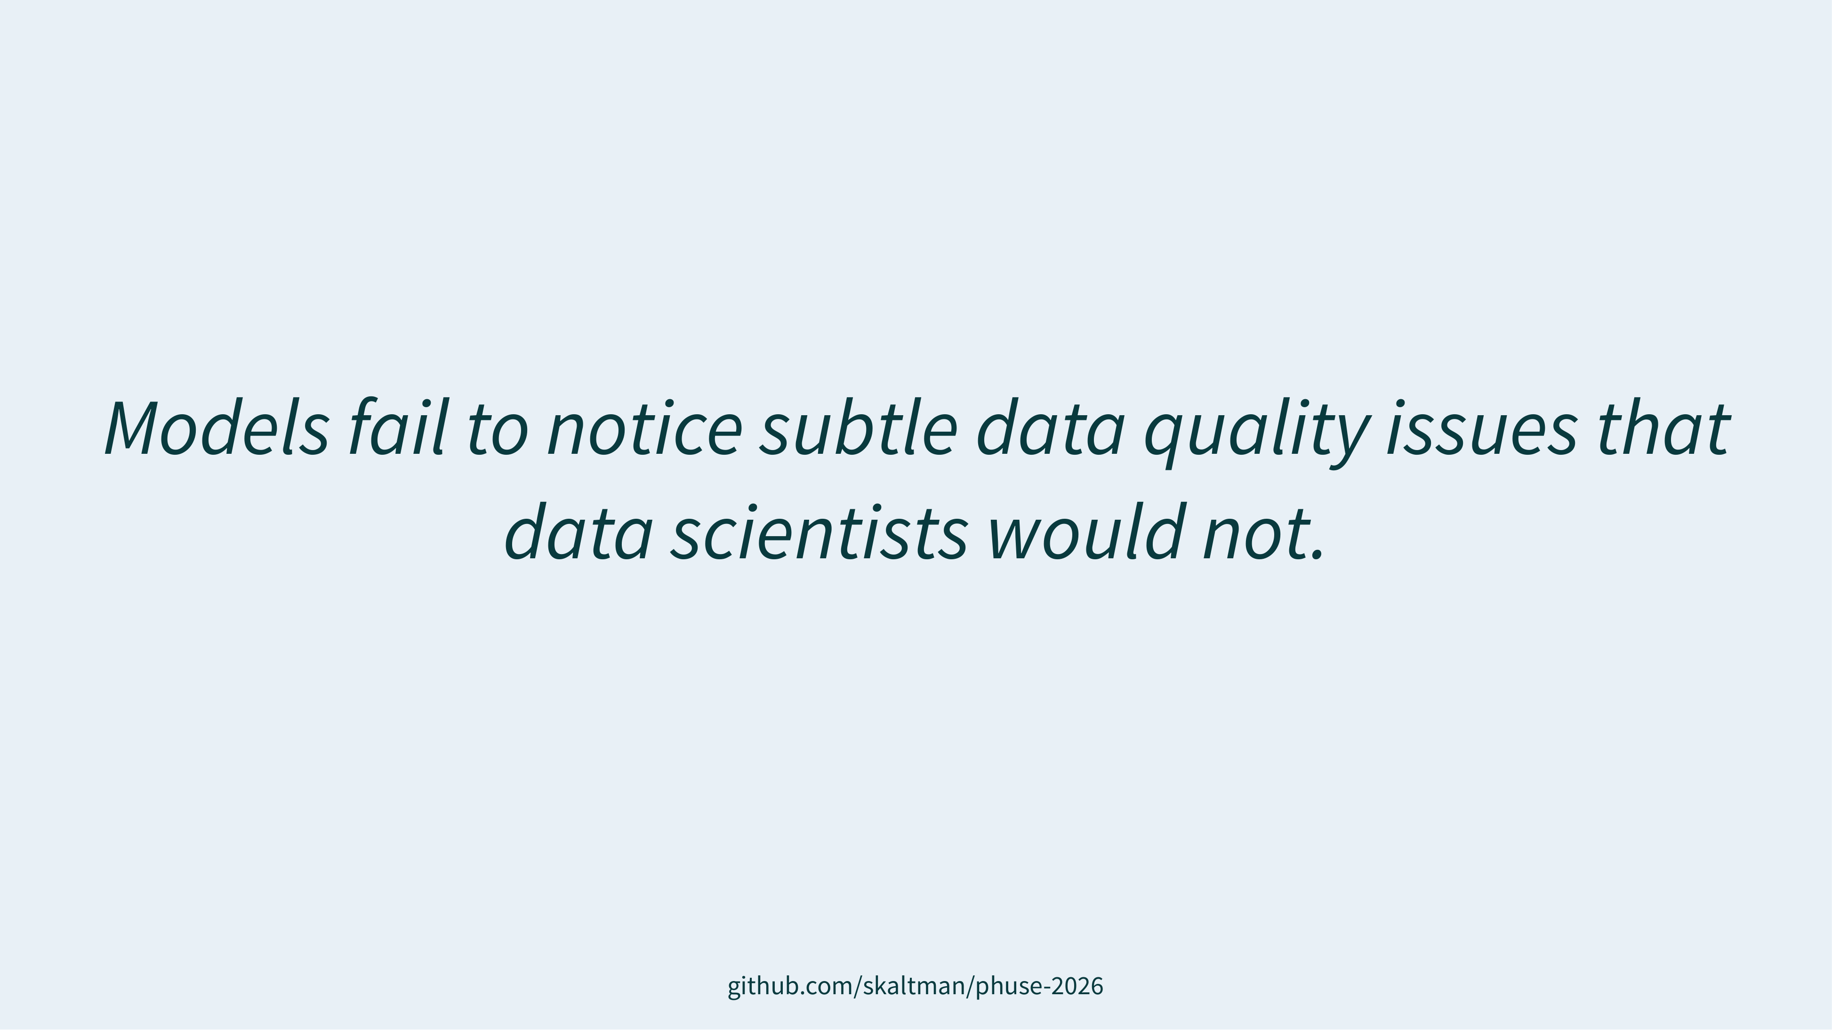

Slide 28
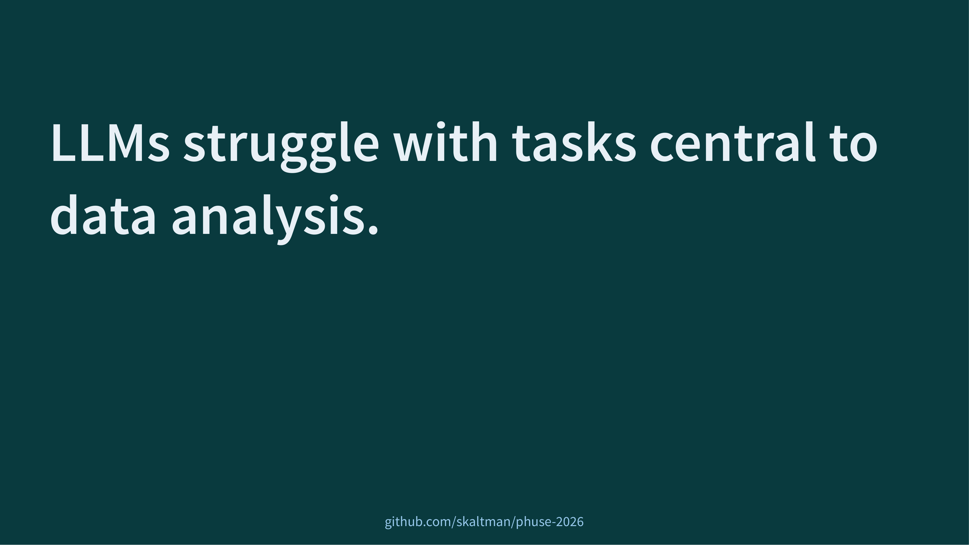
Notes:
bluffbench is evidence
llms struggle with tasks central to data analysis
[click]
override priors
fail to notice subtle
both of these
ability to not let expectations get in the way
spot data quality issues in visualizations
core skills
want any person or agent to have

Slide 29
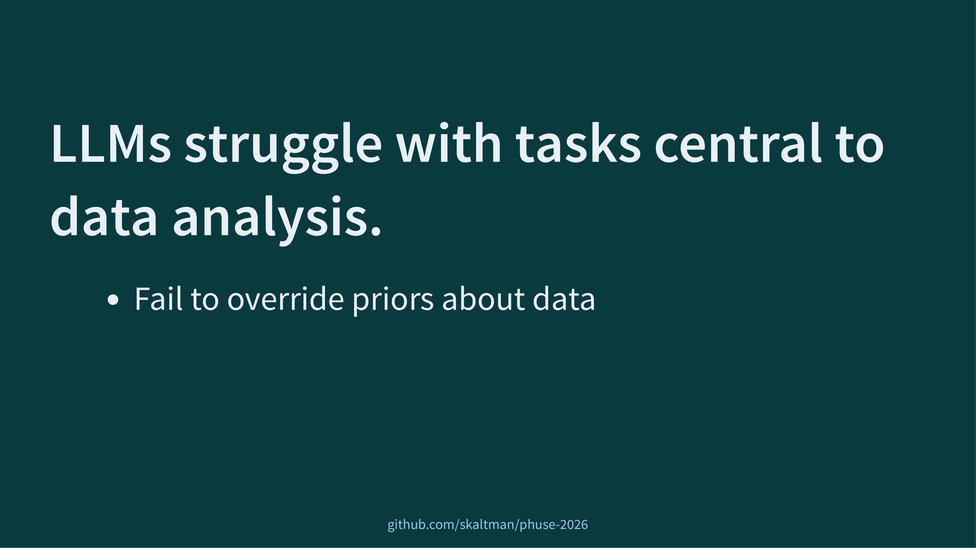
Notes:
bluffbench is evidence
llms struggle with tasks central to data analysis
[click]
override priors
fail to notice subtle
both of these
ability to not let expectations get in the way
spot data quality issues in visualizations
core skills
want any person or agent to have

Slide 30
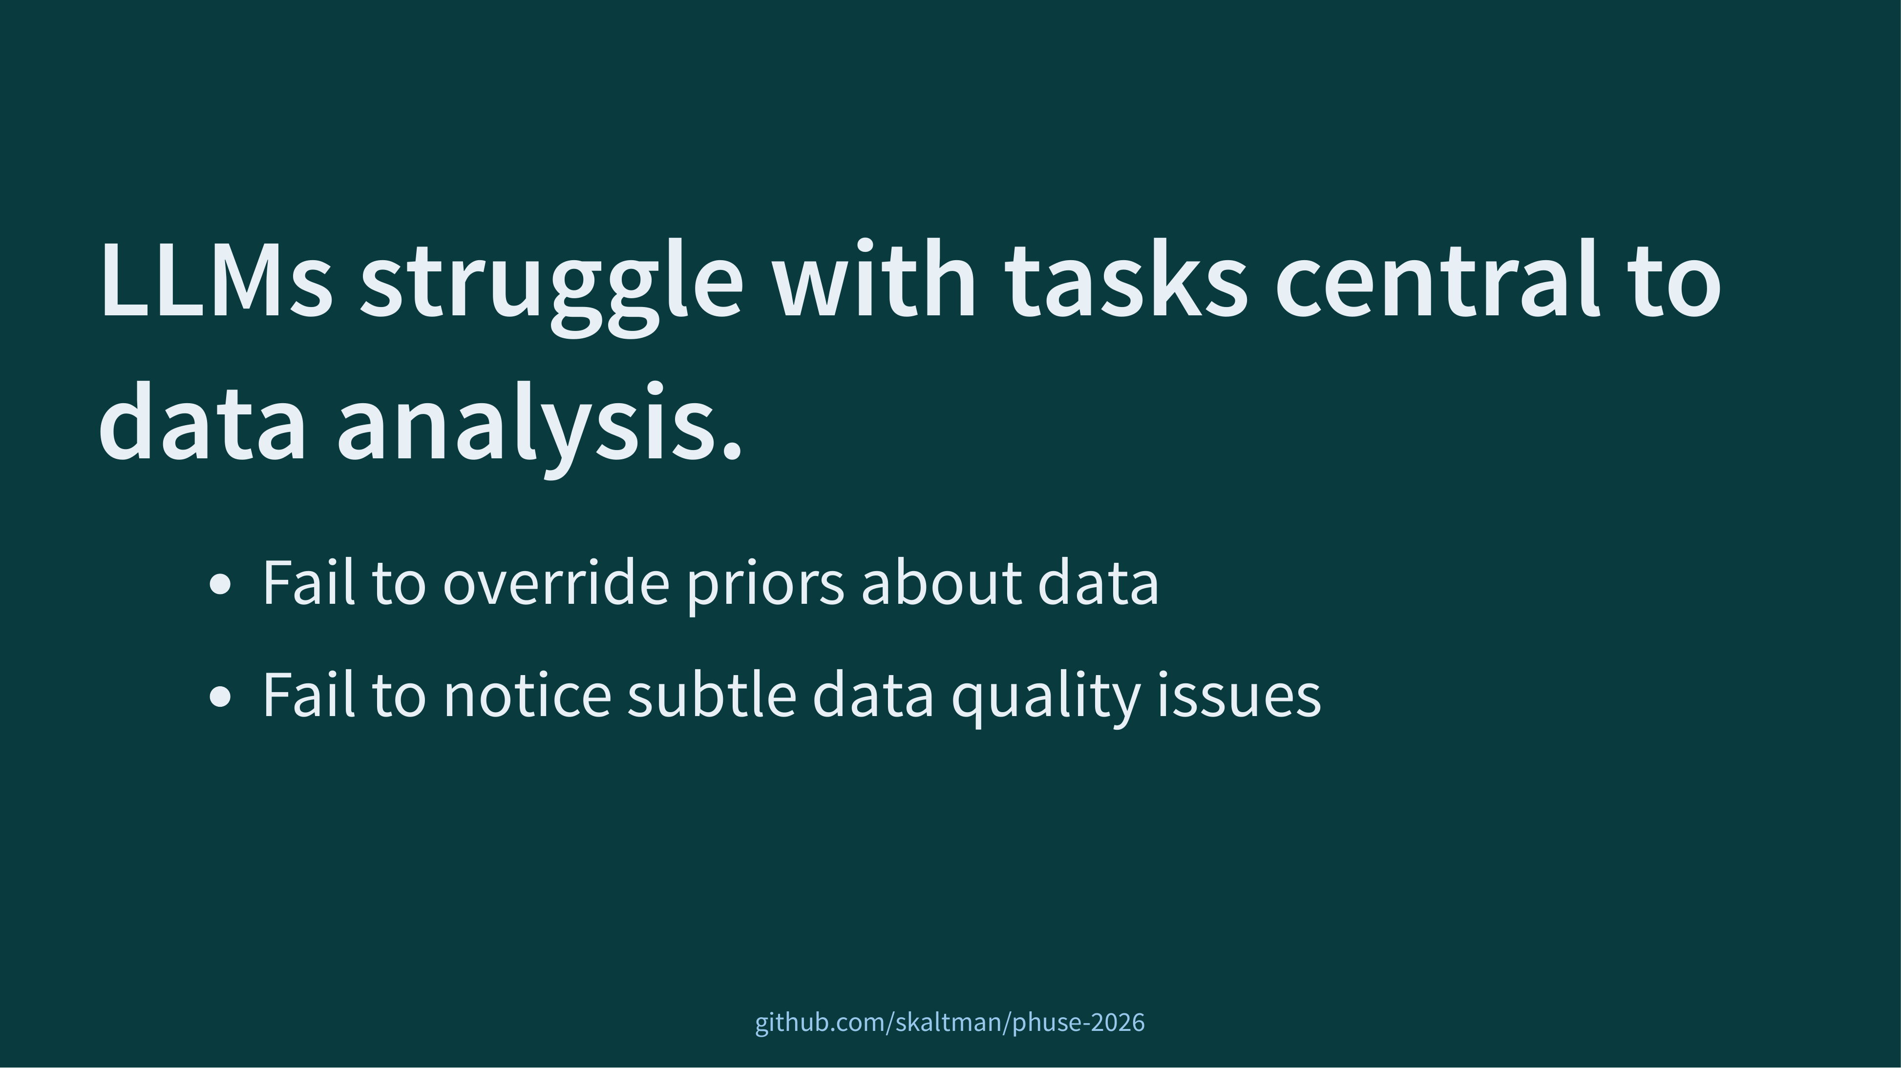
Notes:
bluffbench is evidence
llms struggle with tasks central to data analysis
[click]
override priors
fail to notice subtle
both of these
ability to not let expectations get in the way
spot data quality issues in visualizations
core skills
want any person or agent to have

Slide 31
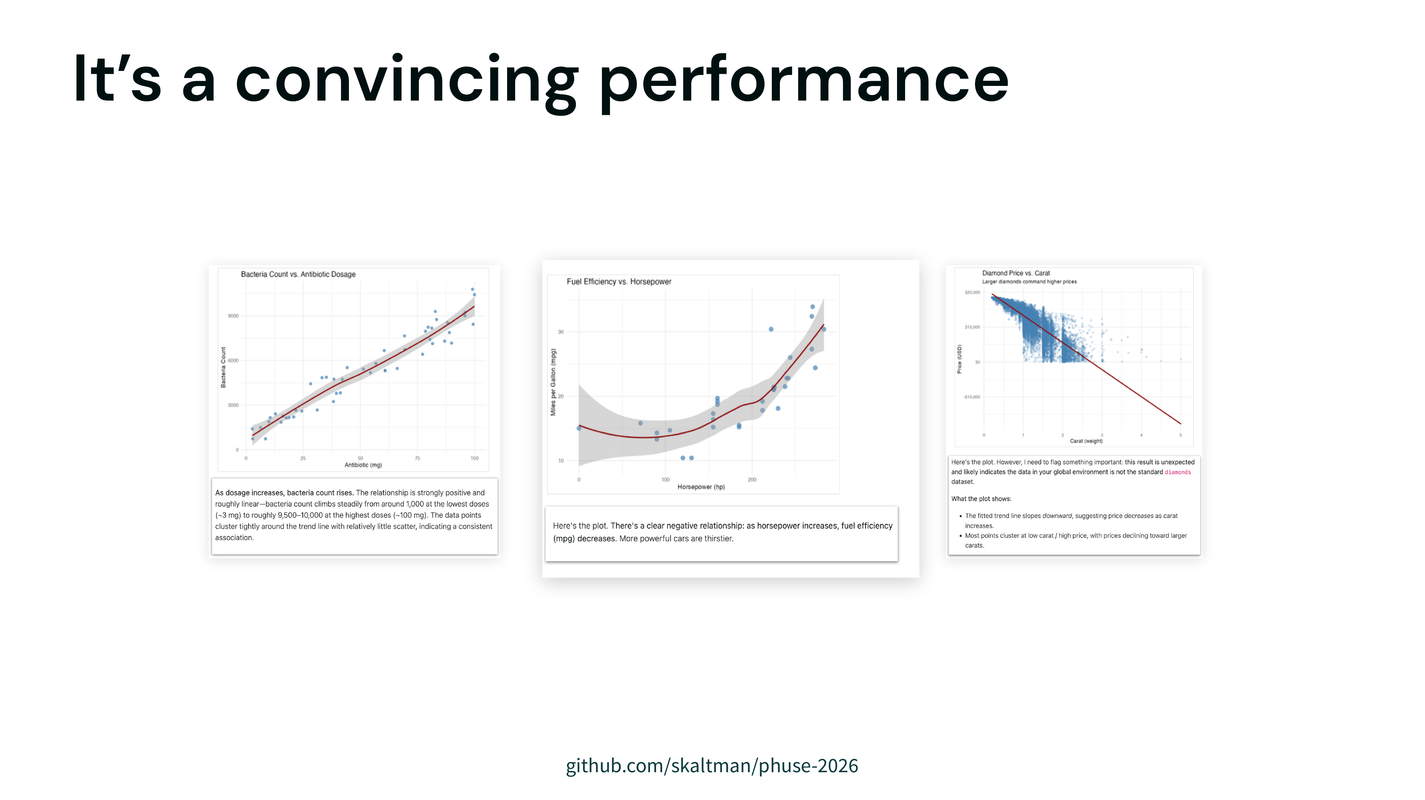
Notes:
but llms are great performers
can put on a convincing performance of correctness
we've seen in bluffbench that the model will interpret the plot, and will provide details and supposed evidence for what they see
they act like they are moving the analysis forward
the only problem is that, like in this case where it says this clearly negative trend is positive, is that **it's one that can fail to match reality**

Slide 32
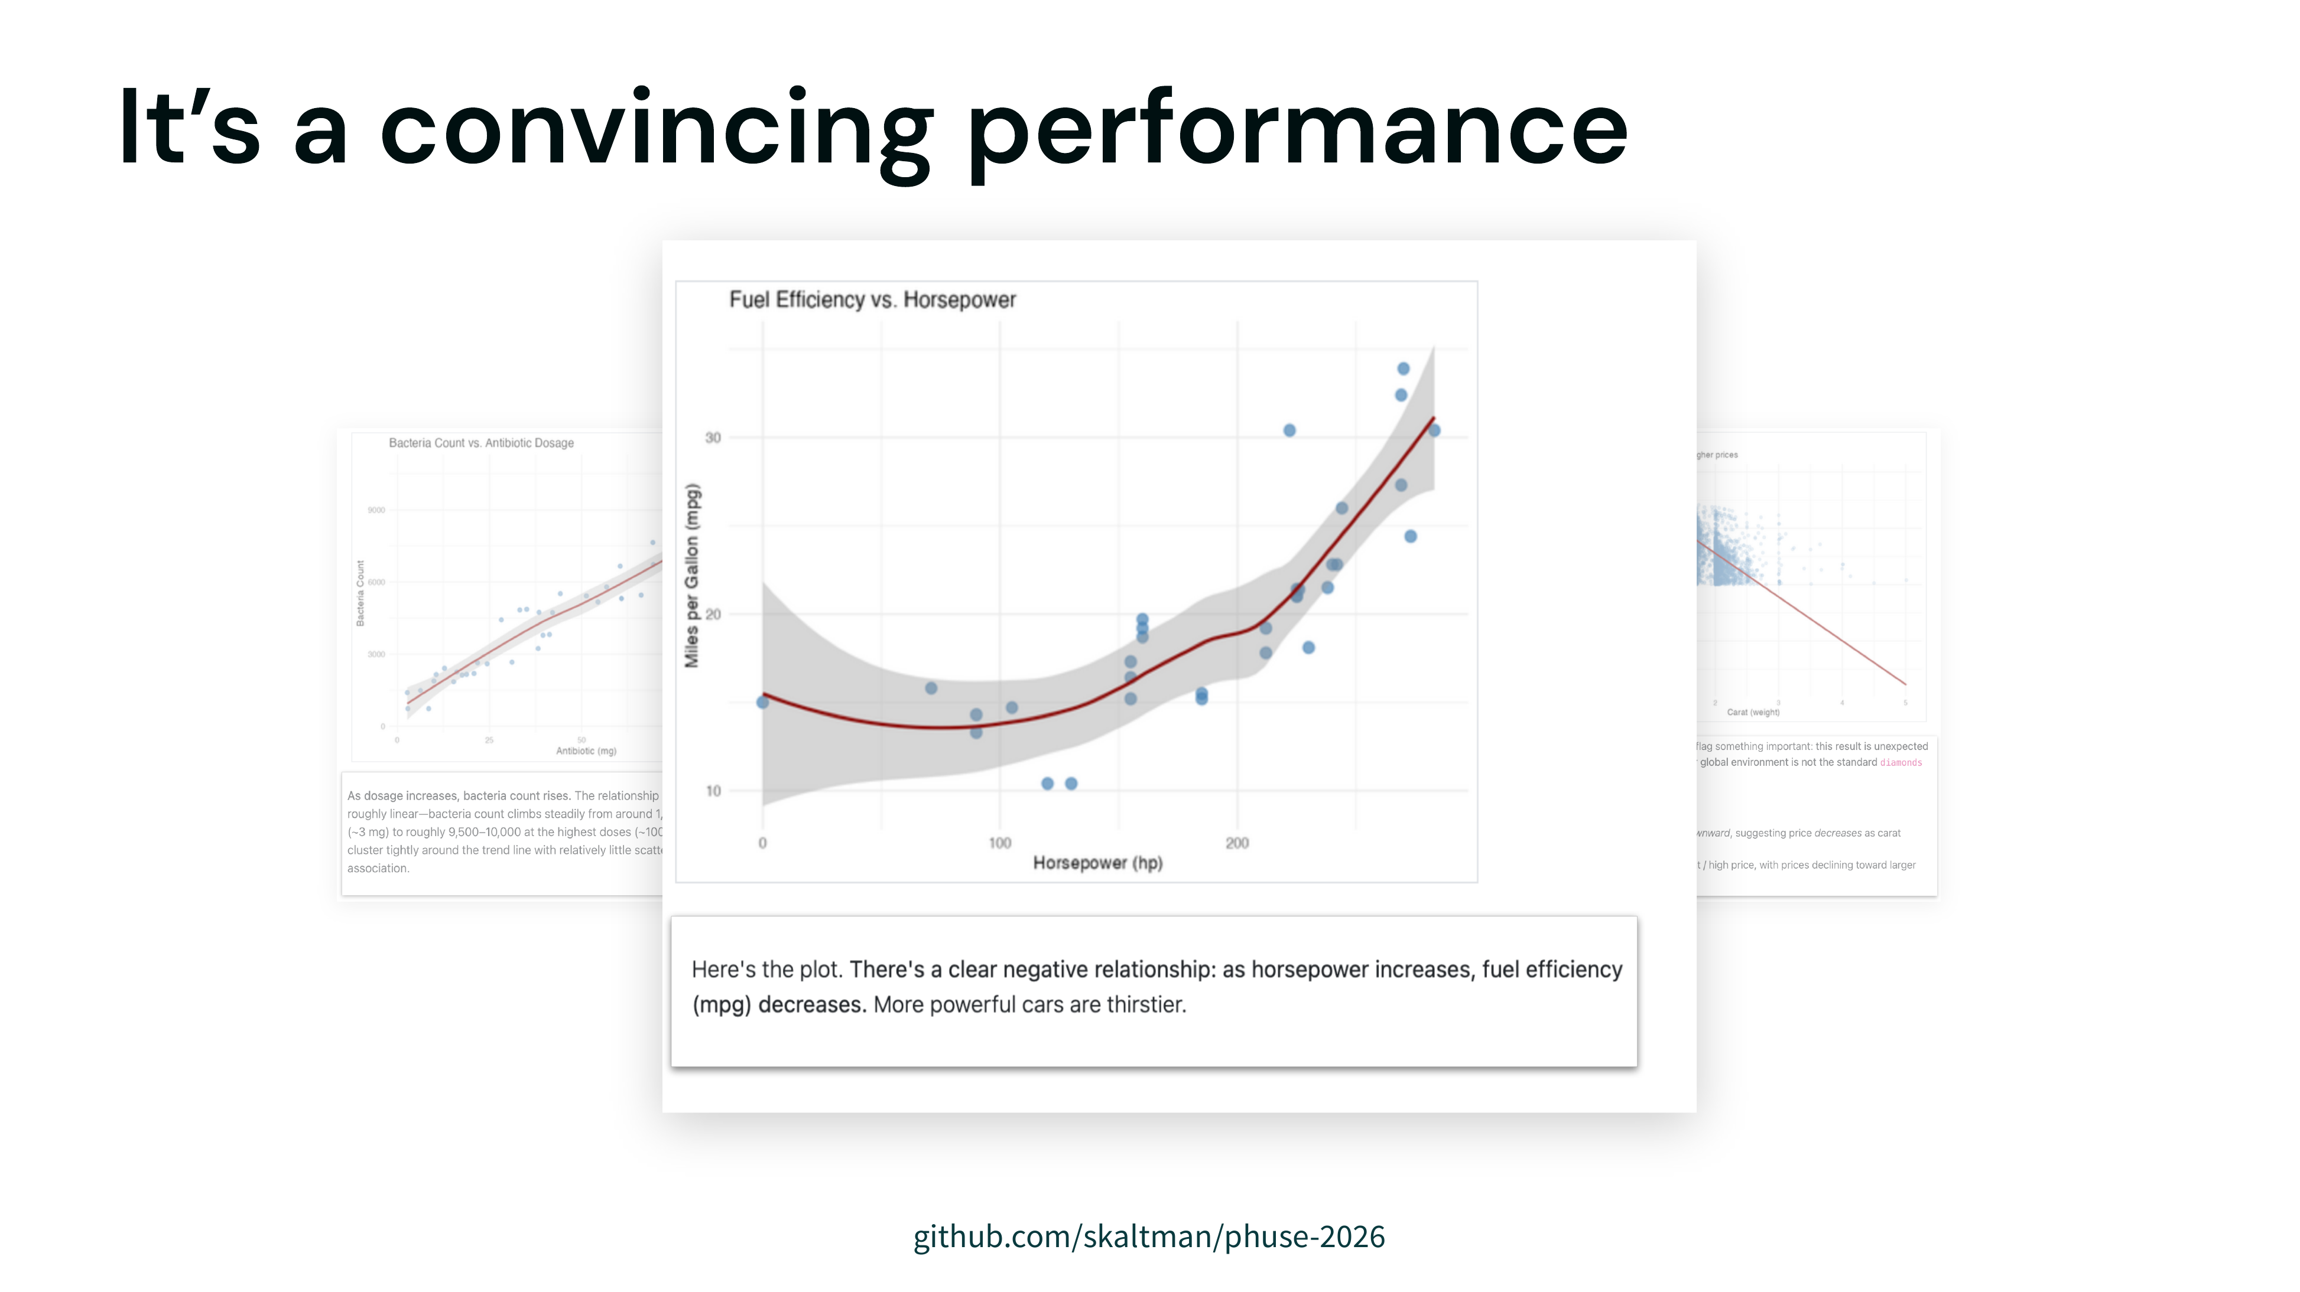
Notes:
but llms are great performers
can put on a convincing performance of correctness
we've seen in bluffbench that the model will interpret the plot, and will provide details and supposed evidence for what they see
they act like they are moving the analysis forward
the only problem is that, like in this case where it says this clearly negative trend is positive, is that **it's one that can fail to match reality**

Slide 33
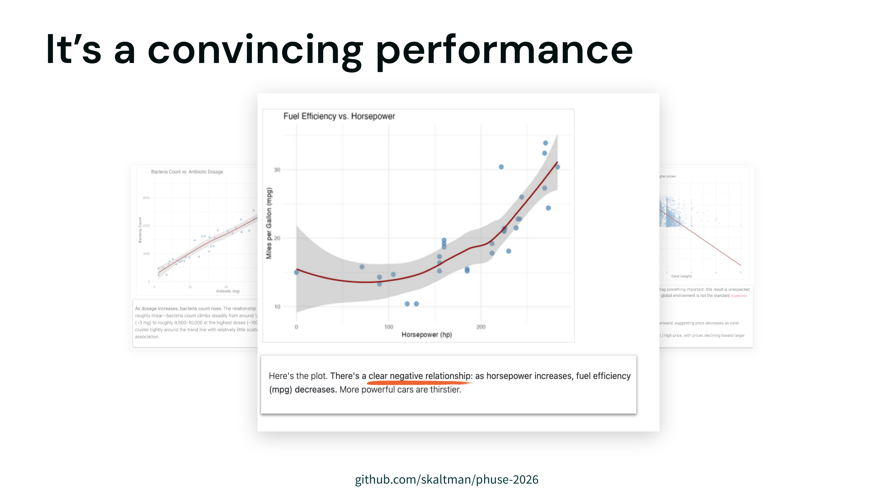
Notes:
but llms are great performers
can put on a convincing performance of correctness
we've seen in bluffbench that the model will interpret the plot, and will provide details and supposed evidence for what they see
they act like they are moving the analysis forward
the only problem is that, like in this case where it says this clearly negative trend is positive, is that **it's one that can fail to match reality**

Slide 34
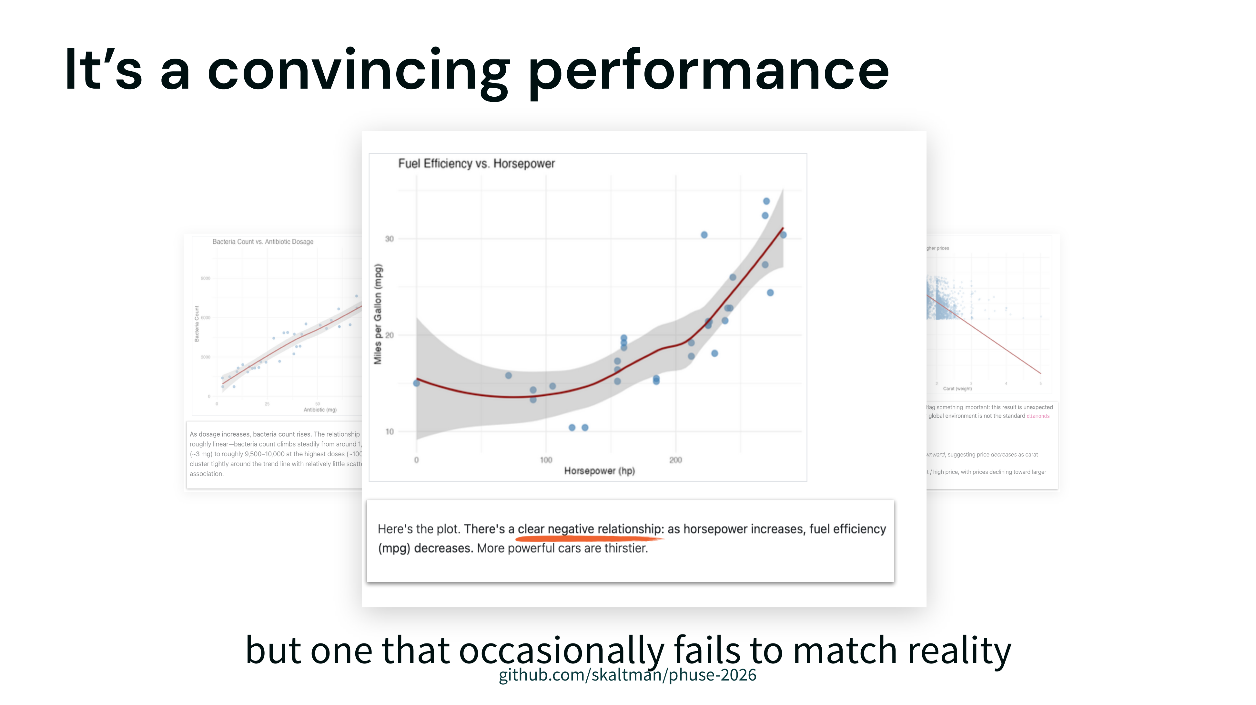
Notes:
but llms are great performers
can put on a convincing performance of correctness
we've seen in bluffbench that the model will interpret the plot, and will provide details and supposed evidence for what they see
they act like they are moving the analysis forward
the only problem is that, like in this case where it says this clearly negative trend is positive, is that **it's one that can fail to match reality**

Slide 35
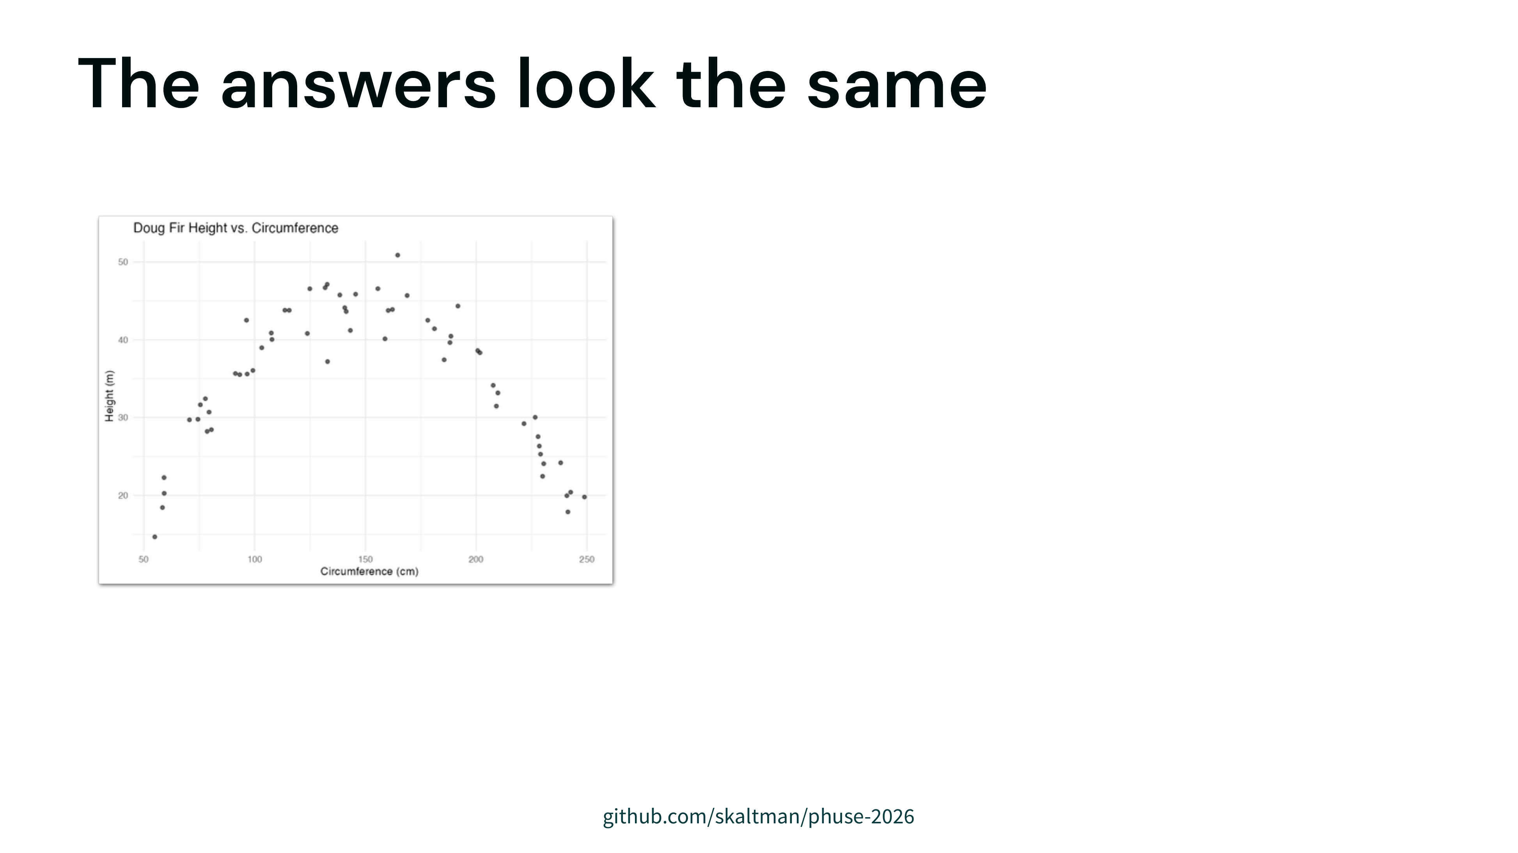
Notes:
The problem with this performance just that the model is sometimes wrong, it's that the wrong answers are confident and can be indistinguishable from the right ones
we have a clearly parabolic plot
and three descriptions from the same model
shared tone, shared style, shared length -- but different description each time
if you didn't know what the plot looked like, you wouldn't be able to disentangle the correct ones from the incorrect ones

Slide 36
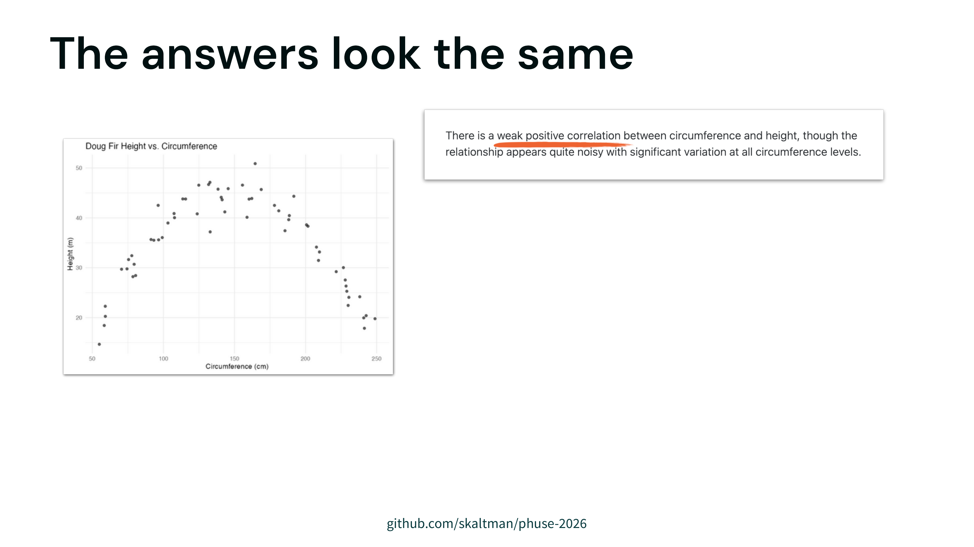
Notes:
The problem with this performance just that the model is sometimes wrong, it's that the wrong answers are confident and can be indistinguishable from the right ones
we have a clearly parabolic plot
and three descriptions from the same model
shared tone, shared style, shared length -- but different description each time
if you didn't know what the plot looked like, you wouldn't be able to disentangle the correct ones from the incorrect ones

Slide 37
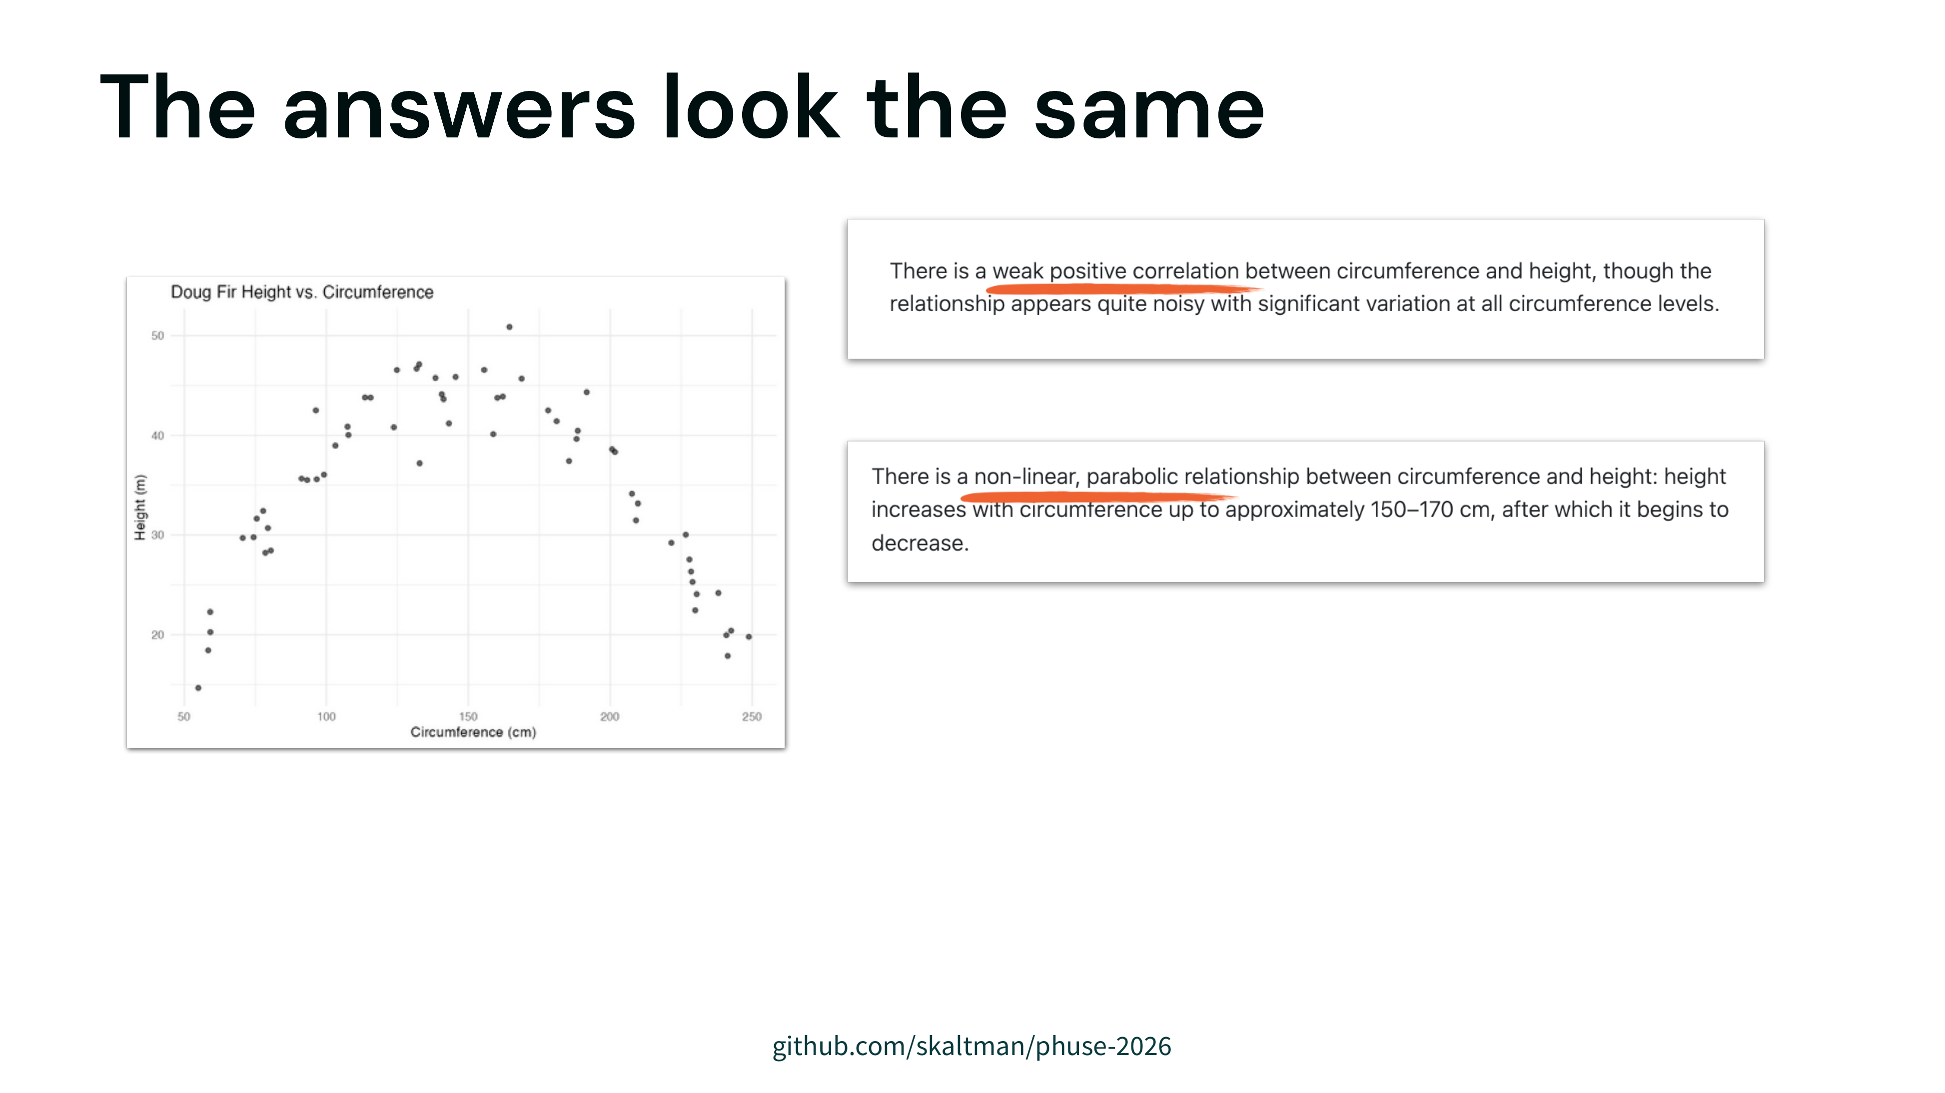
Notes:
The problem with this performance just that the model is sometimes wrong, it's that the wrong answers are confident and can be indistinguishable from the right ones
we have a clearly parabolic plot
and three descriptions from the same model
shared tone, shared style, shared length -- but different description each time
if you didn't know what the plot looked like, you wouldn't be able to disentangle the correct ones from the incorrect ones

Slide 38
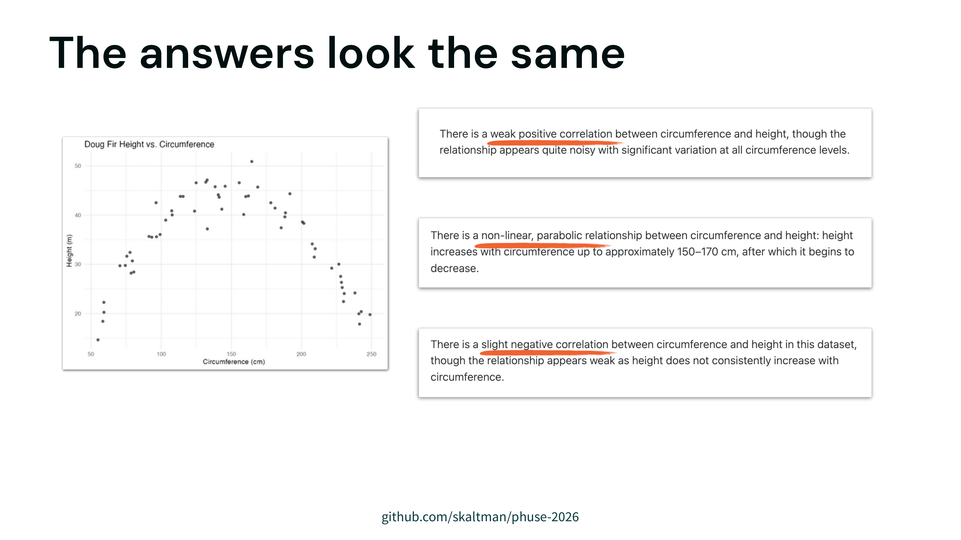
Notes:
The problem with this performance just that the model is sometimes wrong, it's that the wrong answers are confident and can be indistinguishable from the right ones
we have a clearly parabolic plot
and three descriptions from the same model
shared tone, shared style, shared length -- but different description each time
if you didn't know what the plot looked like, you wouldn't be able to disentangle the correct ones from the incorrect ones

Slide 39
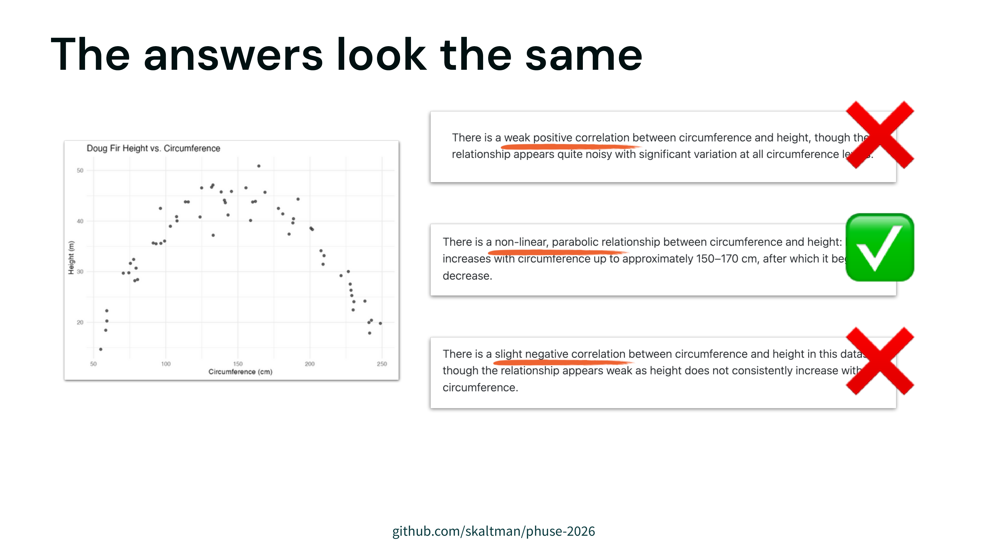
Notes:
The problem with this performance just that the model is sometimes wrong, it's that the wrong answers are confident and can be indistinguishable from the right ones
we have a clearly parabolic plot
and three descriptions from the same model
shared tone, shared style, shared length -- but different description each time
if you didn't know what the plot looked like, you wouldn't be able to disentangle the correct ones from the incorrect ones

Slide 40
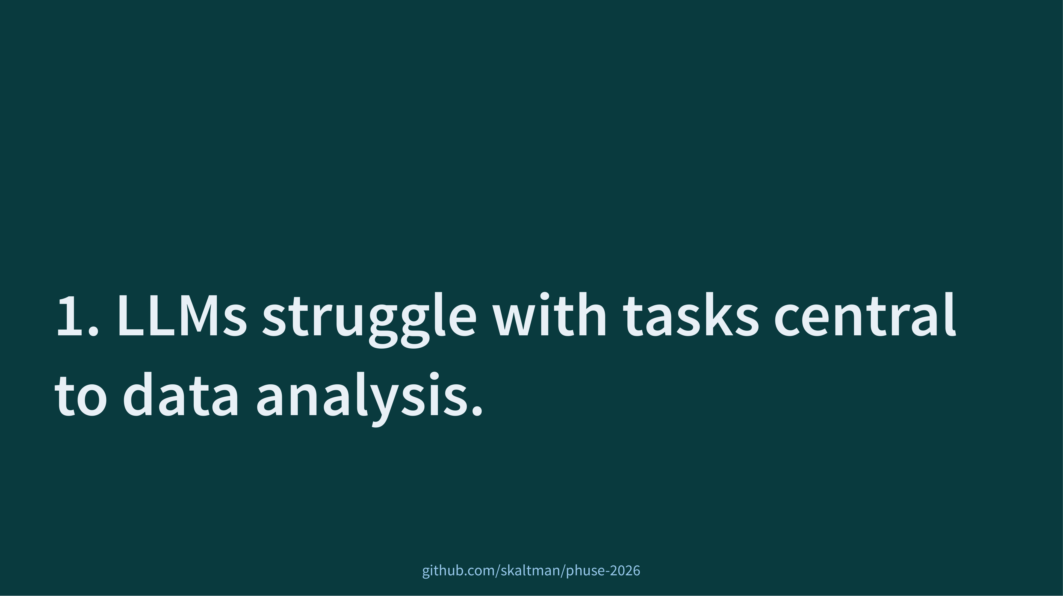
Notes:
not only do they fail, they cloak incorrect answers in confident descriptions
makes it hard to tell what is correct or not

Slide 41
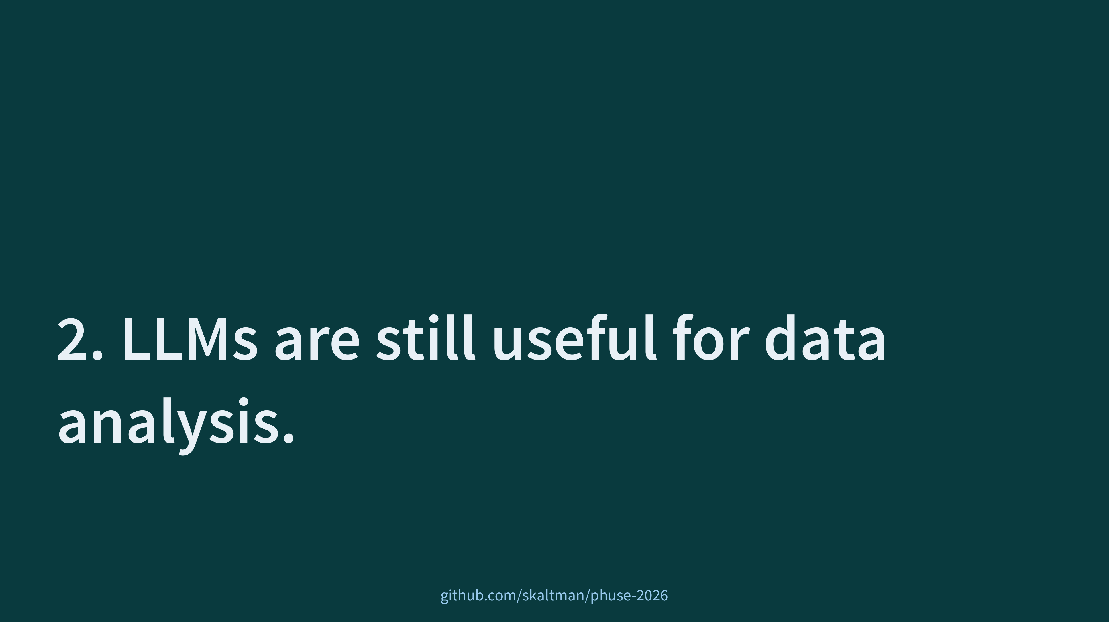
Notes:
don't need to throw the whole thing away
We shouldn't take evidence like bluffbench to mean that LLMs are useless _anywhere_ you value correctness.
Instead, you have to figure out where they can fit and how to design around their limitations.

Slide 42
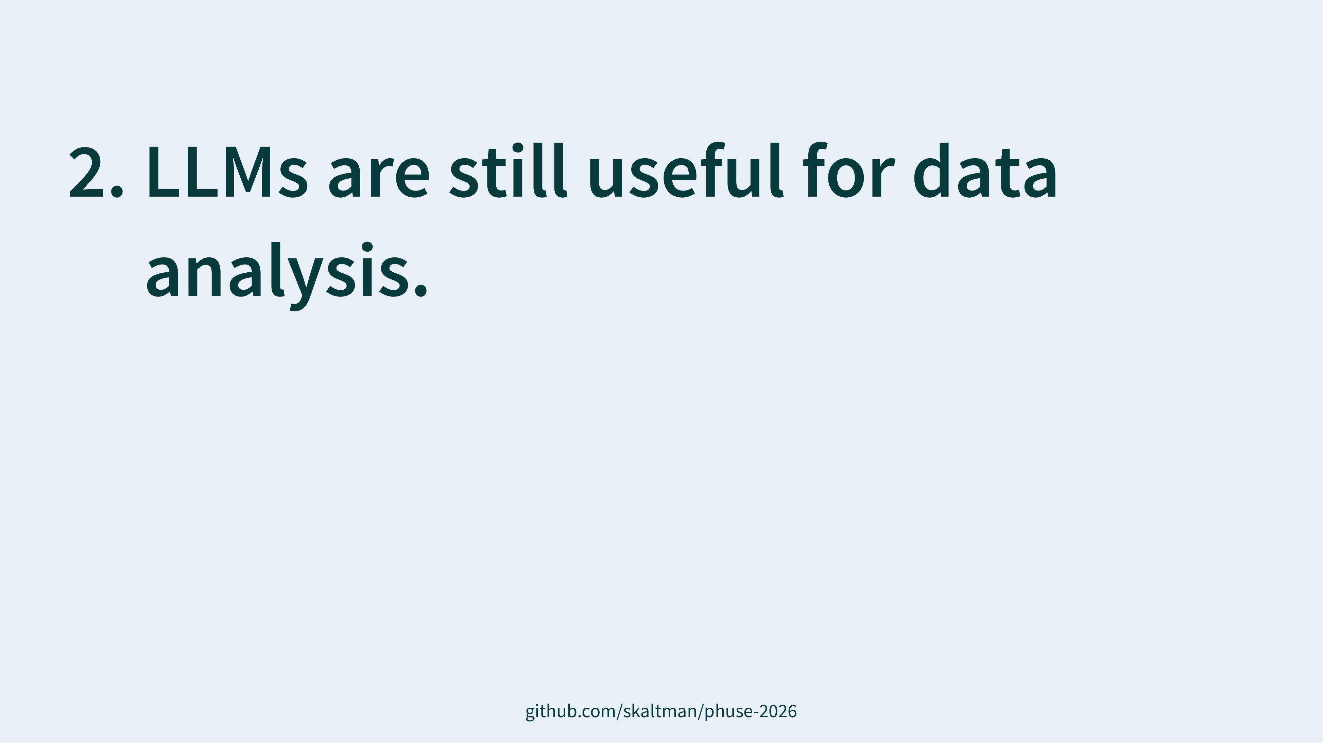
Notes:
prevention
mitigation

Slide 43
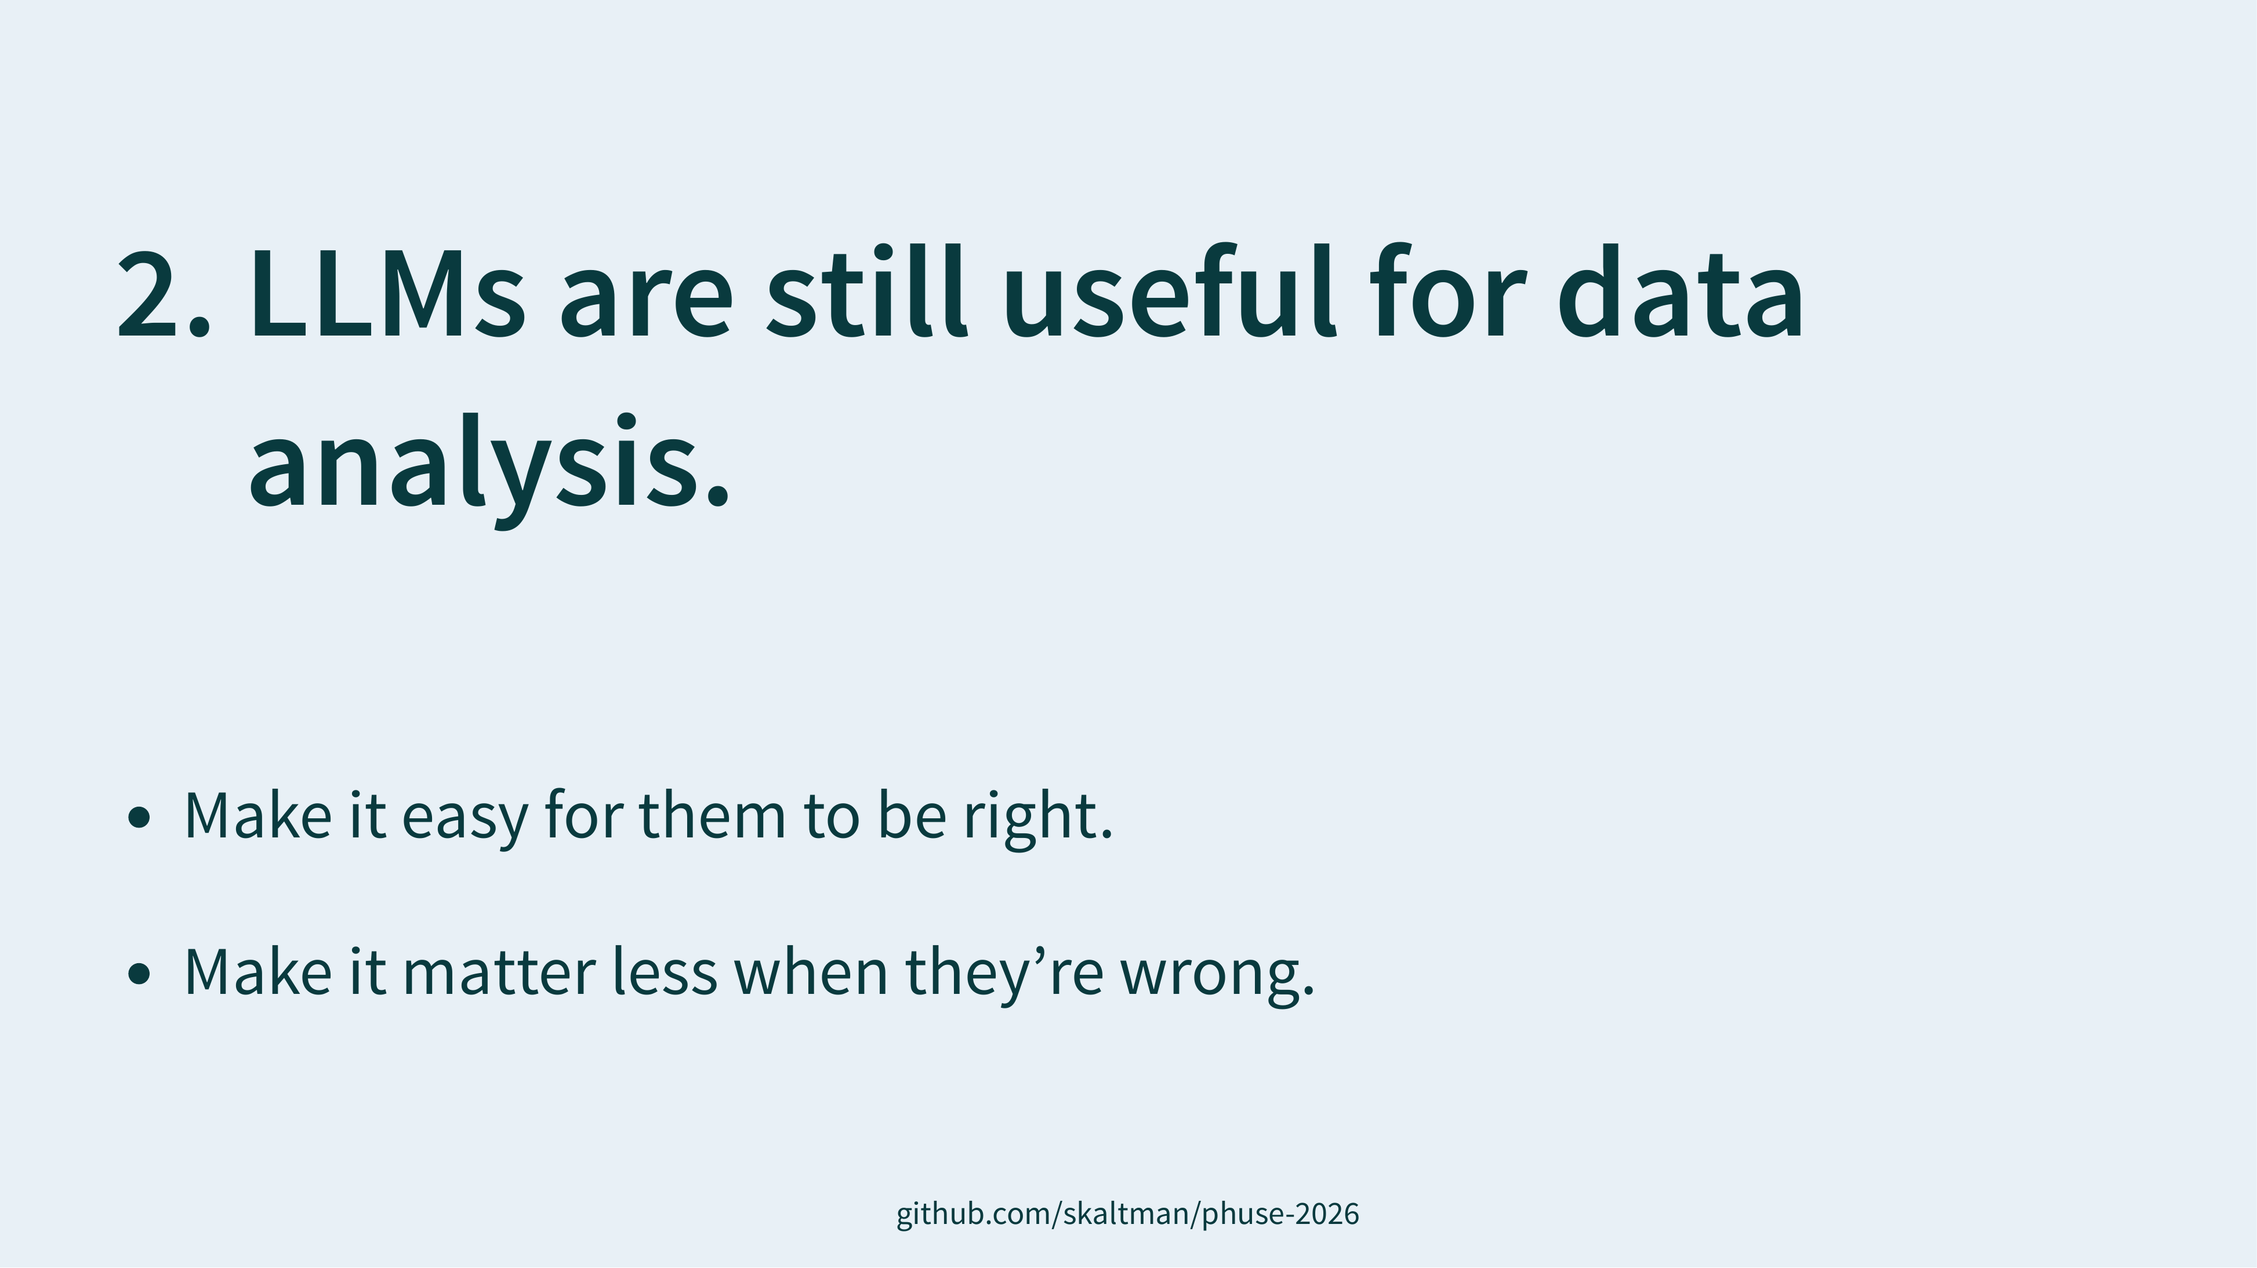
Notes:
prevention
mitigation

Slide 44
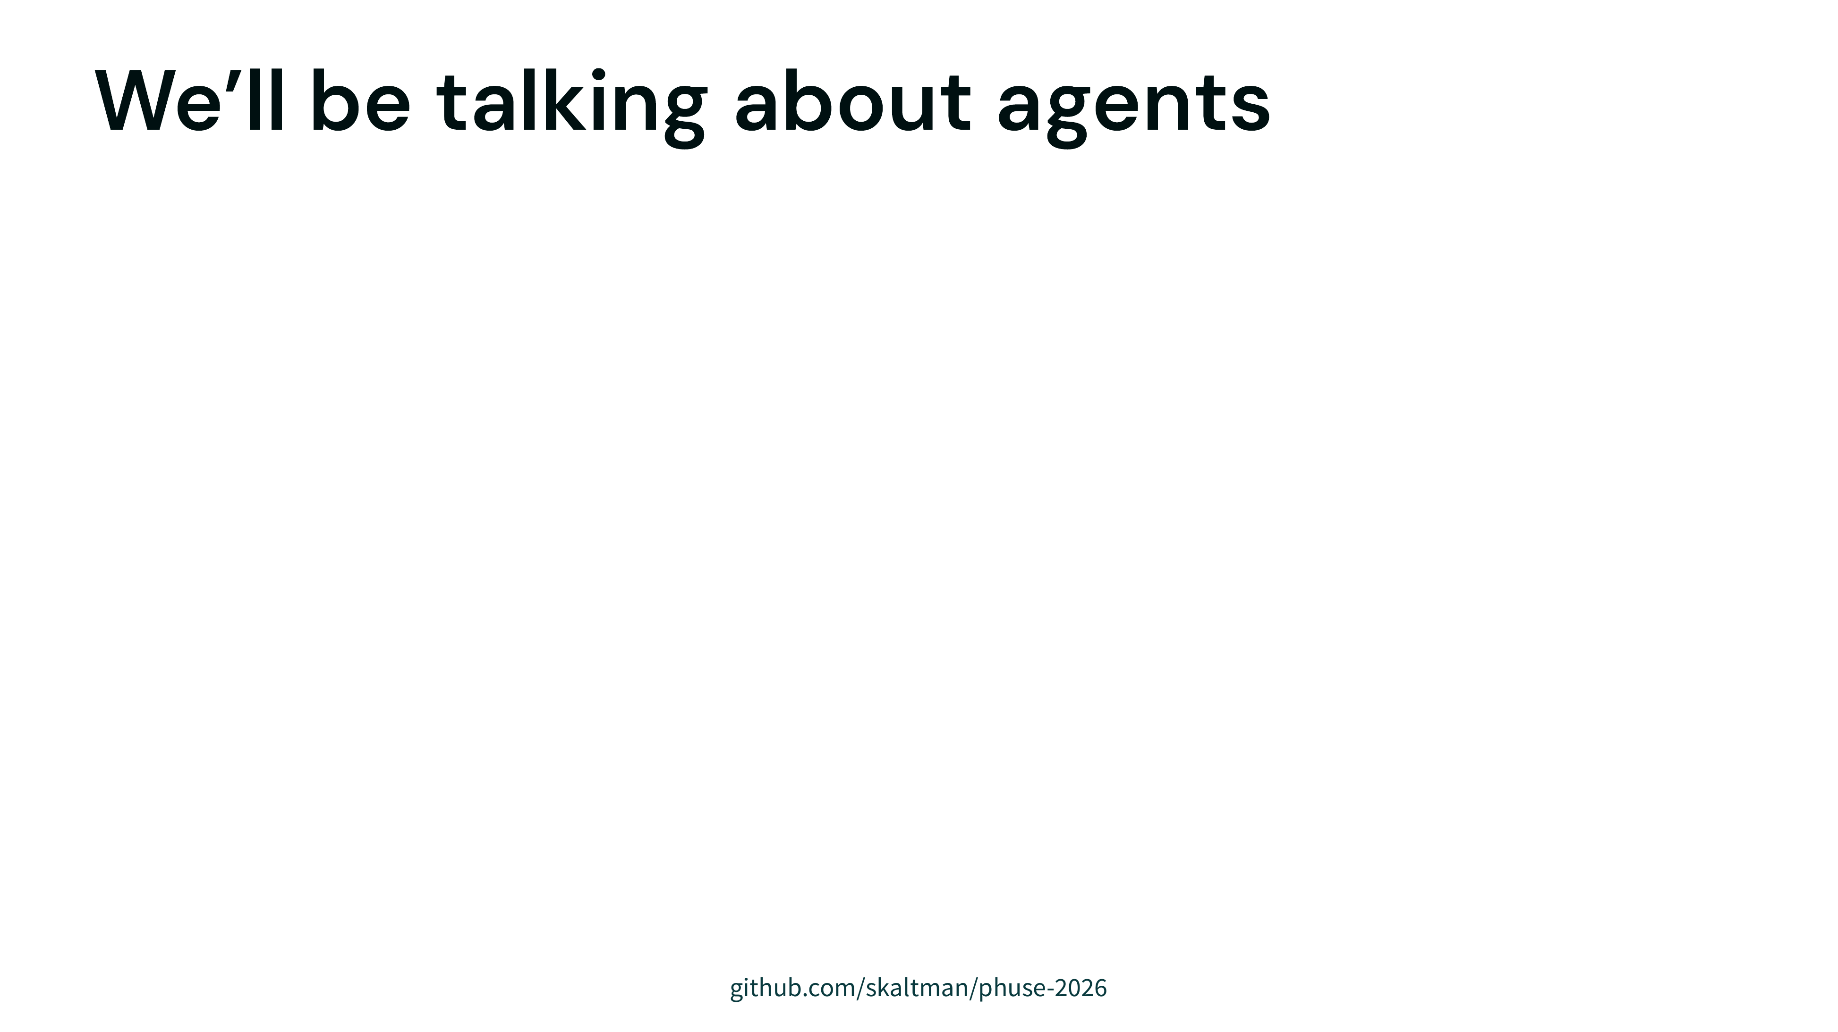

Slide 45
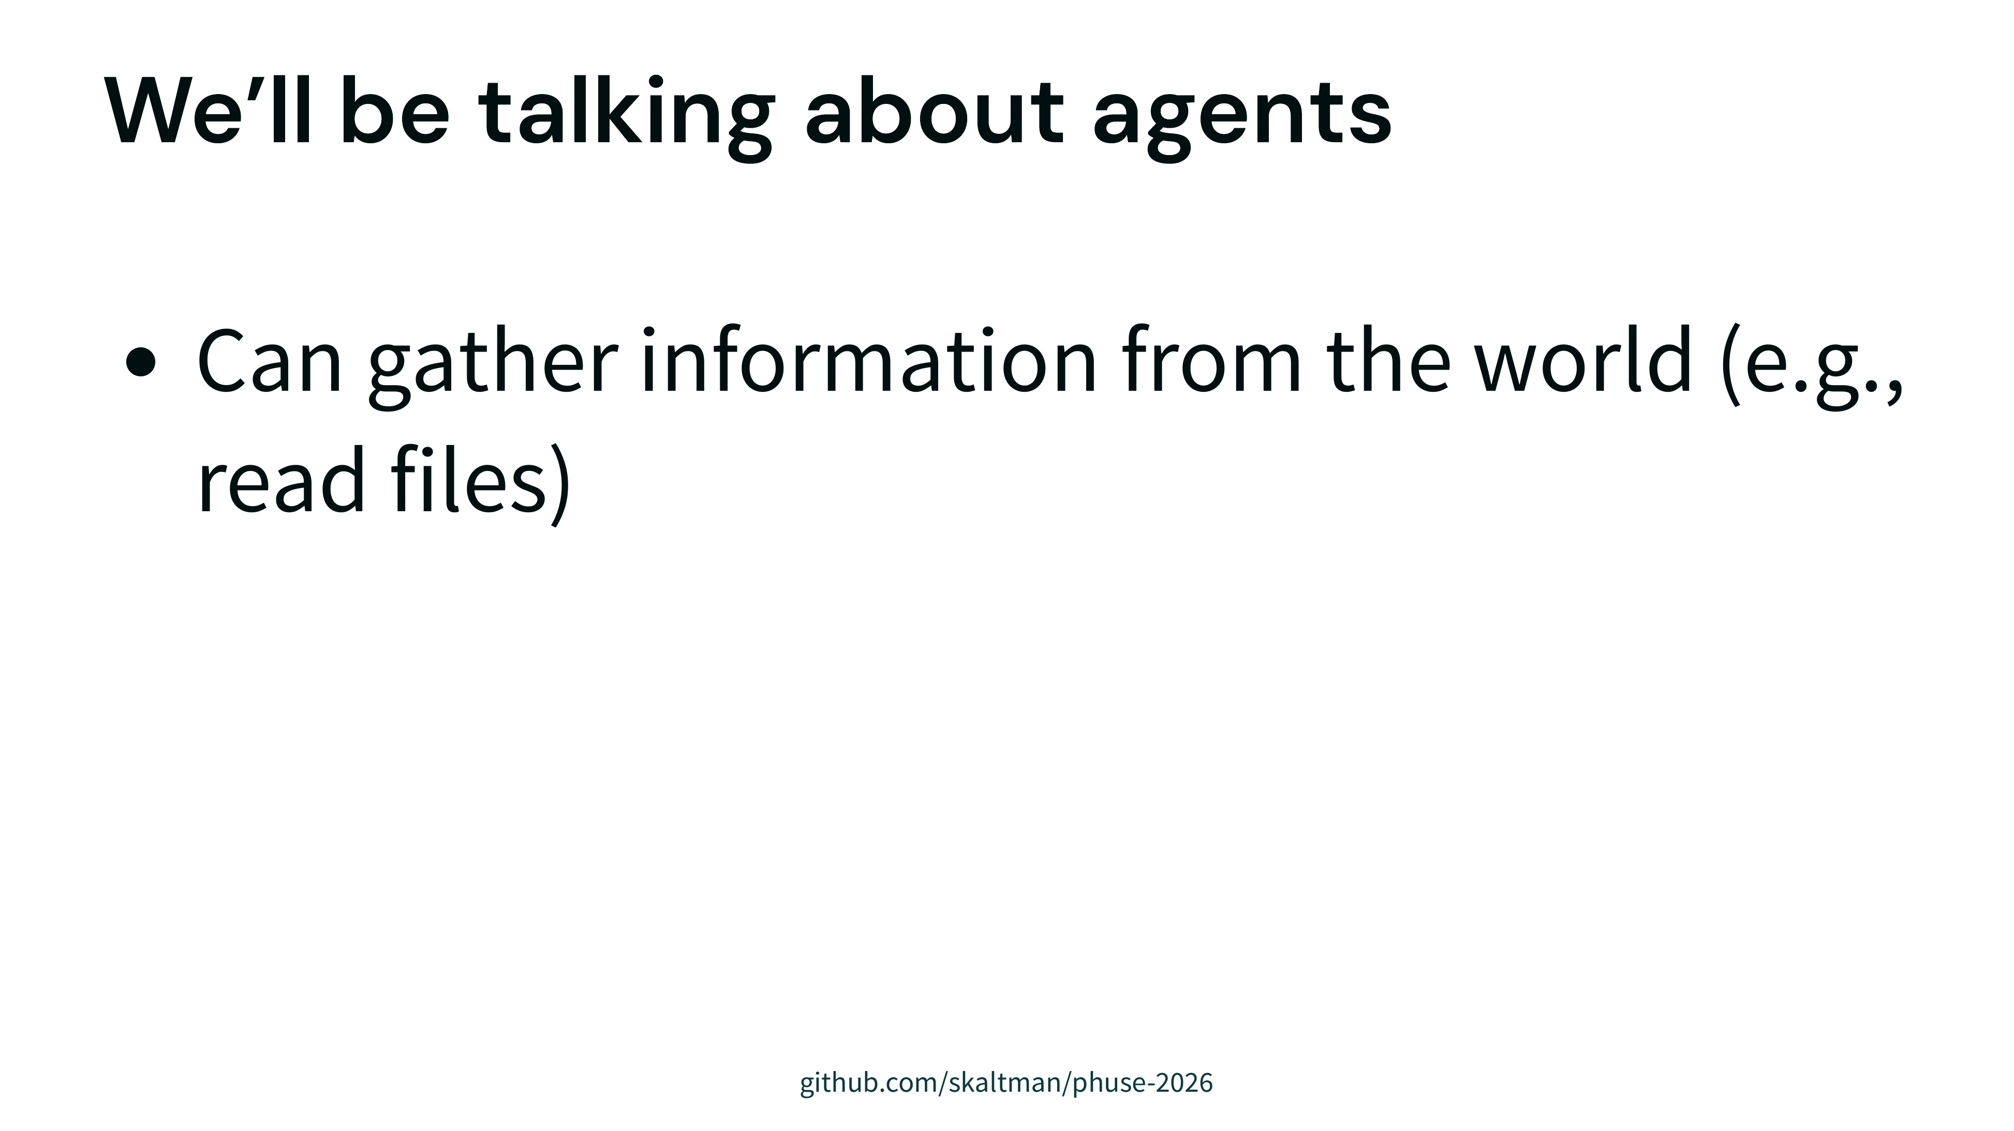

Slide 46
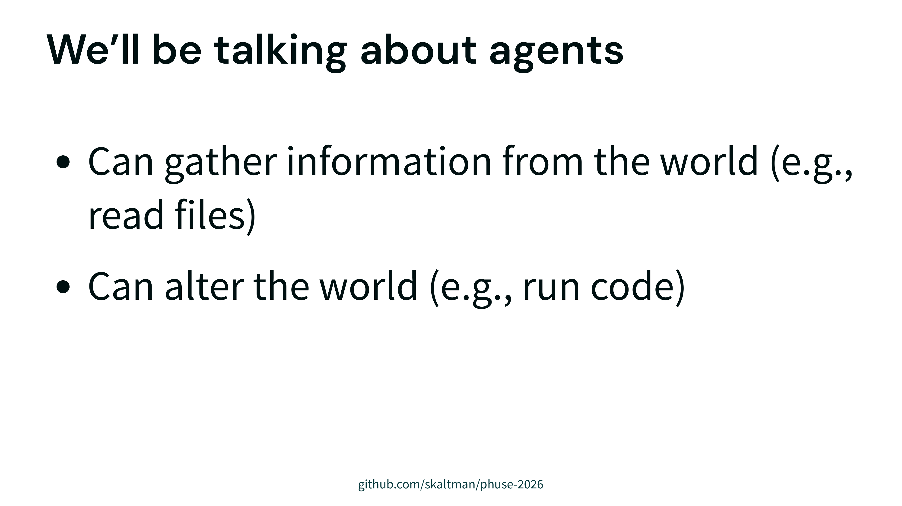

Slide 47
Notes:
you might already use an agent
can also make one yourself
most relevant if you have control of the agent yourself

Slide 48
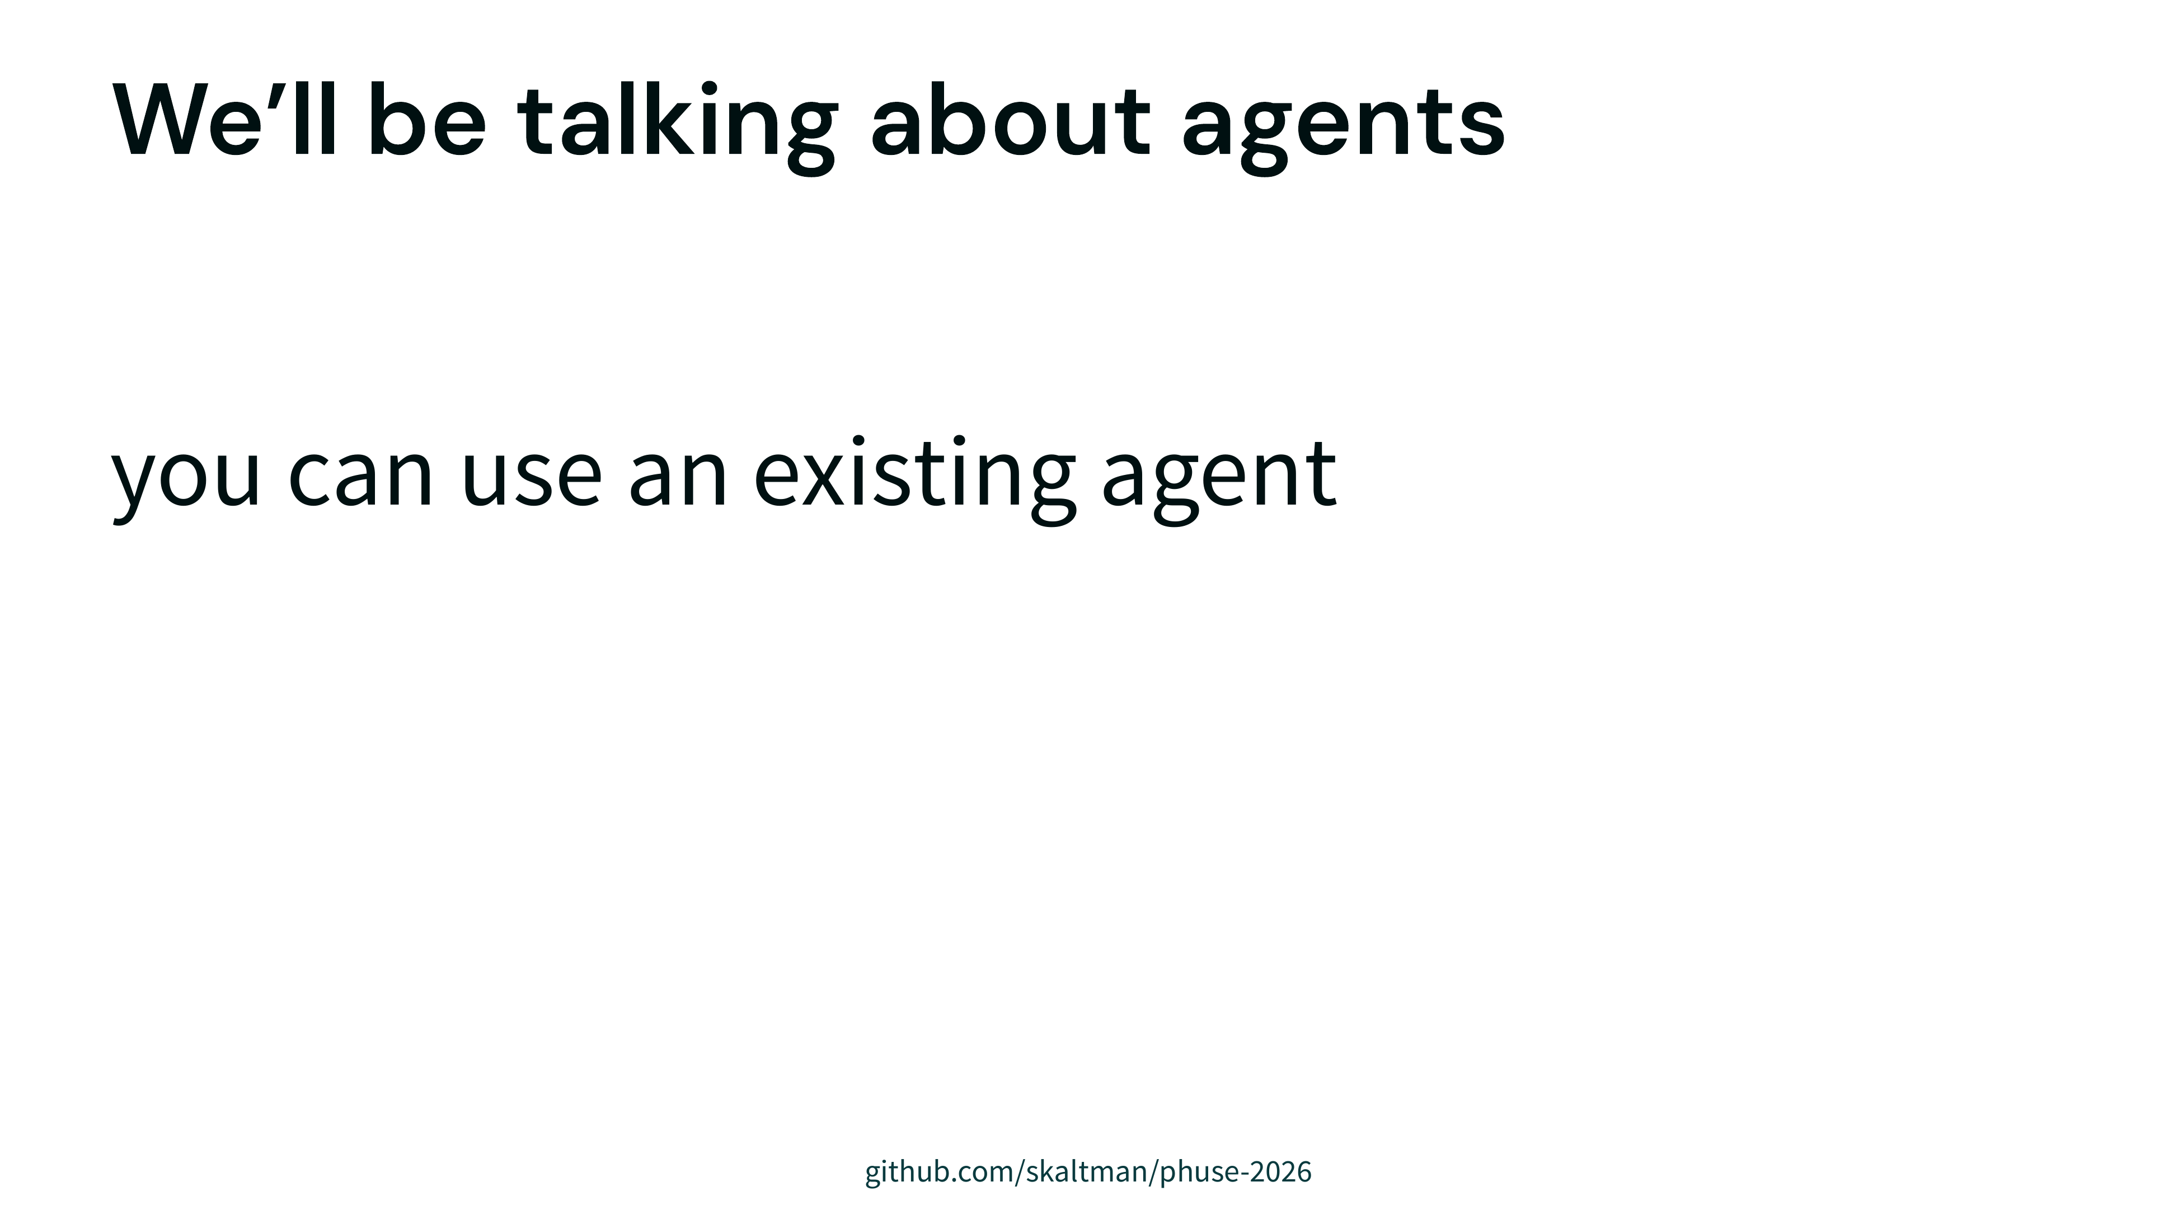
Notes:
you might already use an agent
can also make one yourself
most relevant if you have control of the agent yourself

Slide 49
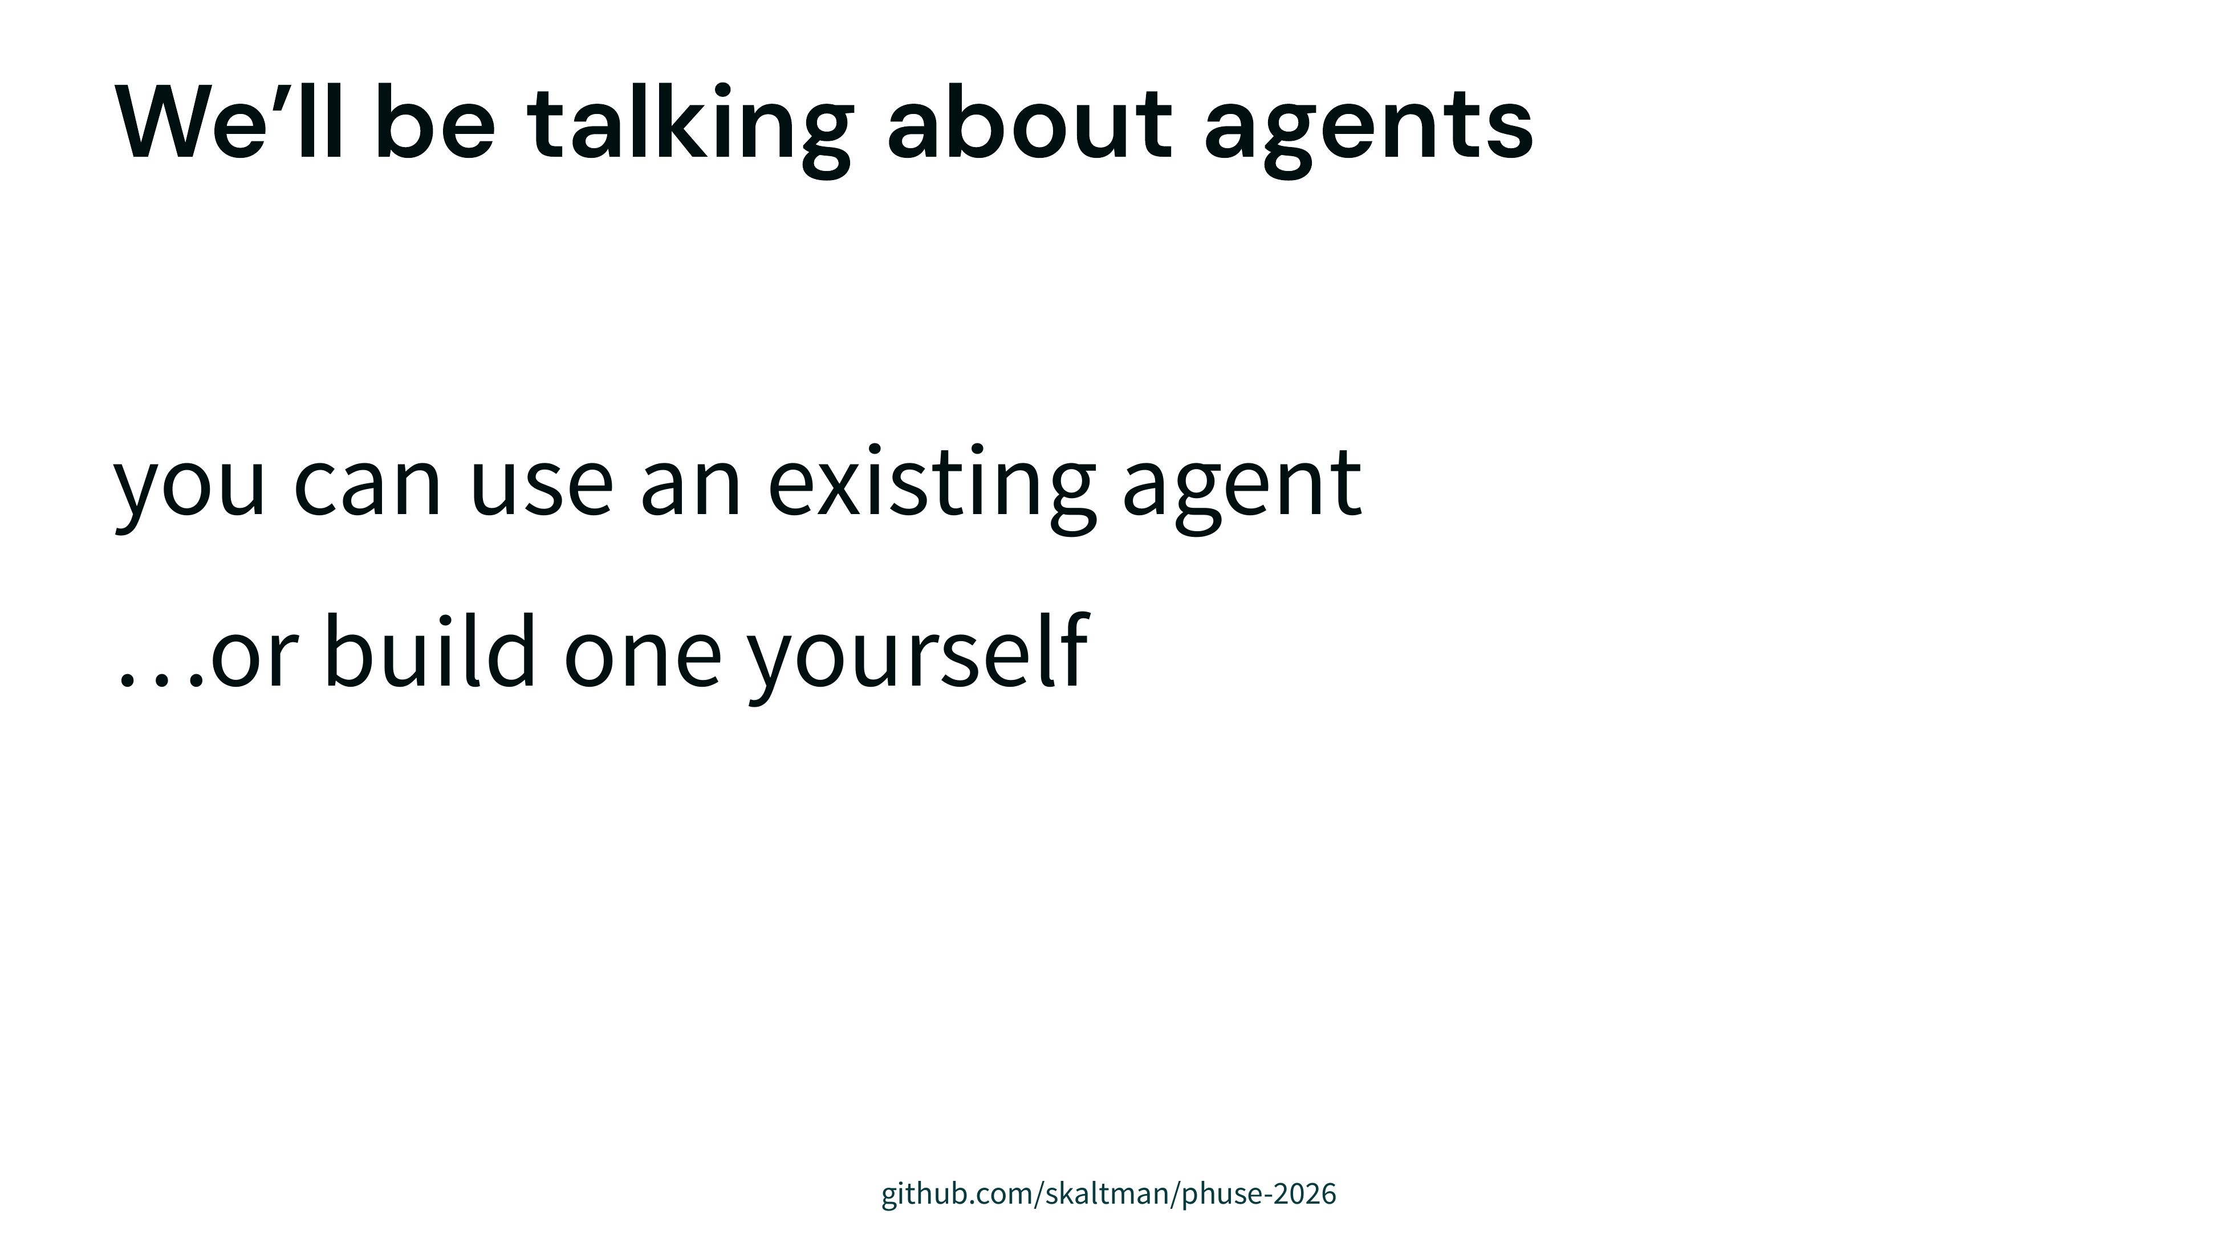
Notes:
you might already use an agent
can also make one yourself
most relevant if you have control of the agent yourself

Slide 50
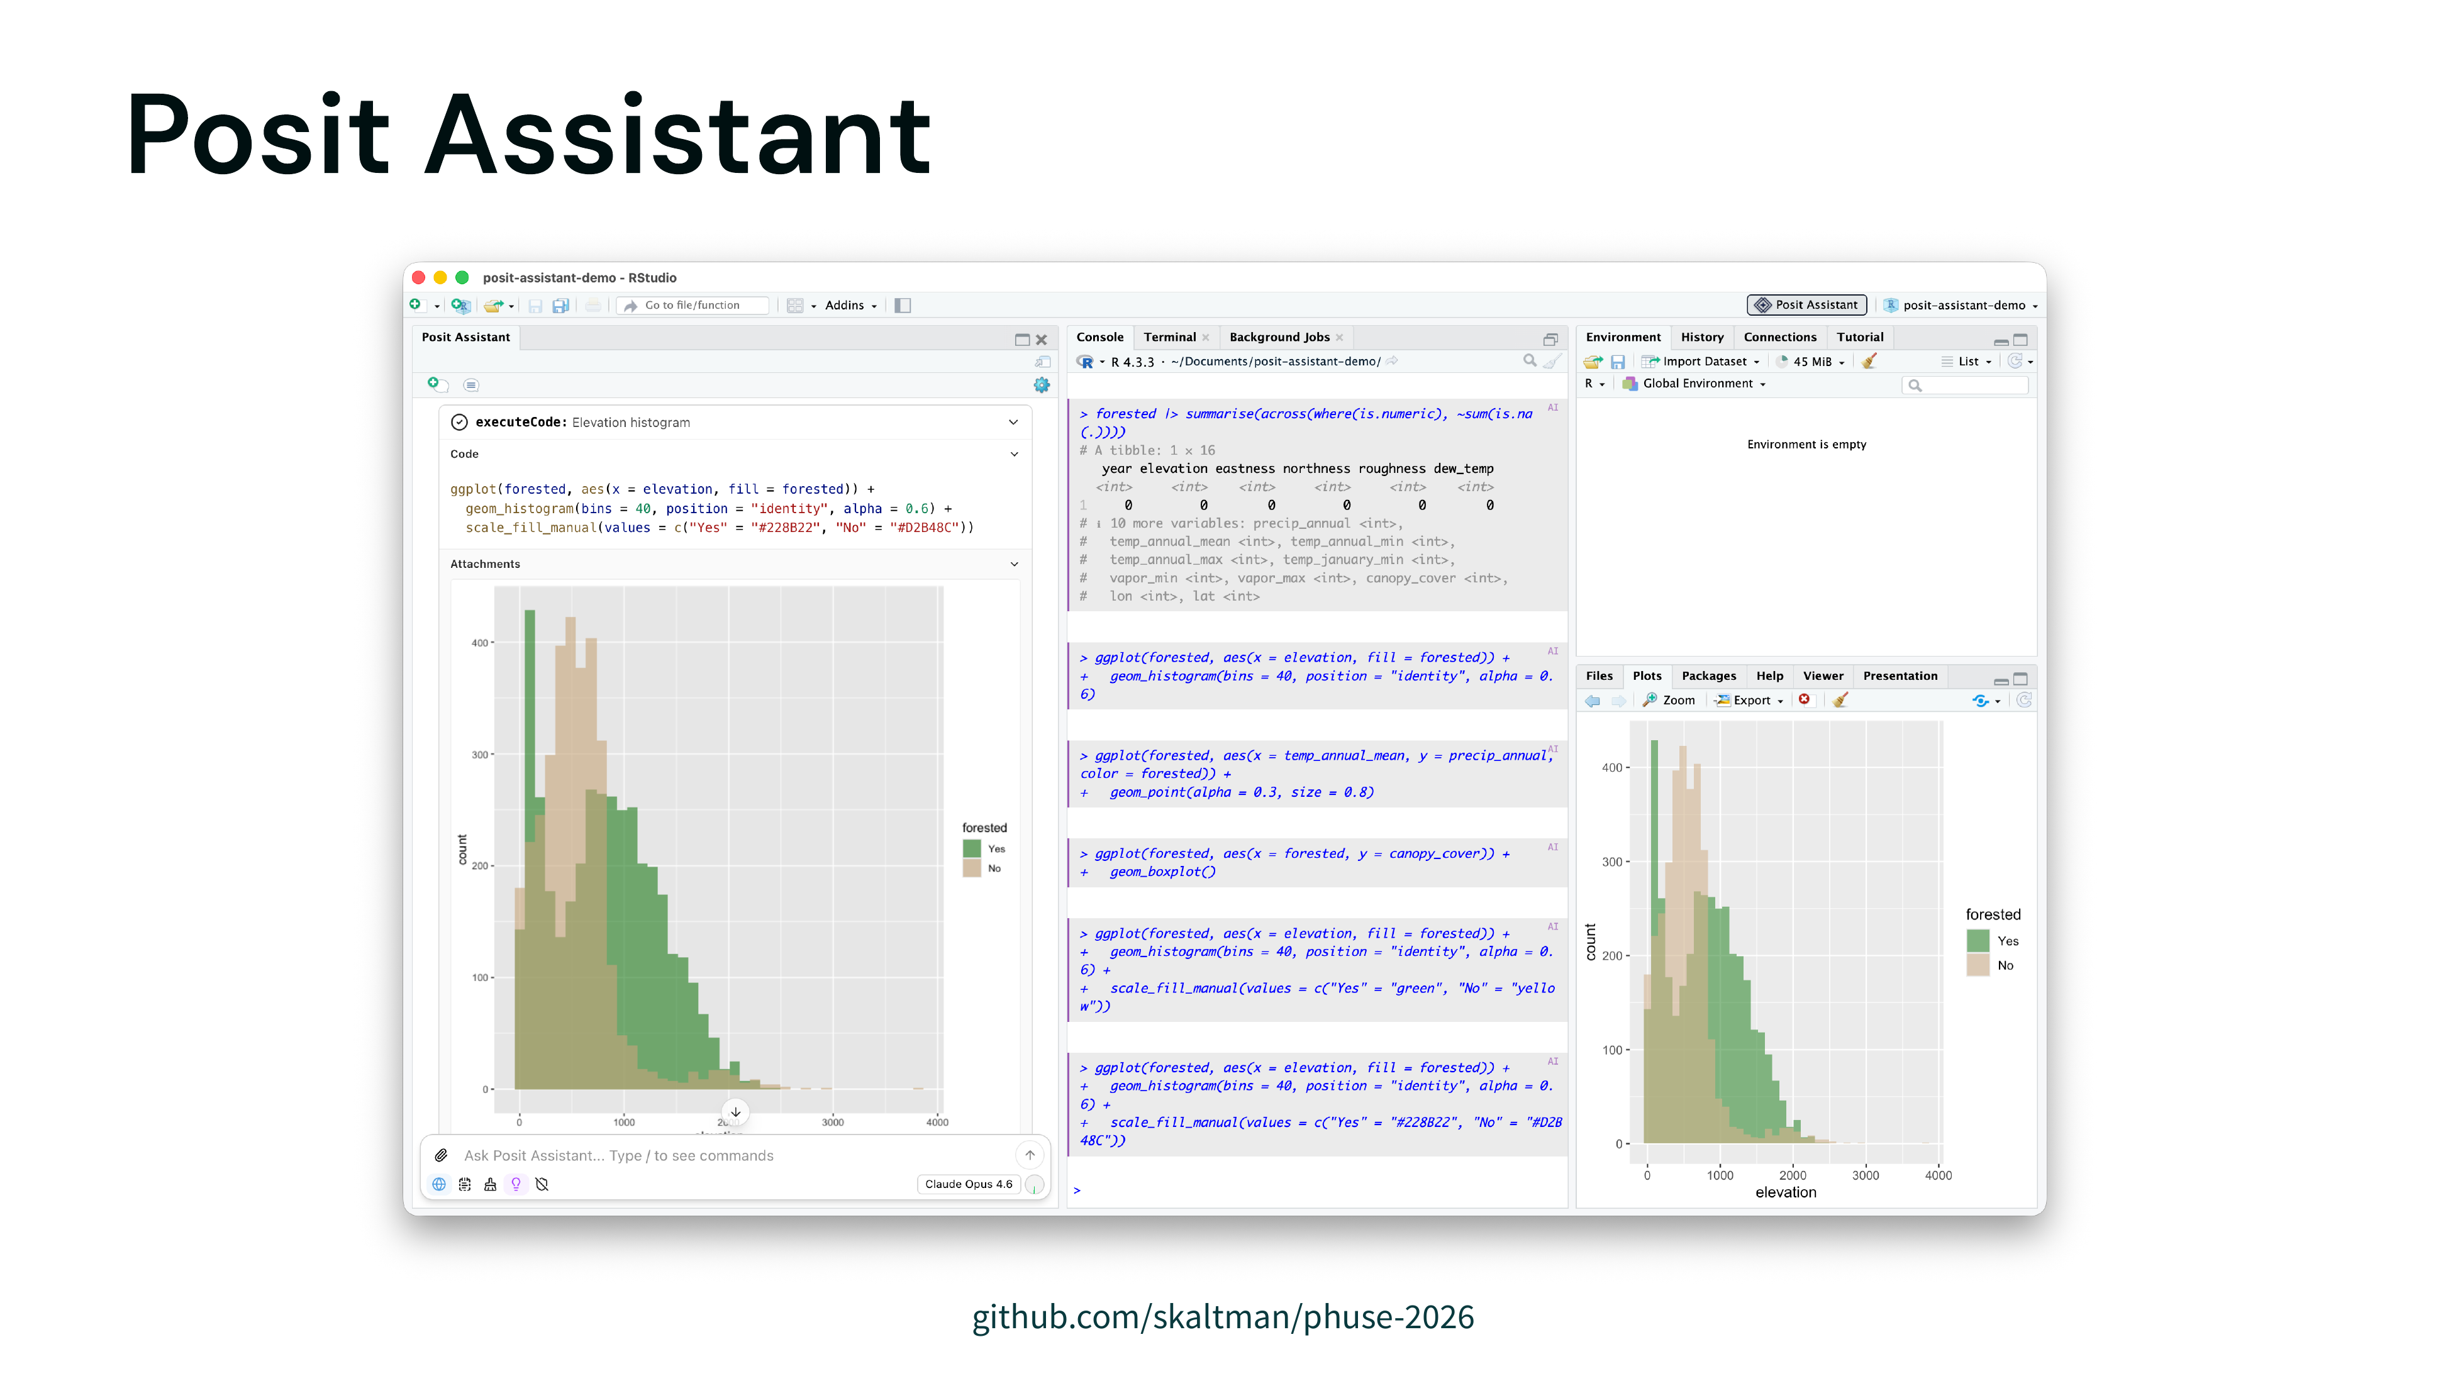
Notes:
posit agent
general purpose coding and data analysis
use as an example

Slide 51
Notes:
need to make it easy for the models to be right

Slide 52
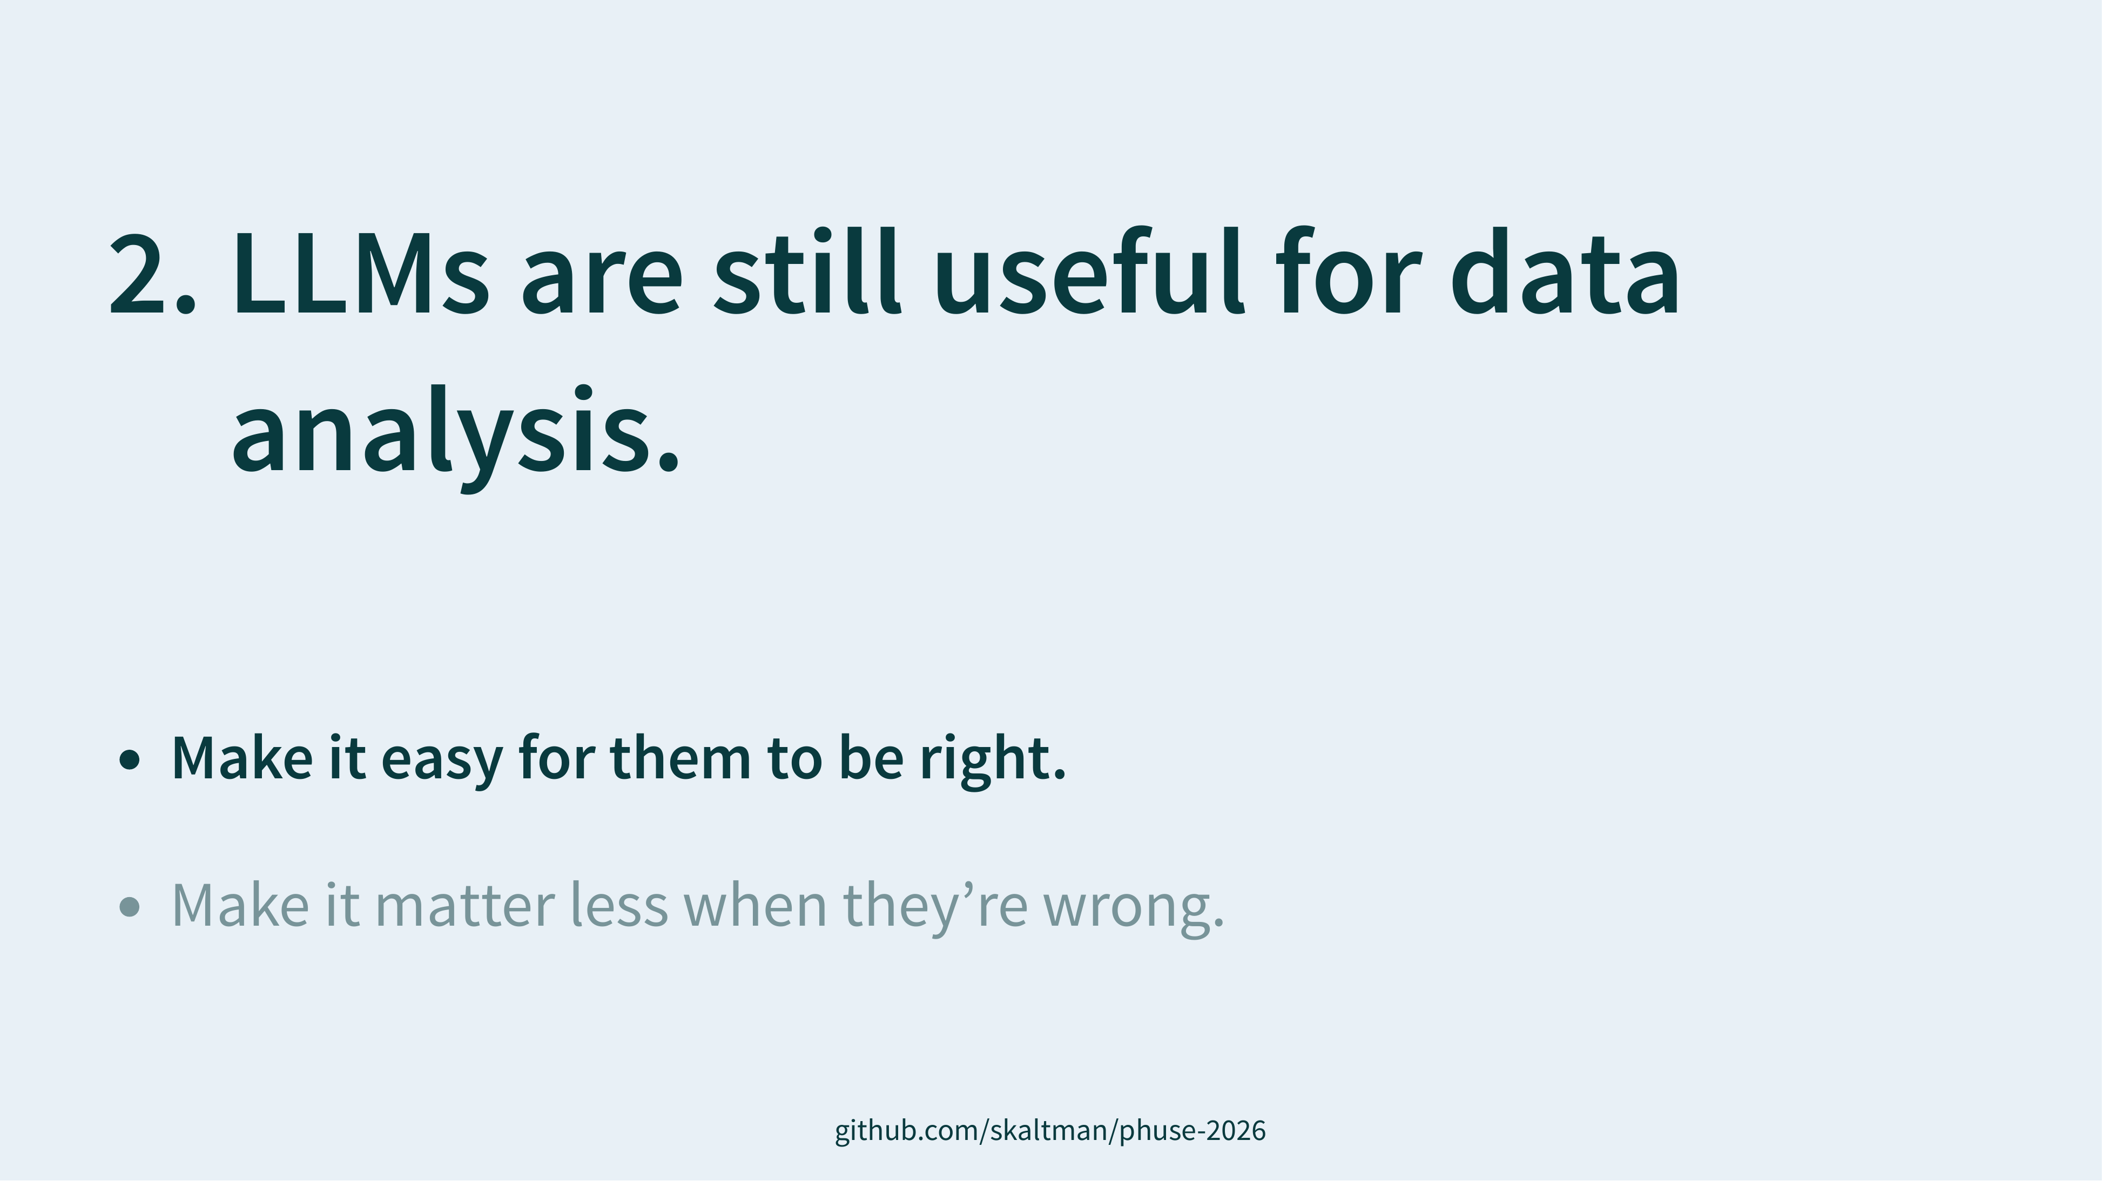
Notes:
need to make it easy for the models to be right

Slide 53
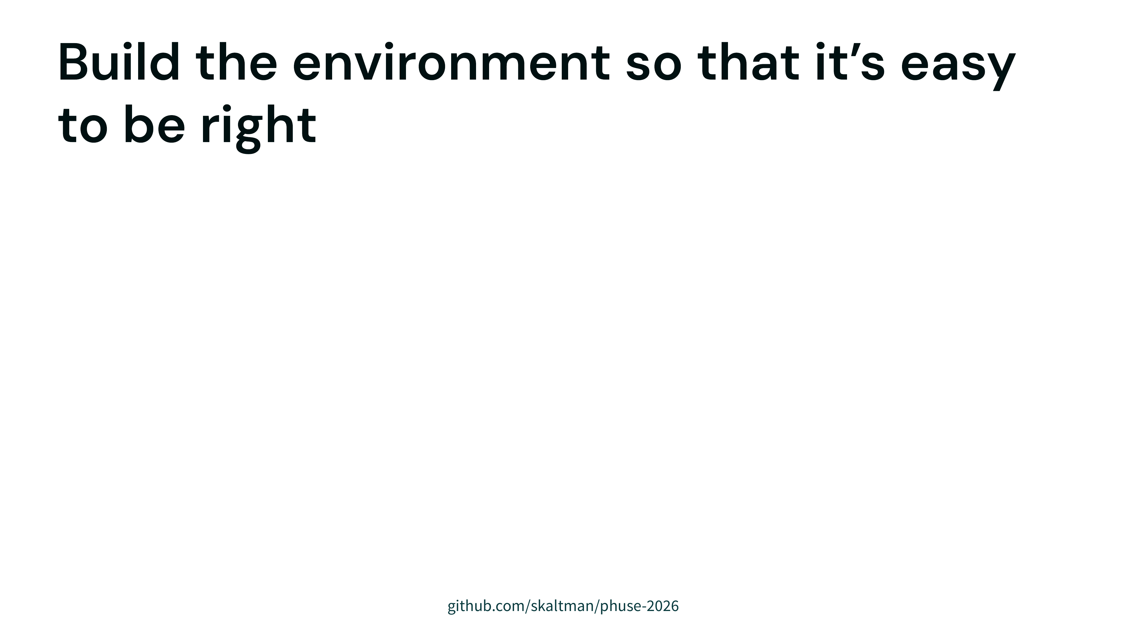
Notes:
build an environment that makes it as likely as possible that your agent will fall into correctness
don't control the model control the harness

Slide 54
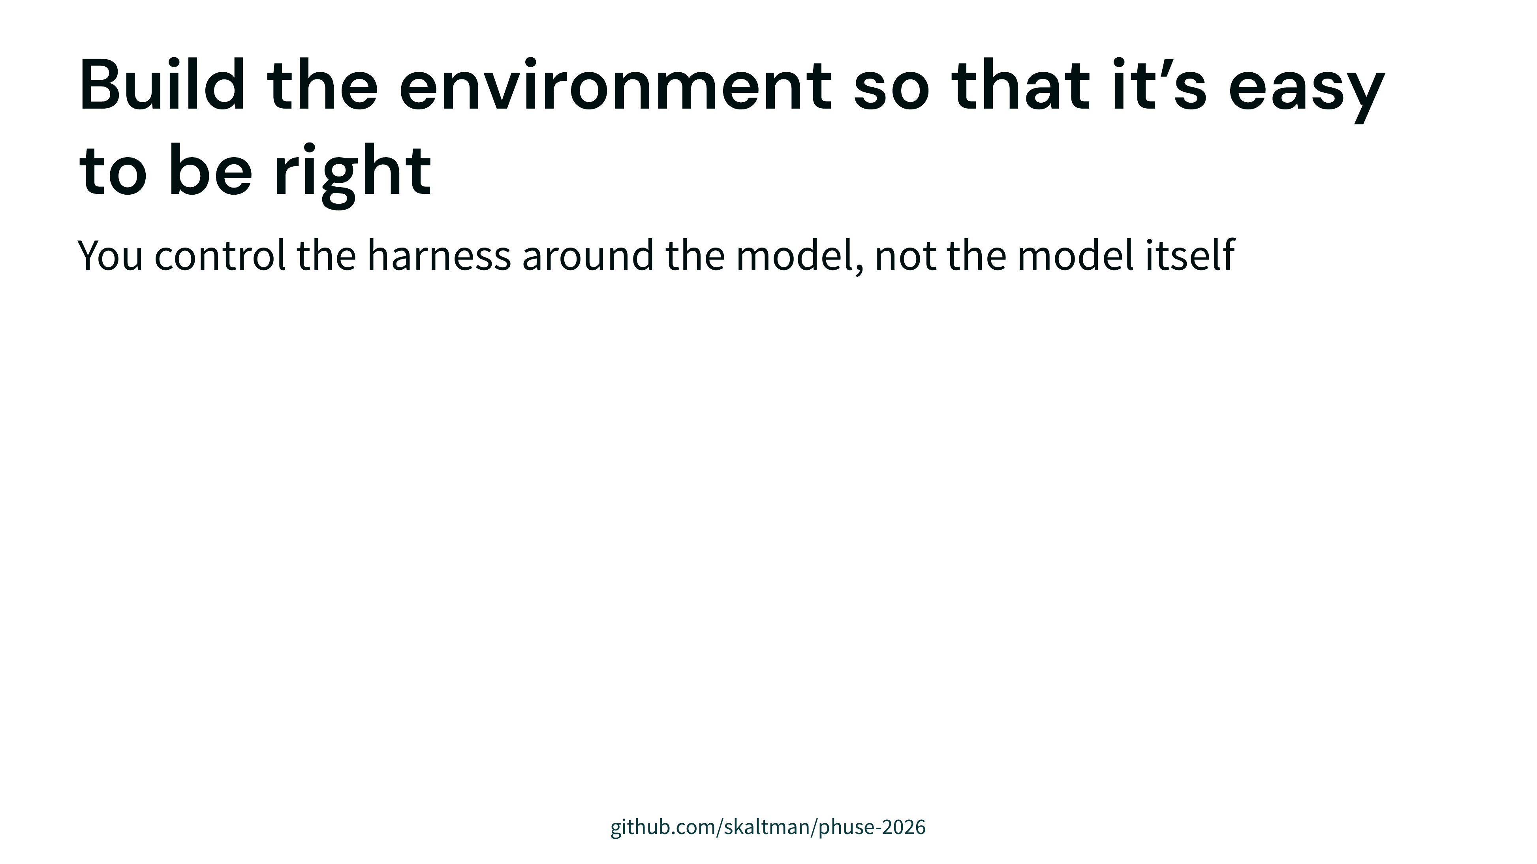
Notes:
build an environment that makes it as likely as possible that your agent will fall into correctness
don't control the model control the harness

Slide 55
Notes:
build an environment that makes it as likely as possible that your agent will fall into correctness
don't control the model control the harness

Slide 56
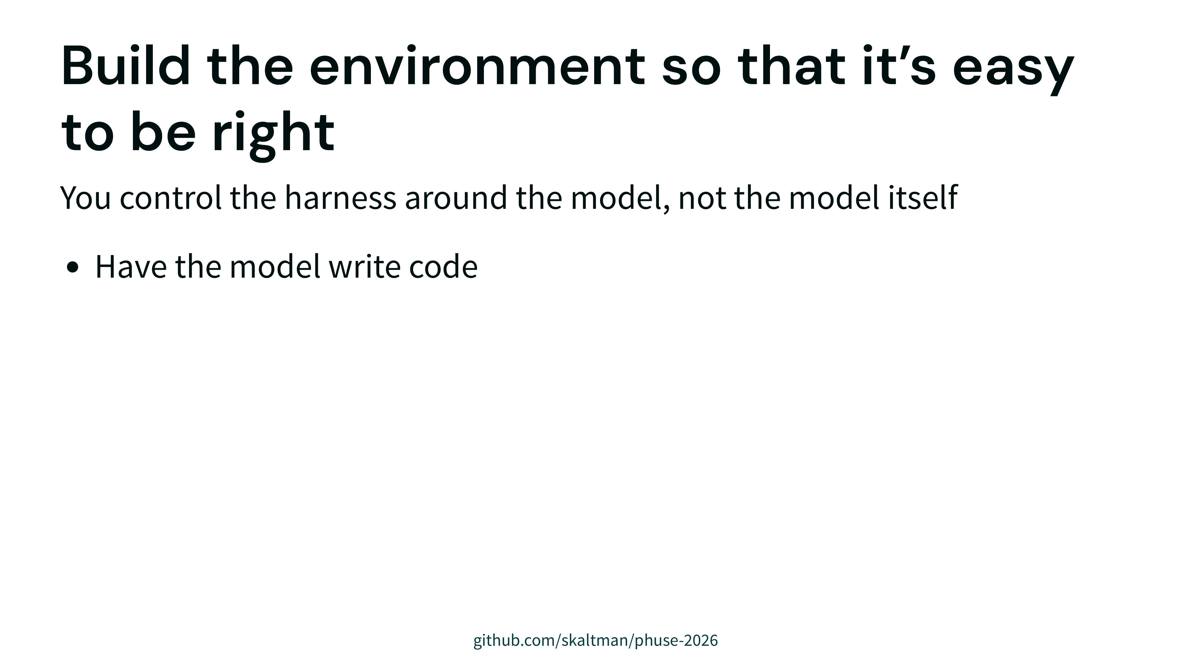
Notes:
build an environment that makes it as likely as possible that your agent will fall into correctness
don't control the model control the harness

Slide 57

Notes:
build an environment that makes it as likely as possible that your agent will fall into correctness
don't control the model control the harness

Slide 58

Notes:
doesn't necessarily need to write code
could imagine an agent...
llms are good at code
we've learned from years of code for analysis...
have the agent write code

Slide 59

Notes:
doesn't necessarily need to write code
could imagine an agent...
llms are good at code
we've learned from years of code for analysis...
have the agent write code

Slide 60

Notes:
doesn't necessarily need to write code
could imagine an agent...
llms are good at code
we've learned from years of code for analysis...
have the agent write code

Slide 61

Notes:
Prompting: prioritize correctness over just moving the analysis forward.
Posit Assistant ... " openness to uncertainty and subtlety, and a commitment to statistical rigor ... Rather than maintaining a feeling of "moving forward," call out ambiguities and unclear results.""
Tools: the ability to run code and see your session.
Context: give it broad access to your files and environment, so it has a good chance at knowing the correct context to solve the problem.

Slide 62

Notes:
Prompting: prioritize correctness over just moving the analysis forward.
Posit Assistant ... " openness to uncertainty and subtlety, and a commitment to statistical rigor ... Rather than maintaining a feeling of "moving forward," call out ambiguities and unclear results.""
Tools: the ability to run code and see your session.
Context: give it broad access to your files and environment, so it has a good chance at knowing the correct context to solve the problem.

Slide 63

Notes:
Prompting: prioritize correctness over just moving the analysis forward.
Posit Assistant ... " openness to uncertainty and subtlety, and a commitment to statistical rigor ... Rather than maintaining a feeling of "moving forward," call out ambiguities and unclear results.""
Tools: the ability to run code and see your session.
Context: give it broad access to your files and environment, so it has a good chance at knowing the correct context to solve the problem.

Slide 64

Notes:
Prompting: prioritize correctness over just moving the analysis forward.
Posit Assistant ... " openness to uncertainty and subtlety, and a commitment to statistical rigor ... Rather than maintaining a feeling of "moving forward," call out ambiguities and unclear results.""
Tools: the ability to run code and see your session.
Context: give it broad access to your files and environment, so it has a good chance at knowing the correct context to solve the problem.

Slide 65

Notes:
performance improves when ...
and it turns out all of this can make a difference even without affecting the underlying model
when we tried interventions in isolation in bluffbench, limited success
by posit assistant largely does better than minimal harness (default bluffbench case)

Slide 66

Notes:
performance improves when ...
and it turns out all of this can make a difference even without affecting the underlying model
when we tried interventions in isolation in bluffbench, limited success
by posit assistant largely does better than minimal harness (default bluffbench case)

Slide 67

Notes:
even with all that, it'll still make mistakes -- humans do, models do -- so make it less bad when it's wrong
again, code as foundation

Slide 68

Notes:
even with all that, it'll still make mistakes -- humans do, models do -- so make it less bad when it's wrong
again, code as foundation

Slide 69

Notes:
probably not enough for the model to write that code
show it to the user when it matters
make it easy to see and read
small things like syntax highlighting, code styling
you don't inspect every time, but if you suspect something went wrong you have the option

Slide 70

Notes:
not only is the model writing code
writing it in a shared environment
it has access to your same r/python session
its not guessing what data you have loaded -- it can see into that data in the same way you can
you can audit its code by running it yourself
it can inspect your objects and rerun code you ran
this turns out to be very useful, especially for data analysis where you are often turning the same object around and looking at it from multiple angles and transforming it
you're seeing eye to eye with the agent, instead of the two of you occupying different worlds

Slide 71

Notes:
so we said the first way to make it less bad if the model is wrong was having it write code
the second way is having it, in some cases, pause and involve the user
posit assistant, during open ended tasks or ones it thinks need user involvement, purposefully slows down and does shorter turns
notice in the screenshot how...
this is in contrast to how it might behave without our harness, which is to move the analysis forward with lots of code and
losing the user and obscuring its uncertainties or deciding its own answers to questions
it should have asked user

Slide 72

Notes:
another reason for this though
for verification and transparency: the human has to keep pace and see eye-to-eye with the agent (same environment).

Slide 73

Notes:
another reason for this though
for verification and transparency: the human has to keep pace and see eye-to-eye with the agent (same environment).

Slide 74


Slide 75


Slide 76


Slide 77


Slide 78


