Slide 1

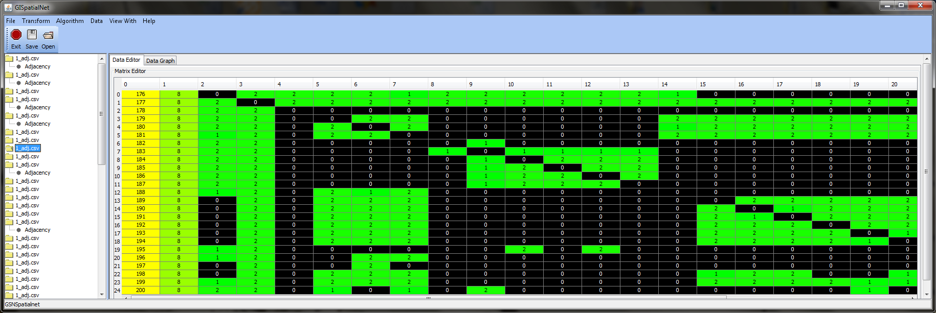
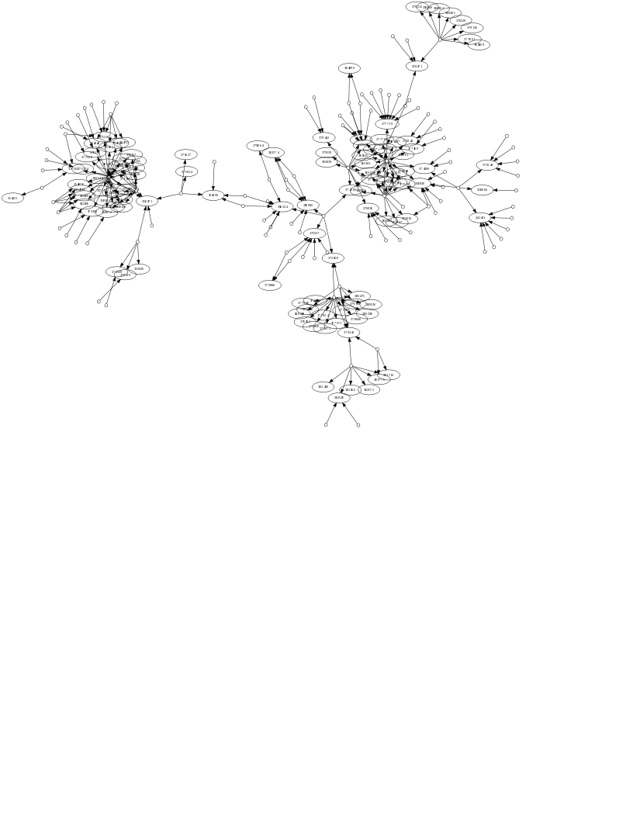

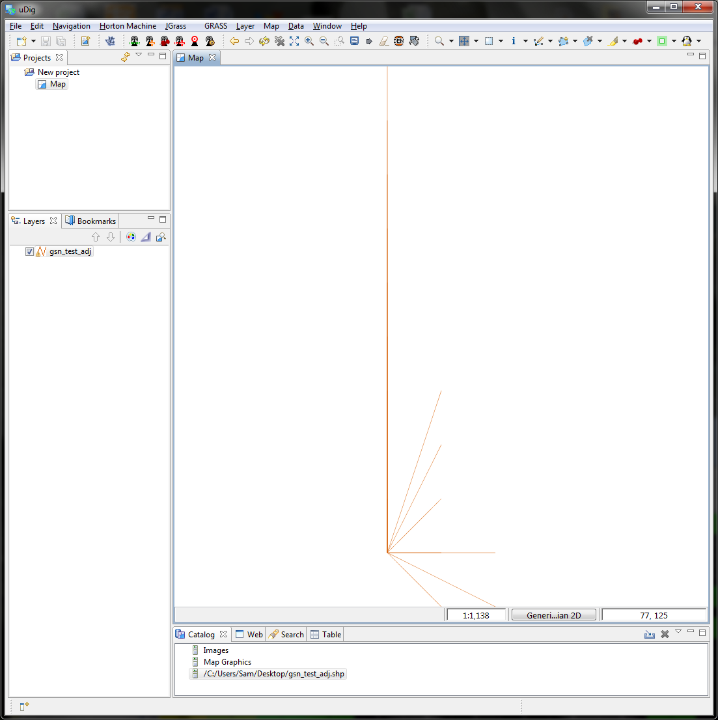




GISpatialNet: GIS Data Representation, Visualization,
and Tool Integration
Samuel C. Tyler, Computer Science
Mentors: Eric Jones, Anthropology
Jan Rychtar, Mathematics
Project Summary
Internal Data Representation
Uses and the Future
The increasing interest in Geographical Information Systems has brought with it an increasing need for GIS-related software. Since there can never be a “be-all, end-all” software program in GIS, we have taken on the task of designing software which:
interacts easily with other program
shows a visual representation of both social networks and physical distances.
Our goal is to create a software application, called GISpatialNet, which can do the following:
import/export data in common file formats
display this data to the user in various ways
modify the data by allowing the user access to it or by running algorithms on it
analyze the data using mathematical algorithms
One of the big challenges of designing software is how to store data so the program can analyze and manipulate it . This task was relatively easy, as the data format which GISpatialNet can read is in a matrix style. A standard matrix is a grid of similar data, such as numbers or letters. GISpatialNet can read files in several formats, including comma-separated value (.csv) , Microsoft Excel (.xls), and DL/UCInet (like csv or xls with extra data) , which are all matrix-style formats.
Since the project needs to work with several matrices simultaneously, we store the data in four matrices per data set: x-coordinates, y-coordinates, adjacencies (connections between nodes), and attributes (extraneous data describing each node).
The image below is a screenshot of GISpatialNet displaying an adjacency matrix (connections between people), which can then be used to build a graph representing this data. Notice how you can determine related nodes (in green) at a glance. This visual display is part of a package of software we use to internally store the matrix data, called “Universal Java Matrix Package,” or UJMP. Another feature of this software is the ease of which it allows us to import data from common file format, which allows us to eliminate a lot of other software requirements.
Most GIS software allows the editing and display of data. GISpatialNet differs from others in that it allows the editing of internal data as it is represented internally. This software also adds clustering analysis to graphs and imports/exports commonly used GIS data formats.
In the future, we will implement more analysis routines, geared towards social connections and spatial relations. We will also implement several visualization routines, including the incorporation of GraphViz, a popular, free program for displaying and manipulating graphs. The image below shows a graph as output by GraphViz.
We also plan on integrating this software into uDig, as a plugin. uDig is based on the same software which was used during GISpatialnet’s development process, the Eclipse platform. Due to its familiarity and popularity, it should be relatively easy to implement the desired plugin.
Implementation
Since we wanted this program to be accessible by as many persons as possible, we released the source code (human-readable version of a computer program) on SourceForge, arguably the most widely used repository of free and open source software (FOSS). Conversely, we incorporated existing open source software into the creation of GISpatialNet.
This program is written in the Java programming language, and will run on Windows, MacOS, Linux, and even some mobile phones, making it the ideal language for wide accessibility.
External Data Representation
The most popular data file format used in Geographical Information Systems is called a shapefile. The shapefile format, an open specification, was created by ESRI for ArcGIS, their commercial suite of GIS software. Since this software is so popular, one of our main goals was to be able to write files in this format for use by other programs. The shapefile specification allows for storing coordinate data, shapes of objects (like lakes and streams), and attributes for each object.
Since we are working with connections between people, we would like to see our spatial data in a visual form. In this image, the data shown in the image above is displayed by uDig, a popular free program used by many government agencies worldwide for all aspects of GIS analysis. This program can import and export many formats of data, including shapefiles. One goal of GISpatialNet is to implement a way to view this graph inside the program.
Algorithm Design
More specifically, GISpatialNet has several built-in algorithms for manipulating relational data which corresponds to spatial data. For instance, we asked “How does distance affect how well people know each other?” In order to answer this, we had to analyze data on the “closeness,” both physical and social, of each person in relation to the others.
During 2009, Eric Jones, Robert Gove, Charles Bevan, Jan Rychtar, and myself worked on those algorithms for analyzing spatial and social relations, as well as a command-line version of GISpatialNet. This year, I have incorporated these features into a Graphical User Interface, which allows for displaying data and analysis results to the user and allowing the user to more easily modify the data.
See Also
GISpatialNet on SourceForge
http://spatialnet.sourceforge.net
The Open Source Geospatial Foundation
http://www.osgeo.org
uDig
http://udig.refractions.net
“Calculating the Size of the ‘Neighborhood’ in Spatial Social Networks” (paper by J. Rychtar, R. Gove, E. Jones, R. Bunch)
http://www.uncg.edu/~j_rychta/MyFiles/preprints/RyJoBuGo09.pdf
ESRI
http://www.esri.com
Eclipse Foundation
http://www.eclipse.org

