Slide 1
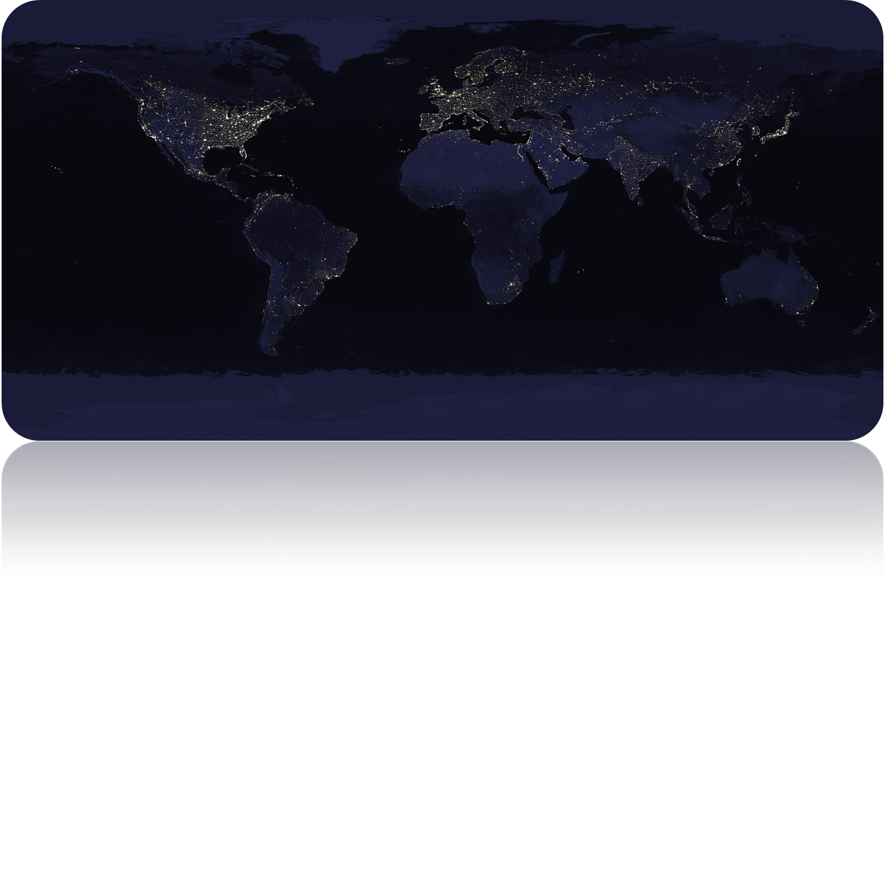


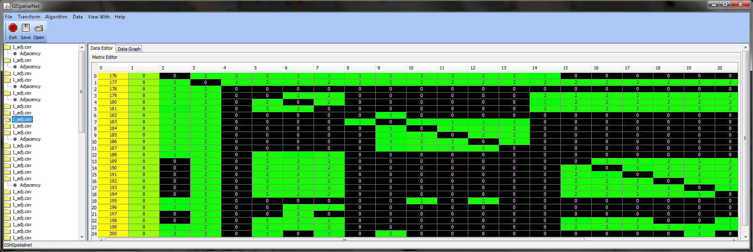
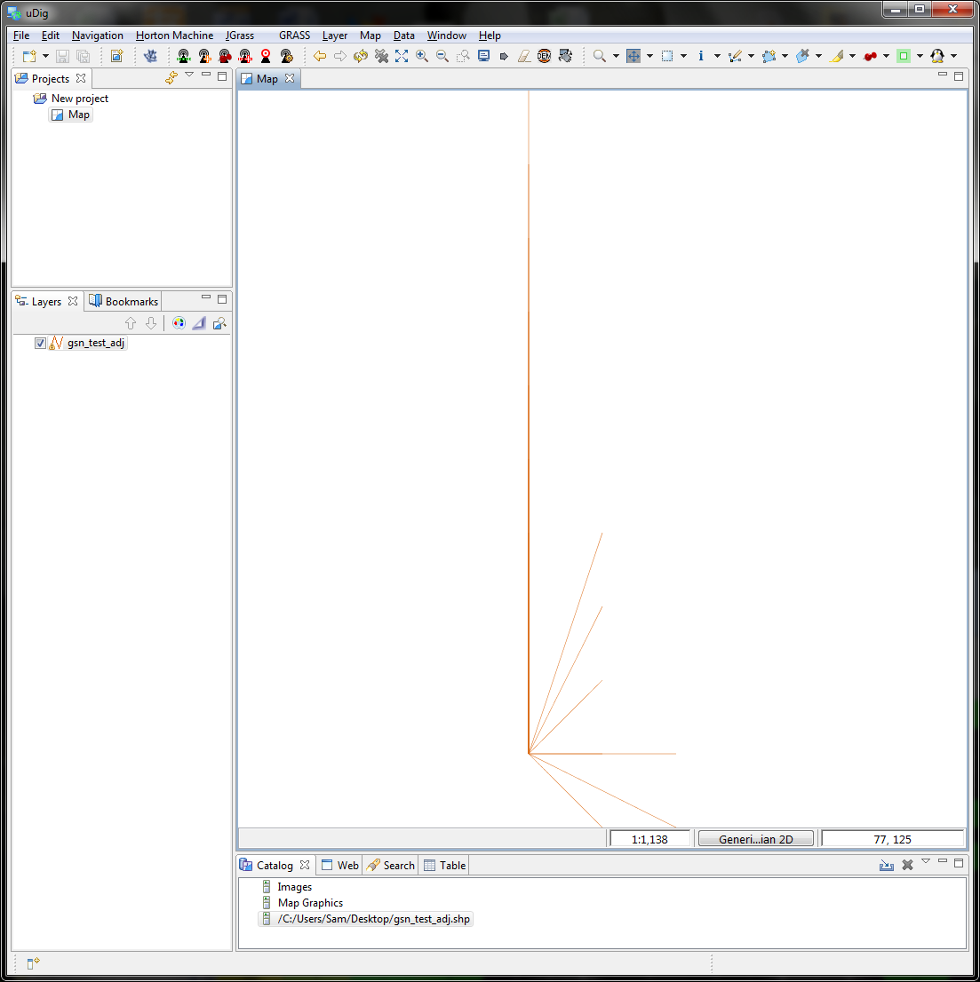
GIS Data Representation, Visualization, and Tool Integration
Samuel C. Tyler
Eric Jones, Anthropology
Introduction
Geo4Win
Java
Materials
See Also
Geo4Win
Java
Method

