Slide 1
Morpheus/Ansible Windows and Unix Deploy

Slide 2
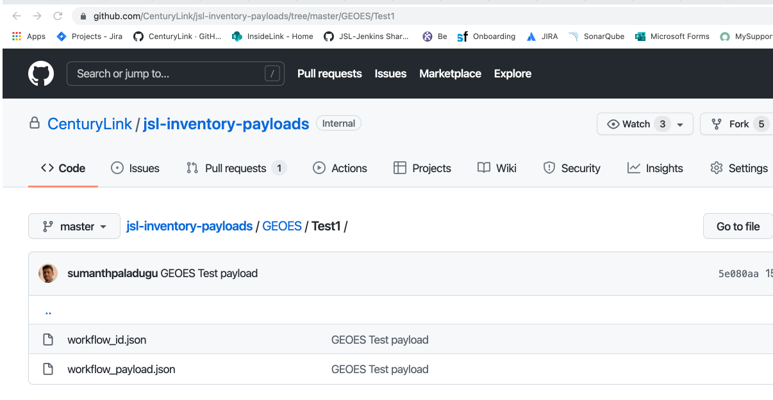
Windows Deploy
Prerequisites:
“ctlansrw” user needs to be added as admin in Windows Servers/Shares.
“ConfigureRemotingForAnsible.ps1” script needs to be run on Windows hosts as Admin to establish connectivity with Ansible.
Adding Inventory:
Inventory payloads needs to be added here(https://github.com/CenturyLink/jsl-inventory-payloads) with Folder structure (MAL/Environment/json files)

Slide 3
workflow_id.json
{
"workflow": 19
}
Workflow ID = 19 For Windows Server Deploy
Work flow ID = 11 For Windows Share deploy

Slide 4
workflow_payload.json
{
"job": {
"customOptions": {
"ansible_hosts":"usomawvdntw004.ctl.intranet,usomawvdntw005.ctl.intranet,usomawvdntw006.ctl.intranet",
"artifact_url": "",
"app_pool": "geoestest1",
"app_site": "'Default Web Site'",
"web_app": "geoestest1",
"host_headers": "geoestest1.test.intranet",
"deploy_dir": "D:\\InetPub\\Approot\\geoestest1\\7.1.0.5",
"env": "test1"
}
}
}
Host Headers (optional):
App Site (optional):
Web App (optional):
App Pool (optional):

Slide 5
Jenkinsfile Deploy Stage
Add Morpheus credentials
MORPHEUS_CREDENTIALS = 'morpheus-secret’
Add Deploy Stage
stage('Deploy') {
agent {
dockerfile {
filename 'Dockerfile'
dir 'cicd/docker/morpheus'
label 'Docker-enabled'
}
}
steps {
script { env.ETS_NEXUS_URL = jslUploadFileToNexus(artifact, path, repo)
jslLoginMorpheus()
jslMorpheusWorkflow(env.ETS_NEXUS_URL, 'Test1', env.PROJECT_MAL)
}
}
}

Slide 6
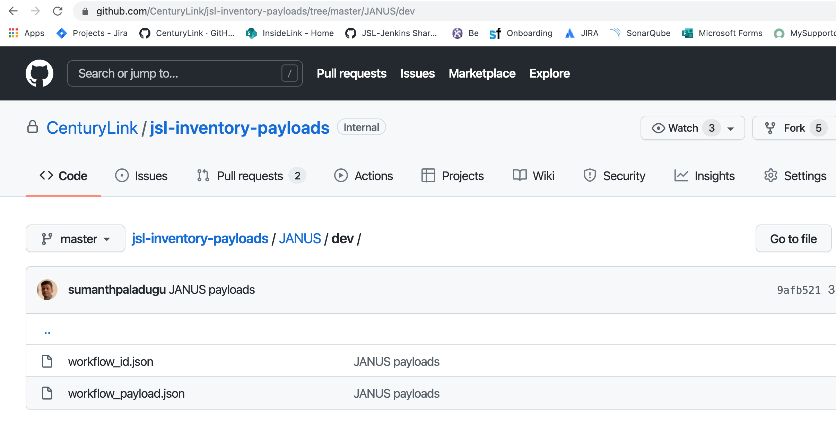
Unix Deploy
Prerequisites:
Unix servers needs to be added in Deployment Coordination Teams Channel(Teams-Channel) . Unix team and Morpheus Team will validate the servers.
Adding Inventory:
Inventory payloads needs to be added here(https://github.com/CenturyLink/jsl-inventory-payloads) with Folder structure (MAL/Environment/json files)

Slide 7
workflow_id.json
{
"workflow": 37
}

Slide 8
workflow_payload.json
{
"job": {
"customOptions": {
"ansible_hosts": "lxomavmtc504.dev.intranet",
"artifact_url": "",
"deploy_script": "/app-imports/janus-dev/builds/bin/deploy_vm.sh",
"deploy_dir": "/app-imports/janus-dev/builds/controlCenter/releases",
"deploy_user": "januslk",
"extract": "off"
}
}
}

Slide 9
Jenkinsfile Deploy Stage
Add Morpheus credentials
MORPHEUS_CREDENTIALS = 'morpheus-secret’
Add Deploy Stage
stage('Deploy') {
agent {
dockerfile {
filename 'Dockerfile'
dir 'cicd/docker/morpheus'
label 'Docker-enabled'
}
}
steps {
script { env.ETS_NEXUS_URL = jslUploadFileToNexus(artifact, path, repo)
jslLoginMorpheus()
jslMorpheusWorkflow(env.ETS_NEXUS_URL, “dev”, env.PROJECT_MAL)
}
}
}

Slide 10
Contacts:
Morpheus/Ansible:
Matthew Brake – matthew.brake@lumen.com
Jonathan Roof - jonathan.roof@lumen.com
Unix :
Sandeep Surve - sandeep.surve@lumen.com
Windows:
Nick Ditallo - nick.ditallo@lumen.com

Slide 11
Thank You

