Slide 1
Time Series Forecasting on Individual Household Electricity Consumption Data
Group 18
Soham Kamble (A20517098)
Pranit Kotkar (A20512027)
Bhavya Chawla (A20516957)

Slide 2
Problem Statement
Given recent power consumption, what is the expected power consumption for the week ahead?
Notes:
2
The goal is to predict total active power usage for each day over the next seven days.
This is a multi-step forecasting problem because it involves predicting multiple future time steps.
The model should consider multiple input variables (multivariate) to forecast the daily power consumption.
This approach is more comprehensive as it takes into account various factors influencing power usage.
A model of this type could be helpful within the household in planning expenditures. It could also be helpful on the supply side for planning electricity demand for a specific household

Slide 3
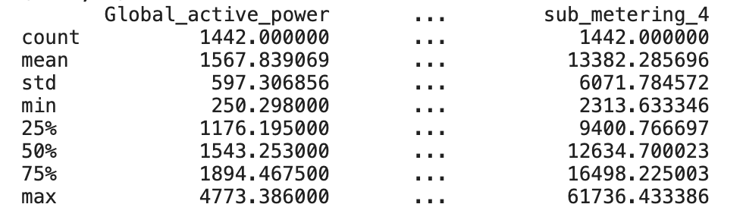
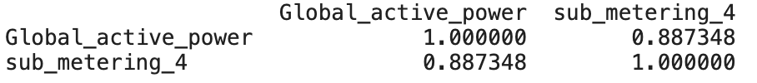
Data-set
The ‘Household Power Consumption‘ dataset is a multivariate time series dataset that describes the electricity consumption for a single household over four years(Dec 2006 to Nov 2010).
sub_metering_4 = (global_active_power * 1000 / 60) - (sub_metering_1 + sub_metering_2 + sub_metering_3)
The current data is recorded per minute, but for the purpose of this model, it's more practical to downsample it to daily totals.
df.shape() => (1442, 8)
df.describe() =>
Notes:
3
2075259 data points
global_active_power: The total active power consumed by the household (kilowatts).
global_reactive_power: The total reactive power consumed by the household (kilowatts).
voltage: Average voltage (volts).
global_intensity: Average current intensity (amps).
sub_metering_1: Active energy for kitchen (watt-hours of active energy).
sub_metering_2: Active energy for laundry (watt-hours of active energy).
sub_metering_3: Active energy for climate control systems (watt-hours of active energy).
A fourth sub-metering variable represents the remainder of the total active energy after accounting for the energy recorded by the first three sub-meters. This is calculated as:
High correlation in a multivariate LSTM can lead to redundant information, increasing the risk of overfitting and making the model less efficient and interpretable.

Slide 4
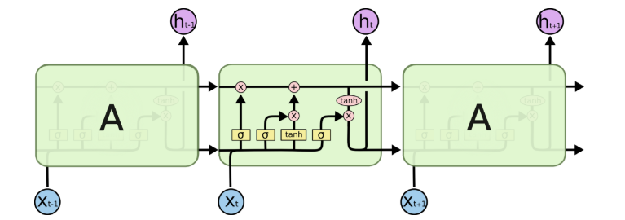
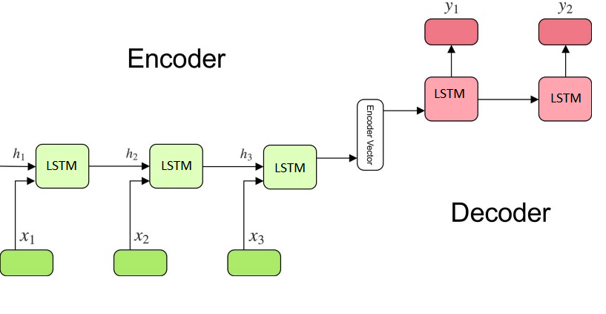
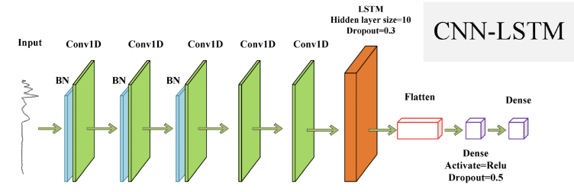
Algorithms
Conv-LSTM
Encoder-Decoder LSTM
CNN-LSTM
Notes:
4
We will use the first three years of data for training predictive models and the final year for evaluating models.
The data in a given dataset will be divided into standard weeks. These are weeks that begin on a Sunday and end on a Saturday.
LSTMs (Long Short-Term Memory networks) are uniquely suited for multi-step time series forecasting due to their inherent ability to process sequence data, handle multivariate inputs efficiently, and directly map these inputs to a vector output representing multiple future time steps.
An encoder-decoder LSTM is a model comprised of two sub-models: one called the encoder that reads the input sequences and compresses it to a fixed-length internal representation, and an output model called the decoder that interprets the internal representation and uses it to predict the output sequence.
A popular approach has been to combine CNNs with LSTMs, where the CNN is as an encoder to learn features from sub-sequences of input data which are provided as time steps to an LSTM. This architecture is called a CNN - LSTM.
A power variation on the CNN LSTM architecture is the ConvLSTM that uses the convolutional reading of input subsequences directly within an LSTM’s units. This approach has proven very effective for time series classification and can be adapted for use in multi-step time series forecasting.

Slide 5
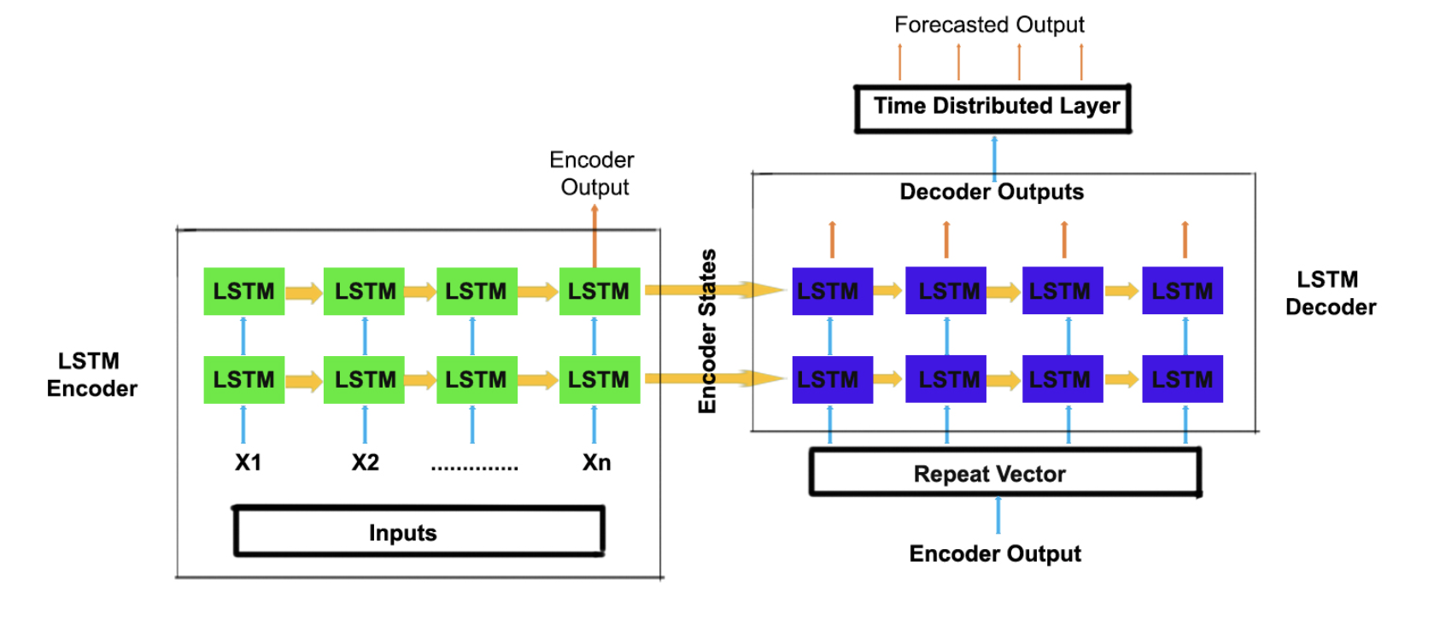
Encoder-Decoder LSTM Model
A 200-unit LSTM encoder was utilized to process 14-day inputs for effective feature extraction, complemented by a 200-unit LSTM decoder to ensure detailed full-sequence output.
TimeDistributed Dense layers, initially comprising 100 units followed by a singular unit, were implemented to facilitate sophisticated interpretation of the LSTM output.
The output data was meticulously reshaped into the format [samples, timesteps, features], a crucial step for ensuring seamless model integration.
Multivariate inputs were integrated to enhance forecasting accuracy.
Notes:
5
Model Parameters:
Epochs: Set to 20, indicating the number of times the entire training dataset will pass through the model.
Batch Size: Defined as 16, this is the number of samples processed before the model is updated.
Verbosity: Set to 0 for silent mode during training.
Input and Output Shapes:
Time Steps (n_timesteps) and Features (n_features) are derived from train_x.
Output Shape (n_outputs) is obtained from train_y.
Output Reshaping: The output data train_y is reshaped to [samples, timesteps, features] to align with LSTM requirements.
Model Architecture:
Initial LSTM Layer: 200 units with 'relu' activation, processing input shaped as [time steps, features].
Repeat Vector: Repeats the input n_output times.
Second LSTM Layer: Another 200 units with 'relu' activation, returning sequences for further processing.
TimeDistributed Dense Layers: First with 100 units (relu activation), followed by a final dense layer with 1 unit for output.
Compilation and Loss Function: The model is compiled with the 'adam' optimizer and 'mse' (mean squared error) as the loss function.
Model Training: The model is trained using the prepared train_x and train_y, with the specified epochs and batch size.
Model Output: The final slide can show the model’s architecture or an example of predictions made by the model, demonstrating its practical application.

Slide 6
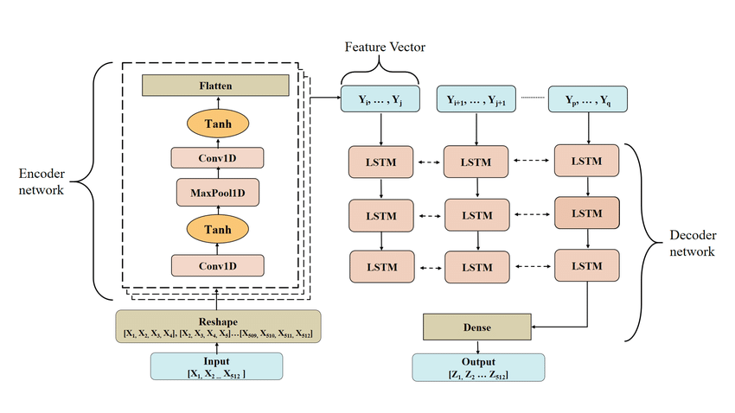
CNN-LSTM Encoder-Decoder Model
Combined CNN with LSTM in an Encoder-Decoder structure, encoding and recognizing patterns in time series data.
Analyzed 14-day sequences of daily power consumption data, with the CNN identifying key features for LSTM interpretation.
The CNN was equipped with two layers and max pooling for spatial patterns; LSTM processed temporal dependencies from CNN's output.
Aimed to recognize complex patterns in time series through spatial-temporal analysis, enhancing understanding of data dynamics with CNN-LSTM synergy.
Trained for 20 epochs with a batch size of 16, using the MSE loss function and the Adam optimizer.
Notes:
1. Model Overview:
Our approach combines Convolutional Neural Networks (CNN) with Long Short-Term Memory (LSTM) networks in an Encoder-Decoder architecture.
The CNN acts as the encoder, automatically learning salient features from the univariate time series input.
2. Data Preprocessing:
We're using daily total power consumption data, structured as sequences of 14 days.
The CNN reads across these sequences, identifying important features, which are then interpreted by the LSTM decoder.
3. Model Architecture:
The CNN encoder consists of two convolutional layers followed by max pooling to capture spatial patterns efficiently.
The flattened output serves as input to the LSTM decoder, which processes the temporal dependencies in the sequence.
4. Expected Impact on Results:
By leveraging both spatial and temporal information, our model is expected to capture complex patterns in the time series.
The hybrid CNN-LSTM architecture aims to enhance the model's understanding of the underlying data dynamics.
5. Training Details:
The model is trained for 20 epochs with a batch size of 16.
We use the mean squared error (MSE) loss function and the Adam optimizer for training. *****More on model arch and role of each layer:
1. Input Layer:
Description:
The input to the model consists of univariate time series data representing daily total power consumption.
Each data point in the time series corresponds to the power consumed on a specific day.
2. Convolutional Neural Network (CNN) Encoder:
a. First Convolutional Layer:
Task:
Convolution Operation: The layer performs convolution operations on the input sequence.
Filters and Kernel Size: 64 filters are applied to the input sequence, each with a kernel size of 3 time steps.
Activation Function: The Rectified Linear Unit (ReLU) activation function is applied element-wise.
b. Second Convolutional Layer:
Task:
Convolution Operation: Similar to the first layer, this layer further captures spatial patterns.
Filters and Kernel Size: Again, 64 filters with a kernel size of 3 are applied.
Activation Function: ReLU is applied.
c. Max Pooling Layer:
Task:
Pooling Operation: The layer performs max pooling, reducing the spatial dimensions of the feature maps.
Pool Size: A pooling window of size 2 is used, keeping the maximum value within each window.
d. Flatten Layer:
Task:
Data Transformation: The flattened layer transforms the 2D feature maps into a 1D vector.
Output: This vector serves as the compressed representation of the spatial features extracted by the CNN encoder.
3. Long Short-Term Memory (LSTM) Decoder:
a. RepeatVector Layer:
Task:
Data Replication: The RepeatVector layer replicates the flattened vector to match the desired number of time steps for the output sequence.
Output: This repetition prepares the data for input into the LSTM layer.
b. LSTM Layer:
Task:
Temporal Dependency Processing: The LSTM layer processes the input sequence, capturing temporal dependencies and patterns.
Number of Units: 200 LSTM units are used.
Activation Function: ReLU is applied, introducing non-linearity to the model.
Return Sequences: Set to True to return sequences, as we are dealing with sequence-to-sequence forecasting.
c. TimeDistributed Dense Layers:
Task:
Dense Layer: Two TimeDistributed Dense layers follow the LSTM layer.
Activation Function: ReLU is applied to the first Dense layer, introducing non-linearity.
Output Layer Activation: Linear activation is used in the final Dense layer.
4. Model Output:
Task:
Output Prediction: The final output is a sequence of predicted values for the future time steps.
Training Objective: The model is trained to minimize the Mean Squared Error (MSE) loss between the predicted and actual values.
Summary:
CNN Encoder: Captures spatial patterns and features from the input sequence.
LSTM Decoder: Processes temporal dependencies and generates predictions.
Output Layer: Produces a sequence of predicted values.
The combined architecture is trained end-to-end to effectively learn and forecast the future power consumption based on historical data. The interplay between the CNN and LSTM layers allows the model to capture both spatial and temporal dependencies in the univariate time series.

Slide 7
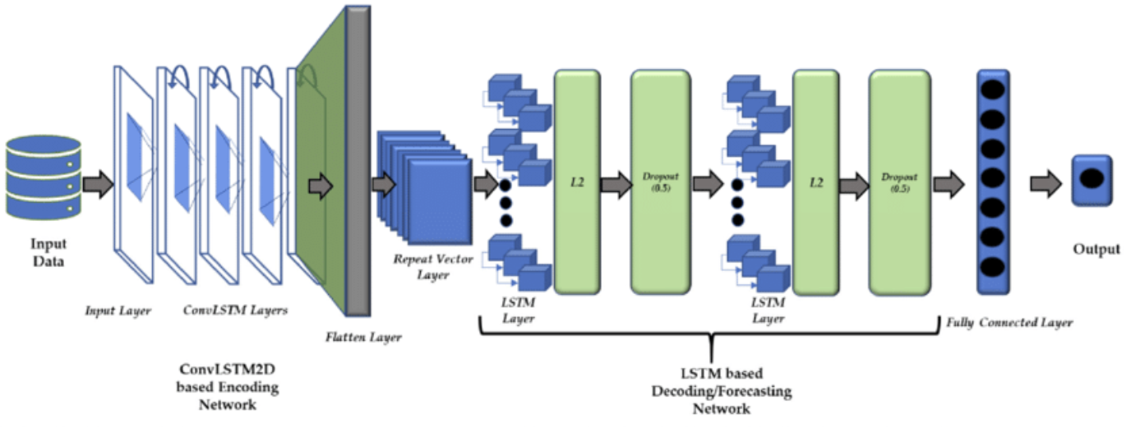
ConvLSTM Encoder-Decoder Model
The ConvLSTM model combines convolutions directly into LSTM units, differing from traditional LSTMs and CNN-LSTMs, making it suitable for spatio-temporal data analysis.
The model is implemented using the ConvLSTM2D class in Keras, designed for handling 2D data in time series forecasting.
Input data is reshaped into a specific format [samples, timesteps, rows, cols, channels], with subsequences created from longer time series data for effective processing.
The ConvLSTM model architecture includes a ConvLSTM2D layer, followed by flattening, LSTM, and Dense layers, with the model accommodating parameterized subsequences for flexibility.
The model's performance is evaluated using real-world datasets, with experimentation showing that using two convolutional layers enhances model stability compared to a single layer.
Notes:
Unlike an LSTM that reads the data in directly in order to calculate internal state and state transitions, and unlike the CNN-LSTM that is interpreting the output from CNN models, the ConvLSTM is using convolutions directly as part of reading input into the LSTM units themselves.
We are working with a one-dimensional sequence of total power consumption, which we can interpret as one row with 14 columns, if we assume that we are using two weeks of data as input.
For the ConvLSTM, this would be a single read: that is, the LSTM would read one time step of 14 days and perform a convolution across those time steps.
This is not ideal.
Instead, we can split the 14 days into two subsequences with a length of seven days. The ConvLSTM can then read across the two time steps and perform the CNN process on the seven days of data within each.
For this chosen framing of the problem, the input for the ConvLSTM2D would therefore be:
Samples: n, for the number of examples in the training dataset.
Time: 2, for the two subsequences that we split a window of 14 days into.
Rows: 1, for the one-dimensional shape of each subsequence.
Columns: 7, for the seven days in each subsequence.
Channels: 1, for the single feature that we are working with as input.
We can then define the encoder as a ConvLSTM hidden layer followed by a flatten layer ready for decoding.
Today, I'll introduce an innovative approach to multi-step time series forecasting using theConvLSTM. This model uniquely combines the spatial feature extraction capabilities of CNNs with the temporal sequencing strength of LSTMs. Our focus is on 1D sequence data, specifically power consumption, which we handle through a five-dimensional input structure. This structure includes samples, timesteps, and channels, tailored to fit our data's characteristics.
In our model configuration, we use the ConvLSTM2D layer. This layer is a powerhouse, performing convolutions within LSTM units, enabling our model to learn complex spatio-temporal patterns. The architecture of our model is a blend of ConvLSTM2D and traditional LSTM layers, with additional layers like Flatten and TimeDistributed to process the data effectively for multi-step forecasting.
A critical aspect of our approach is data preparation. We reshape our data into subsequences, fitting the model's input requirements. This preparation is key to capturing the nuances of power consumption over time. Finally, our forecast function is fine-tuned to leverage this reshaped data, ensuring accurate and reliable predictions. This ConvLSTM model is not just a step forward—it's a leap in time series forecasting, blending spatial and temporal analysis for unprecedented insight and accuracy.
This innovative model combines the best of two worlds - the spatial feature extraction of CNNs and the time sequencing abilities of LSTMs. We're focusing on one-dimensional data like power consumption, using a special input format that includes samples, timesteps, and channels, tailored for our specific data. At the core of our model is the ConvLSTM2D layer. This layer is key because it performs convolutions right inside the LSTM units. This means our model can learn complex patterns that change over both space and time. The architecture of our model includes both ConvLSTM2D and regular LSTM layers, along with Flatten and TimeDistributed layers to effectively handle multi-step forecasting. One important part of our process is how we prepare our data. We reshape our power consumption data into smaller parts that fit the model's needs. This is crucial for accurately capturing how power usage changes over time and ensuring our predictions are both precise and dependable.

Slide 8
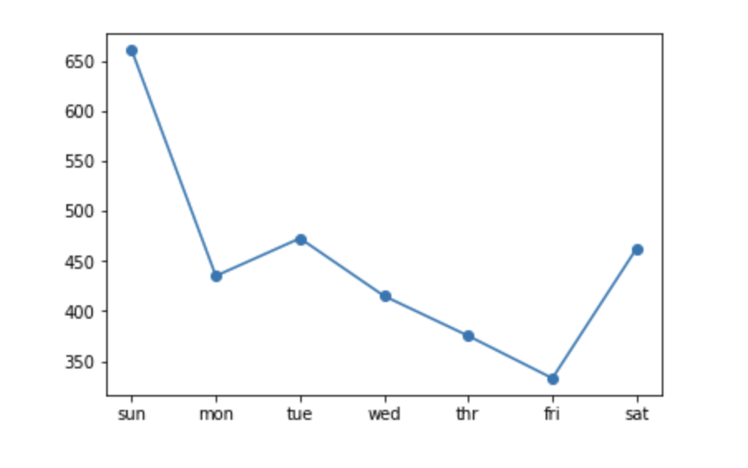
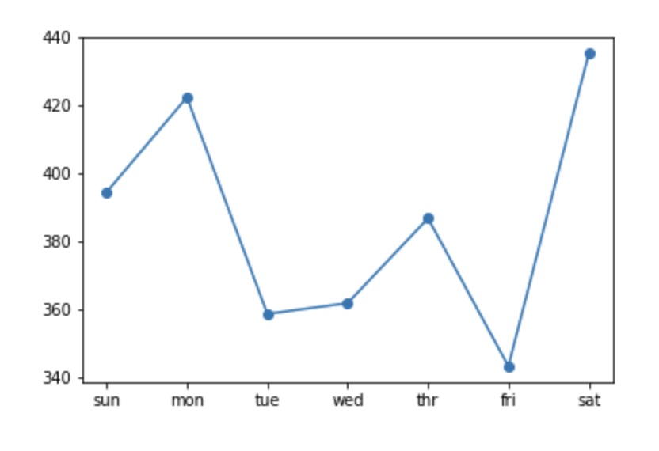
Evaluation Metrics
Mean Absolute Error - Forecasting Accuracy
Root Mean Squared Error - Sensitive to outliers
Mean Absolute Percentage Error - Relative Error
Symmetric Mean Absolute Percentage Error - Zero Values.
Coefficient of Determinant(R-squared) - overall measure.
Encoder-Decoder LSTM Model
CNN-LSTM Encoder-Decoder Model
Notes:
We will be using several evaluation metrics to check how good our forecasts are: Mean Absolute Error for average errors, Root Mean Squared Error for pointing out impact of outliers, Mean Absolute Percentage Error to tell us about the relative errors (errors compared to real values), Symmetric Mean Absolute Percentage Error for handling of zero values, and R-squared for overall predictive power. As you can see these are the per day RMSE plots for Encoder-Decoder LSTM and CNN-LSTM models.

Slide 9
References
Gers, F.A., Eck, D., Schmidhuber, J. (2001). Applying LSTM to Time Series Predictable through Time-Window Approaches. In: Dorffner, G., Bischof, H., Hornik, K. (eds) Artificial Neural Networks — ICANN 2001. ICANN 2001. Lecture Notes in Computer Science, vol 2130. Springer, Berlin, Heidelberg. https://doi.org/10.1007/3-540-44668-0_93
Hebrail,Georges and Berard,Alice. (2012). Individual household electric power consumption. UCI Machine Learning Repository. https://doi.org/10.24432/C58K54.
Shi et. al., Convolutional LSTM Network: A Machine Learning Approach for Precipitation Nowcasting, arXiv:1506.04214
Sepp Hochreiter, Jürgen Schmidhuber; Long Short-Term Memory. Neural Comput 1997; 9 (8): 1735–1780. doi: https://doi.org/10.1162/neco.1997.9.8.1735
Sutskever et. al., Sequence to Sequence Learning with Neural Networks, arXiv:1409.3215
Kingma et. al., Adam: A Method for Stochastic Optimization, arXiv:1412.6980
Sainath, T. N., Vinyals, O., Senior, A., & Sak, H. (2015). Convolutional, Long Short-Term Memory, fully connected Deep Neural Networks. 2015 IEEE International Conference on Acoustics, Speech and Signal Processing (ICASSP).

