Slide 1
IMMUNIchain A Blockchain Network
Kevin Lee
Undergraduate Researcher
University of Illinois at Urbana-Champaign
Some slides adapted from blockchain presentations by Alex Kim, Jin VanStee, and the IMMUNIchain WSC team

Slide 2
Special Thanks
Mentoring Team
Len Santalucia, CTO, Business Development Manager - Vicom Infinity, Inc.
Jin VanStee, Transformation Leader, NA z Systems Technical Sales - IBM
David Rossi, Cybersecurity Architect - IBM
Alex Kim, System z Solutions Architect - Vicom Infinity, Inc.
Mike Bonett, Executive I/T Specialist - IBM
Mark Rader, Certified I/T Specialist - IBM
Guy Shevik, Cerified I/T Consultant - IBM
Suzie Wendler, IMS Support - IBM
Barry Silliman, IBM Sales & Distributions, zGrowth Team - IBM
Eva Yan, Executive I/T Specialist - IBM
David Morlitz, IBM Architectural Thought Leader - IBM
Qi Ye, LinuxONE Community Cloud Architect - IBM

Slide 3
A Crash Course on Blockchain
A digital ledger in which transactions are recorded chronologically and publically
My own experience: cryptocurrency researcher at the Decentralized Systems Lab with Dr. Andrew Miller
Hyperledger Fabric
Distributed/shared database with a consensus network
Permission-oriented membership enrollment
Business rules in the network (smart contract)
Cryptographically secure
Cross-platform capability, including mainframe
Notes:
Ask: Does anyone know what blockchain is? Sell myself
IBM Blockchain based on Hyperledger Fabric from the Linux Foundation
Hyperledger, an open source collaborative effort to advance cross-industry blockchain technologies, is hosted by The Linux Foundation®. IBM provides blockchain solutions and services leveraging Hyperledger technologies, including Hyperledger Fabric and Hyperledger Composer.
Hyperledger Fabric is a business blockchain framework hosted by the Linux Foundation intended as a foundation for developing blockchain applications or solutions with a modular architecture. Hyperledger Fabric allows components such as consensus and membership services to be plug-and-play.

Slide 4
Under the Hood
Hyperledger deploys the following open source technologies:
GoLang, Java, Node.js - provides runtime for Chaincode
Docker/Vagrant - encapsulates Chaincode in a secure manner
gRPC - enables the peer-to-peer network
golevelDB/CouchDB - persistent state database using a key-value store interface
PKI/TLS - for certificate authority and secure transmission/authentication

Slide 5
What is Hyperledger Composer?
Blockchains provide a low-level interface for business applications
Smart contract code runs on a distributed processing system
Inputs go into an immutable ledger; outputs to a data store
Applications are built on top of a low level of abstraction
Hyperledger Composer
A suite of high level application abstractions for business networks
Emphasis on business-centric vocabulary for quick solution creation
Features
Model your business network, test and deploy
Applications use APIs to interact with a business network
Integrate existing systems of record using loopback/REST
Notes:
Open Tools, APIs and libraries to support these activities
Exploits Hyperledger Fabric blockchain technology
Accepted as an official Linux Foundation Hyperledger project

Slide 6
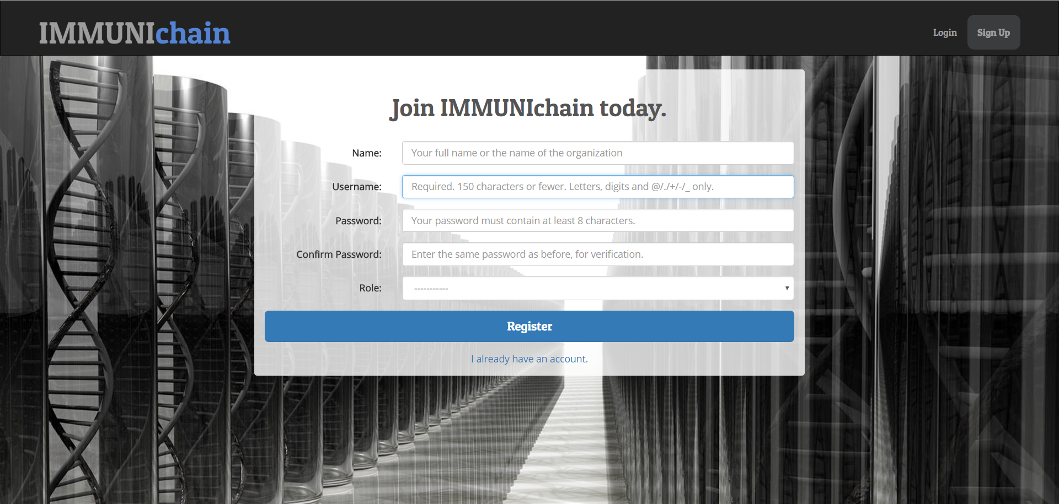
Demo
Also available here: https://immunichain.zcloud.marist.edu

Slide 7
Introducing IMMUNIchain
Designed by Suzie Wendler, Guy Shevik, Mark Rader and Mike Bonett from the IBM Washington Systems Center, won an internal Blockchain Hackathon
The challenge
A child's immunization record is one that:
Is updated and maintained (annually) by only medical providers
Is kept by guardians who ensure that the child is immunized
Conforms to the requirements defined by the CDC/state/school district
Is requested/required by:
Schools on an annual basis
Summer camps, athletic programs, etc.
Today, when requested, the record:
Must be current with the most recent updates
Is usually provided as a paper printout
Is mailed/delivered/faxed to different organizations throughout the year (could be multiple times)
Notes:
When needed, it is transferred between providers
Different states have different requirements

Slide 8
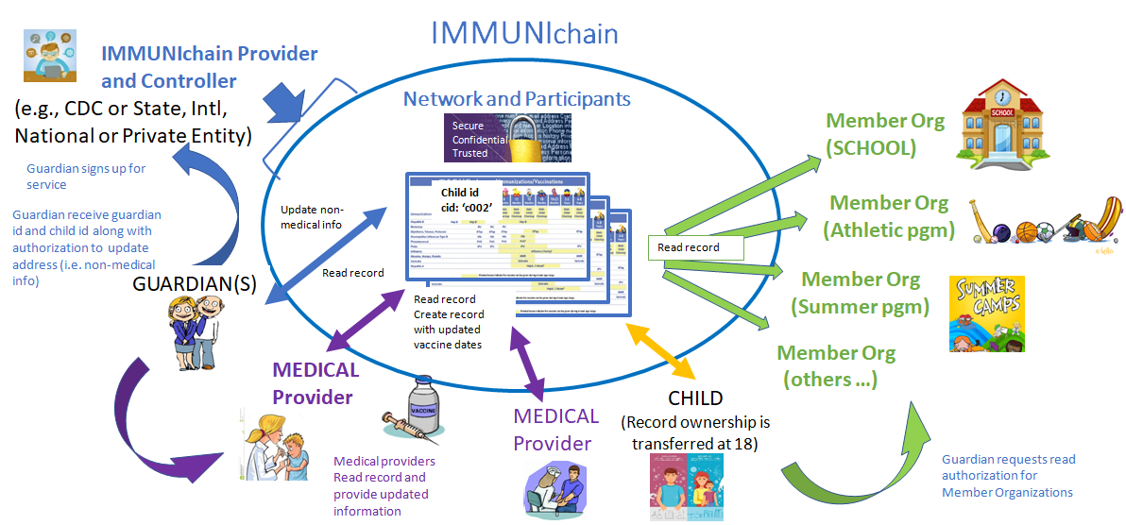
The Solution - Streamlined, Fast, Secure
A blockchain allowing doctors/medical practitioners to provide updated records of the child's immunizations. Guardians may authorize service providers (member) to view the record.

Slide 9
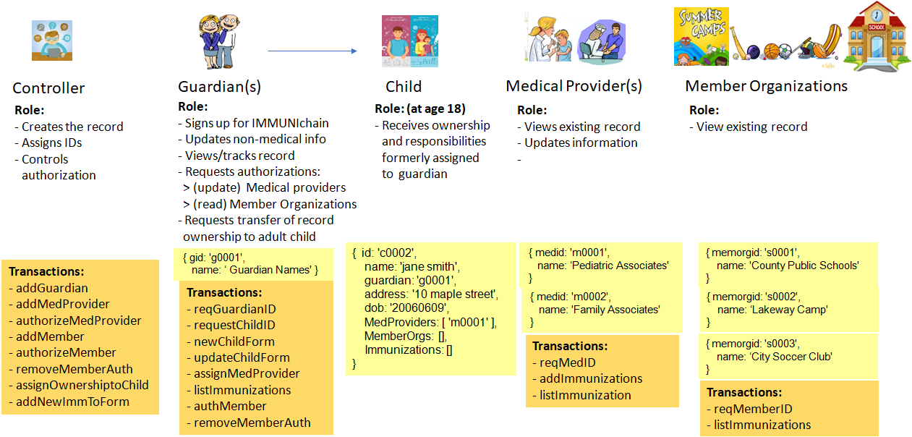
Participants, Roles, and Transactions

Slide 10
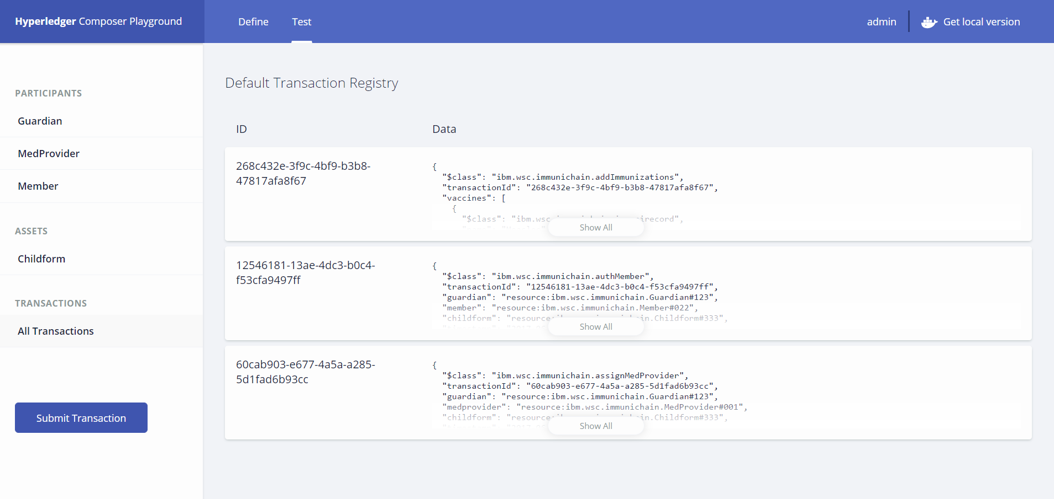
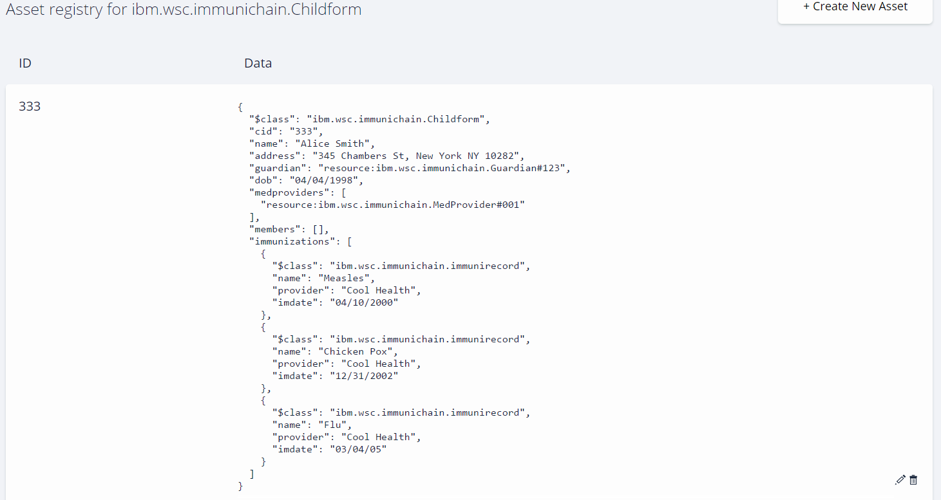
Development
Set up Hyperledger Composer on a LinuxONE Community Cloud instance running SLES12 SP2
Used Composer Playground to define the assets, participants, transactions, and permissions for the IMMUNIchain network.
Locally tested the business network and made necessary adjustments.

Slide 11
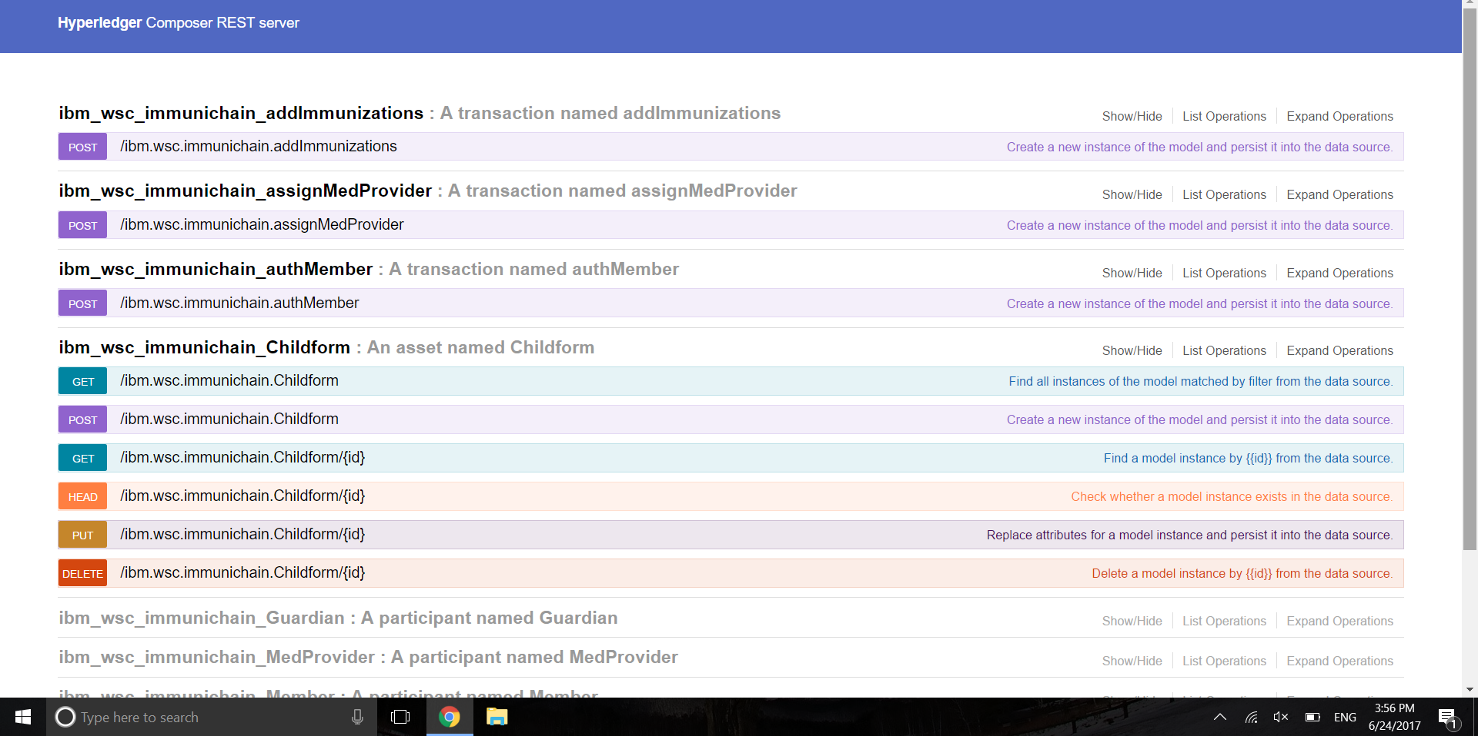
Development (cont’d)
Exported the business network as a business network archive (.bna), and deployed it onto a running Fabric v1.0.0-beta on the SLES12 image.
Tested the updated business network model on Fabric v1.0.0-beta to verify its correctness.
Used the REST APIs created and exposed by the Composer REST Server to make transactions within the IMMUNIchain network

Slide 12
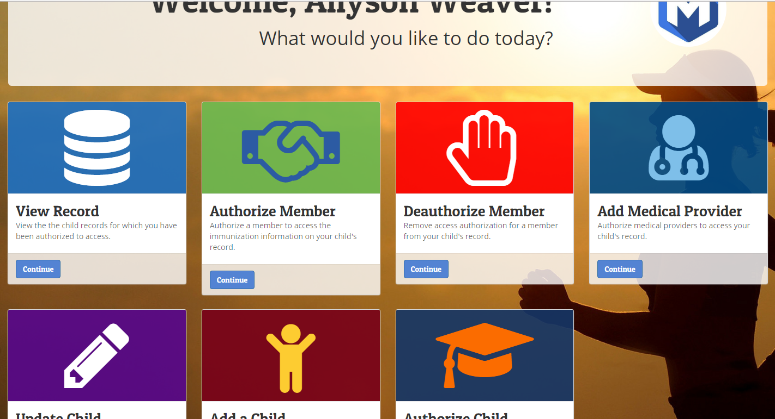
Development (cont’d)
Used the REST APIs from Composer REST Server to develop a front-end web application using Django Python Framework to interact with the IMMUNIchain network running on Fabric
Used Apache HTTP Server on Linux on z to bring up a webserver for the IMMUNIchain network which interacts with Django.
SSL enabled the web server and acquired a domain name.

Slide 13
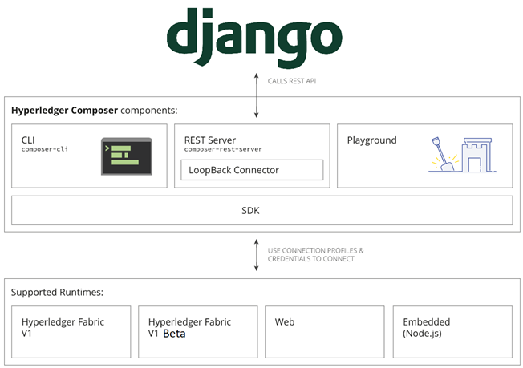
Structure of Setup
Beta

Slide 14
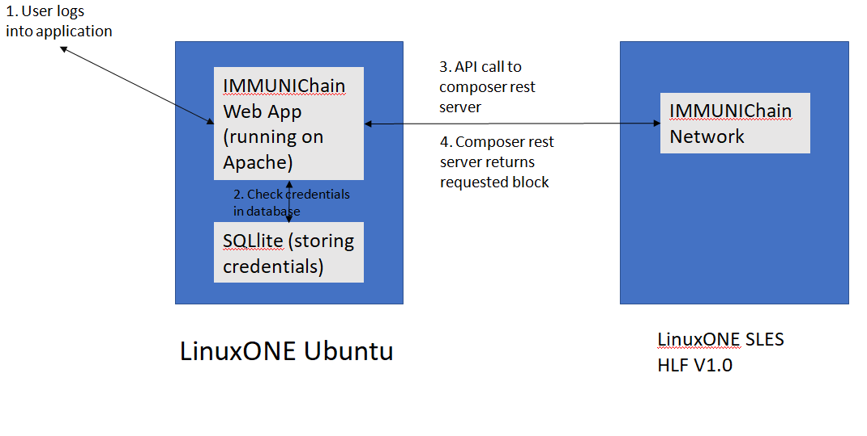
Structure of Setup (cont’d)

Slide 15
Future Developments
Add a mobile app for IMMUNIchain
Create a controller view
Let users view which block their transaction is in.
Future bidirectional integration with z/OS health care application via z/OS Connect v3.
Notes:
Many large applications on zOS, some data already on IMMUNIchain and some not on IMMUNIchain. Enabling read from zOS onto the blockchain. Not isolated.

Slide 16
Questions?

Slide 17
Thank you!
Email: klee160@illinois.edu
LinkedIn: linkedin.com/in/klee160

Slide 18
IMMUNIchain A Blockchain Network
Appendix - Backup Charts
Kevin Lee
University of Illinois at Urbana-Champaign

Slide 19
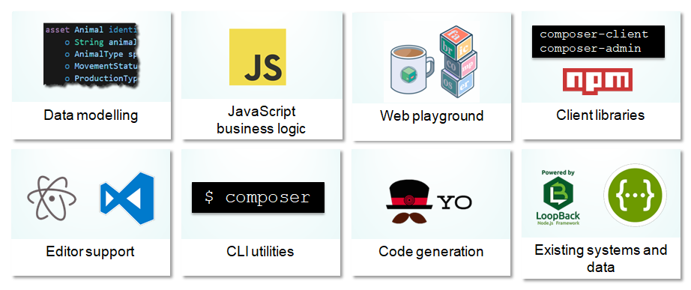
Extensive, Familiar, Open Development Toolset
Notes:
Benefits of Fabric Composer (vs Golang)
Increases understanding
Bridges simply from business concepts to blockchain
Saves time
Develop blockchain applications more quickly and cheaply
Reduces risk
Well tested, efficient design conforms to best practice
Increases flexibility
Higher level abstraction makes it easier to iterate

Slide 20
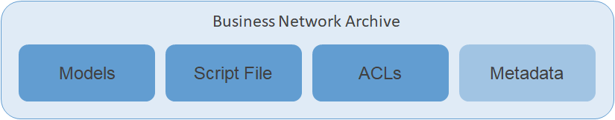
Conceptual Components and Structure
Business Network is defined by Models, Script Files, ACLs and Metadata and packaged in a Business Network Archive
Notes:
Solution Developer models the business network, implements the script files that define transaction behaviour and packages into a business network archive
Solution Administrator provision the target environment and may manage deploy

Slide 21
Business Use Cases & Sample Networks
Sample networks developed using HyperLedger Composer (tested and deployed)
Trading (Marbles Trading App)
Auctions (Car Auction Network)
Asset Tracking (Animal Tracking Network)
Buy and Sell (Digital Property App)
Healthcare (IMMUNIchain)

Slide 22
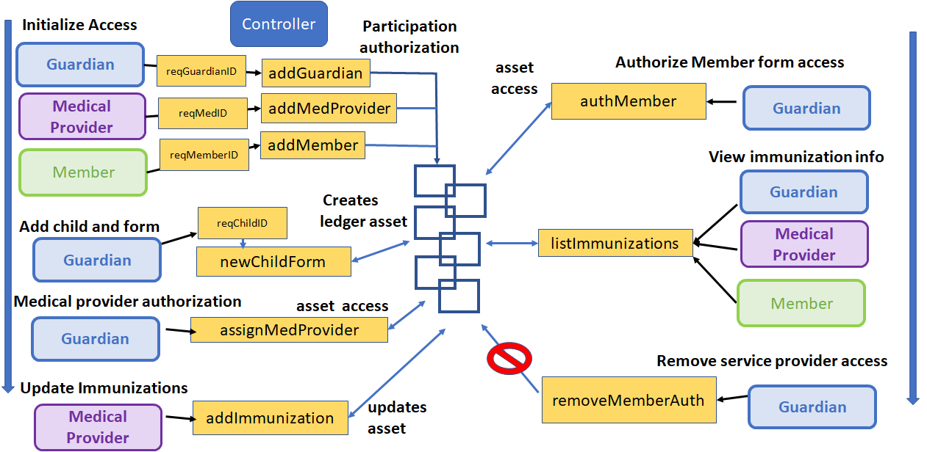
Process Flow

