Slide 1
Vehicle Parking Management System Developed in PHP & MySQL

Slide 2
Abstract
Vehicle Parking Management System maintains a good record of vehicles check in and checkout time. Both two wheeler & four wheeler can be managed by this system and have different pricing system.
Vehicle parking management system that enables the time management and control of vehicles by using parking number.
The system that will track the entry and exit of vehicles, maintain a listing of vehicle within the parking lot, and determine the parking and it will also determine the cost of parking of vehicle.

Slide 3
Introduction
Vehicle Parking Management system is a web-based technology that will manage the records of the incoming and outgoing vehicles in an parking house. It’s an easy for Admin to retrieve the data if the vehicle has been visited through number he can get that data. Vehicle parking management system is an automatic system which delivers data processing in very high speed in systematic manner.
In VPMS we use PHP and MySQL database. This is the project which keeps records of the vehicle which is going to park in the parking area. VPMS has two module admin and user.
User
Admin

Slide 4
Admin Module
Dashboard: In this sections, admin can briefly view the number of vehicle entries in a particular period.
Category: In this section, admin can manage category (add/update/delete).
Add Vehicle: In this section, admin add vehicle which is going to park.
Manage Vehicle: In this section, admin can manage incoming and outgoing vehicle and admin can also add parking charges and his/her remarks.
Reports: In this section admin can generate vehicle entries reports between two dates.
Search: In this section, admin can search a particular vehicle by parking number.
Admin can also update his profile, change the password and recover the password.

Slide 5
User Module
Home: It is welcome page for user.
Dashboard: It is welcome page for an users.
View Vehicle: In this section, users view the details of vehicle parking which is parked by him/her.
Users can also update his profile, change the password and recover the password.
.

Slide 6
Requirement Specification
Hardware Configuration:
Client Side
Server Side
RAM | 512 MB
Hard Disk | 10GB
Processor | 1.0 GHz
RAM | 1 GB
Hard Disk | 20GB
Processor | 2.0GHz

Slide 7
Continue.....
Software Requirement:
Client Side
Server Side
Web Browser | Google Chrome or any compatible browser
Operating System | Windows or any equivalent OS
Web Server | APACHE
Server side Language | PHP5.6 or above version
Database Server | MySQL
Web Browser | Google Chrome or any compatible browser
Operating System | Windows or any equivalent OS

Slide 8
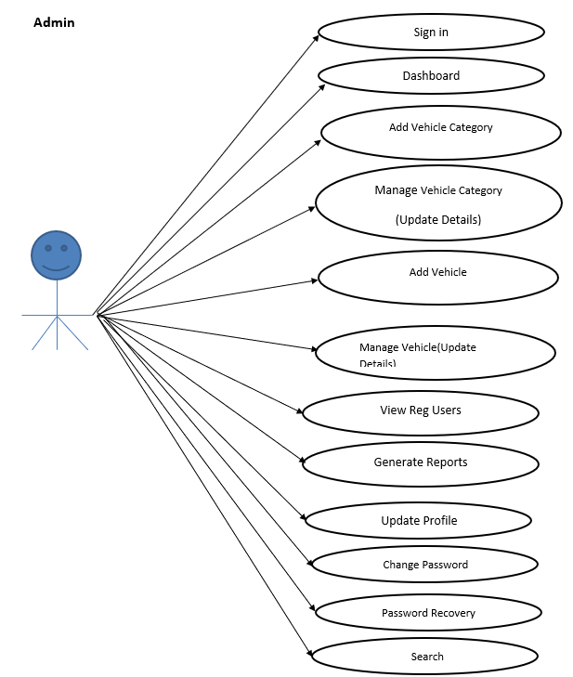
Use Case Diagram
Notes:
USECASE DIAGRAM: A Use case is a description of set of sequence of actions. Graphically it is rendered as an ellipse with solid line including only its name. Use case diagram is a behavioral diagram that shows a set of use cases and actors and their relationship. It is an association between the use cases and actors. An actor represents a real-world object. Primary Actor – Sender, Secondary Actor Receiver.

Slide 9
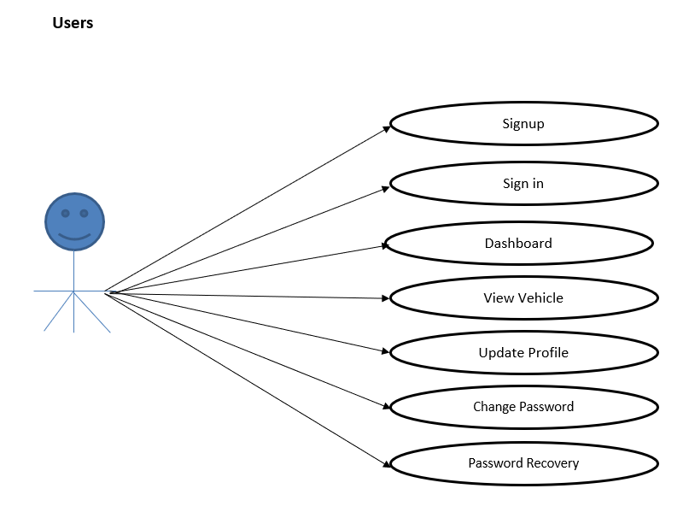
Continue…

Slide 10
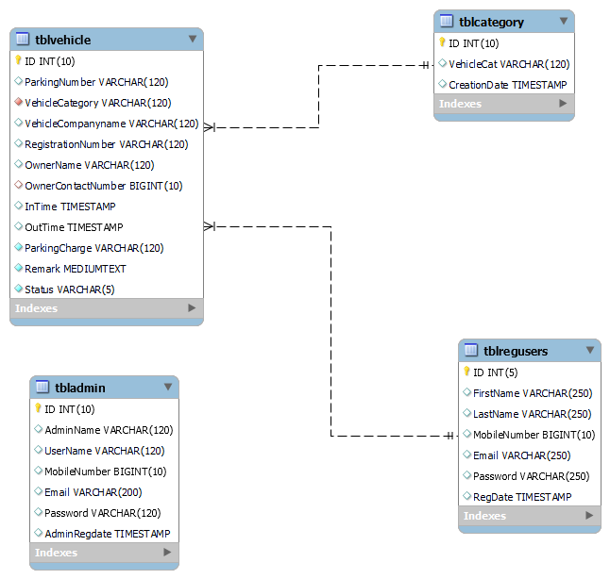
Class Diagram
Notes:
Class Diagram:
A description of set of objects that share the same attributes operations, relationships, and semantics

Slide 11
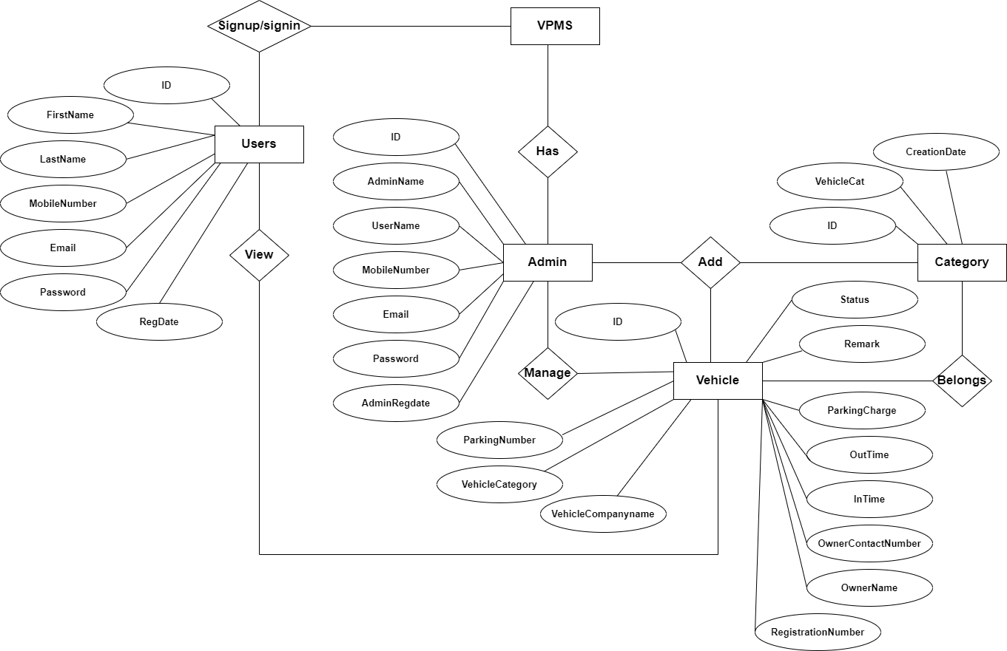
ER Diagram

Slide 12
Data Flow Diagram
A data flow diagram is graphical tool used to describe and analyze movement of data through a system. These are the central tool and the basis from which the other components are developed. The transformation of data from input to output, through processed, may be described logically and independently of physical components associated with the system.
These are known as the logical data flow diagrams. The physical data flow diagrams show the actual implements and movement of data between people, departments and workstations.

Slide 13
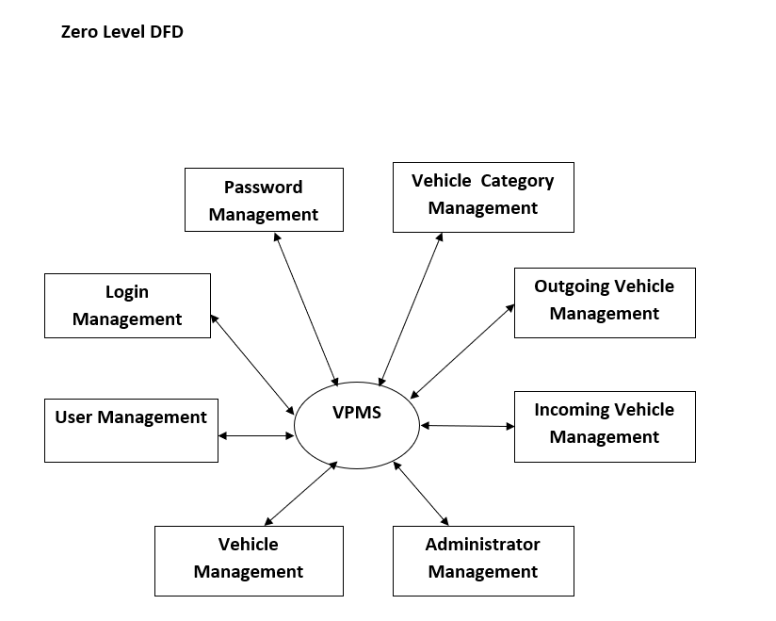
Continue….

Slide 14
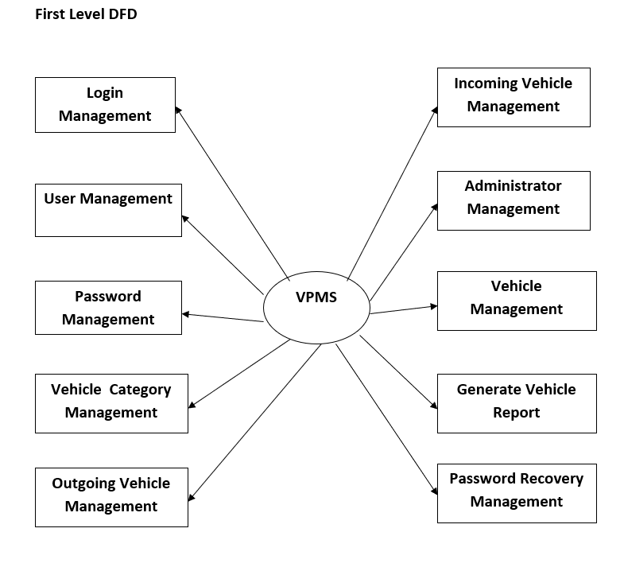
Continue….

Slide 15
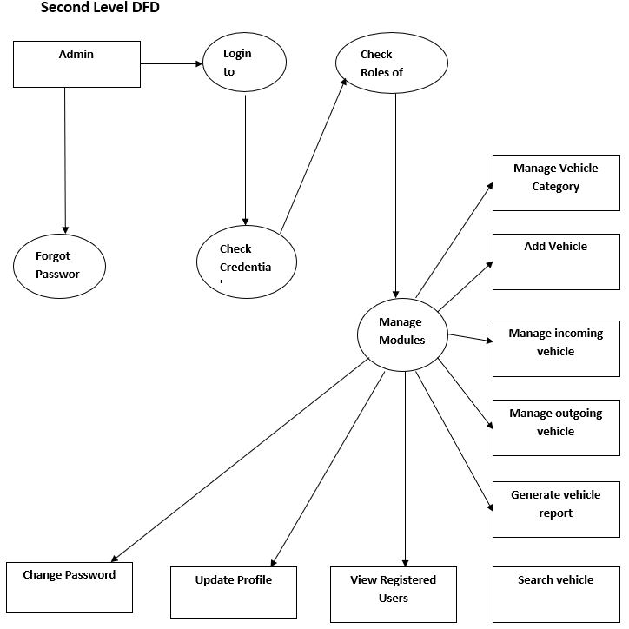
Continue….

Slide 16
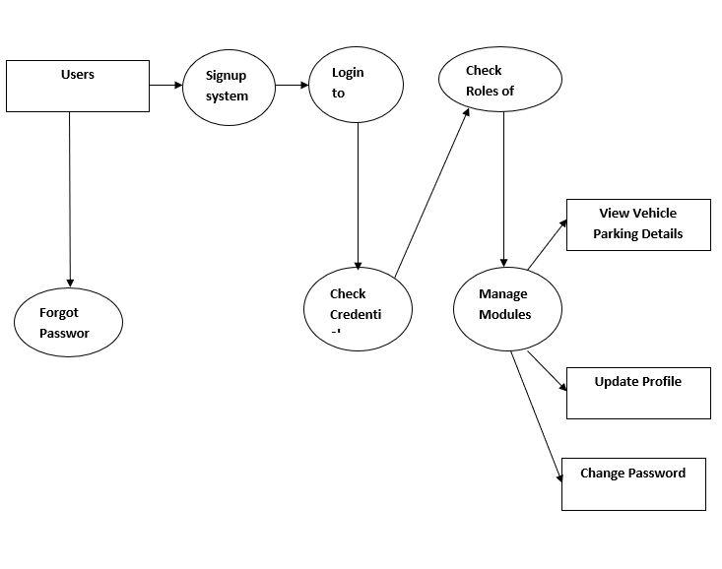
Continue….

Slide 17
Implementation and System Testing
After all phase have been perfectly done, the system will be implemented to the server and the system can be used.
System Testing
The goal of the system testing process was to determine all faults in our project .The program was subjected to a set of test inputs and many explanations were made and based on these explanations it will be decided whether the program behaves as expected or not. Our Project went through two levels of testing
Unit testing
Integration testing

Slide 18
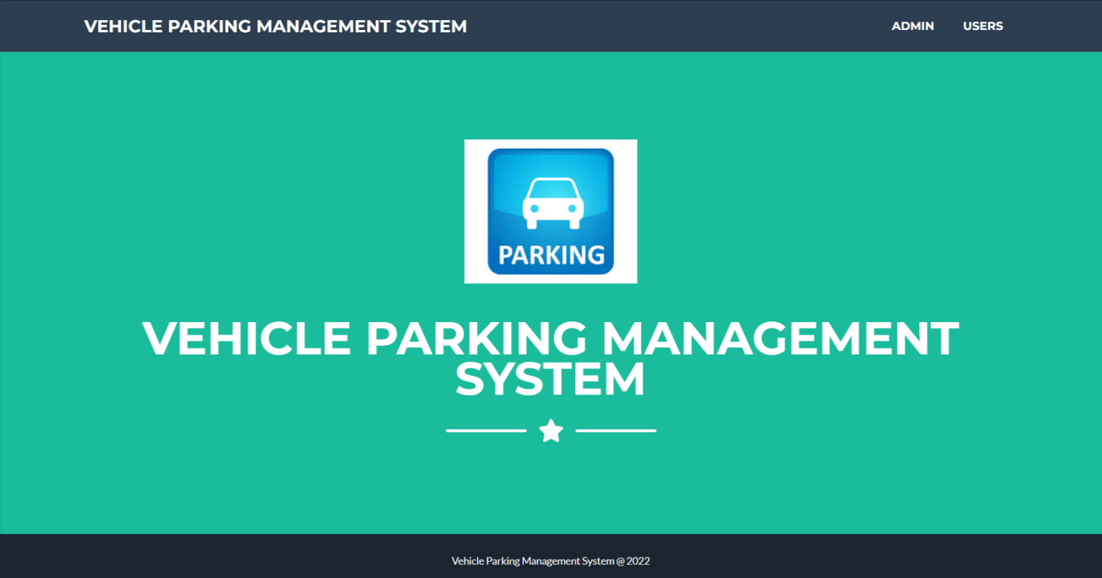
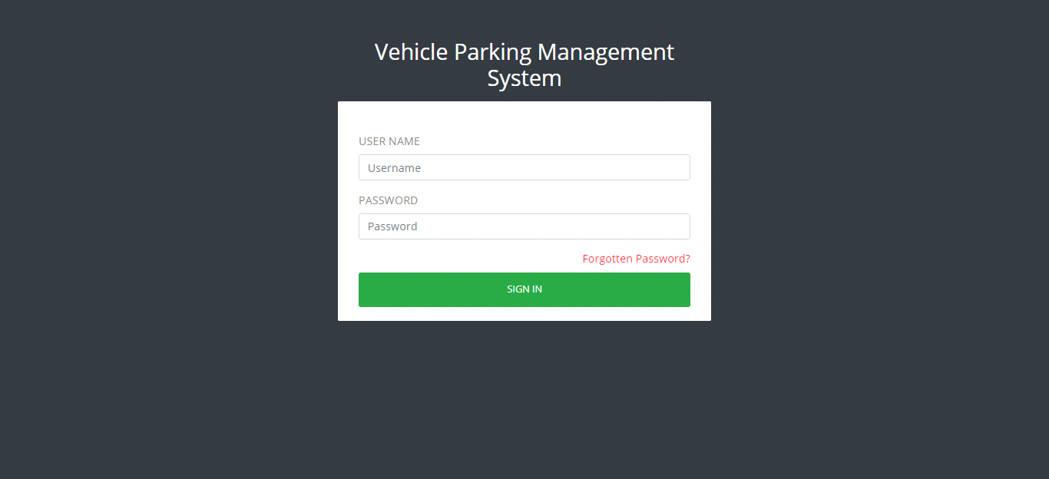
Project Screens

Slide 19
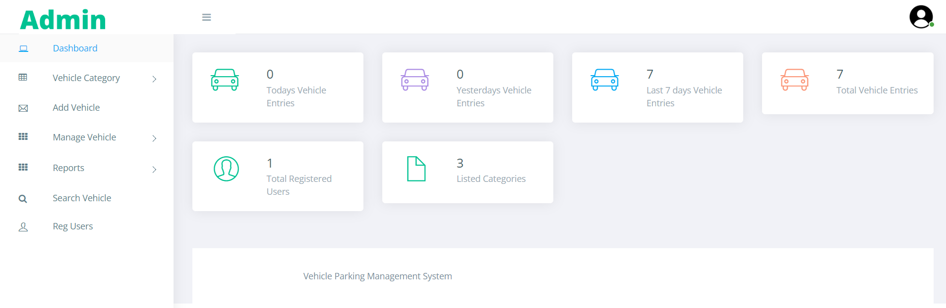
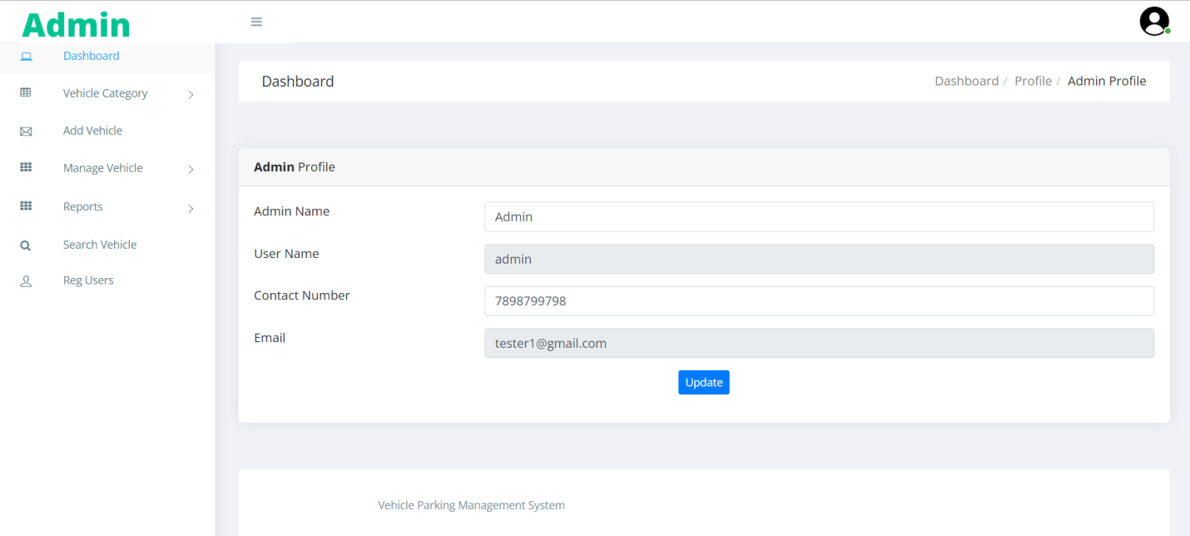

Slide 20
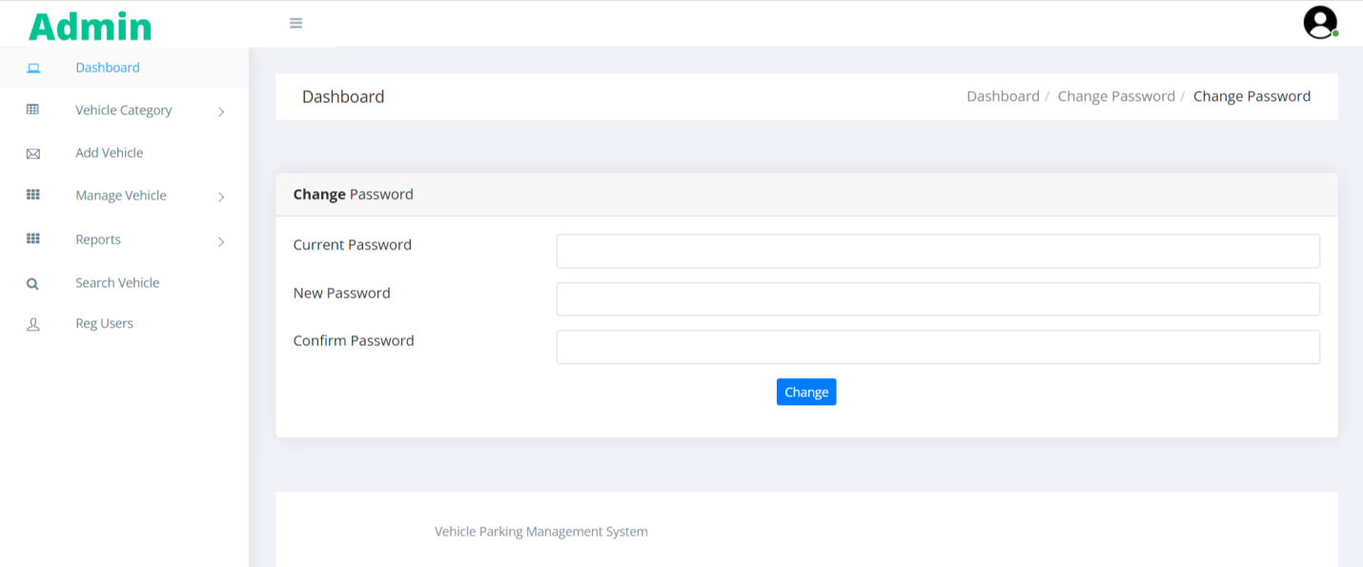
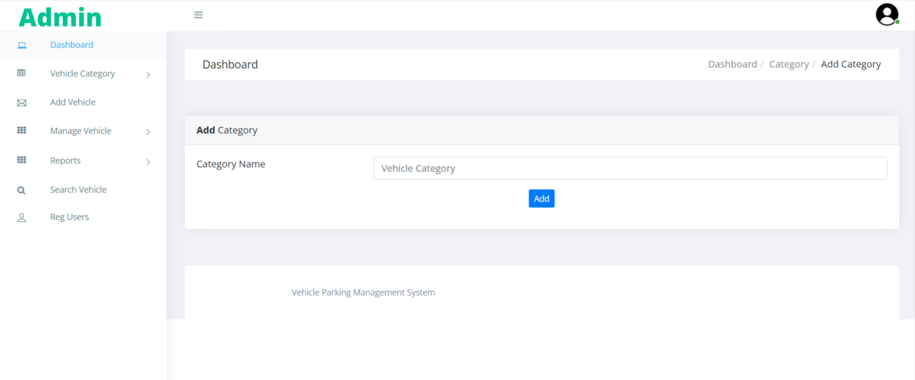

Slide 21
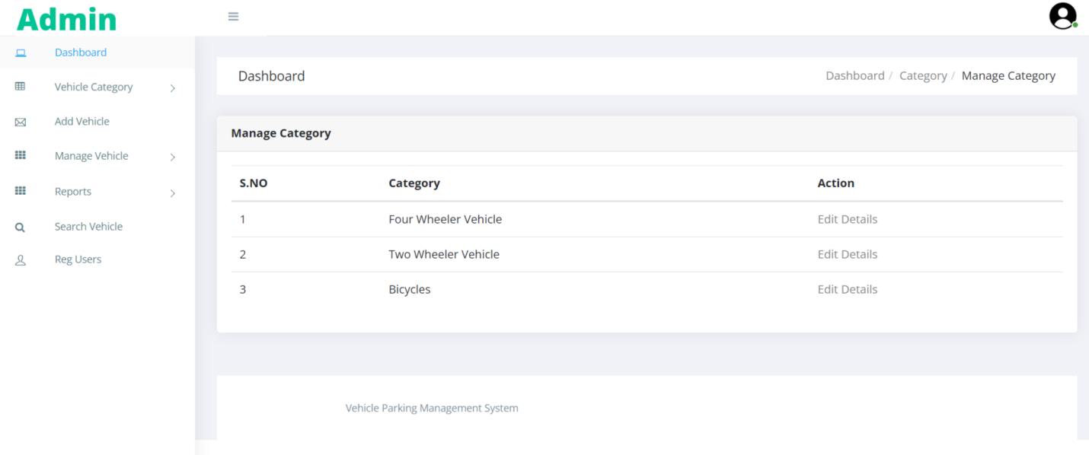
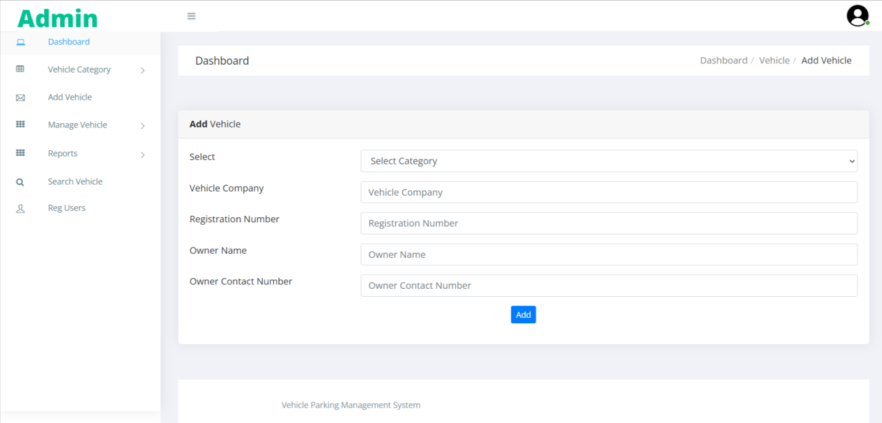

Slide 22
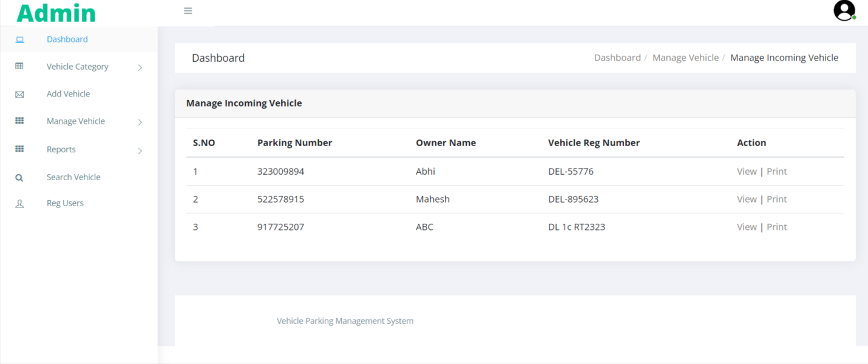
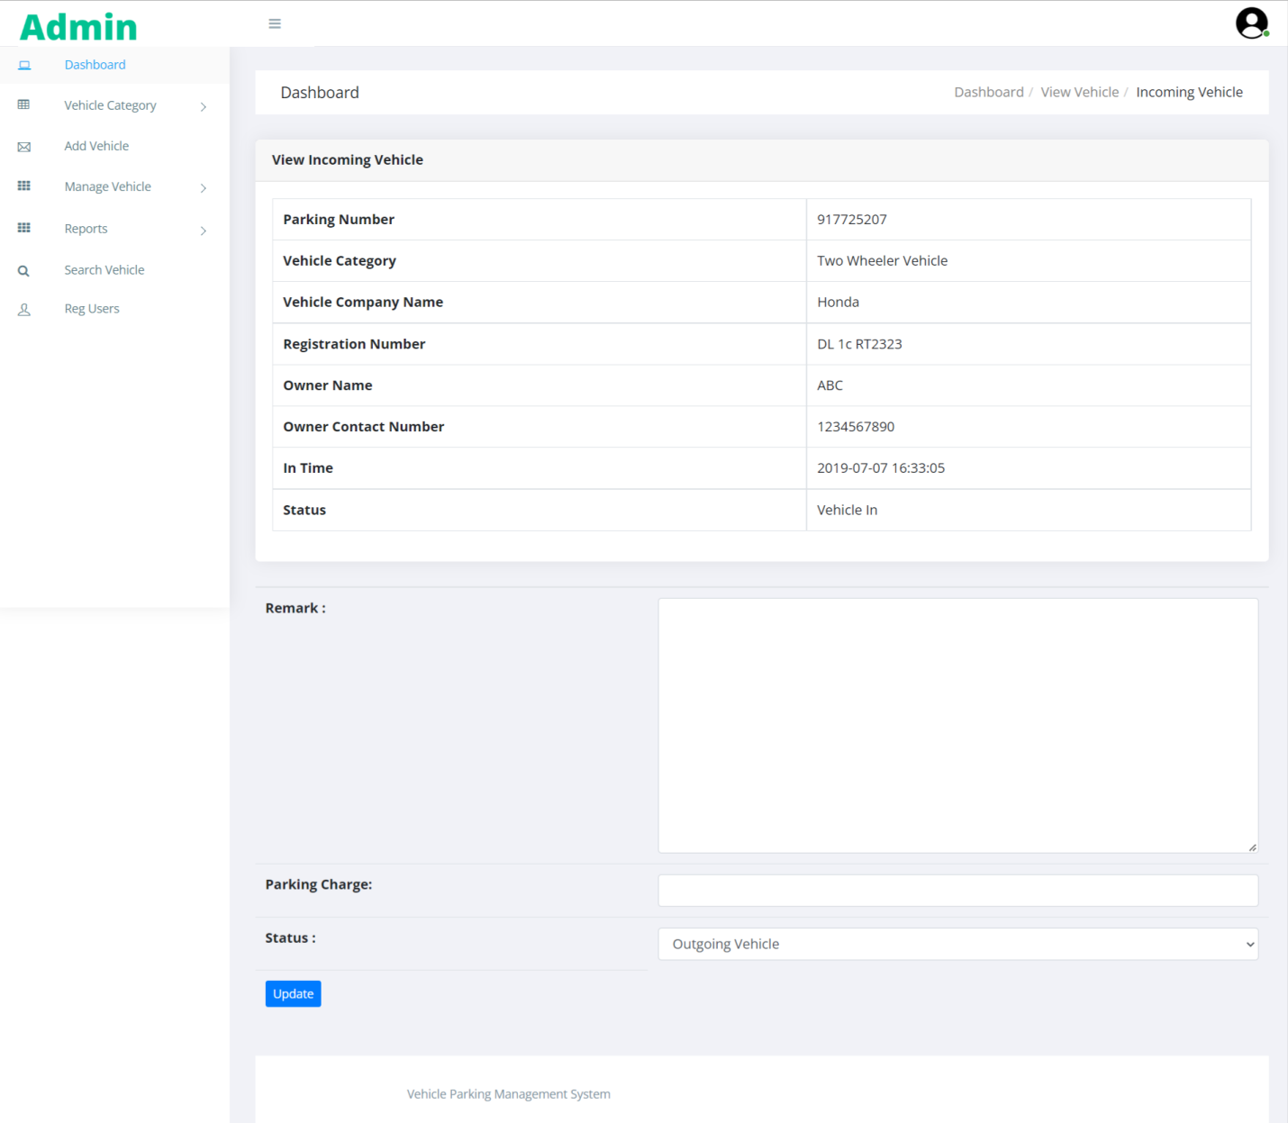

Slide 23
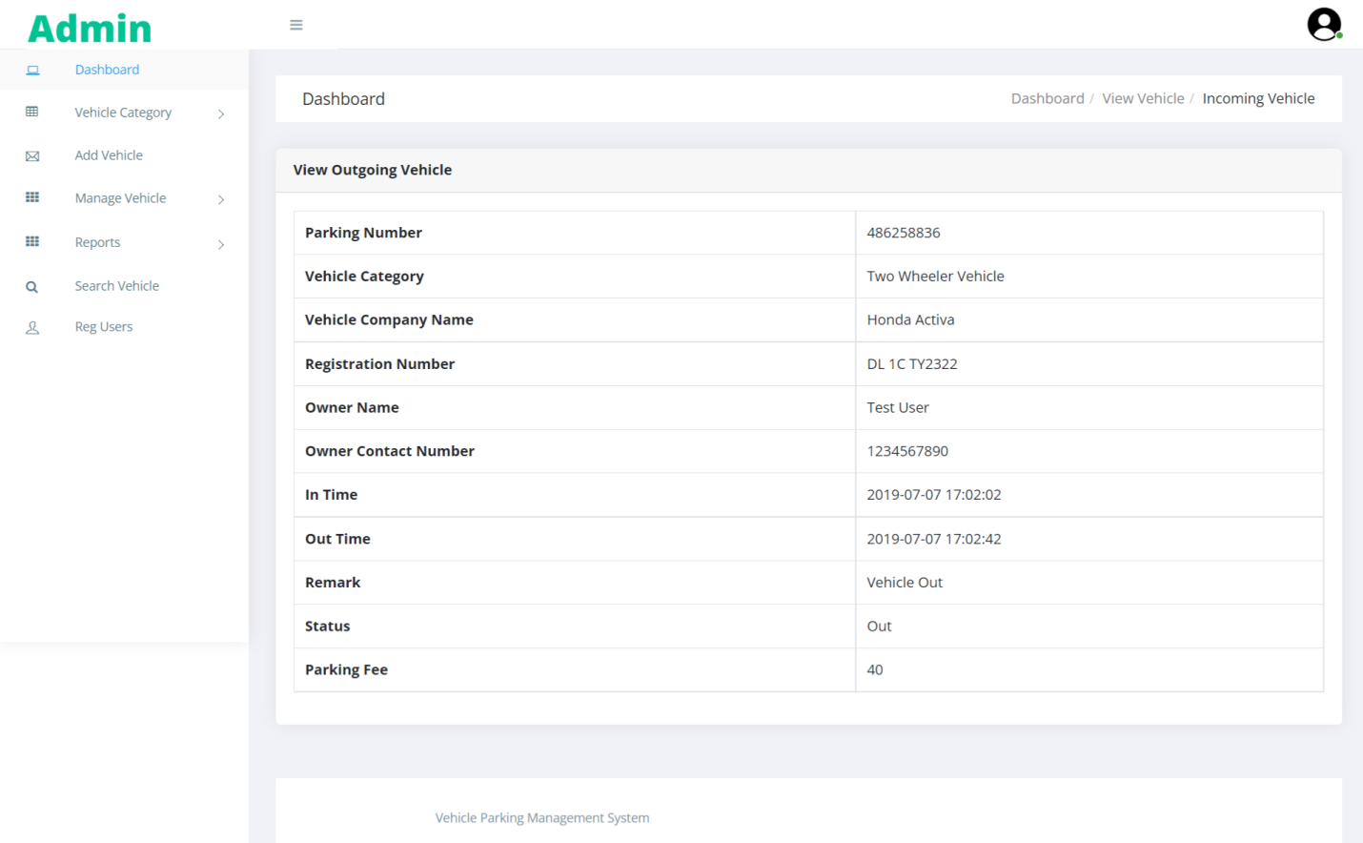
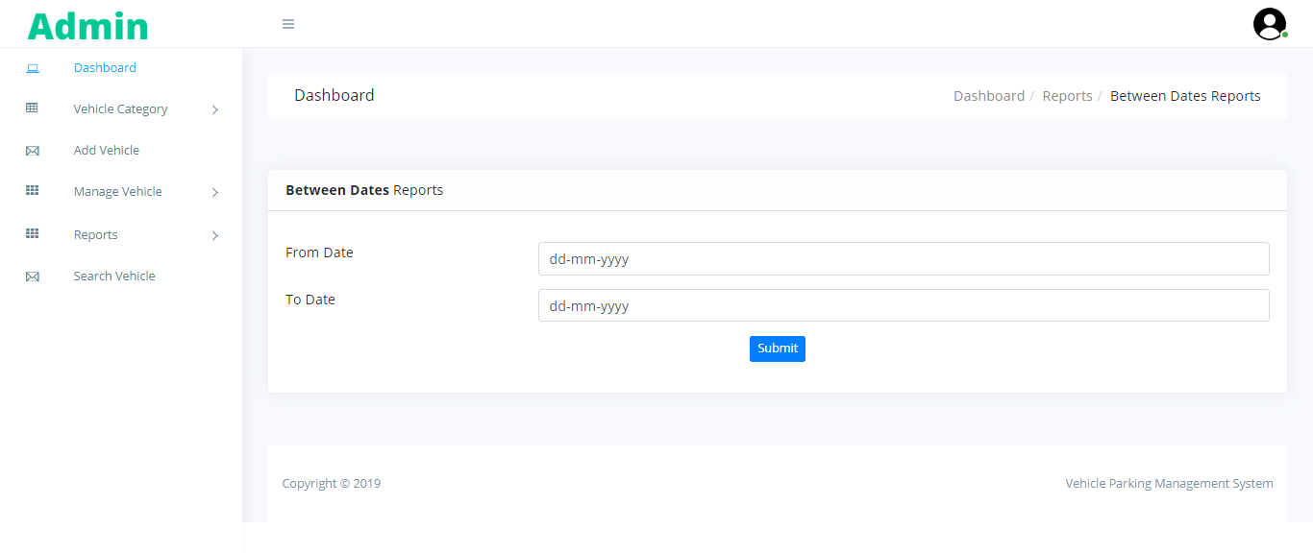

Slide 24
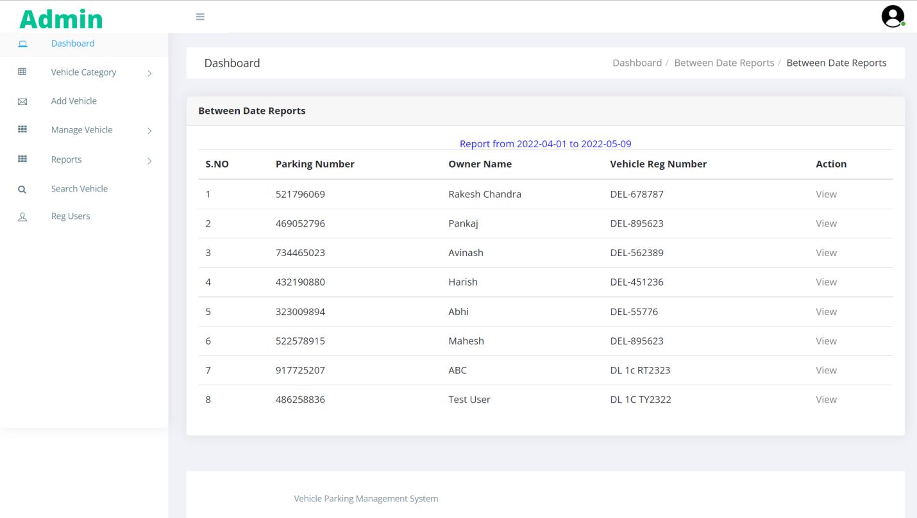
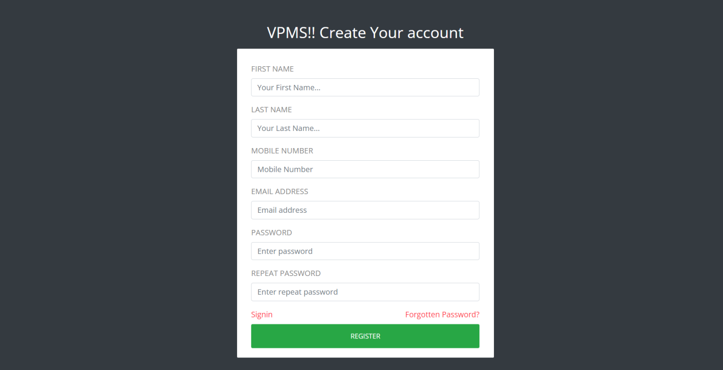

Slide 25
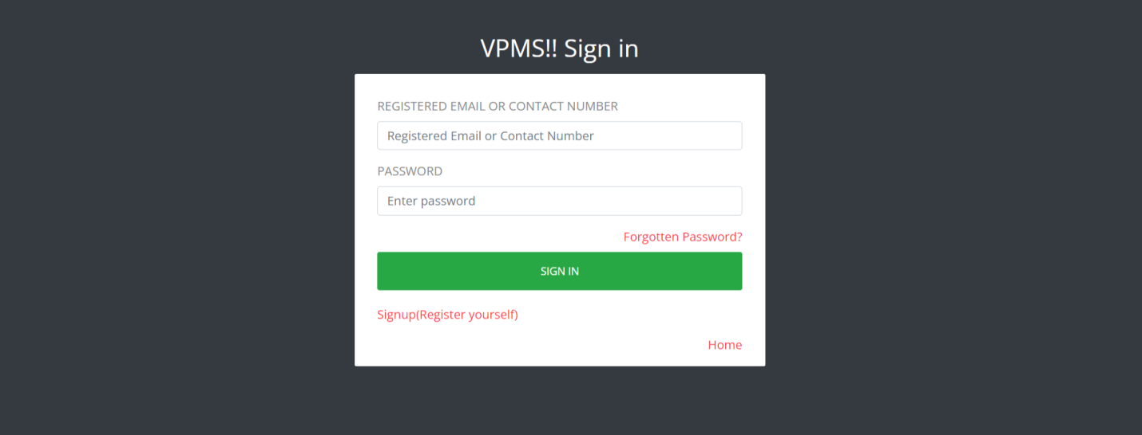
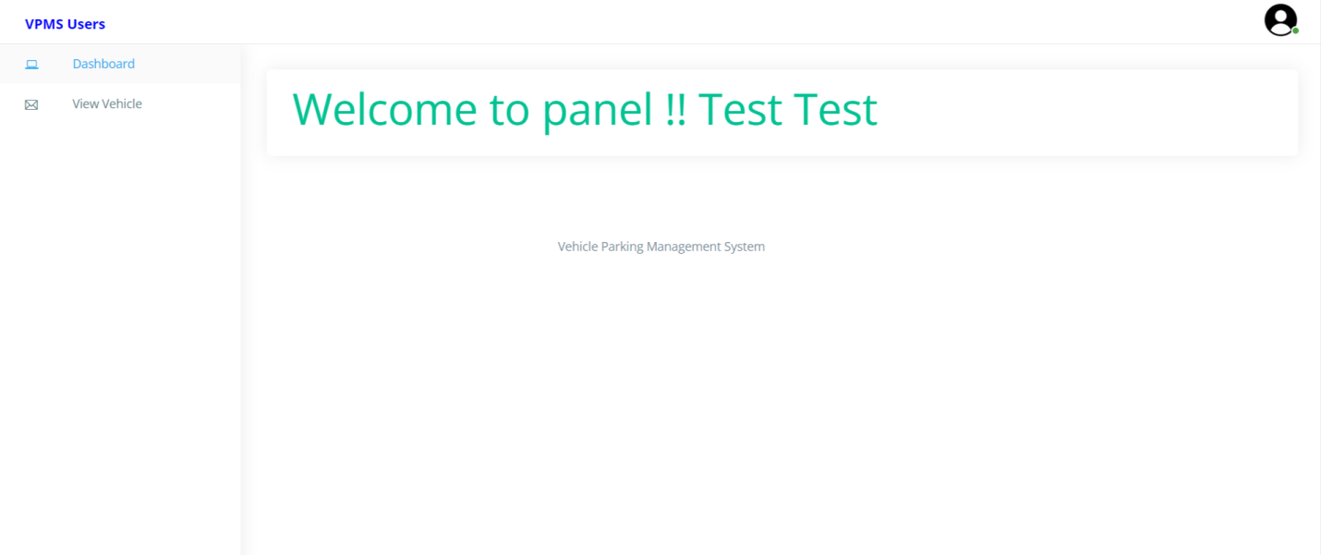

Slide 26
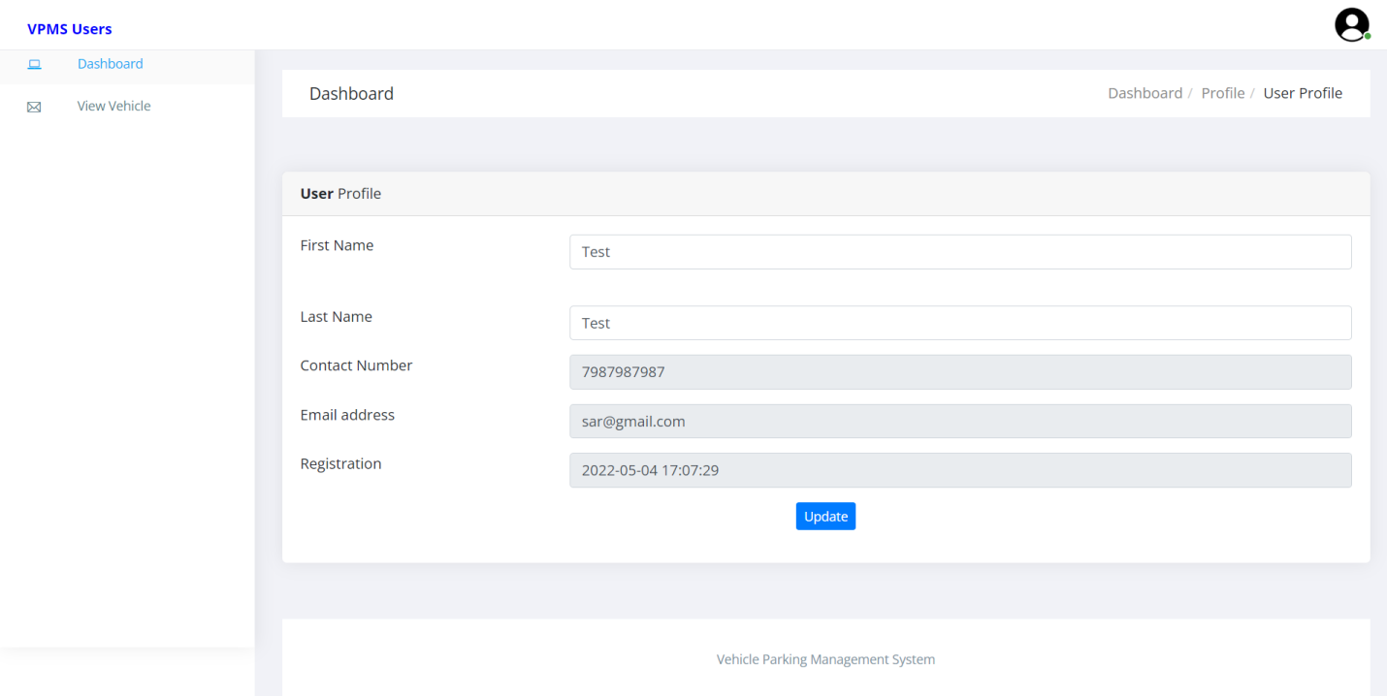
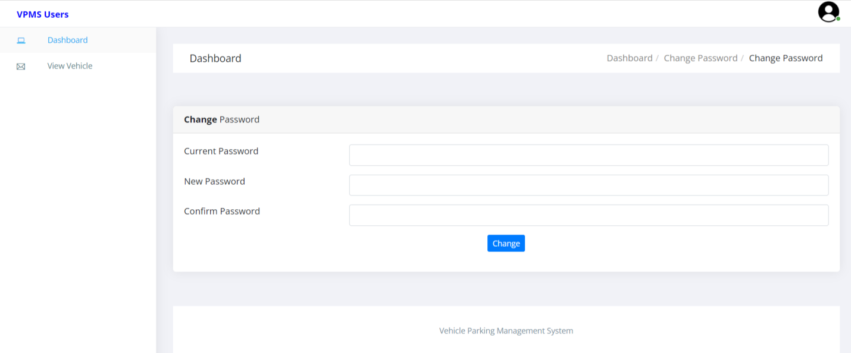

Slide 27
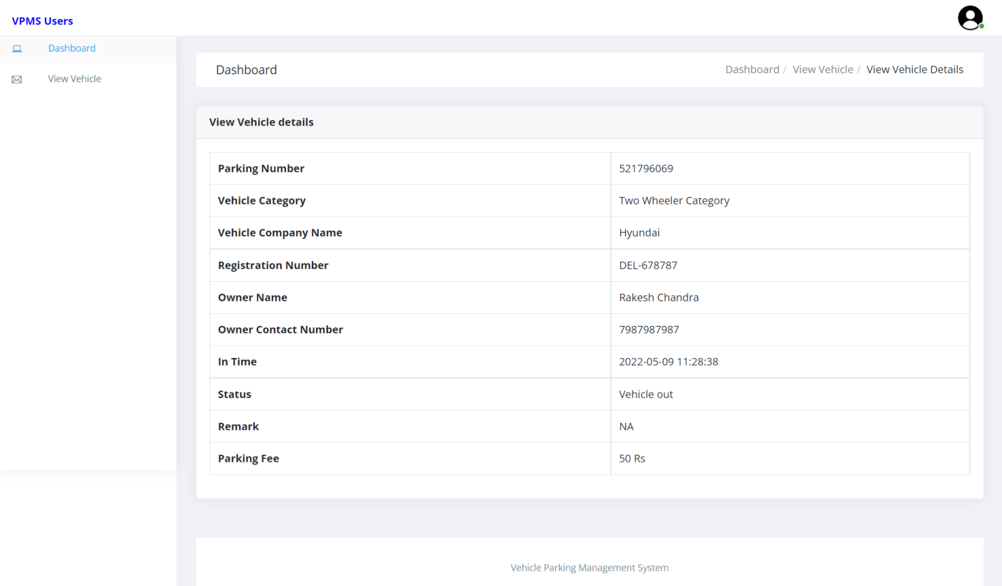
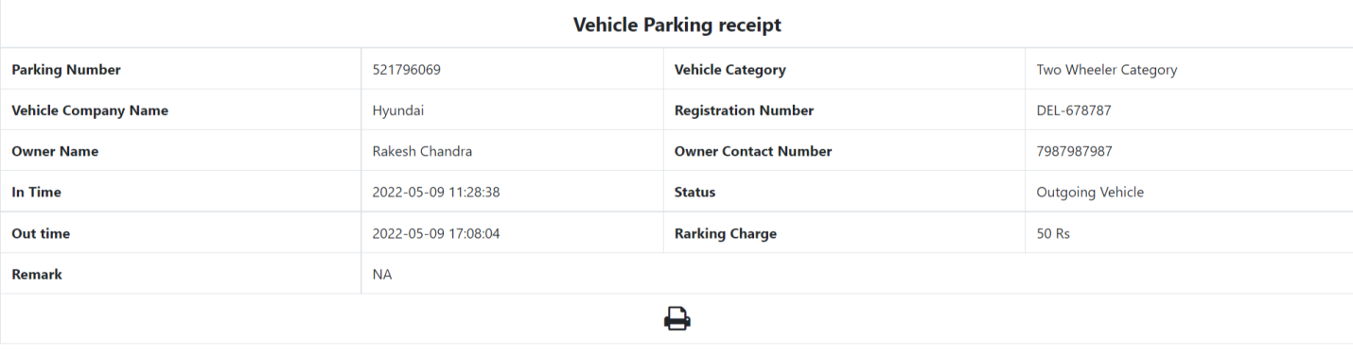

Slide 28
Conclusion
This Application provides a computerized version of Vehicle Parking Management System which will benefit the parking premises.
It makes entire process online and can generate reports. It has a facility of staff’s login where staff can fill the visitor details and generate report.
The Application was designed in such a way that future changes can be done easily. The following conclusions can be deduced from the development of the project.
Automation of the entire system improves the productivity.
It provides a friendly graphical user interface which proves to be better when compared to the existing system.
It gives appropriate access to the authorized users depending on their permissions.
It effectively overcomes the delay in communications.
Updating of information becomes so easier.
System security, data security and reliability are the striking features.
The System has adequate scope for modification in future if it is necessary.

Slide 29
Bibliography
For PHP
https://www.w3schools.com/php/default.asp
https://www.sitepoint.com/php/
https://www.php.net/
For MySQL
https://www.mysql.com/
http://www.mysqltutorial.org
For XAMPP
https://www.apachefriends.org/download.html

Slide 30
Thank You

