Slide 1
Introduction of Databases
Realized by Skander Houidi

Slide 2
Introduction:
The relational data model, which organizes data in tables of rows and columns, predominates in database management tools. Today there are other data models, including NoSQL and NewSQL, but relational database management systems (RDBMSs) remain dominant for storing and managing data worldwide.
This article compares and contrasts three of the most widely implemented open-source RDBMSs: SQLite, MySQL, and PostgreSQL. Specifically, it will explore the data types that each RDBMS uses, their advantages and disadvantages, and situations where they are best optimized.

Slide 3
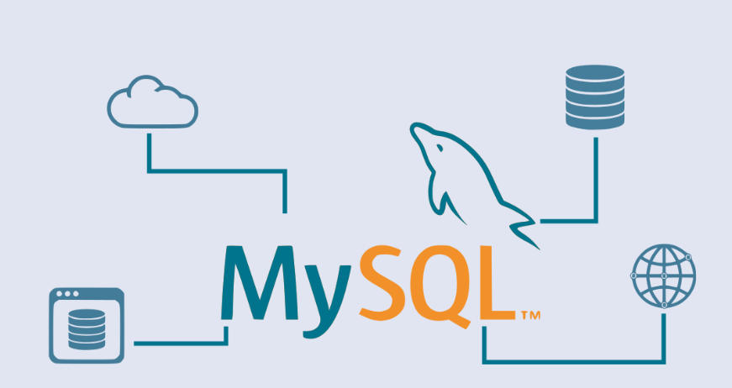
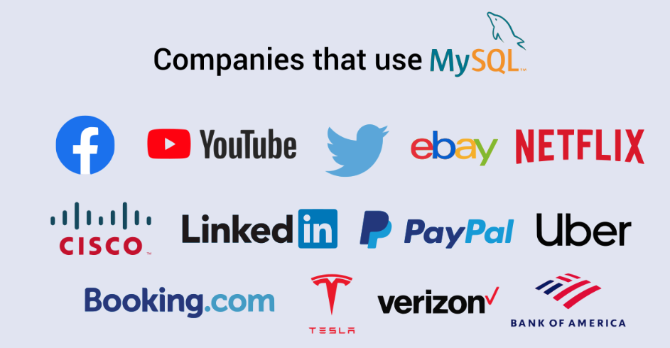
MySQL:
MySQL occupies a prominent place among open-source RDBMSs. Many prominent companies use it since MySQL offers several key advantages.

Slide 4
Key features of MySQL:
As an RDBMS, MySQL is based on SQL. The key features of MySQL are as follows:
The creators of this RDBMS used C and C++ to create MySQL.
MySQL uses a client-server architecture.
This RDBMS works with a wide range of operating systems like Windows, Linux, Unix, OS/2, FreeBSD, etc.
You can install and run MySQL on all key platforms.

Slide 5
Advantages of MySQL
Disadvantages of MySQL
The ease of installation
Tooling support
Compatibility
The ease of use
Security
Performance
Scalability
Availability
High productivity
Efficiency
Support
Limitations vis-a-vis embedding in an application
Business logic-related limitations
Stability issues
The dependency on add-ons
Limitations concerning tools when compared to paid databases
MySQL isn’t very efficient when handling large databases
MySQL versions prior to 5.0 don’t support commits and stored procedures

Slide 6
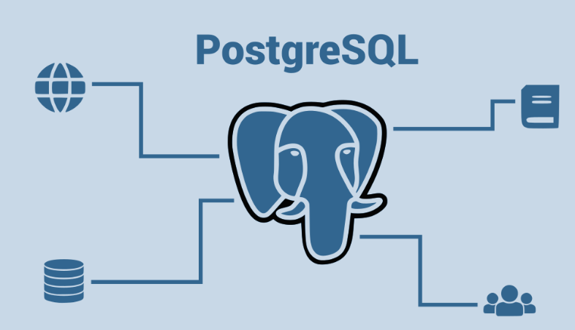
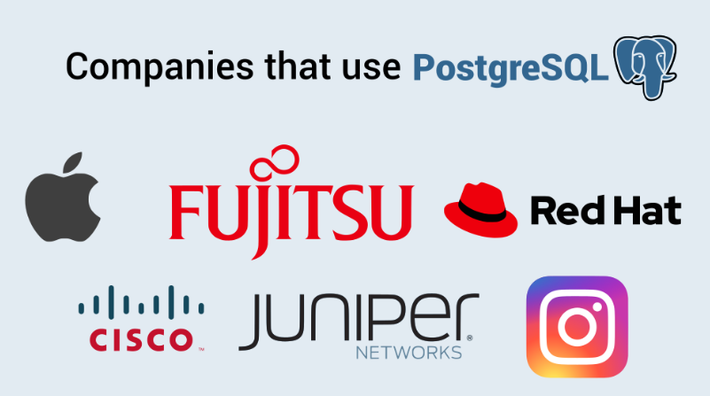
PostgreSQL:
Among the established open-source RDBMSs, PostgreSQL enjoys a lot of prominences. This RDBMS is also known as “Postgres”, and it enjoys high popularity.

Slide 7
Key features of PostreSQL:
The following are the noticeable features of PostgreSQL:
This open-source RDBMS is free.
Its creators used the C language to develop PostgreSQL.
PostgreSQL supports all the key platforms like Windows, Linux, Mac, etc.
This RDBMS uses SQL and offers features similar to traditional RDBMSs like Oracle and DB2.
PostgreSQL offers noticeable extensibility. You can use it along with other popular RDBMSs like Oracle and MySQL. Furthermore, you can use it along with popular NoSQL databases like MongoDB.
PostgreSQL supports all popular languages like Java, Python, C, C++, C#, JavaScript, Ruby, Go, etc.

Slide 8
Advantages of PostreSQL
Disadvantages of PostreSQL
Powerful features
The ease of handling transactions
“Code comments”
Parameters
Extensibility
Security
“Rich” SQL
Flexibility
Performance
Popularity
Support
The lack of data compression
Analytics-related limitations
Performance-related limitations
Administration-related challenges

Slide 9
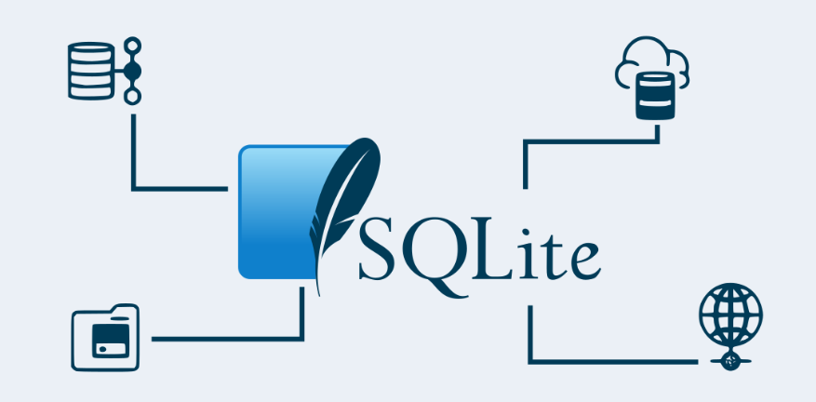
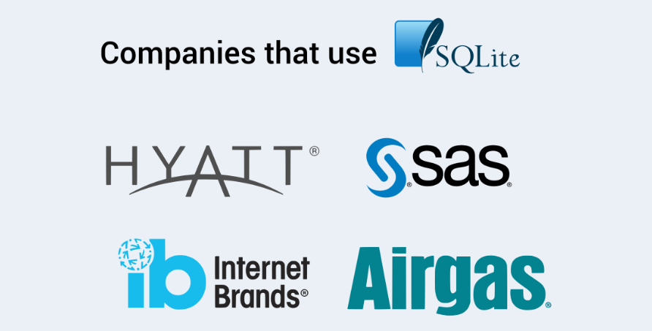
SQLite:
SQLite is another popular open-source RDBMS. Unlike other popular open-source RDBMSs we talked about, SQLite doesn’t use a client-server database engine. Your development team can embed it into the program code.

Slide 10
Key features of SQLite :
SQLite is a free RDBMS since it’s open-source. The following features of SQLite are noteworthy:
SQLite was developed using ANSI-C.
SQLite doesn’t require a server specifically for database management.
This flexible database allows you to work with multiple databases simultaneously.
SQLite supports a wide range of operating systems like Windows, Mac OS, Linux, and Unix.
This RDBMS doesn’t require configuration and administration.

Slide 11
Advantages of SQLite
Disadvantages of SQLite
Ease of use
Lightweight
Performance
Reliability
Flexibility
Compatibility
Tooling
Cost savings
Limitations in terms of functionalities
Limitations in terms of features
Volume-related restrictions

Slide 12
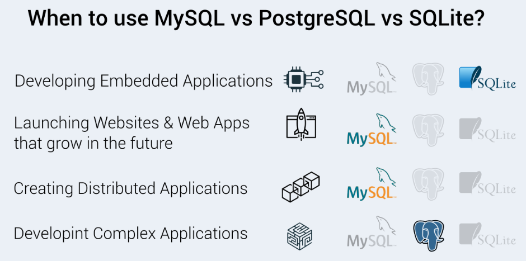
MySQL vs PostgreSQL vs SQLite:

Slide 13
Thank you for your attention

