Slide 1
Capstone project

Slide 2
Business Problem
Problem Statement:
Find a house at a convenient distance from desired amenities (e.g. pubs, cafes, supermarkets etc)
Stakeholders:
People who are looking to switch house in Lewisham Council In London, UK.
WHY:
Finding a house in London is a difficult task especially when you have specific requirements for the surroundings. So, this program should help stakeholders to narrow down their search. This solution can be extended to any council in London or even any other city

Slide 3
Assumptions:
Data is downloaded from Doogle and it comprises of postcodes in Lewisham council In London, UK.
Assuming that this data is limited and doesn't represent actual availability of the house. But that should be easy as we could just focus on the area here.
Our focus will only be on Forest Hill part of the Lewisham as FourSquare api has aggressive rate limit for explore api calls/day.

Slide 4
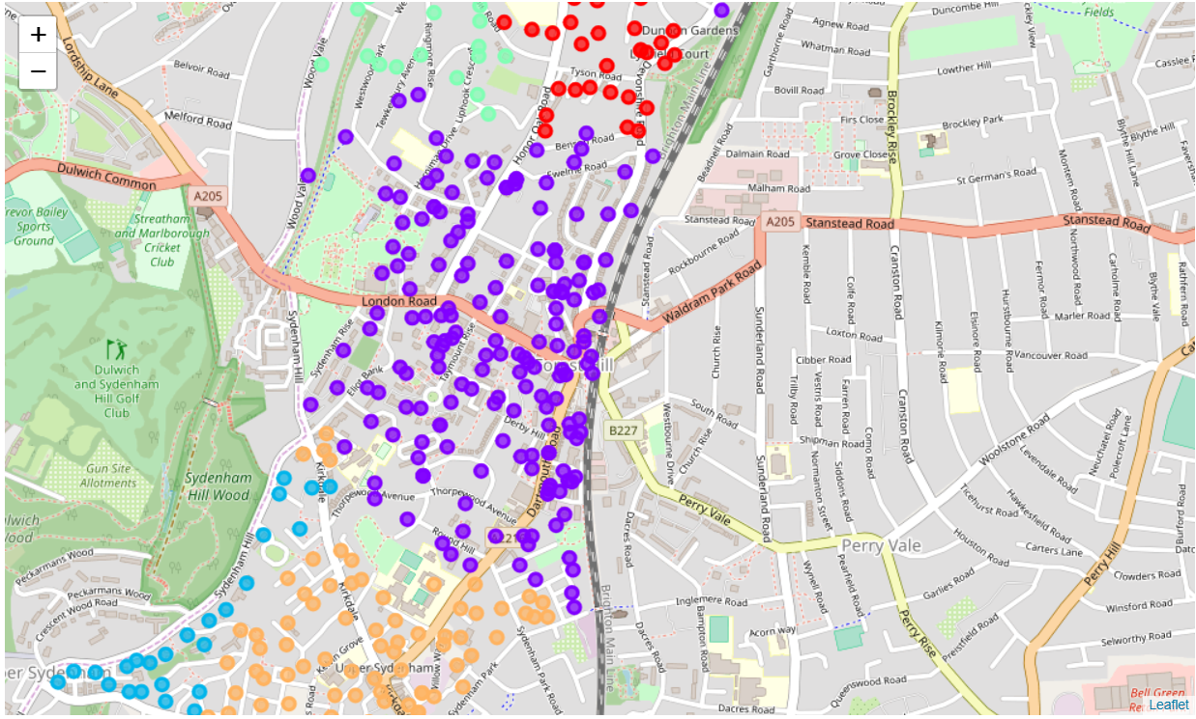
Forest Hill Clusters

Slide 5
Report:
By analyzing the clusters we can see that there are 5 very different kinds of areas in the Forest Hill.
Cluster 0 - Contains houses with proximity to Indian Restaurants, Bus Stops, Train stations etc
Cluster 1 - For youngsters - The cluster highlights all houses in the proximity to cafes, pubs and nightlife etc.
Cluster 2 - Contains houses with proximity to Vintage stores, nature reserves etc.
Cluster 3 - Contains houses with proximity to Japanese restaurant, Grocery Stores, Mobile shops etc.
Cluster 4 - Suitable for those who like greenery, nearby forest, parks etc.
By looking at the previous graph one can easily decide which part of the Forest Hill they would like to live. So I hope it solves the important problem of narrowing down the search for the house.

