Slide 1
Project Assessment Report Course: Deep Learning and Reinforcement Learning ROCK, PAPER & SCISSORS using CNN CLASSIFIER By: SPOORTHI S GOWDA(1BG23CS155) V M Skandamahima(1BG23CS172) YASHASWINI M(1BG23CS192)

Slide 2
PROJECT OBjeCTIVE
To build an interactive ML based game that plays Rock, Paper, Scissors using real-time webcam input, where a Convolutional Neural Network (CNN) classifies user gestures and plays against a computer opponent.

Slide 3

Methodology and Workflow
Data Collection: Used a labeled dataset of Rock, Paper, and Scissors hand gestures.
Model Training:
Built and trained a CNN model using TensorFlow/Keras.
Preprocessed images (resize, normalize).
Model Export: Saved as .h5 or .keras format
Gesture Capture and Prediction
Used OpenCV to access and display the webcam feed in real-time.
Captured user gesture frames after a countdown.
Processed the captured frame to match the model's input format.
Ran the frame through the trained CNN to predict the hand gesture.
Gameplay Logic:
Captures user's hand gesture via webcam.
Sends it to backend model for prediction.
Compares with computer's random move to decide winner.
Model Export
Data Collection
Modelling Training
Game Play Logic
Gesture Capture

Slide 4
Key ASSUMPTIONS
User's hand is clearly visible and centered within the webcam frame.
The training dataset is diverse enough to generalize to different users.
The model is loaded and run locally, without relying on any web server or API calls
Lighting conditions are consistent for accurate gesture recognition..

Slide 5

Model Analysis
Model Type: Convolutional Neural Network (CNN) with softmax output layer for 3 classes (Rock, Paper, Scissors).
Evaluation Metrics:
Accuracy on validation and test sets.
Confusion matrix to analyze per-class performance.
Performance:
Achieved ~95–98% test accuracy.
Slight confusion between Paper and Scissors due to visual similarity in some hand gestures.
Tools Used:
TensorFlow / Keras for model building and training.
OpenCV for real-time webcam integration and gesture capture.

Slide 6
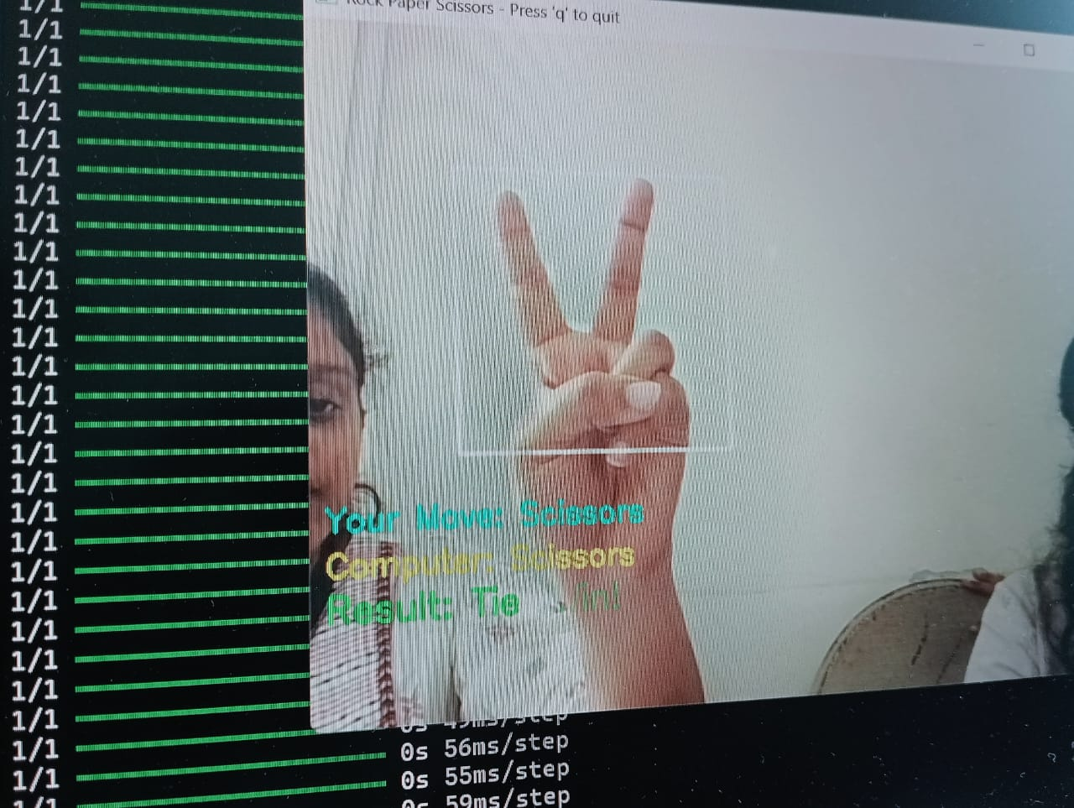
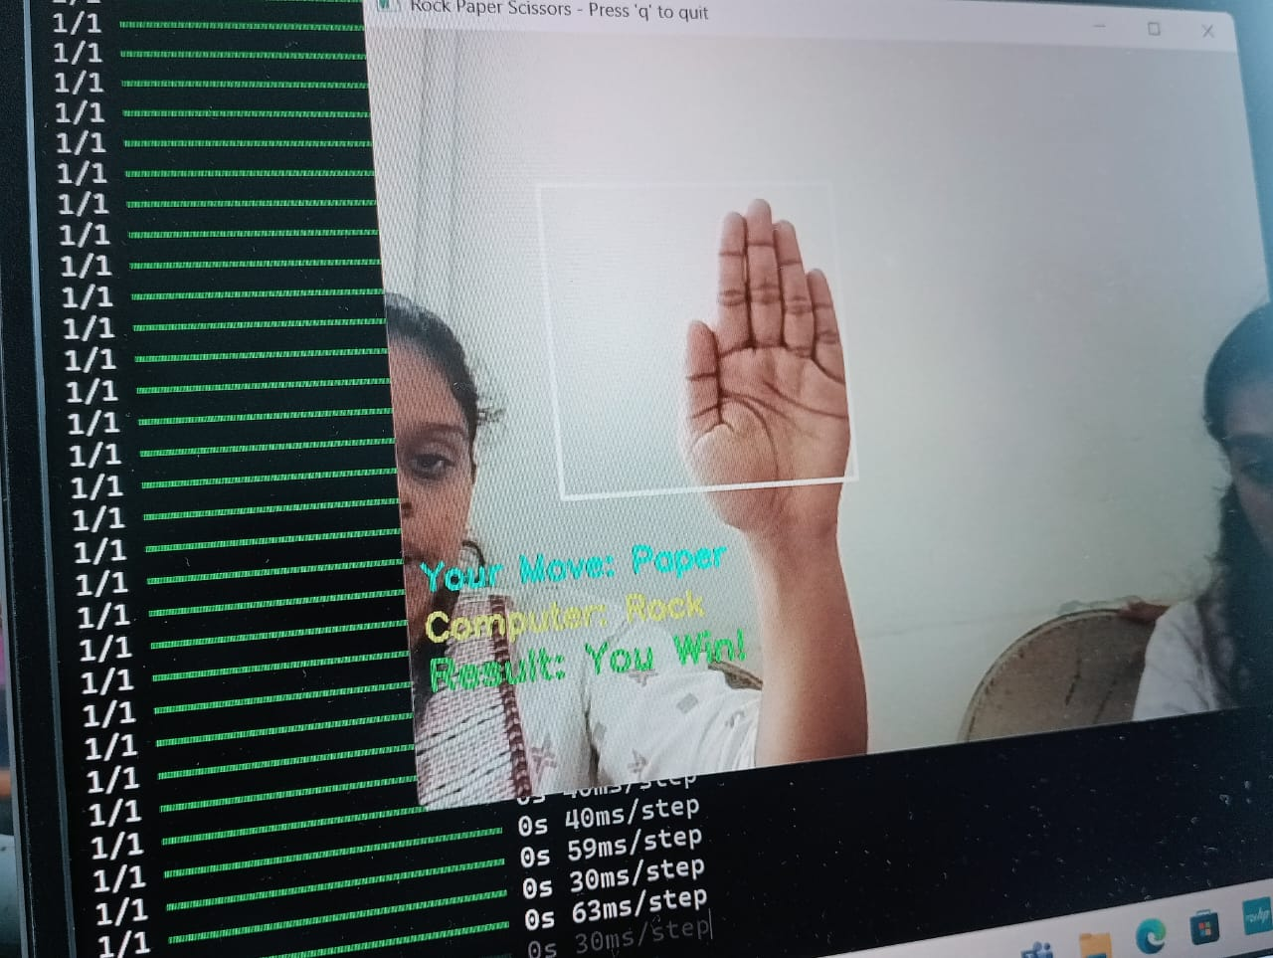
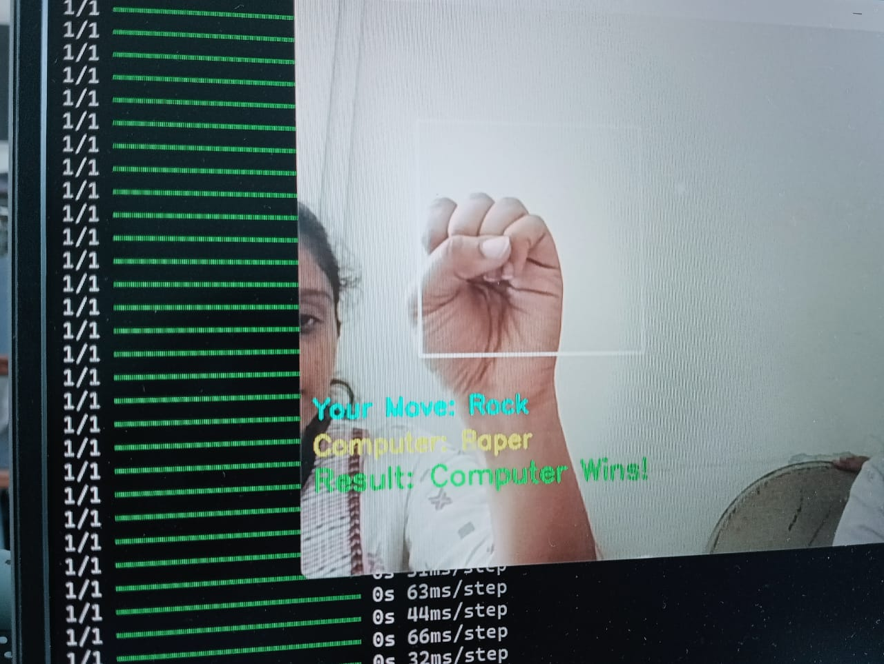
Project Summary and Outcomes
Image classification via CNN
Real-time gesture capture via webcam.

Slide 7
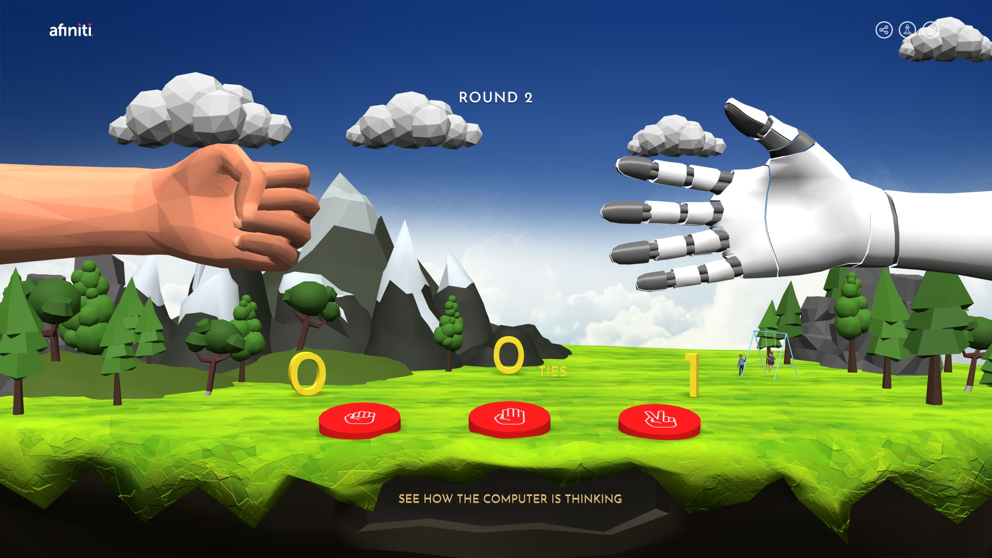
Future Improvements and extensions
Replace mock predictions with live model inference from captured webcam frames.
Enhance prediction accuracy using:
More diverse datasets (different backgrounds, skin tones, hand orientations).
Data augmentation techniques (rotation, brightness/contrast adjustments).
Add real-time feedback UI — e.g., show the predicted gesture before final result.
Add sound effects, score tracking, or multiplayer features.

Slide 8
Reflections and Learning Outcomes
Technical Skills Gained:
Building and training CNN models for image classification.
Using OpenCV for live webcam capture and overlaying visual results.
Managing local ML model loading and inference.
Conceptual Learnings:
Importance of data quality, lighting, and hand placement in image-based models.
Handling model compatibility issues (e.g., .h5 vs .keras formats).
Challenges of bringing machine learning into real-time, interactive applications.

Slide 9
Thank you

