Slide 1

SMART INDIA HACKATHON 2026
EIDOLON // SENTINEL-NET
Problem Statement ID: SIH26145
Problem Statement Title: AI-Based Detection of Cyber Threats in Unidirectional IP Traffic
Theme: Software / Blockchain & Cybersecurity
PS Category: Software
Organization: NTRO
Team Name: EIDOLON

Slide 2
THE PROBLEM
THE PROBLEM
OBSERVABLE NETWORK
Modern threat detection often assumes bidirectional network visibility.
But SIH26145 imposes a fundamentally different constraint:
• Traffic can be observed only in one direction.
• No return-path dependency.
• No active probes or scanning.
• No mitigation commands can be sent back.
• Detection must rely entirely on passively observable packet/flow metadata.
No Return Path
ONE-WAY IP TRAFFIC
EIDOLON SENSOR
AI THREAT DETECTION
“HOW DO WE DETECT CYBER THREATS WHEN WE CAN ONLY OBSERVE?”
Modern threat detection often assumes bidirectional network visibility.
But SIH26145 imposes a fundamentally different constraint:
• Traffic can be observed only in one direction.
• No return-path dependency.
• No active probes or scanning.
• No mitigation commands can be sent back.
• Detection must rely entirely on passively observable packet/flow metadata.

Slide 3
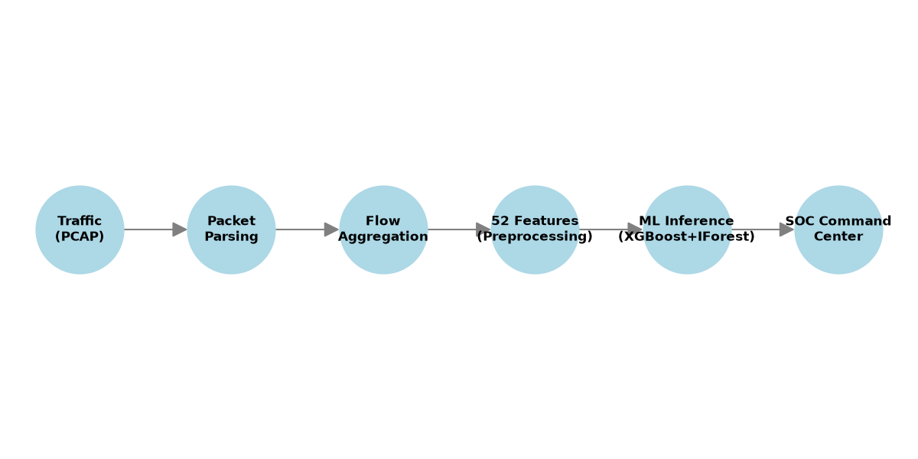
TECHNICAL APPROACH
EIDOLON
Traffic/PCAP
AI & FEATURE ENGINEERING:
• 52 canonical features (41 usable after preprocessing).
• Models: XGBoost, Random Forest, Logistic Regression, Isolation Forest.
• Simulated unidirectional telemetry constraint (passive/read-only).
• Supervised models detect learned classes; Isolation Forest flags anomalies.
Packet Parsing
Flow Aggregation
52 Features
Preprocessing
ML Detection
Evidence/Risk
SOC Command Center

Slide 4
FEASIBILITY AND VIABILITY
EIDOLON
SCIENTIFIC HONESTY & LIMITATIONS:
• Unseen C2 Recall: 0% (@ 1% FPR) and 1.7% (@ 5% FPR).
• Supervised models fail when classes are entirely unseen. We do not claim universal zero-day detection.
• Anomaly detection provides novelty-ranking, but operational FPR remains high.
ROBUSTNESS & EXPLAINABILITY:
• System resists timing jitter, packet-size noise, duration scaling, and metadata dropout.
• ATT&CK mapping serves as contextual evidence, not definitive proof of attribution.
• System does NOT claim to be production-ready.

Slide 5
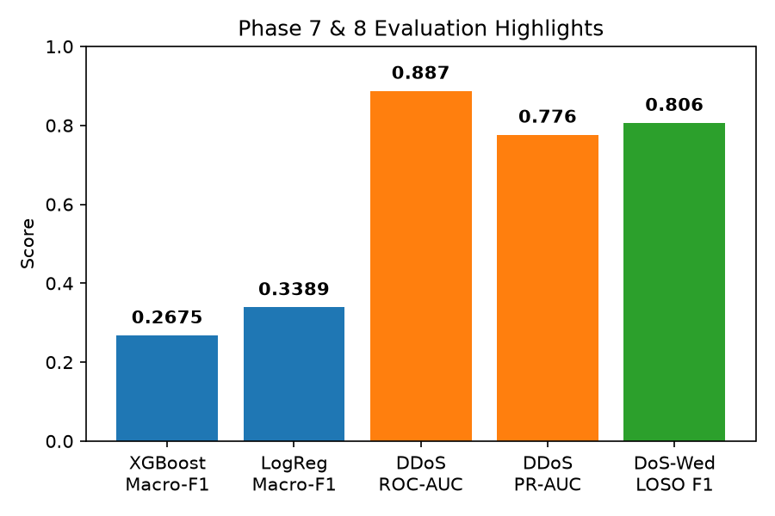
IMPACT AND BENEFITS
EIDOLON
Performance & Generalization Results:
- Supervised: XGBoost macro-F1 (0.2675); Logistic Regression macro-F1 (0.3389).
- Anomaly & Novel Threat Findings: Isolation Forest provides crucial novelty-ranking signal.
- Unseen DDoS: ROC-AUC 0.887, PR-AUC 0.776, Anomaly F1 0.571 (strongest generalization case).
- DoS-Wednesday LOSO F1: 0.806.
Target Use-Cases & Impact:
- Critical infrastructure monitoring and air-gapped/segmented environments.
- Empowers SOC analyst workflows through a seamless UI.

Slide 6
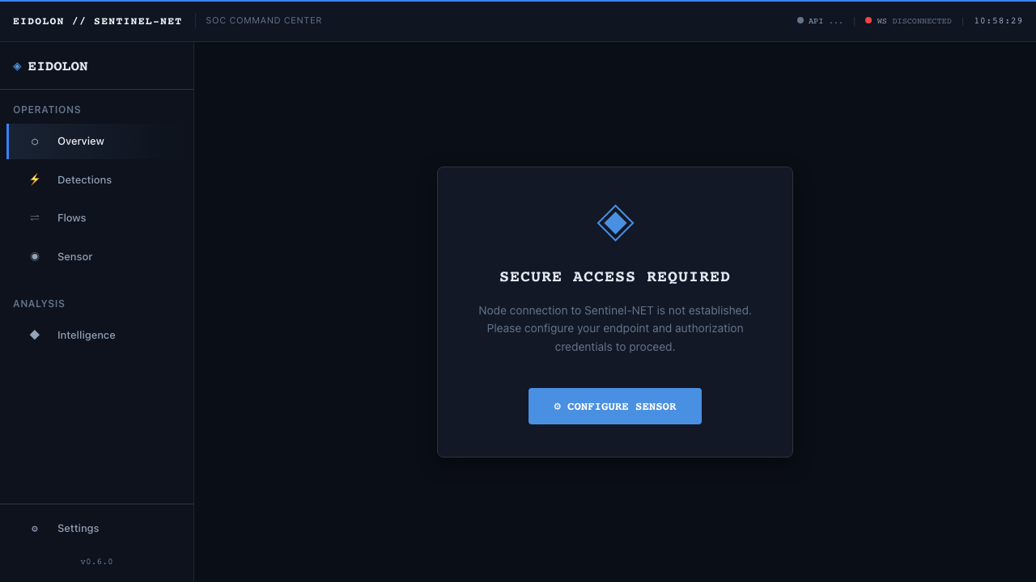
DEMO & RESEARCH
EIDOLON
DETERMINISTIC PCAP REPLAY / RECORDED TRAFFIC:
• The demo utilizes recorded traffic through the real ingestion pipeline, NOT live Internet traffic.
• End-to-End: PCAP → Pipeline → Feature Extraction → ML Inference → SQLite → WebSocket → SOC.
SCIENTIFIC RIGOR:
• 531 automated tests pass locally.
• Real-data evaluation with explicit known vs. unseen splits.

