Slide 1

SMART INDIA HACKATHON 2026
TITLE PAGE
Problem Statement ID: SIH26145
Problem Statement Title: AI-Based Detection of Cyber Threats in Unidirectional IP Traffic
Theme: Software / Blockchain & Cybersecurity
PS Category: Software
Organization: NTRO

Slide 2
EIDOLON // SENTINEL-NET
Your Team Name
Problem:
- AI-based detection of cyber threats in unidirectional IP traffic.
- Constraint: Passive/read-only observation. No probes, no return-path dependency.
Our Solution: EIDOLON
- Passive, read-only, AI-driven, explainable, near-real-time architecture.
- Replaces active polling with deterministic flow aggregation & scenario-aware ML inference on unidirectional metadata.

Slide 3
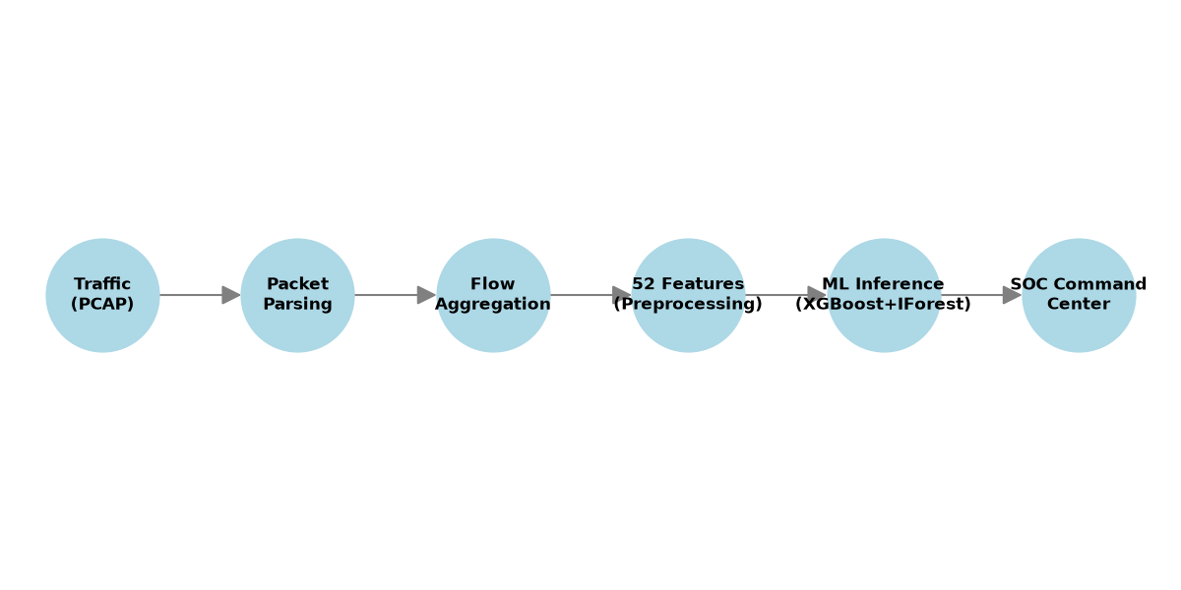
TECHNICAL APPROACH
Your Team Name
Architecture Pipeline:
Traffic / PCAP → Packet Parsing → Flow Aggregation → 52 Canonical Features → Preprocessing → ML Models → SOC Command Center via REST/WebSocket
AI & Feature Engineering:
- Models: XGBoost, Random Forest, Logistic Regression, Isolation Forest
- 52 canonical features (41 usable post-preprocessing). Highlights: flow behavior, packet size, IAT, TCP flags, directionality.
- Explainability: MITRE ATT&CK contextual mapping & deterministic rationale.

Slide 4
FEASIBILITY AND VIABILITY
Your Team Name
Analysis of the feasibility of the idea
Potential challenges and risks
Strategies for overcoming these challenges

Slide 5
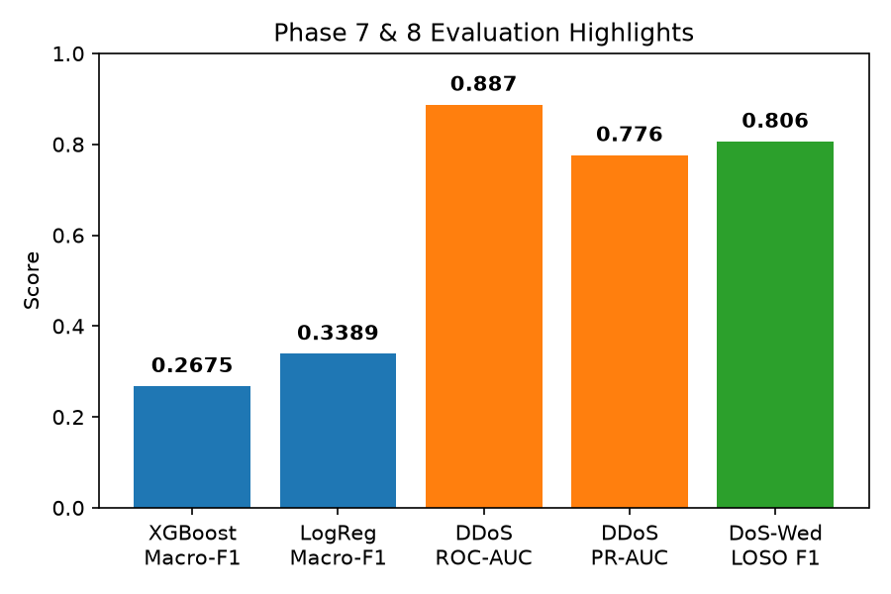
IMPACT AND BENEFITS
Your Team Name
Performance & Generalization Results:
- Supervised: XGBoost macro-F1 (0.2675); Logistic Regression macro-F1 (0.3389).
- Anomaly & Novel Threat Findings: Isolation Forest provides crucial novelty-ranking signal.
- Unseen DDoS: ROC-AUC 0.887, PR-AUC 0.776, Anomaly F1 0.571 (strongest generalization case).
- DoS-Wednesday LOSO F1: 0.806.
Target Use-Cases & Impact:
- Critical infrastructure monitoring and air-gapped/segmented environments.
- Empowers SOC analyst workflows through a seamless UI.

Slide 6
RESEARCH AND REFERENCES
Your Team Name
Details / Links of the reference and research work

