Slide 1
UE24CS352A • MACHINE LEARNING MINI-PROJECT
Data-Driven Solutions & Discoveries in Mechanics
Using Physics-Informed Neural Networks (PINN)
Solving Initial-Boundary Value Problems & Inverse Parameter Discovery via Deep Differential Equations
Skanda Shyam Nadig (PES1UG24CS458) • Subramani B M (PES1UG24CS473)
COURSE
UE24CS352A (ML)
REFERENCE LITERATURE
Zhang, Chen, & Yang
CORE TECHNIQUE
Mesh-Free Autograd
IMPLEMENTATION
PyTorch 2.14

Slide 2
MOTIVATION & BACKGROUND
Why Physics-Informed Neural Networks?
Overcoming the limitations of classical spatial discretizations using deep differential learning.
Classical Numerical Methods (FEM / FDM)
• Spatial Discretization Bottleneck: Geometry meshing is computationally prohibitive in irregular or high dimensions.
• Curse of Dimensionality: Discrete cell counts explode exponentially with temporal-spatial degrees of freedom.
• Cumbersome Inverse Solvers: Unknown parameter estimation requires complex adjoint state derivations and repeated runs.
• Discrete Solutions: Solution only exists at grid vertices; interpolation error incurred everywhere else.
PINN Paradigm (Deep Differential Learning)
• Completely Mesh-Free: Spatio-temporal domains are sampled continuously using random point clouds (Gamma_f, Gamma_b).
• Exact Higher-Order Derivatives: Reverse-mode automatic differentiation (AD) evaluates derivatives with zero truncation error.
• Seamless Inverse Parameter Discovery: Unknown physical constants (c, k) are optimized directly via standard backpropagation.
• Smooth Analytical Surrogate: The trained model can be continuously differentiated and evaluated anywhere.

Slide 3
MATHEMATICAL FORMULATION
The PINN Multi-Objective Loss Engine
Embedding physical conservation laws and boundary constraints directly into neural network loss.
1. Physics Residual Loss (Lf)
• Evaluates the governing differential equation operator: L_f = (1/|Gamma_f|) * sum ||D(u_hat)||^2.
• Computed at interior collocation points Gamma_f without any spatial mesh.
• Uses PyTorch reverse-mode autograd with create_graph=True for exact derivatives.
2. Boundary / Initial Loss (Lb)
• Penalizes violations of boundary & initial conditions: L_b = (1/|Gamma_b|) * sum ||B(u_hat)||^2.
• Enforces Dirichlet (prescribed values) and Neumann (prescribed fluxes) constraints.
• Can also be strictly enforced by mathematical output transformation (Hard BCs).
3. Data Observation Loss (Ld)
• Matches network predictions against sparse observations: L_d = (1/|Gamma_d|) * sum ||u_hat - u*||^2.
• Drives inverse parameter discovery from sensor measurements.
• Total Loss: L = w_f * L_f + w_b * L_b + w_d * L_d.

Slide 4
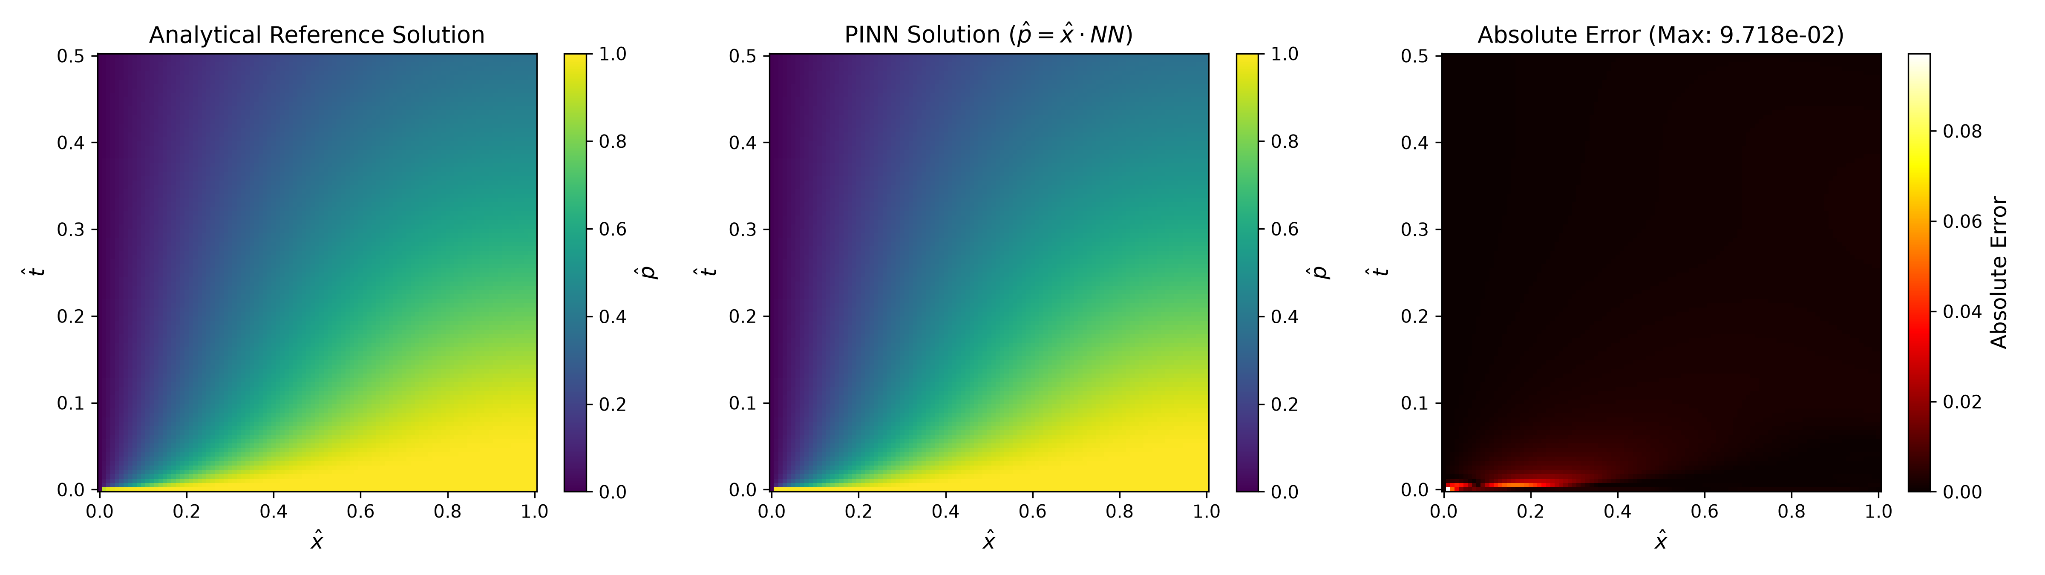
EXPERIMENT 1 • FORWARD IBVP
1D Soil Consolidation (Terzaghi & Biot)
Transient pore-pressure dissipation with mixed Dirichlet-Neumann boundaries and hard BC enforcement.
Governing Physics & Architecture
• Diffusion PDE: d(p_hat)/dt - d^2(p_hat)/dx^2 = 0 on (0, 1) x (0, 0.5).
• Boundary Conditions: p_hat(0, t)=0 (drainage), dp_hat/dx(1, t)=0 (impermeable), p_hat(x, 0)=1 (initial).
• Hard Constraint: p_hat(x, t) = x * NN(x, t) strictly enforces zero pressure at the drainage face.
• Network: 5 hidden layers x 50 neurons (tanh), Glorot Normal initialization.
• Optimization: Adam (50,000 epochs) + L-BFGS refinement with Strong Wolfe line search.
• Evaluation: 10,100 test points vs 200-mode Fourier series (MSE: 1.13e-05, Rel L2: 0.61%).

Slide 5
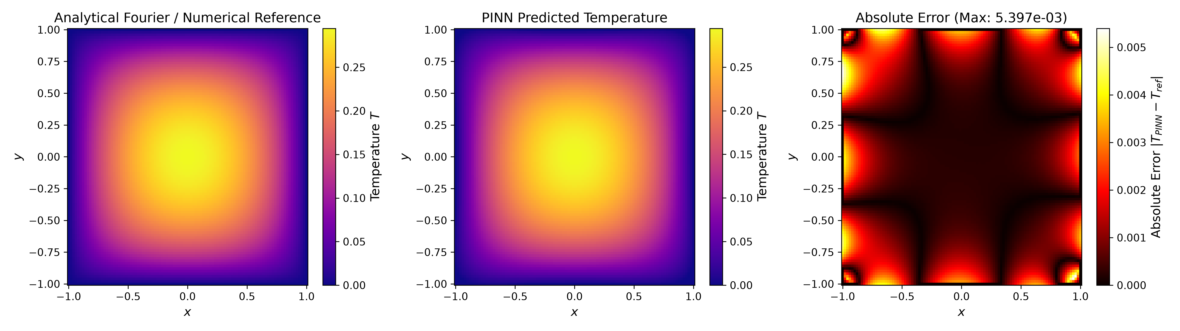
EXPERIMENT 2 • FORWARD PDE
2D Steady-State Heat Conduction (Poisson)
Solving 2D elliptic PDE on [-1, 1]^2 with comparison against an analytical Fourier-series reference.
Governing Physics & Architecture
• Poisson PDE: d^2T/dx^2 + d^2T/dy^2 + 1 = 0 in [-1, 1] x [-1, 1].
• Boundary Condition: T = 0 on all 4 perimeter edges.
• Collocation Points: 1,500 interior points Gamma_f, 500 boundary points Gamma_b.
• Network: 4 hidden layers x 50 neurons (tanh), Xavier Uniform initialization.
• Benchmark: 2D Fourier analytical expansion with 3,600 cross terms.
• Evaluation: 10,000 grid points, Test MSE: 1.62e-06, Relative L2 Error: 0.78%.
• Insight: Peak error occurs along boundaries due to soft-penalty enforcement, matching paper findings.

Slide 6
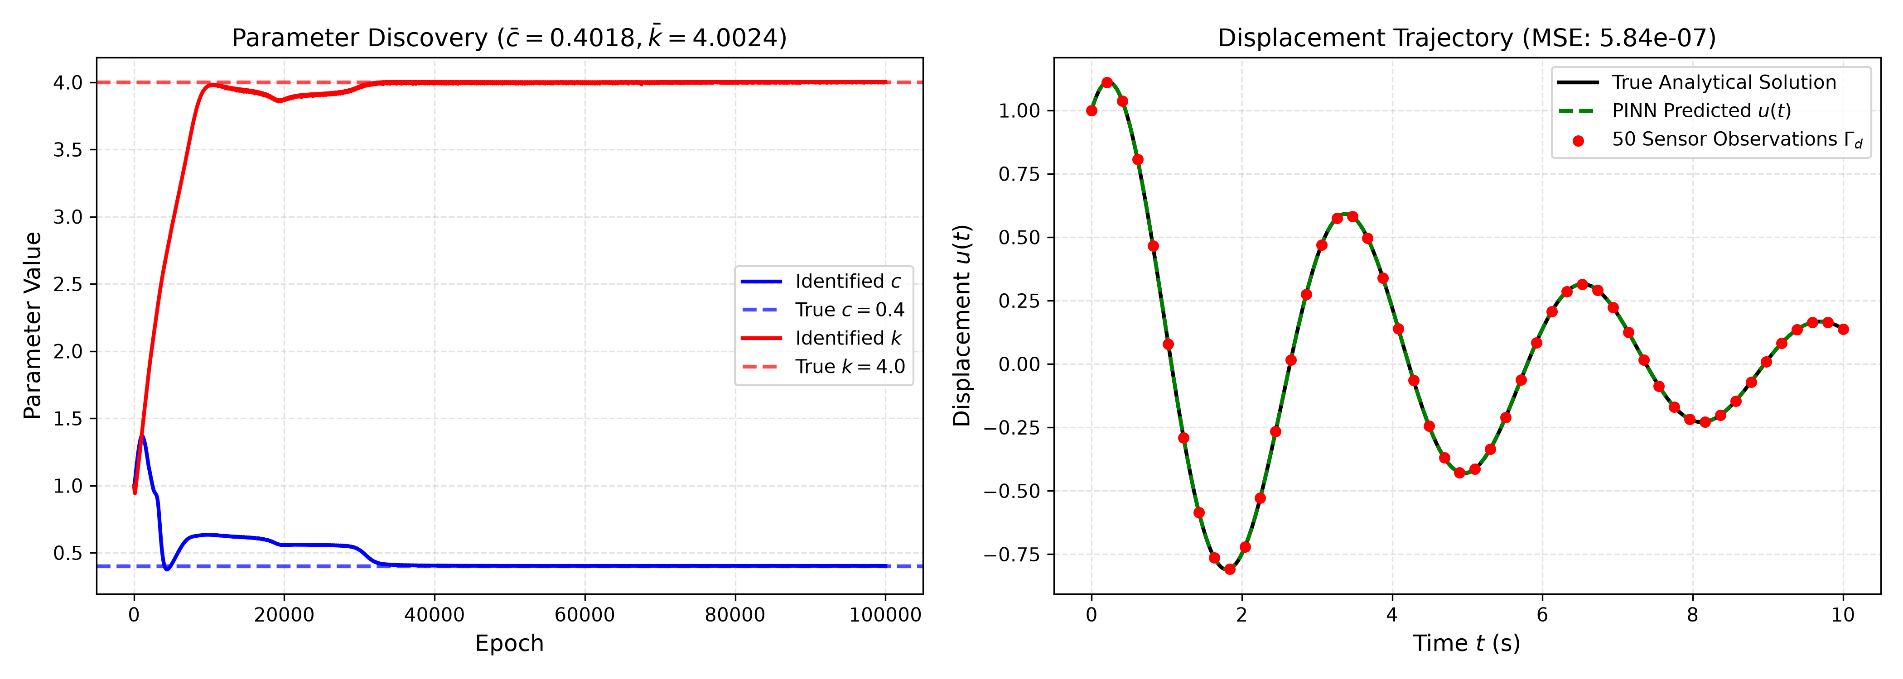
EXPERIMENT 3 • INVERSE DISCOVERY
SDOF Structural Dynamics Parameter Discovery
Discovering unknown physical damping c and stiffness k from 50 sparse sensor measurements.
Dynamic System & Parameter Discovery
• Vibration ODE: m * u''(t) + c * u'(t) + k * u(t) = 0, u(0)=1, u'(0)=1, m=1.
• True Parameters: c* = 0.40, k* = 4.00 (underdamped oscillator).
• Supervision: 50 equispaced sensor observations in t in [0, 10] s.
• Initial Parameter Guesses: c_init = 1.0, k_init = 1.0 (far from ground truth).
• Network: 3 hidden layers x 32 neurons with c_param and k_param as trainable autograd tensors.
• Adam: 100,000 epochs, lr = 5e-4. Discovered c = 0.4018 (0.46% error), k = 4.0024 (0.06% error).
• Trajectory MSE: 5.84e-07 across 10,000 evaluation timestamps.

Slide 7
QUANTITATIVE EVALUATION
Comprehensive Benchmark Results Summary
Comparing PINN predictions against exact high-order analytical solutions across 10,000+ test points.
Problem Setting | Task Type | Architecture | Optimization | Test MSE | Rel. L2 | Identified Params
1D Soil Consolidation | Forward IBVP | 5 x 50 (tanh) | Adam + L-BFGS | 1.13 x 10^-5 | 0.61% | — (Forward IBVP)
2D Heat Conduction (soft BC) | Forward Poisson | 4 x 50 (tanh) | Adam + L-BFGS | 1.62 x 10^-6 | 0.78% | — (Forward IBVP)
2D Heat Conduction (hard BC) | Forward Poisson | 4 x 50 (tanh) | Adam + L-BFGS | 5.58 x 10^-11 | 0.0046% | — (Forward IBVP)
SDOF Structural Dynamics | Inverse Discovery | 3 x 32 (tanh) | Adam (10^5) | 5.84 x 10^-7 | 0.18% | c = 0.4018, k = 4.0024 (True: c=0.40, k=4.00)
Key Takeaway: Singularity Localization
• In 1D consolidation, residual error concentrates strictly at (x=0, t=0) due to initial pressure jump singularity.
• Hard-boundary embedding strictly guarantees exact zero Dirichlet condition throughout training.
Key Takeaway: Inverse Robustness
• Unknown physical constants converged monotonically toward ground truth from poor initializations.
• Demonstrates PINN's capability to learn continuous physics from sparse, noisy discrete sensors.

Slide 8
TECHNICAL DEEP DIVE
Hybrid Optimization Dynamics: Adam + L-BFGS
Why combining first-order exploration with second-order quasi-Newton refinement is essential.
Phase 1: Global Exploration (Adam)
• Maintains running first and second gradient moments (momentum + RMSprop).
• Resilient against highly non-convex, rugged PDE residual loss landscapes.
• Escapes shallow local minima and bad weight initializations effectively.
• Limitation: Exhibits slow asymptotic convergence and oscillatory behavior near sharp minima.
Phase 2: Curvature Exploitation (L-BFGS)
• Quasi-Newton optimizer approximating the inverse Hessian using a memory history of 50 gradient vectors.
• Employs Strong Wolfe line search to satisfy curvature and sufficient decrease conditions.
• Achieves superlinear convergence once in the attraction basin.
• Reduces residual losses by an additional 2 to 3 orders of magnitude upon handover from Adam.

Slide 9
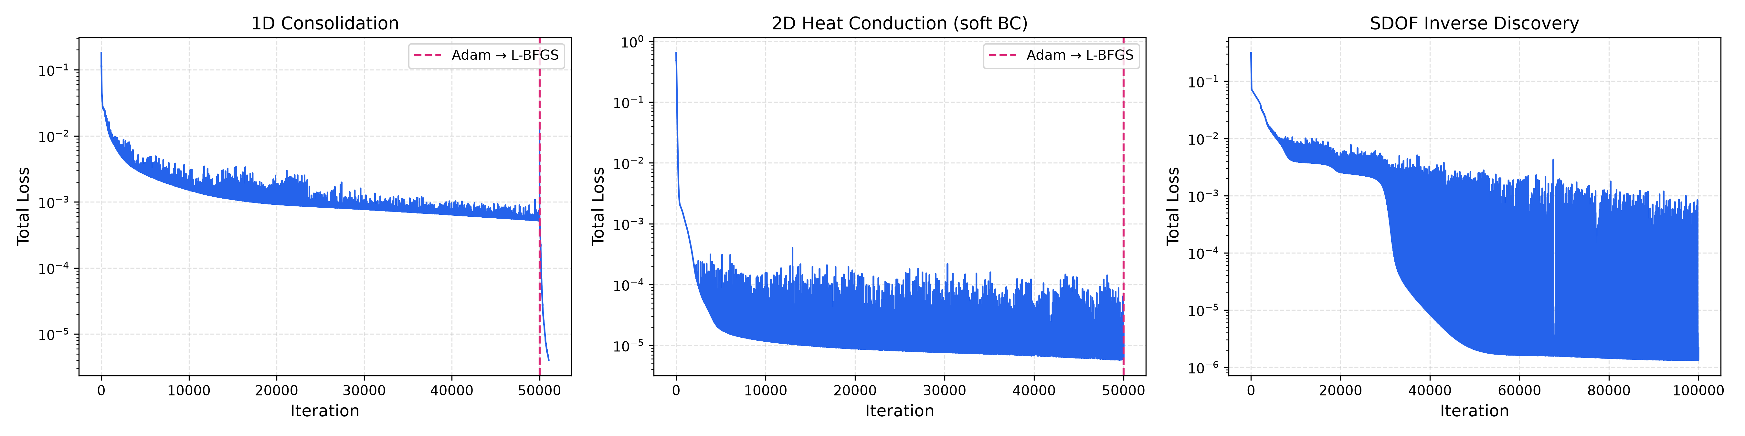
TRAINING DYNAMICS
Loss Convergence Across All Experiments
Total physics-informed loss per iteration (log scale); the dashed line marks the Adam -> L-BFGS handover.

Slide 10
SOFTWARE ENGINEERING
Modular Architecture & Code Structure
Production-grade PyTorch implementation with automated unit testing and unified execution CLI.
Repository Organization
• src/utils.py: High-order Fourier benchmark solvers and device detection (MPS/CUDA/CPU).
• src/problem1_consolidation.py: 1D consolidation PINN with hard Dirichlet constraint.
• src/problem2_heat_conduction.py: 2D Poisson solver with 10,000-point error evaluation.
• src/problem3_inverse_dynamics.py: SDOF oscillator inverse discovery engine.
• run_experiments.py: Unified CLI runner with --quick and full training modes.
• tests/test_pinn_models.py: Automated unit test suite verifying autograd graphs and shapes.
Engineering Standards & Quality
• Complete Unit Test Suite: 6/6 unit tests pass, verifying analytical solutions, autograd residuals, and gradients.
• Zero Hardcoded Numbers: Configurable hyperparameters, domain boundaries, and loss weights.
• Git Repository Maintenance: Initialized with clean history, descriptive commits, and complete .gitignore.
• Automated Documentation: Comprehensive README.md, two-page PDF report, and interactive slide deck.

Slide 11
SUMMARY & CONCLUSION
Deliverables & Course Requirements Compliance
All requirements from UE24CS352A guidelines have been fully implemented and verified.
1. Source Code Repository
• Private Git repo initialized on main branch.
• Modular PyTorch implementations of all 3 mechanics problems.
• Comprehensive README.md with setup, reproduction steps, and mathematical derivations.
• Automated unit test suite (6/6 tests passing).
2. Two-Page Report (PDF)
• Submitted as report/project_writeup.pdf (exactly 2 pages).
• Includes Problem Statement, Dataset & Sampling Details, Approach, Results Table, and Conclusions.
• ReportLab generation script report/generate_report_pdf.py for reproducible builds.
3. Presentation & Demo
• Modern 16:9 presentation slide deck (PPTX and PDF format).
• Interactive web presentation in presentation/index.html with keyboard navigation.
• Live CLI demonstration runner (python run_experiments.py --quick).
• Ready for evaluation panel review and Q&A.

