Slide 1

- Skanda Vishwanath

Slide 2
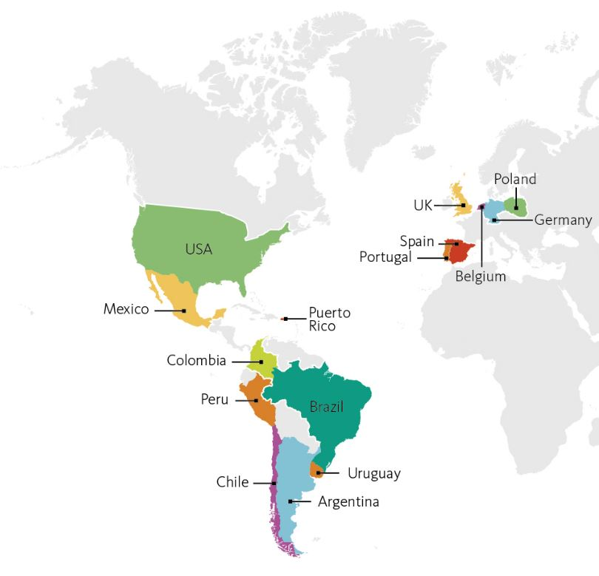
BACKGROUND & OBJECTIVE
Background:
Santander is a popular bank from Spain
The group has expanded since 2000 through a number of acquisitions, with operations across Europe, Latin America, North America and Asia.
They offer a wide variety of products and services and have over $54 Billion in deposits
Objective:
Predict the products that Santander’s customers will use in the coming month based on their past preferences and customers attributes

Slide 3
Data Cleaning
Identify NAs
Impute NAs using business context.
Delete redundant columns
Recalculated tenure variable
Summary Statistics
3 channels contribute to 80% of all purchases
Average number of products per customer falls over time
Trend is consistent over every segment of customers
Almost no new customers get added between January and June
Creation of Analytical Dataset
Encapsulate customer journey up to the last month
How?
Roll up data for up to the last month
For each product, added number of times each customer subscribed to the product , number of breaks and the whether or not he is a current subscriber
Added a label column for each combination of subscription

Slide 4
Model Building and Results
Model Used:
PCA + Multinomial Logistic model
Results:
Accuracy rate of 95.5% was achieved

