Slide 1
DEEP LEARNING · PROJECT 1
CIFAR-10 Image Classification
with a Convolutional Neural Network
Build · Train · Evaluate — a 3-day iterative modeling project
Skander
Ironhack AI Engineering Bootcamp
Notes:
Welcome, project overview: 3-day CNN project on CIFAR-10, 7 models built and compared.

Slide 2

Goal & Dataset
Classify images into 10 categories using a CNN trained on CIFAR-10.
60,000
10
32×32
6,000 images
per class
total images
balanced classes
pixel resolution
Officially pre-split and pre-labeled — no manual annotation required. CIFAR-10 is a public benchmark dataset from the University of Toronto (2009), the standard first dataset for learning CNNs.
45,000 train 5,000 validation 10,000 test
Classes: airplane · automobile · bird · cat · deer · dog · frog · horse · ship · truck
Notes:
CIFAR-10: 60k images, 10 balanced classes, standard benchmark dataset, not something Ironhack built themselves.

Slide 3

Approach & Architecture
Iterative, one-change-at-a-time strategy across 7 models.
1
Start simple
Base CNN Design
Build a baseline CNN (3 conv blocks)
Conv2D 32 · 3×3
MaxPooling 2×2
2
Change one thing
Conv2D 64 · 3×3
Filters, augmentation, dropout, epochs, LR, transfer learning
MaxPooling 2×2
Conv2D 64/128 · 3×3
3
Track & compare
Flatten
Log accuracy + notes after every model
Dense 64
Dense 10 · Softmax
Filters grow with depth (32→64→128); resolution shrinks each pool — simple edges early, abstract shapes later.
Notes:
Explain the 3-step iterative approach and walk through the base CNN architecture stack.

Slide 4

All 7 Models — Validation Accuracy
One targeted change per model to isolate what actually works.
Best model
Model 5
77.4%
validation accuracy
Augmentation + 25 epochs
+ Early Stopping restored best weights, keeping the train/val gap under 3%.
*Model 6: training repeatedly interrupted by a Colab connection issue — not fully comparable.
Notes:
Walk through the bar chart, then land on Model 5 as the winner and why.

Slide 5


What Actually Helped?
Testing one variable at a time revealed which changes really mattered.
WORKED
DIDN'T HELP
Data Augmentation
Dropout on top of augmentation
Nearly eliminated overfitting (train/val gap flipped negative)
No extra benefit once augmentation already controlled overfitting
More training time
Transfer Learning (VGG16)
25 vs 10 epochs + early stopping → biggest single gain: +6.9%
Slightly worse + more overfitting — ImageNet photos differ from CIFAR-10
Notes:
Key lesson: not every 'best practice' technique automatically helps — test and measure.

Slide 6
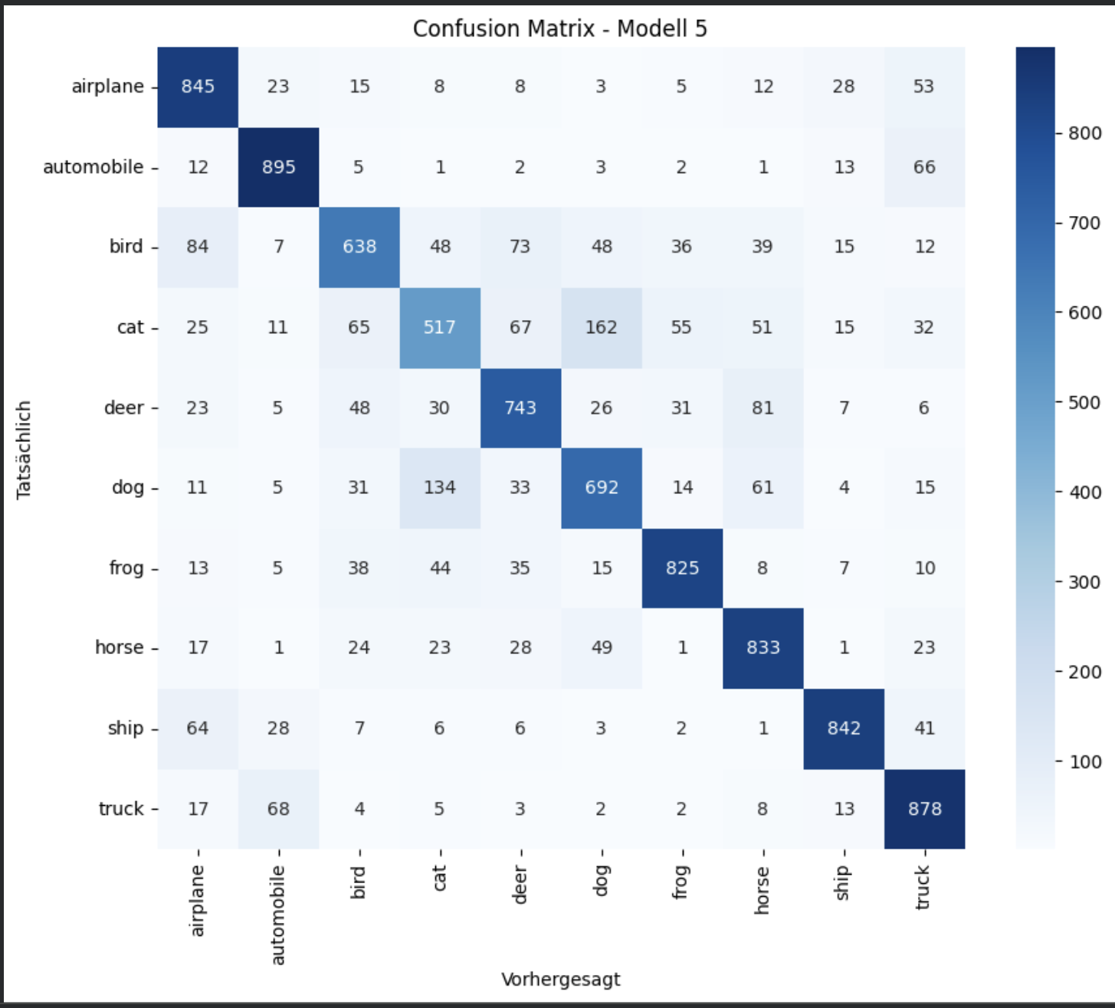
Evaluation — Where Does It Struggle?
Confusion matrix on the 10,000-image test set, Model 5.
Strongest
automobile (90%), ship, truck, frog, horse — clearly separated
Weakest: cat
Only 52% recall — most confused with dog
Main confusion
cat ↔ dog (both furry, four-legged pets)
Secondary
automobile ↔ truck (similar vehicle shape)
Test accuracy: 77.1% · F1 range 0.57 (cat) – 0.87 (automobile/ship)
Notes:
Cat/dog confusion is the dominant error — reasonable mistake, not random noise. Model learned real patterns.

Slide 7



Challenges, Conclusion & Next Steps
CHALLENGES SOLVED
Colab session drops
Result
Lost in-memory data → saved everything to Google Drive
77.1% test accuracy
Repeated training interruptions
Custom CNN · data augmentation · 25 epochs · early stopping
Solved with automatic ModelCheckpoint saving
Next steps
Overfitting (Models 1-2)
More epochs & augmentation types
Solved via data augmentation
Fine-tune upper VGG16 layers
Ensemble Model 5 + Model 7
Full code, report & analysis on GitHub
Thank you — questions?
Notes:
Wrap up: summarize the final result, technical challenges solved, and possible future improvements. Open for questions.

