Slide 1
DEEP LEARNING · PROJECT 1
CIFAR-10 Image Classification
with a Convolutional Neural Network
Build · Train · Evaluate — a 3-day iterative modeling project
Skander
Ironhack AI Engineering Bootcamp
Notes:
Welcome, project overview: 3-day CNN project on CIFAR-10, 7 models built and compared.

Slide 2

Intro — Dataset & Solution Overview
Classify CIFAR-10 images into 10 categories using a CNN, built and refined iteratively.
60,000
10
32×32
Solution Overview
total images
balanced classes
pixel resolution
Built 7 CNN variants, one targeted change per model
Dataset: CIFAR-10 — public benchmark dataset, University of Toronto (2009)
Compared filters, augmentation, dropout, training length, learning rate, and transfer learning (VGG16)
Classes: airplane · automobile · bird · cat · deer · dog · frog · horse · ship · truck
45,000 train 5,000 validation 10,000 test
Logged every result to isolate what actually improves accuracy
Best model: custom CNN, 77.1% test accuracy
Notes:
Dataset: CIFAR-10, 60k images, 10 classes. Solution: 7 iteratively built CNN models, best reaching 77.1% test accuracy.

Slide 3





Data Processing Pipeline
From raw CIFAR-10 images to model-ready batches.
Load
Normalize
Split
Augment
60,000 images via Keras (no manual download)
Pixels scaled from [0,255] to [0,1]
45k train / 5k validation / 10k test
Random rotation, shift, horizontal flip (live, training only)
Note: the official 10,000-image test set is kept fully separate — never used in training, validation, or augmentation.
Data augmentation is applied only from Model 3 onward, and only to the training set — the validation/test sets always use the original, unaltered images to keep evaluation honest.
Notes:
Explain the 4-step pipeline: load, normalize, split, augment (training only). Test set is never touched.

Slide 4

CNN Architecture — Design
Base structure used across all custom models (Models 1-6).
1
Filters grow with depth
Layer Stack
32 → 64 → 128: simple edge/color detectors early, abstract class-specific shapes deeper
Conv2D 32 · 3×3 + ReLU
MaxPooling 2×2
2
Resolution shrinks each pool
Conv2D 64 · 3×3 + ReLU
Exact pixel position matters less than presence of a feature
MaxPooling 2×2
Conv2D 64/128 · 3×3 + ReLU
3
Flatten + Dense head
Flatten
Combines all detected features into a final 10-class decision
Dense 64 + ReLU
Dense 10 · Softmax
4
Softmax output
Optimizer: Adam · Loss: sparse categorical crossentropy · Batch size: 64
Converts raw scores into class probabilities summing to 100%
Notes:
Walk through the layer stack and explain why filter count grows while spatial size shrinks.

Slide 5
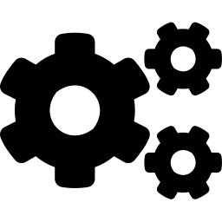

From Baseline to Final Model
One targeted change per model — the story of what improved accuracy.
M1
M2
M3
M4
M5
Baseline
+Filters
+Augment.
+Dropout
+25 Epochs
68.7%
71.1%
70.5%
70.3%
77.4%
Model 5 = winner: +6.9% from extended training alone, more than any other single change.
Optimization Techniques Used
Adam optimizer — adaptive learning rate, default lr=0.001
Early Stopping — patience=5 on val_accuracy, restores best weights
Data Augmentation — acts as regularization, nearly removed overfitting
Learning rate tuning — tested 0.0005 — no improvement over default
Notes:
Story: baseline improved with more filters, then augmentation fixed overfitting, dropout added nothing extra, and extended training with early stopping gave the biggest jump.

Slide 6


Transfer Learning — VGG16
An alternative approach: reuse a pretrained network instead of training from scratch.
Pretrained model: VGG16
RESULT
75.8%
Why VGG16?
Well-established, widely benchmarked ImageNet-pretrained CNN with a simple, well-documented architecture — a natural first choice for evaluating whether transfer learning outperforms a custom model on this task.
test accuracy — vs. 77.1% for the best custom CNN (Model 5)
Modifications made:
Slightly underperformed the custom CNN, with a larger train/validation gap (~9.6% vs ~2.3%).
Input resized from 32×32 to 96×96 (VGG16's minimum usable input)
Likely cause: VGG16 was pretrained on large, natural photographs (ImageNet). CIFAR-10's small, low-resolution images — even after upscaling — differ enough from that domain that the pretrained features transferred less effectively than expected.
Convolutional base loaded with ImageNet weights and frozen (not trainable)
Original 1000-class output head removed (include_top=False)
Custom head added: Flatten → Dense(64, ReLU) → Dense(10, Softmax)
Takeaway: transfer learning is not automatically superior — domain match matters.
Notes:
VGG16 chosen as a standard, well-known transfer learning baseline. Frozen convolutional base + custom dense head. Result: slightly worse than the custom CNN, likely due to domain mismatch between ImageNet and CIFAR-10.

Slide 7

All 7 Models — Validation Accuracy
One targeted change per model to isolate what actually works.
Best model
Model 5
77.4%
validation accuracy
Augmentation + 25 epochs
+ Early Stopping restored best weights, keeping the train/val gap under 3%.
*Model 6: training repeatedly interrupted by a Colab connection issue — not fully comparable.
Notes:
Walk through the bar chart, then land on Model 5 as the winner and why.

Slide 8
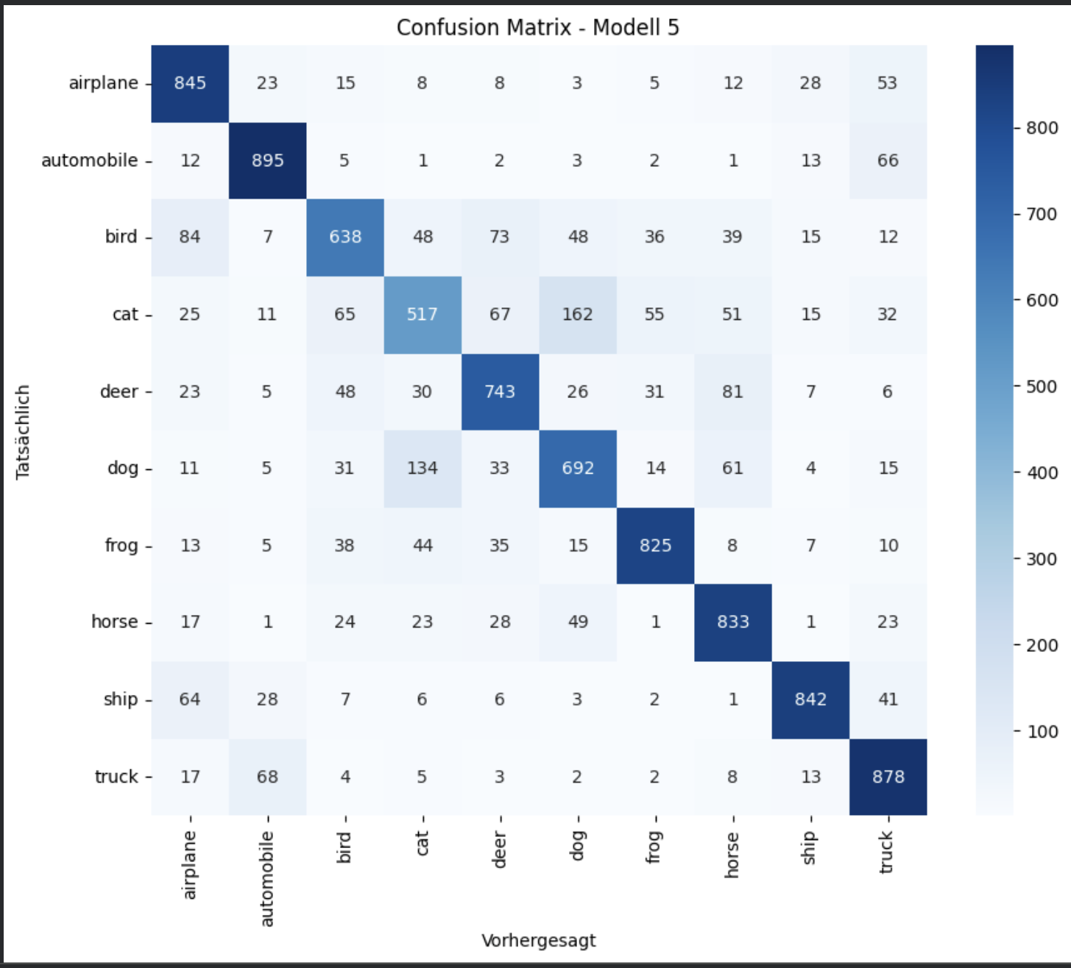
Evaluation — Where Does It Struggle?
Confusion matrix on the 10,000-image test set, Model 5.
Strongest
automobile (90%), ship, truck, frog, horse — clearly separated
Weakest: cat
Only 52% recall — most confused with dog
Main confusion
cat ↔ dog (both furry, four-legged pets)
Secondary
automobile ↔ truck (similar vehicle shape)
Test accuracy: 77.1% · F1 range 0.57 (cat) – 0.87 (automobile/ship)
Notes:
Cat/dog confusion is the dominant error — reasonable mistake, not random noise. Model learned real patterns.

Slide 9


Project Overview & Conclusion
CHALLENGES SOLVED
Colab session drops
Result
Lost in-memory data → saved everything to Google Drive
77.1% test accuracy
Repeated training interruptions
Custom CNN · data augmentation · 25 epochs · early stopping
Solved with automatic ModelCheckpoint saving
Next steps
Overfitting (Models 1-2)
More epochs & augmentation types
Solved via data augmentation
Fine-tune upper VGG16 layers
Ensemble Model 5 + Model 7
Full code, report & analysis on GitHub
Thank you — questions?
Notes:
Wrap up: summarize the final result, technical challenges solved, and possible future improvements. Open for questions.

