Slide 1
Jenkins
Saurabh Kandhway
02/06/2023

Slide 2
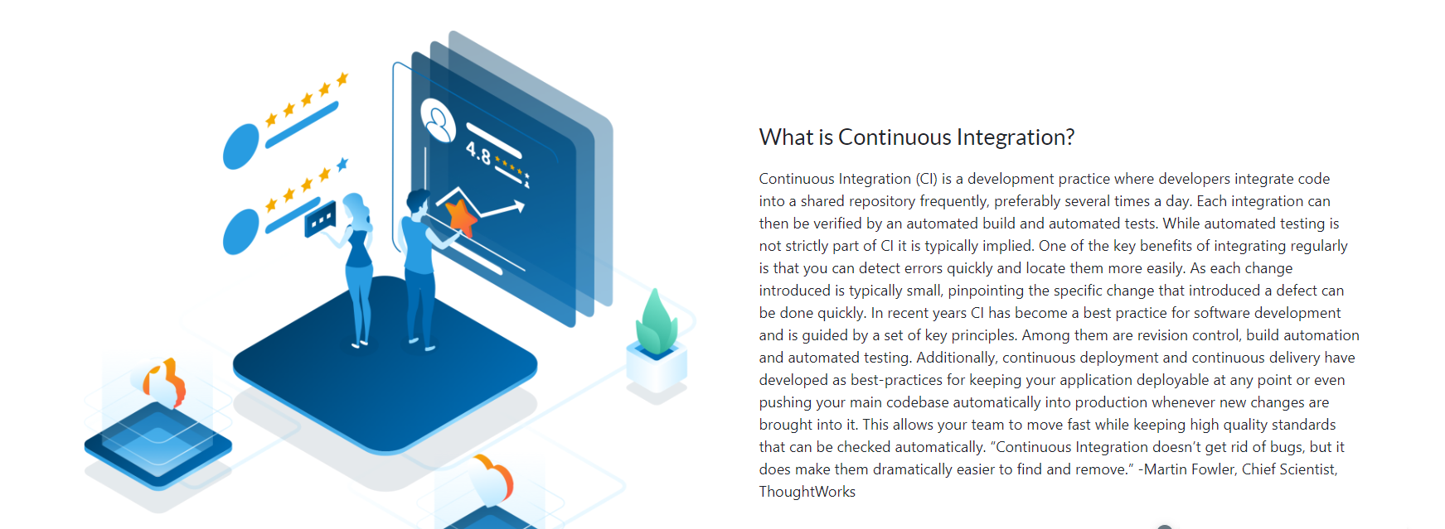
Continuous Integration

Slide 3
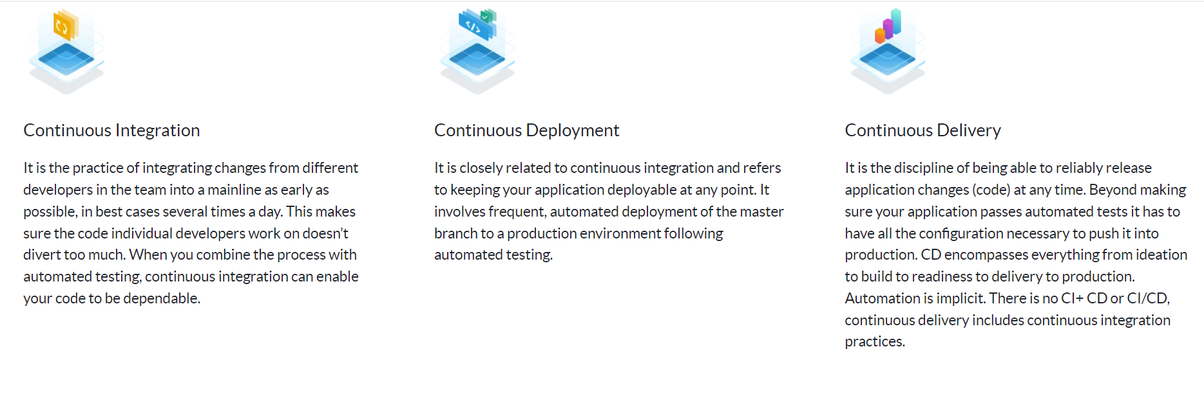
CICD Process

Slide 4
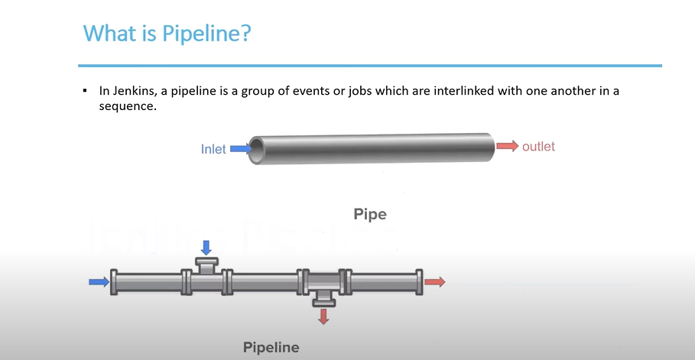
Pipeline

Slide 5
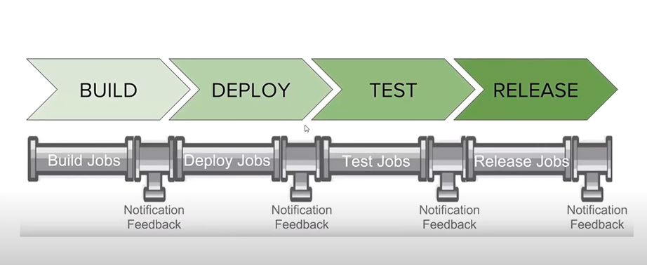
Stages of CICD

Slide 6
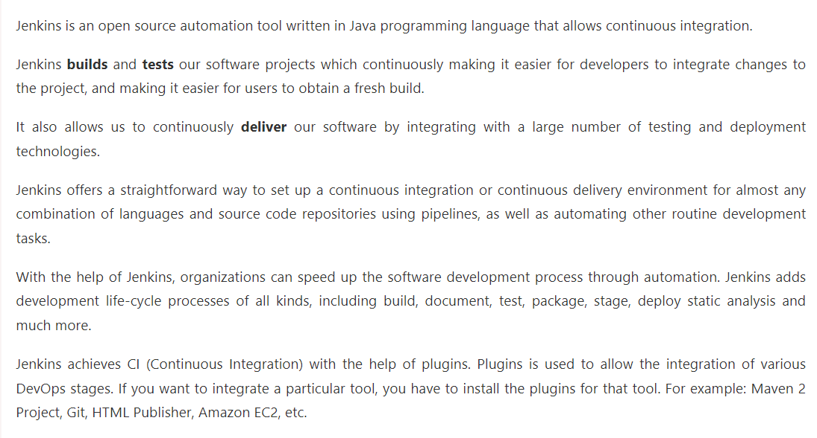
Jenkins –What is Jenkins

Slide 7
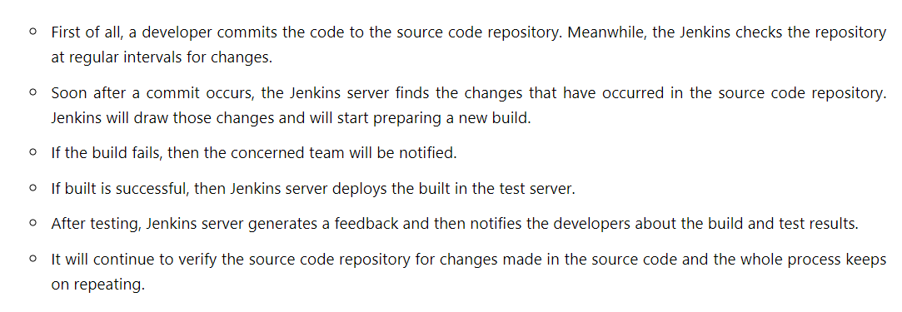
How does Jenkins work

Slide 8
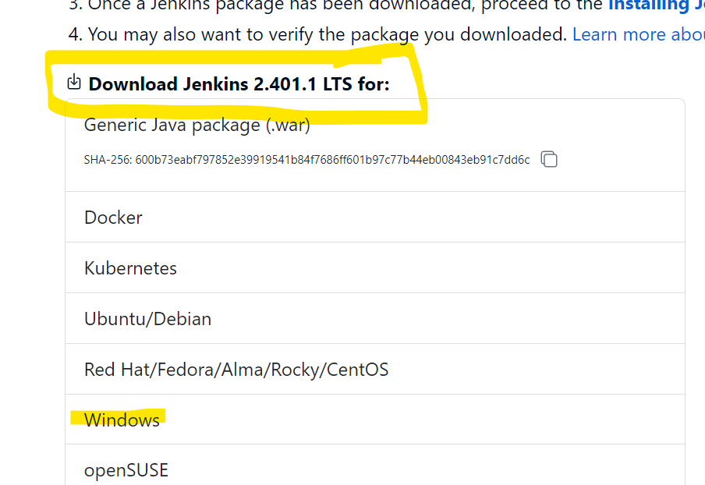
Set up jenkins
Download Jenkins
https://www.jenkins.io/download/

Slide 9
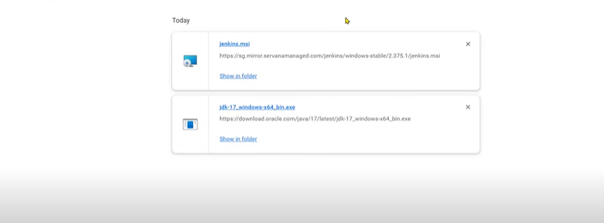
Set up jenkins

Slide 10
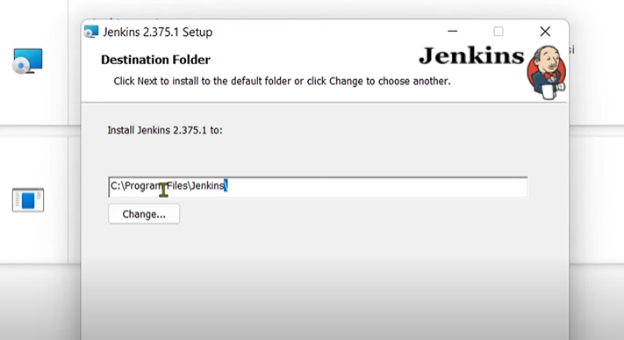
Set up jenkins

Slide 11
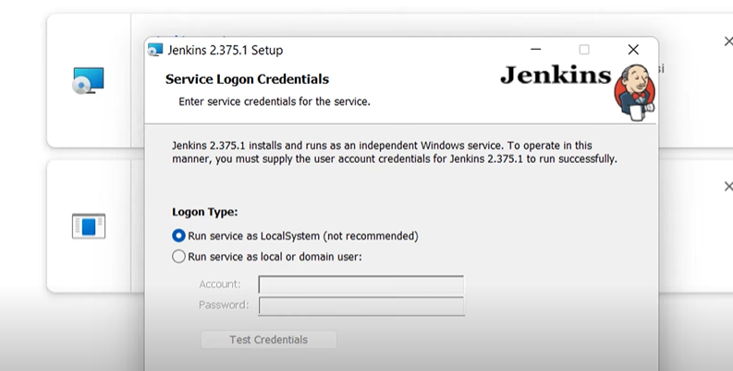
Set up jenkins

Slide 12
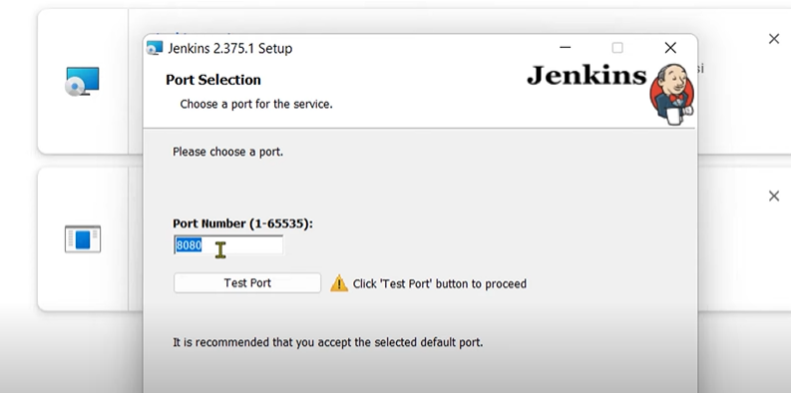
Set up jenkins

Slide 13
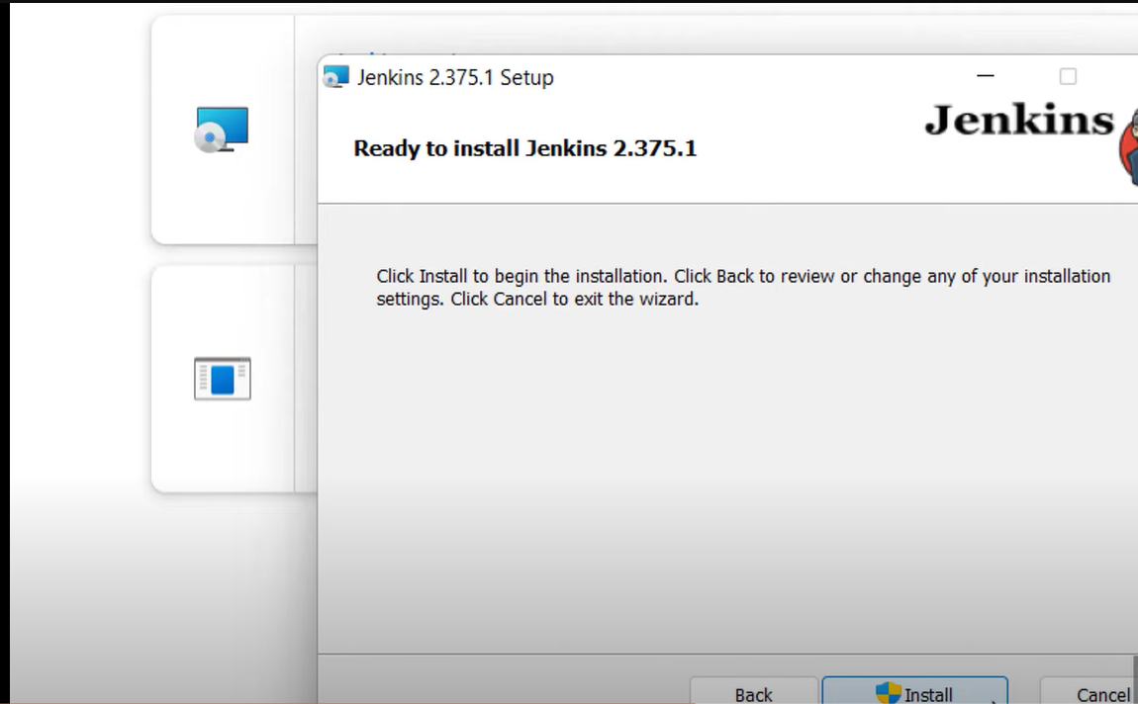
Set up jenkins

Slide 14
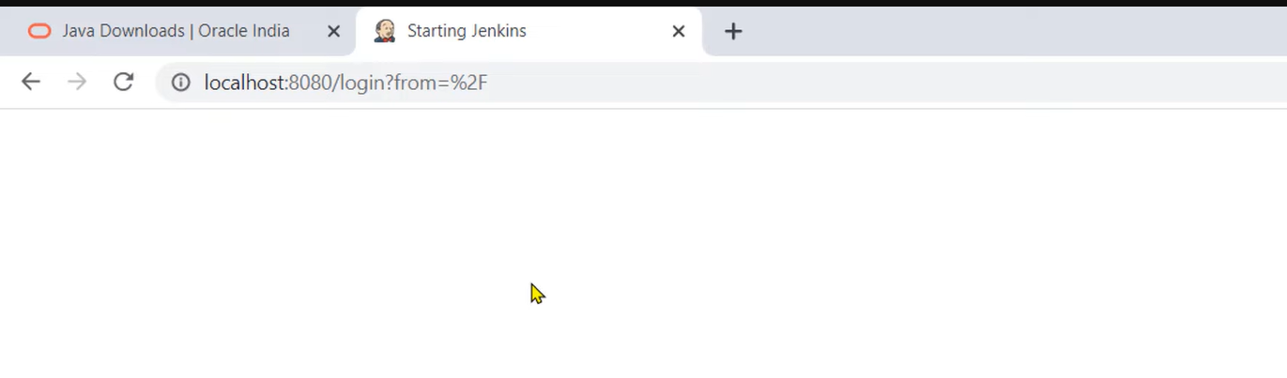
Set up jenkins

Slide 15
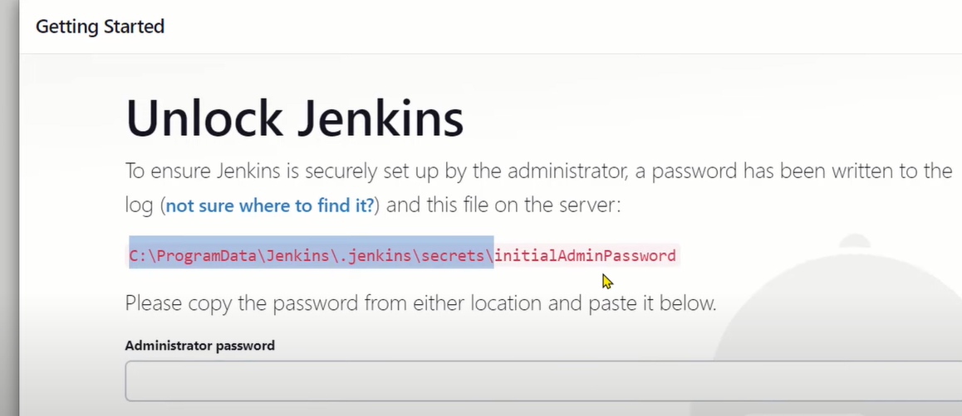
Set up jenkins

Slide 16
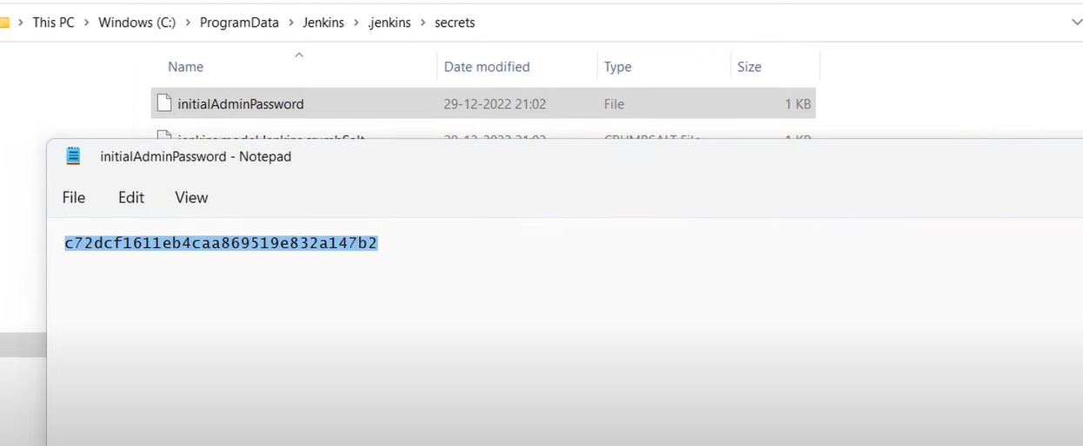
Set up jenkins

Slide 17
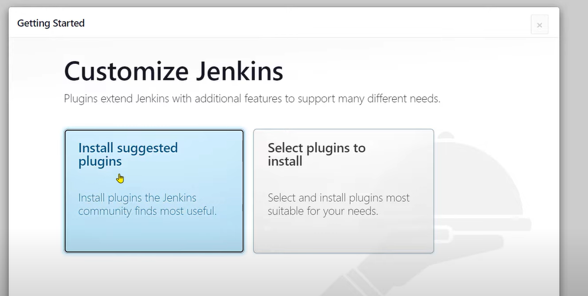
Set up jenkins

Slide 18
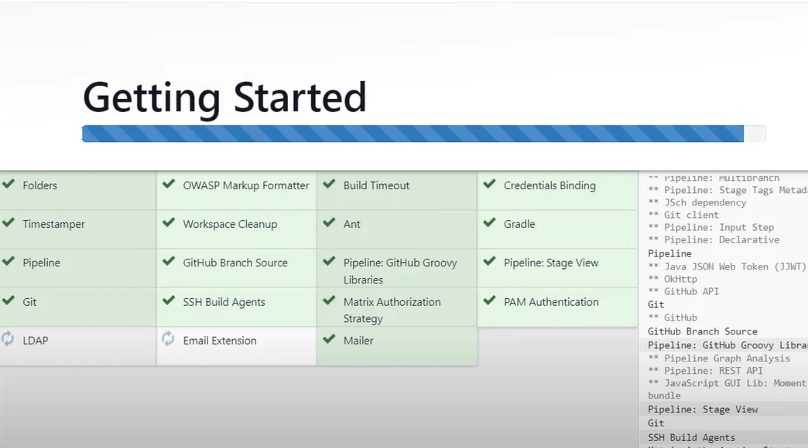
Set up jenkins

Slide 19
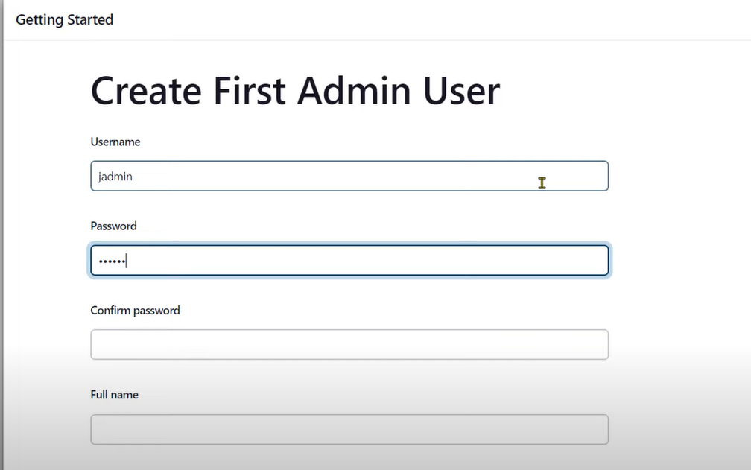
Set up jenkins

Slide 20
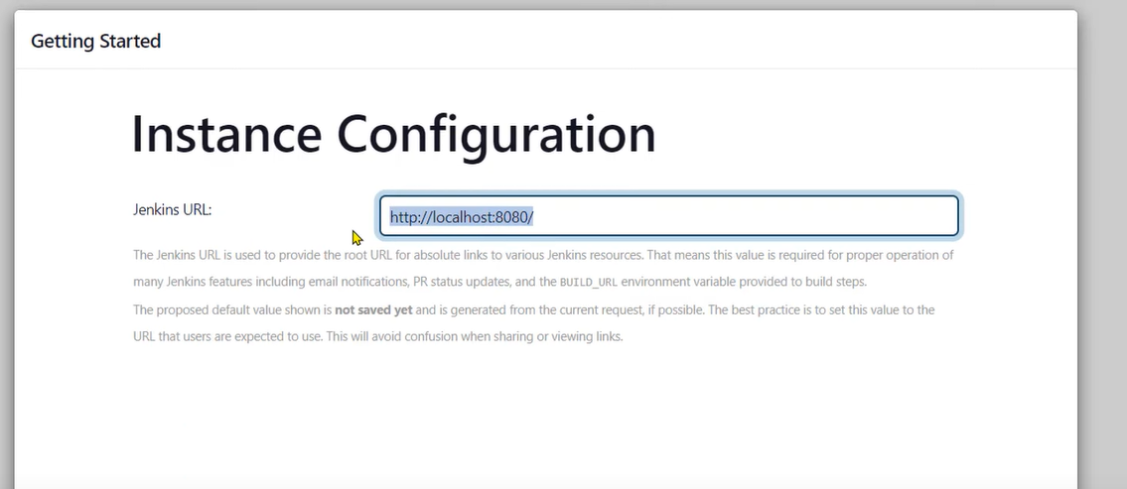
Set up jenkins

Slide 21
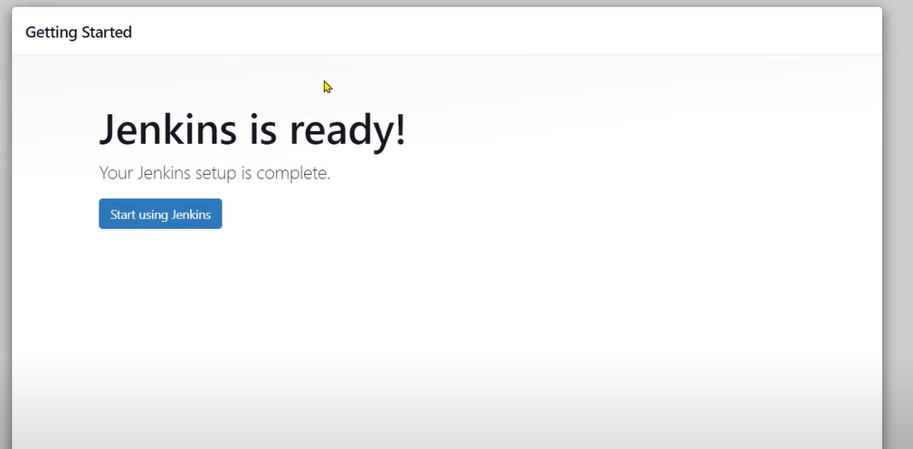
Set up jenkins

