Slide 2
Overview and Challenges with Legacy Approach
Earlier, you could only load a handful of different browsers on your local machine. So if you had a windows machine, you couldn’t test on Safari browsers. Similarly, if you had a Mac machine then you couldn’t test on IE or Edge browsers. In addition, running tests on a single machine was a time-consuming process. Also, if you have multiple computers, why test on a single one at a time?
The ideal scenario would be to test on a network of interconnected machines having different browser environments running multiple tests cases concurrently, in parallel, and reducing the overall testing time by multiple folds. And here I am also including time taken for cross browser testing as well.
This is exactly why Selenium Grid is built. It can help you test on all major browsers, all major operating systems, and even on mobile device browsers. You can get a huge browser coverage in all your functional tests ensuring the perfect experience for a wide range of your potential users.

Slide 3
What is Selenium GRID
Before we start with what is Selenium Grid, it is necessary to realize the basics of a Selenium Grid. Selenium Grid allows parallel testing against various browsers & OS combinations through a Client-Server model. Here, the Server is known as the Hub which has multiple Clients to interact with.
With Selenium Grid, you can connect a server to multiple remote machines which can then be used to run a browser automation script over multiple browser + OS configurations, simultaneously.
HUB-It is the center of the Selenium Grid architecture that manages the network of the test machines. There is only one hub in a network which is assigned to a test of DesiredCapabilities(operating system, browser, browser versions) and then the hub finds the test that matches the given configurations. A Selenium Hub is referred as the server.
Nodes-Nodes are the test machines that execute the test that was earlier loaded on the hub. There can be multiple nodes configured with a different operating system and different browsers. It is not mandatory for the node to run on the same platform on which the hub is running. Selenium nodes are referred as clients connected to a server i.e. a Hub.

Slide 4
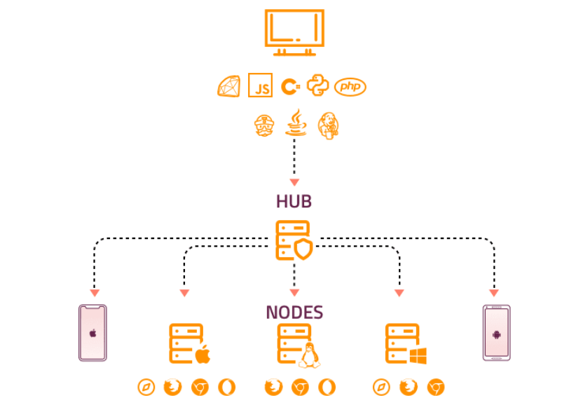
Architecture of Selenium GRID

Slide 5
Selenium Grid Setup Steps
Download and extract Selenium Standalone server JAR files. You can download them from here.(https://www.selenium.dev/downloads/)
Configuring A Selenium Hub
Configuring Nodes For Selenium Grid
Configuring ChromeDriver In Selenium Grid Setup
Configuring Firefox(Gecko) Driver In Selenium Grid Setup
Configuring IE(Internet Explorer) Driver In Selenium Grid Setup
Create a Java Class using TestNG Annotation to mention all the steps to execute
Create a TestNg.xml to handle capabilities of different browser and drivers

Slide 6
Drawback of Selenium Grid
However, the script would only run on the browser and browser version that is currently installed on the test machine. Suppose, if you try running your test on Chrome 72 and you only have Chrome 74 installed on your test machine, then your script would show an error. This same scenario occurs while you opt for the different operating system compared to the operating system of your test machines.
In addition, it is quite expensive to invest in new Mac and Windows environments every time a new OS is launched.
So, if you wish to perform automated cross browser testing on different browsers, browser versions and operating systems then I would recommend you look for a tool that offers Selenium Grid setup on-cloud, such as LambdaTest.

Slide 7
What is Lambda Test
LambdaTest is a cross browser testing platform on the cloud which allows you to test your website/ web application across 3000+ combinations of browsers, browser versions, and operating systems.
LambdaTest offers a cloud Selenium Grid to help you automate browser testing in parallel. You could also integrate your LambdaTest account with numerous CI/CD tools, project management tools, codeless automation tools etc. for faster go-to-market launch. Check out all of the LambdaTest integrations.Even perform live interactive real time cross browser testing, responsive testing of your web app/ website as well.
LambdaTest saves you from the hassle of maintaining your Selenium Grid setup, so you could focus on writing better automation code. LambdaTest also empowers you with that ability of Selenium Grid for parallel execution, all on the cloud.

Slide 8
Features of Lambda Test
We support automated cross-browser testing across 2,000+ real browsers, platforms, and device emulators.
Tests were executed on a scalable, reliable, and secure cloud-based Selenium Grid.
Minimal effort is required in porting local Selenium Grid tests to the cloud-based Selenium Grid by LambdaTest.
Supports automation testing with Selenium 4, the latest release of the Selenium framework.
Parallel testing in LambdaTest helps in reducing testing efforts, as automation tests can be executed concurrently across different browser and platform combinations. The extent of parallelism depends on the pricing plan with LambdaTest.
Test the locally hosted pages with the Lambda Tunnel–an SSH-based integration tunnel.
It lets you check the responsiveness of the website and web applications across different devices (iOS and Android) and viewport sizes.
It can be used to perform visual cross-browser testing across different devices and OS combinations. During the test cycle(s), the platform auto-generates full-page screenshots of the web pages which is a useful resource for visual testing.
It supports integration with popular CI/CD tools like Jenkins, CircleCI, GitLab CI, Semaphore CI, AWS CodePipeline, TeamCity, and more.

Slide 9
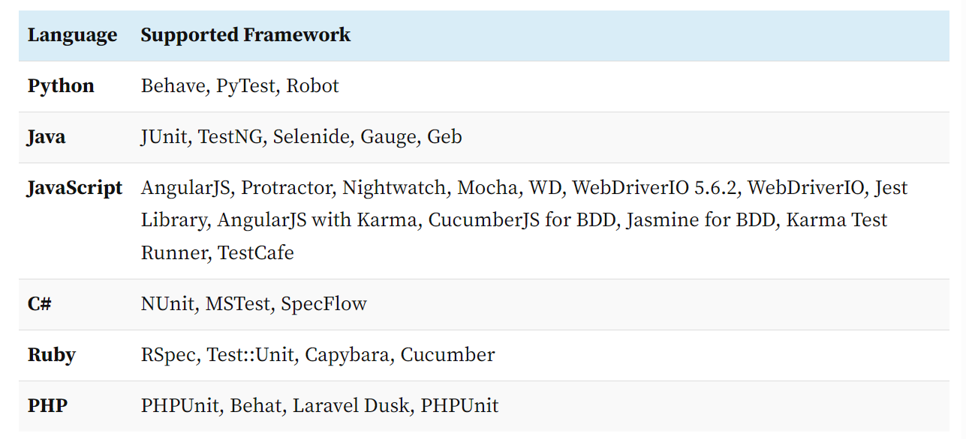
Programming Languages and Automation Framework Supported by LambdaTest

Slide 10
Extra Features With LambdaTest
Lambda Tunnel
Network Throttling
Geolocation Testing
Headless Browser Testing
Capture Network Logs
Testing at Different TimeZones
Mobile Testing with Appium

