Slide 1
Cucumber
Simplilearn – 31/03/2023

Slide 2
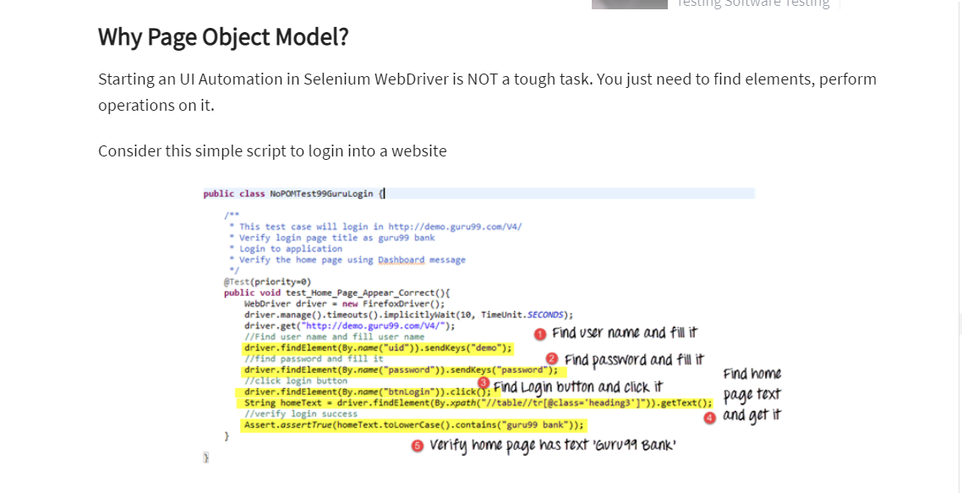
Why page object model

Slide 3
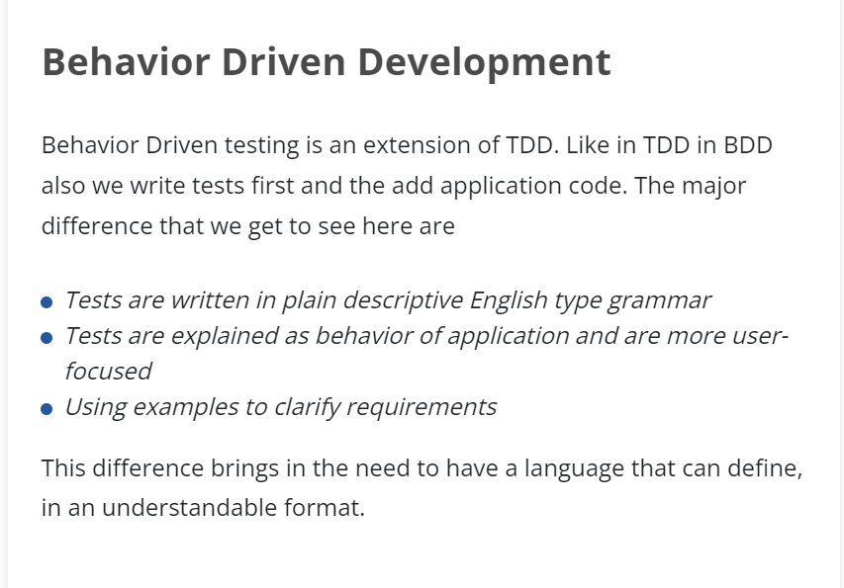
Behaviour Driven Development

Slide 4
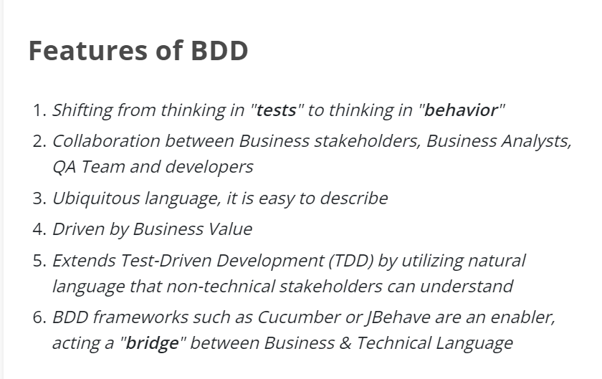
Features of BDD

Slide 5
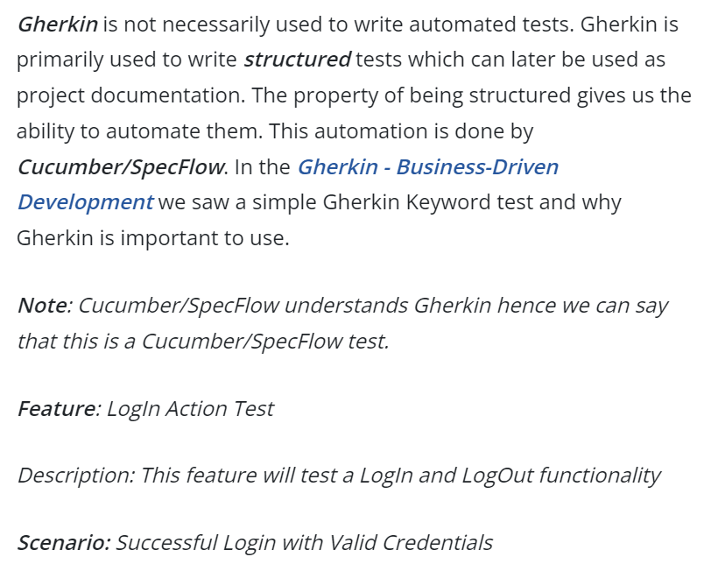
Gherkin Keyword

Slide 6
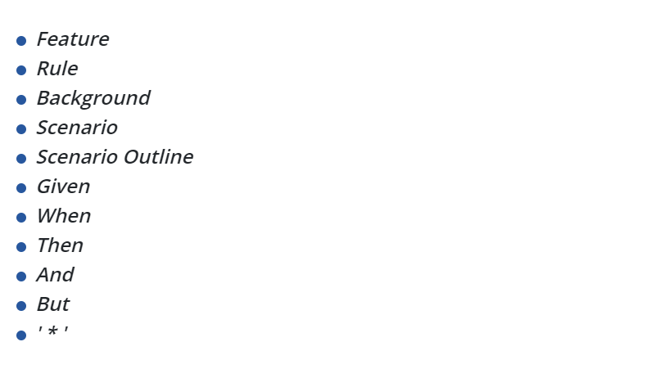
Different Keywords in Gherkin

Slide 7
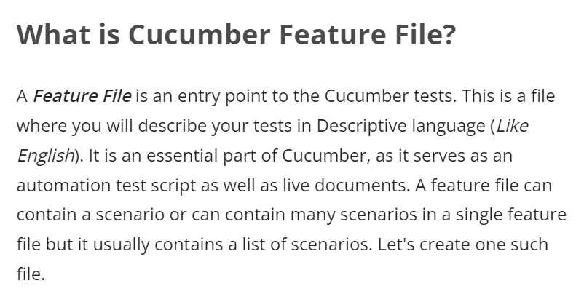
Feature File in Cucumber

Slide 8
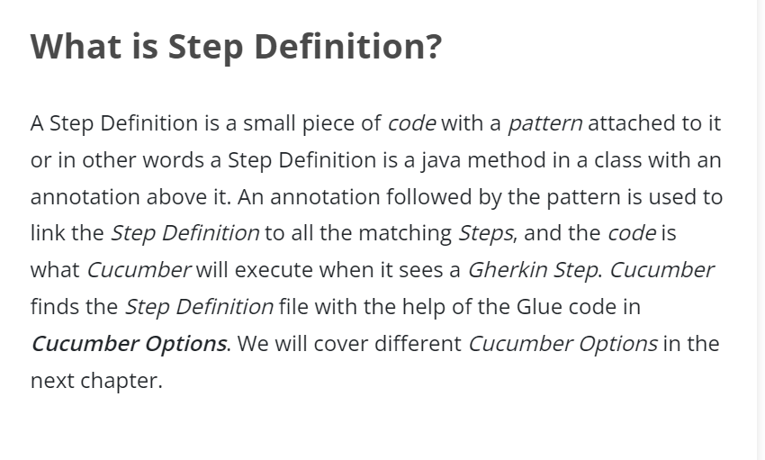
Step Definition in Cucumber

Slide 9
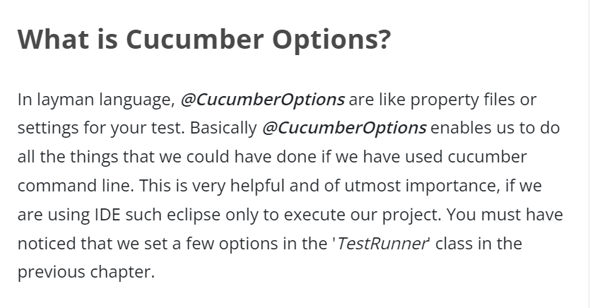
Options in Cucumber

Slide 10
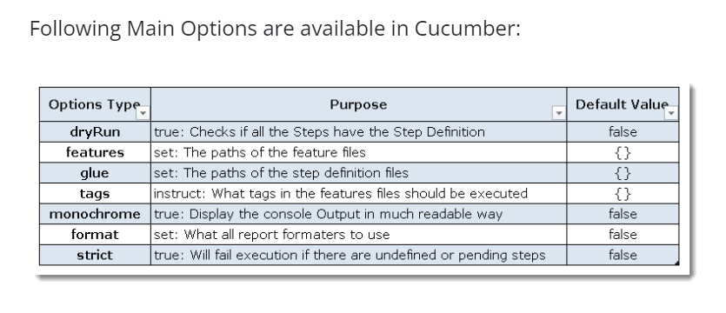
Cucumber Options

Slide 11
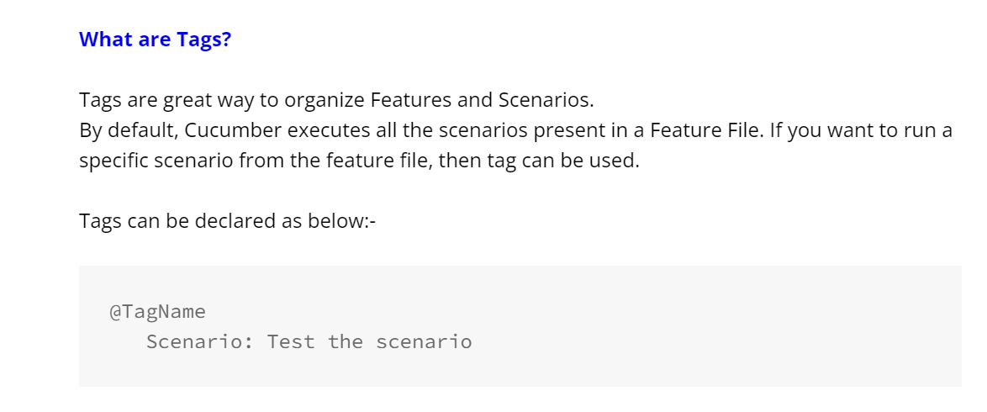
Cucumber Tags

Slide 12
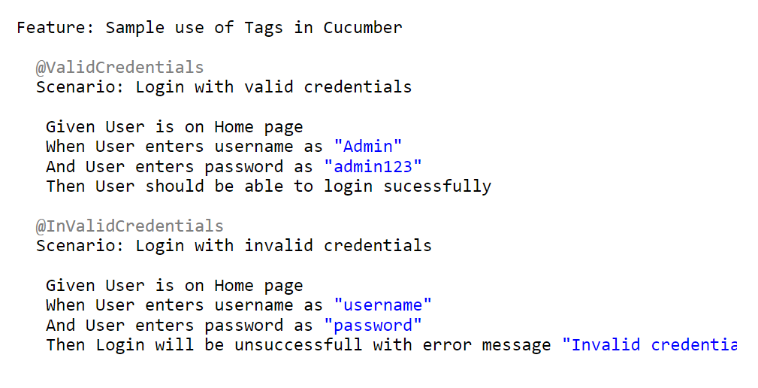
Basic Example of Cucumber Tags

Slide 13
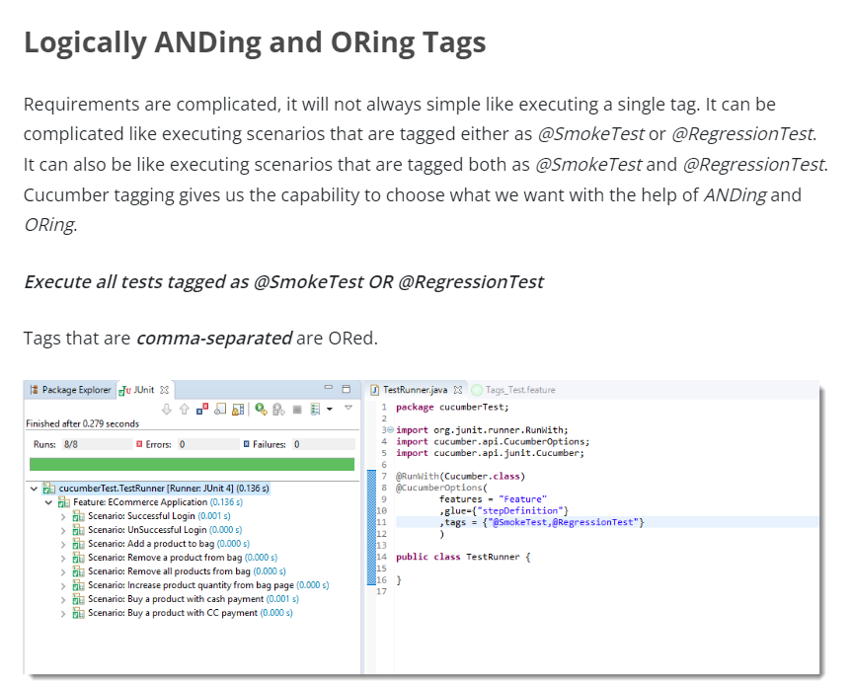
Logically ANDing and OR ing Cucumber Tags

Slide 14
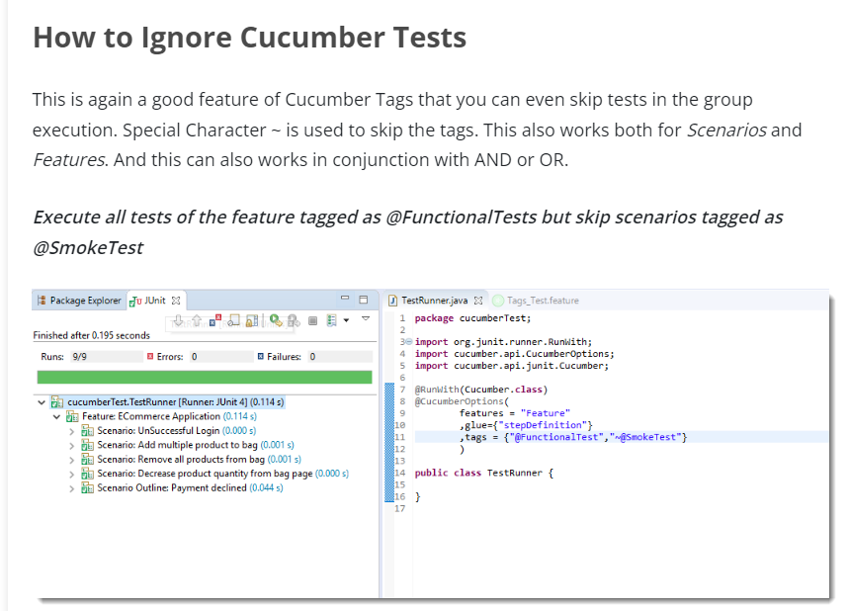
Ignoring Cucumber Tags

Slide 15
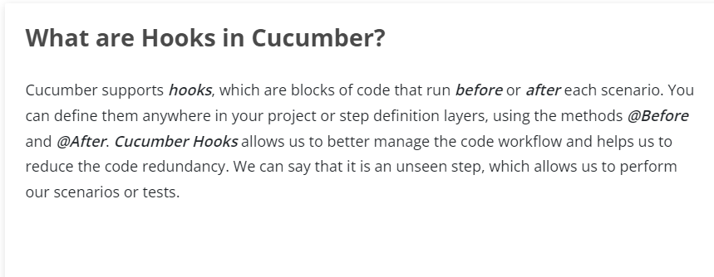
Cucumber Hooks

Slide 16
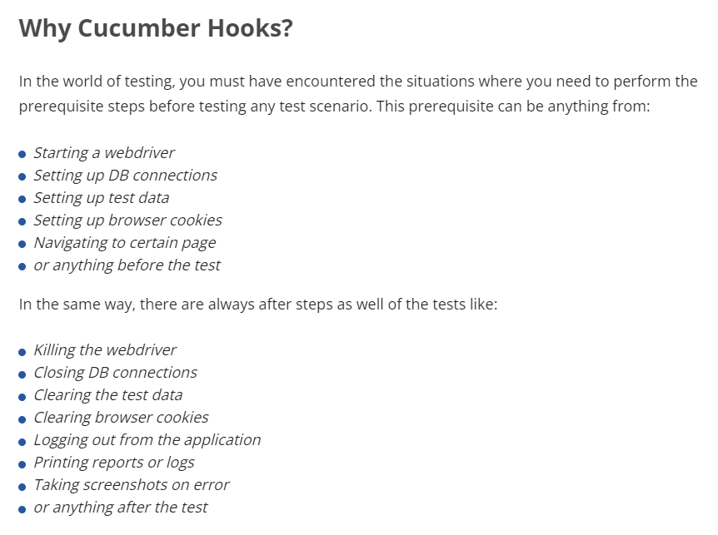
Why Cucumber Hooks ?

Slide 17
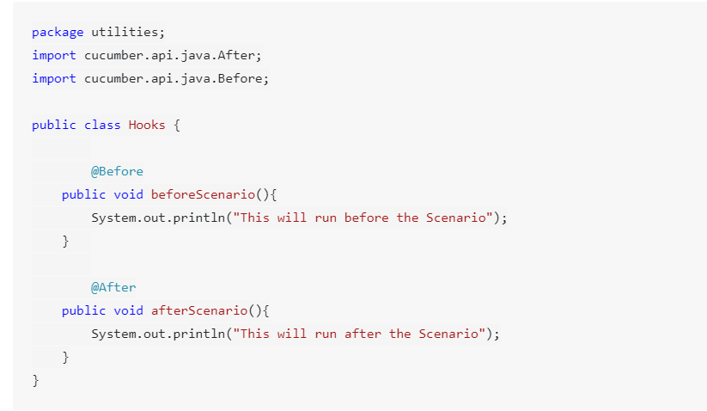
How to Use Cucumber Hooks

Slide 18
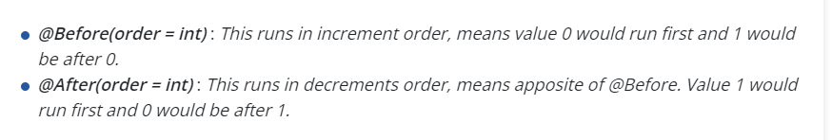
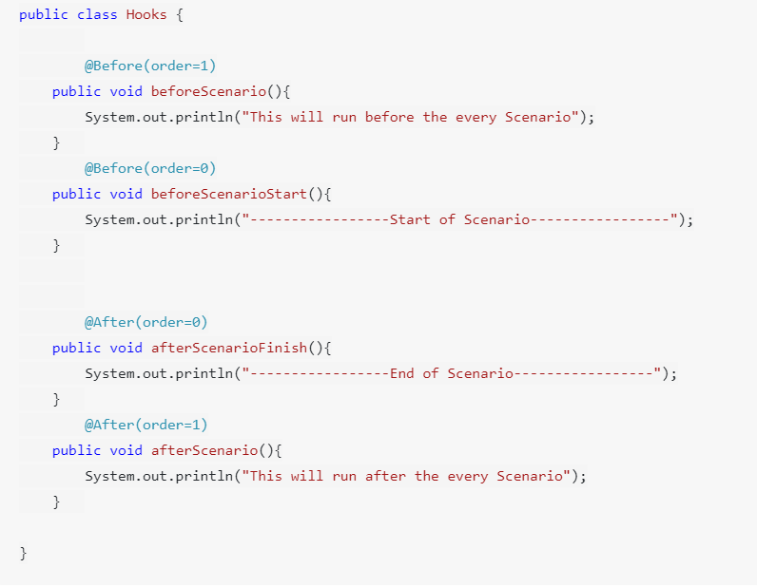
Priority of Cucumber Hooks

Slide 19
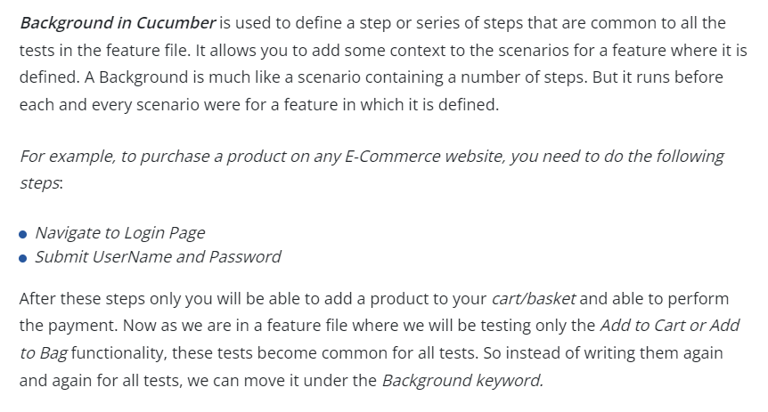
Background Keyword in cucumber

Slide 20
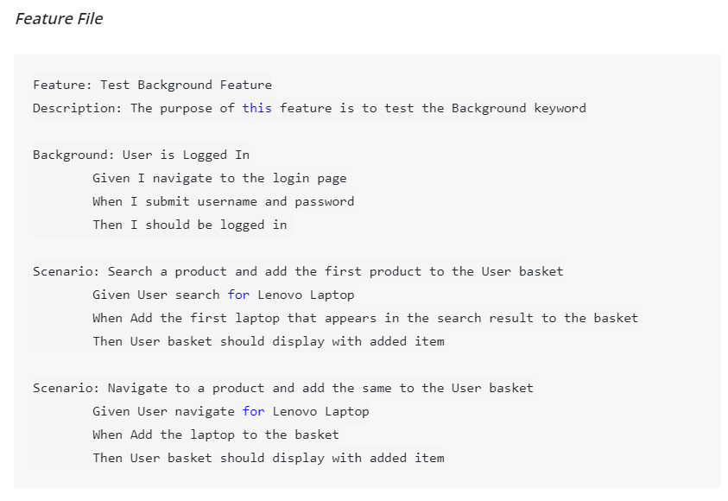
Example of background in cucumber

Slide 21
Page object model
Page Object Model (POM) is a design pattern, popularly used in test automation that creates Object Repository for web UI elements. The advantage of the model is that it reduces code duplication and improves test maintenance.
Under this model, for each web page in the application, there should be a corresponding Page Class. This Page class will identify the WebElements of that web page and also contains Page methods which perform operations on those WebElements. Name of these methods should be given as per the task they are performing, i.e., if a loader is waiting for the payment gateway to appear, POM method name can be waitForPaymentScreenDisplay().

Slide 22
Why page object model

Slide 23
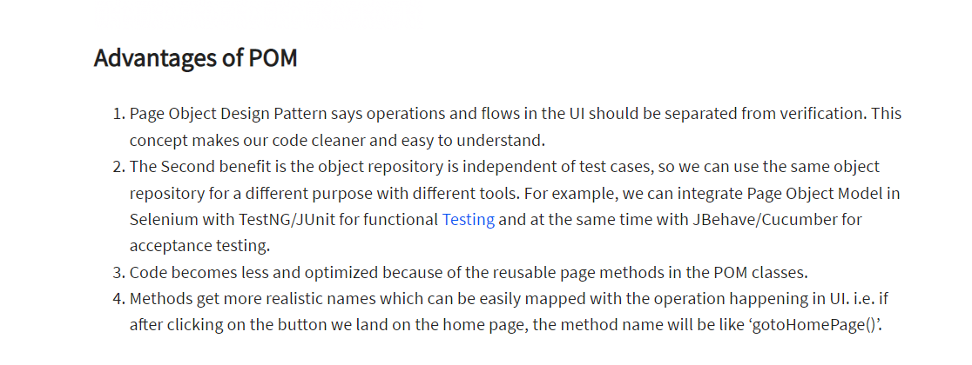
Advantages of page object model

Slide 24
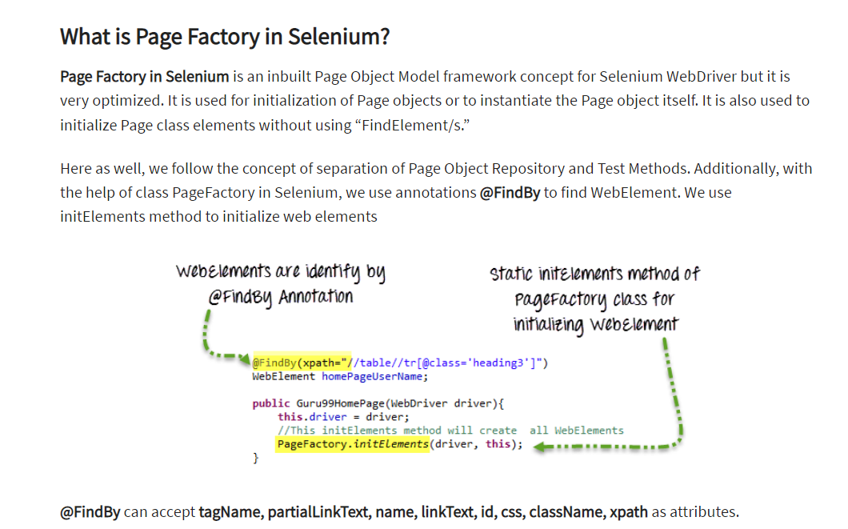
Page factory in selenium

