Slide 1
Principles of software testing

Slide 2
Principles of software testing
The seven principles of software can help you do just that. These principles of software testing describe how testing engineers or software testers should develop code that is error-free, clear, and maintainable.
According to the ISTQB (International Software Testing Qualifications Board), the seven principles of software testing are:
Testing shows the presence of defects
Exhaustive testing is impossible
Early testing
Defect clustering
Pesticide paradox
Testing is context dependent
Absence-of-errors fallacy

Slide 3
Quality engineering
Quality Engineering consists of analysis methods and the development of systems to ensure products or services are designed, developed and manufactured to meet or exceed the customer’s requirements and expectations. Quality Engineering encompasses all activities related to the analysis of a product’s design, development and manufacturing processes for the purpose of improving the quality of the product and the production process while identifying and reducing waste in its many forms
Quality Engineers are the front-line forces for developing, implementing and maintaining the various quality disciplines within the world of Quality Engineering. They are professionals who have gained a thorough understanding of quality principles and product and process evaluation and control. Quality Engineers are normally responsible for developing, implementing and maintaining the systems used to measure, monitor and control product and process quality in the production process

Slide 4
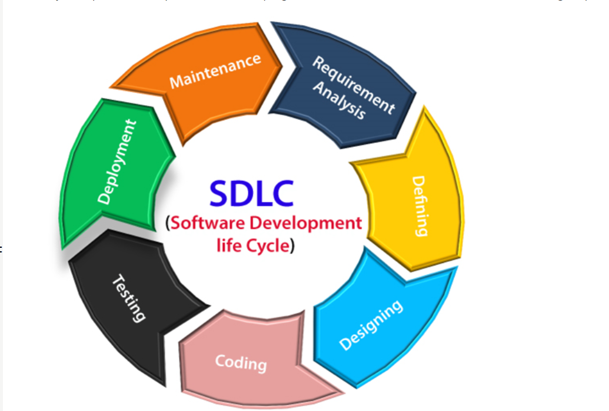
Software development lifecycle
A software life cycle model (also termed process model) is a pictorial and diagrammatic representation of the software life cycle. A life cycle model represents all the methods required to make a software product transit through its life cycle stages. It also captures the structure in which these methods are to be undertaken.

Slide 5
Stages of sdlc
Planning and requirement analysis
Requirement Analysis is the most important and necessary stage in SDLC.
The senior members of the team perform it with inputs from all the stakeholders and domain experts or SMEs in the industry.
Planning for the quality assurance requirements and identifications of the risks associated with the projects is also done at this stage.
Once the requirement is understood, the SRS (Software Requirement Specification) document is created. The developers should thoroughly follow this document and also should be reviewed by the customer for future reference.

Slide 6
Stages of sdlc
Defining Requirements
Once the requirement analysis is done, the next stage is to certainly represent and document the software requirements and get them accepted from the project stakeholders.
This is accomplished through "SRS"- Software Requirement Specification document which contains all the product requirements to be constructed and developed during the project life cycle.
Designing the Software
The next phase is about to bring down all the knowledge of requirements, analysis, and design of the software project. This phase is the product of the last two, like inputs from the customer and requirement gathering.

Slide 7
Stages of sdlc
Developing the project
In this phase of SDLC, the actual development begins, and the programming is built. The implementation of design begins concerning writing code. Developers have to follow the coding guidelines described by their management and programming tools like compilers, interpreters, debuggers, etc. are used to develop and implement the code.
Testing
After the code is generated, it is tested against the requirements to make sure that the products are solving the needs addressed and gathered during the requirements stage.
During this stage, unit testing, integration testing, system testing, acceptance testing are done.

Slide 8
Stages of sdlc
Deployment
Once the software is certified, and no bugs or errors are stated, then it is deployed.
Then based on the assessment, the software may be released as it is or with suggested enhancement in the object segment.
After the software is deployed, then its maintenance begins.
Maintenance
Once when the client starts using the developed systems, then the real issues come up and requirements to be solved from time to time.
This procedure where the care is taken for the developed product is known as maintenance.

Slide 9
Types of models in sdlc
1.Waterfall Model
2. V model
3. Incremental Model
4. Prototype Model
5. Spiral Model
6. Agile Model

Slide 10
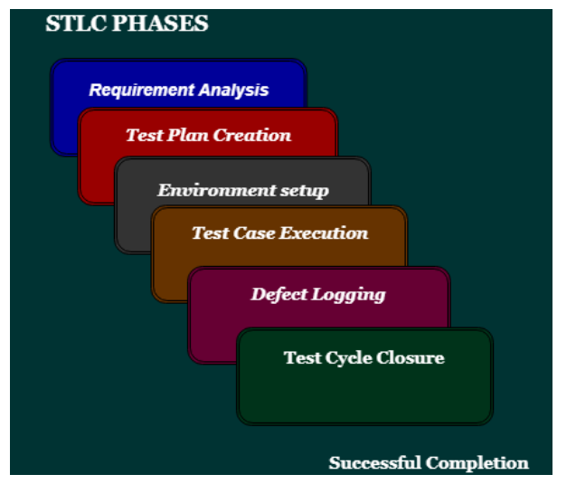
Software test lifecycle

Slide 11
error
The Problem in code leads to errors, which means that a mistake can occur due to the developer's coding error as the developer misunderstood the requirement or the requirement was not defined correctly. The developers use the term error or mistake
Errors can occur during any phase of the software development process, such as requirements gathering, design, coding, or testing. Errors are introduced by people and can lead to faults in the software.

Slide 12
Bug defect and failure
What is a bug?
In software testing, a bug is the informal name of defects, which means that software or application is not working as per the requirement. When we have some coding error, it leads a program to its breakdown, which is known as a bug. The test engineers use the terminology Bug.
If a QA (Quality Analyst) detect a bug, they can reproduce the bug and record it with the help of the bug report template.

Slide 13
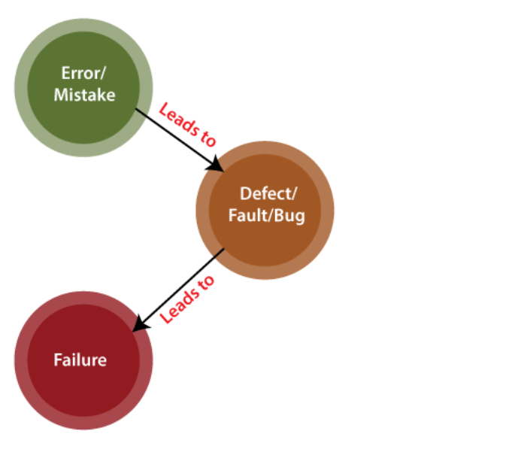
failure
Failure is the accumulation of several defects that ultimately lead to Software failure and results in the loss of information in critical modules thereby making the system unresponsive. Generally, such situations happen very rarely because before releasing a product all possible scenarios and test cases for the code are simulated. Failure is detected by end-users once they face a particular issue in the software.

Slide 14
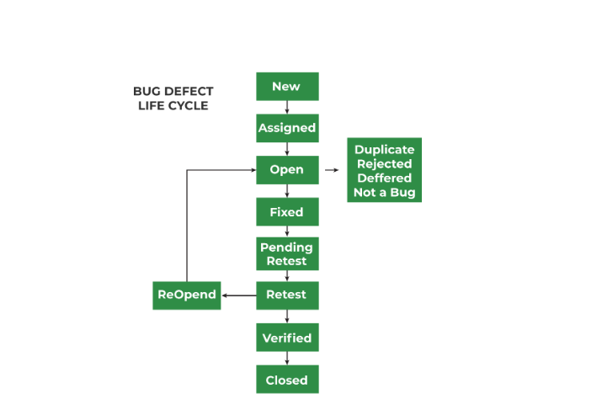
Defect lifecycle

Slide 16
Web application testing
Web application testing, a software testing technique exclusively adopted to test the applications that are hosted on web in which the application interfaces and other functionalities are tested.

Slide 17
Test Plan
A test plan is a document that consists of all future testing-related activities. It is prepared at the project level and in general, it defines work products to be tested, how they will be tested, and test type distribution among the testers. Before starting testing there will be a test manager who will be preparing a test plan. In any company whenever a new project is taken up before the tester is involved in the testing the test manager of the team would prepare a test Plan.
The test plan serves as the blueprint that changes according to the progressions in the project and stays current at all times.
It serves as a base for conducting testing activities and coordinating activities among a QA team.
It is shared with Business Analysts, Project Managers, and anyone associated with the project.

Slide 18
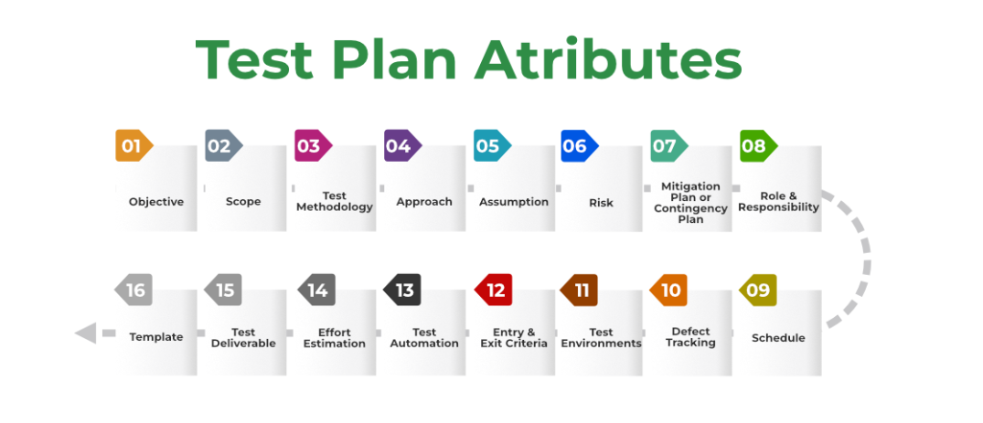
Components of test plan

Slide 19
Test strategy
Test strategy is a high-level plan consisting of principles that guide the overall software testing process. It provides a structured approach to the entire QA team, guiding them toward achieving testing objectives in the most efficient way.
In addition, the test strategy provides the following details, which are required while writing the test document:
What technique must be used in addition to this?
Which of the modules will be examined?
What criteria apply for entry and exit?
What kind of testing is necessary?

Slide 20
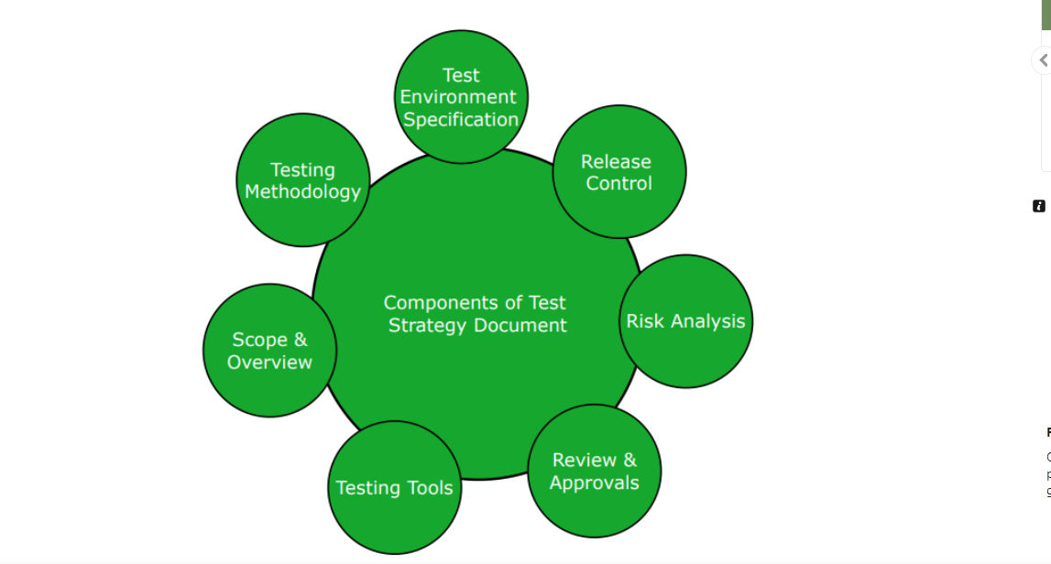
Components of test strategy

Slide 21
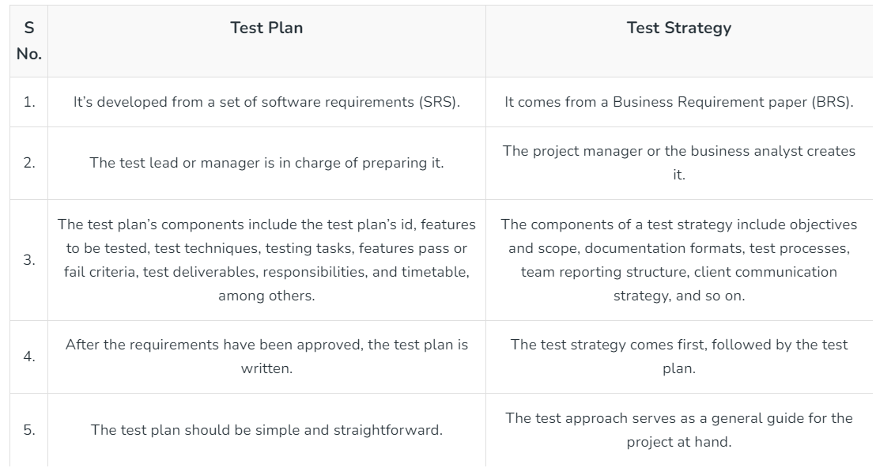
Test plan vs test strategy

Slide 22
Test scenario
A test scenario, sometimes called a scenario test, is the documentation of a use case. In other words, it describes an action the user may undertake with a website or app. It may also represent a situation the user may find themselves in while using that software or product.
Test Scenarios are required to verify the entire system’s performance from the users’ perspective. When creating them, testers need to place themselves in the users’ shoes to clarify what real-world scenarios the software will have to handle when made public.

Slide 23
Severity and priority of defect
Severity is defined as the extent to which a particular defect can create an impact on the software. Severity is a parameter to denote the implication and the impact of the defect on the functionality of the software.
A higher effect of the bug on system functionality will lead to a higher severity level.
A QA engineer determines the severity level of a bug.
Critical: This severity level implies that the process has been completely shut off and no further action can be taken.
Major: This is a significant flaw that causes the system to fail. However, certain parts of the system remain functional.
Medium: This flaw results in unfavorable behavior but the system remains functioning.
Low: This type of flaw won’t cause any major breakdown in the system.

Slide 24
Priority of a defect
Priority is defined as a parameter that decides the order in which a defect should be fixed. Defects having a higher priority should be fixed first.
Defects/ bugs that leave the software unstable and unusable are given higher priority over the defects that cause a small functionality of the software to fail.
It refers to how quickly the defect should be rectified.
Types of Priorities:
Priority in software testing can be divided into 3 categories:
Low: The defect is irritant but a repair can be done once the more serious defects can be fixed.
Medium: The defect should be resolved during the normal course of the development but it can wait until a new version is created.
High: The defect must be resolved as soon as possible as it affects the system severely and cannot be used until it is fixed.

Slide 25
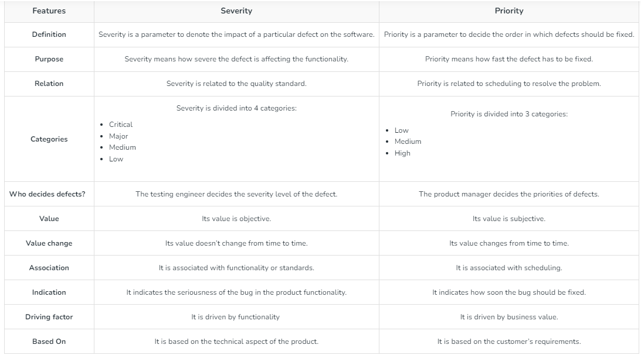
Difference between severity and priority

Slide 26
Test data preparation
In software testing, test data refers to the input values, conditions, and scenarios useful for validating and verifying the functionality, performance, and behavior of the software. It is crucial because it helps assess the software’s performance under various circumstances and ensures that the product meets the specified requirements and functions. And before you start creating your new data for test cases, don’t forget that data is both positive and negative as per the tests. The former data type is to verify the expected results of the software, while the latter data type is to validate the exceptional and error-handling cases.

Slide 27
Test data generation
Test data generation refers to the process of creating and maintaining values for testing with the intention of using it for testing purposes. It consists of creating synthetic or representative data to validate the functionality, performance, security, and various other aspects of the software.
There are several reasons why creating test data is crucial: it should match the test environment and be relevant to the testing at present. And not every data can be used for every type of testing. So, clearly, you need to generate data that is useful.
In practice, there are two ways to create test data in software testing:
Manually
By using test data creation automation tools
Migrating existing data from production to the testing environment

Slide 28
Types of test data
Blank Data
Valid Test
Invalid Test
Boundary Conditions
Huge Test

Slide 29
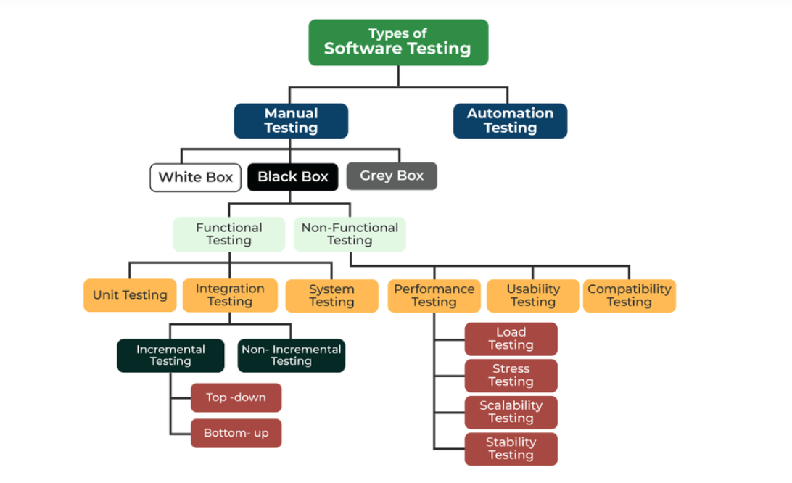
Types of software testing

Slide 30
White box testing
White box testing techniques analyze the internal structures the used data structures, internal design, code structure, and the working of the software rather than just the functionality as in black box testing. It is also called glass box testing or clear box testing or structural testing. White Box Testing is also known as transparent testing or open box testing.
White box testing is a software testing technique that involves testing the internal structure and workings of a software application. The tester has access to the source code and uses this knowledge to design test cases that can verify the correctness of the software at the code level.
White box testing is also known as structural testing or code-based testing, and it is used to test the software’s internal logic, flow, and structure. The tester creates test cases to examine the code paths and logic flows to ensure they meet the specified requirements.

Slide 31
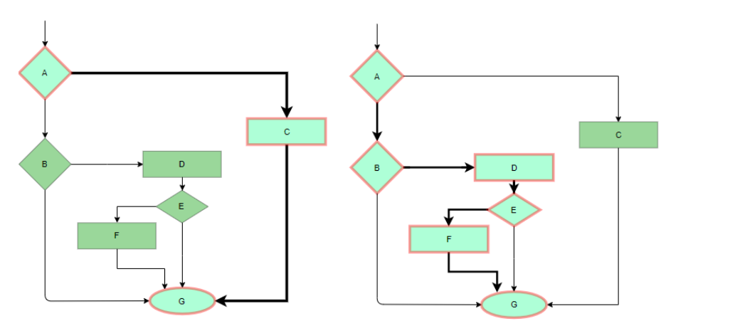
White box testing technique
Statement Coverage
In this technique, the aim is to traverse all statements at least once. Hence, each line of code is tested. In the case of a flowchart, every node must be traversed at least once. Since all lines of code are covered, it helps in pointing out faulty code.

Slide 32
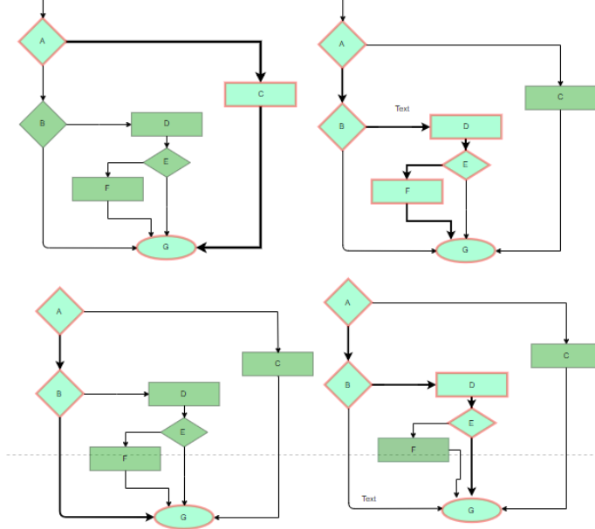
White box testing technique
Branch Coverage
In this technique, test cases are designed so that each branch from all decision points is traversed at least once. In a flowchart, all edges must be traversed at least once.

Slide 33
White box testing technique
Condition Coverage
In this technique, all individual conditions must be covered as shown in the following example:
READ X, Y
IF(X == 0 || Y == 0)
PRINT ‘0’
#TC1 – X = 0, Y = 55
#TC2 – X = 5, Y = 0

Slide 34
White box testing technique
Loops are widely used and these are fundamental to many algorithms hence, their testing is very important. Errors often occur at the beginnings and ends of loops.
Simple loops: For simple loops of size n, test cases are designed that:
Skip the loop entirely
Only one pass through the loop
2 passes
m passes, where m < n
n-1 ans n+1 passes
Nested loops: For nested loops, all the loops are set to their minimum count, and we start from the innermost loop. Simple loop tests are conducted for the innermost loop and this is worked outwards till all the loops have been tested.
Concatenated loops: Independent loops, one after another. Simple loop tests are applied for each. If they’re not independent, treat them like nesting.

Slide 35
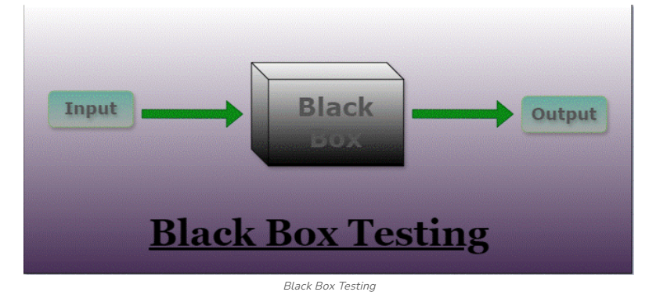
Black box testing
Black-box testing is a type of software testing in which the tester is not concerned with the internal knowledge or implementation details of the software but rather focuses on validating the functionality based on the provided specifications or requirements.

Slide 36
Types of black box testing
Functional Testing
2.Nonfunctional Testing (NFT)
Functional Testing:
Functional testing is defined as a type of testing that verifies that each function of the software application works in conformance with the requirement and specification. This testing is not concerned with the source code of the application. Each functionality of the software application is tested by providing appropriate test input, expecting the output, and comparing the actual output with the expected output. This testing focuses on checking the user interface, APIs, database, security, client or server application, and functionality of the Application Under Test. Functional testing can be manual or automated. It determines the system’s software functional requirements.

Slide 37
Types of black box testing
Nonfunctional Testing:
Non-functional testing is a software testing technique that checks the non-functional attributes of the system. Non-functional testing is defined as a type of software testing to check non-functional aspects of a software application. It is designed to test the readiness of a system as per nonfunctional parameters which are never addressed by functional testing. Non-functional testing is as important as functional testing. Non-functional testing is also known as NFT. This testing is not functional testing of software. It focuses on the software’s performance, usability, and scalability.

Slide 38
Ways of black box testing
Equivalence partitioning – It is often seen that many types of inputs work similarly so instead of giving all of them separately we can group them and test only one input of each group. The idea is to partition the input domain of the system into several equivalence classes such that each member of the class works similarly, i.e., if a test case in one class results in some error, other members of the class would also result in the same error.
Boundary value analysis – Boundaries are very good places for errors to occur. Hence, if test cases are designed for boundary values of the input domain then the efficiency of testing improves and the probability of finding errors also increases. For example – If the valid range is 10 to 100 then test for 10,100 also apart from valid and invalid inputs.

Slide 39
Ways of black box testing
Decision tables are used in various engineering fields to represent complex logical relationships. This testing is a very effective tool in testing the software and its requirements management. The output may be dependent on many input conditions and decision tables give a tabular view of various combinations of input conditions and these conditions are in the form of True(T) and False(F). Also, it provides a set of conditions and its corresponding actions required in the testing.

Slide 40
Functional testing types
Unit testing is a type of software testing that focuses on individual units or components of a software system. The purpose of unit testing is to validate that each unit of the software works as intended and meets the requirements. Developers typically perform unit testing, and it is performed early in the development process before the code is integrated and tested as a whole system.
Objective of Unit Testing
The objective of Unit Testing are follows
To isolate a section of code.
To verify the correctness of the code.
To test every function and procedure.
To fix bugs early in the development cycle and to save costs.
To help the developers understand the code base and enable them to make changes quickly.
To help with code reuse.

Slide 41
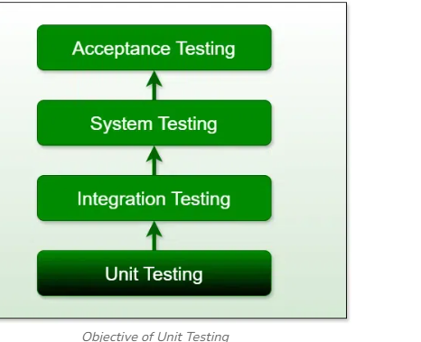
Objective of unit testing

Slide 42
Tools for unit testing
Unit Testing Tools
Here are some commonly used Unit Testing tools:
Jtest
Junit
NUnit
EMMA
PHPUnit

Slide 43
Integration testing
Integration testing is the process of testing the interface between two software units or modules. It focuses on determining the correctness of the interface. The purpose of integration testing is to expose faults in the interaction between integrated units. Once all the modules have been unit-tested, integration testing is performed.
The goal of integration testing is to identify any problems or bugs that arise when different components are combined and interact with each other. Integration testing is typically performed after unit testing and before system testing. It helps to identify and resolve integration issues early in the development cycle, reducing the risk of more severe and costly problems later on.

Slide 44
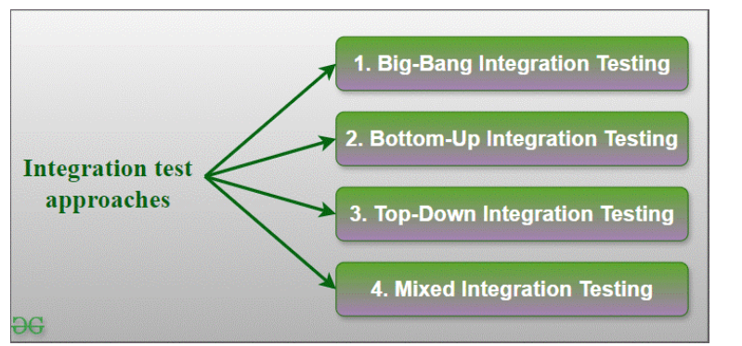
Integration testing approach

Slide 45
Big bang integration testing
It is the simplest integration testing approach, where all the modules are combined and the functionality is verified after the completion of individual module testing. In simple words, all the modules of the system are simply put together and tested. This approach is practicable only for very small systems. If an error is found during the integration testing, it is very difficult to localize the error as the error may potentially belong to any of the modules being integrated. So, debugging errors reported during Big Bang integration testing is very expensive to fix.

Slide 46
Bottom up integration testing
In bottom-up testing, each module at lower levels are tested with higher modules until all modules are tested. The primary purpose of this integration testing is that each subsystem tests the interfaces among various modules making up the subsystem. This integration testing uses test drivers to drive and pass appropriate data to the lower-level modules.

Slide 47
Top down integration testing
Top-down integration testing technique is used in order to simulate the behaviour of the lower-level modules that are not yet integrated. In this integration testing, testing takes place from top to bottom. First, high-level modules are tested and then low-level modules and finally integrating the low-level modules to a high level to ensure the system is working as intended.

Slide 48
Mixed integration testing
A mixed integration testing is also called sandwiched integration testing. A mixed integration testing follows a combination of top down and bottom-up testing approaches. In top-down approach, testing can start only after the top-level module have been coded and unit tested. In bottom-up approach, testing can start only after the bottom level modules are ready.

