Slide 1
Principles of software testing

Slide 2
Principles of software testing
The seven principles of software can help you do just that. These principles of software testing describe how testing engineers or software testers should develop code that is error-free, clear, and maintainable.
According to the ISTQB (International Software Testing Qualifications Board), the seven principles of software testing are:
Testing shows the presence of defects
Exhaustive testing is impossible
Early testing
Defect clustering
Pesticide paradox
Testing is context dependent
Absence-of-errors fallacy

Slide 3
Quality engineering
Quality Engineering consists of analysis methods and the development of systems to ensure products or services are designed, developed and manufactured to meet or exceed the customer’s requirements and expectations. Quality Engineering encompasses all activities related to the analysis of a product’s design, development and manufacturing processes for the purpose of improving the quality of the product and the production process while identifying and reducing waste in its many forms
Quality Engineers are the front-line forces for developing, implementing and maintaining the various quality disciplines within the world of Quality Engineering. They are professionals who have gained a thorough understanding of quality principles and product and process evaluation and control. Quality Engineers are normally responsible for developing, implementing and maintaining the systems used to measure, monitor and control product and process quality in the production process

Slide 4
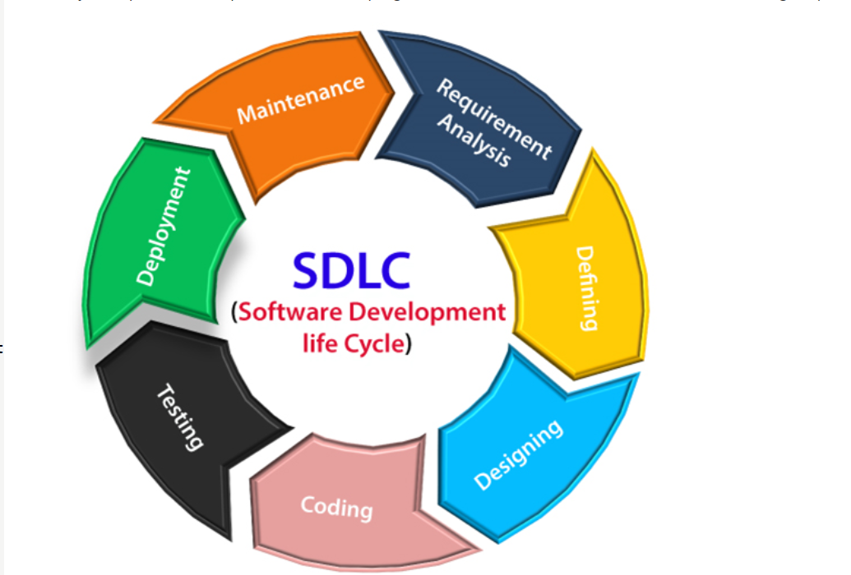
Software development lifecycle
A software life cycle model (also termed process model) is a pictorial and diagrammatic representation of the software life cycle. A life cycle model represents all the methods required to make a software product transit through its life cycle stages. It also captures the structure in which these methods are to be undertaken.

Slide 5
Stages of sdlc
Planning and requirement analysis
Requirement Analysis is the most important and necessary stage in SDLC.
The senior members of the team perform it with inputs from all the stakeholders and domain experts or SMEs in the industry.
Planning for the quality assurance requirements and identifications of the risks associated with the projects is also done at this stage.
Once the requirement is understood, the SRS (Software Requirement Specification) document is created. The developers should thoroughly follow this document and also should be reviewed by the customer for future reference.

Slide 6
Stages of sdlc
Defining Requirements
Once the requirement analysis is done, the next stage is to certainly represent and document the software requirements and get them accepted from the project stakeholders.
This is accomplished through "SRS"- Software Requirement Specification document which contains all the product requirements to be constructed and developed during the project life cycle.
Designing the Software
The next phase is about to bring down all the knowledge of requirements, analysis, and design of the software project. This phase is the product of the last two, like inputs from the customer and requirement gathering.

Slide 7
Stages of sdlc
Developing the project
In this phase of SDLC, the actual development begins, and the programming is built. The implementation of design begins concerning writing code. Developers have to follow the coding guidelines described by their management and programming tools like compilers, interpreters, debuggers, etc. are used to develop and implement the code.
Testing
After the code is generated, it is tested against the requirements to make sure that the products are solving the needs addressed and gathered during the requirements stage.
During this stage, unit testing, integration testing, system testing, acceptance testing are done.

Slide 8
Stages of sdlc
Deployment
Once the software is certified, and no bugs or errors are stated, then it is deployed.
Then based on the assessment, the software may be released as it is or with suggested enhancement in the object segment.
After the software is deployed, then its maintenance begins.
Maintenance
Once when the client starts using the developed systems, then the real issues come up and requirements to be solved from time to time.
This procedure where the care is taken for the developed product is known as maintenance.

Slide 9
Types of models in sdlc
1.Waterfall Model
2. V model
3. Incremental Model
4. Prototype Model
5. Spiral Model
6. Agile Model

Slide 10
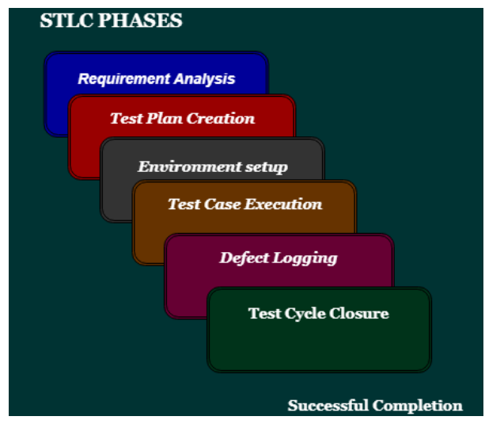
Software test lifecycle

Slide 11
error
The Problem in code leads to errors, which means that a mistake can occur due to the developer's coding error as the developer misunderstood the requirement or the requirement was not defined correctly. The developers use the term error or mistake
Errors can occur during any phase of the software development process, such as requirements gathering, design, coding, or testing. Errors are introduced by people and can lead to faults in the software.

Slide 12
Bug defect and failure
What is a bug?
In software testing, a bug is the informal name of defects, which means that software or application is not working as per the requirement. When we have some coding error, it leads a program to its breakdown, which is known as a bug. The test engineers use the terminology Bug.
If a QA (Quality Analyst) detect a bug, they can reproduce the bug and record it with the help of the bug report template.

Slide 13
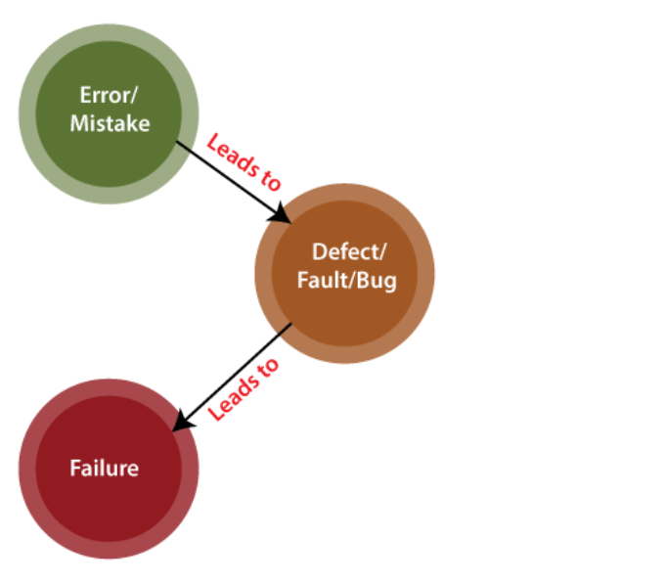
failure
Failure is the accumulation of several defects that ultimately lead to Software failure and results in the loss of information in critical modules thereby making the system unresponsive. Generally, such situations happen very rarely because before releasing a product all possible scenarios and test cases for the code are simulated. Failure is detected by end-users once they face a particular issue in the software.

Slide 14
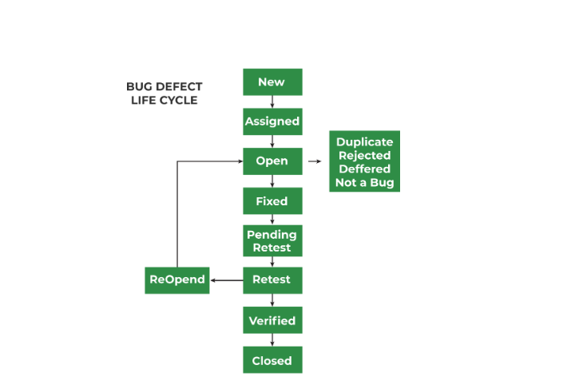
Defect lifecycle

Slide 16
Web application testing
Web application testing, a software testing technique exclusively adopted to test the applications that are hosted on web in which the application interfaces and other functionalities are tested.

Slide 17
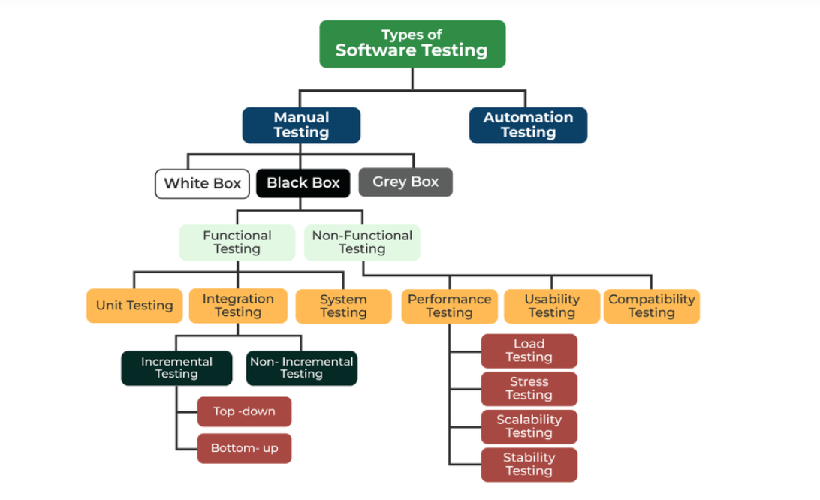
Types of software testing

Slide 18
Test Plan
A test plan is a document that consists of all future testing-related activities. It is prepared at the project level and in general, it defines work products to be tested, how they will be tested, and test type distribution among the testers. Before starting testing there will be a test manager who will be preparing a test plan. In any company whenever a new project is taken up before the tester is involved in the testing the test manager of the team would prepare a test Plan.
The test plan serves as the blueprint that changes according to the progressions in the project and stays current at all times.
It serves as a base for conducting testing activities and coordinating activities among a QA team.
It is shared with Business Analysts, Project Managers, and anyone associated with the project.

Slide 19
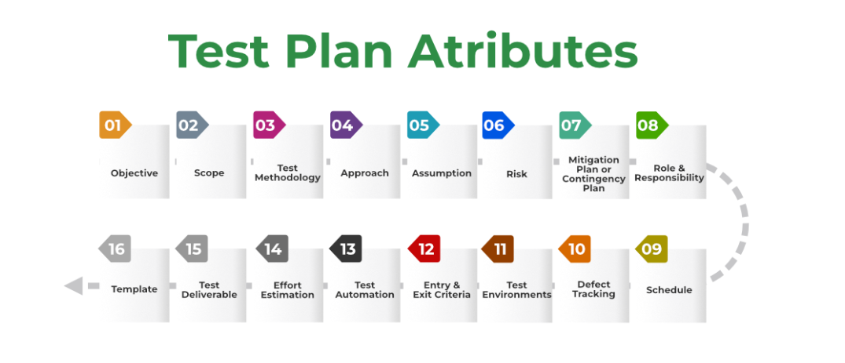
Components of test plan

Slide 20
Test strategy
Test strategy is a high-level plan consisting of principles that guide the overall software testing process. It provides a structured approach to the entire QA team, guiding them toward achieving testing objectives in the most efficient way.
In addition, the test strategy provides the following details, which are required while writing the test document:
What technique must be used in addition to this?
Which of the modules will be examined?
What criteria apply for entry and exit?
What kind of testing is necessary?

Slide 21
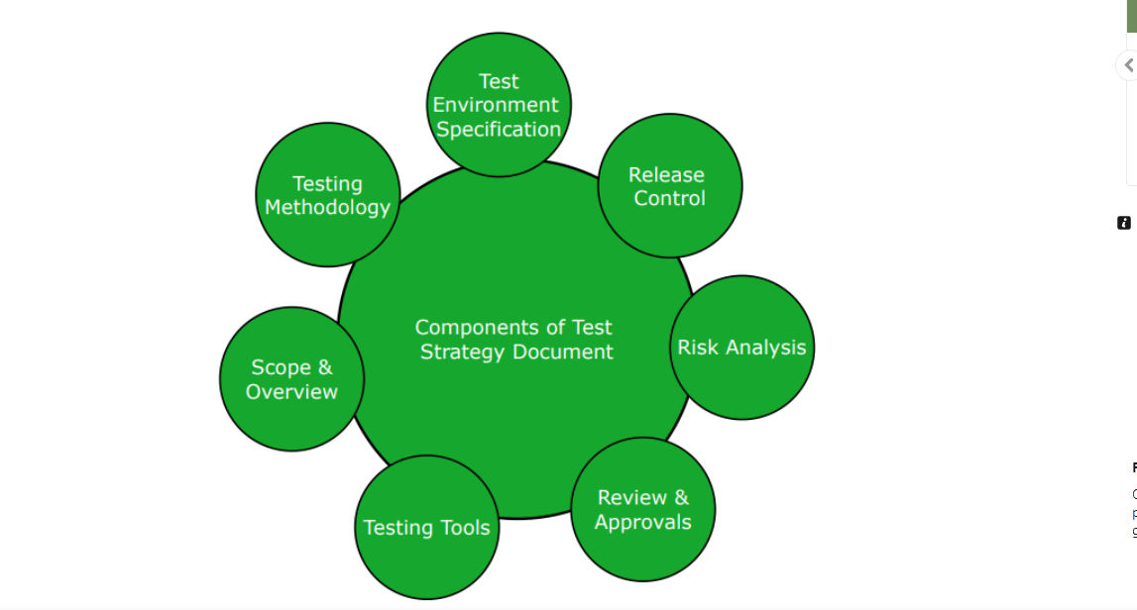
Components of test strategy

Slide 22
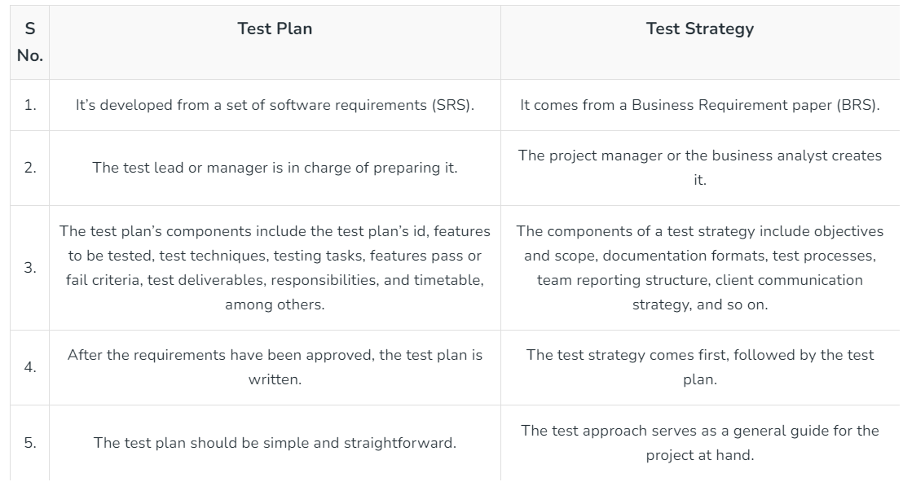
Test plan vs test strategy

Slide 23
Test scenario
A test scenario, sometimes called a scenario test, is the documentation of a use case. In other words, it describes an action the user may undertake with a website or app. It may also represent a situation the user may find themselves in while using that software or product.
Test Scenarios are required to verify the entire system’s performance from the users’ perspective. When creating them, testers need to place themselves in the users’ shoes to clarify what real-world scenarios the software will have to handle when made public.

Slide 24
Severity and priority of defect
Severity is defined as the extent to which a particular defect can create an impact on the software. Severity is a parameter to denote the implication and the impact of the defect on the functionality of the software.
A higher effect of the bug on system functionality will lead to a higher severity level.
A QA engineer determines the severity level of a bug.
Critical: This severity level implies that the process has been completely shut off and no further action can be taken.
Major: This is a significant flaw that causes the system to fail. However, certain parts of the system remain functional.
Medium: This flaw results in unfavorable behavior but the system remains functioning.
Low: This type of flaw won’t cause any major breakdown in the system.

Slide 25
Priority of a defect
Priority is defined as a parameter that decides the order in which a defect should be fixed. Defects having a higher priority should be fixed first.
Defects/ bugs that leave the software unstable and unusable are given higher priority over the defects that cause a small functionality of the software to fail.
It refers to how quickly the defect should be rectified.
Types of Priorities:
Priority in software testing can be divided into 3 categories:
Low: The defect is irritant but a repair can be done once the more serious defects can be fixed.
Medium: The defect should be resolved during the normal course of the development but it can wait until a new version is created.
High: The defect must be resolved as soon as possible as it affects the system severely and cannot be used until it is fixed.

Slide 26
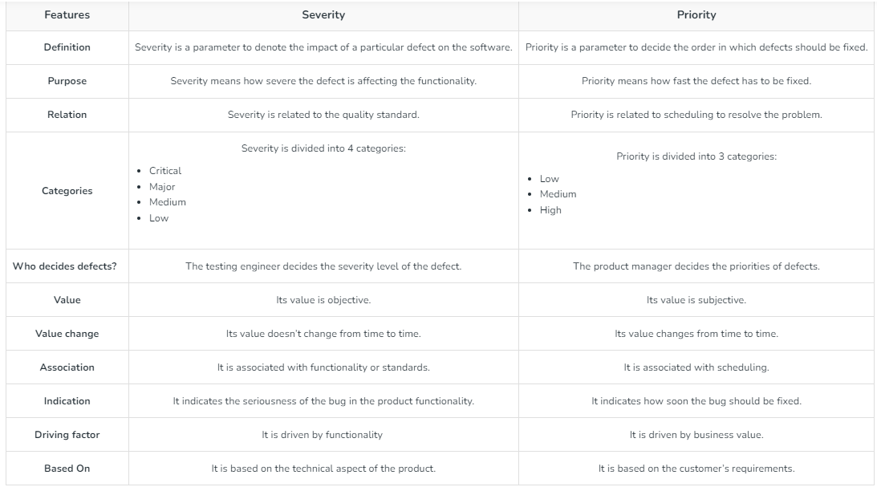
Difference between severity and priority

Slide 27
Test data preparation
In software testing, test data refers to the input values, conditions, and scenarios useful for validating and verifying the functionality, performance, and behavior of the software. It is crucial because it helps assess the software’s performance under various circumstances and ensures that the product meets the specified requirements and functions. And before you start creating your new data for test cases, don’t forget that data is both positive and negative as per the tests. The former data type is to verify the expected results of the software, while the latter data type is to validate the exceptional and error-handling cases.

Slide 28
Test data generation
Test data generation refers to the process of creating and maintaining values for testing with the intention of using it for testing purposes. It consists of creating synthetic or representative data to validate the functionality, performance, security, and various other aspects of the software.
There are several reasons why creating test data is crucial: it should match the test environment and be relevant to the testing at present. And not every data can be used for every type of testing. So, clearly, you need to generate data that is useful.
In practice, there are two ways to create test data in software testing:
Manually
By using test data creation automation tools
Migrating existing data from production to the testing environment

Slide 29
Types of test data
Blank Data
Valid Test
Invalid Test
Boundary Conditions
Huge Test

Slide 30
White box testing
White box testing techniques analyze the internal structures the used data structures, internal design, code structure, and the working of the software rather than just the functionality as in black box testing. It is also called glass box testing or clear box testing or structural testing. White Box Testing is also known as transparent testing or open box testing.
White box testing is a software testing technique that involves testing the internal structure and workings of a software application. The tester has access to the source code and uses this knowledge to design test cases that can verify the correctness of the software at the code level.
White box testing is also known as structural testing or code-based testing, and it is used to test the software’s internal logic, flow, and structure. The tester creates test cases to examine the code paths and logic flows to ensure they meet the specified requirements.

Slide 31
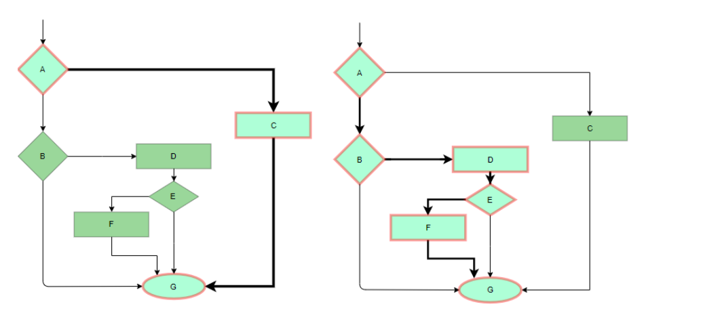
White box testing technique
Statement Coverage
In this technique, the aim is to traverse all statements at least once. Hence, each line of code is tested. In the case of a flowchart, every node must be traversed at least once. Since all lines of code are covered, it helps in pointing out faulty code.

Slide 32
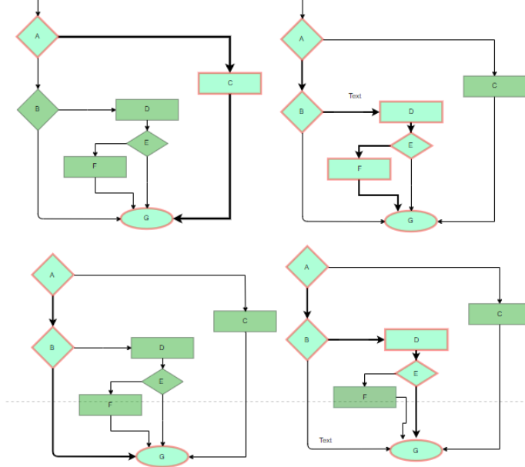
White box testing technique
Branch Coverage
In this technique, test cases are designed so that each branch from all decision points is traversed at least once. In a flowchart, all edges must be traversed at least once.

Slide 33
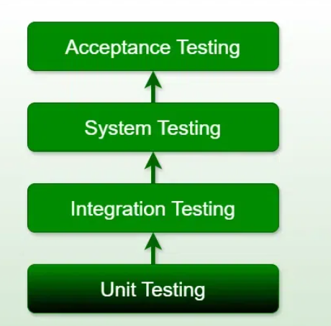
Unit testing
Unit testing is a type of software testing that focuses on individual units or components of a software system. The purpose of unit testing is to validate that each unit of the software works as intended and meets the requirements. Developers typically perform unit testing, and it is performed early in the development process before the code is integrated and tested as a whole system.

