Slide 1
Principles of software testing

Slide 2
Principles of software testing
The seven principles of software can help you do just that. These principles of software testing describe how testing engineers or software testers should develop code that is error-free, clear, and maintainable.
According to the ISTQB (International Software Testing Qualifications Board), the seven principles of software testing are:
Testing shows the presence of defects
Exhaustive testing is impossible
Early testing
Defect clustering
Pesticide paradox
Testing is context dependent
Absence-of-errors fallacy

Slide 3
Quality engineering
Quality Engineering consists of analysis methods and the development of systems to ensure products or services are designed, developed and manufactured to meet or exceed the customer’s requirements and expectations. Quality Engineering encompasses all activities related to the analysis of a product’s design, development and manufacturing processes for the purpose of improving the quality of the product and the production process while identifying and reducing waste in its many forms
Quality Engineers are the front-line forces for developing, implementing and maintaining the various quality disciplines within the world of Quality Engineering. They are professionals who have gained a thorough understanding of quality principles and product and process evaluation and control. Quality Engineers are normally responsible for developing, implementing and maintaining the systems used to measure, monitor and control product and process quality in the production process

Slide 4
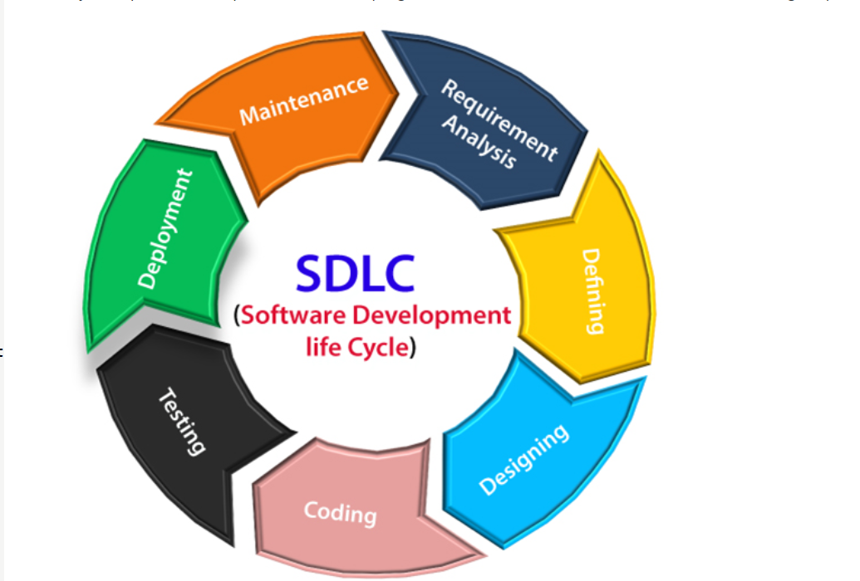
Software development lifecycle
A software life cycle model (also termed process model) is a pictorial and diagrammatic representation of the software life cycle. A life cycle model represents all the methods required to make a software product transit through its life cycle stages. It also captures the structure in which these methods are to be undertaken.

Slide 5
Stages of sdlc
Planning and requirement analysis
Requirement Analysis is the most important and necessary stage in SDLC.
The senior members of the team perform it with inputs from all the stakeholders and domain experts or SMEs in the industry.
Planning for the quality assurance requirements and identifications of the risks associated with the projects is also done at this stage.
Once the requirement is understood, the SRS (Software Requirement Specification) document is created. The developers should thoroughly follow this document and also should be reviewed by the customer for future reference.

Slide 6
Stages of sdlc
Defining Requirements
Once the requirement analysis is done, the next stage is to certainly represent and document the software requirements and get them accepted from the project stakeholders.
This is accomplished through "SRS"- Software Requirement Specification document which contains all the product requirements to be constructed and developed during the project life cycle.
Designing the Software
The next phase is about to bring down all the knowledge of requirements, analysis, and design of the software project. This phase is the product of the last two, like inputs from the customer and requirement gathering.

Slide 7
Stages of sdlc
Developing the project
In this phase of SDLC, the actual development begins, and the programming is built. The implementation of design begins concerning writing code. Developers have to follow the coding guidelines described by their management and programming tools like compilers, interpreters, debuggers, etc. are used to develop and implement the code.
Testing
After the code is generated, it is tested against the requirements to make sure that the products are solving the needs addressed and gathered during the requirements stage.
During this stage, unit testing, integration testing, system testing, acceptance testing are done.

Slide 8
Stages of sdlc
Deployment
Once the software is certified, and no bugs or errors are stated, then it is deployed.
Then based on the assessment, the software may be released as it is or with suggested enhancement in the object segment.
After the software is deployed, then its maintenance begins.
Maintenance
Once when the client starts using the developed systems, then the real issues come up and requirements to be solved from time to time.
This procedure where the care is taken for the developed product is known as maintenance.

Slide 9
Types of models in sdlc
1.Waterfall Model
2. V model
3. Incremental Model
4. Prototype Model
5. Spiral Model
6. Agile Model

Slide 10
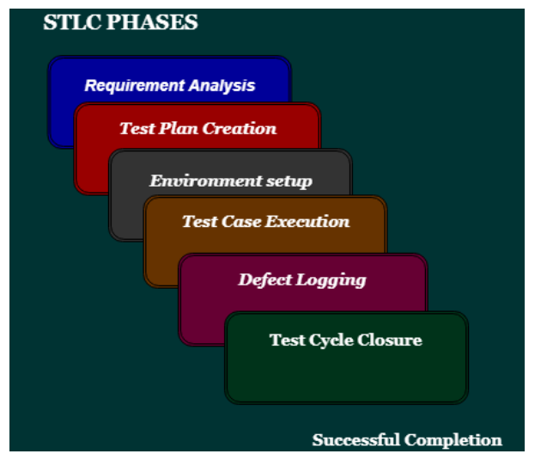
Software test lifecycle

Slide 11
error
The Problem in code leads to errors, which means that a mistake can occur due to the developer's coding error as the developer misunderstood the requirement or the requirement was not defined correctly. The developers use the term error or mistake
Errors can occur during any phase of the software development process, such as requirements gathering, design, coding, or testing. Errors are introduced by people and can lead to faults in the software.

Slide 12
Bug defect and failure
What is a bug?
In software testing, a bug is the informal name of defects, which means that software or application is not working as per the requirement. When we have some coding error, it leads a program to its breakdown, which is known as a bug. The test engineers use the terminology Bug.
If a QA (Quality Analyst) detect a bug, they can reproduce the bug and record it with the help of the bug report template.

Slide 13
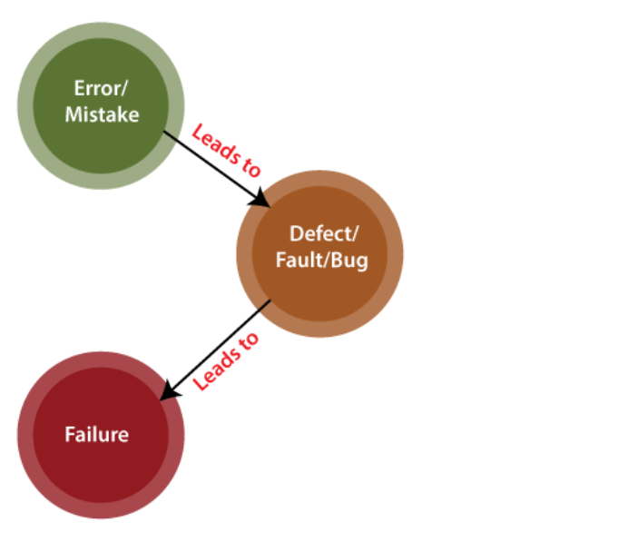
failure
Failure is the accumulation of several defects that ultimately lead to Software failure and results in the loss of information in critical modules thereby making the system unresponsive. Generally, such situations happen very rarely because before releasing a product all possible scenarios and test cases for the code are simulated. Failure is detected by end-users once they face a particular issue in the software.

Slide 14
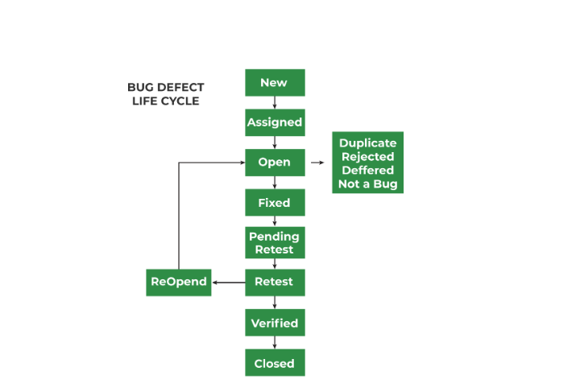
Defect lifecycle

Slide 16
Web application testing
Web application testing, a software testing technique exclusively adopted to test the applications that are hosted on web in which the application interfaces and other functionalities are tested.

Slide 17
Test Plan
A test plan is a document that consists of all future testing-related activities. It is prepared at the project level and in general, it defines work products to be tested, how they will be tested, and test type distribution among the testers. Before starting testing there will be a test manager who will be preparing a test plan. In any company whenever a new project is taken up before the tester is involved in the testing the test manager of the team would prepare a test Plan.
The test plan serves as the blueprint that changes according to the progressions in the project and stays current at all times.
It serves as a base for conducting testing activities and coordinating activities among a QA team.
It is shared with Business Analysts, Project Managers, and anyone associated with the project.

Slide 18
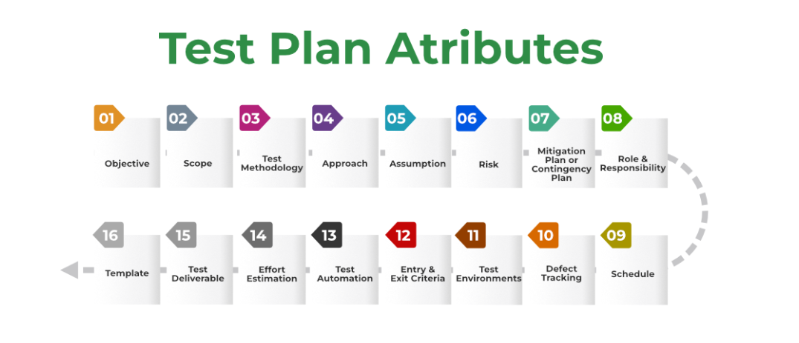
Components of test plan

Slide 19
Test strategy
Test strategy is a high-level plan consisting of principles that guide the overall software testing process. It provides a structured approach to the entire QA team, guiding them toward achieving testing objectives in the most efficient way.
In addition, the test strategy provides the following details, which are required while writing the test document:
What technique must be used in addition to this?
Which of the modules will be examined?
What criteria apply for entry and exit?
What kind of testing is necessary?

Slide 20
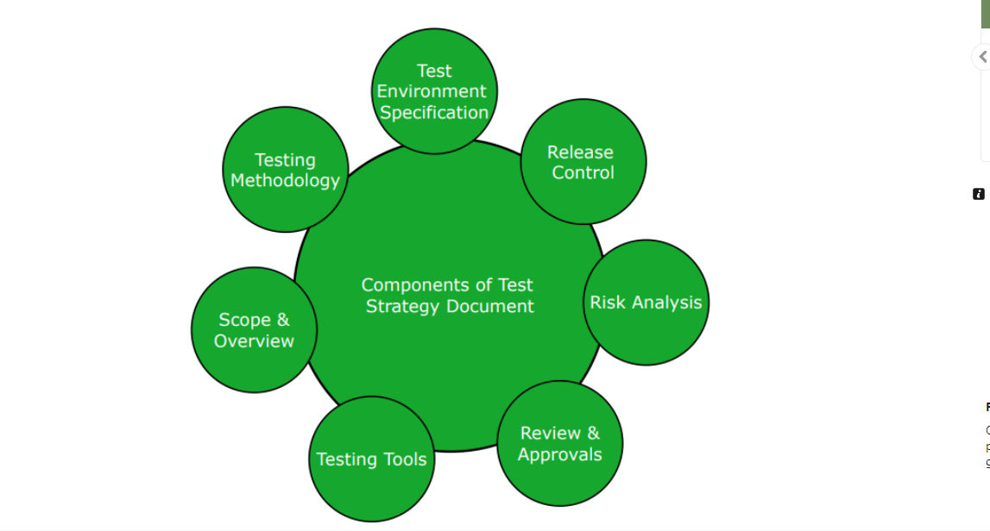
Components of test strategy

Slide 21
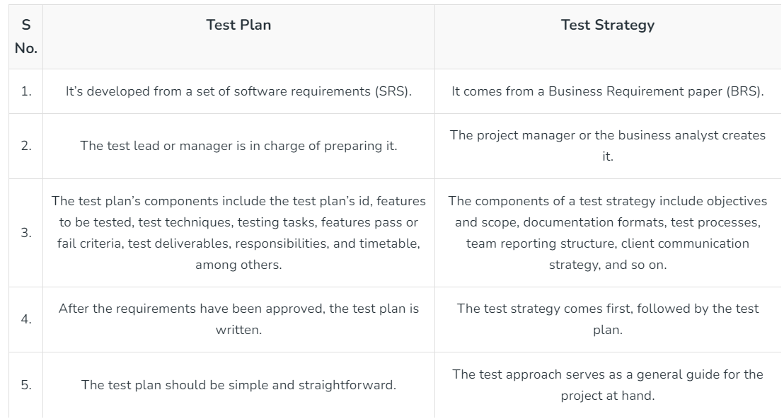
Test plan vs test strategy

Slide 22
Test scenario
A test scenario, sometimes called a scenario test, is the documentation of a use case. In other words, it describes an action the user may undertake with a website or app. It may also represent a situation the user may find themselves in while using that software or product.
Test Scenarios are required to verify the entire system’s performance from the users’ perspective. When creating them, testers need to place themselves in the users’ shoes to clarify what real-world scenarios the software will have to handle when made public.

Slide 23
Severity and priority of defect
Severity is defined as the extent to which a particular defect can create an impact on the software. Severity is a parameter to denote the implication and the impact of the defect on the functionality of the software.
A higher effect of the bug on system functionality will lead to a higher severity level.
A QA engineer determines the severity level of a bug.
Critical: This severity level implies that the process has been completely shut off and no further action can be taken.
Major: This is a significant flaw that causes the system to fail. However, certain parts of the system remain functional.
Medium: This flaw results in unfavorable behavior but the system remains functioning.
Low: This type of flaw won’t cause any major breakdown in the system.

Slide 24
Priority of a defect
Priority is defined as a parameter that decides the order in which a defect should be fixed. Defects having a higher priority should be fixed first.
Defects/ bugs that leave the software unstable and unusable are given higher priority over the defects that cause a small functionality of the software to fail.
It refers to how quickly the defect should be rectified.
Types of Priorities:
Priority in software testing can be divided into 3 categories:
Low: The defect is irritant but a repair can be done once the more serious defects can be fixed.
Medium: The defect should be resolved during the normal course of the development but it can wait until a new version is created.
High: The defect must be resolved as soon as possible as it affects the system severely and cannot be used until it is fixed.

Slide 25
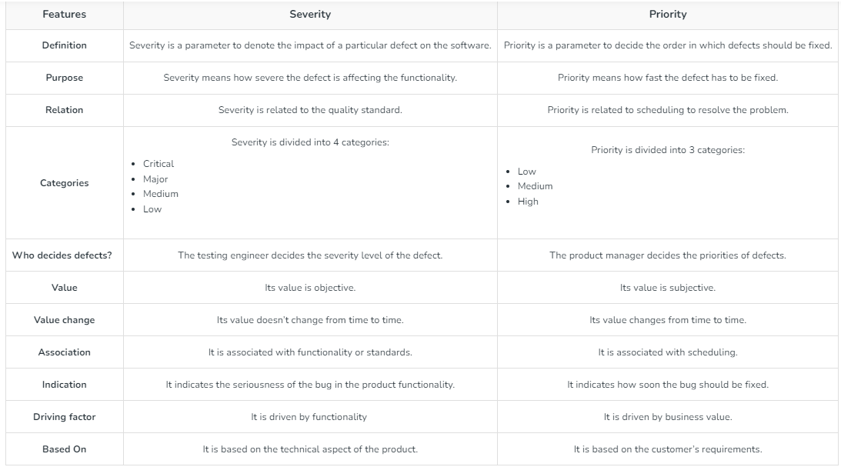
Difference between severity and priority

Slide 26
Test data preparation
In software testing, test data refers to the input values, conditions, and scenarios useful for validating and verifying the functionality, performance, and behavior of the software. It is crucial because it helps assess the software’s performance under various circumstances and ensures that the product meets the specified requirements and functions. And before you start creating your new data for test cases, don’t forget that data is both positive and negative as per the tests. The former data type is to verify the expected results of the software, while the latter data type is to validate the exceptional and error-handling cases.

Slide 27
Test data generation
Test data generation refers to the process of creating and maintaining values for testing with the intention of using it for testing purposes. It consists of creating synthetic or representative data to validate the functionality, performance, security, and various other aspects of the software.
There are several reasons why creating test data is crucial: it should match the test environment and be relevant to the testing at present. And not every data can be used for every type of testing. So, clearly, you need to generate data that is useful.
In practice, there are two ways to create test data in software testing:
Manually
By using test data creation automation tools
Migrating existing data from production to the testing environment

Slide 28
Types of test data
Blank Data
Valid Test
Invalid Test
Boundary Conditions
Huge Test

Slide 29
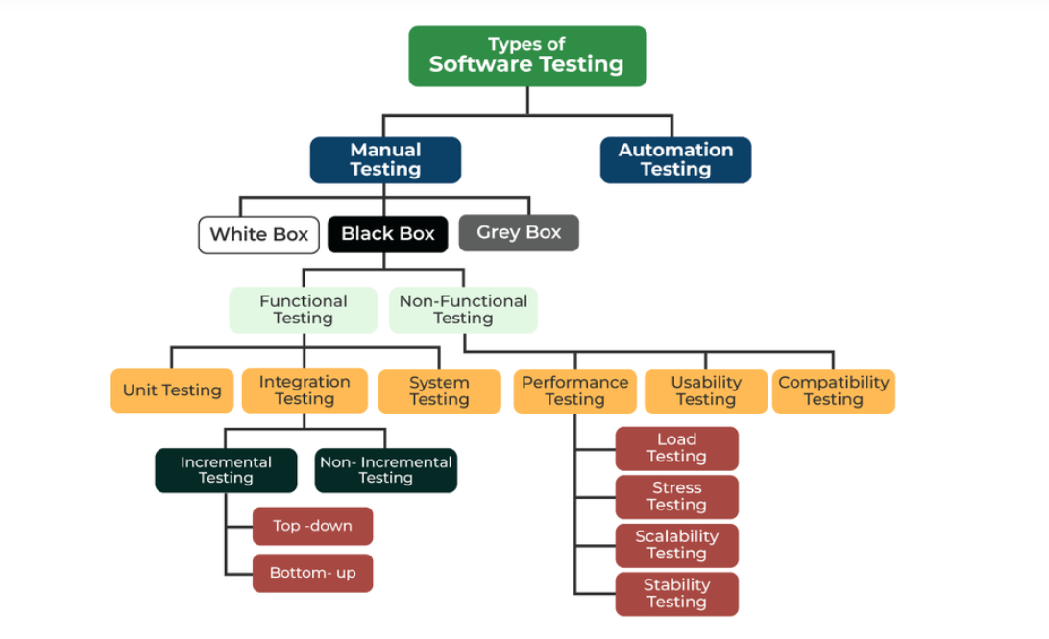
Types of software testing

Slide 30
White box testing
White box testing techniques analyze the internal structures the used data structures, internal design, code structure, and the working of the software rather than just the functionality as in black box testing. It is also called glass box testing or clear box testing or structural testing. White Box Testing is also known as transparent testing or open box testing.
White box testing is a software testing technique that involves testing the internal structure and workings of a software application. The tester has access to the source code and uses this knowledge to design test cases that can verify the correctness of the software at the code level.
White box testing is also known as structural testing or code-based testing, and it is used to test the software’s internal logic, flow, and structure. The tester creates test cases to examine the code paths and logic flows to ensure they meet the specified requirements.

Slide 31
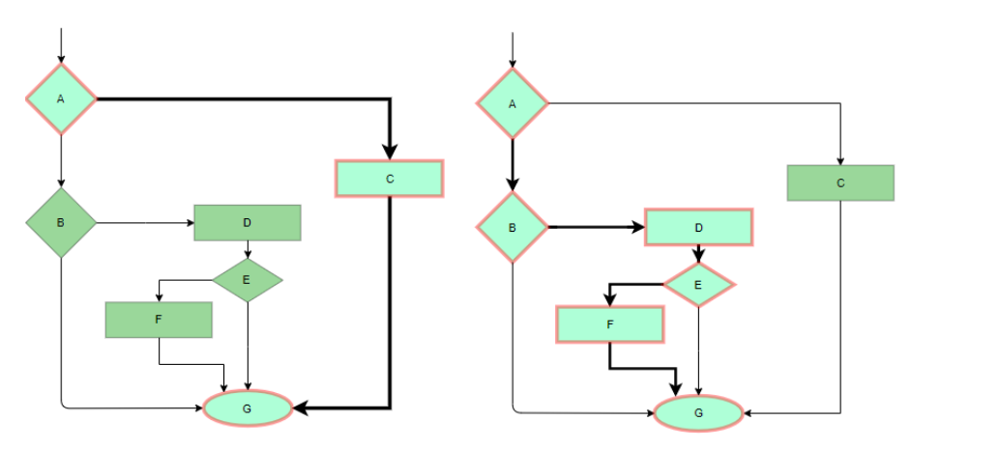
White box testing technique
Statement Coverage
In this technique, the aim is to traverse all statements at least once. Hence, each line of code is tested. In the case of a flowchart, every node must be traversed at least once. Since all lines of code are covered, it helps in pointing out faulty code.

Slide 32
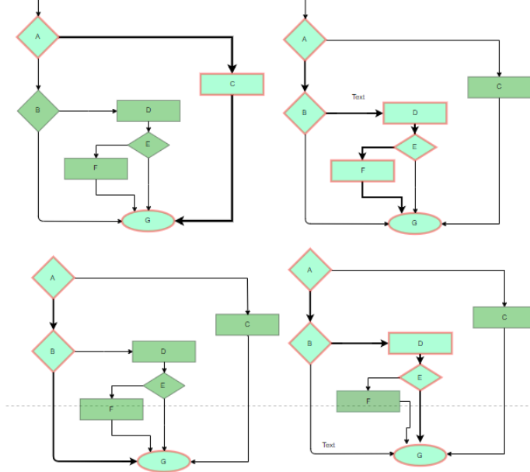
White box testing technique
Branch Coverage
In this technique, test cases are designed so that each branch from all decision points is traversed at least once. In a flowchart, all edges must be traversed at least once.

Slide 33
White box testing technique
Condition Coverage
In this technique, all individual conditions must be covered as shown in the following example:
READ X, Y
IF(X == 0 || Y == 0)
PRINT ‘0’
#TC1 – X = 0, Y = 55
#TC2 – X = 5, Y = 0

Slide 34
White box testing technique
Loops are widely used and these are fundamental to many algorithms hence, their testing is very important. Errors often occur at the beginnings and ends of loops.
Simple loops: For simple loops of size n, test cases are designed that:
Skip the loop entirely
Only one pass through the loop
2 passes
m passes, where m < n
n-1 ans n+1 passes
Nested loops: For nested loops, all the loops are set to their minimum count, and we start from the innermost loop. Simple loop tests are conducted for the innermost loop and this is worked outwards till all the loops have been tested.
Concatenated loops: Independent loops, one after another. Simple loop tests are applied for each. If they’re not independent, treat them like nesting.

Slide 35
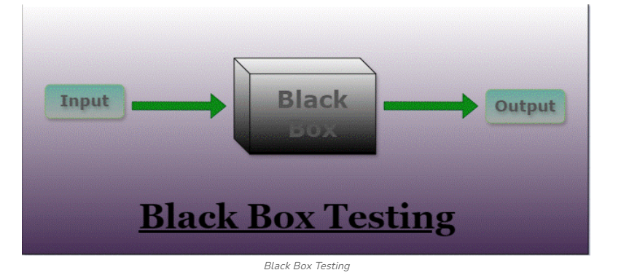
Black box testing
Black-box testing is a type of software testing in which the tester is not concerned with the internal knowledge or implementation details of the software but rather focuses on validating the functionality based on the provided specifications or requirements.

Slide 36
Types of black box testing
Functional Testing
2.Nonfunctional Testing (NFT)
Functional Testing:
Functional testing is defined as a type of testing that verifies that each function of the software application works in conformance with the requirement and specification. This testing is not concerned with the source code of the application. Each functionality of the software application is tested by providing appropriate test input, expecting the output, and comparing the actual output with the expected output. This testing focuses on checking the user interface, APIs, database, security, client or server application, and functionality of the Application Under Test. Functional testing can be manual or automated. It determines the system’s software functional requirements.

Slide 37
Types of black box testing
Nonfunctional Testing:
Non-functional testing is a software testing technique that checks the non-functional attributes of the system. Non-functional testing is defined as a type of software testing to check non-functional aspects of a software application. It is designed to test the readiness of a system as per nonfunctional parameters which are never addressed by functional testing. Non-functional testing is as important as functional testing. Non-functional testing is also known as NFT. This testing is not functional testing of software. It focuses on the software’s performance, usability, and scalability.

Slide 38
Ways of black box testing
Equivalence partitioning – It is often seen that many types of inputs work similarly so instead of giving all of them separately we can group them and test only one input of each group. The idea is to partition the input domain of the system into several equivalence classes such that each member of the class works similarly, i.e., if a test case in one class results in some error, other members of the class would also result in the same error.
Boundary value analysis – Boundaries are very good places for errors to occur. Hence, if test cases are designed for boundary values of the input domain then the efficiency of testing improves and the probability of finding errors also increases. For example – If the valid range is 10 to 100 then test for 10,100 also apart from valid and invalid inputs.

Slide 39
Ways of black box testing
Decision tables are used in various engineering fields to represent complex logical relationships. This testing is a very effective tool in testing the software and its requirements management. The output may be dependent on many input conditions and decision tables give a tabular view of various combinations of input conditions and these conditions are in the form of True(T) and False(F). Also, it provides a set of conditions and its corresponding actions required in the testing.

Slide 40
Functional testing types
Unit testing is a type of software testing that focuses on individual units or components of a software system. The purpose of unit testing is to validate that each unit of the software works as intended and meets the requirements. Developers typically perform unit testing, and it is performed early in the development process before the code is integrated and tested as a whole system.
Objective of Unit Testing
The objective of Unit Testing are follows
To isolate a section of code.
To verify the correctness of the code.
To test every function and procedure.
To fix bugs early in the development cycle and to save costs.
To help the developers understand the code base and enable them to make changes quickly.
To help with code reuse.

Slide 41
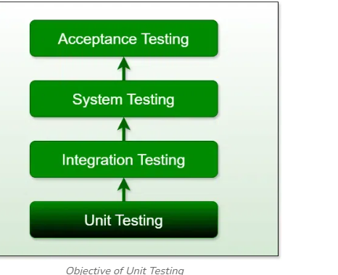
Objective of unit testing

Slide 42
Tools for unit testing
Unit Testing Tools
Here are some commonly used Unit Testing tools:
Jtest
Junit
NUnit
EMMA
PHPUnit

Slide 43
Integration testing
Integration testing is the process of testing the interface between two software units or modules. It focuses on determining the correctness of the interface. The purpose of integration testing is to expose faults in the interaction between integrated units. Once all the modules have been unit-tested, integration testing is performed.
The goal of integration testing is to identify any problems or bugs that arise when different components are combined and interact with each other. Integration testing is typically performed after unit testing and before system testing. It helps to identify and resolve integration issues early in the development cycle, reducing the risk of more severe and costly problems later on.

Slide 44
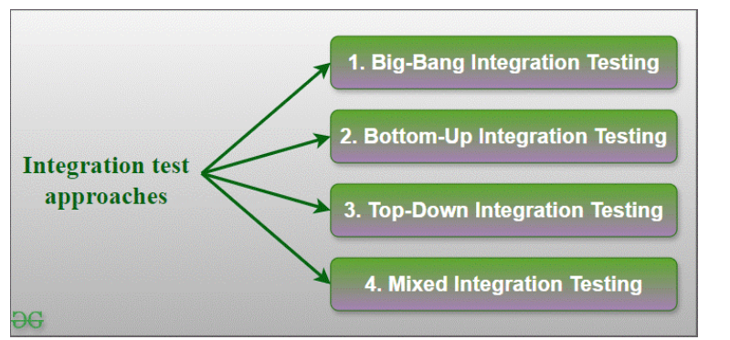
Integration testing approach

Slide 45
Big bang integration testing
It is the simplest integration testing approach, where all the modules are combined and the functionality is verified after the completion of individual module testing. In simple words, all the modules of the system are simply put together and tested. This approach is practicable only for very small systems. If an error is found during the integration testing, it is very difficult to localize the error as the error may potentially belong to any of the modules being integrated. So, debugging errors reported during Big Bang integration testing is very expensive to fix.

Slide 46
Bottom up integration testing
In bottom-up testing, each module at lower levels are tested with higher modules until all modules are tested. The primary purpose of this integration testing is that each subsystem tests the interfaces among various modules making up the subsystem. This integration testing uses test drivers to drive and pass appropriate data to the lower-level modules.

Slide 47
Top down integration testing
Top-down integration testing technique is used in order to simulate the behaviour of the lower-level modules that are not yet integrated. In this integration testing, testing takes place from top to bottom. First, high-level modules are tested and then low-level modules and finally integrating the low-level modules to a high level to ensure the system is working as intended.

Slide 48
Mixed integration testing
A mixed integration testing is also called sandwiched integration testing. A mixed integration testing follows a combination of top down and bottom-up testing approaches. In top-down approach, testing can start only after the top-level module have been coded and unit tested. In bottom-up approach, testing can start only after the bottom level modules are ready.

Slide 49
SYSTEM testing
System Testing is a type of software testing that is performed on a completely integrated system to evaluate the compliance of the system with the corresponding requirements. In system testing, integration testing passed components are taken as input.
The goal of integration testing is to detect any irregularity between the units that are integrated. System testing detects defects within both the integrated units and the whole system. The result of system testing is the observed behavior of a component or a system when it is tested.
System Testing is carried out on the whole system in the context of either system requirement specifications or functional requirement specifications or the context of both. System testing tests the design and behavior of the system and also the expectations of the customer.

Slide 50
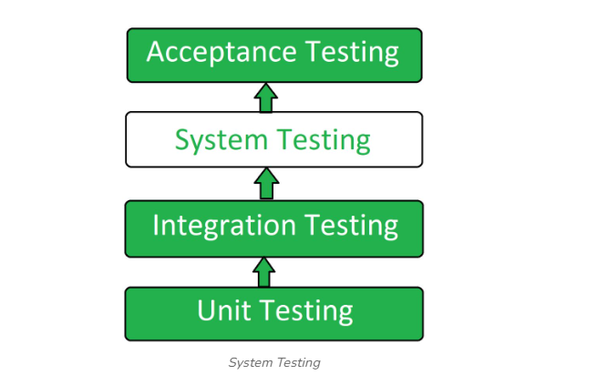
System testing level

Slide 51
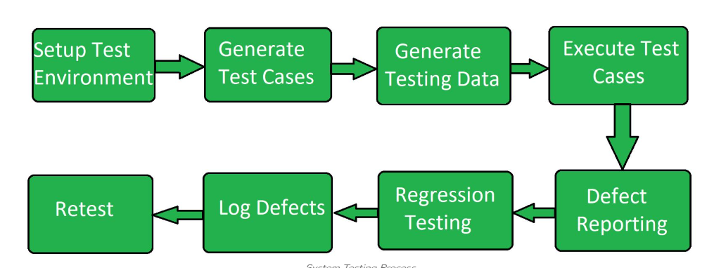
System testing process

Slide 52
Testing based on changes in application
There are 4 major types of testing done based on changes in software application
1. Retesting
2.Regression Testing
3.Sanity Testing
4.Smoke Testing

Slide 53
Retesting
Retesting
Retesting is a procedure where we need to check that particular test cases that are found with some bugs during the execution time. Retesting also occurs when the product is already tested and due to some problems, it needs to be tested again. This test is named retesting.
Retesting depends on the developer department whether they are going to accept the bug testing or reject it. Retesting is done when there is a specific bug when the bug is rejected by the developer and the tester department needs to test the issues when the user reports a problem for retesting and fixing an issue for better application and better workflow.

Slide 54
Usage of retesting
Retesting is used when there is any specific error or bug which needs to be verified.
It is used when the bug is rejected by the developers then the testing department tests whether that bug is actual or not.
It is also used to check the whole system to verify the final functionality.
It also checks the quality of a specific part of a system.
When some user demands retesting of their system.

Slide 55
Regression testing
Regression testing is a crucial aspect of software engineering that ensures the stability and reliability of a software product. It involves retesting the previously tested functionalities to verify that recent code changes haven’t adversely affected the existing features.
By identifying and fixing any regression or unintended bugs, regression testing helps maintain the overall quality of the software. This process is essential for software development teams to deliver consistent and high-quality products to their users.

Slide 56
When to do regression testing
When to do regression testing?
When new functionality is added to the system and the code has been modified to absorb and integrate that functionality with the existing code.
When some defect has been identified in the software and the code is debugged to fix it.
When the code is modified to optimize its working.

Slide 57
Advantages of regression testing
Automated unit testing
Comprehensive test coverage
System integration
Faster test execution completion
Improved developer productivity
Parallel testing
Reduced costs
Regression testing improves product quality

Slide 58
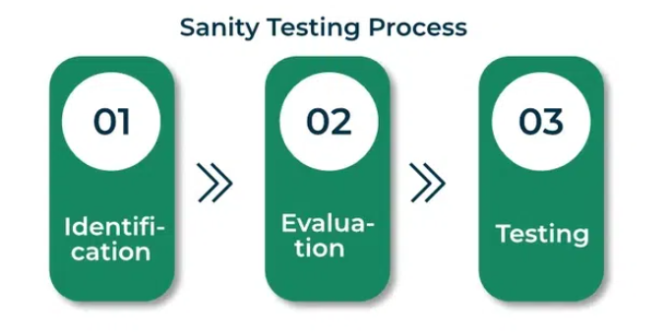
Sanity testing
It is a subset of regression testing. Sanity testing is performed to ensure that the code changes that are made are working properly. Sanity testing is a stoppage to check whether testing for the build can proceed or not. The focus of the team during the sanity testing process is to validate the functionality of the application and not detailed testing. Sanity testing is generally performed on a build where the production deployment is required immediately like a critical bug fix.

Slide 59
Advantages of sanity testing
Sanity testing helps to quickly identify defects in the core functionality.
It can be carried out in lesser time as no documentation is required for sanity testing.
If the defects are found during sanity testing, project is rejected that is helpful in saving time for execution of regression tests.
This testing technique is not so expensive when compared to another types of testing.
It helps to identify the dependent missing objects.
It is used to verify a small functionality of the system application whether it is still working or not even after a small change.

Slide 60
Smoke testing
Smoke testing, also known as “Build Verification Testing” or “Build Acceptance Testing,” is a type of software testing that is typically performed at the beginning of the development process to ensure that the most critical functions of a software application are working correctly. It is used to quickly identify and fix any major issues with the software before more detailed testing is performed. The goal of smoke testing is to determine whether the build is stable enough to proceed with further types of testing.

Slide 61
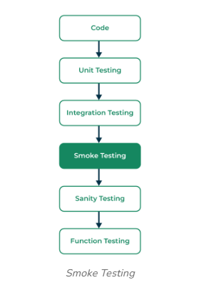
Level of SMOKE testing

Slide 62
Advantages of smoke testing
Smoke testing is easy to perform.
It helps in identifying defects in the early stages.
It improves the quality of the system.
Smoke testing reduces the risk of failure.
Smoke testing makes progress easier to access.
It saves test effort and time.
It makes it easy to detect critical errors and helps in the correction of errors.
It runs quickly.
It minimizes integration risks.

Slide 63
Installation testing
Installation testing is a type of software testing that verifies the software’s installation process and ensures that the software is installed correctly on various systems and configurations. It is a critical aspect of the software testing process and helps ensure that the software can be easily installed, configured, and uninstalled without any issues.
The primary goal of installation testing is to ensure that the software is installed correctly and that the software’s functionality is not compromised during the installation process.
The installation testing ensures that the software application has been successfully installed with all its inherent features or not. It is also named implementation testing, mainly it’s done in the end phase.

Slide 64
Advantages of installation testing
The first biggest advantage is that it verifies the designs of apps and software on a basic level of test performance.
It’s a very crucial part of STLC which helps in maintaining the standard according to that.
It’s a very quick and handy method to check the version of the software
The greater output results of installation testing help the developer to improve the app or software.
Improved software quality: Installation testing helps to identify and fix installation issues and errors, improving the software’s overall quality. This reduces the risk of negative user experiences and reviews, which can impact the software’s reputation.
Enhanced user experience: Installation testing helps to ensure that the software is installed and configured correctly, providing users with a smooth and hassle-free installation process. This improves the user experience and increases user satisfaction.

Slide 65
Non functional testing
Non-functional Testing is a type of Software Testing that is performed to verify the non-functional requirements of the application. It verifies whether the behavior of the system is as per the requirement or not. It tests all the aspects that are not tested in functional testing.
Increased usability: To increase usability, efficiency, maintainability, and portability of the product.
Reduction in production risk: To help in the reduction of production risk related to non-functional aspects of the product.
Cost Reduction: To help in the reduction of costs related to non-functional aspects of the product.
Optimize installation: To optimize the installation, execution, and monitoring way of the product.
Collect metrics: To collect and produce measurements and metrics for internal research and development.
Enhance knowledge of product: To improve and enhance knowledge of the product behavior and technologies in use.

Slide 66
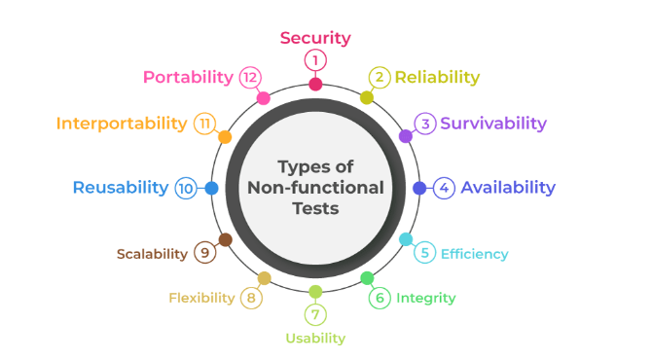
Non functional testing parameters

Slide 67
Non functional testing techniques
Compatibility testing: is a type of testing to ensure that a software program or system is compatible with other software programs or systems. For example, in this, the tester checks that the software is compatible with other software, operating systems, etc.
Compliance testing: is a type of testing to ensure that a software program or system meets a specific compliance standard, such as HIPAA or Sarbanes-Oxley. It is often the first type of testing that is performed when accessing the control environment.
Endurance testing: is a type of testing to ensure that a software program or system can handle a long-term, continuous load. For example for the banking application, the application is tested to know if the system can sustain under the continuous expected load.

Slide 68
Non functional testing techniques
Load testing: is a type of testing to ensure that a software program or system can hanLoad testingdle a large number of users or transactions. For example, Running multiple applications on the computer simultaneously.
Performance testing: is a type of testing to ensure that a software program or system meets specific performance goals, such as response time or throughput. For example, organizations perform performance tests to identify performance-related bottlenecks.
Recovery testing: is a type of testing to ensure that a software program or system can be recovered from a failure or data loss. For example, when the application is running and the computer is restarted, check the validity of the application’s integrity.
Security testing: is a type of testing to ensure that a software program or system is secure from unauthorized access or attack. For example, Organizations perform security testing to reveal flaws in the security mechanism of the information system.

Slide 69
Non functional testing techniques
Scalability testing: is a type of testing to ensure that a software program or system can be scaled up or down to meet changing needs. For example, to measure the application’s capability to scale up or scale out in terms of non-functional capability.
Stress testing: is a type of testing to ensure that a software program or system can handle an unusually high load. For example, extremely large numbers of concurrent users try to log into the application.
Usability testing: is a type of testing to ensure that a software program or system is easy to use. For example, on the e-commerce website, it can be tested whether the users can easily locate the Buy Now button or not.
Volume testing: is a type of testing to ensure that a software program or system can handle a large volume of data. For example, if the website is developed to handle traffic of 500 users, volume testing will whether the site is able to handle 500 users or not.

Slide 70
Test pyramid
The testing pyramid is a testing strategy that can help developers and testers create high-quality products. It lets developers quickly identify whether their code changes have caused any issues, thus saving them time. Also, it helps QAs to build a powerful test suite.
It was introduced by Mike Cohn in his book “Succeeding with Agile.” It is one of the popular strategies in software testing that illustrates the distribution of different types of tests in a test suite.

Slide 71
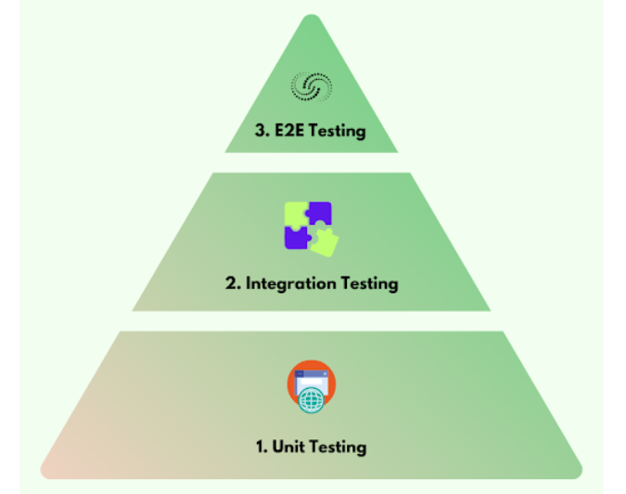
Test pyramid phases

Slide 72
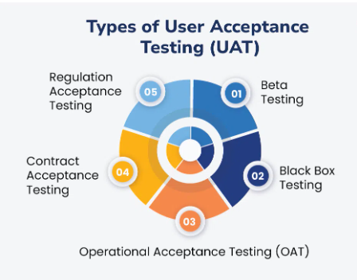
USER Acceptance testing
User Acceptance Testing (UAT) is a crucial phase in software testing where the software is tested in a real-world scenario by end-users to ensure it meets their requirements and functions as expected. Unlike other forms of testing, UAT focuses on validating the software’s user-friendliness, functionality, and performance from the user’s perspective.

Slide 73
Types of uat
Beta User Acceptance Testing
Beta UAT means that users who have completed one or more rounds of tests will be shown a popup stating if they are accepted for testing by the new version of Angular2 (a beta release).
Black Box Testing
In black box testing, end-users or testers evaluate specific functionalities of the software without knowing the internal workings or code structure.
Operational Acceptance Testing (OAT)
Operational Acceptance Testing (OAT) is a software testing technique that evaluates a software application’s operational readiness before release or production.

Slide 74
Types of uat
Contract Acceptance Testing
Contract Acceptance Testing refers to the process of testing developed software against predefined and agreed-upon criteria and specifications.
Regulation Acceptance Testing
Regulation AT is generally called Compliance AT.
This sort of affirmation testing is done to guarantee the thing dismisses no rules and rules that are set by the regulating associations of the particular country where the thing is being conveyed.

Slide 75
Compatibility testing
Checking the functionality of an application on different software, hardware platforms, network, and browsers is known as compatibility testing.
Types of Compatibility testing
Software
Hardware
Network
Mobile

Slide 76
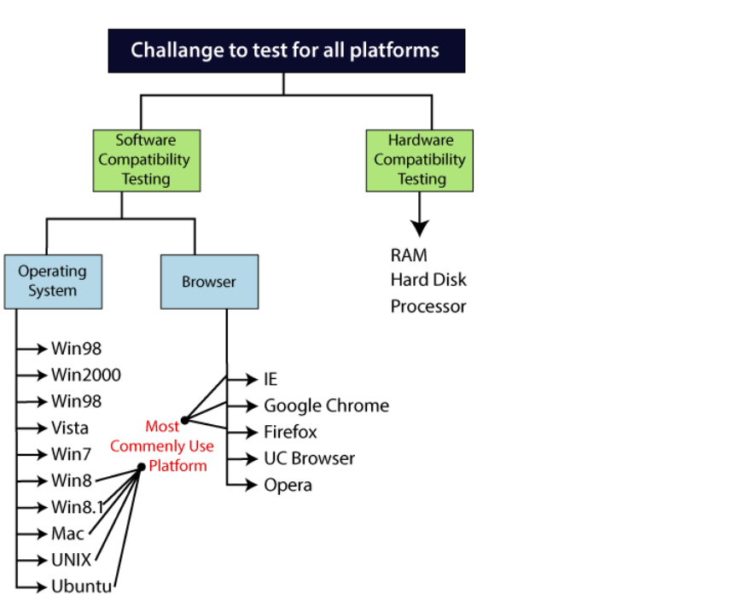
Compatibility testing process

Slide 77
Ui /ux testing
UI/UX testing is the process of verifying the functionalities of the user interface (UI) and keeping the user experience (UX) in check. It helps explore critical bugs that can quickly magnify and may hinder performing basic operations on a web application.
Requirements for a Good UI/UX
Accessibility
Perceivability
Operability
Ease of Navigation
High Performance
Understandable Interface

Slide 78
G11n, I18N,T9N and L10N Testing
Globalization – Globalization(G11N) consists internationalization, translation and localization. In order to take your product to global market and reach wider audience across globe it is important that you also provide your product into different locales. Many product based companies have been very actively globalizing their product. Product in regional language attracts more number of customer, Globalization makes it easier for people to use product in their regional language.
Internalization(I18N)is a process of developing your source code according to international languages. For ex: There is different currency sign, date month year format used across world hence these fields should not be hard coded and flexible according to locales having said that while writing source code it should always be considered that this product will not only be used in English but it will be used by different locales and develop product accordingly.

Slide 79
G11n, I18N,T9N and L10N Testing
Localization(L10N) – A process of integrating translation back into source code or original file format and create final output. Localization also includes converting content according to geographical adaptability. For example any document which has polar bear in it and if document to be release in Arab then it make more sense to have Camel in it instead of Polar bear.
Translation(T9N): The process of translating text from one language into another.
Some key elements of translation are:
Translation Memory (TM)– Translation memory is simply a database of previous translations. Each time a new string is translated, the source text (original language) and its target text (translation language) are paired together and added to the translation memory.
When a translator is presented with similar source text in the future, its target text pairing may be suggested. Translators can then pull translation memory matches to reduce redundant work and maintain linguistic consistency when completing future translations.

