Slide 1
Cucumber
Simplilearn – 31/03/2023

Slide 2
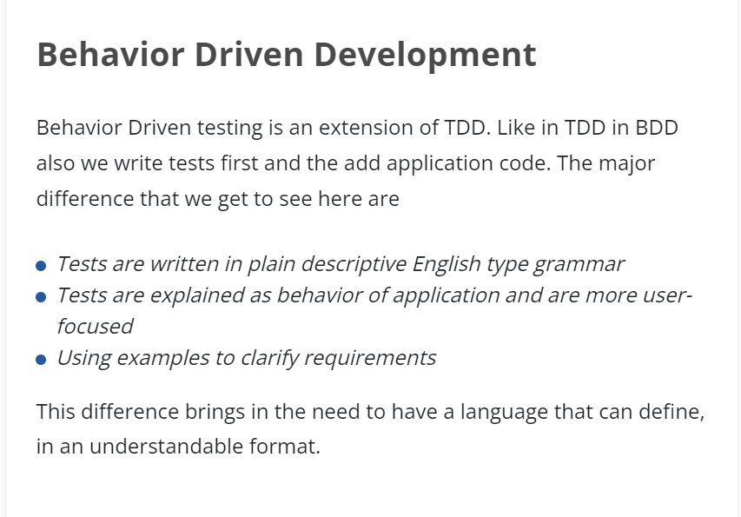
Behaviour Driven Development

Slide 3
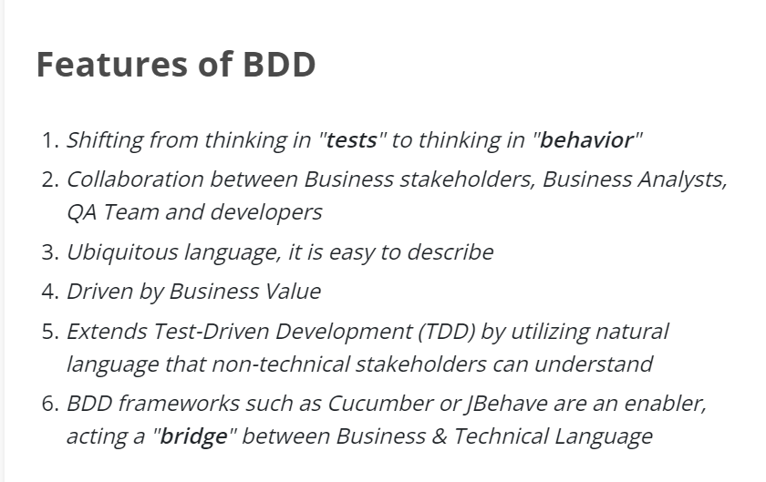
Features of BDD

Slide 4
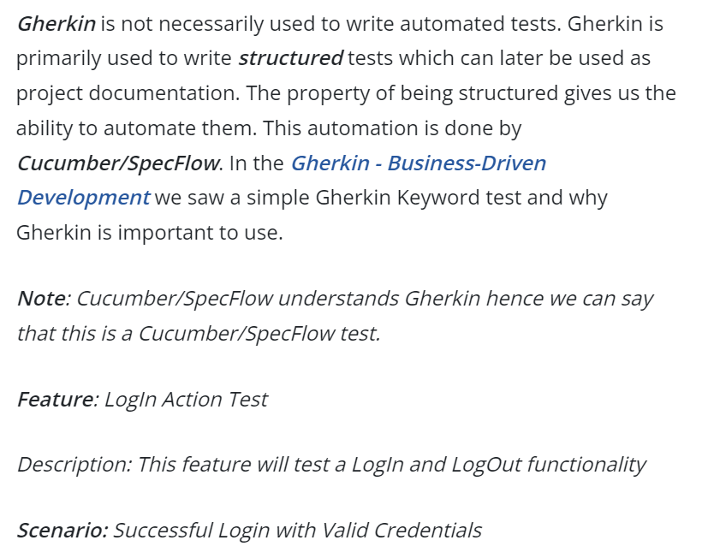
Gherkin Keyword

Slide 5
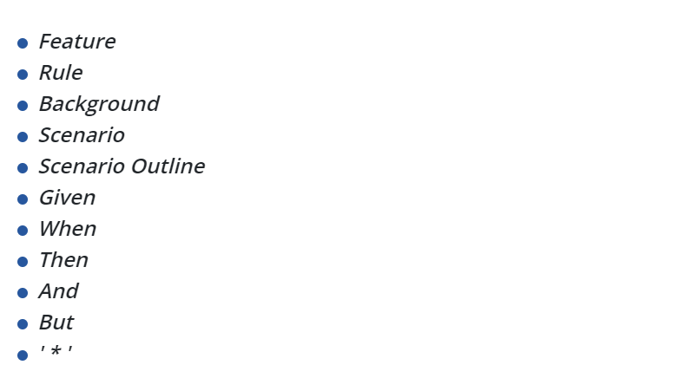
Different Keywords in Gherkin

Slide 6
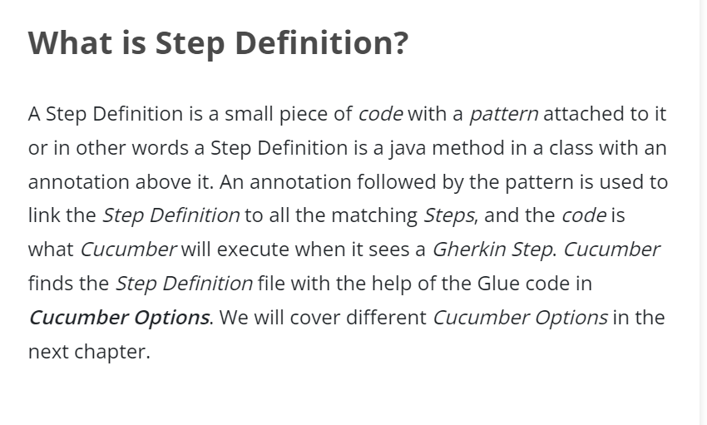
Step Definition in Cucumber

Slide 7
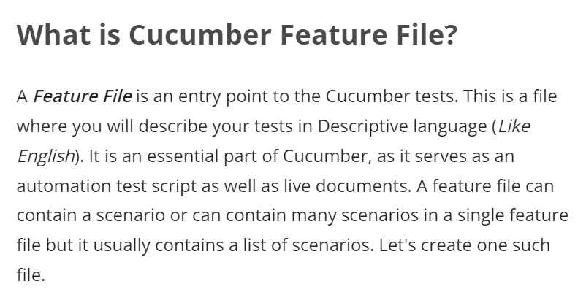
Feature File in Cucumber

Slide 8
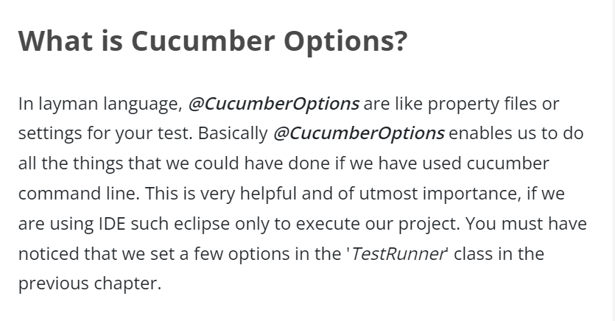
Options in Cucumber

Slide 9
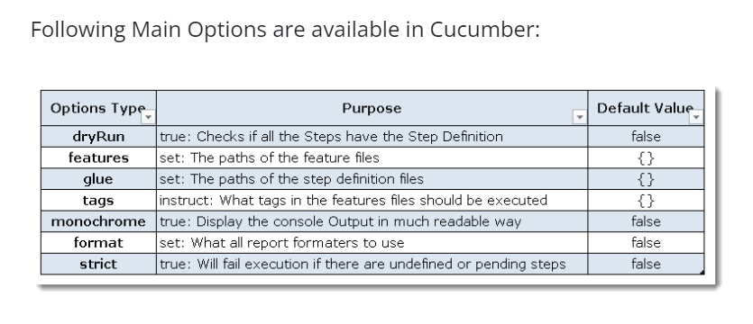
Cucumber Options

Slide 10
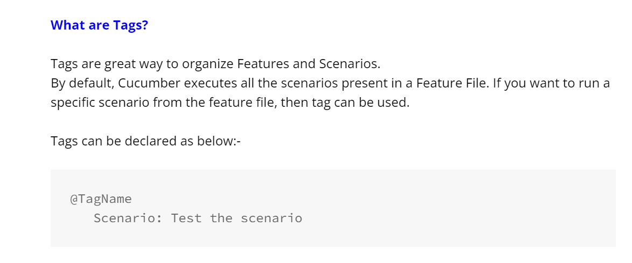
Cucumber Tags

Slide 11
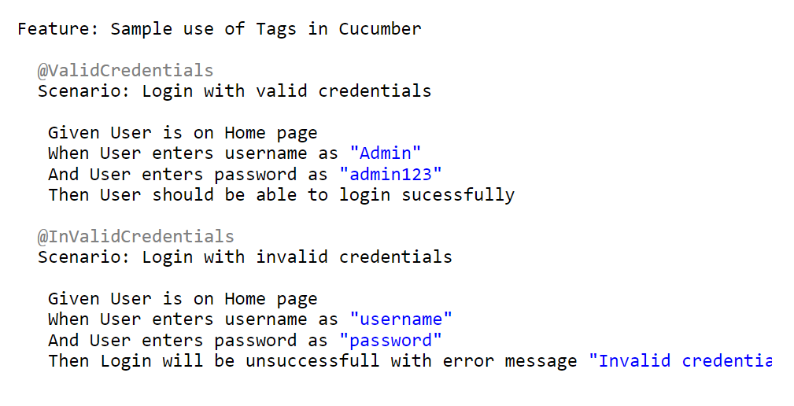
Basic Example of Cucumber Tags

Slide 12
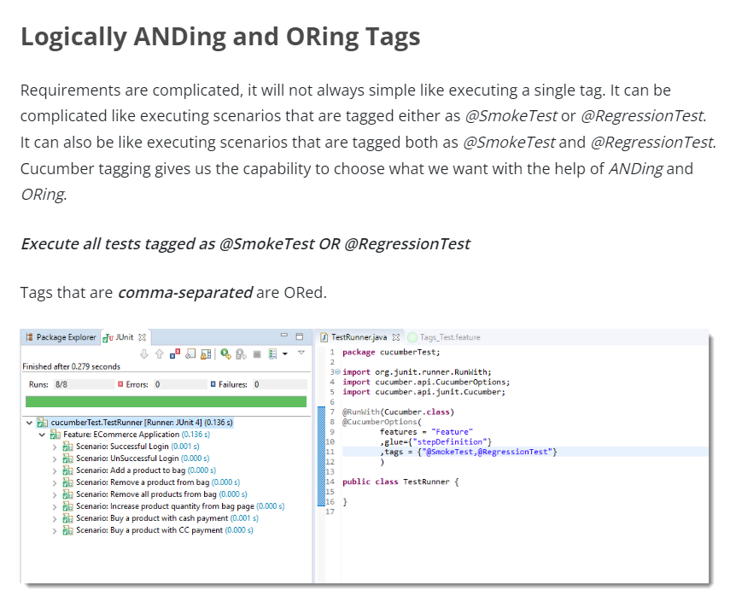
Logically ANDing and OR ing Cucumber Tags

Slide 13
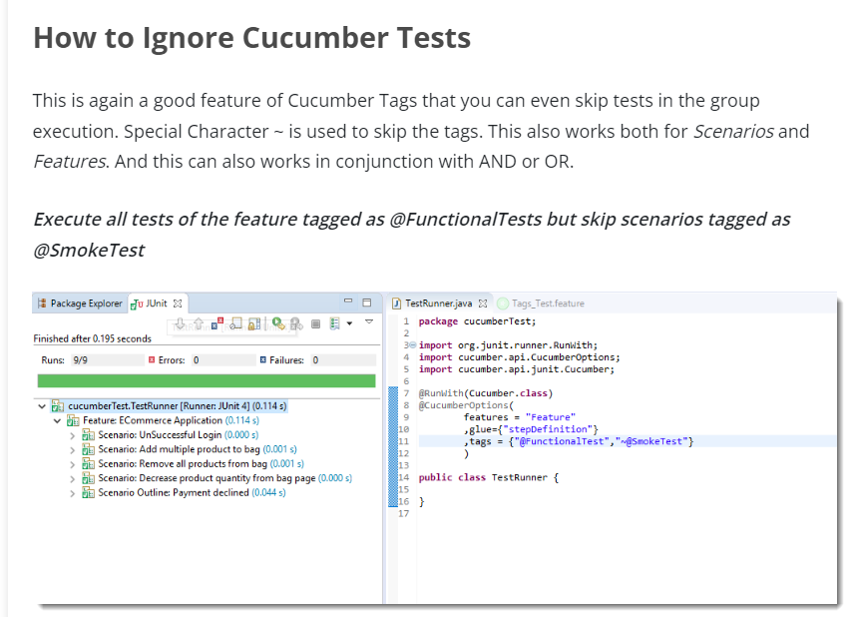
Ignoring Cucumber Tags

Slide 14
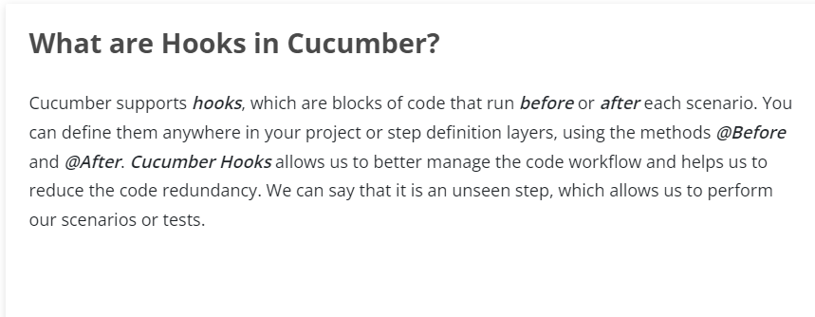
Cucumber Hooks

Slide 15
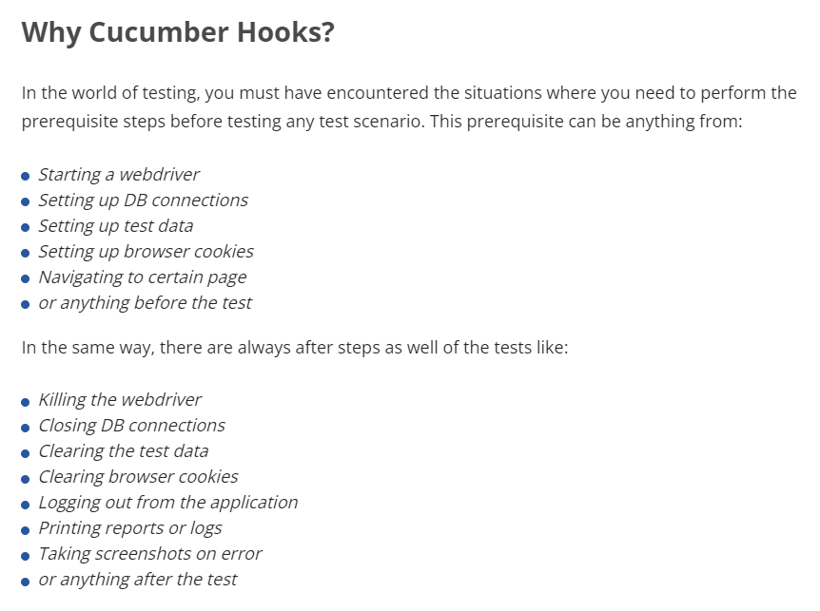
Why Cucumber Hooks ?

Slide 16
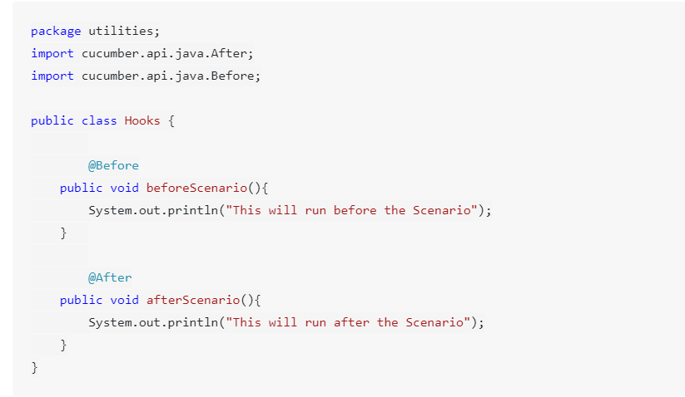
How to Use Cucumber Hooks

Slide 17
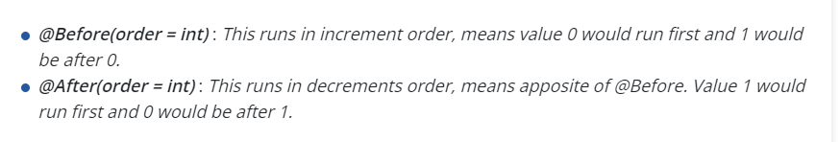
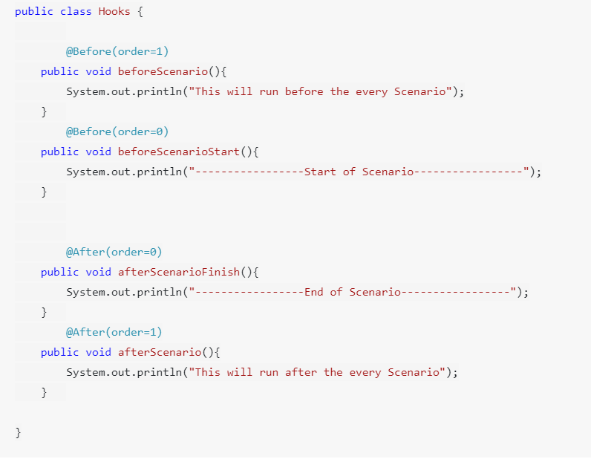
Priority of Cucumber Hooks

Slide 18
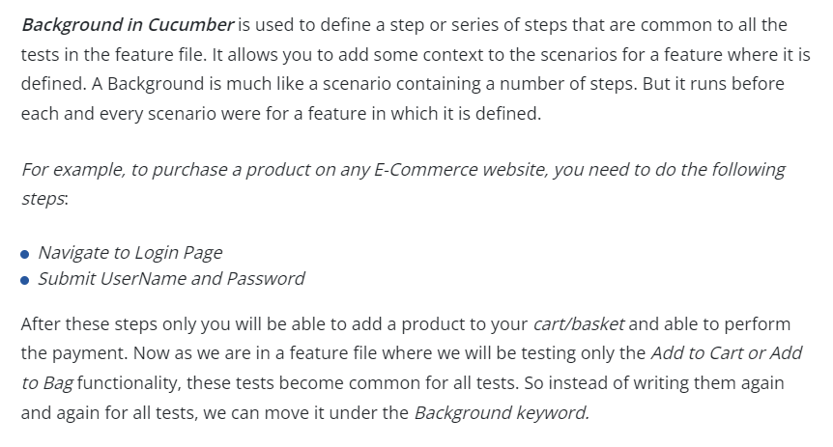
Background Keyword in cucumber

Slide 19
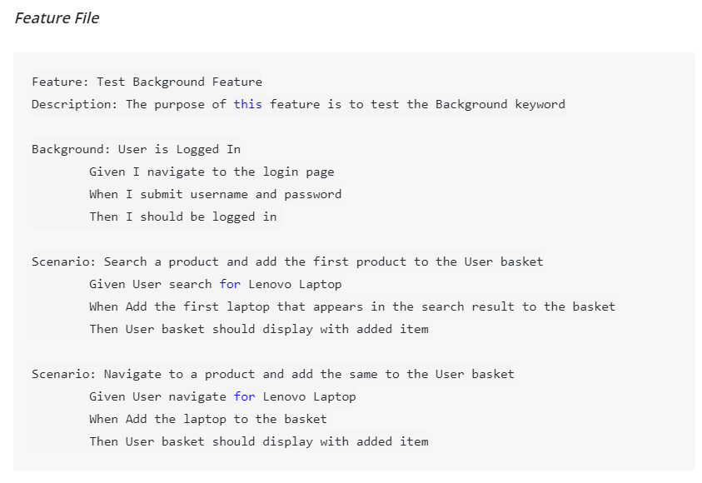
Example of background in cucumber

