Slide 1
JDBC

Slide 2
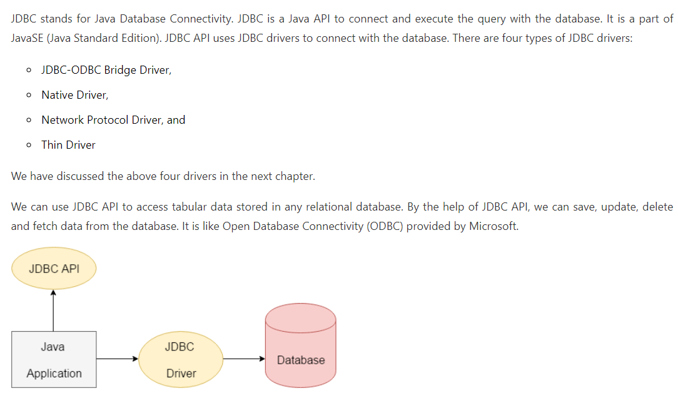
What is JDBC

Slide 3
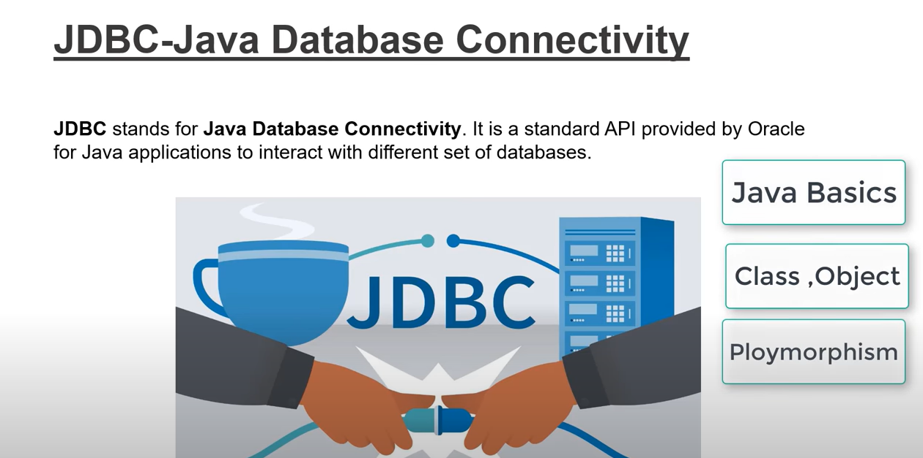
Prerequisite for Knowing JDBC
DATABASE KNOWLEDGE

Slide 4
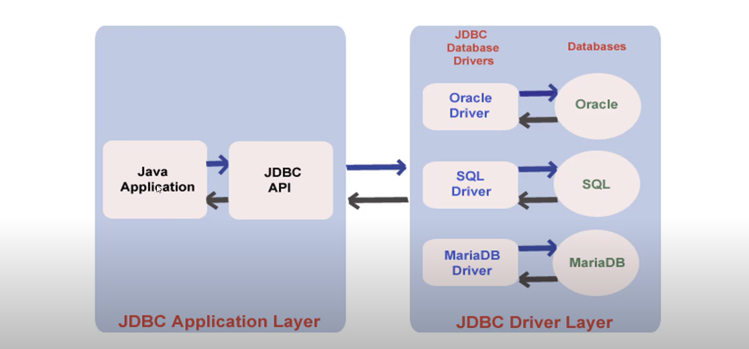
JDBC ARCHITECTURE

Slide 5
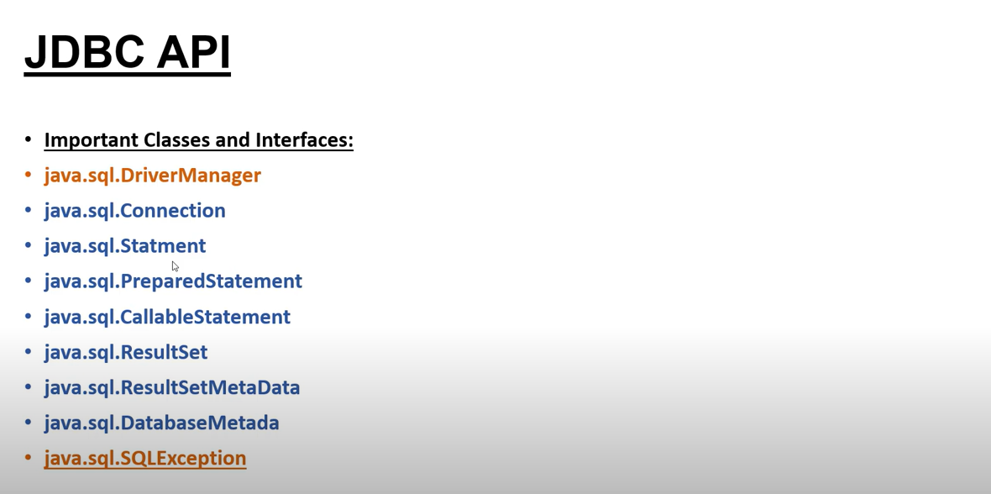
Classes And Interfaces for JDBC

Slide 6
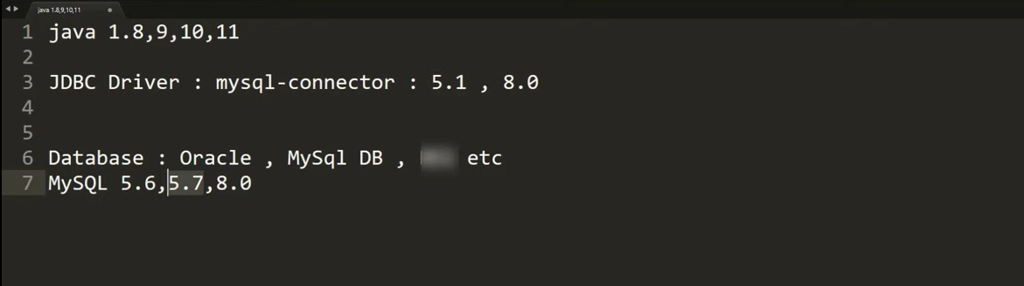
Toolset Required for JDBC

Slide 7
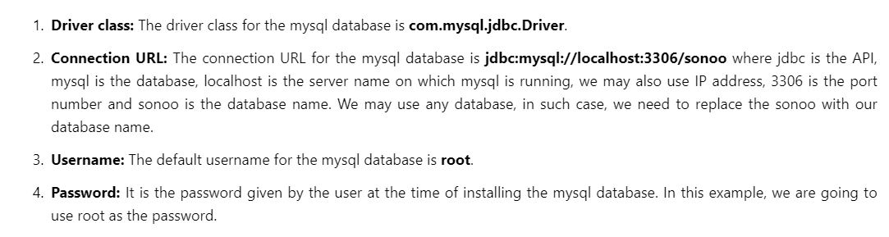
Important Terminologies Required for JDBC

Slide 8
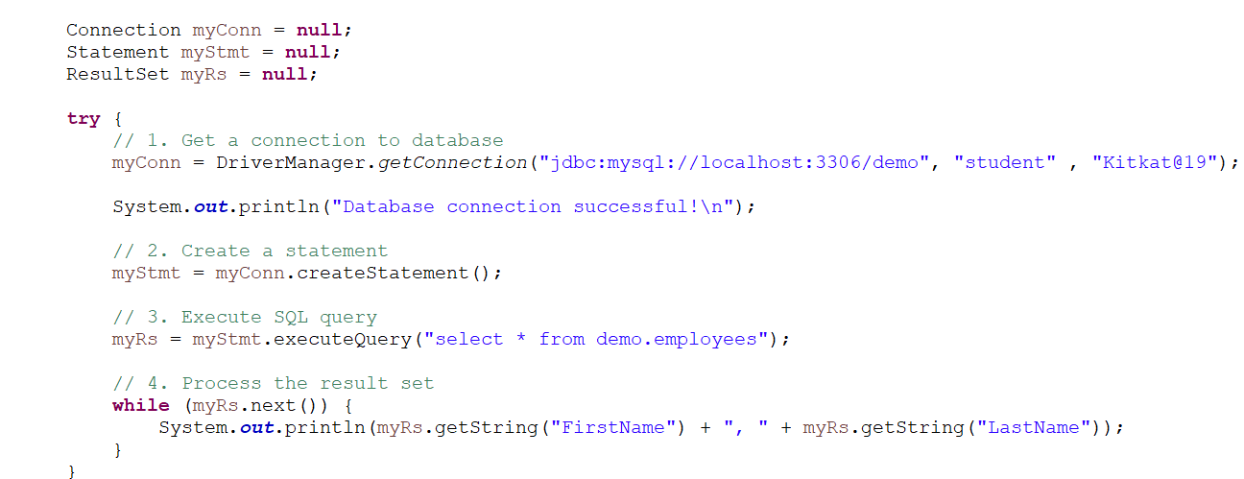
Test The Connection

Slide 9
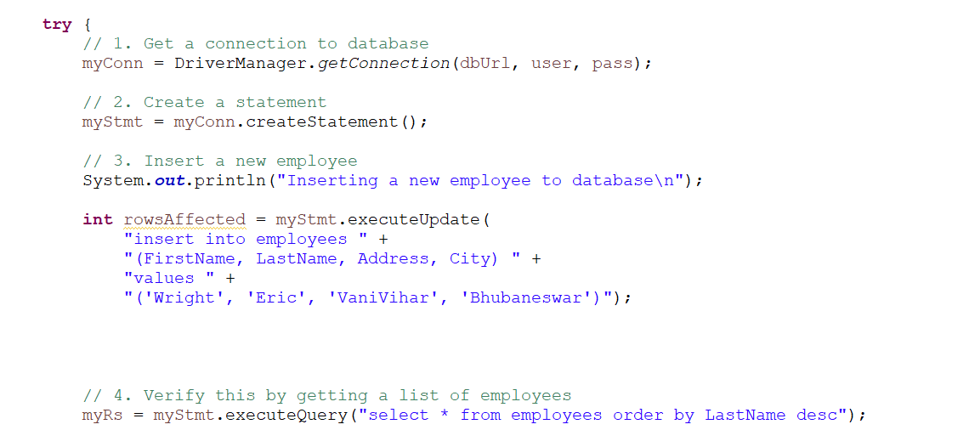
Inserting Data in the Database

Slide 10
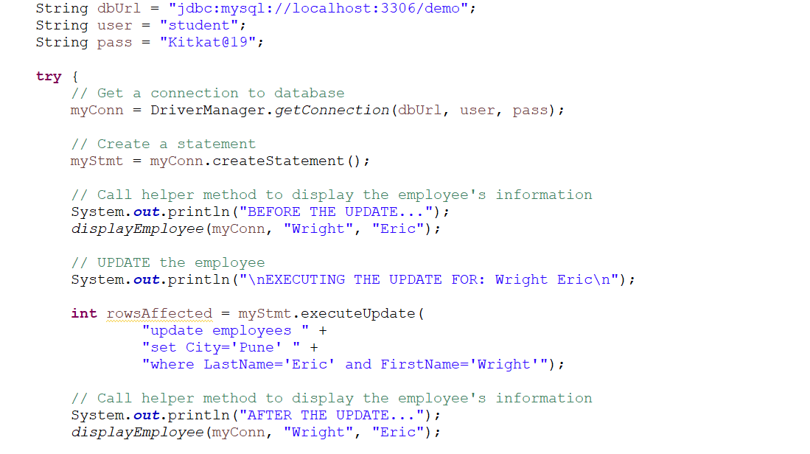
Updating Data into the Database

Slide 11
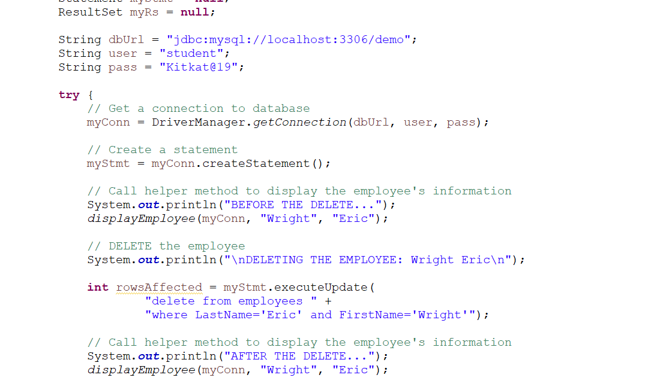
Deleting Data from the Database

Slide 12
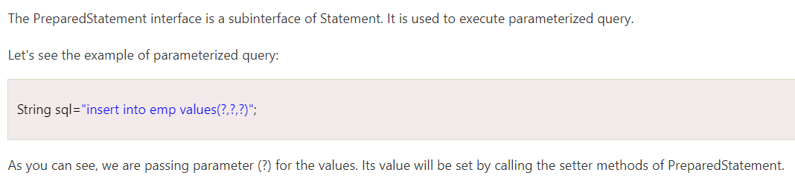
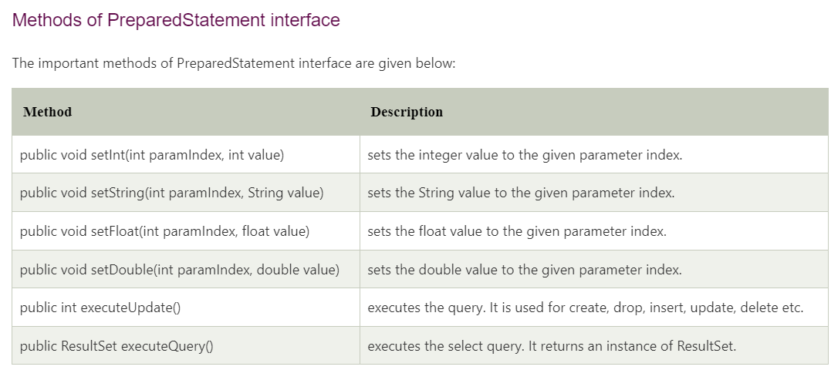
Prepared Statement

