Slide 1
Junit
Saurabh Kandhway
Simplilearn – 19th March 2023

Slide 2
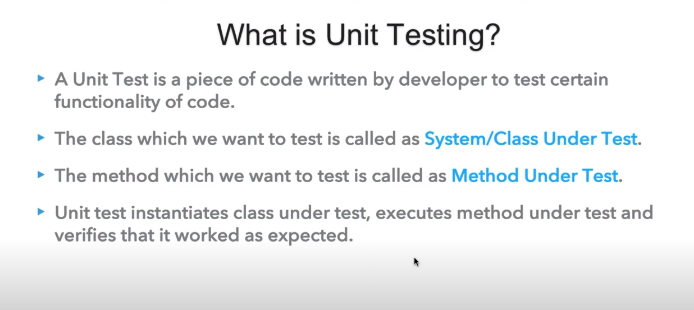
DEFINITION OF UNIT TESTING

Slide 3
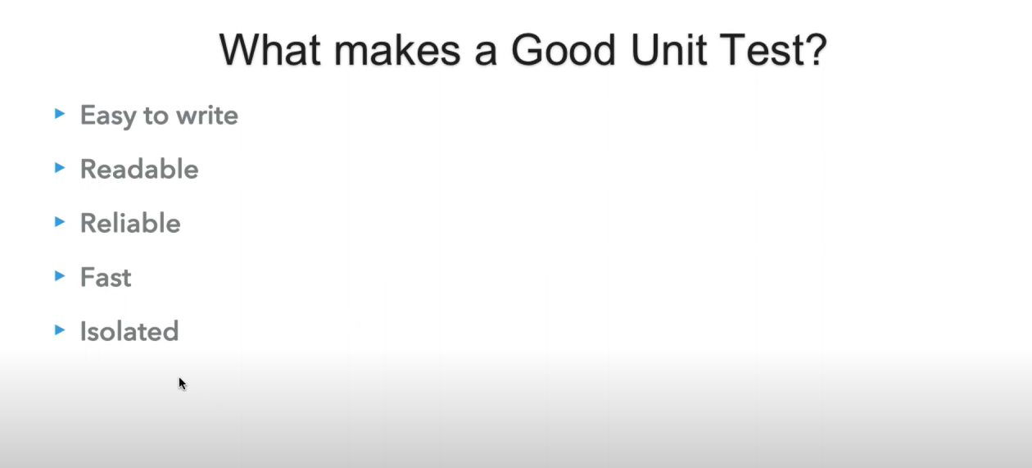
Pre Conditions for GOOD Unit test

Slide 4
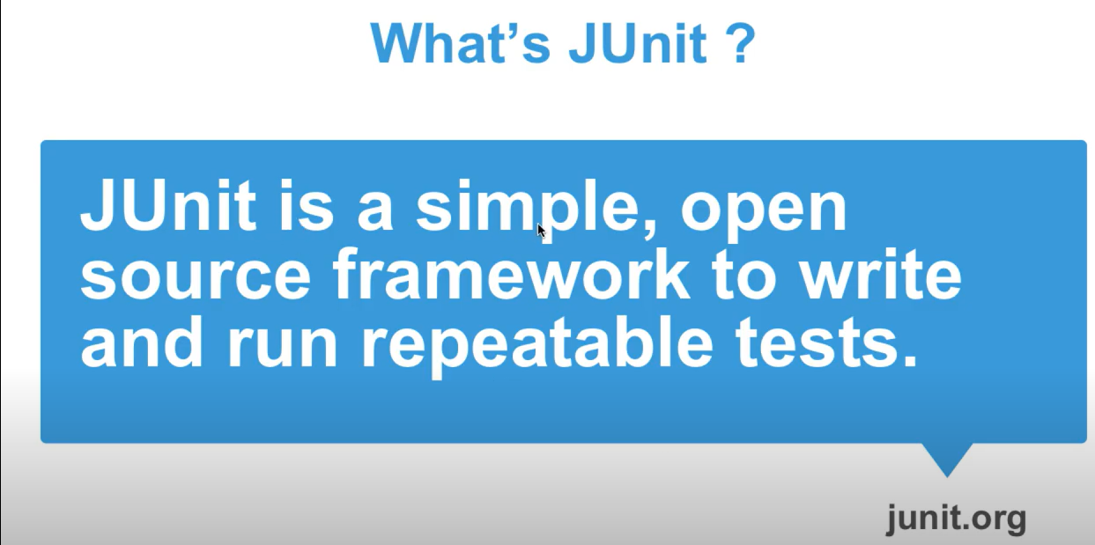
Definition of Junit

Slide 5
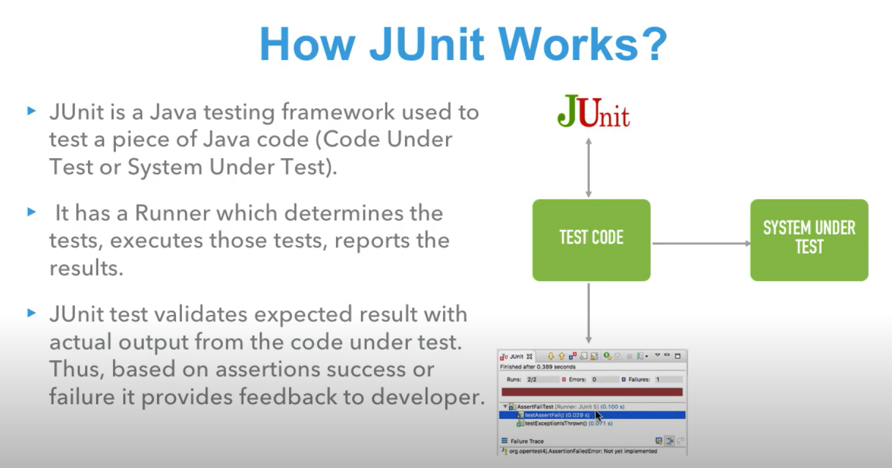
Working of Junit

Slide 6
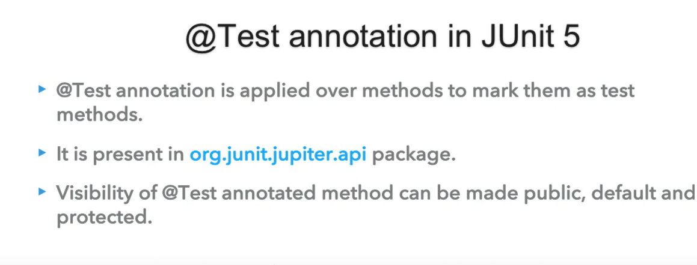
Test Annotation in Junit

Slide 7
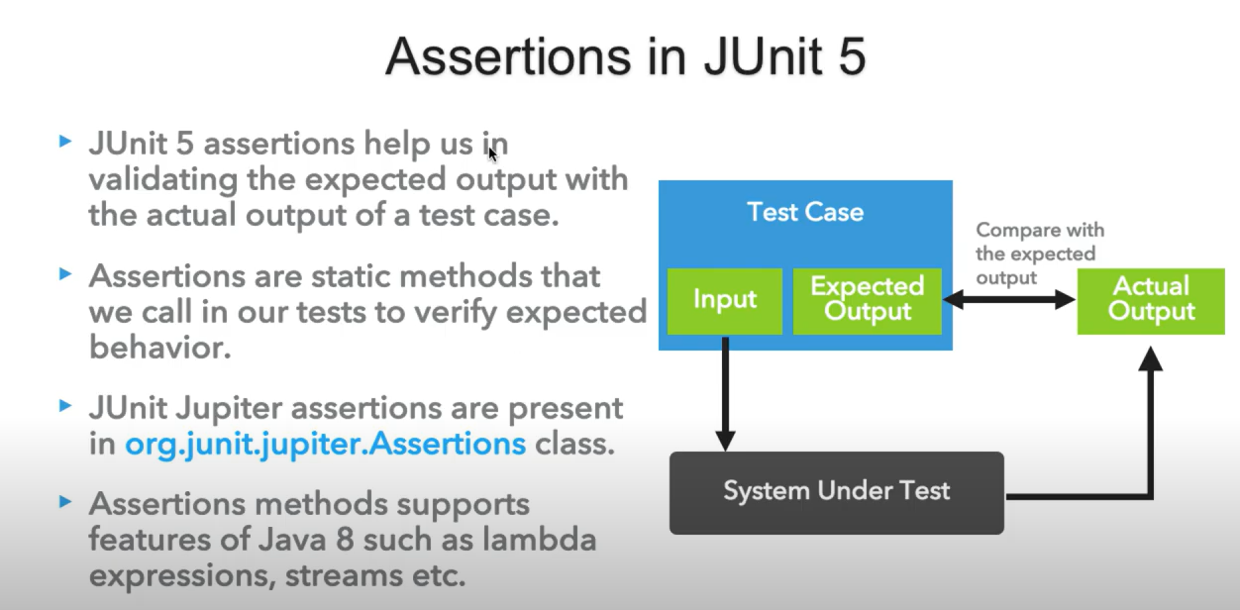
Assertions in Junit

Slide 8
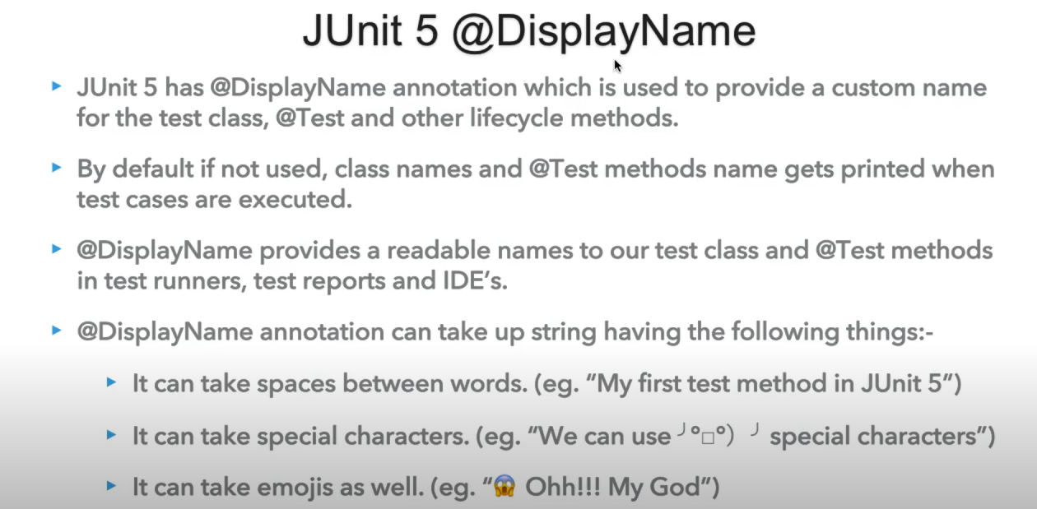
Junit Display Name

Slide 9
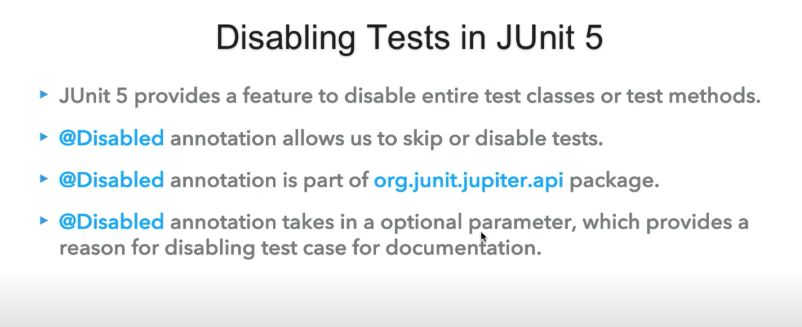
Disabling Test in Junit5

Slide 10
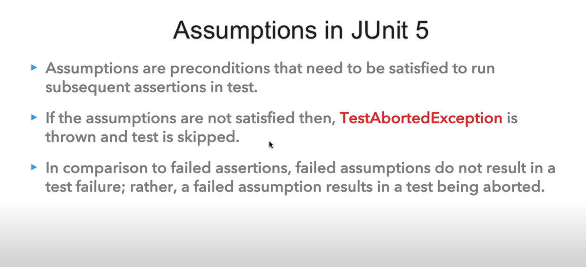
Assumptions in Junit5

Slide 11
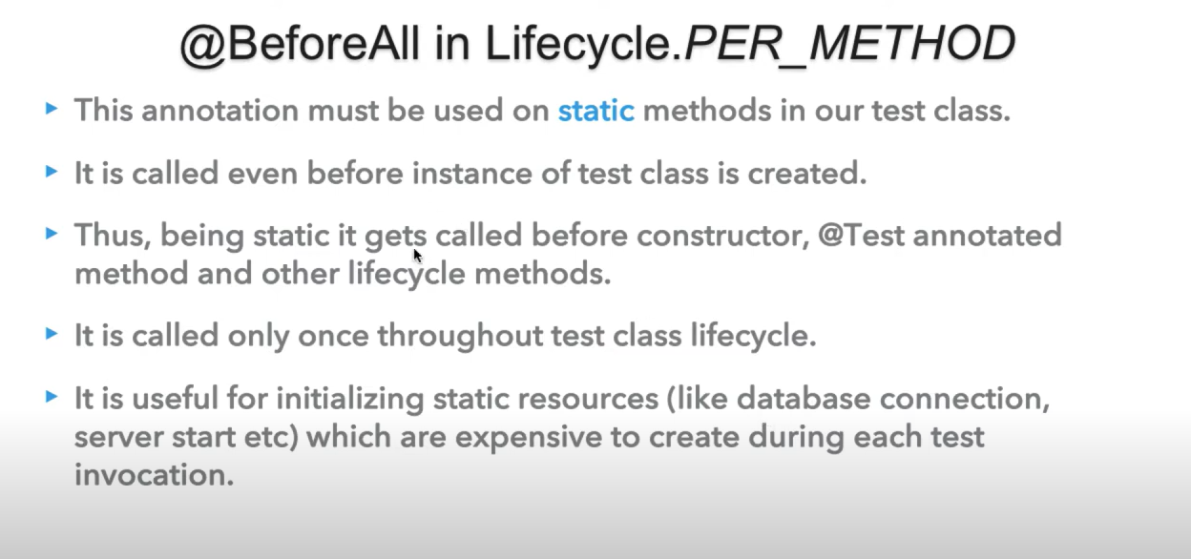
Before All Method

Slide 12
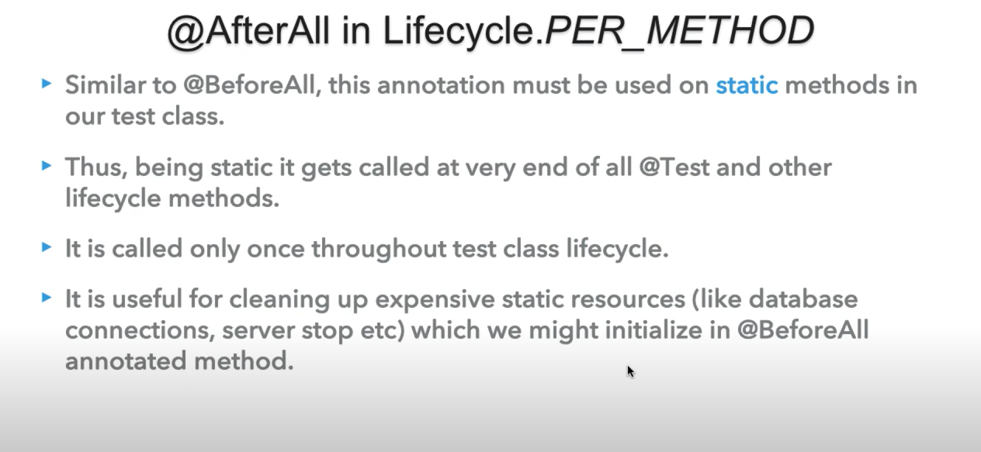
After All method

Slide 13
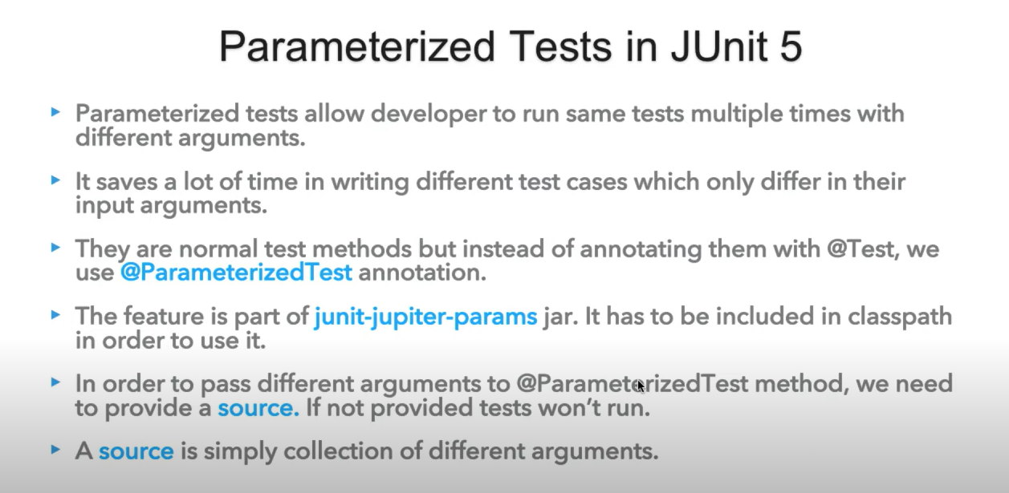
Parameterized Testing using junit5

Slide 14
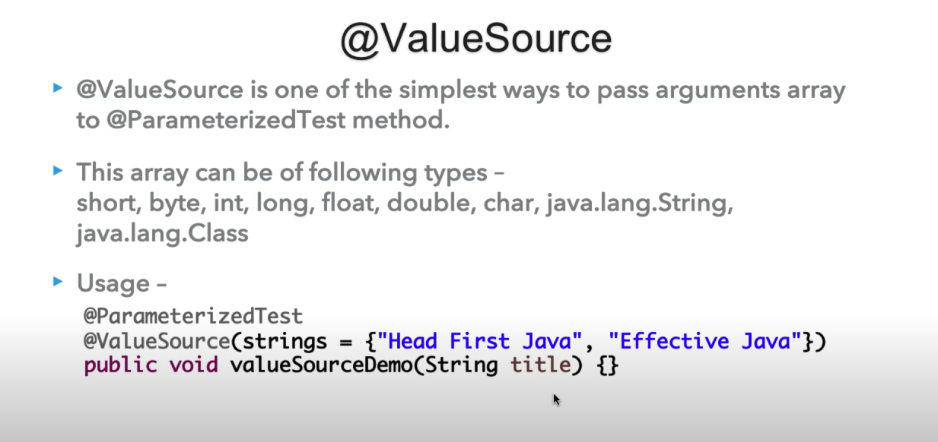
Value Source in Junit

Slide 15
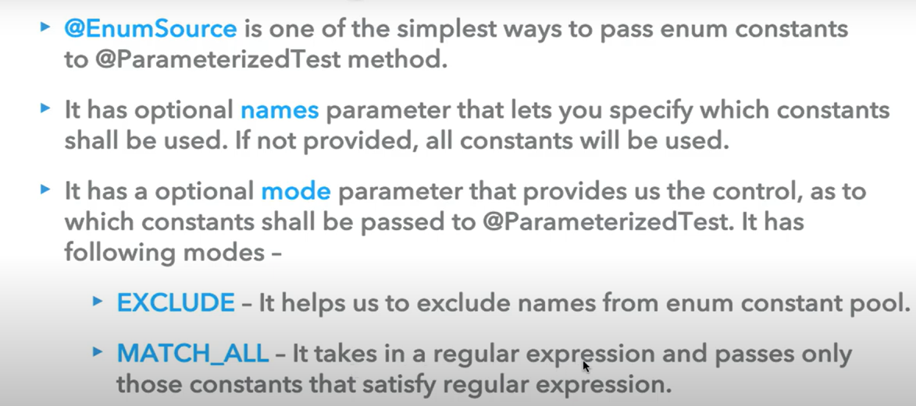
Enum Source

